Slide 1

Netflix Dataset Analysis
Presented by Shahin Sulaiman M
Date : 20.02.2025
Tableau Analysis & Insights

Slide 2
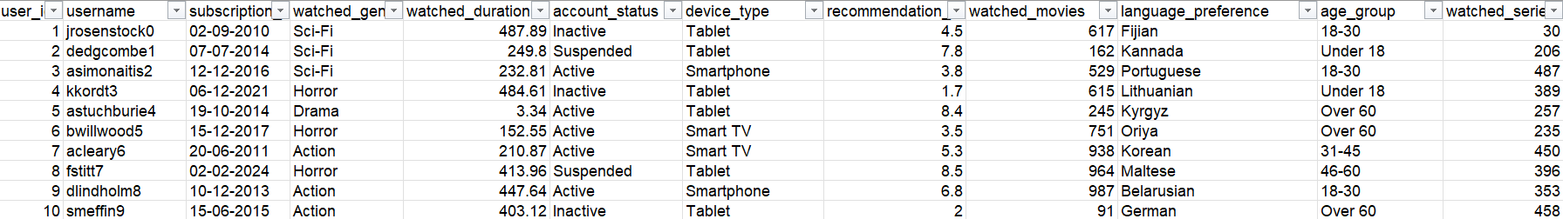
Dataset Overview
Source: Mockaroo-generated Netflix dataset
Attributes: User ID, Username, Subscription Date, Genres, Watch Time, Account Status, Device, Recommendation Score, Watched Movies, Language Preference, Watched Series, Age Group.
Data Size: 1000 records
Purpose: Analyze user engagement, preferences, and trends

Slide 3
Dashboard Overview
Created using Tableau
Key Visuals:
- Watch Time by Genre (Bar Chart)
- Subscription Trends (Bubble Chart)
- Account Status Distribution (Pie Chart)
- Device Usage (Bar Chart)
Interactive Filters: Age group, Device Type, Account Status

Slide 4
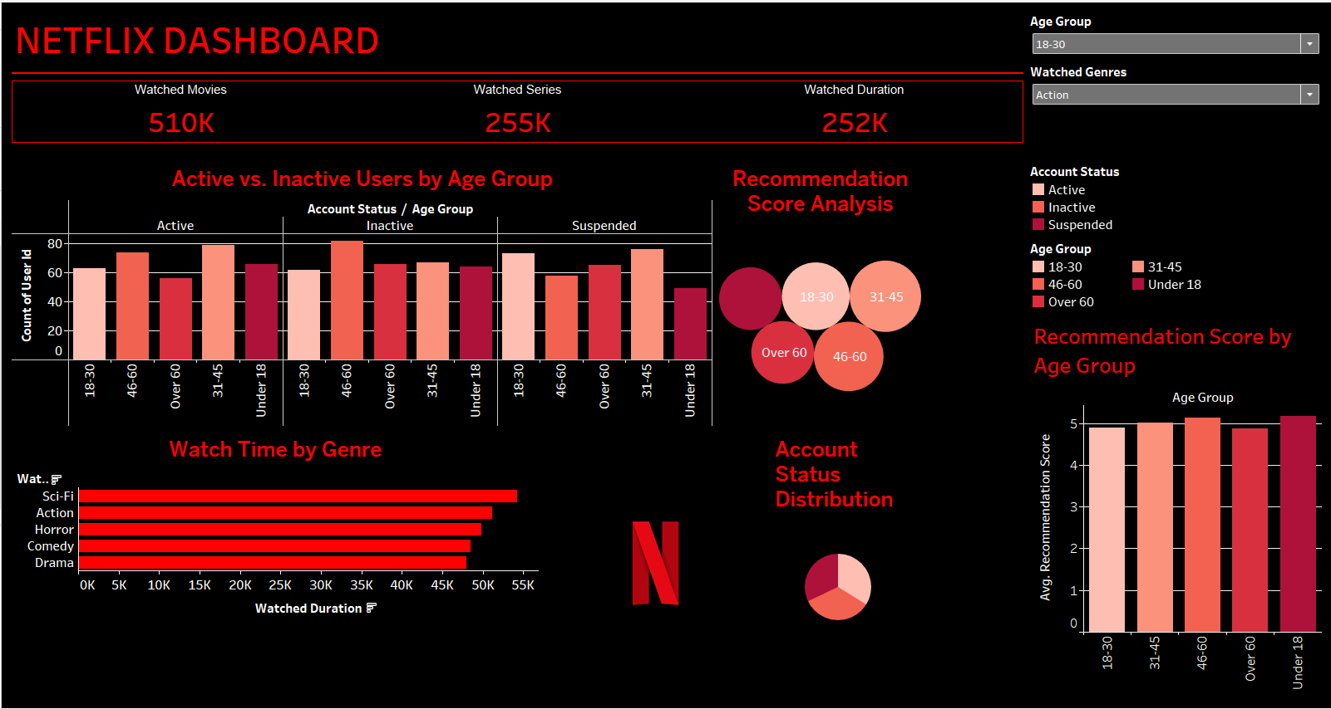
Dashboard

Slide 5
Key Insights
Sci-Fi and Horror are the most-watched genres
Majority of users access Netflix via Smartphones
Active user count increased significantly in recent years
Older age groups have lower engagement levels
Recommendation scores impact watch duration

Slide 6
Conclusion & Recommendations
Subscription growth is steady, but retention is key
Optimize recommendations for better user engagement
Target older demographics with personalized content
Enhance mobile user experience for maximum retention
Future Work: Deeper analysis with AI-driven insights

Slide 7


