Slide 2
Portfolio dashboard

Slide 3
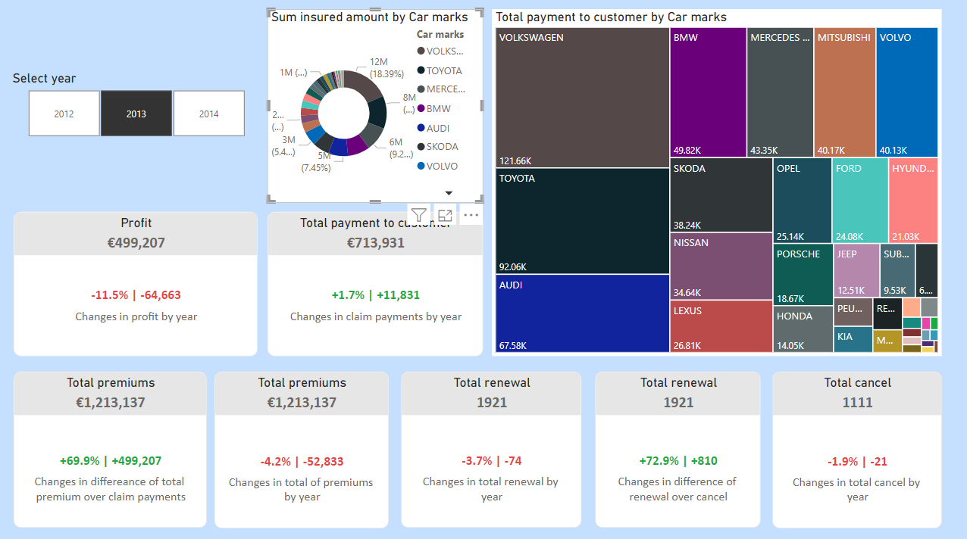

Slide 4
Analyses of “Portfolio” dashboard
There are 9 analyses which 7 analyses are Cards, 1 analysis is Treemap and 1 analysis is a Dount chart.
Also, 8 analyses in the dashboard can be classified as bivariate analyses but one Dount chart analysis should be classified as a univariate analysis
If I need to talk about more calculated measures, calculated measures were linked to profit, premiums, payment amount from payment needed claims, total renewal amount, and total cancel amount. Measures show individual value changes by current and previous year with numbers and percentages. Also, some measures show values versus another value by year in numbers and percentages.
I prefer to choose default Cards because row-level security can be violated by using custom Cards from the market. Insurance data sets can contain PII(Personal Identifying Information) data which should be considered while using third-party analyses.

Slide 5
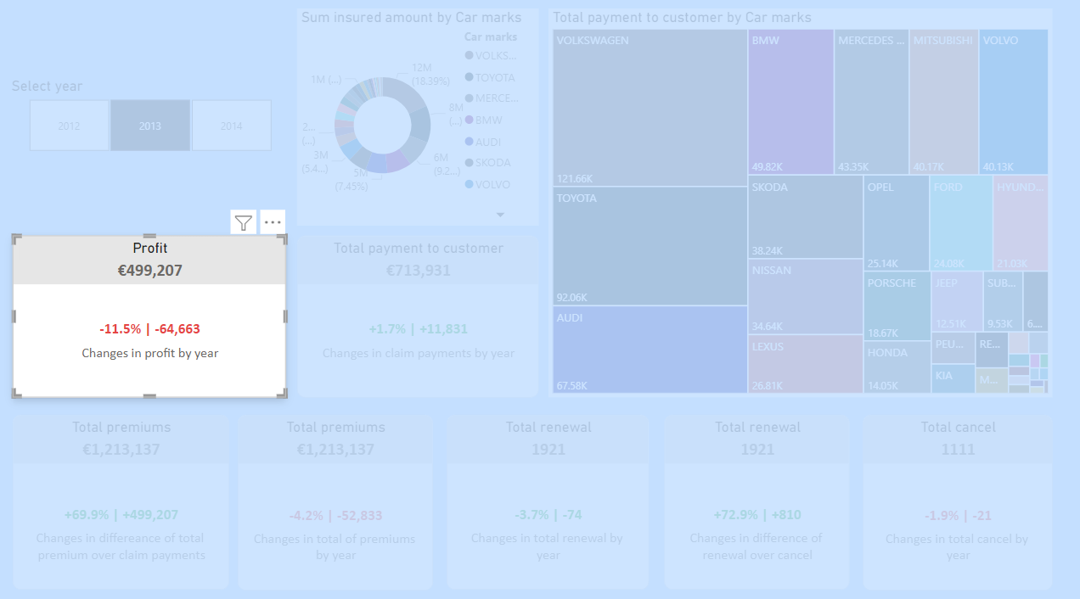
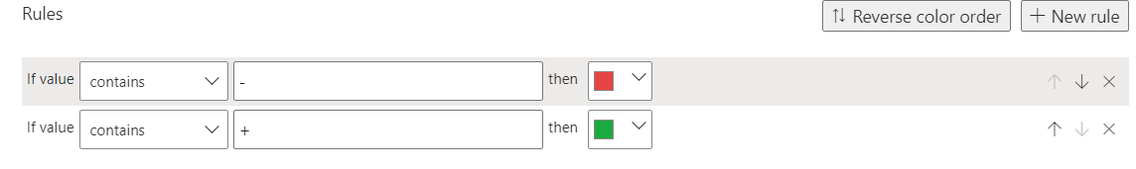
DAX formula of calculating profit by selected year:
DAX formula calculating percentage and number of increases by selected and previous year according to a selected year from the slicer. Exception handling was added to the DAX formula. DAX formula:
KPI Profit = FORMAT([TotalProfit], "€#,0") & ""
KPI Increase Profit ThisYear =
VAR Selected_Year = SELECTEDVALUE('policies'[Year])
VAR Profit_SelectedYear =
CALCULATE(
'calculations'[TotalProfit],
FILTER(
ALL('policies'),
'policies'[Year] = Selected_Year
)
)
VAR Profit_PreviousYear =
CALCULATE(
'calculations'[TotalProfit],
FILTER(
ALL('policies'),
'policies'[Year] = Selected_Year - 1
)
)
VAR Increase_Profit =
IF(
Selected_Year = 2012,
0,
Profit_SelectedYear - Profit_PreviousYear
)
VAR Percentage_Increase =
IF(
Profit_PreviousYear = 0,
BLANK(),
DIVIDE(Profit_SelectedYear - Profit_PreviousYear, Profit_PreviousYear)
)
VAR _sign = IF(Increase_Profit > 0, "+", "")
RETURN
IF(
Increase_Profit = 0,
"There is no data",
_sign & FORMAT(Percentage_Increase, "#0.0%") & " | " & _sign & FORMAT(Increase_Profit, "#0,#")
)
Ruleset for changing colors:

Slide 6
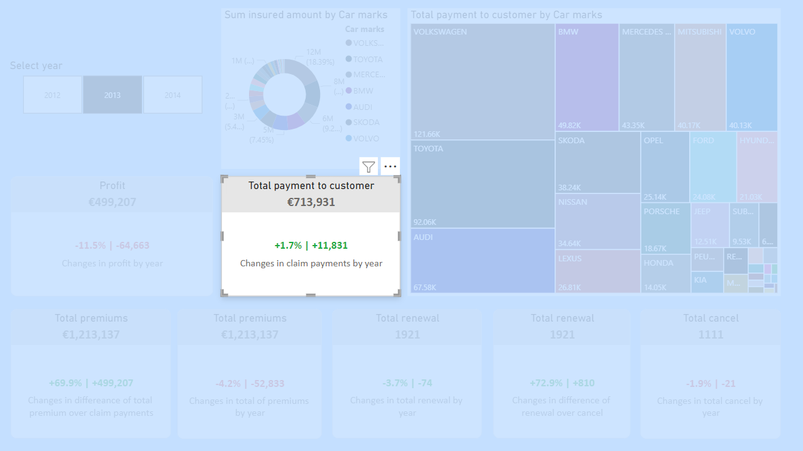
DAX formula calculating percentage and number of total incurred amount increases from payment needed claims by the selected and previous year. The previous year is determined by the selected year from the slicer. Also, exception handling was added to the DAX formula. DAX formula:
KPI Increase Payment to Customer ThisYear =
VAR Selected_Year = SELECTEDVALUE('policies'[Year])
VAR Incurred_Amount_SelectedYear =
CALCULATE(
SUM('claims'[PaymentToCustomer]),
FILTER(
ALL('policies'),
'policies'[Year] = Selected_Year
)
)
VAR Incurred_Amount_PreviousYear =
CALCULATE(
SUM('claims'[PaymentToCustomer]),
FILTER(
ALL('policies'),
'policies'[Year] = Selected_Year - 1
)
)
VAR Increase_Incurred_Amount =
IF(
Selected_Year = 2012,
0,
DAX formula of calculating profit by selected year:
KPI Payment to Customer = FORMAT([SumOfPaymentToCustomer], "€#,0") & ""
Incurred_Amount_SelectedYear - Incurred_Amount_PreviousYear
)
VAR Percentage_Increase =
IF(
Incurred_Amount_PreviousYear = 0,
BLANK(),
DIVIDE(Incurred_Amount_SelectedYear - Incurred_Amount_PreviousYear, Incurred_Amount_PreviousYear)
)
VAR _sign = IF(Increase_Incurred_Amount > 0, "+", "")
RETURN
IF(
Increase_Incurred_Amount = 0,
"There is no data",
_sign & FORMAT(Percentage_Increase, "#0.0%") & " | " & _sign & FORMAT(Increase_Incurred_Amount, "#0,#")
)
Ruleset for changing colors:

Slide 7
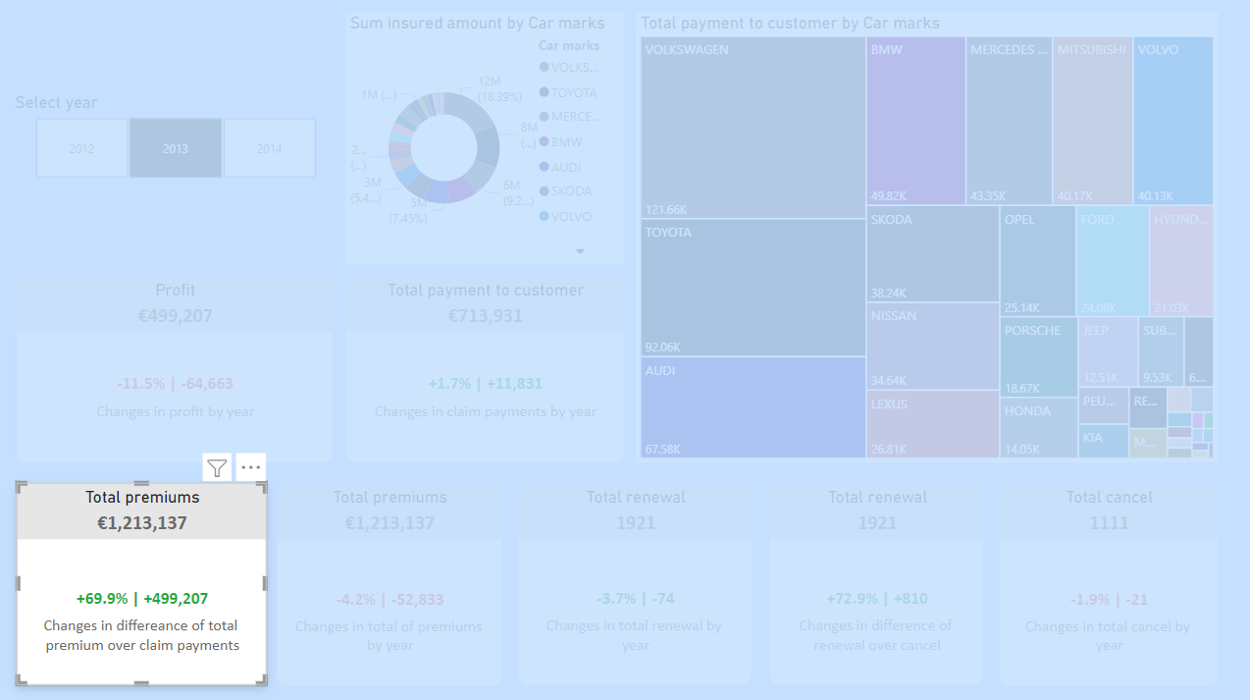
DAX formula calculates how much increases are noticed by comparing the incurred amount of payment needed claims versus premiums of the selected year. DAX formula:
(Total Premium vs Payment to Customer) | Profit =
VAR _var = [SumOfPremium] -[SumOfPaymentToCustomer]
VAR _pct = DIVIDE([SumOfPremium],[SumOfPaymentToCustomer]) -1
VAR _sign = IF(_var >0,"+", "")
RETURN
_sign & FORMAT(_pct, "#0.0%") & " | " &_sign & FORMAT(_var, "#0,#")
Ruleset for changing colors:
DAX formula of calculating total premiums by selected year:
KPI Total Premiums = FORMAT([SumOfPremium], "€#,0") & ""

Slide 8
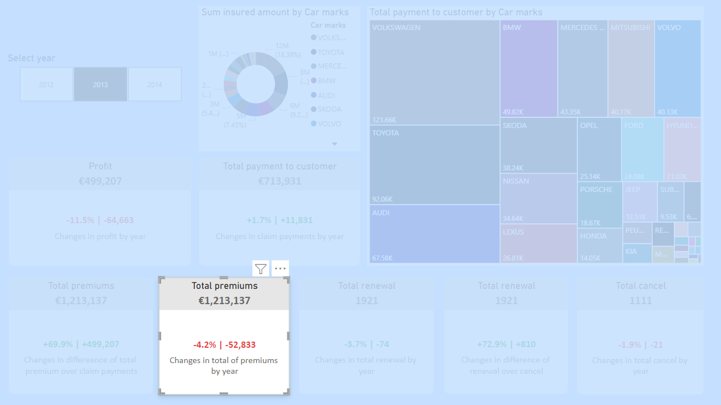
DAX formula calculates the percentage and number of increases in total premium amount by selected and previous year. The previous year is determined by the selected year from the slicer. Also, Exception handling was added to the DAX formula. DAX formula:
KPI Increase Premium ThisYear =
VAR Selected_Year = SELECTEDVALUE('policies'[Year])
VAR Premium_SelectedYear =
CALCULATE(
SUM('policies'[premium]),
FILTER(
ALL('policies'),
'policies'[Year] = Selected_Year
)
)
VAR Premium_PreviousYear =
CALCULATE(
SUM('policies'[premium]),
FILTER(
ALL('policies'),
'policies'[Year] = Selected_Year - 1
)
)
VAR Increase_Premium =
IF(
Selected_Year = 2012,
0,
Premium_SelectedYear - Premium_PreviousYear
)
VAR Percentage_Increase =
IF(
Premium_PreviousYear = 0,
BLANK(),
DIVIDE(Premium_SelectedYear - Premium_PreviousYear, Premium_PreviousYear)
)
VAR _sign = IF(Increase_Premium > 0, "+", "")
RETURN
IF(
Increase_Premium = 0,
"There is no data",
_sign & FORMAT(Percentage_Increase, "#0.0%") & " | " & _sign & FORMAT(Increase_Premium, "#0,#")
)
DAX formula of calculating total premiums by selected year:
KPI Total Premiums = FORMAT([SumOfPremium], "€#,0") & ""

Slide 9
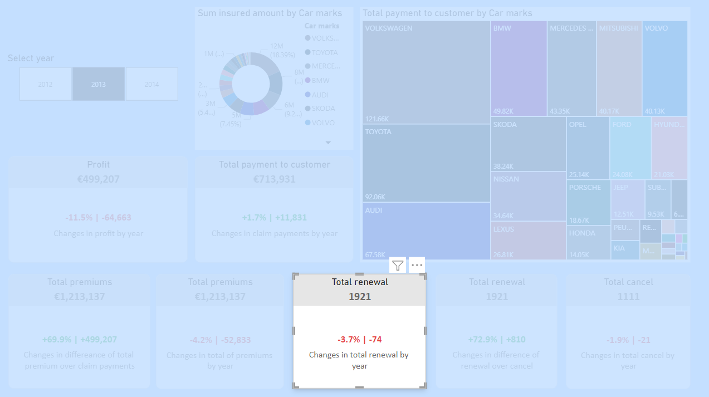
dssdsdsds
KPI Increase Renewal ThisYear =
VAR Selected_Year = SELECTEDVALUE('policies'[Year])
VAR Renewal_SelectedYear =
CALCULATE(
'calculations'[TotalRenewal],
FILTER(
ALL('policies'),
'policies'[Year] = Selected_Year
)
)
VAR Renewal_PreviousYear =
CALCULATE(
'calculations'[TotalRenewal],
FILTER(
ALL('policies'),
'policies'[Year] = Selected_Year - 1
)
)
VAR Increase_Renewal =
IF(
Selected_Year = 2012,
0,
Renewal_SelectedYear - Renewal_PreviousYear
)
VAR Percentage_Increase =
IF(
Renewal_PreviousYear = 0,
BLANK(),
DIVIDE(Renewal_SelectedYear - Renewal_PreviousYear, Renewal_PreviousYear)
)
VAR _sign = IF(Increase_Renewal > 0, "+", "")
RETURN
IF(
Increase_Renewal = 0,
"There is no data",
_sign & FORMAT(Percentage_Increase, "#0.0%") & " | " & _sign & FORMAT(Increase_Renewal, "#0,#")
)
sdsdadasda
KPI Total Renewal = [TotalRenewal] & ""

Slide 10
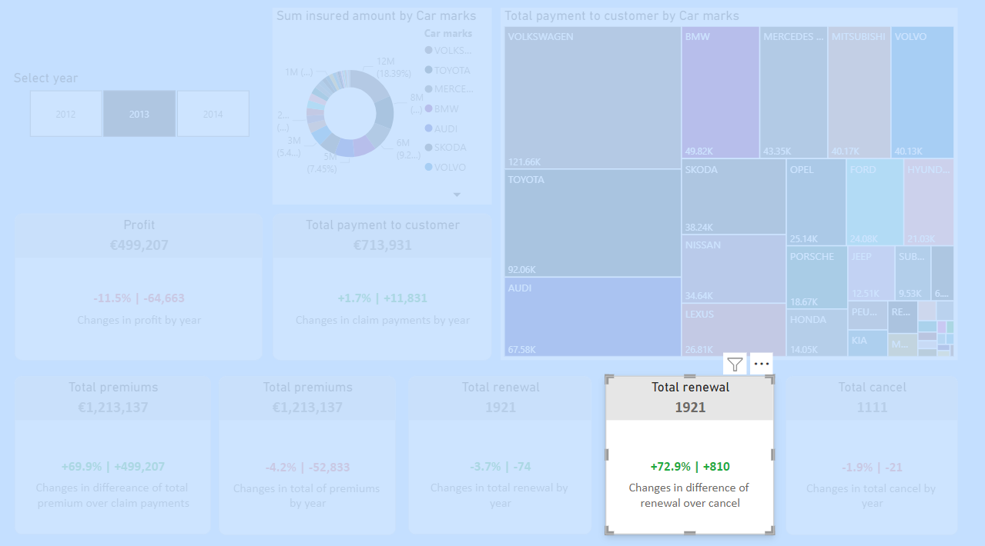
sdadasda
KPI Total Renewal = [TotalRenewal] & ""
sdsdsadasda
KPI Renewal Versus Cancel =
VAR _var = [TotalRenewal] -[TotalCancel]
VAR _pct = DIVIDE([TotalRenewal],[TotalCancel]) -1
VAR _sign = IF(_var >0,"+", "")
RETURN
_sign & FORMAT(_pct, "#0.0%") & " | " &_sign & FORMAT(_var, "#0,#")

Slide 11
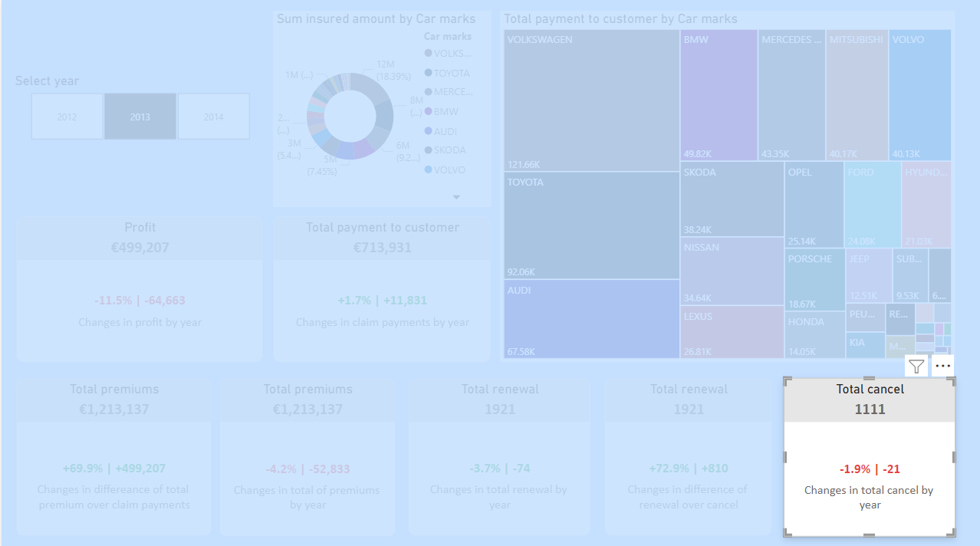
sdasdasdas
KPI Increase Cancel ThisYear =
VAR Selected_Year = SELECTEDVALUE('policies'[Year])
VAR Cancel_SelectedYear =
CALCULATE(
'calculations'[TotalCancel],
FILTER(
ALL('policies'),
'policies'[Year] = Selected_Year
)
)
VAR Cancel_PreviousYear =
CALCULATE(
'calculations'[TotalCancel],
FILTER(
ALL('policies'),
'policies'[Year] = Selected_Year - 1
)
)
VAR Increase_Cancel =
IF(
Selected_Year = 2012,
0,
Cancel_SelectedYear - Cancel_PreviousYear
)
VAR Percentage_Increase =
IF(
Cancel_PreviousYear = 0,
BLANK(),
DIVIDE(Cancel_SelectedYear - Cancel_PreviousYear, Cancel_PreviousYear)
)
VAR _sign = IF(Increase_Cancel > 0, "+", "")
RETURN
IF(
Increase_Cancel = 0,
"There is no data",
_sign & FORMAT(Percentage_Increase, "#0.0%") & " | " & _sign & FORMAT(Increase_Cancel, "#0,#")
)
dadasda
KPI Total Cancel = [TotalCancel] & ""

Slide 12
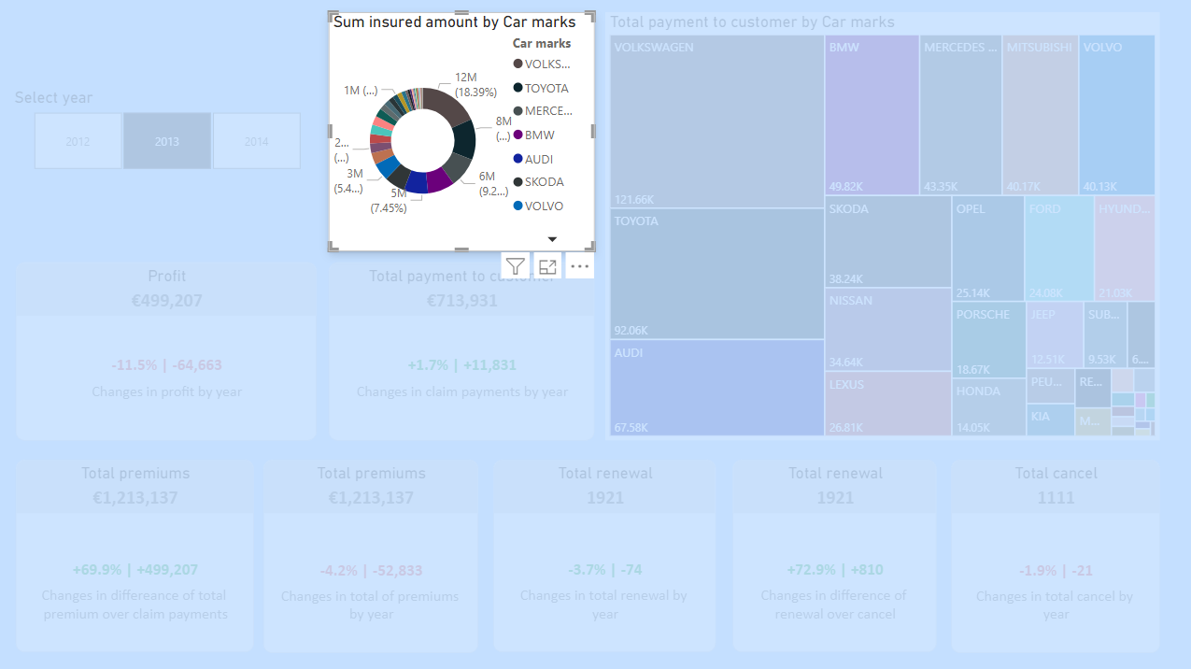
dsfsdfdfsfsdfs

Slide 13
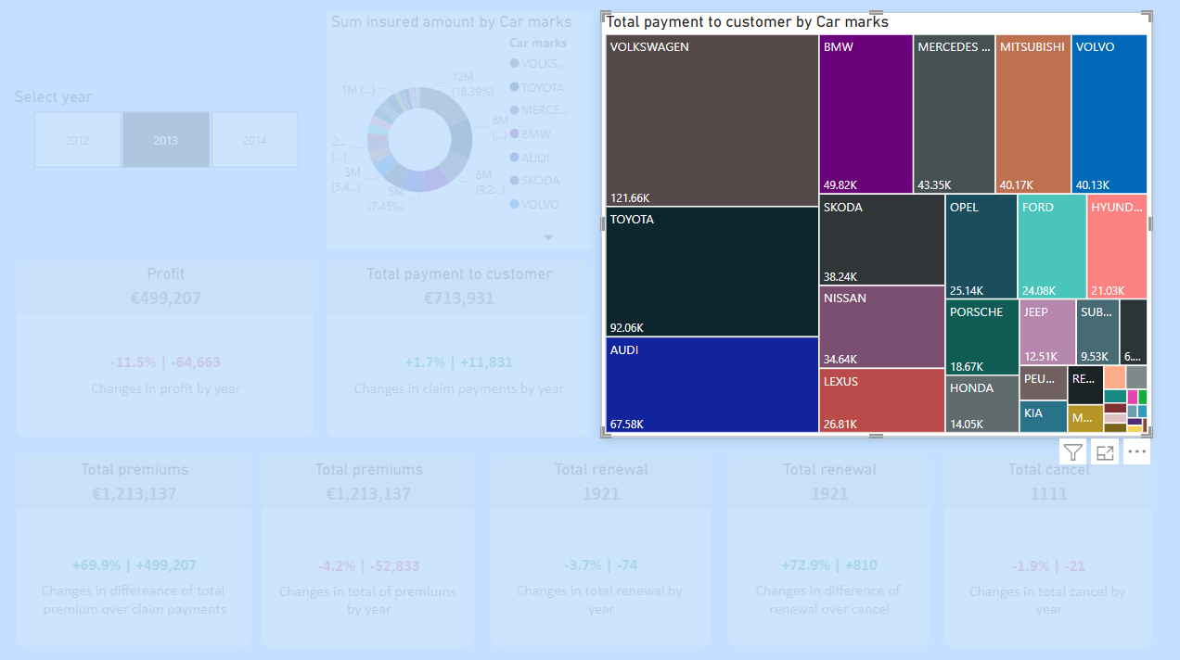
Total payment to customer from payment needed claims by mark of car. The Total number of payments is calculated by the DAX formula, which is calculated from the calims table.
DAX formula for total payment to the customers:
SumOfPaymentToCustomer = SUM(claims[PaymentToCustomer])
DAX formula for creating a calculated column of payment to customers which after deductible. The amount is paid from customer’s pocket:
PaymentToCustomer =
IF(
'Claims'[ClaimType] = "glass",
MAX('Claims'[IncurredAmount] - RELATED('policies'[Deductible_glass]), 0),
MAX('Claims'[IncurredAmount] - RELATED('policies'[Deductible_general]), 0)
)

Slide 14
Trends in claims

Slide 15
“Trends in claims” dashboard
There are 5 analyses in the dashboard, 2 of them is Stacked column chart, 1 is clustered bar chart, and 2 of them are line chart
All analyses can be categorized as univariate quantitive analyses
2 Line charts aim to show claims by registration year and vehicle year seperatly. 2 Stacked column shows total payment needed claims by Leasing status with the Vehicle type and Vehicle usage separately. And, one Clustered chart just shows the total number of payments needed claims by engine type.

Slide 16
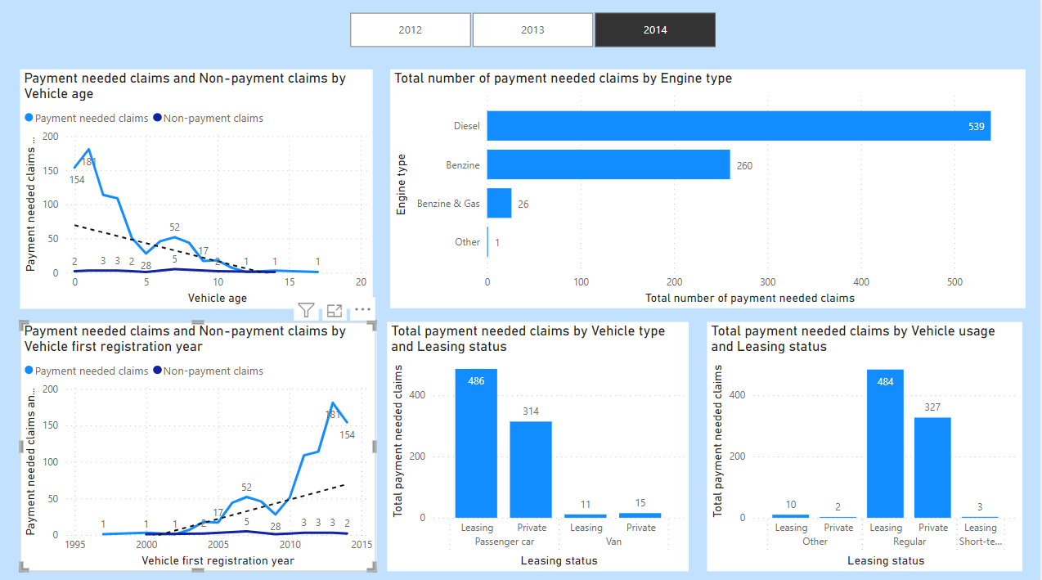

Slide 17
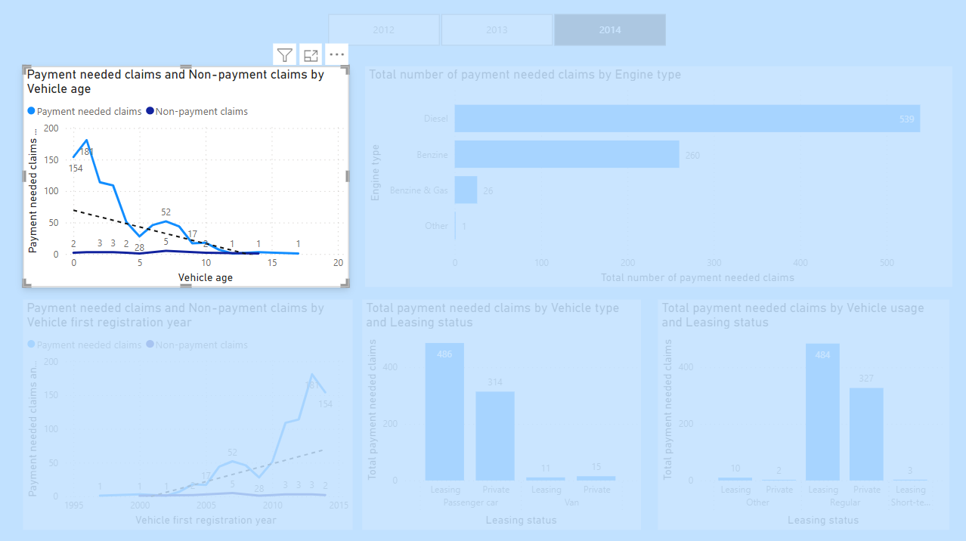
DAX formula for finding count of payment needed claims
TotalNonZeroPayments =
COUNTROWS(
FILTER(
'Claims',
'Claims'[PaymentToCustomer] <> 0
)
)
Trend: We observe trends related to non-payment claims and payment-needed claims based on the age of vehicles. The data suggests that newer cars tend to generate more insurance claims, leading insurance company to set higher premium amounts for these vehicles.

Slide 18
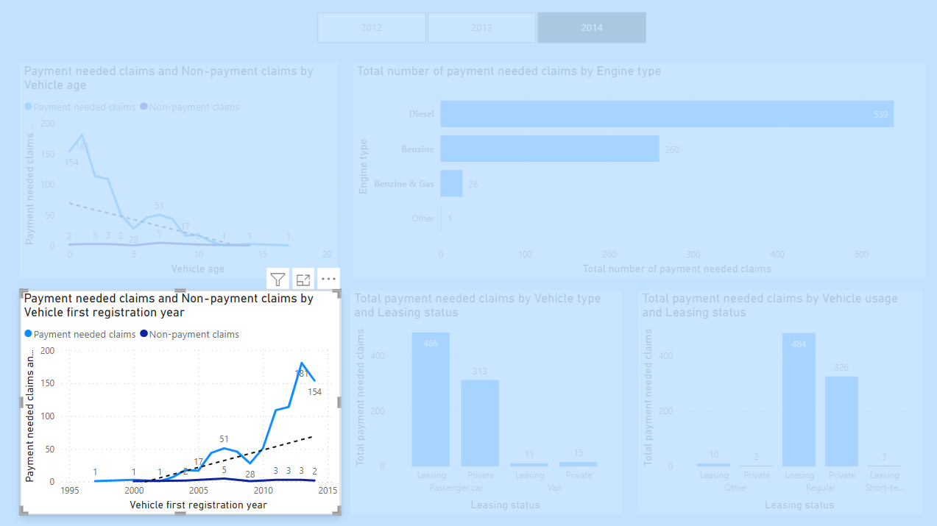
Trend: The Line chart also reveals trends in non-payment claims and payment registered claims based on the year of a vehicle's first registration. The data indicates that cars registered in more recent years are more likely to have higher claim rates compared to long-term customers with older vehicles
DAX formula for finding count of no payment needed claims
TotalZeroPayments =
COUNTROWS(
FILTER(
'Claims',
'Claims'[PaymentToCustomer] = 0
)
)
DAX formula for finding the count of payment needed claims
TotalNonZeroPayments =
COUNTROWS(
FILTER(
'Claims',
'Claims'[PaymentToCustomer] <> 0
)
)

Slide 19
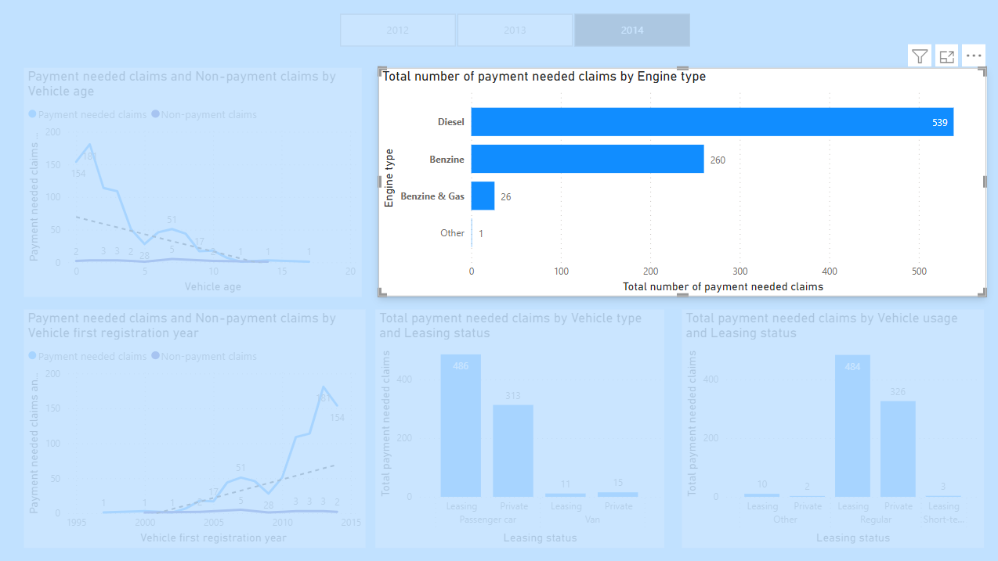
DAX formula for finding count of payment needed claims
TotalNonZeroPayments =
COUNTROWS(
FILTER(
'Claims',
'Claims'[PaymentToCustomer] <> 0
)
)
Trend: The Clustered bar chart compares different Engine types with the total number of payment needed claims. The data shows that cars equipped with Diesel and Benzine engines tend to result in more payment-needed claims, indicating that insurance premiums for such vehicles should be higher

Slide 20
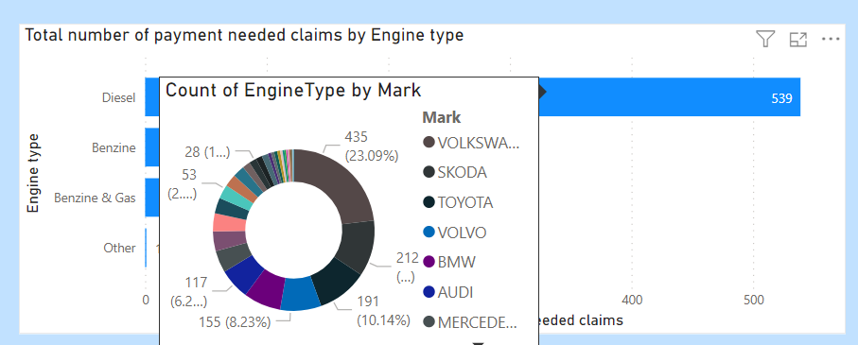
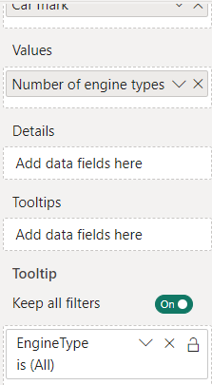
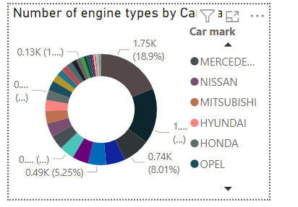

Slide 21
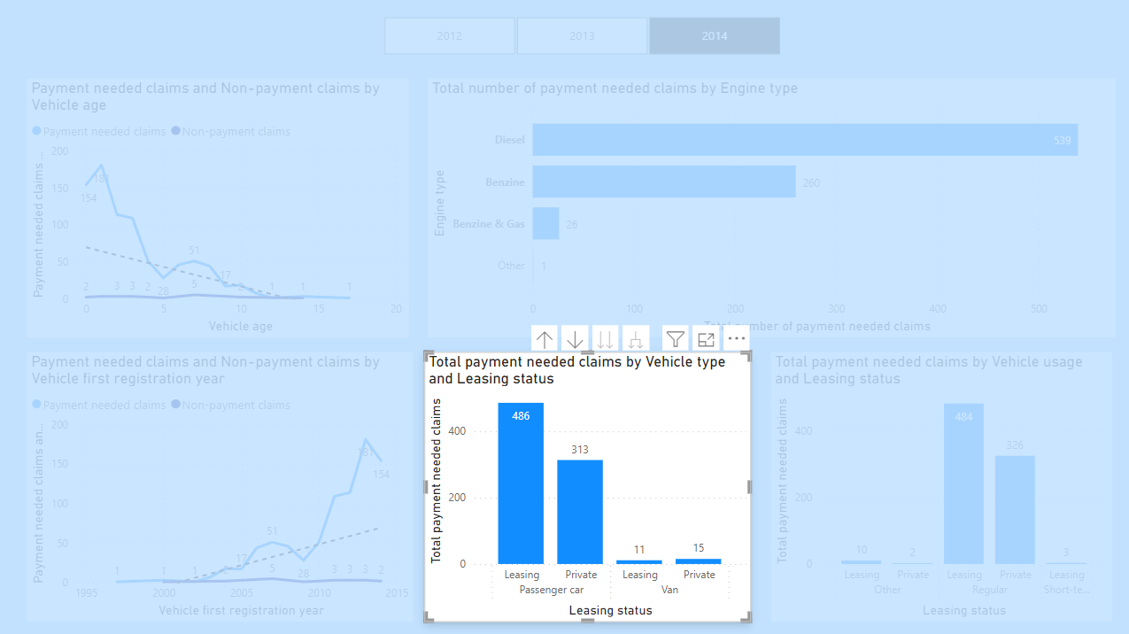
DAX formula for finding count of payment needed claims
TotalNonZeroPayments =
COUNTROWS(
FILTER(
'Claims',
'Claims'[PaymentToCustomer] <> 0
)
)
DAX formula for converting numeric values to understandable strings
LeasingStatus =
IF('policies'[leasing] = 1, "leasing", "private")
Trend: The Stacked column charts demonstrate that leasing cars, particularly passenger cars, have a higher probability of generating payment needed claims.

Slide 22
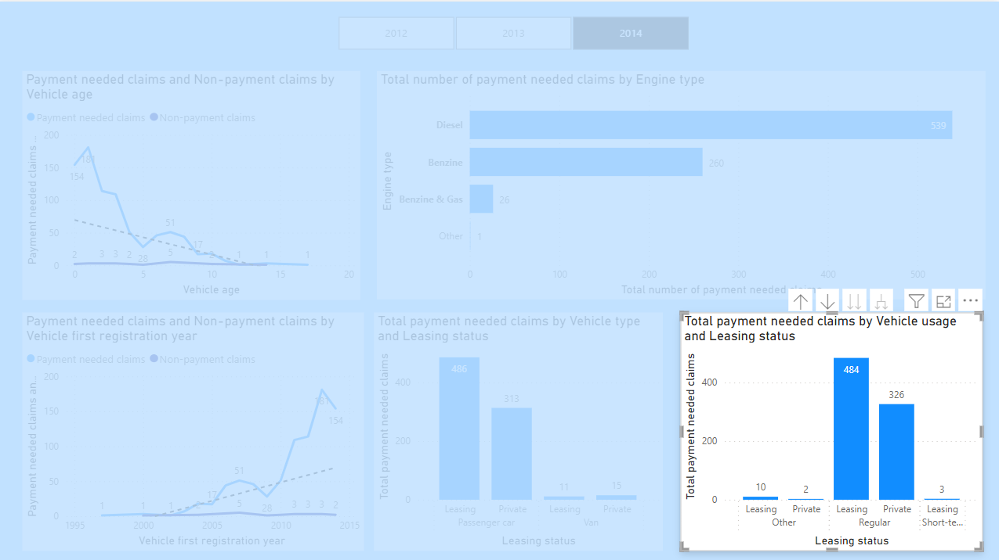
DAX formula for finding count of payment needed claims
Trend: The Stacked column charts demonstrate that leasing cars, particularly cars used regularly, have a higher probability of generating payment needed claims.
TotalNonZeroPayments =
COUNTROWS(
FILTER(
'Claims',
'Claims'[PaymentToCustomer] <> 0
)
)
DAX formula for converting numeric values to understandable strings
LeasingStatus =
IF('policies'[leasing] = 1, "leasing", "private")

Slide 23
Finding trends
In the Line chart, we observe trends related to non-payment claims and payment-needed claims based on the age of vehicles. The data suggests that newer cars tend to generate more insurance claims, leading insurance company to set higher premium amounts for these vehicles.
The Line chart also reveals trends in non-payment claims and payment registered claims based on the year of a vehicle's first registration. The data indicates that cars registered in more recent years are more likely to have higher claim rates compared to long-term customers with older vehicles.
The Clustered bar chart compares different Engine types with the total number of payment needed claims. The data shows that cars equipped with Diesel and Benzine engines tend to result in more payment needed claims, indicating that insurance premiums for such vehicles should be higher.
Furthermore, the Stacked column charts demonstrate that leasing cars, particularly passenger cars used regularly, have a higher probability of generating payment needed claims.

Slide 24
“Introduction of claims” dashboard
How much and kind of analyses in dashboard?
Type analyses
Same groups

Slide 25
“Introduction of claims” dashboard

Slide 26
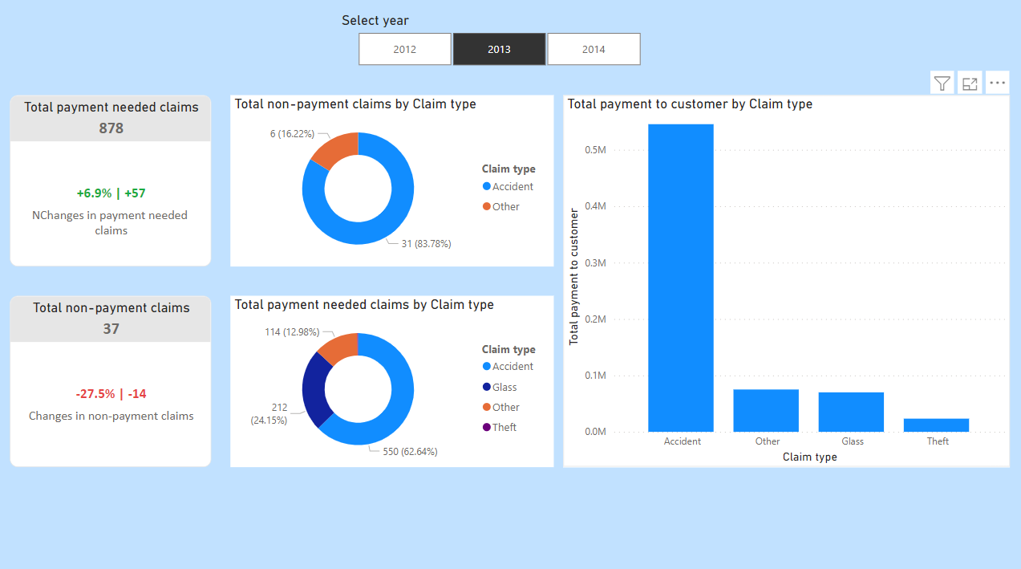

Slide 27
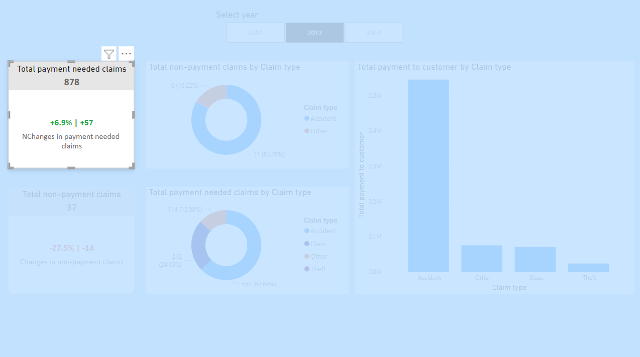
DAX formula calculates the percentage and number of increases in claims which needs payment to the customer by selected and previous year according to a selected year from the slicer. Exception handling was added to the DAX formula. DAX formula:
KPI Increase Number of Claims ThisYear =
VAR Selected_Year = SELECTEDVALUE('policies'[Year])
VAR Claims_SelectedYear =
CALCULATE(
[TotalNonZeroPayments],
FILTER(
ALL('policies'),
'policies'[Year] = Selected_Year
)
)
VAR Claims_PreviousYear =
CALCULATE(
[TotalNonZeroPayments],
FILTER(
ALL('policies'),
'policies'[Year] = Selected_Year - 1
)
)
VAR Increase_Claims =
IF(
Selected_Year = 2012,
0,
Claims_SelectedYear - Claims_PreviousYear
)
VAR Percentage_Increase =
IF(
Claims_PreviousYear = 0,
BLANK(),
DIVIDE(Claims_SelectedYear - Claims_PreviousYear, Claims_PreviousYear)
)
VAR _sign = IF(Increase_Claims > 0, "+", "")
RETURN
IF(
Increase_Claims = 0,
"There is no data",
_sign & FORMAT(Percentage_Increase, "#0.0%") & " | " & _sign & FORMAT(Increase_Claims, "#0,#")
)
DAX formula of calculating total payment needed claims by selected year:
KPI NonZero Payment Claims = [TotalNonZeroPayments] & ""

Slide 28
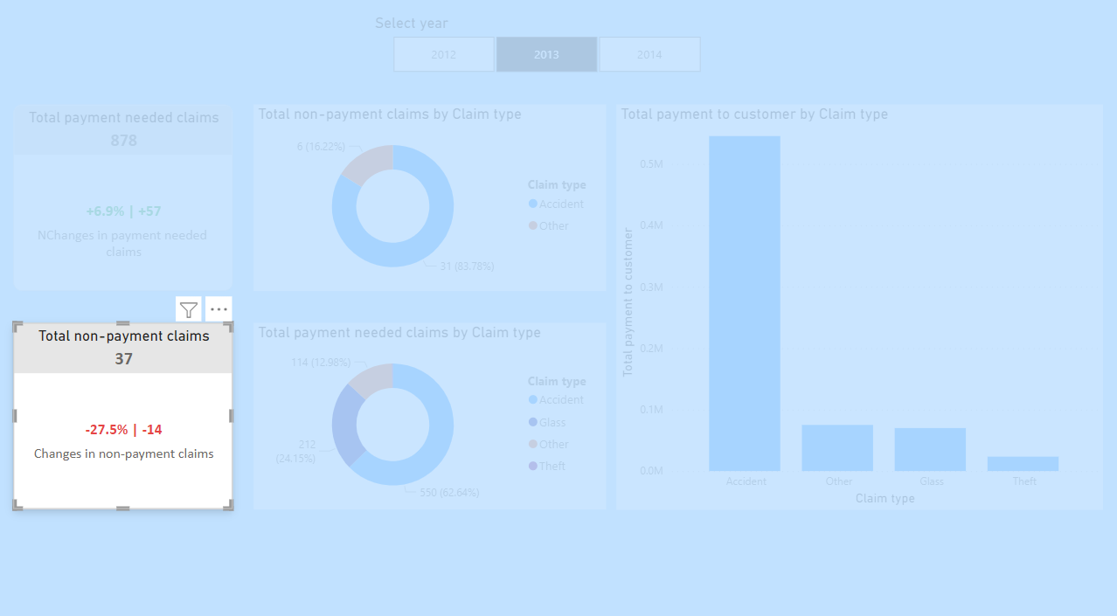
DAX formula calculates the percentage and number of increases in claims which needs no payment to the customer by selected and previous year according to a selected year from the slicer. Exception handling was added to the DAX formula. DAX formula:
KPI Increase Number of Non Payment Claims ThisYear =
VAR Selected_Year = SELECTEDVALUE('policies'[Year])
VAR Claims_SelectedYear =
CALCULATE(
[TotalZeroPayments],
FILTER(
ALL('policies'),
'policies'[Year] = Selected_Year
)
)
VAR Claims_PreviousYear =
CALCULATE(
[TotalZeroPayments],
FILTER(
ALL('policies'),
'policies'[Year] = Selected_Year - 1
)
)
VAR Increase_Claims =
IF(
Selected_Year = 2012,
0,
Claims_SelectedYear - Claims_PreviousYear
)
VAR Percentage_Increase =
IF(
Claims_PreviousYear = 0,
BLANK(),
DIVIDE(Claims_SelectedYear - Claims_PreviousYear, Claims_PreviousYear)
)
VAR _sign = IF(Increase_Claims > 0, "+", "")
RETURN
IF(
Increase_Claims = 0,
"There is no data",
_sign & FORMAT(Percentage_Increase, "#0.0%") & " | " & _sign & FORMAT(Increase_Claims, "#0,#")
)
DAX formula of calculating total non-payment claims by selected year:
KPI Zero Payment Claims = [TotalZeroPayments] & ""

Slide 29
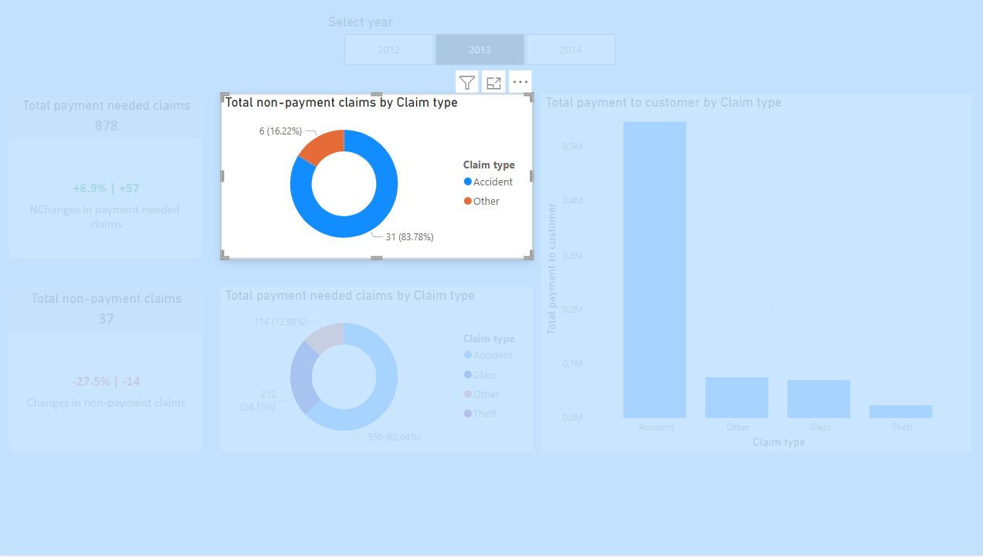
sdasda
TotalZeroPayments =
COUNTROWS(
FILTER(
'Claims',
'Claims'[PaymentToCustomer] = 0
)
)

Slide 30
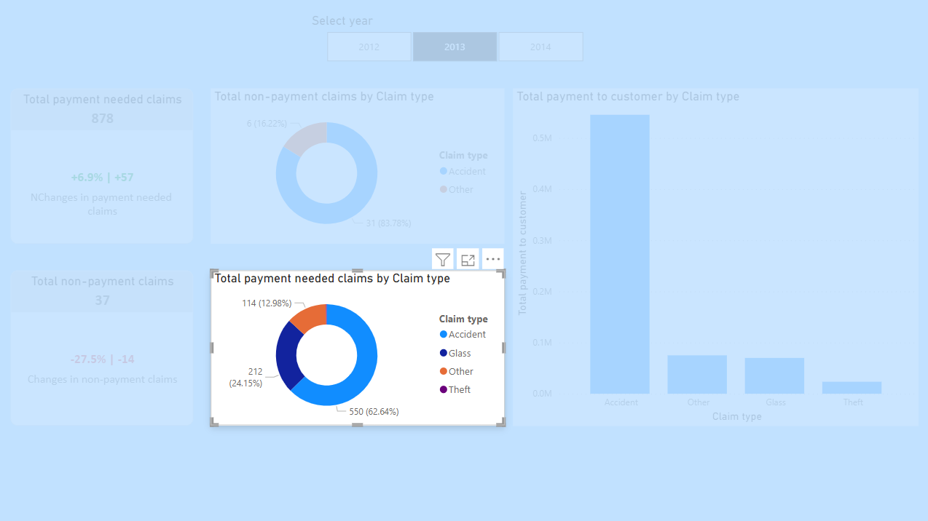
asdasdasdasda
TotalNonZeroPayments =
COUNTROWS(
FILTER(
'Claims',
'Claims'[PaymentToCustomer] <> 0
)
)

Slide 31
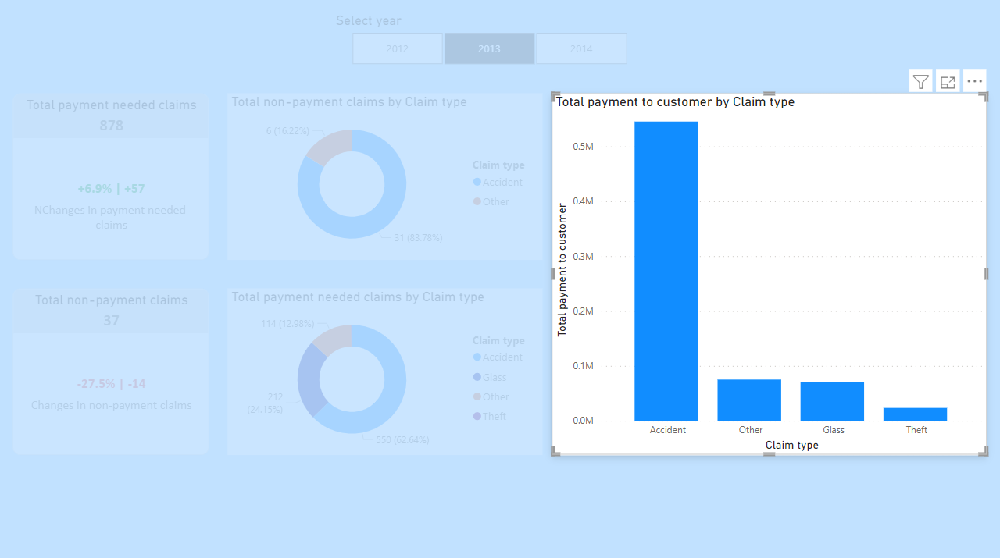
sdasdasdasdsa
PaymentToCustomer =
IF(
'Claims'[ClaimType] = "glass",
MAX('Claims'[IncurredAmount] - RELATED('policies'[Deductible_glass]), 0),
MAX('Claims'[IncurredAmount] - RELATED('policies'[Deductible_general]), 0)
)

Slide 32
Finding trends
Total non-payment claims by Claim type analyses: We can see glass-related damages covered by the insurance company because there is not any glass-related non-payment needed claim
Total payment to the customer by Claim type analyses: The company should avoid customers which a high risk of Accidents because the total number of payments is more than the total of other claim types
Cards: They show trends in which there are always non-payment needed claims each year but they are a minority. The insurance company can focus on customers who potentially do non-payment claims

