Slide 1
Homework task
Shahin Yusifli

Slide 2
“Portfolio” dashboard
There are 9 analyses which 7 analyses are Cards, 1 analysis is Treemap and 1 analysis is a Dount chart.
Also, 8 analyses in the dashboard can be classified as bivariate analyses but one Dount chart analysis should be classified as a univariate analysis
If I need to talk about more calculated measures, calculated measures were linked to profit, premiums, payment amount from payment needed claims, total renewal amount, and total cancel amount. Measures show individual value changes by current and previous year with numbers and percentages. Also, some measures show values versus another value by year in numbers and percentages.
I prefer to choose default Cards because row-level security can be violated by using custom Cards from the market. Insurance data sets can contain PII(Personal Identifying Information) data which should be considered while using third-party analyses.

Slide 3
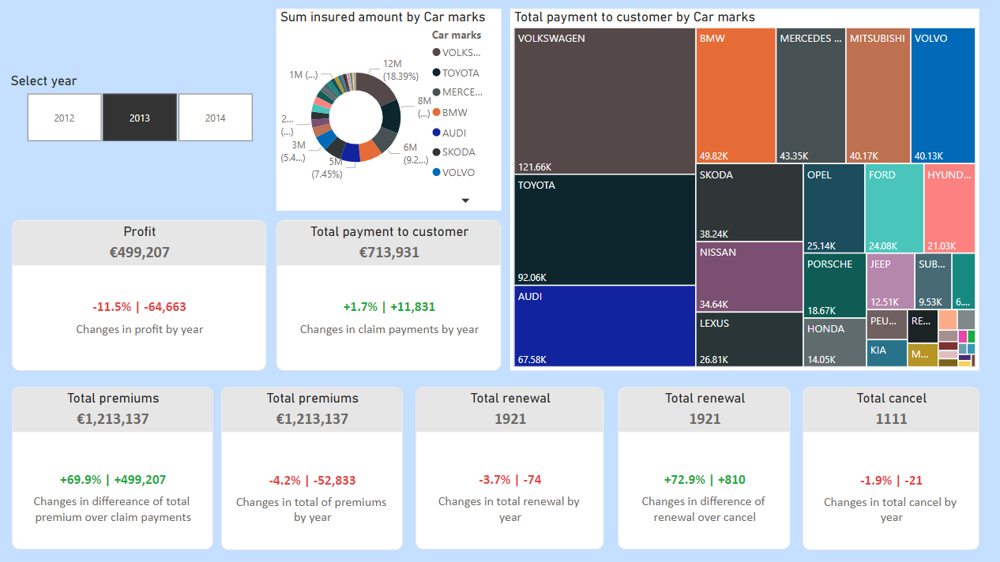

Slide 4
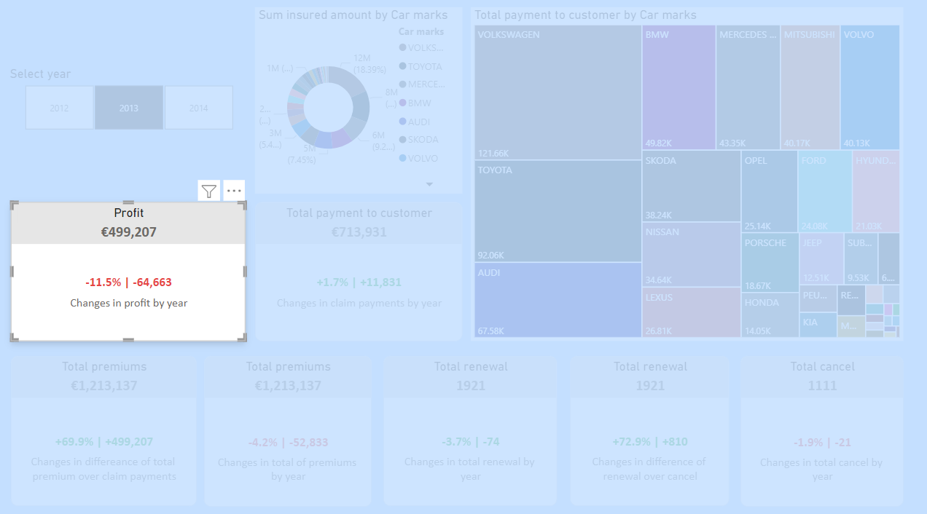
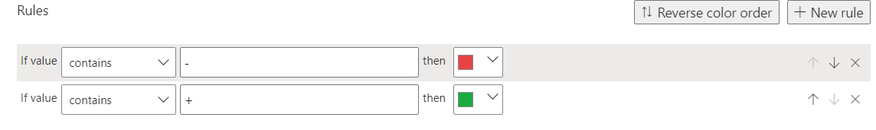
Total profit by euro format
DAX formula calculating percentage and number of changes by selected and previous year according to a selected year from the slicer. Exception handling was added to the DAX formula. DAX formula:
KPI Profit = FORMAT([TotalProfit], "€#,0") & ""
KPI Increase Profit ThisYear =
VAR Selected_Year = SELECTEDVALUE('policies'[Year])
VAR Profit_SelectedYear =
CALCULATE(
'calculations'[TotalProfit],
FILTER(
ALL('policies'),
'policies'[Year] = Selected_Year
)
)
VAR Profit_PreviousYear =
CALCULATE(
'calculations'[TotalProfit],
FILTER(
ALL('policies'),
'policies'[Year] = Selected_Year - 1
)
)
VAR Increase_Profit =
IF(
Selected_Year = 2012,
0,
Profit_SelectedYear - Profit_PreviousYear
)
VAR Percentage_Increase =
IF(
Profit_PreviousYear = 0,
BLANK(),
DIVIDE(Profit_SelectedYear - Profit_PreviousYear, Profit_PreviousYear)
)
VAR _sign = IF(Increase_Profit > 0, "+", "")
RETURN
IF(
Increase_Profit = 0,
"There is no data",
_sign & FORMAT(Percentage_Increase, "#0.0%") & " | " & _sign & FORMAT(Increase_Profit, "#0,#")
)
Ruleset for changing colors:

Slide 5
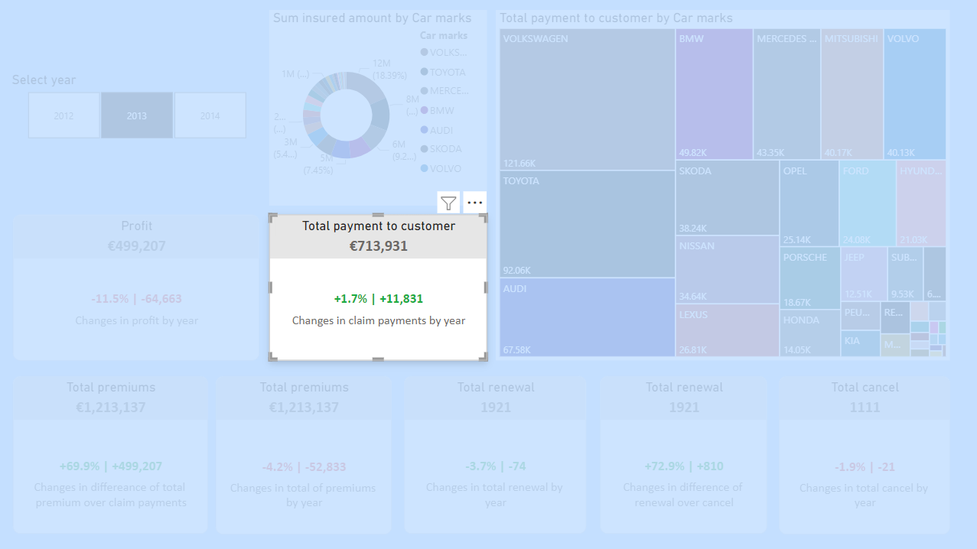
DAX formula calculating percentage and number of total incurred amount changes from payment needed claims by the selected and previous year. The previous year is determined by the selected year from the slicer. Also, exception handling was added to the DAX formula. DAX formula:
KPI Increase Payment to Customer ThisYear =
VAR Selected_Year = SELECTEDVALUE('policies'[Year])
VAR Incurred_Amount_SelectedYear =
CALCULATE(
SUM('claims'[PaymentToCustomer]),
FILTER(
ALL('policies'),
'policies'[Year] = Selected_Year
)
)
VAR Incurred_Amount_PreviousYear =
CALCULATE(
SUM('claims'[PaymentToCustomer]),
FILTER(
ALL('policies'),
'policies'[Year] = Selected_Year - 1
)
)
VAR Increase_Incurred_Amount =
IF(
Selected_Year = 2012,
0,
DAX formula of calculating profit by selected year:
KPI Payment to Customer = FORMAT([SumOfPaymentToCustomer], "€#,0") & ""
Incurred_Amount_SelectedYear - Incurred_Amount_PreviousYear
)
VAR Percentage_Increase =
IF(
Incurred_Amount_PreviousYear = 0,
BLANK(),
DIVIDE(Incurred_Amount_SelectedYear - Incurred_Amount_PreviousYear, Incurred_Amount_PreviousYear)
)
VAR _sign = IF(Increase_Incurred_Amount > 0, "+", "")
RETURN
IF(
Increase_Incurred_Amount = 0,
"There is no data",
_sign & FORMAT(Percentage_Increase, "#0.0%") & " | " & _sign & FORMAT(Increase_Incurred_Amount, "#0,#")
)
Ruleset for changing colors:

Slide 6
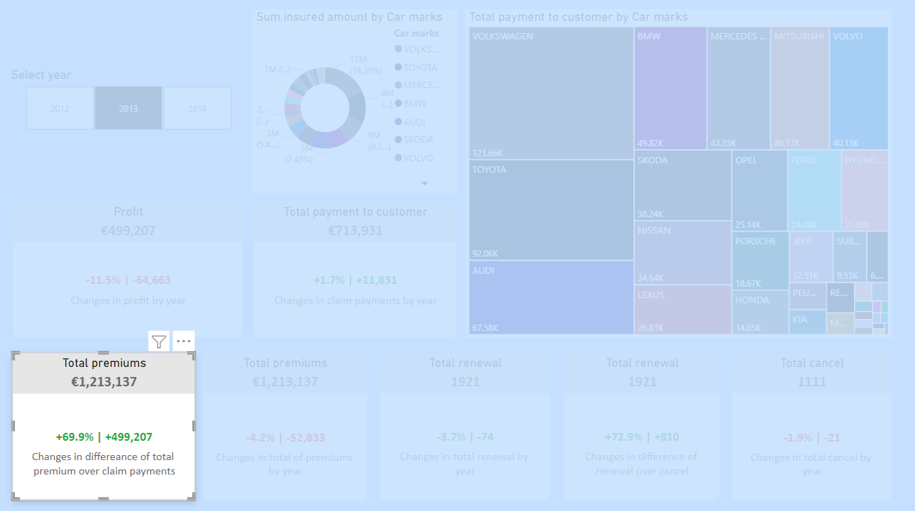
DAX formula calculates how much changes are noticed by comparing the incurred amount of payment needed claims versus premiums of the selected year. DAX formula:
(Total Premium vs Payment to Customer) | Profit =
VAR _var = [SumOfPremium] -[SumOfPaymentToCustomer]
VAR _pct = DIVIDE([SumOfPremium],[SumOfPaymentToCustomer]) -1
VAR _sign = IF(_var >0,"+", "")
RETURN
_sign & FORMAT(_pct, "#0.0%") & " | " &_sign & FORMAT(_var, "#0,#")
Ruleset for changing colors:
DAX formula of calculating total premiums by selected year:
KPI Total Premiums = FORMAT([SumOfPremium], "€#,0") & ""

Slide 7
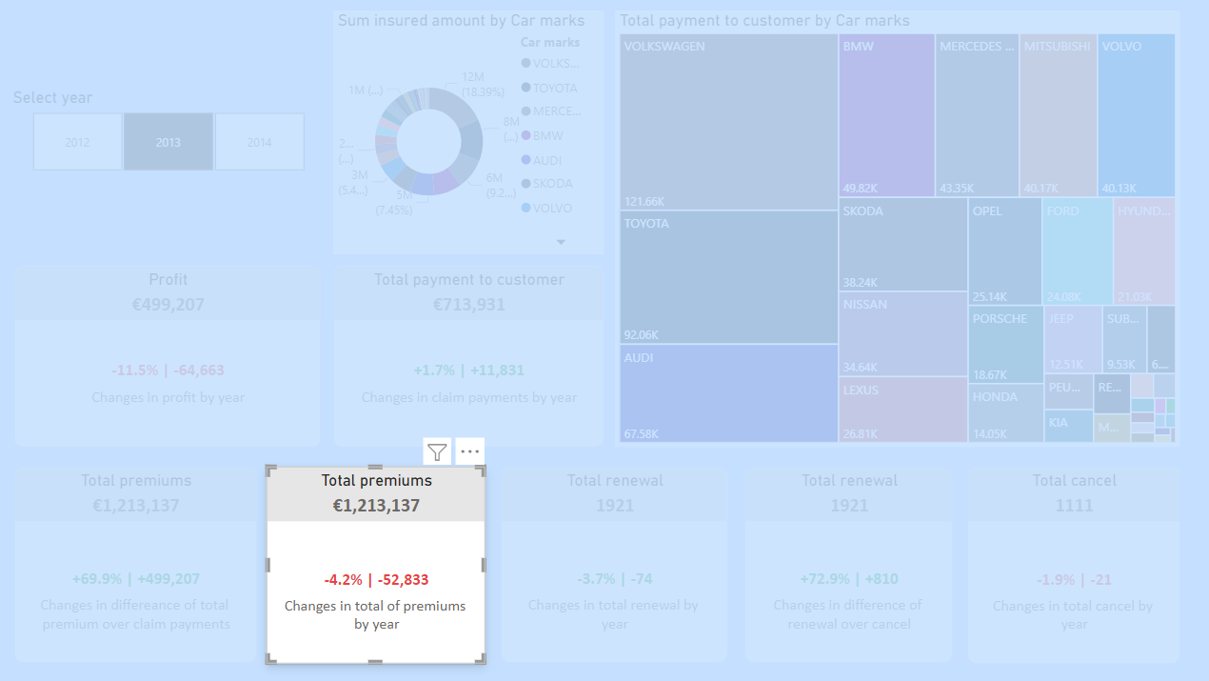
DAX formula calculates the percentage and number of changes in total premium amount by selected and previous year. The previous year is determined by the selected year from the slicer. Also, Exception handling was added to the DAX formula. DAX formula:
KPI Increase Premium ThisYear =
VAR Selected_Year = SELECTEDVALUE('policies'[Year])
VAR Premium_SelectedYear =
CALCULATE(
SUM('policies'[premium]),
FILTER(
ALL('policies'),
'policies'[Year] = Selected_Year
)
)
VAR Premium_PreviousYear =
CALCULATE(
SUM('policies'[premium]),
FILTER(
ALL('policies'),
'policies'[Year] = Selected_Year - 1
)
)
VAR Increase_Premium =
IF(
Selected_Year = 2012,
0,
Premium_SelectedYear - Premium_PreviousYear
)
VAR Percentage_Increase =
IF(
Premium_PreviousYear = 0,
BLANK(),
DIVIDE(Premium_SelectedYear - Premium_PreviousYear, Premium_PreviousYear)
)
VAR _sign = IF(Increase_Premium > 0, "+", "")
RETURN
IF(
Increase_Premium = 0,
"There is no data",
_sign & FORMAT(Percentage_Increase, "#0.0%") & " | " & _sign & FORMAT(Increase_Premium, "#0,#")
)
DAX formula of calculating total premiums by selected year:
KPI Total Premiums = FORMAT([SumOfPremium], "€#,0") & ""

Slide 8
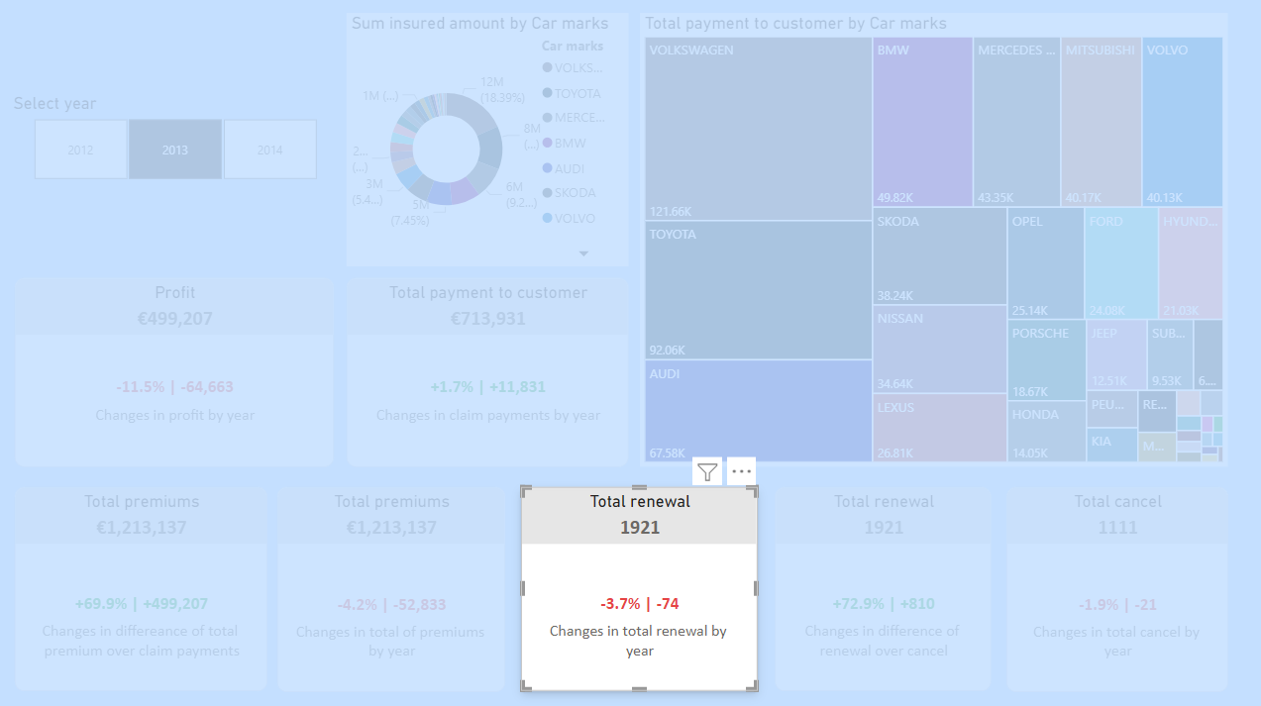
DAX formula calculate total number renewal changes by selected year with compare it previous year
KPI Increase Renewal ThisYear =
VAR Selected_Year = SELECTEDVALUE('policies'[Year])
VAR Renewal_SelectedYear =
CALCULATE(
'calculations'[TotalRenewal],
FILTER(
ALL('policies'),
'policies'[Year] = Selected_Year
)
)
VAR Renewal_PreviousYear =
CALCULATE(
'calculations'[TotalRenewal],
FILTER(
ALL('policies'),
'policies'[Year] = Selected_Year - 1
)
)
VAR Increase_Renewal =
IF(
Selected_Year = 2012,
0,
Renewal_SelectedYear - Renewal_PreviousYear
)
VAR Percentage_Increase =
IF(
Renewal_PreviousYear = 0,
BLANK(),
DIVIDE(Renewal_SelectedYear - Renewal_PreviousYear, Renewal_PreviousYear)
)
VAR _sign = IF(Increase_Renewal > 0, "+", "")
RETURN
IF(
Increase_Renewal = 0,
"There is no data",
_sign & FORMAT(Percentage_Increase, "#0.0%") & " | " & _sign & FORMAT(Increase_Renewal, "#0,#")
)
DAX formula format total number of renewal
KPI Total Renewal = [TotalRenewal] & ""

Slide 9
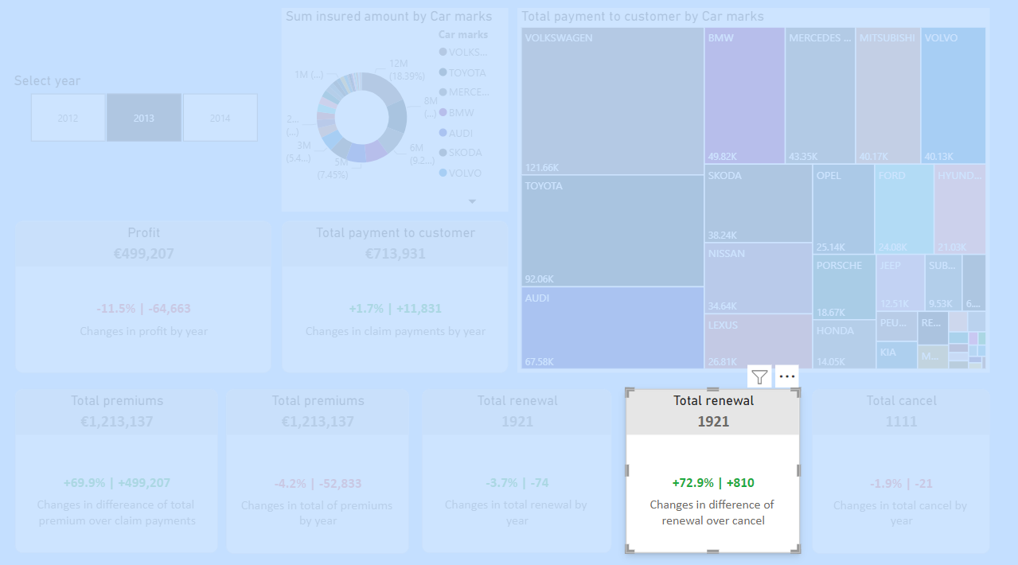
DAX formula calculates the total number of renewal changes over cancel by selected year with compares it previous year a
DAX formula format total number of renewal
KPI Total Renewal = [TotalRenewal] & ""
KPI Renewal Versus Cancel =
VAR _var = [TotalRenewal] -[TotalCancel]
VAR _pct = DIVIDE([TotalRenewal],[TotalCancel]) -1
VAR _sign = IF(_var >0,"+", "")
RETURN
_sign & FORMAT(_pct, "#0.0%") & " | " &_sign & FORMAT(_var, "#0,#")

Slide 10
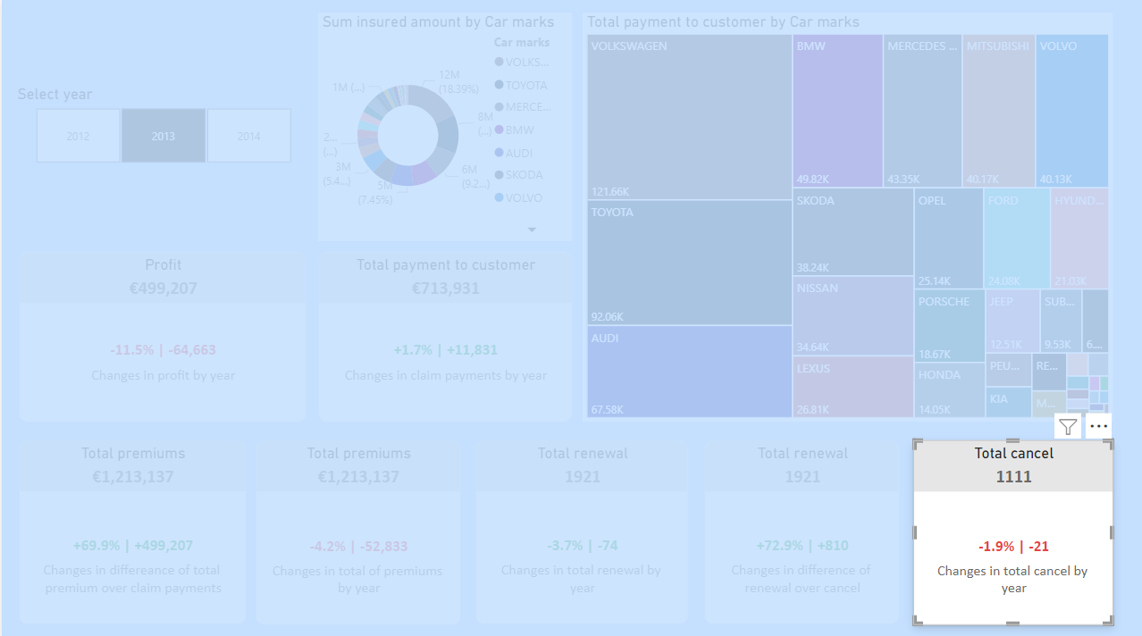
DAX formula calculates total number of cancel changes by selected year with compares it previous year
KPI Increase Cancel ThisYear =
VAR Selected_Year = SELECTEDVALUE('policies'[Year])
VAR Cancel_SelectedYear =
CALCULATE(
'calculations'[TotalCancel],
FILTER(
ALL('policies'),
'policies'[Year] = Selected_Year
)
)
VAR Cancel_PreviousYear =
CALCULATE(
'calculations'[TotalCancel],
FILTER(
ALL('policies'),
'policies'[Year] = Selected_Year - 1
)
)
VAR Increase_Cancel =
IF(
Selected_Year = 2012,
0,
Cancel_SelectedYear - Cancel_PreviousYear
)
VAR Percentage_Increase =
IF(
Cancel_PreviousYear = 0,
BLANK(),
DIVIDE(Cancel_SelectedYear - Cancel_PreviousYear, Cancel_PreviousYear)
)
VAR _sign = IF(Increase_Cancel > 0, "+", "")
RETURN
IF(
Increase_Cancel = 0,
"There is no data",
_sign & FORMAT(Percentage_Increase, "#0.0%") & " | " & _sign & FORMAT(Increase_Cancel, "#0,#")
)
DAX formula format total number of cancel
KPI Total Cancel = [TotalCancel] & ""

Slide 11
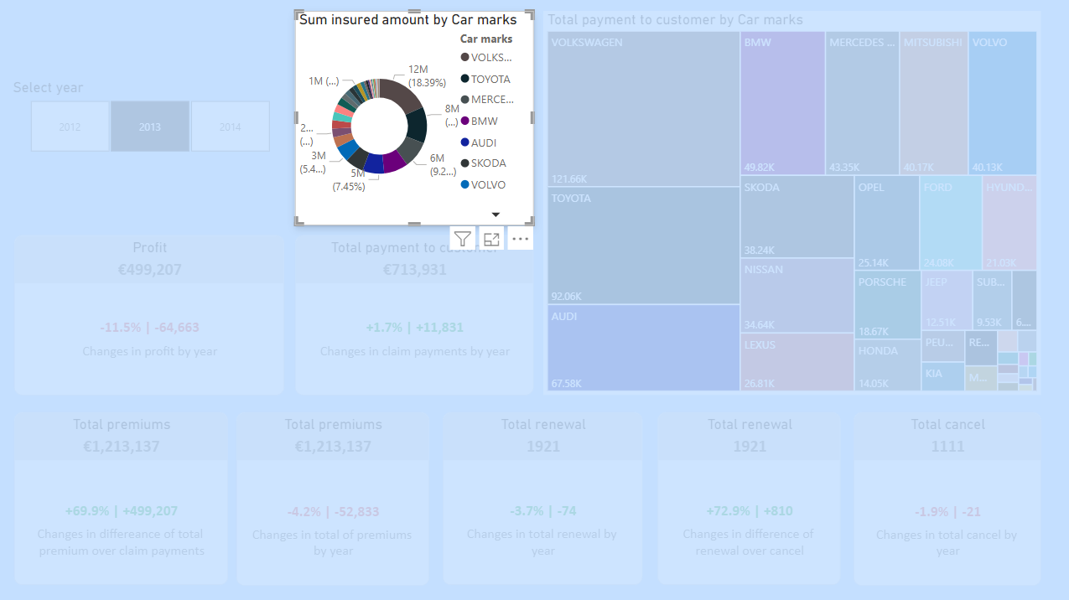
Identified tend: The product manager can get overall information about possible payments by each car mark. The first noticeable trends Volkswagen, Toyota, and Mercedes mark cars have more potential to get payment in the worst scenario in 2013

Slide 12
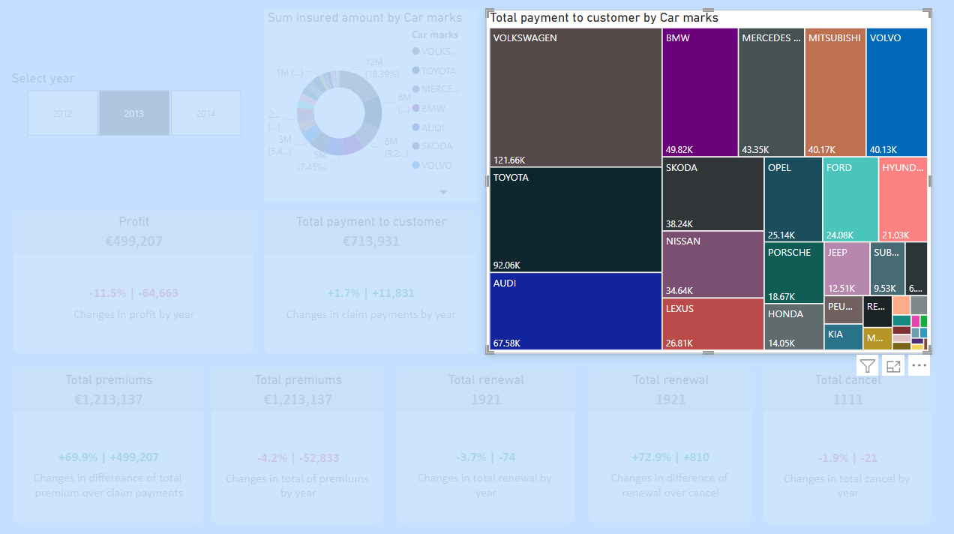
Total payment to customer from payment needed claims by mark of car. The Total number of payments is calculated by the DAX formula, which is calculated from the calims table.
DAX formula for total payment to the customers:
SumOfPaymentToCustomer = SUM(claims[PaymentToCustomer])
DAX formula for creating a calculated column of payment to customers which after deductible. The amount is paid from customer’s pocket:
PaymentToCustomer =
IF(
'Claims'[ClaimType] = "glass",
MAX('Claims'[IncurredAmount] - RELATED('policies'[Deductible_glass]), 0),
MAX('Claims'[IncurredAmount] - RELATED('policies'[Deductible_general]), 0)
)
Identified tend: The product manager can get overall information about the paid amount by each car mark. The first noticeable trends Volkswagen, Toyota, and AUDI mark face more bad damage which causes payments to payment needed claims

Slide 13
“Trends in claims” dashboard
There are 5 analyses in the dashboard, 2 of them is Stacked Column Chart, 1 is Clustered Bar Chart, and 2 of them are Line Chart
All analyses can be categorized as univariate quantitive analyses
2 Line Charts aim to show claims by registration year and vehicle year separately. These line charts are powered with forecasting. 2 Stacked Column Chart shows total payment needed claims by leasing status with the vehicle type and vehicle usage separately. And, one Clustered Chart just shows the total number of payments needed claims by engine type.

Slide 14
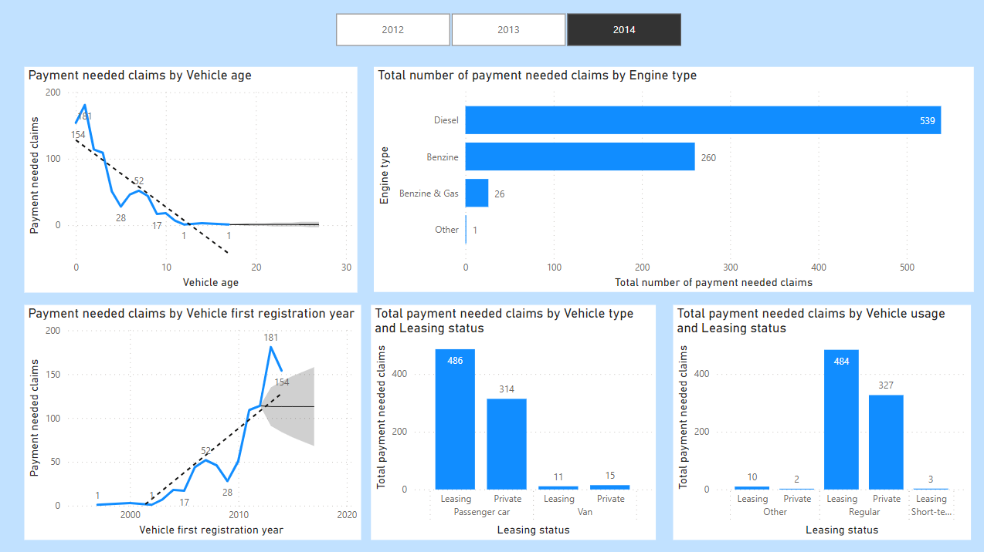

Slide 15
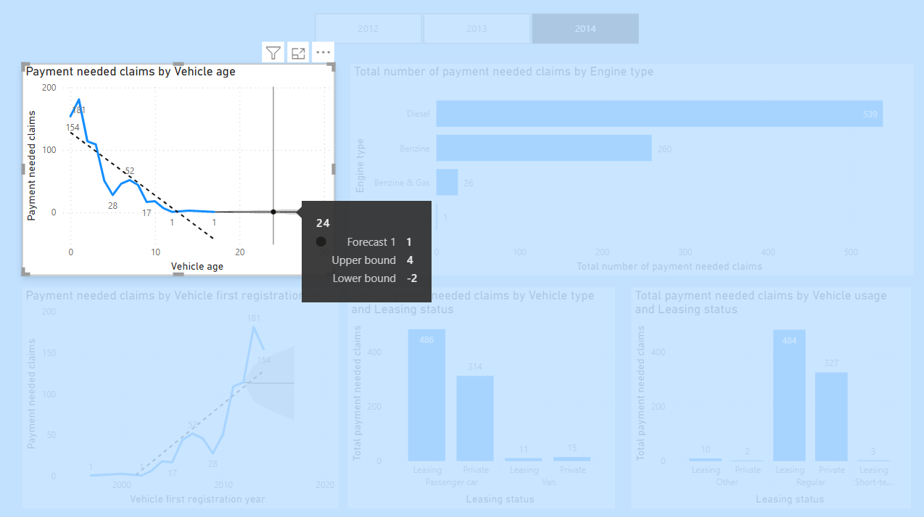
DAX formula for finding count of payment needed claims
TotalNonZeroPayments =
COUNTROWS(
FILTER(
'Claims',
'Claims'[PaymentToCustomer] <> 0
)
)
Identified trend: We observe trends related to non-payment claims and payment-needed claims based on the age of vehicles. First trend: the data suggests that newer cars tend to generate more insurance claims, leading insurance companies to set higher premium amounts for these vehicles. Second trend: forecast shows the same prediction older cars are not relevant to payment needed claims

Slide 16
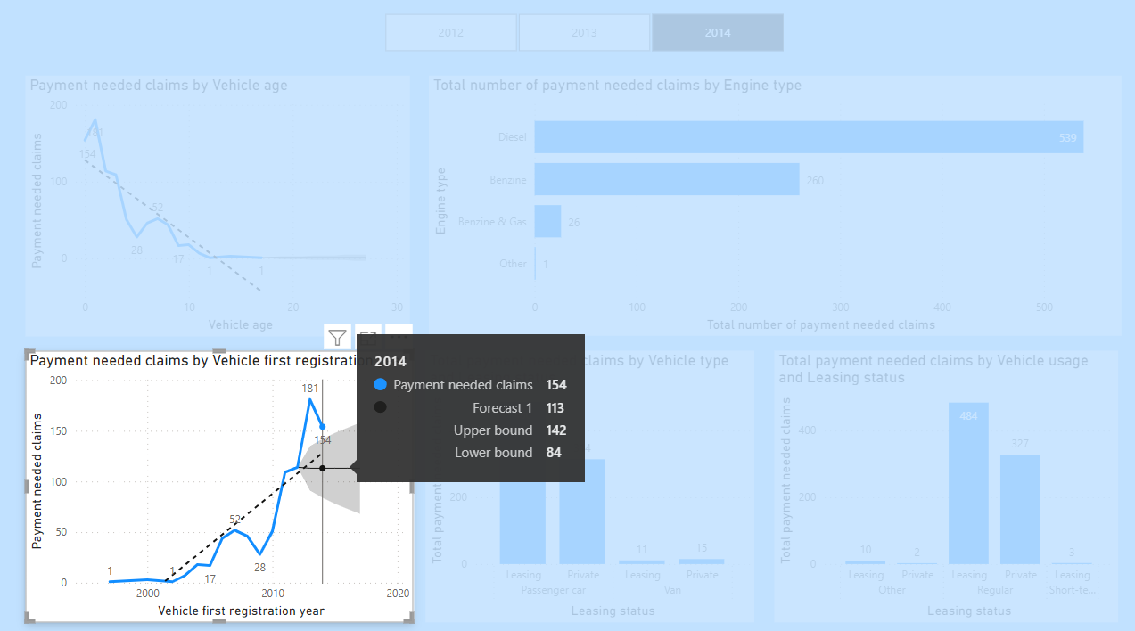
Identified trend: The Line chart also reveals trends in payment registered claims based on the year of a vehicle's first registration. The first trend: the data indicates that cars registered in more recent years are more likely to have higher claim rates compared to long-term customers with older vehicles. Second trend: we can see some predictions from a forecast of a trend which shows newer registered cars can cause payment needed claims in the future. It can be an informative chart for insurance brokers for predictive analyses.
DAX formula for finding the count of payment needed claims
TotalNonZeroPayments =
COUNTROWS(
FILTER(
'Claims',
'Claims'[PaymentToCustomer] <> 0
)
)

Slide 17
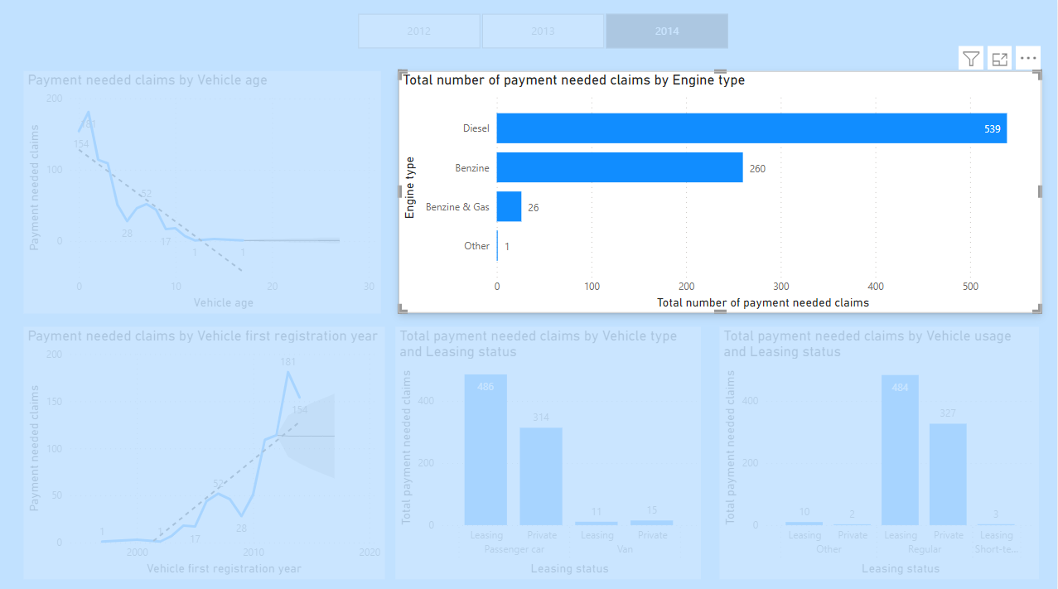
DAX formula for finding count of payment needed claims
TotalNonZeroPayments =
COUNTROWS(
FILTER(
'Claims',
'Claims'[PaymentToCustomer] <> 0
)
)
Identified trend: The Clustered bar chart compares different Engine types with the total number of payment needed claims. The first trend in analyses shows that cars equipped with Diesel and Benzine engines tend to result in more payment-needed claims, indicating that insurance premiums for such vehicles should be higher

Slide 18
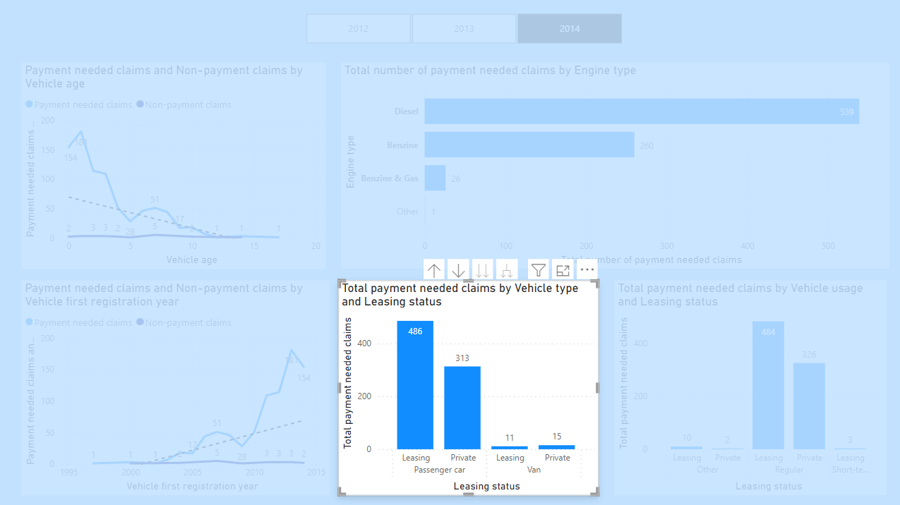
DAX formula for finding count of payment needed claims
TotalNonZeroPayments =
COUNTROWS(
FILTER(
'Claims',
'Claims'[PaymentToCustomer] <> 0
)
)
DAX formula for converting numeric values to understandable strings
LeasingStatus =
IF('policies'[leasing] = 1, "leasing", "private")
Identified trend: The Stacked column charts demonstrate the first trend in which leasing cars, particularly passenger cars, have a higher probability of causing payment-needed claims.

Slide 19
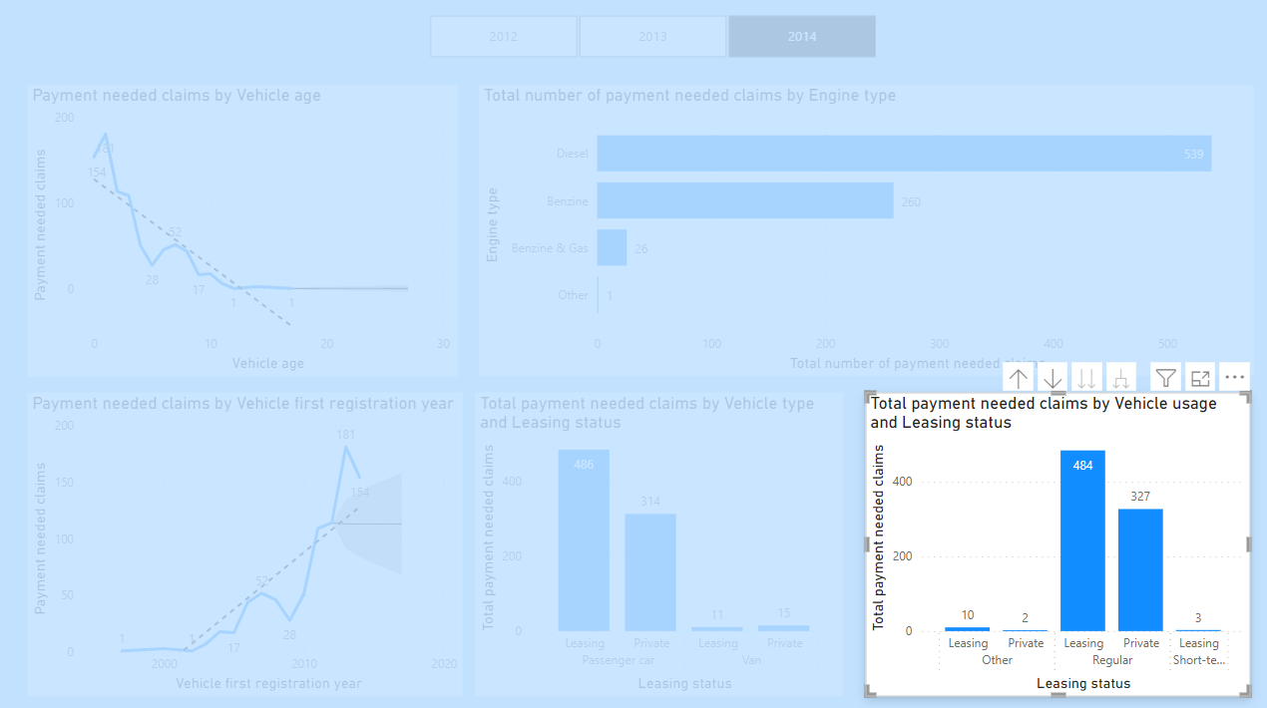
DAX formula for finding count of payment needed claims
Identified trend: The Stacked column charts demonstrate a trend that leasing cars, particularly cars used regularly, have a higher probability of generating payment needed claims.
TotalNonZeroPayments =
COUNTROWS(
FILTER(
'Claims',
'Claims'[PaymentToCustomer] <> 0
)
)
DAX formula for converting numeric values to understandable strings
LeasingStatus =
IF('policies'[leasing] = 1, "leasing", "private")

Slide 20
“Introduction of claims” dashboard
There are a total of 5 analyses in the dashboard. Out of these, 2 analyses fall under the category of bivariate, while the remaining 3 are classified as univariate analyses. All 5 analyses are focused on quantitative data.
The first 2 bivariate analyses are presented as Cards. These Cards display changes in payment needed and non-payment claims for the selected year.
Additionally, there are 2 Dount charts that illustrate the distribution of claim types based on the total number of payment needed and non-payment claims.
Finally, the last analysis is represented by a Stacked Column Chart, showcasing the total payment to customers from claims, categorized by claim type.

Slide 21
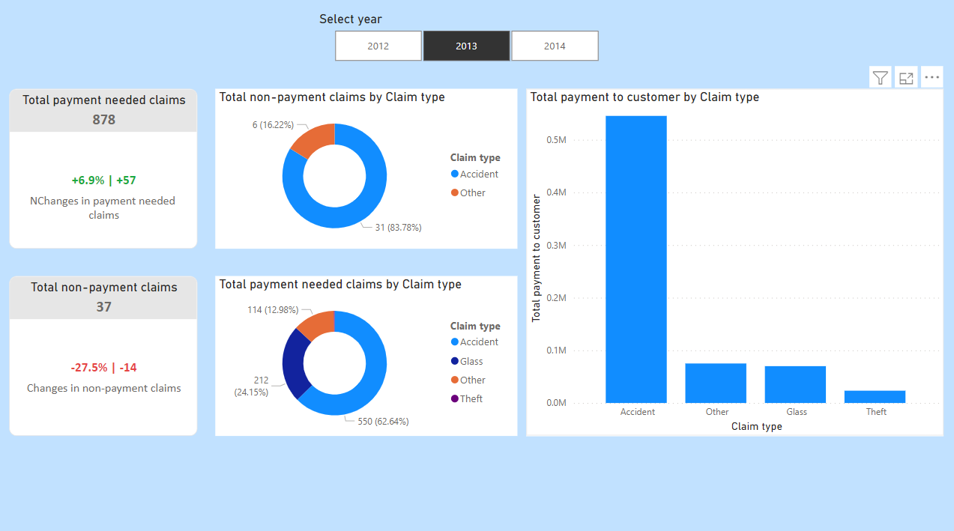

Slide 22
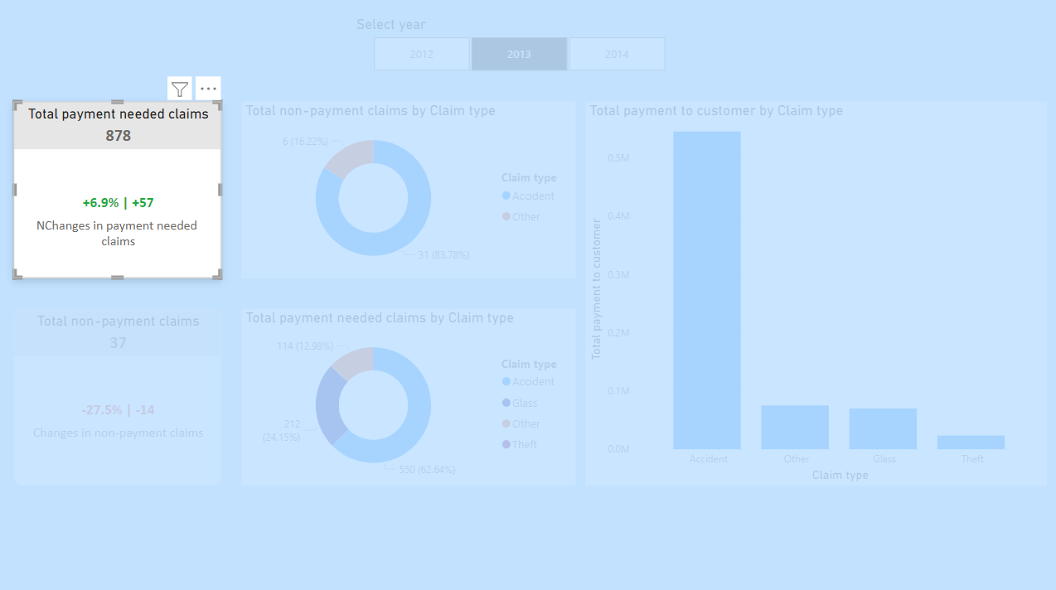
DAX formula calculates the percentage and number of changes in claims which needs payment to the customer by selected and previous year according to a selected year from the slicer. Exception handling was added to the DAX formula. DAX formula:
KPI Increase Number of Claims ThisYear =
VAR Selected_Year = SELECTEDVALUE('policies'[Year])
VAR Claims_SelectedYear =
CALCULATE(
[TotalNonZeroPayments],
FILTER(
ALL('policies'),
'policies'[Year] = Selected_Year
)
)
VAR Claims_PreviousYear =
CALCULATE(
[TotalNonZeroPayments],
FILTER(
ALL('policies'),
'policies'[Year] = Selected_Year - 1
)
)
VAR Increase_Claims =
IF(
Selected_Year = 2012,
0,
Claims_SelectedYear - Claims_PreviousYear
)
VAR Percentage_Increase =
IF(
Claims_PreviousYear = 0,
BLANK(),
DIVIDE(Claims_SelectedYear - Claims_PreviousYear, Claims_PreviousYear)
)
VAR _sign = IF(Increase_Claims > 0, "+", "")
RETURN
IF(
Increase_Claims = 0,
"There is no data",
_sign & FORMAT(Percentage_Increase, "#0.0%") & " | " & _sign & FORMAT(Increase_Claims, "#0,#")
)
DAX formula of calculating total payment needed claims by selected year:
KPI NonZero Payment Claims = [TotalNonZeroPayments] & ""

Slide 23
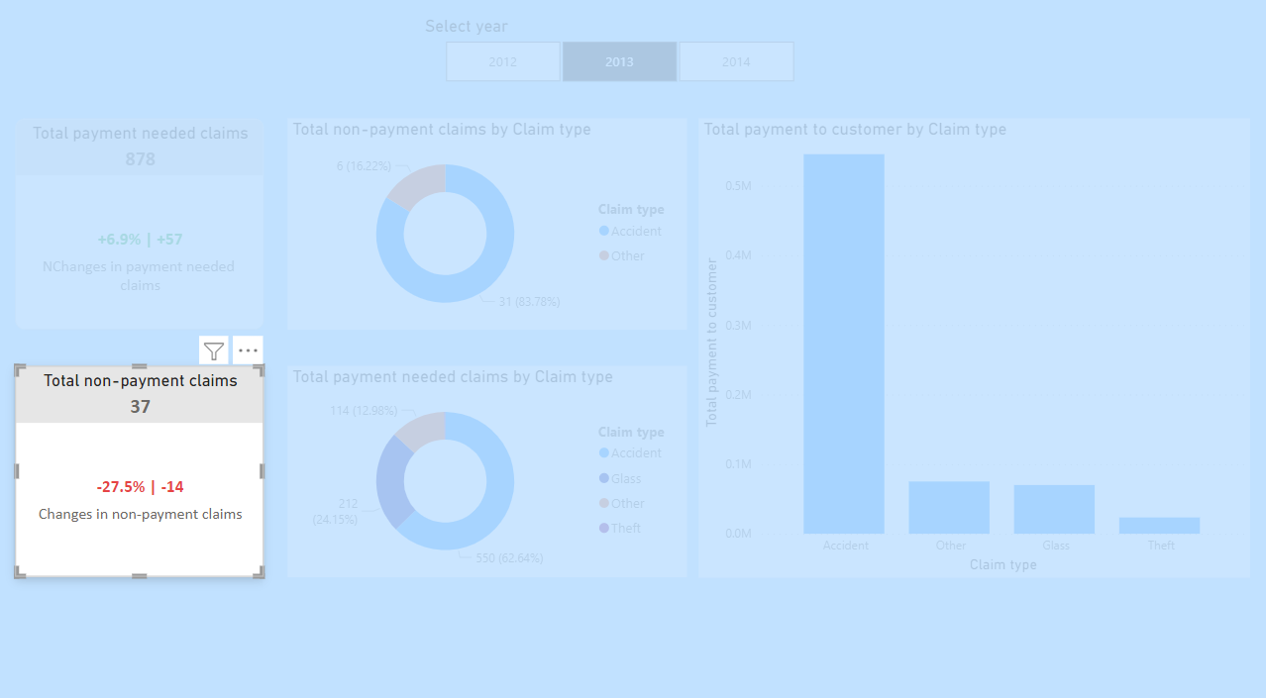
DAX formula calculates the percentage and number of changes in claims which needs no payment to the customer by selected and previous year according to a selected year from the slicer. Exception handling was added to the DAX formula. DAX formula:
KPI Increase Number of Non Payment Claims ThisYear =
VAR Selected_Year = SELECTEDVALUE('policies'[Year])
VAR Claims_SelectedYear =
CALCULATE(
[TotalZeroPayments],
FILTER(
ALL('policies'),
'policies'[Year] = Selected_Year
)
)
VAR Claims_PreviousYear =
CALCULATE(
[TotalZeroPayments],
FILTER(
ALL('policies'),
'policies'[Year] = Selected_Year - 1
)
)
VAR Increase_Claims =
IF(
Selected_Year = 2012,
0,
Claims_SelectedYear - Claims_PreviousYear
)
VAR Percentage_Increase =
IF(
Claims_PreviousYear = 0,
BLANK(),
DIVIDE(Claims_SelectedYear - Claims_PreviousYear, Claims_PreviousYear)
)
VAR _sign = IF(Increase_Claims > 0, "+", "")
RETURN
IF(
Increase_Claims = 0,
"There is no data",
_sign & FORMAT(Percentage_Increase, "#0.0%") & " | " & _sign & FORMAT(Increase_Claims, "#0,#")
)
DAX formula of calculating total non-payment claims by selected year:
KPI Zero Payment Claims = [TotalZeroPayments] & ""

Slide 24
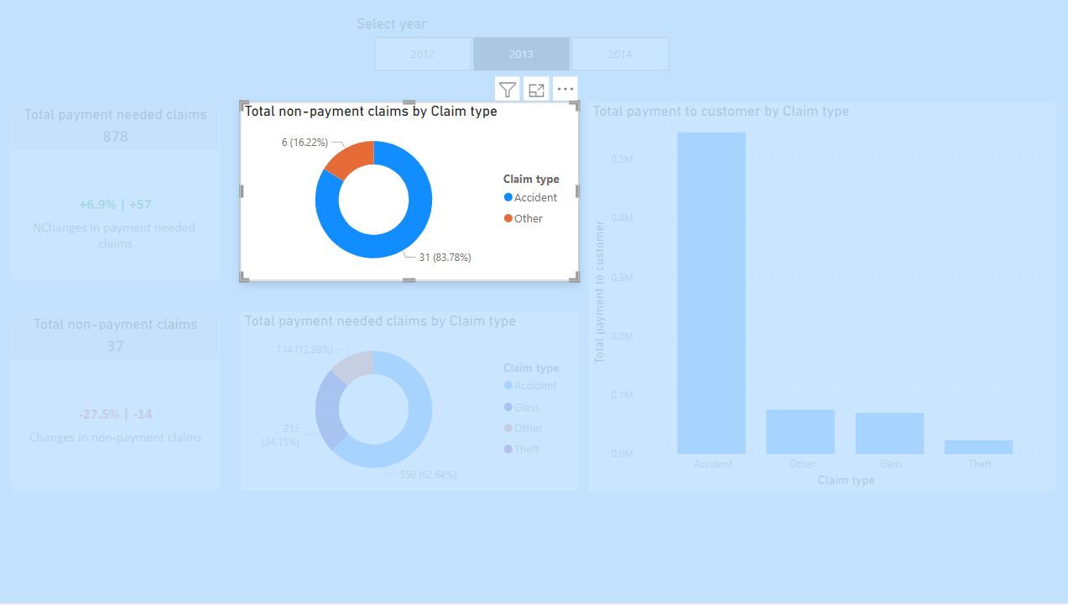
Identified trend: Total non-payment claims by Claim type analyses: We can see trend in which glass-related damages are covered by the insurance company because there is not any glass-related non-payment needed claim
Total number of non-payment needed calims
TotalZeroPayments =
COUNTROWS(
FILTER(
'Claims',
'Claims'[PaymentToCustomer] = 0
)
)

Slide 25
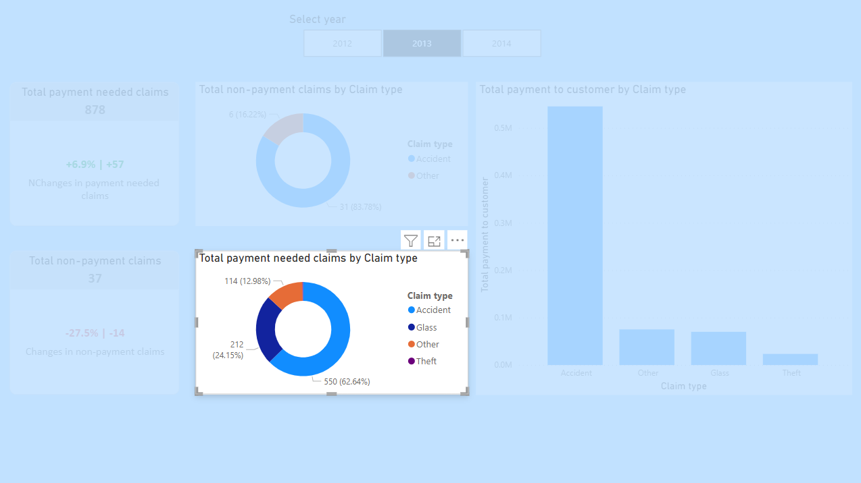
Total number of payment needed claims
TotalNonZeroPayments =
COUNTROWS(
FILTER(
'Claims',
'Claims'[PaymentToCustomer] <> 0
)
)
Identified trend: Trend shows accidents was responsible for more payment to customers than a total of payment of other types.

Slide 26
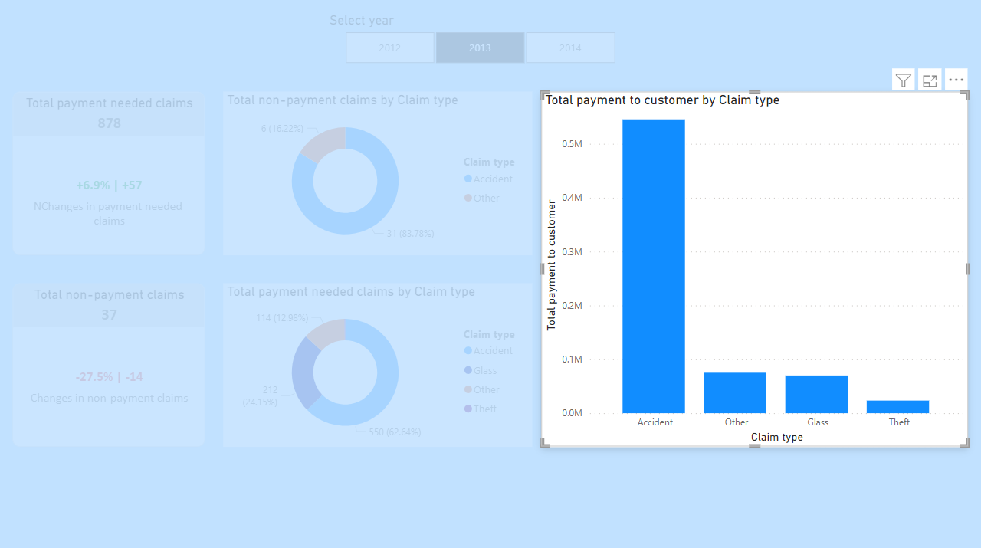
Identified trend: Total payment to the customer by Claim type analyses: The trend shows company should avoid customers which a high risk of Accidents because the total number of payments is more than the total of other claim types
Total number of payments to the customer according to claim type and the difference between incurred amount and deductible amount
PaymentToCustomer =
IF(
'Claims'[ClaimType] = "glass",
MAX('Claims'[IncurredAmount] - RELATED('policies'[Deductible_glass]), 0),
MAX('Claims'[IncurredAmount] - RELATED('policies'[Deductible_general]), 0)
)

Slide 27
“Trends in sales” dashboard
The dashboard includes 5 quantitative analyses. Two of these are Line Charts, which utilize the Forecast functionality to display the total premium based on Year and Vehicle Age. Another insightful analysis is presented through a Clustered Bar Chart, illustrating the total premium amount categorized by Leasing status and Engine type. Additionally, there is a Line and Stacked Column Chart that implements the Pareto principle to calculate premium against the total premium. Finally, the dashboard features a Ribbon Chart, depicting the sum of premiums by year and mark.

Slide 28
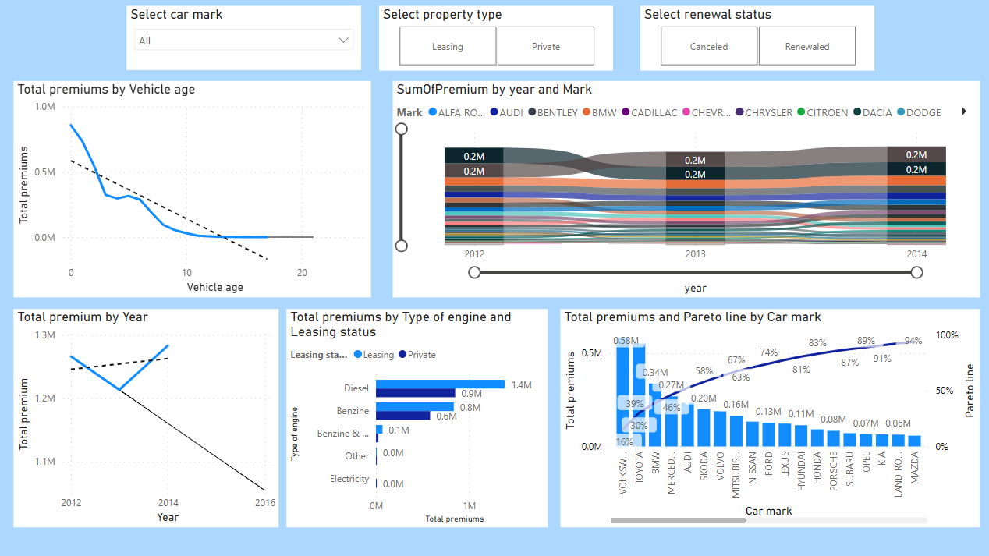

Slide 29
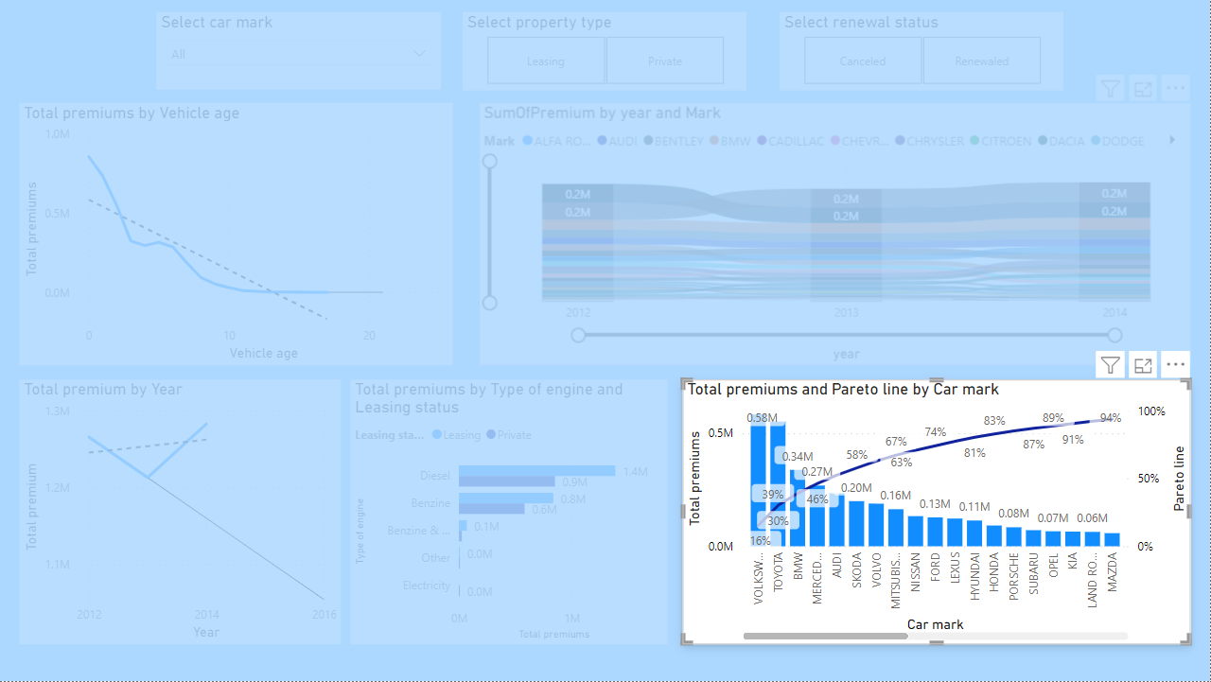
Identified trends: The first trend is collected premium amounts of Volkswagen, Toyota, BMW, and Mercedes some more than the total of others which can be seen correctly by implementing the PARETO principle. Second trend: car marks which are placed after 80 percent in the PARETO line, should be less valuable because the PARETO principle can increase sales if we can implement an 80/20 proportion
Percentage of cumulative value over total amount of premiums
Cumulative Premium (%) =
VAR Cumulative = [Cumulative Premium]
VAR TotalPremiums = CALCULATE([SumOfPremium], ALL(Policies[Mark]))
RETURN
DIVIDE(Cumulative, TotalPremiums, 0)
Total number of premiums
Cumulative Premium =
VAR Cumulative = CALCULATE([SumOfPremium])
RETURN
CALCULATE(
[SumOfPremium],
FILTER(
ALL(Policies[Mark]),
CALCULATE([SumOfPremium]) >= Cumulative
)
)
SumOfPremium = SUM(policies[premium])

Slide 30
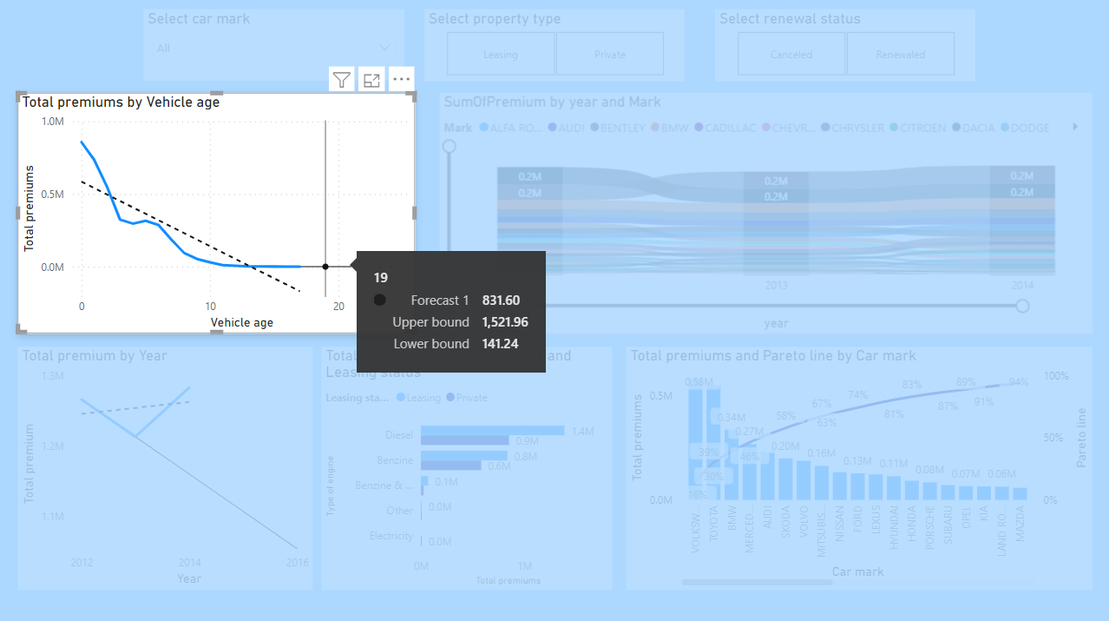
Total number of premiums
SumOfPremium = SUM(policies[premium])
Identified trends: The first trend is the age of the vehicle has a direct effect on paid premiums which newer cars can pay more premiums than old ones. The second trend is 19 years old cars can source of 831.60 euro premium in total which can prove the first trend too

Slide 31
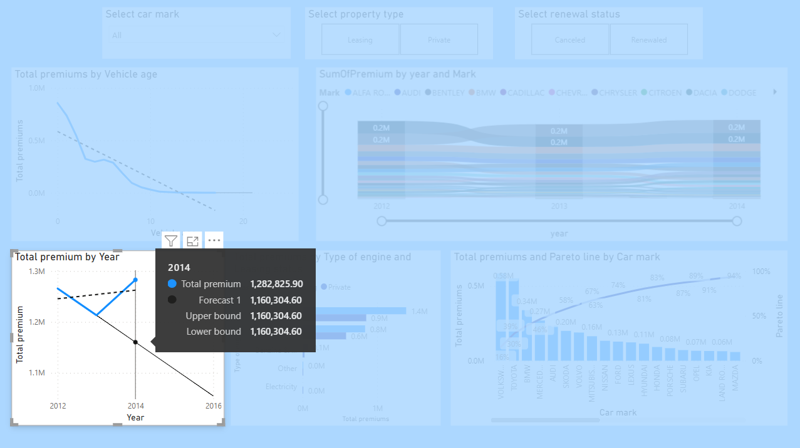
Total number of premiums
SumOfPremium = SUM(policies[premium])
Identified trends: First thing is if there will not be any change in policies can be decreased in the next years. We can see this predictive trend with forecast

Slide 32
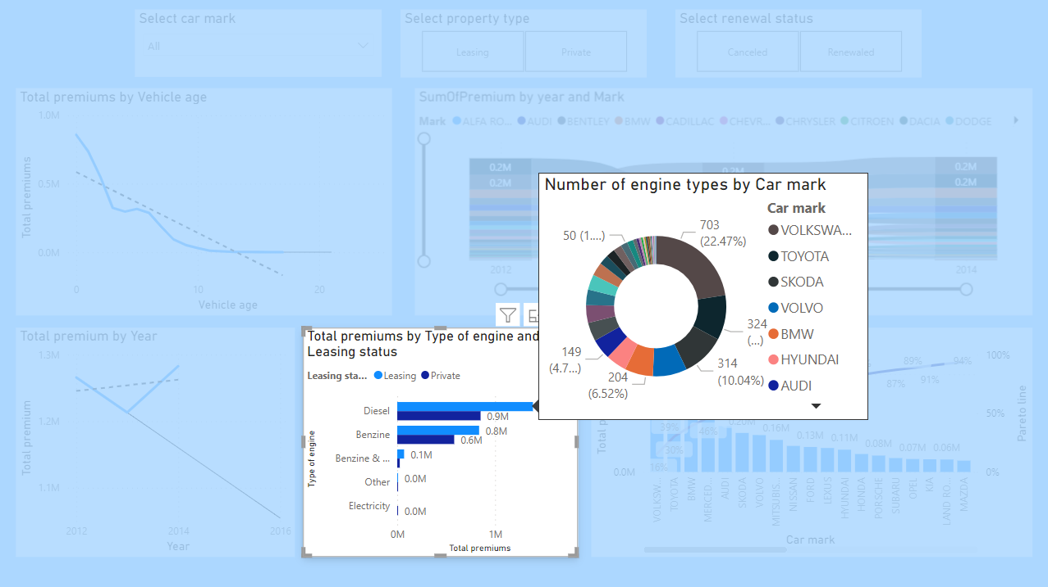
Identified trends: The first trend is diesel types of cars can be relevant to pay more premium amounts than total premiums from other motor types of cars. The second trend is leasing property-type cars has more potential to pay more premiums than private cars.
Custom tooltip
Total number of premiums
SumOfPremium = SUM(policies[premium])
LeasingStatus =
IF('policies'[leasing] = 1, "Leasing", "Private")

Slide 33
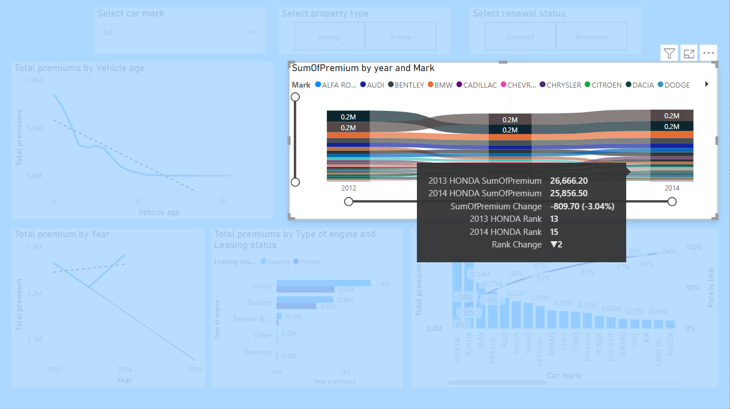
Total number of premiums
SumOfPremium = SUM(policies[premium])
Identified trends: The first trend is the premium amount of some car brands such as Porsche, Land Rover, and LEXUS has increased by more than 60 percent compared to 2013 and 2014. It can be a good opportunity to investing these policies and campaigns which can attract more premium amounts. The second trend is the same with other traditionally more premium payers car brands keeping the same place.
Tooltip: people can see increase rate and amount

Slide 34
“Motor product profitability” dashboard
The dashboard includes 4 quantitative univariate analyses. Two of these analyses are presented as Line and Clustered Column Charts. These charts display the average and count of premiums along with the total payment to customers and the renewal indicator.
Additionally, there is a Donut Chart that provides a clear count of premiums categorized by the type of engine.
Finally, there is a Stacked Bar Chart that presents the total number of non-payment and payment-needed claims, segmented by the type of motor.

Slide 35
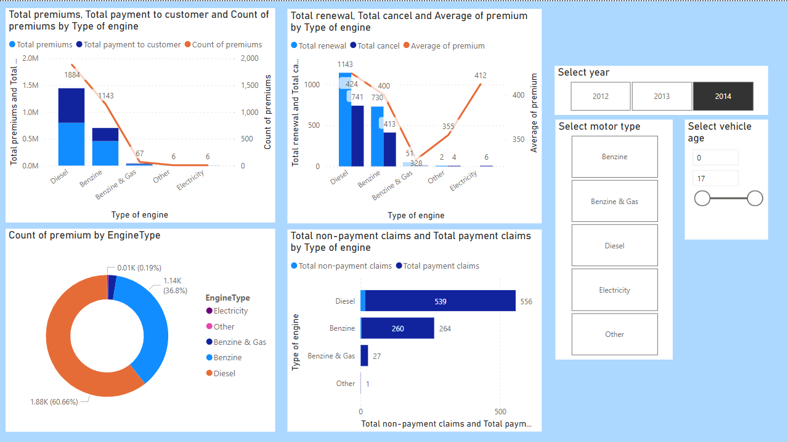

Slide 36
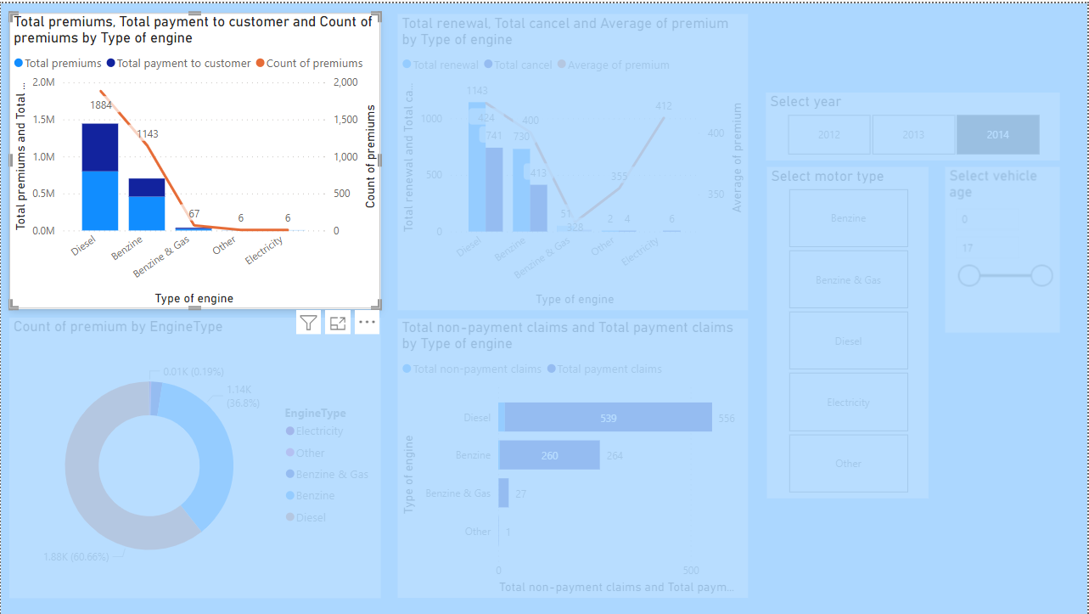
DAX formula calculates sum of payments of payment needed claims
SumOfPaymentToCustomer = SUM(claims[PaymentToCustomer])
DAX formula calculates sum of premiums
SumOfPremium = SUM(policies[premium])
Identified trend: Some motor product types (e.g., Diesel) have more claims payments than premiums, leading to lower profitability. Diesel product type has a large number of premium payers, but higher claims costs are impacting its profitability. On the other hand, product types like Benzine seem to be more profitable with lower claims relative to premiums. However, the number of premium payments for Benzine is currently low, limiting its overall profit potential. By optimizing claims costs and increasing premium payments for Benzine policies, we can enhance profitability for this motor product type.

Slide 37
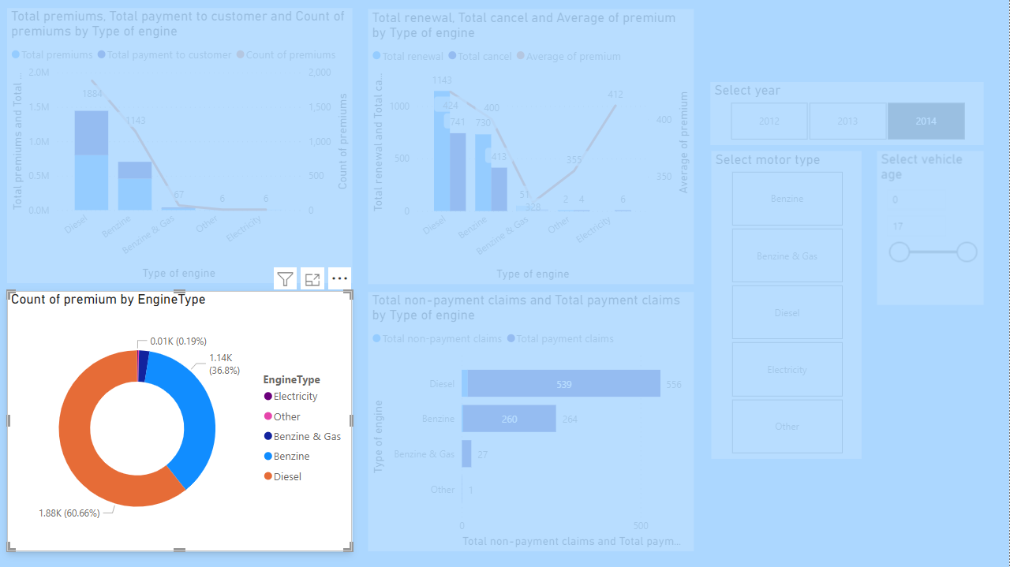
Identified trend: Benzine and Diesel product types keep a large proportion in a portfolio which means more time and resources need to investment overall

Slide 38
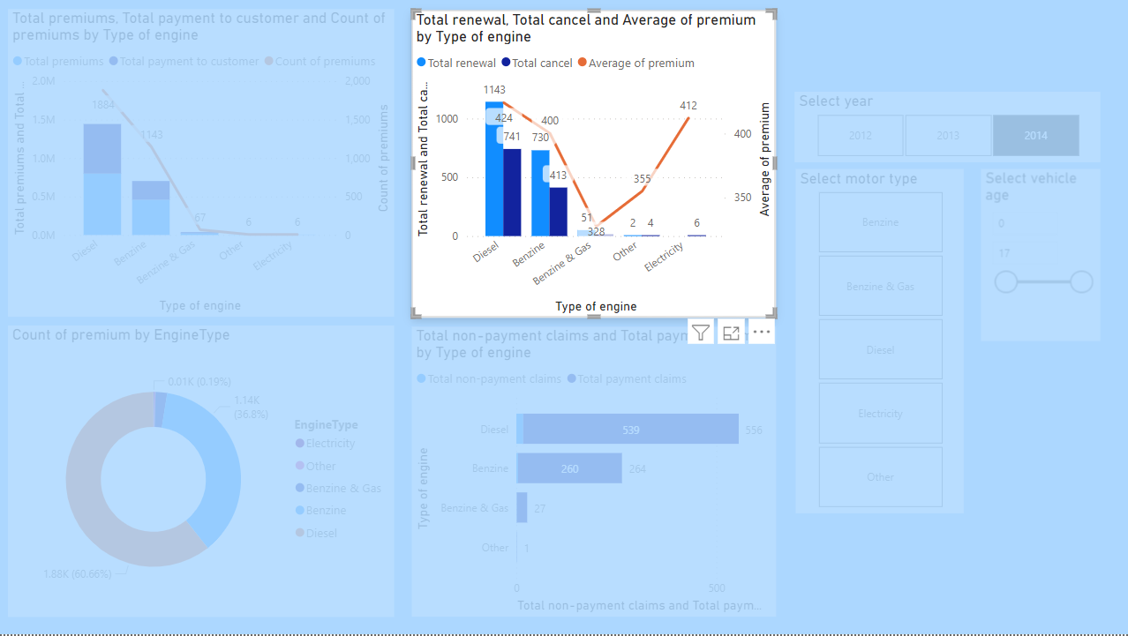
Identified trend: There is some trend in analyses in which the cancel rate is directly related to the average premium number by each motor product type. Therefore, if we would like to attract more profitable motor product types such as Benzine and Electric, then we should keep the premium amount less.
DAX formula format total number of cancel
DAX formula format total number of renewal
TotalCancel = COUNTROWS(FILTER('policies', 'policies'[RenewalIndicator] = 0))
TotalRenewal = COUNTROWS(FILTER('policies', 'policies'[RenewalIndicator] = 1))

Slide 39
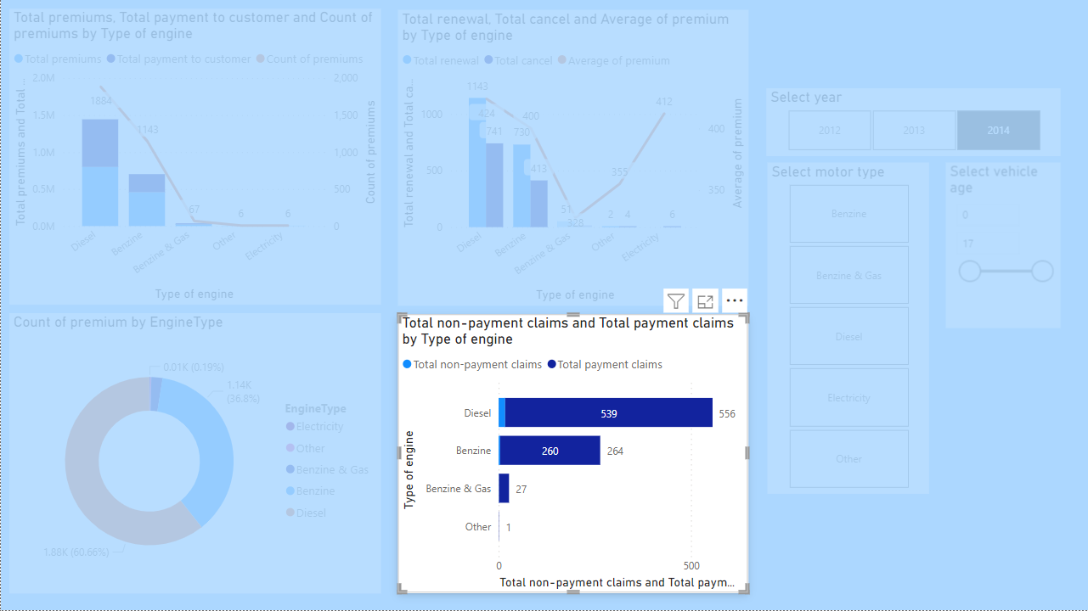
DAX calculates total number of payment needed claims
TotalNonZeroPayments =
COUNTROWS(
FILTER(
'Claims',
'Claims'[PaymentToCustomer] <> 0
)
)
Identified trend: There is some trend in analyses in which Diesel motor product types contain more non-payment claims than a total of other motor product types. Probably, it happens because this motor product contains most of the data

Slide 40
End of presentation Thank you

