Slide 1

DonorDesk
IMPELEMENTATION WITH GUIDED EXCELLENCE
Your whole programme,
in one place.
October 2026 · Version 2.007 · donordesk.online

Slide 2
THE PROBLEM
Every quarter, the programme is rebuilt by hand
• Indicators sit in one spreadsheet, activities in another, evidence in folders and chat threads.
• The report is assembled in the last weeks before the deadline, from numbers nobody can trace back.
• Compliance gaps — a missing document, an unverified figure — surface at submission, when there is no time to fix them.
• Every donor wants the same facts in a different template, so the work is repeated for each grant.
• Field staff report after the fact, from memory — and the numbers arrive late, incomplete or in chat messages.
HOW DONORDESK ANSWERS IT
• Logframe and targets imported once from Excel, CSV or Google Sheets
• Activities recorded in the field; the period derived from the date
• Evidence linked to the work, fingerprinted where cited
• Donor templates extracted by AI, approved by a person
• One gate for approval, preflight, submission and export
• Hash-chained audit log over every change
The work happened. Proving it is the hard part — the number no one remembers, the file no one can find, the checklist item found on the last day.
DonorDesk · Sales deck v2.007 · October 2026 · donordesk.online
2

Slide 3
THE SHIFT
Stop rebuilding the programme every quarter
1 · Plan
Set the logframe, indicators, baselines and targets once. Import what you already have from Excel, CSV or Google Sheets.
2 · Deliver
Field staff record activities as they happen, from a phone, typed or dictated. Indicator values are entered once per period.
UNDER THE HOOD
• Import resolves logframe parents and codes automatically
• Reporting period derived from each activity's date — never guessed
• Readiness computed live; data-settled checklist items close themselves
• Drafts cite evidence, activity records and indicator values
• Versioned AI writer contract (v6 in production), mirrored and pinned by tests
3 · Monitor
Every indicator, every period, one sheet against its own target. Gaps show while there is still time to act.
4 · Demonstrate
The donor's template structures the report. Drafts cite their sources. A person approves before export.
Enter each value once. The record holds the work — the report is one thing it produces.
DonorDesk · Sales deck v2.007 · October 2026 · donordesk.online
3

Slide 4
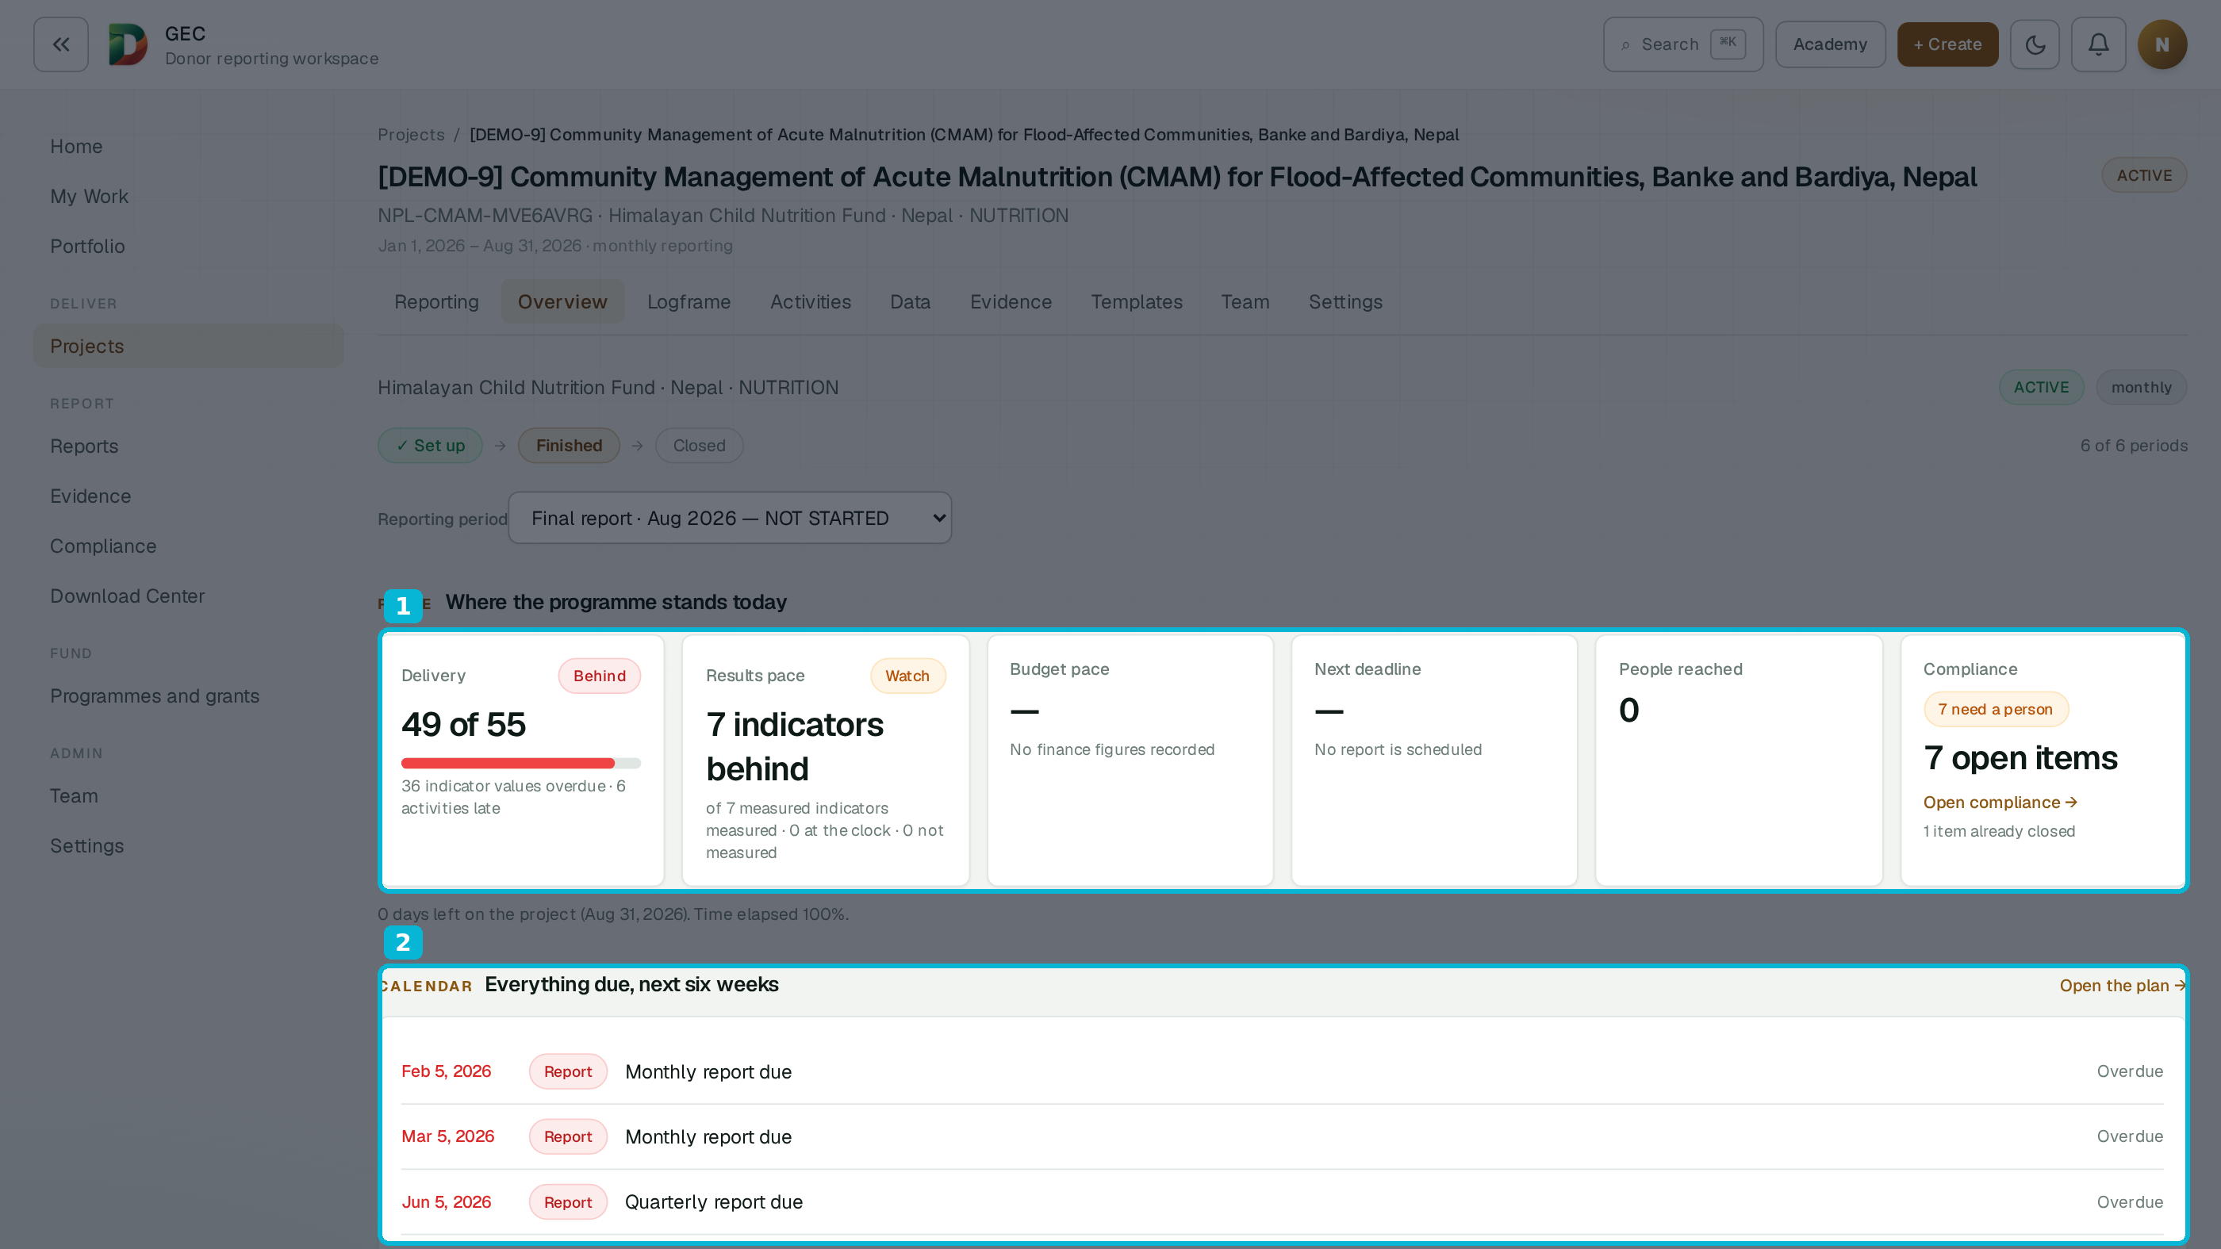
IN THE PRODUCT · PROJECT OVERVIEW · DEMO-9
Where the programme stands today
1
Pulse — delivery, results pace, compliance, in one view
2
Calendar — everything due, next six weeks
Live screens from the demo workspace — sample data · October 2026.
DonorDesk · Sales deck v2.007 · October 2026 · donordesk.online
4

Slide 5
WHAT YOU GET
Six capabilities your team feels in the first month
01 Logframe & Data Center
Targets set once; every indicator value across every period in one sheet, with charts drawn from the data.
02 Field capture
Activities recorded the day they happen — typed or dictated — and reviewed in one queue.
03 Evidence library
Files stay linked to the work they prove, fingerprinted when cited, exportable as a pack.
ALSO ON BOARD
• My Work — one queue across every project
• In-app notifications for reviews, comments, approvals
• Seven roles, least privilege, set per project
• Version history on every report section
• Guided tour plus the Academy demo project
• Help articles inside the app
04 Donor templates
Upload each donor's format once; the outline, questions and required tables are extracted for review.
05 AI-assisted drafting
Sections drafted from your record, every statement sourced, every figure checked against the inputs.
06 Compliance, approval & export
Gaps surface early; a clean, sealed submission exports to Word, PDF, Excel and ZIP.
DonorDesk · Sales deck v2.007 · October 2026 · donordesk.online
5

Slide 6
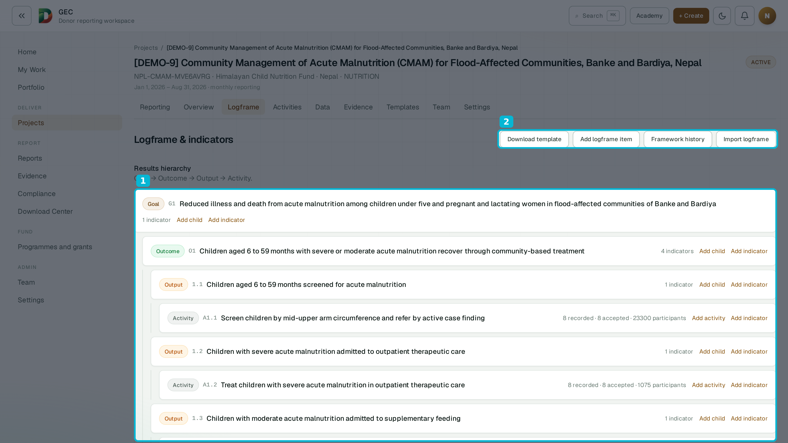
IN THE PRODUCT · LOGFRAME · DEMO-9
The plan behind the results
1
Results hierarchy — goal → outcome → output → activity, with live progress
2
Framework history — every change kept as a version
Live screens from the demo workspace — sample data · October 2026.
DonorDesk · Sales deck v2.007 · October 2026 · donordesk.online
6

Slide 7
PLAN & MONITOR
Set the target once. Enter each value once.
Logframe
Goal, outcome, output and activity levels, imported from Excel, CSV or text — parent links and codes resolved automatically.
Indicators
Baseline, target, frequency, aggregation and disaggregation defined once. Indicators are archived, never deleted, so history stays honest.
TECHNICAL NOTES
• Aggregation: sum, latest or rate; higher-or-lower direction
• Import preview blocks any bad row; empty cells never clear stored values
• Moving or deleting an indicator is refused once an approved report used it
• Charts: different units never share an axis; rates stay out of progress charts
• Server-rendered charts (ECharts → PNG) so exports match the screen
Per-period grid
A spreadsheet-style grid per reporting period. It suggests the previous value and running totals — suggestions never overwrite a typed value.
Data Center
Every indicator, every period, one sheet. Download to Excel, edit, import back with a full preview — and draw charts straight from the data.
The same numbers feed every report, chart and export — entered once, reused everywhere.
DonorDesk · Sales deck v2.007 · October 2026 · donordesk.online
7

Slide 8
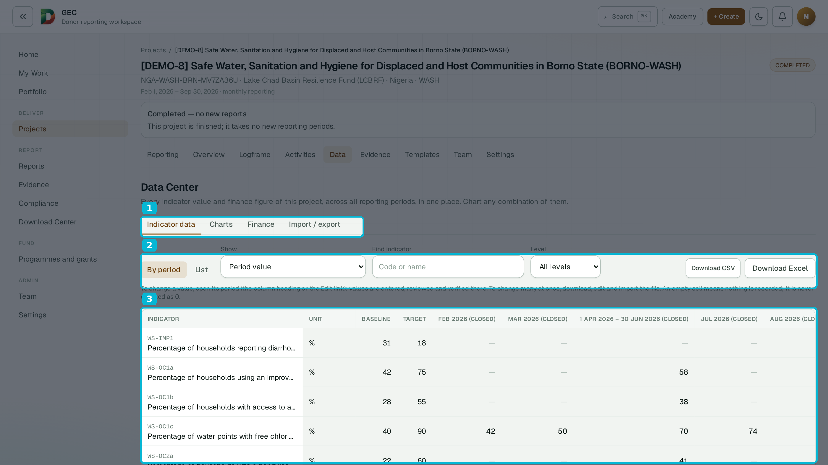
IN THE PRODUCT · DATA CENTER · DEMO-8
Every indicator, every period, one sheet
1
Tabs — indicator data, charts, finance, import / export
2
Download, edit offline, import back with a full preview
3
Period columns — a missing value stays blank, never zero
Live screens from the demo workspace — sample data · October 2026.
DonorDesk · Sales deck v2.007 · October 2026 · donordesk.online
8

Slide 9
FIELD CAPTURE
The record starts where the work happens
• Record in a few lines. Date, place, participants with breakdowns, and a narrative — captured from a phone, the day it happens.
• Dictate the story. The form fills date, place and people only from what your words state; it never invents a detail.
• Works with weak signal. A finished activity is kept on the device and sent when the connection returns; drafts save as you type.
• Managers stay in control. Accept, request changes or reject in bulk — and an accepted record is not quietly undone once an approved report has used it.
TECHNICAL NOTES
• Narrative proposal fills only what the words state — never invents
• Dictation via browser speech recognition (Chrome, Edge, Safari)
• Offline queue in per-user IndexedDB; the entry id doubles as the create's idempotency key
• Status transitions enforced in one table, shared by UI and server
• Spreadsheet import names any row with a problem — nothing dropped silently
Status workflow
Draft → Submitted → Accepted
Needs revision → back to the officer
Rejected or withdrawn, with a reason
Stated plainly
The app needs a connection to open. Offline use is queued saving — nothing is lost, nothing is faked.
DonorDesk · Sales deck v2.007 · October 2026 · donordesk.online
9

Slide 10
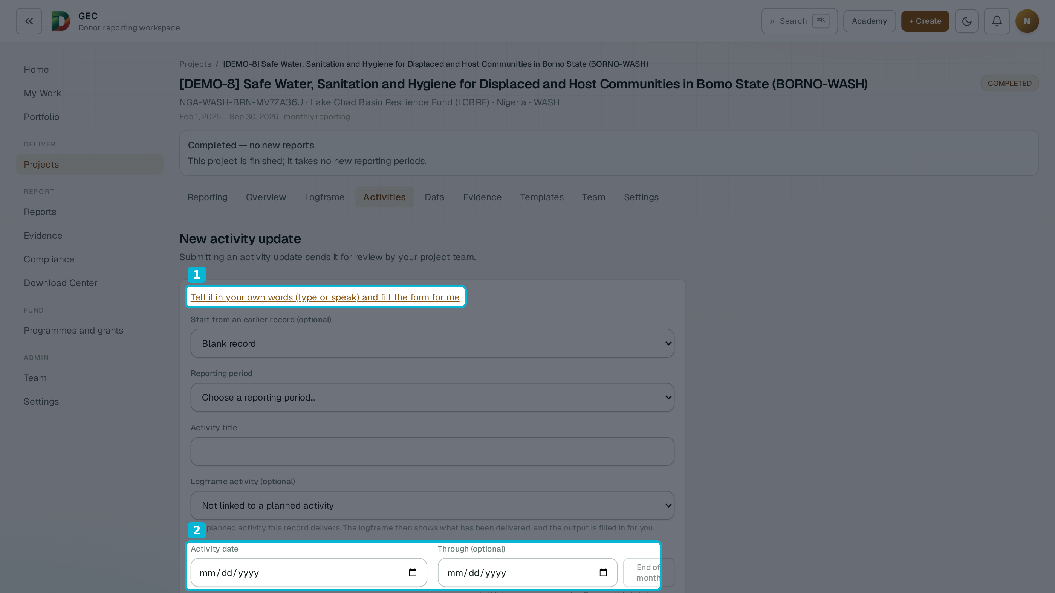
IN THE PRODUCT · ACTIVITY CAPTURE · DEMO-8
Capture in the field — type or speak
1
“Type or speak” — the form fills what your words state
2
Date and Through — the reporting period follows the date
Live screens from the demo workspace — sample data · October 2026.
DonorDesk · Sales deck v2.007 · October 2026 · donordesk.online
10

Slide 11
EVIDENCE
Proof that stays linked to the work it proves
Your files, your place
Keep evidence in your own Google Drive — linked files do not count toward storage — or in DonorDesk managed storage.
Linked and verified
Each file is attached to the activity or indicator value it proves, and carries its own verification state.
TECHNICAL NOTES
• Google Drive link-first; Cloudflare R2 for managed storage
• Text extraction from Word, PDF, Excel, CSV, text and Markdown (Tika flow)
• SHA-256 fingerprint over the exact text a draft cites — later edits detectable
• Evidence packs: ZIP with README, 150 MB cap, exclusions named
• Restricted sources block submission while cited (confidentiality gate)
Cited, fingerprinted
Text is read from Word, PDF, Excel and more so drafts can cite it; the cited text is fingerprinted, so a later change to the source is detectable.
Packs, not scavenger hunts
AI suggests tags for a person to confirm. Export the ZIP evidence pack behind any report — the README names anything not included.
Auditors, evaluators and donors can follow every claim back to a file — in minutes, not weeks.
DonorDesk · Sales deck v2.007 · October 2026 · donordesk.online
11

Slide 12
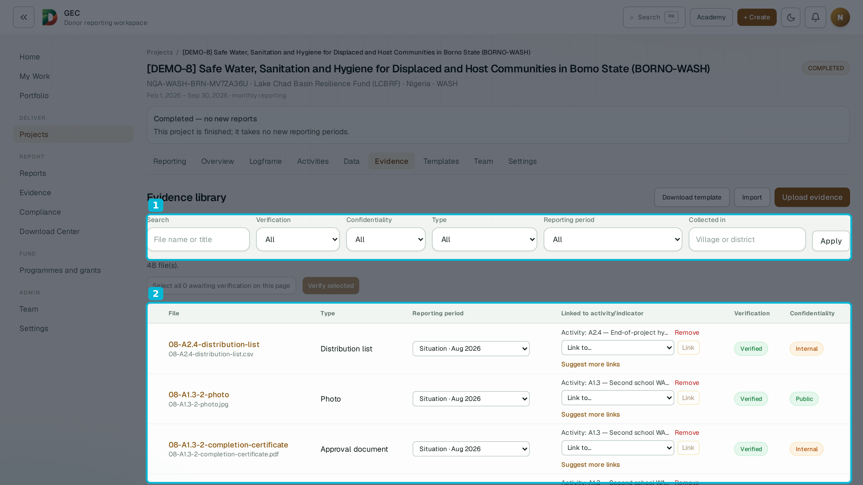
IN THE PRODUCT · EVIDENCE LIBRARY · DEMO-8
Evidence, linked and verified
1
Filter by verification, confidentiality, type, period
2
Every file linked to the activity or value it proves
Live screens from the demo workspace — sample data · October 2026.
DonorDesk · Sales deck v2.007 · October 2026 · donordesk.online
12

Slide 13
DONOR TEMPLATES
Load each donor's format once — reuse it on every grant
Any format in
Upload Word, PDF, text, Markdown, Excel or CSV. Scanned, styled or plain — the structure is read either way.
AI does the reading
The outline, instructions, mandatory questions, evidence needs, required tables and page limits are extracted — with a flagged fallback when the file resists.
TECHNICAL NOTES
• Formats: DOCX, PDF, XLSX, CSV, TXT, Markdown
• Table-of-contents-first extraction over the whole document; titles grounded and ordered
• Hierarchy kept: level, numbering and parent links per section
• A full draft pins the reviewed template as a snapshot
• Donor instructions, questions, tables and page limits travel into every draft
• Heuristic fallback is flagged, never passed off as AI output
People approve
Nothing reaches a draft until a person has reviewed and approved the extracted template. Every edit is saved as a version.
Defaults per report type
One default template per report type. Uploading or approving a template never silently changes a default.
The same facts, in each donor's own structure — without retyping a word.
DonorDesk · Sales deck v2.007 · October 2026 · donordesk.online
13

Slide 14
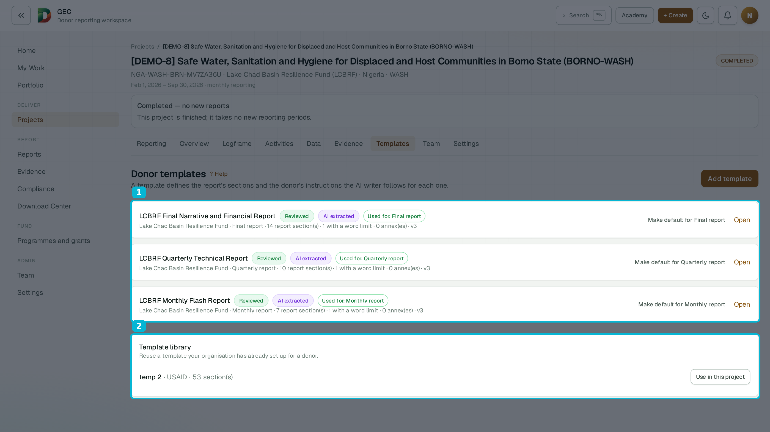
IN THE PRODUCT · DONOR TEMPLATES · DEMO-8
The donor's template, extracted and reviewed
1
Reviewed, AI-extracted — one per report type
2
Template library — reuse across projects
Live screens from the demo workspace — sample data · October 2026.
DonorDesk · Sales deck v2.007 · October 2026 · donordesk.online
14

Slide 15
AI-ASSISTED DRAFTING
Drafts you can defend
• Drafted from your record. Each section follows the approved donor template — its instructions, questions and word limits — and draws on activities, verified indicator values, evidence text and your story inputs.
• Every statement shows its source. The evidence file, activity record or indicator value behind each claim is one click away.
• Numbers are guarded. A figure that is not in the inputs is rejected and regenerated. If it still fails, the section falls back to plain text that says why.
• Claims are checked. Each factual claim is verified against evidence and your own records; conflicting figures are flagged for a person.
• Your style, your credits. A team writing style shapes tone — never facts. Failed or timed-out drafts are not billed.
TECHNICAL NOTES
• Draft → critique → refine pipeline under writer contract v6 (Python SSOT, TS mirror pinned by tests)
• Semantic retrieval over embedded evidence (pgvector, HNSW index)
• Grounding: every figure walked against the request; deterministic fallback that says why
• Per-section time budget; timed-out drafts are not billed
• Prior-period consistency with previously approved narrative
• Manual writing never uses AI credits
Verified numbers
Built from verified data — the AI writes prose only.
Human approval
Nothing is final until a person approves it.
Fully traceable
Model, prompt version and sources stored per output.
DonorDesk · Sales deck v2.007 · October 2026 · donordesk.online
15

Slide 16
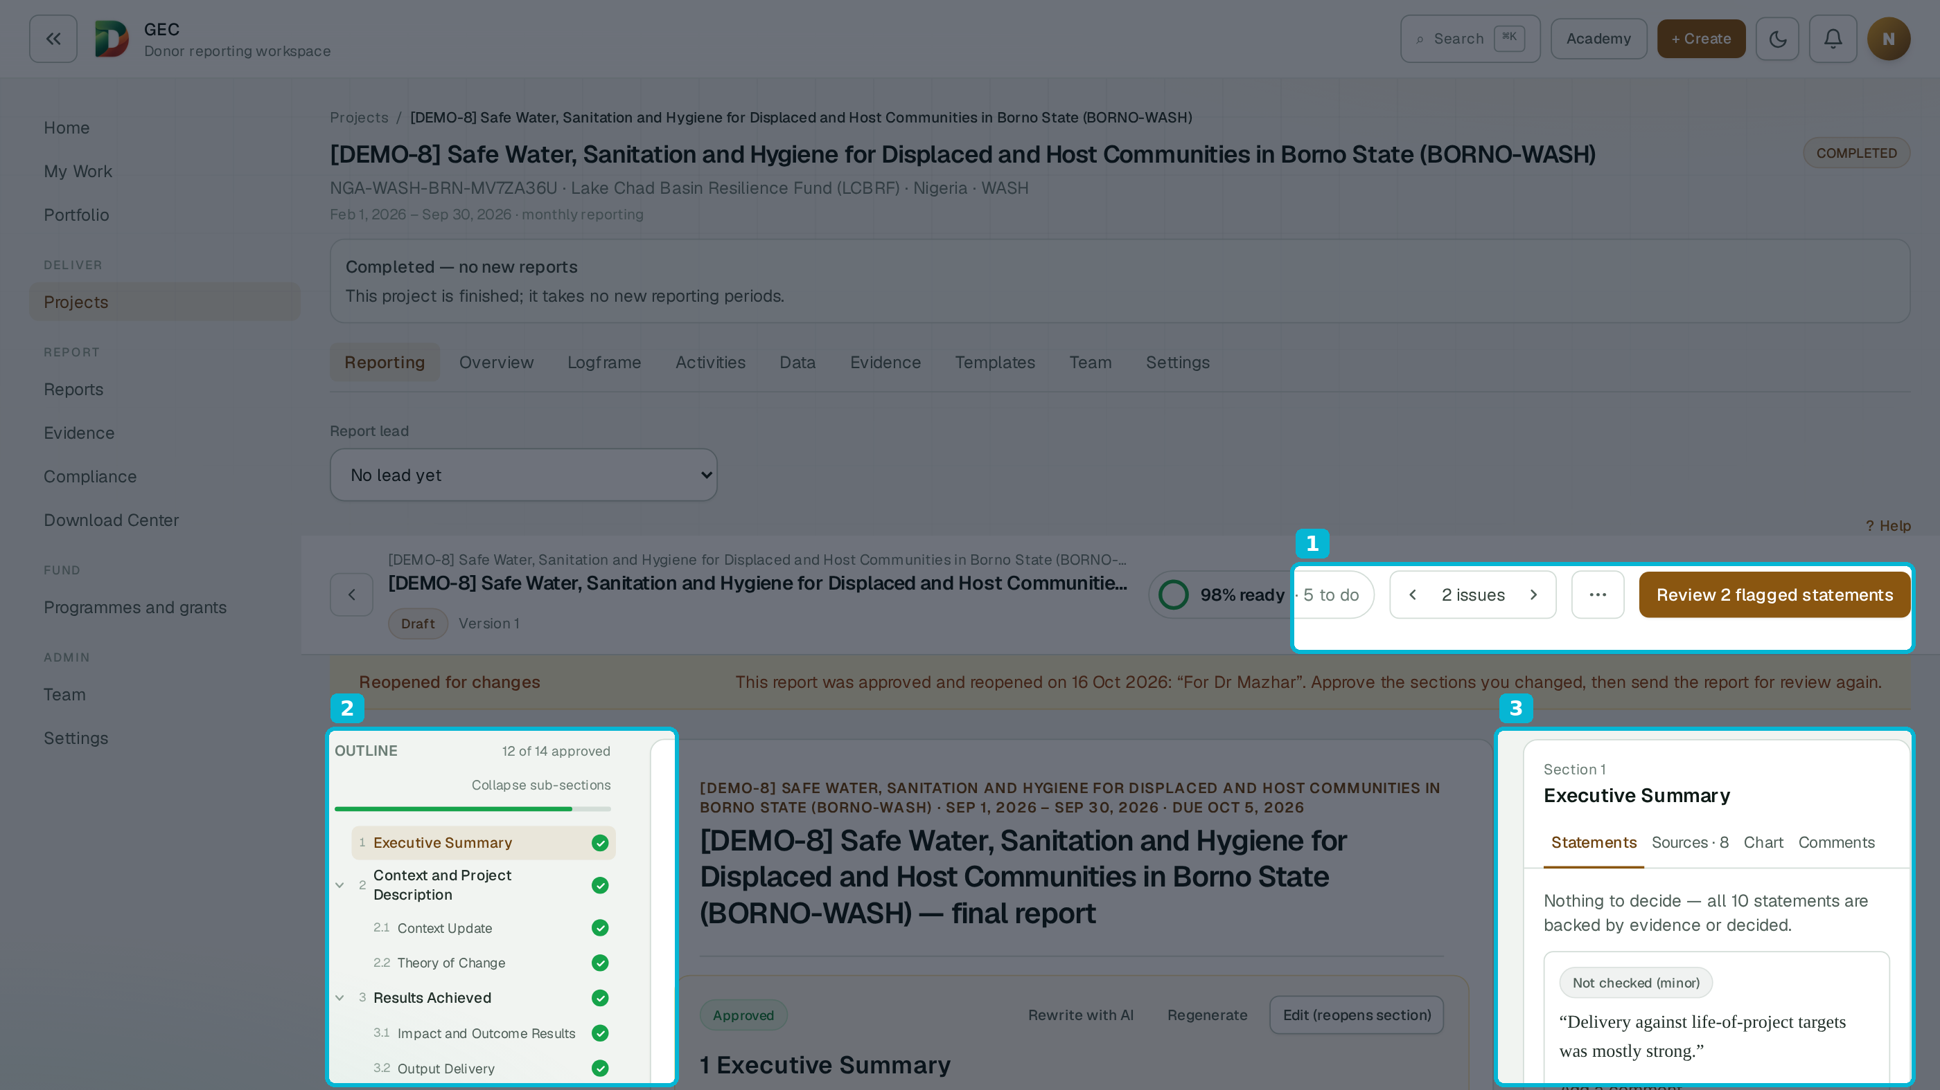
IN THE PRODUCT · REPORT WORKSPACE · DEMO-8
The report workspace — 98% ready
1
98% ready, two statements flagged for a person
2
Outline — 12 of 14 sections approved
3
Sources beside every statement — all 10 backed
Live screens from the demo workspace — sample data · October 2026.
DonorDesk · Sales deck v2.007 · October 2026 · donordesk.online
16

Slide 17
COMPLIANCE
Gaps surface in week one, not on deadline day
A live checklist
Drawn from the donor template and the project's own rules: missing evidence, unverified indicators, late activities, open confidentiality checks.
It closes itself where it can
A verified procurement document closes its item. Items that need a person stay open until a person decides.
TECHNICAL NOTES
• Two checklist kinds: items data settles close themselves; attestations wait for a person
• Readiness stages: drafting, review, submission
• A decided attestation is never raised again unless a new one appears
• Every blocker names its cause and deep-links to the work that closes it
• Closing-report plan lists what the final report still needs
Readiness by stage
Drafting, review and submission each report readiness — every blocker with plain-language advice and the action that closes it.
A hard gate where it matters
Submission stays blocked while a confidentiality check is open or a restricted source is cited.
The final report is a list you have been working through all quarter — not a surprise.
DonorDesk · Sales deck v2.007 · October 2026 · donordesk.online
17

Slide 18
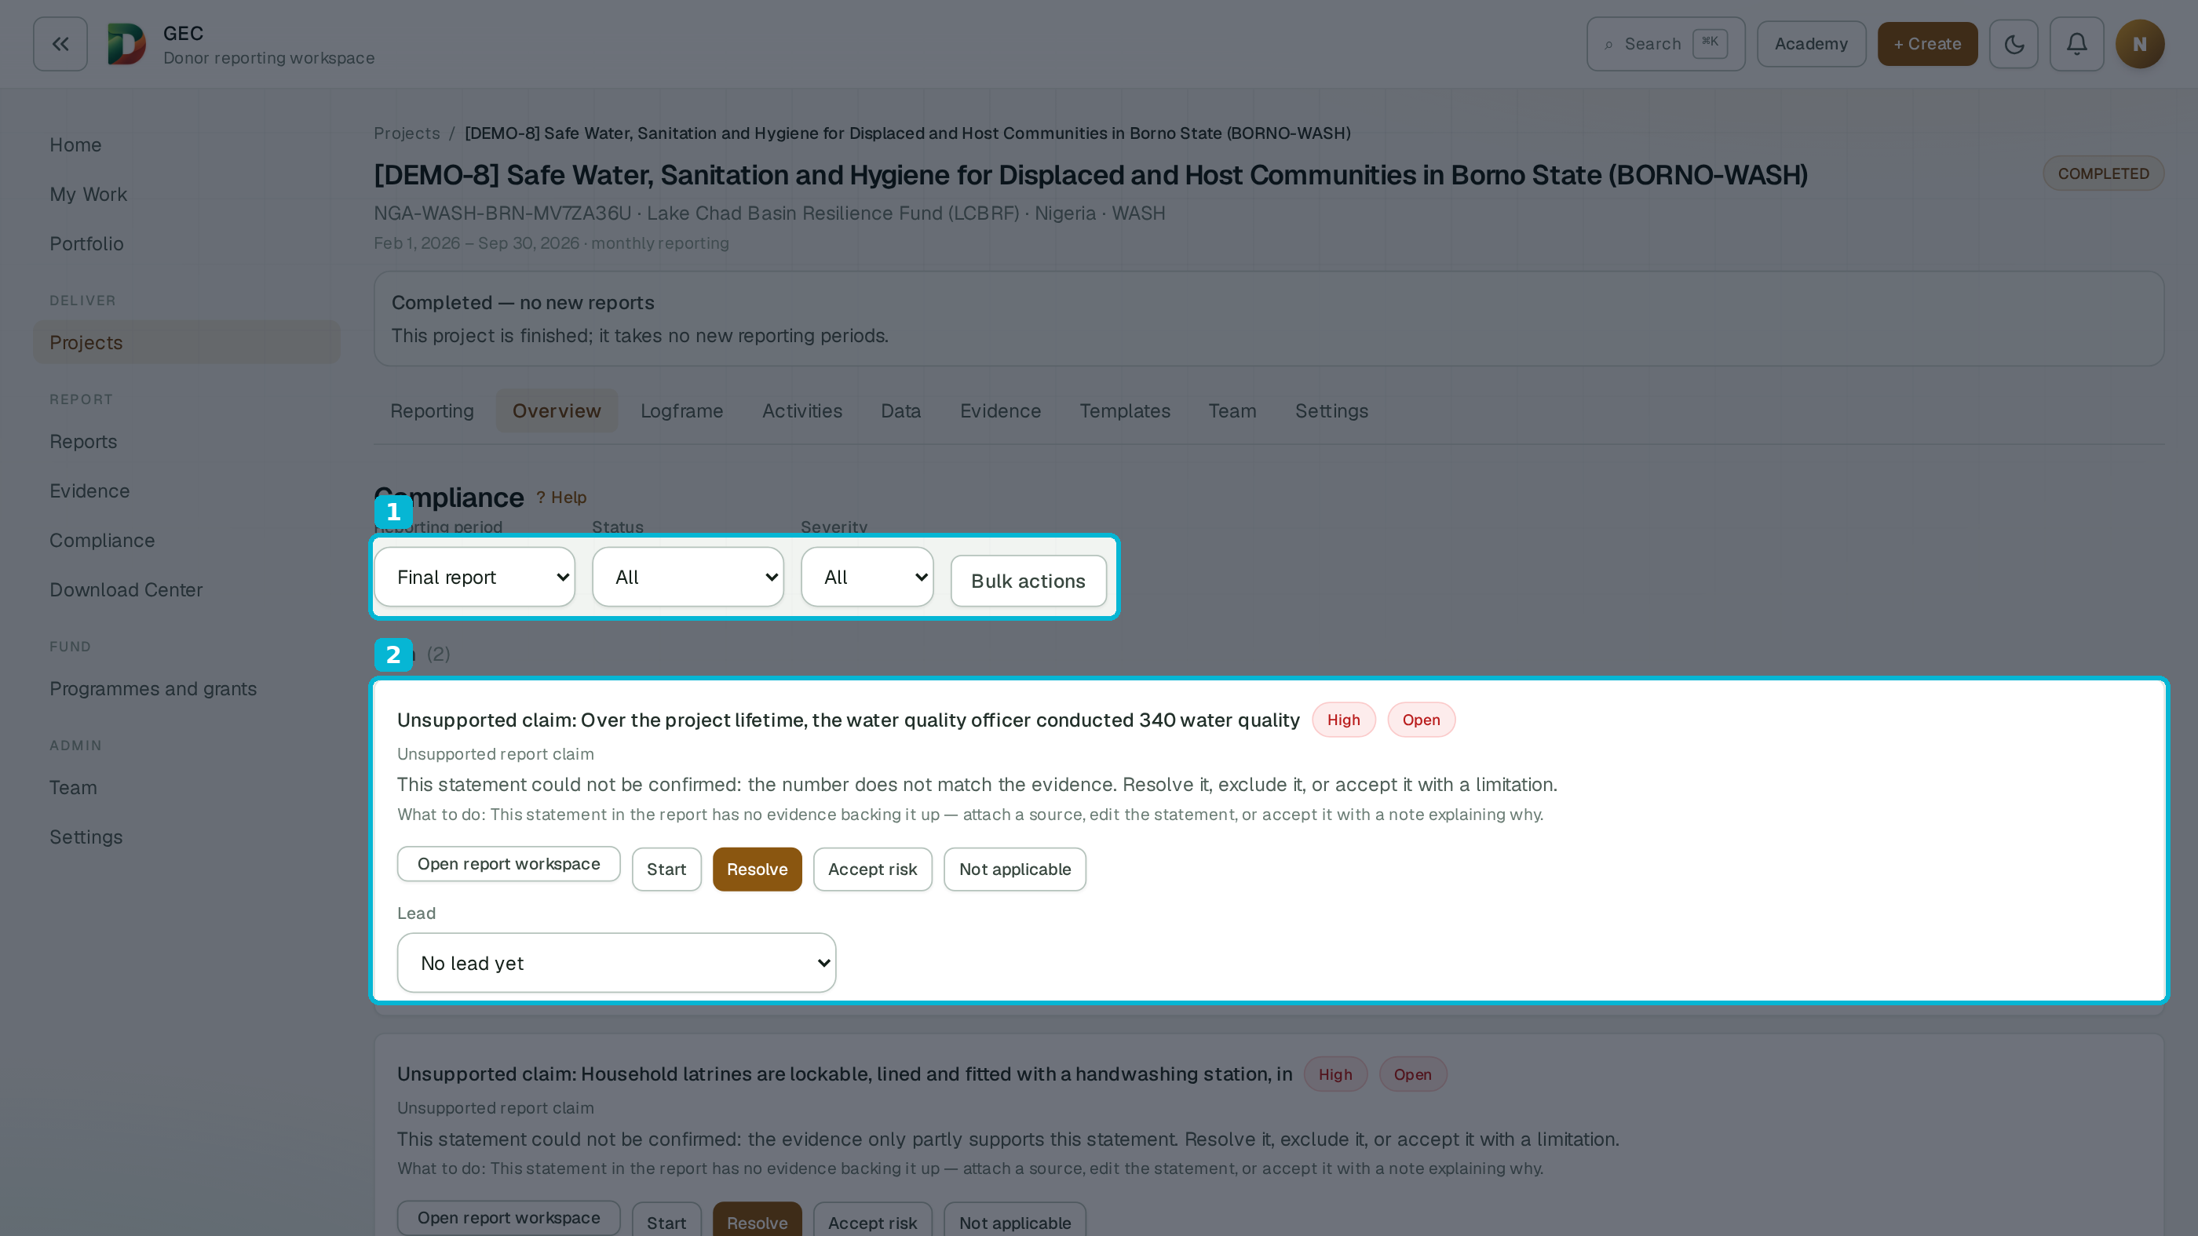
IN THE PRODUCT · COMPLIANCE · DEMO-8
Every gap has a next action
1
Filter by period, status and severity
2
A flagged claim with its options: resolve, accept risk, not applicable
Live screens from the demo workspace — sample data · October 2026.
DonorDesk · Sales deck v2.007 · October 2026 · donordesk.online
18

Slide 19
APPROVE & EXPORT
From approved draft to sealed submission
One gate, everywhere
The same rule decides approval, preflight, submission and export — no weak side door.
Approvals with teeth
Second-approver rules per project; the author cannot quietly approve their own report, and self sign-off is audited.
TECHNICAL NOTES
• One gate evaluator shared by approval, preflight, submission and export
• Sealed submission snapshot; approved figures locked, reopening audited with a reason
• Watermark on every page of internal review copies
• Excel output: indicator tables and the full data sheet
• A report is only compared with reports of its own type
Two kinds of export
Any draft becomes a watermarked internal review copy. A donor submission needs a clean, sealed snapshot — that sealed file is what goes to the donor.
Locked once approved
Approved figures cannot change under a report; a correction goes through reopening, with a reason. Formats: Word, PDF, Excel and ZIP evidence packs.
Periods: monthly, quarterly, semi-annual, annual, final and custom — roll-ups show life-of-project totals and % of target.
DonorDesk · Sales deck v2.007 · October 2026 · donordesk.online
19

Slide 20
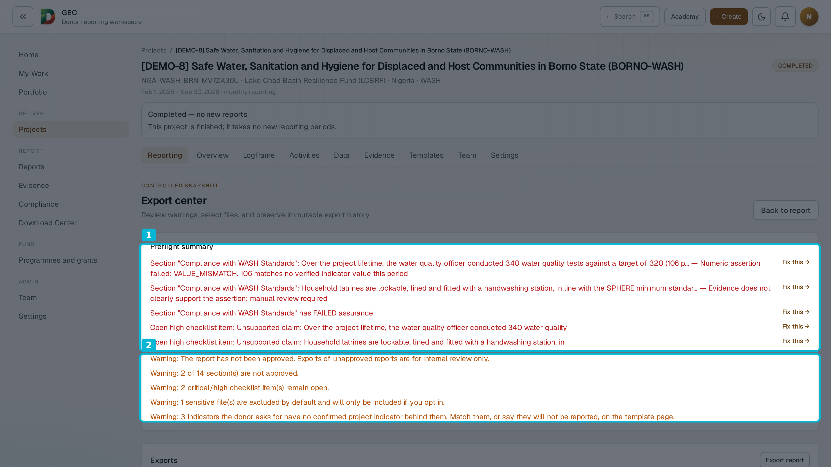
IN THE PRODUCT · EXPORT CENTER · DEMO-8
The gate before export
1
Numeric assertion failed — “Fix this” opens the sentence
2
Unapproved reports export as watermarked internal review only
Live screens from the demo workspace — sample data · October 2026.
DonorDesk · Sales deck v2.007 · October 2026 · donordesk.online
20

Slide 21
WORK PLAN · NEW IN 2026
Plan ahead, watch it deliver
Start from the logframe
Planned activities with dates, a lead and a place — proposed from your logframe in three steps. One date makes a milestone.
One honest signal
On time, Late or Done, per planned activity — worked out from the completed work linked to it, with the reason in words.
TECHNICAL NOTES
• Delivery state derived from dates and linked completed work — never stored
• A milestone is a planned activity with start = end — same table, no special case
• Recording a finished activity moves its plan item to Done
• Risks: four fields, 30-day review, never sent to the AI writer
• Plan dates are plain calendar days; moved items keep their original dates
Overview cards
Done, late and starting soon; per output, activities done of planned beside the indicator's percent of target.
Problems and risks
What happened, how serious, what we are doing, who owns it — reviewed every 30 days. They live on the Overview, never inside a donor report.
Live today on the product; further programme-management features (requests, reminders, portfolio view) are rolling out — ask us for the current status.
DonorDesk · Sales deck v2.007 · October 2026 · donordesk.online
21

Slide 22
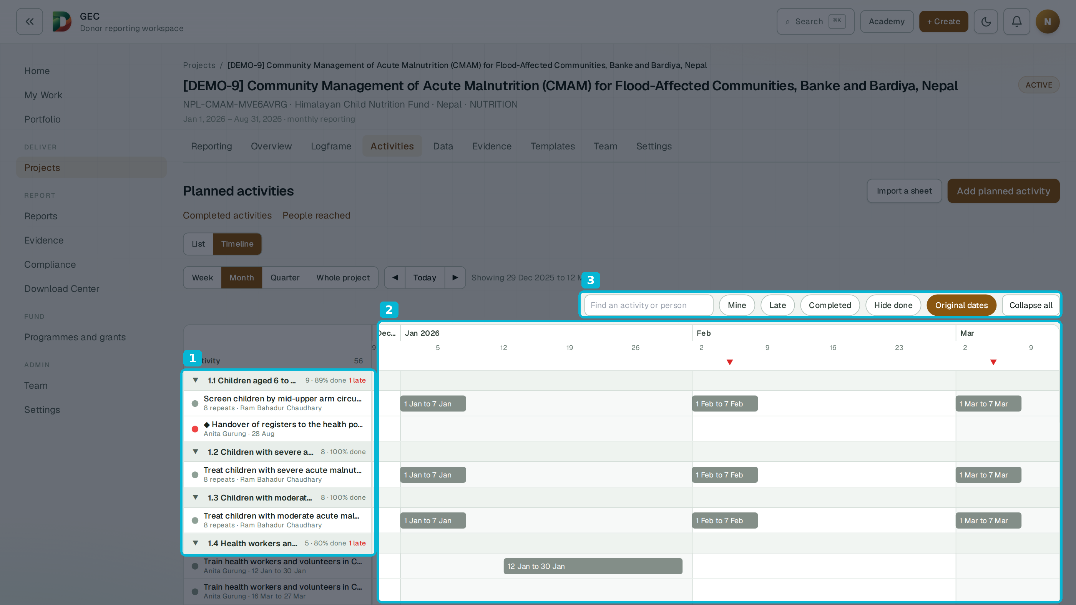
IN THE PRODUCT · WORK PLAN · DEMO-9
The plan, on a timeline
1
Outputs with done counts and late flags
2
Timeline with today markers and date spans
3
Mine, Late, Completed — one click each
Live screens from the demo workspace — sample data · October 2026.
DonorDesk · Sales deck v2.007 · October 2026 · donordesk.online
22

Slide 23
WHO IT'S FOR
Every role gets its day back
M&E Officer
Enter each value once; every report, chart and export reads the same data.
Grants Officer
See readiness and blockers weeks before the deadline — and what closes each one.
Project Manager
Review and accept field records in one place; the plan shows what is late.
GOVERNANCE
• Roles set per project; the UI hides what a role cannot use
• Access follows project membership; removed members lose access at once
• Bulk attestation limited to Admin and Project Manager
• Self sign-off is allowed only where the rule permits — and always audited
• The audit log answers “who changed what” per section
Field Officer
Record what happened in a few lines, or by dictation, before leaving the site.
Compliance Officer
Every claim links to its evidence; the audit log shows who changed what.
Director / approver
Second-approver rules and a sealed snapshot — sign what you can actually check.
Seven roles, least privilege per project — each person sees the work they own.
DonorDesk · Sales deck v2.007 · October 2026 · donordesk.online
23

Slide 24
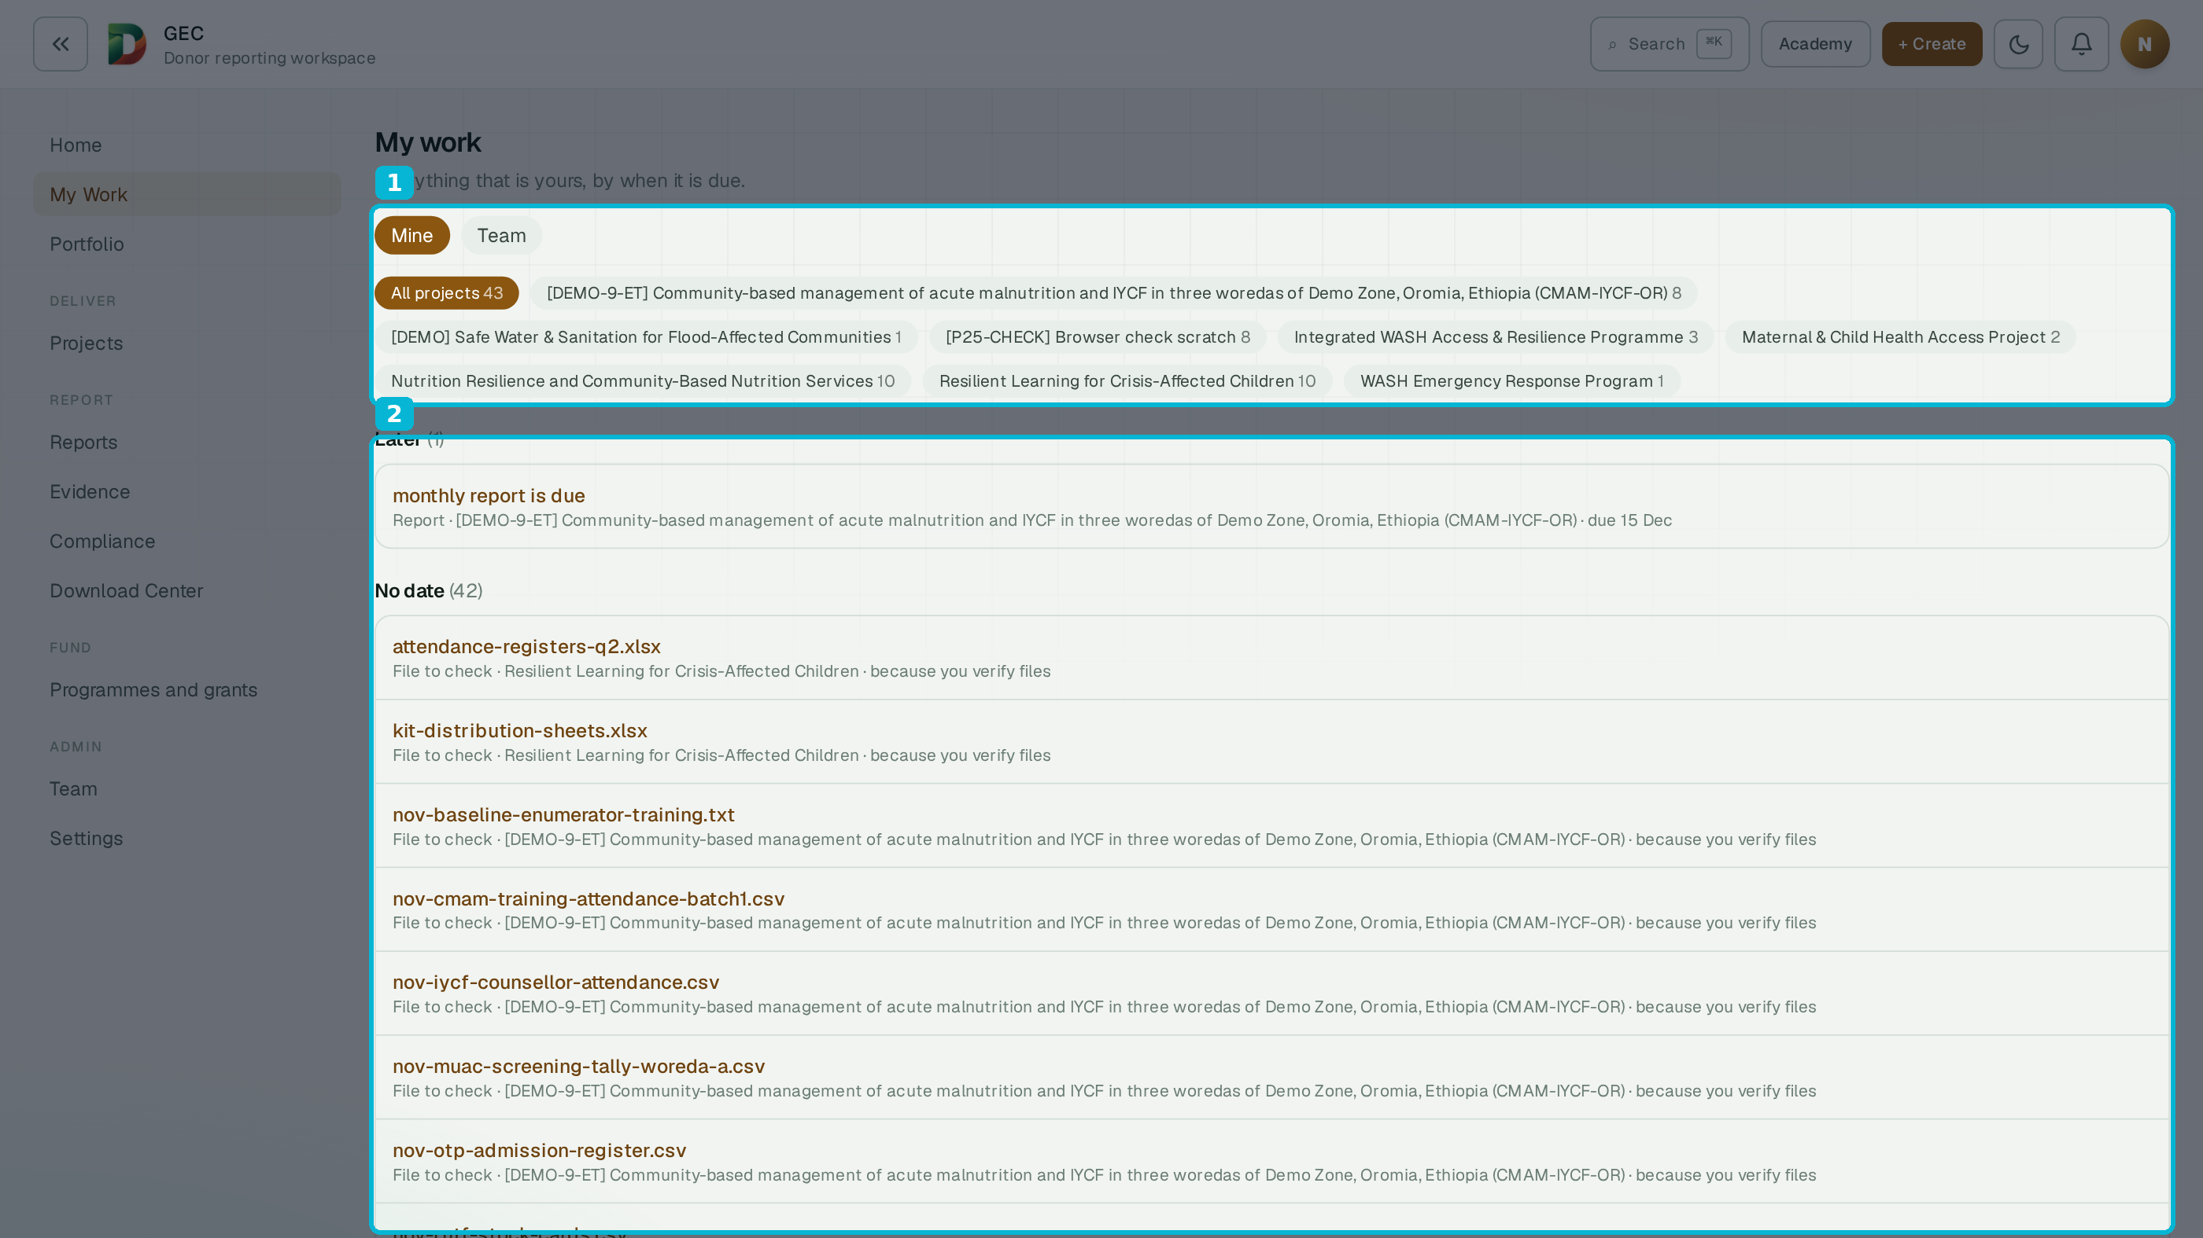
IN THE PRODUCT · MY WORK
Everything that is yours, by due day
1
One queue across every project — 43 items here
2
Everything by due day — files to check, reports due
Live screens from the demo workspace — sample data · October 2026.
DonorDesk · Sales deck v2.007 · October 2026 · donordesk.online
24

Slide 25
TRUST
Auditable by design
• Hash-chained audit log. Every change is recorded; any later edit to history is detectable.
• Tenant isolation. Row-level security in the database keeps each organisation's data separate.
• Least-privilege roles. Seven roles, set per project; removed or suspended people lose access at once.
• AI traceability. Each AI output stores its model, prompt version and sources; AI cost and usage are itemised per month.
• Published legal pack. Privacy, terms, DPA, subprocessor list and a security page — on the site, not on request.
SECURITY BASELINE
• PostgreSQL row-level security per organisation
• Audit log append-only by privilege, not only by hash chain
• Secrets never exported; backup restore tested, checksums verified
• Enterprise: OIDC single sign-on and SCIM 2.0 provisioning
• Two-step sign-in per person completing rollout
What we will not claim
No external certifications are held, and none are claimed. We say what the product does — and what it does not — on every page.
DonorDesk · Sales deck v2.007 · October 2026 · donordesk.online
25

Slide 26
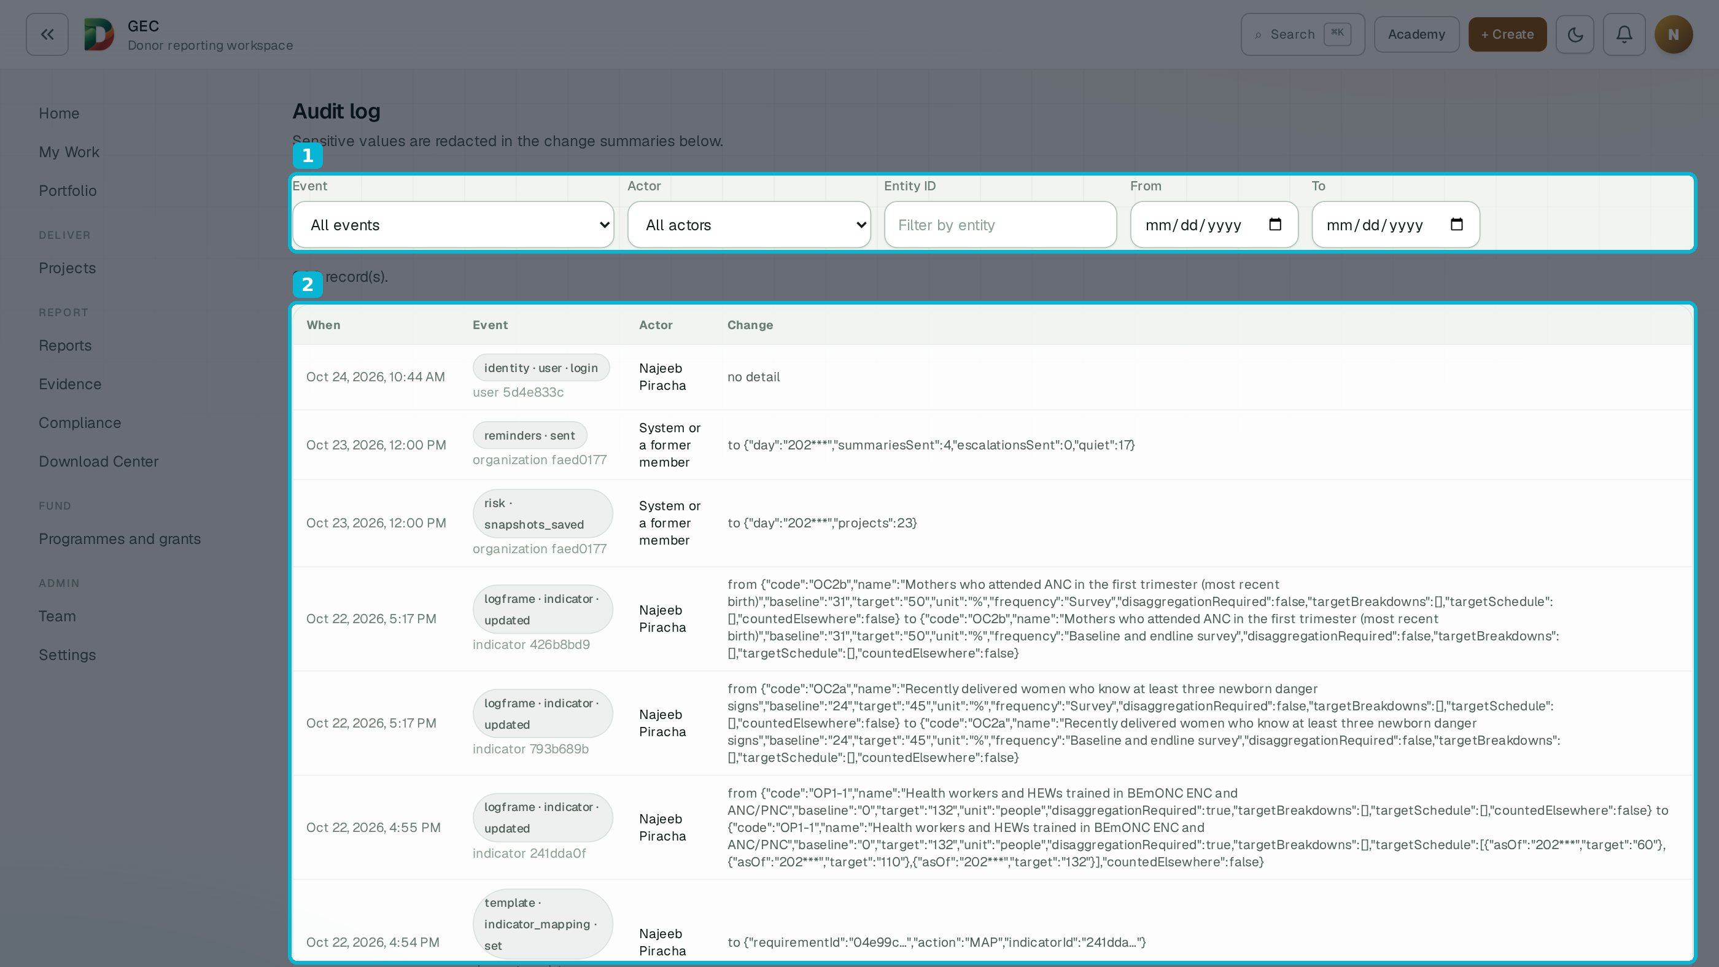
IN THE PRODUCT · AUDIT LOG
Who changed what — and when
1
Filter by event, actor, entity, date
2
Every change: actor, entity, redacted detail
Live screens from the demo workspace — sample data · October 2026.
DonorDesk · Sales deck v2.007 · October 2026 · donordesk.online
26

Slide 27
FAIR QUESTIONS
Straight answers before you ask
“We already use Excel / Kobo / ActivityInfo.”
Keep them. DonorDesk holds the programme record your reports are built from — and it imports from Excel, CSV and Google Sheets.
“Will the AI invent numbers?”
No. Tables and charts come from verified data; a figure not in the inputs is rejected and regenerated. A person approves every section.
GOOD TO KNOW
• Imports: logframes, indicator sheets, activity spreadsheets, plans
• Manual writing never uses AI credits
• Failed or timed-out drafts are never billed
• The demo project uses no AI credits
• Free Starter forever; 25% nonprofit discount in year one
• Direct submission to donors is deliberately not a feature — you upload the approved file
“Who owns our data?”
You do. Evidence can stay in your own Google Drive, tenant data is isolated in the database, and export is built in.
“Our donor has a specific template.”
Upload it once. DonorDesk extracts the outline, questions and required tables — you approve them before any draft uses them.
DonorDesk · Sales deck v2.007 · October 2026 · donordesk.online
27

Slide 28
HOW WE COMPARE
Built for the whole journey — the rest cover a slice
Capability | DonorDesk | Spreadsheets | Data-collection apps (Kobo, SurveyCTO) | M&E platforms (ActivityInfo, DevResults) | Generic AI assistants
Field activities recorded as they happen — typed or dictated | ✓ | — | ✓ | Partial | —
Indicator values entered once, reused in every report | ✓ | Manual | Partial | ✓ | —
Donor template loaded once and reused per grant | ✓ | — | — | — | —
Report drafted from your record, in the donor's format | ✓ | Manual | — | — | Text only
Every figure checked against the inputs before you see it | ✓ | — | — | Partial | —
Statement-level sources and evidence links | ✓ | — | — | Partial | —
Compliance checklist with readiness by stage | ✓ | — | — | — | —
Approval rules, sealed submission, hash-chained audit log | ✓ | — | — | Partial | —
Each of them holds a slice. DonorDesk holds the record — the report is what it produces.
Category-level comparison by general product scope, October 2026. The DonorDesk column lists live capabilities only.
DonorDesk · Sales deck v2.007 · October 2026 · donordesk.online
28

Slide 29
PLANS
Start free. Upgrade when the programme grows.
Plan | Projects | Full seats | AI drafts / month | Managed storage | Price
Starter | 1 | 1 + 2 viewers | 5 | 1 GB | Free
Team | 5 | 5 | 20 | 25 GB | $79 / month
Growth | 20 | 15 | 100 | 100 GB | $149 / month
Enterprise | Unlimited | Contracted | Unlimited | Contracted | By contract
COMMERCIAL NOTES
• Top-up packs: +50 drafts $79 (Team), +100 drafts $149 (Growth)
• Growth and Enterprise: connect your own AI provider — zero DonorDesk credits used
• Viewer seats unlimited from Team upward
• Enterprise adds SSO (OIDC) and SCIM provisioning by contract
• Seats include the owner; invited and suspended members count
• Annual billing is two months free (Team $790/yr · Growth $1,490/yr). Verified nonprofits: 25% off Team and Growth in the first year.
• Failed or timed-out drafts are never billed — manual writing never uses credits.
DonorDesk · Sales deck v2.007 · October 2026 · donordesk.online
29

Slide 30
NEXT STEP
See it on a real programme.
Take the narrated tour donordesk.online/tour
Fifteen minutes through the whole workflow — plan, record, check, report.
Create a free workspace donordesk.online/signup
The Starter plan is free forever; the demo project is included and uses no AI credits.
Read the fine print donordesk.online/help
Every feature documented with its limits. We publish what the product does not do, too.
Talk to us support@donordesk.online
A walkthrough on your own donor template — bring the format your team dreads most.
DonorDesk · Manage the grant. Report on it. · donordesk.online

