Slide 1
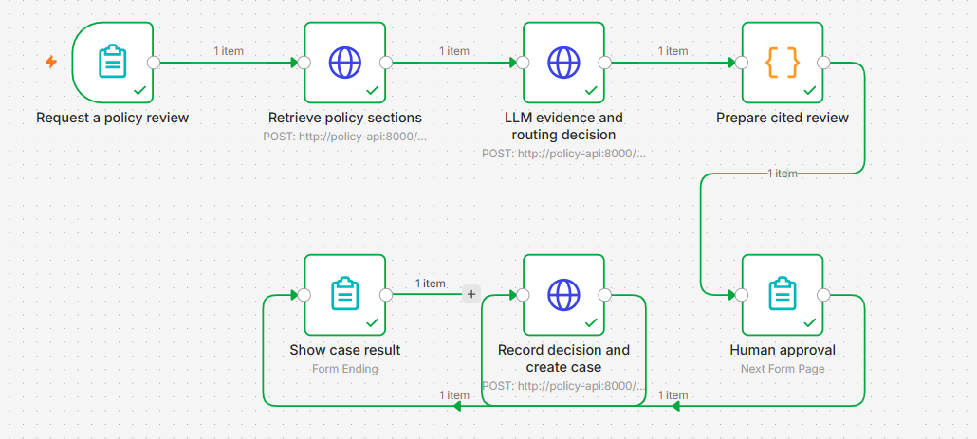
Governed AI Policy Review Agent
Cedarbridge Bank • fictional financial-services customer
An operations analyst needs to find the right policy and review team. This demo brings the source evidence, routing recommendation and approval into one workflow.
Core pattern
Retrieve → Ground → Recommend → Review → Validate → Act
Recorded n8n workflow
Approved
Rejected
Insufficient
• Example: customer statements in a public AI chatbot.
Review case created
No case created
No case created
• Policy AI-01 directs the request to SecurityReview.
• Approval opens a review case; it never permits the upload.
Jeen AI Solution Engineer Home Assignment
Shahista Tamkeen
Notes:
I’ll start with the customer problem. Cedarbridge Bank is fictional, and the policies are synthetic. I chose a bank because an AI answer is not enough in this setting. The user also needs to see the source, understand who owns the next step, and know exactly what the approval allows.
I imagined an operations analyst receiving questions about AI use or a new vendor. That person may have to search several documents and then decide which team should review the request. The example I use throughout the demo asks whether customer statements can be uploaded to a public AI chatbot for summarization.
The AI Use Policy says those statements must not be uploaded, and it routes requests involving customer data and an external AI service to SecurityReview. The workflow finds that passage, shows it to a reviewer, and can open a SecurityReview case after approval. The case starts a review. It does not authorize the upload or create a policy exception.
I kept the action this specific so I could test the complete path. The three outcomes at the bottom are from separate n8n runs: supported evidence plus approval created a case; rejection created no case; and insufficient evidence created no case even when approval was attempted.
The idea I want to keep clear is simple: the system finds and shows the evidence, the reviewer decides, and the API controls whether anything is saved.

Slide 2
Why this use case is worth prioritizing
A focused pilot for policy lookup, review routing and controlled case creation.
Business problem
Good pilot characteristics
Operations teams search separate policies and decide who should review each request. A useful pilot should reduce lookup effort and make routing more consistent, while keeping the reviewer in control.
• One policy owner and a small, inspectable corpus.
• A limited action: open a review case for the right team.
• Agreed measures for relevance, routing and reviewer overrides.
Pilot success measures
Current pain
AI-assisted improvement
How I would measure it
Acceptance gate
Policy lookup
One cited evidence view
Time to locate evidence
Reviewer confirms relevance
Routing inconsistency
Queue constrained by policy
Correct queue / override rate
No unknown queues
Unsafe automation
Action gated by approval
Cases created without approval
Zero
Measure against the manual baseline
Compare handling time, routing accuracy and reviewer overrides.
Jeen AI Solution Engineer Home Assignment
Shahista Tamkeen
Notes:
I kept the first pilot small on purpose: three documents and one action, opening a review case. That was enough to demonstrate retrieval, a model decision, human review and persistence while still letting me inspect every source passage.
The everyday problem has two parts. One is the time spent searching policies. The other is sending a request to the wrong team. The workflow puts the passage and proposed queue on the same page so a reviewer can check them together.
If I were doing discovery with a customer, I would ask who receives these requests today, which policy copy is authoritative, who can approve each case, whether the requester can also be the reviewer, and what information the existing case system requires.
For a pilot, I would first measure the current manual process. Then I would compare handling time, routing accuracy and reviewer overrides. I would also track when the workflow stops because the documents do not contain the answer. In a policy workflow, stopping can be the correct result.
I have not measured customer time savings in this proof of concept. The results later in the deck are technical validation results. I would only make a business impact claim after a real pilot against an agreed baseline.

Slide 3
Workflow and technical architecture
n8n runs the forms and workflow; the Python API owns retrieval, validation and storage.
1
Request
2
Retrieve
3
LLM decision
4
Validate
5
Human review
6
Create / close
Question and request ID
BM25 retrieves up to 4 sections
Select evidence IDs and a queue
Check IDs and queue metadata
Check relevance; approve or reject
Check approval and stored proposal
Technical choices
• BM25: inspectable retrieval for this small policy corpus.
• OpenAI: selects evidence; the API shows original excerpts.
• Python + SQLite: validation, cases and audit records.
• Docker Compose: runs n8n and the API with persistent data.
3 synthetic documents / 8 policy sections
Sources: AI Use Policy • Vendor Intake Policy • Policy Review Procedure
Jeen AI Solution Engineer Home Assignment
Shahista Tamkeen
Notes:
This slide follows one request through the system. n8n manages the forms and the order of the steps. The Python service owns retrieval, the model call, validation, storage and case creation. The two services communicate over HTTP with JSON.
The sources are the AI Use Policy, Vendor Intake Policy and Policy Review Procedure. They are synthetic and split into eight sections. When the user submits a question, BM25 ranks the sections and keeps up to four candidates. The API saves that result and returns a retrieval ID.
The proposal step loads the saved question and passages. The configured OpenAI model selects one to three evidence IDs and suggests a review queue, or it returns insufficient. The policy text shown to the reviewer comes from the documents; the model does not write that passage.
The API checks that the selected IDs were part of the retrieval and that the queue agrees with the source metadata. n8n then shows the original excerpts and waits for a person to approve or reject. After the decision, the API loads the stored proposal and checks it before creating or closing the case.
I used BM25 because eight sections with specific policy language did not require an embedding service. I used SQLite because the demo needed persistent records and transactions without another database service. Docker Compose starts n8n and the API and keeps their data across restarts.
The recorded live evaluation used the configured gpt-5.6-sol OpenAI model. This project uses direct HTTP and JSON between n8n and the API. It does not implement MCP, FastAPI, Kubernetes or Terraform.

Slide 4
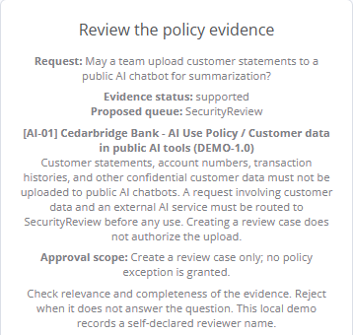
Evidence is visible before action is allowed
The reviewer sees the source passage, the proposed queue and the action scope before deciding.
What the reviewer sees
• AI-01, its policy title, section and original passage.
• Customer data must not go into a public AI chatbot.
• SecurityReview is the queue named in the policy.
• A review case does not grant a policy exception.
Before a case is created
The reviewer checks relevance. The API checks stored support status, explicit approval, proposal expiry, source hashes and replay state.
Evidence first
Human approval
Server validation
Scoped action
Jeen AI Solution Engineer Home Assignment
Shahista Tamkeen
Notes:
This is the review page from the customer-statements example. I would point first to the question, then the SecurityReview queue, citation AI-01 and the original passage.
The passage says that customer statements and other confidential customer data must not be uploaded to public AI chatbots. It also says that a request involving customer data and an external AI service must be routed to SecurityReview before use.
The API can check exact conditions. It verifies that the evidence IDs came from the saved retrieval, that the queue matches the source metadata, that the proposal has not expired, that the source files have not changed, and that the same proposal has not already been processed.
Those checks do not prove that a passage is relevant. A real citation can still be the wrong citation for the question. The reviewer makes that judgment by reading the passage. That is why I separate the human relevance check from the API checks.
The approval scope is also visible on the page. Approving this request only opens a review case. It does not permit the upload or grant a policy exception.
The HTTP calls use an integration token, and the provider key remains in the API environment. The current reviewer name is typed into the form, so it is not a verified identity. Before a pilot, I would add sign-in, role-based approval, document permissions and protected audit storage.

Slide 5
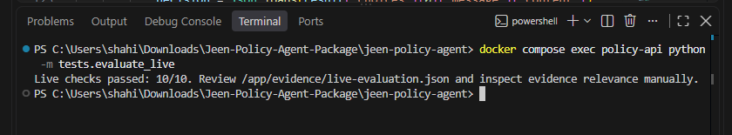
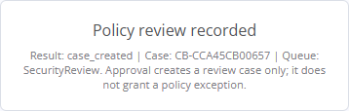


Validation results and recorded workflow outcomes
Results cover the recorded test set; they do not establish general model accuracy.
27/27
10/10
3
Application tests
Fixed model responses
Curated live-model
checks
Recorded n8n
outcomes
Recorded live-model evaluation
Three separate n8n runs
Supported + approved → case created
Supported + rejected → no case
Insufficient + approved → no case
Next: production
SSO/RBAC • Document permissions • Case-system connector • Protected audit storage
Jeen AI Solution Engineer Home Assignment
Shahista Tamkeen
Notes:
I separate the evidence on this slide because the three numbers answer different questions.
The 27 application and HTTP checks use fixed model responses. That makes them repeatable and lets me test approval, rejection, expiry, source changes, repeated decisions, concurrent approvals and authentication without relying on a live provider every time.
The ten curated checks use the live OpenAI model. Four questions were expected to return supported evidence with the right source IDs and queue. Six questions were expected to stop because the answer was missing or the prompt was adversarial. All ten matched those expected outcomes in the saved run.
The three images are separate n8n executions. The first created a SecurityReview case after supported evidence and approval. The second created no case after rejection. The third created no case from an insufficient proposal, even when approval was selected.
The ten live checks evaluate the recommendation step; they do not call the decision endpoint. That is why I do not use the live run to claim that zero cases were created. The three n8n executions demonstrate the action behavior.
This is a small curated set, so I would not describe it as a general model accuracy score. Before a customer pilot, I would add more realistic questions and have policy owners judge the evidence relevance. I would also add SSO and role-based approval, document permissions, a real case-system connector and protected audit storage.
My closing line is: the policy passage stays connected to the recommendation, the human decision and the saved case. The model helps with evidence selection and routing, while the reviewer and API keep control of the action.

