Slide 1
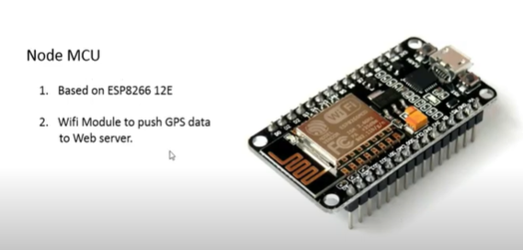
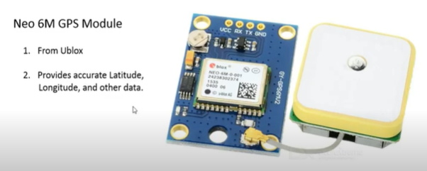
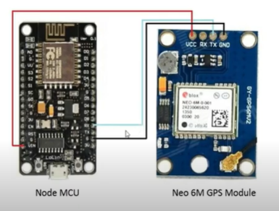
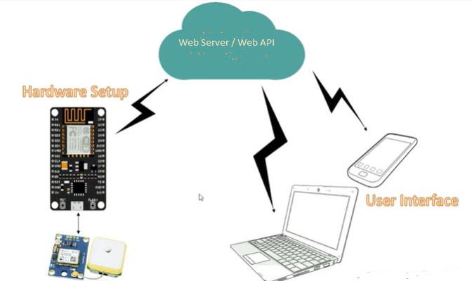
Truck Plan GPS Tracker System
01. Hardware requirement
Node MCU – Push GPS Coordinate to web server
Neo 6M GPS Module – To communicate with satellite
Connection between Node MCU and Neo 6M GPS
Block Diagram of Truck GPS Tracker System

Slide 2
02. Software part
Create Truck Plan API to keep the truck location records every 5 mins. Interval.
Use OAuth2 Authentication
Default authorization user name : Admin, password: 123456, Client Id and client secret is optional.
Two types of API version 1 and Version 2. API’s are Truck Info, Driver Info, User Info, and GPS Truck Records.
GPS Truck Records Get only three data from server GPSDeviceID, Latitude and Longitude, and then stored into GPSTruckRecord Table by using /api/v2/GPSTruckRecords.
Country calculation is dynamic from Latitude and Longitude.
Kilometer calculation is also dynamic – with two points – current and 5 mins back. First record at the beginning of the day is zero.
So, final data table records for each row is GPSDeviceID, Latitude and Longitude, Country,Kilometer, record date.
Web part is also include here, named as TruckPlanWebApp. TruckPlanApiClient project is the middle ware to communicate with Web API

Slide 3
Techniques and Features
JWT Authentication
Secure JWT using Encryption (JWE)
Logging to File, Console and Database using Elmah & NLog
Logging to sentry.io (Log Management System)
Exception Handling using Custom Middleware
Automatic Validation
Standard API Resulting
Dependency Injection using Autofac (Ioc Container)
Map resources using AutoMapper
Async/Await Best Practices
Versioning Management
Using Swagger (Swashbuckle)
Auto Document Generator for Swagger
Integrate Swagger and Versioning
Integrate Swagger and JWT/OAuth Authentication
Best Practices for Performance and Security

