Slide 1
CLN Optimality

Slide 2
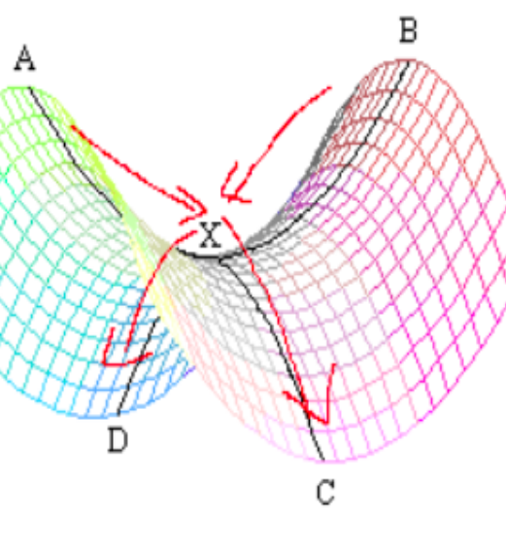
Background: NN Optimality
Several NN architectures shown to achieve results optimal solutions
Key to success is overparameterization
Local minima convert to saddle points
Local minima in overparamerized network are usually good solutions
http://mitliagkas.github.io/ift6085-2019/ift-6085-bonus-lecture-saddle-points-notes.pdf

Slide 3
Can we do same for CLNs?
Analysis: gradient on B smoothing works in our favor
will always increase smoothing when solution is incorrect
Will always decrease smoothing when solution is correct
→ Should help learn precision solutions

Slide 4
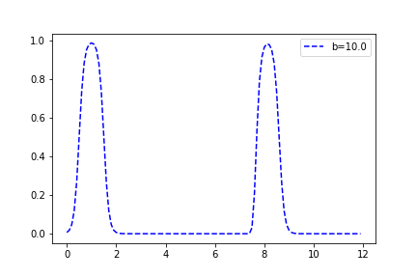
Can we do same for CLNs?
Problem: Using just B smoothing results in local minimas with product tnorms:
$$\left(x=1\right)∨(\left(x>8\right)∧\left(x>8\right)∧\left(x>8\right)∧\left(x<8.1\right))$$
Looks correct…

Slide 5
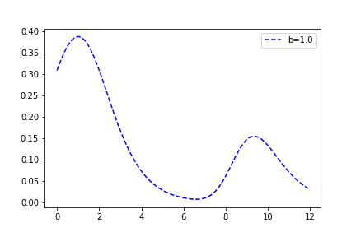
Can we do same for CLNs?
Using just B smoothing results in local minimas with product tnorms:
$$\left(x=1\right)∨(\left(x>8\right)∧\left(x>8\right)∧\left(x>8\right)∧\left(x<8.1\right))$$
Not quite <8.1

Slide 6
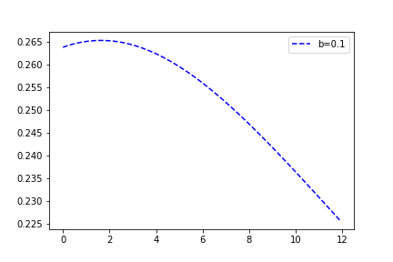
Can we do same for CLNs?
Using just B smoothing results in local minimas with product tnorms:
$$\left(x=1\right)∨(\left(x>8\right)∧\left(x>8\right)∧\left(x>8\right)∧\left(x<8.1\right))$$

Slide 7
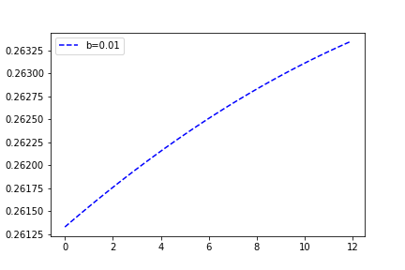
Can we do same for CLNs?
Using just B smoothing results in local minimas with product tnorms:
$$\left(x=1\right)∨(\left(x>8\right)∧\left(x>8\right)∧\left(x>8\right)∧\left(x<8.1\right))$$
Local minima here (increasing smoothing does not help) →

Slide 8
Can we do same for CLNs?
Can construct similar counterexamples with individual Bs per constraint
Also counterexamples with Godel t-norm

Slide 9
Other parameterization?
Try adding shift params:
(x < b) → (x < b + shift)
Add regularization to pressure shift towards 0

Slide 10
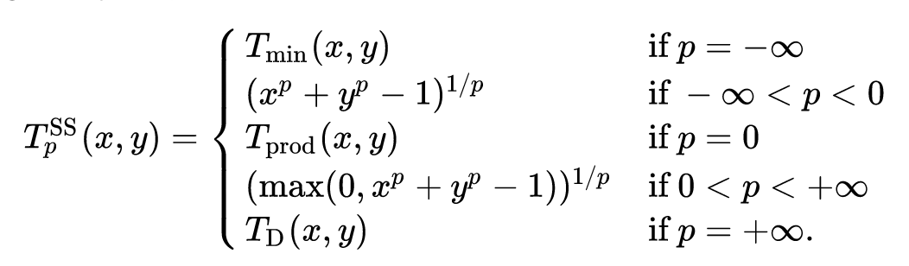
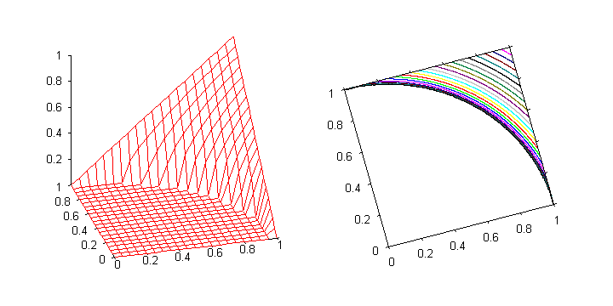
Other parameterization?
Parameterized t-norms:
Schweizer–Sklar t-norms
Schweizer–Sklar t-norms

Slide 11
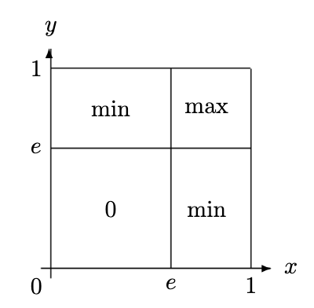
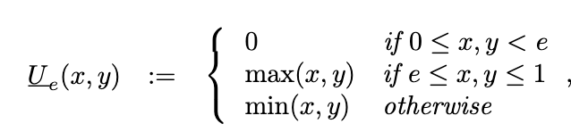
Other parameterization?
Uninorm functions:
https://www.researchgate.net/publication/220354760_Structure_of_Uninorms

Slide 12
Future directions:
Exploring new parameterizations of smt constraints
Exploring new parameterizations of logic
Different structures of relaxations (i.e. making constraints share some parameters selectively)

