Slide 1
MACHINE LEARNING • MINI PROJECT
Activity Recognition
Using Cell Phones
Recognising everyday human activities from smartphone motion sensors
SMARTPHONE
Accelerometer + Gyroscope
WALKING
SITTING
LAYING
Juhi Shah • PES University
GitHub: shahjuhi22/activity-recognition-ml

Slide 2
Can a phone tell what a person is doing?
PROBLEM
People move differently, but those movements create recognisable patterns in sensor signals.
The challenge
The opportunity
Project goal
Raw motion readings are numerical and noisy. The same device must distinguish activities that can look similar.
A smartphone already contains motion sensors that can capture movement without a camera.
Train classifiers to map sensor-derived features to one of six everyday activities.
Target: useful activity predictions from sensor data, not visual recognition.
Activity Recognition Using Cell Phones • Mini Project
2

Slide 3
Project objectives
PROBLEM
Build an end-to-end human activity recognition pipeline using the UCI HAR dataset.
Input
561 pre-extracted features per sensor window
Train and compare Logistic Regression and Random Forest classifiers.
Output
Evaluate predictions on the held-out test set using accuracy, precision, recall and F1 score.
One of six predicted activity labels
Make the trained model accessible through an interactive Streamlit dashboard.
Interface
Upload a CSV or try a test-set sample
Activity Recognition Using Cell Phones • Mini Project
3

Slide 4
Dataset: smartphone motion in six classes
DATA
10,299
7,352
2,947
561
total examples
training examples
test examples
features per window
Dataset characteristics
Why this dataset?
30 volunteers performed everyday activities.
A standard benchmark with a fixed train/test split and pre-engineered time- and frequency-domain features.
Samsung Galaxy S II smartphone worn at the waist.
Accelerometer and gyroscope signals sampled at 50 Hz.
Each feature row summarises a 2.56-second sensor window.
Six labelled activities; no missing values reported in the project README.
Activity Recognition Using Cell Phones • Mini Project
4

Slide 5
Six activities the model recognises
DATA
WALKING
UPSTAIRS
DOWNSTAIRS
Regular movement
Climbing stairs
Descending stairs
SITTING
STANDING
LAYING
Seated posture
Upright posture
Lying down
The classifier chooses among these labels from the feature vector for each window.
Activity Recognition Using Cell Phones • Mini Project
5

Slide 6
End-to-end system workflow
METHOD
01
02
03
04
05
Download
Prepare
Train
Evaluate
Deploy
UCI HAR dataset
Load split + labels
LR and Random Forest
Held-out metrics
Streamlit dashboard
Reproducible scripts separate data acquisition, model training and user-facing inference.
Activity Recognition Using Cell Phones • Mini Project
6

Slide 7
From sensor windows to model inputs
METHOD
Raw sensor signals
Feature extraction
Label mapping
Accelerometer measures linear acceleration; gyroscope measures rotational motion.
The benchmark provides 561 statistical and frequency-domain features per window.
Each row is associated with one of six activity classes for supervised learning.
Model input
x = [feature₁, feature₂, …, feature₅₆₁] → predicted activity ∈ {6 classes}
The project uses the dataset's pre-extracted features rather than processing raw waveforms from scratch.
Activity Recognition Using Cell Phones • Mini Project
7

Slide 8
Two classifiers, two learning strategies
METHOD
Logistic Regression
Random Forest
• Multiclass classifier using a softmax probability distribution
• Solver: L-BFGS
• Simple and fast; effective when features separate classes well
• Ensemble of decision trees trained on random feature subsets
• Each tree votes; the majority class is predicted
• 100 trees in this project; reduces dependence on one tree
Both models are evaluated on the same held-out test set of 2,947 examples.
Activity Recognition Using Cell Phones • Mini Project
8

Slide 9
How performance is measured
METHOD
Accuracy
Precision
Fraction of all test examples predicted correctly.
Of the examples predicted as a class, how many were correct?
Recall
F1 score
Of the real examples in a class, how many were found?
Harmonic mean of precision and recall.
A separate test set gives a more realistic estimate than training accuracy alone.
Activity Recognition Using Cell Phones • Mini Project
9

Slide 10
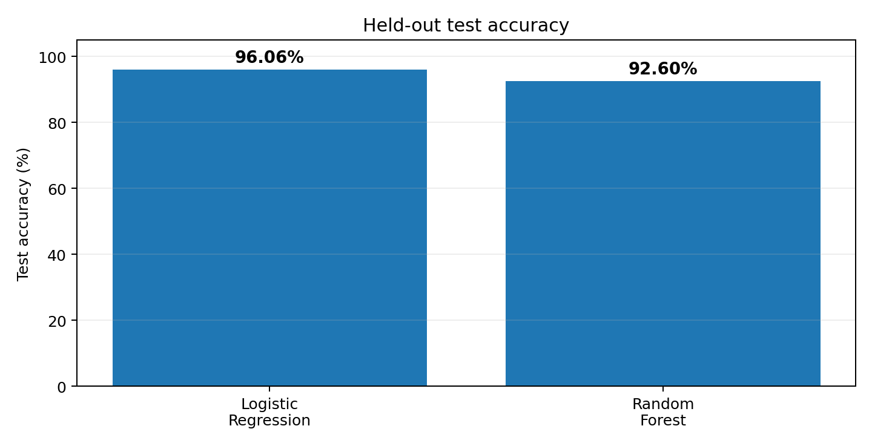
Logistic Regression leads on the test set
RESULTS
96.06%
Logistic Regression accuracy
92.60%
Random Forest accuracy
+3.46 pp
Accuracy advantage for Logistic Regression
Reported values are from the repository's held-out test evaluation.
Activity Recognition Using Cell Phones • Mini Project
10

Slide 11
Model comparison at a glance
RESULTS
Model | Accuracy | Precision | Recall | F1 score
Logistic Regression | 96.06% | 96.20% | 96.06% | 96.05%
Random Forest | 92.60% | 92.73% | 92.60% | 92.59%
Interpretation
Logistic Regression has the strongest overall scores in the reported test evaluation.
Random Forest performs well, but its ensemble does not improve on these pre-engineered features.
Precision, recall and F1 are close to accuracy, suggesting balanced class-wise performance overall.
Activity Recognition Using Cell Phones • Mini Project
11

Slide 12
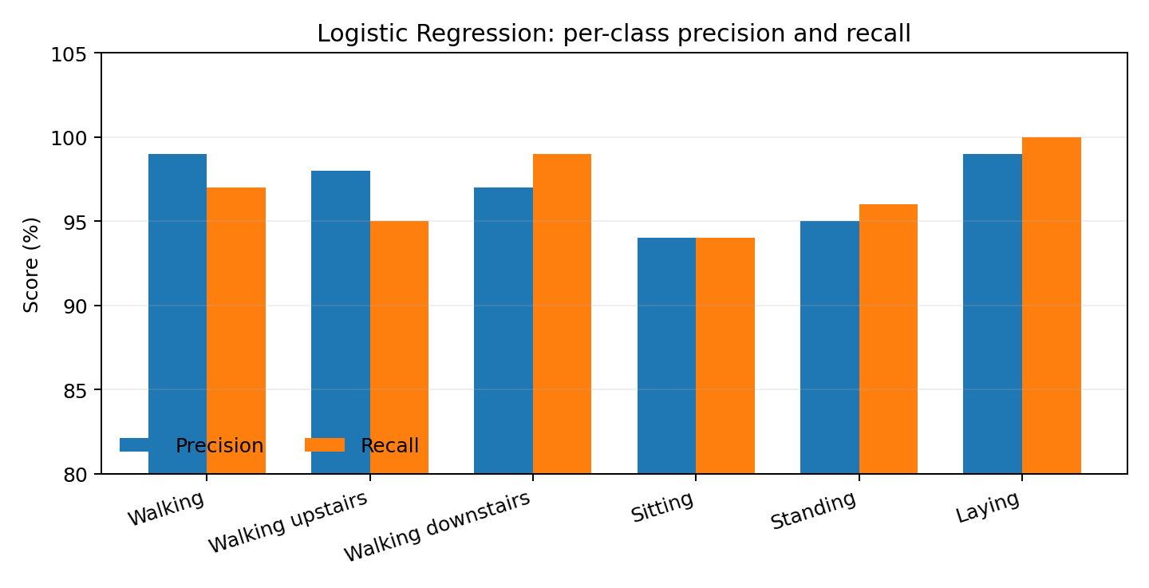
Performance across the six activities
RESULTS
Strong recall
Laying: 1.00
Walking downstairs: 0.99
More challenging
Sitting: precision and recall 0.94
Values shown are the Logistic Regression per-class results in the repository README.
Activity Recognition Using Cell Phones • Mini Project
12

Slide 13
A usable interface, not just a trained model
APPLICATION
ACTIVITY RECOGNITION DASHBOARD
Dashboard pages
Home
Predicted activity
Home: project overview and workflow
Prediction
WALKING
Activity Prediction: upload CSV or try a test sample
Performance
Model Performance: metrics, comparison chart and confusion matrix
Dataset Explorer
Confidence / class probabilities
About
Walking
Dataset Explorer: activity distribution and feature statistics
Standing
Sitting
About: technologies, methodology and references
Interface mockup for illustration; the repository describes these five pages.
Activity Recognition Using Cell Phones • Mini Project
13

Slide 14
Implementation and repository structure
ENGINEERING
Run sequence
activity-recognition-ml/
├── app.py Streamlit dashboard
├── train_model.py Training + evaluation
├── download_dataset.py Dataset downloader
├── generate_sample_csv.py Sample CSV generator
├── sample_input.csv Example input
├── model.pkl Saved model artifact
├── requirements.txt Dependencies
└── outputs/ Metrics and plots
1
pip install -r requirements.txt
Install dependencies
2
python download_dataset.py
Download and extract data
3
python train_model.py
Train, evaluate and save model
4
streamlit run app.py
Launch the dashboard
Activity Recognition Using Cell Phones • Mini Project
14

Slide 15
Applications and current limitations
DISCUSSION
Potential applications
Current limitations
Fitness and wellness tracking
Context-aware mobile apps
Activity-aware assistive systems
Benchmark data rather than live phone streams
Pre-extracted features limit raw-signal experimentation
Performance may vary across people and device placement
Next steps
Test on sensor data collected directly from a phone.
Evaluate generalisation to unseen users and different device placements.
Explore additional models and tune hyperparameters.
Optimise inference and improve confidence-aware predictions.
Activity Recognition Using Cell Phones • Mini Project
15

Slide 16
Conclusion
WRAP-UP
Smartphone sensors carry useful activity signals
01
The UCI HAR dataset provides 561 features for six everyday activities.
Logistic Regression was the best of the two tested models
02
It achieved 96.06% test accuracy, compared with 92.60% for Random Forest.
The model is packaged for interactive use
03
A Streamlit dashboard supports prediction, evaluation and dataset exploration.
Real-world validation is the next step
04
Test on live sensor data and across users before claiming deployment readiness.
Thank you • Questions?
Activity Recognition Using Cell Phones • Mini Project
16

Slide 17
References and project link
REFERENCES
Project repository: github.com/shahjuhi22/activity-recognition-ml
UCI Machine Learning Repository: Human Activity Recognition Using Smartphones (Dataset 240).
Anguita et al. (2013), “A Public Domain Dataset for Human Activity Recognition Using Smartphones,” ESANN.
Scikit-learn documentation: Logistic Regression and Random Forest classifiers.
Streamlit documentation: building Python data applications.
Project results in this deck are taken from the repository README; no new experiments were run for this presentation.
Activity Recognition Using Cell Phones • Mini Project
17

