Slide 1
case project-2
Sales Prediction Dataset
Khushi Shah
IIT Gandhinagar 24110326@iitgn.ac.in

Slide 2
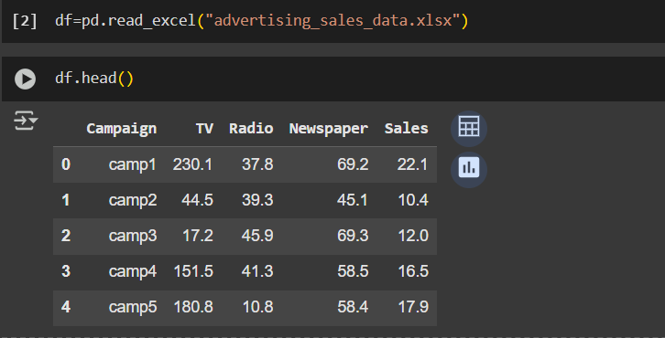
Dataset analysis:
Initial Step:
Display the dataset to be know about the columns and the datatypes present.
Number of NaN values present in each column and either removing them or replacing them with mean or zero.

Slide 3
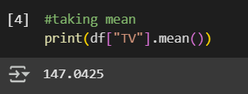
Question-1
What is the average amount spent on TV advertising in the dataset?

Slide 4
APPROACH:
Using "mean" method to directly calculate the average amount spent on TV advertising.

Slide 5
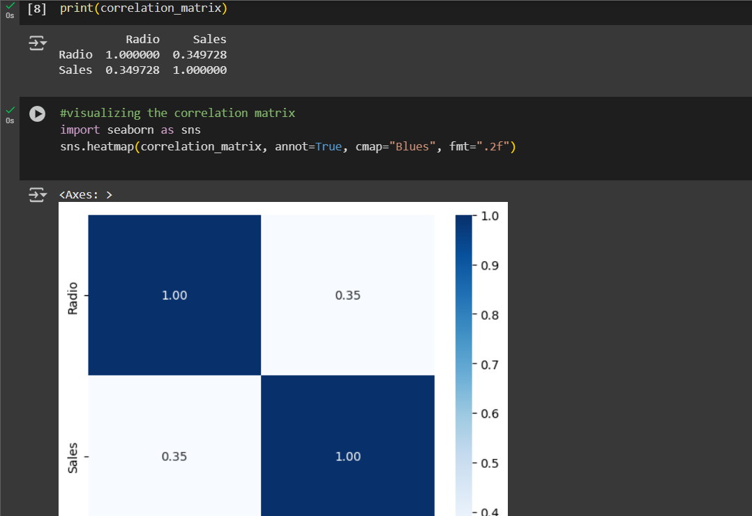
Question-2
What is the correlation between radio advertising expenditure and product sales?

Slide 6
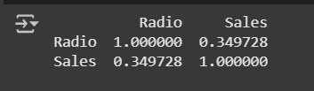
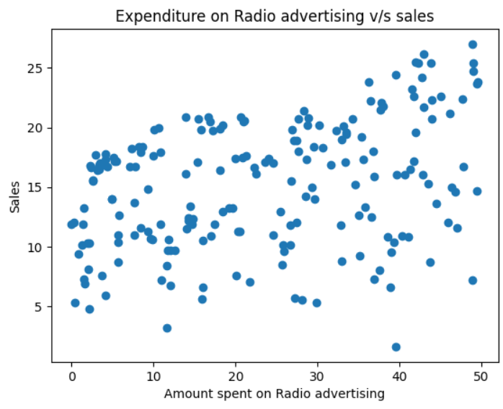
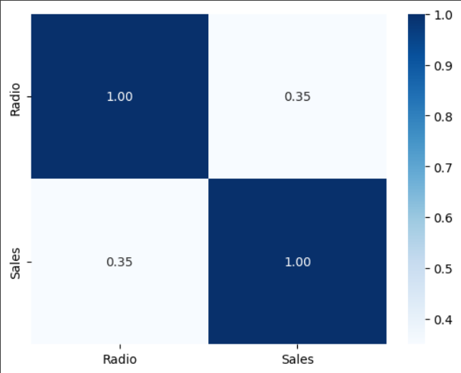
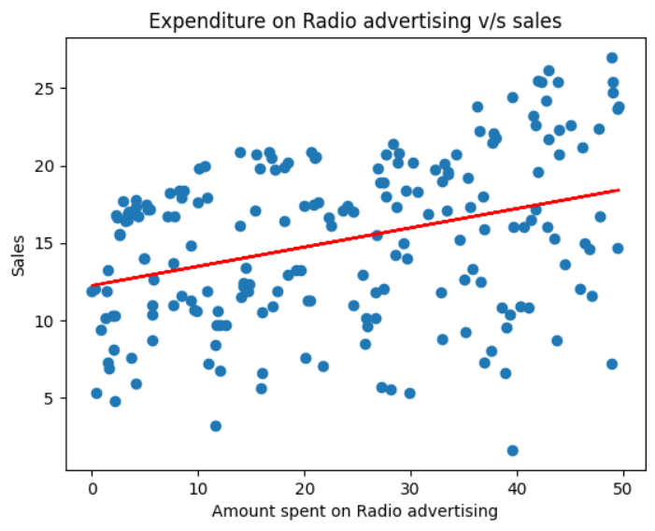
APPROACH:
To check the presence of any NaN (not a number) values.
Started with plotting a scatter plot to visualize the data and then using Linear regression model to check the relation between radio advertisement and sales.
Created a correlation matrix to analyze the data and visualized it by plotting a heatmap.
CONCLUSION:
There is not a significant correlation between the amount spent on advertising the product with the help of radio and overall sales that took place (0.35).
Although the correlations are positive—Indicating that as radio advertisement increase
Indirect proportionality
Direct proportionality
INTERPRETATION:
-1
1
A correlation matrix checks the extent of linear proportionality among variables. The above matrix depicts that the amount spent on Radio advertisement and the overall sales is positively correlated, but the magnitude of correlation is less than 0.5 which represents slightly weak correlation.
the sales increase as well—the strength of these relationships is weak.

Slide 7
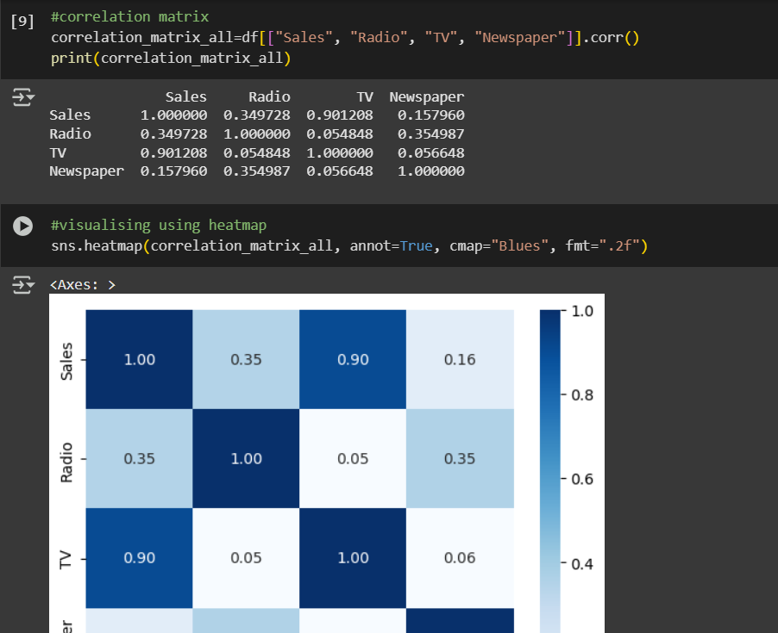
Question-3
Which advertising medium has the highest impact on sales based on the dataset?

Slide 8
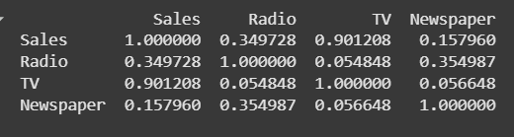
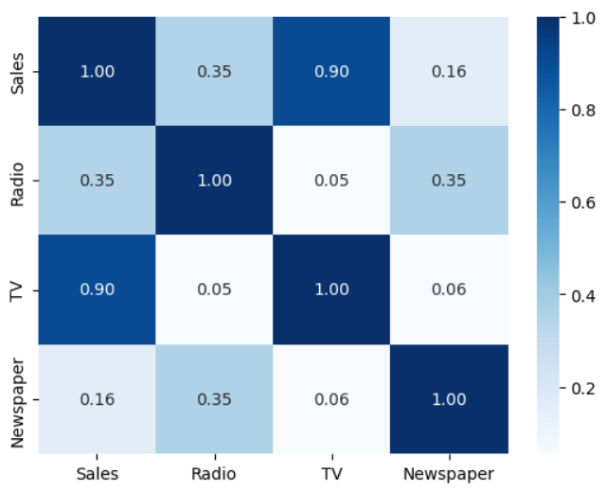
APPROACH:
To check the presence of any NaN (not a number) values.
To observe the impact of each advertising medium on sales – correlation matrix is useful as it helps in determining the strongest linear relationship with sales.
Created a correlation matrix to analyze the data and visualized it by plotting a heatmap.
CONCLUSION:
The correlation analysis reveals that TV advertising has the strongest positive relationship with Sales (0.90), suggesting it significantly influences customer purchases. Radio shows a moderate correlation (0.35), while Newspaper has a weak correlation (0.16), indicating limited impact. Therefore, among the three advertising mediums, TV appears to be the most effective in driving sales. Businesses should consider allocating more budget to TV advertising for better returns.
INTERPRETATION:
The correlation matrix shows how strongly each advertising medium is related to Sales. TV has the highest correlation with Sales (0.90), indicating a strong positive relationship. Radio has a moderate correlation with Sales (0.35), while Newspaper has a weak one (0.16).

Slide 9
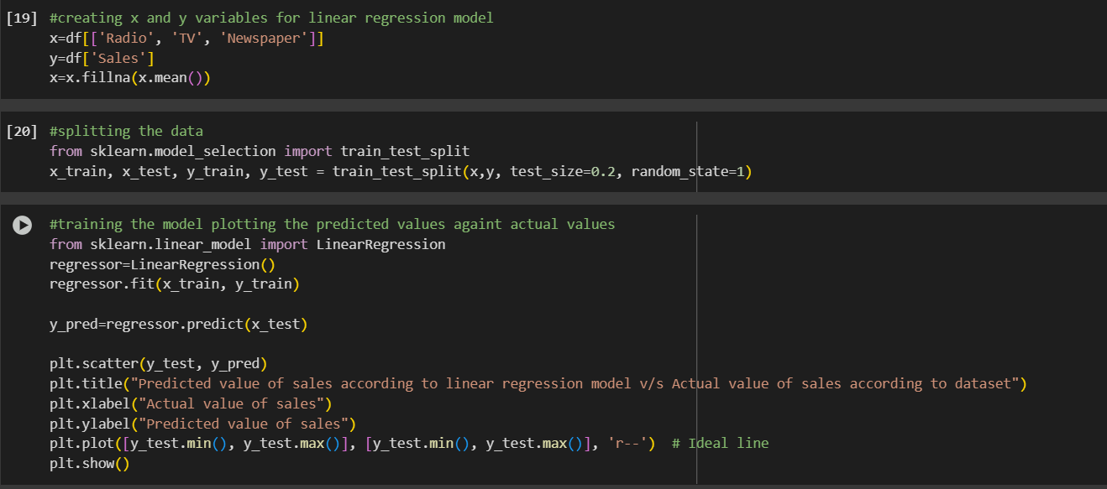
Question-4
Plot a linear regression line that includes all variables (TV, Radio, Newspaper) to predict Sales, and visualize the model's predictions against the actual sales values.

Slide 10
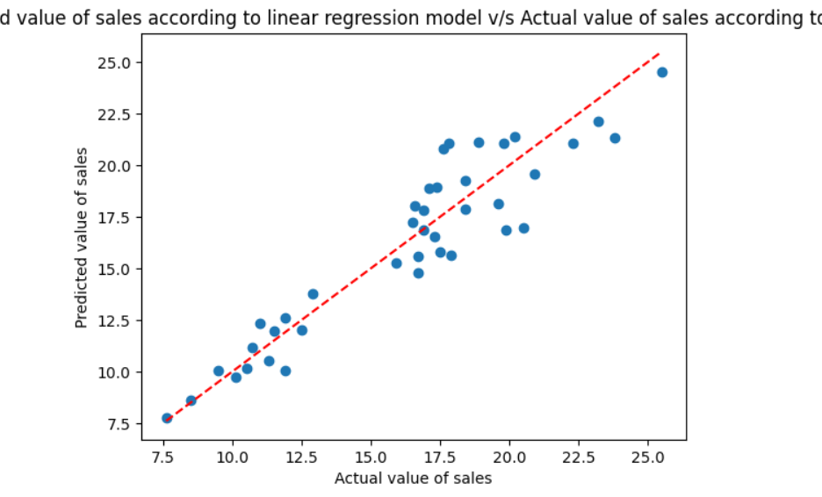
APPROACH:
Define variables x and y for the linear regression model.
Splitting the data into training set and testing set.
Training the dataset using linear regression model and finding the predicted y variable.
Plotting the predicted values against the actual values according to dataset.
CONCLUSION:
INTERPRETATION:
The linear regression model performs well, with predicted sales values closely matching actual values. The strong alignment with the red line suggests the model effectively captures the relationship between advertising and sales. Also, the upward trend confirms that the model has learned the positive relationship between input features (TV, Radio, Newspaper) and Sales.
The red dashed line represents y=x i.e., when the model is 100% accurate-all the predicted values match the sales dataset.
The blue dots are the predicted sales value by the linear regression model.
The closeness to the red line indicates the accuracy of the model.

Slide 11
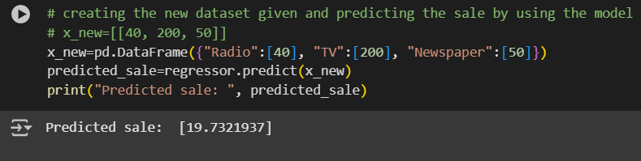
Question-5
How would sales be predicted for a new set of advertising expenditures: $200 on TV, $40 on Radio, and $50 on Newspaper?

Slide 12
APPROACH:
Create a new dataset for the given value of the independent variables.
Using the previously trained model, the sales of the new dataset is predicted.

Slide 13
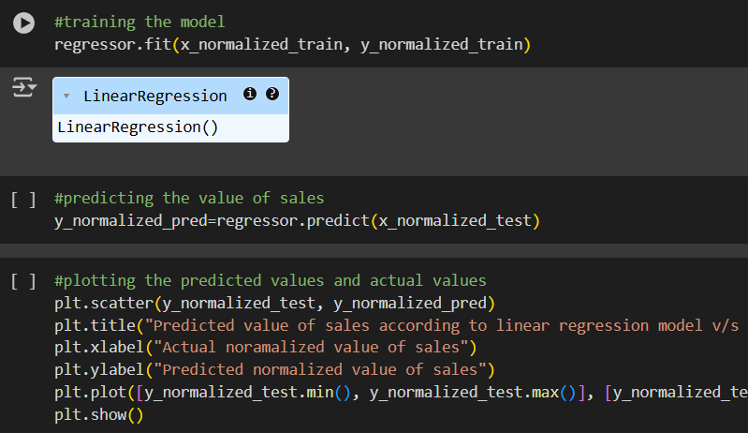
Question-6
How does the performance of the linear regression model change when the dataset is normalized?

Slide 14
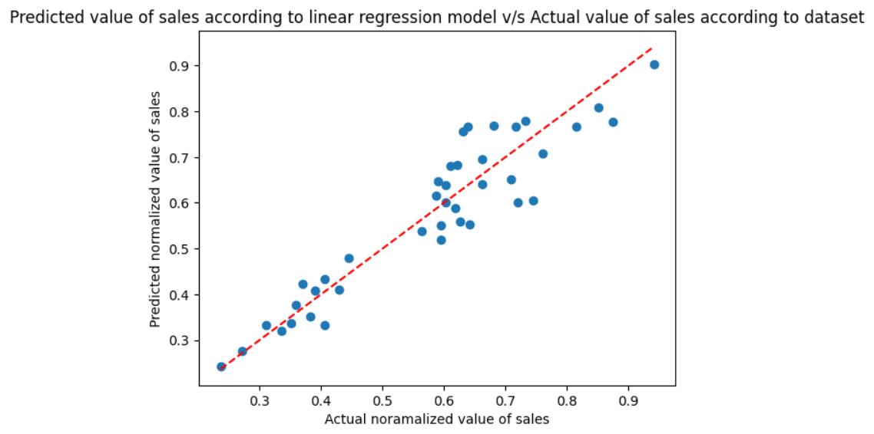
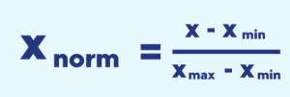
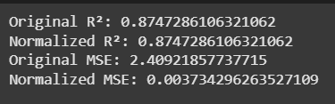
APPROACH:
Normalizing the dataset using the formula:
Creating variables x and y and training the linear regression model.
Plotting scatter plot and comparing it with the original data graph.
Calculating r^2 and MSE to further review the effect of normalization.
CONCLUSION:
The scatter plot nature remains the same, this suggests that normalization only scales down the data and does not affect its nature.
The R² value remains the same (0.8747) for both the original and normalized datasets, indicating that the model explains approximately 87.5% of the variance in sales regardless of scaling.
However, the MSE drops significantly from 2.41 (original) to 0.0037 (normalized) because normalization rescales the output values. This doesn't mean improved performance — it just reflects the change in scale, not accuracy.
INTERPRETATION:
The plot of normalized dataset is same as the graph of the original dataset.
R^2(coefficient of determination): Measures how well the independent variables explain the variation in the dependent variable.
MSE(Mean squared error): The average of the squared differences between actual and predicted values.

Slide 15
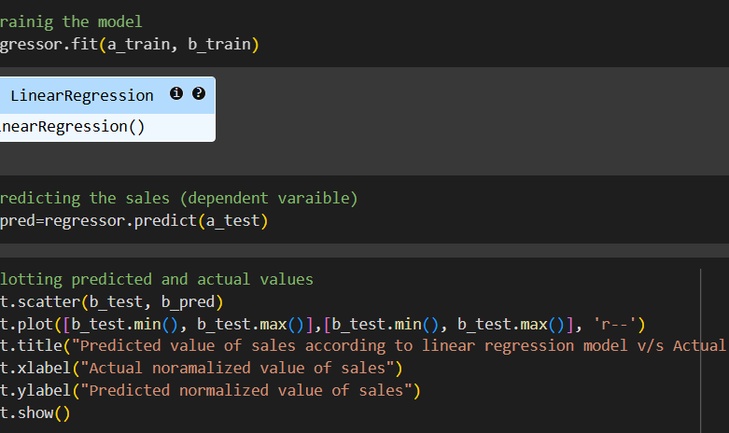
Question-7
What is the impact on the sales prediction when only radio and newspaper advertising expenditures are used as predictors?

Slide 16
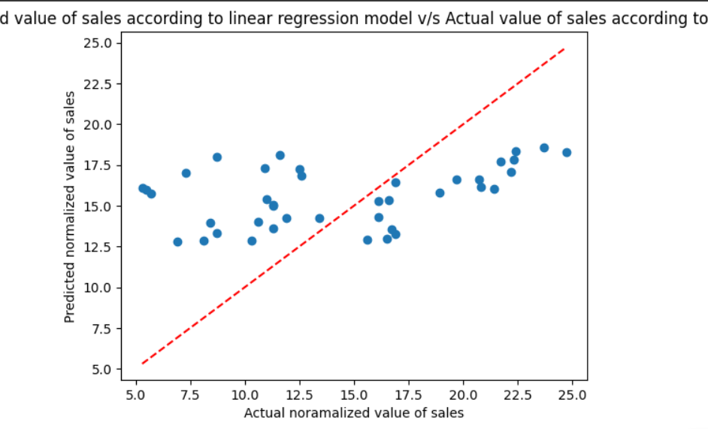
APPROACH:
Define variables x and y for the linear regression model.
Splitting the data into training set and testing set.
Training the dataset using linear regression model and finding the predicted y variable.
Plotting the predicted values against the actual values according to dataset.
CONCLUSION:
The predicted values are more horizontally clustered, indicating the model outputs are compressed within a smaller range. The model seems to underestimate high sales and overestimate low sales. This highlights the significant role of TV advertising in predicting sales. Without TV data, the model cannot capture the true variation in sales, leading to underfitting. Given that TV had the highest correlation (0.90) with sales in the earlier correlation matrix, excluding it causes a clear drop in prediction accuracy.
INTERPRETATION:
The red dashed line represents y=x i.e., when the model is 100% accurate-all the predicted values match the sales dataset.
The blue dots are the predicted sales value by the linear regression model.
The closeness to the red line indicates the accuracy of the model.

Slide 17
Thankyou!
Google colab link-https://colab.research.google.com/drive/1Vk9o9fbJUWgep5noEM_o7P4sVbUt0-S8?usp=sharing

