Slide 1
case project-1
Facebook Live Sellers Dataset
Khushi Shah
IIT Gandhinagar 24110326@iitgn.ac.in

Slide 2
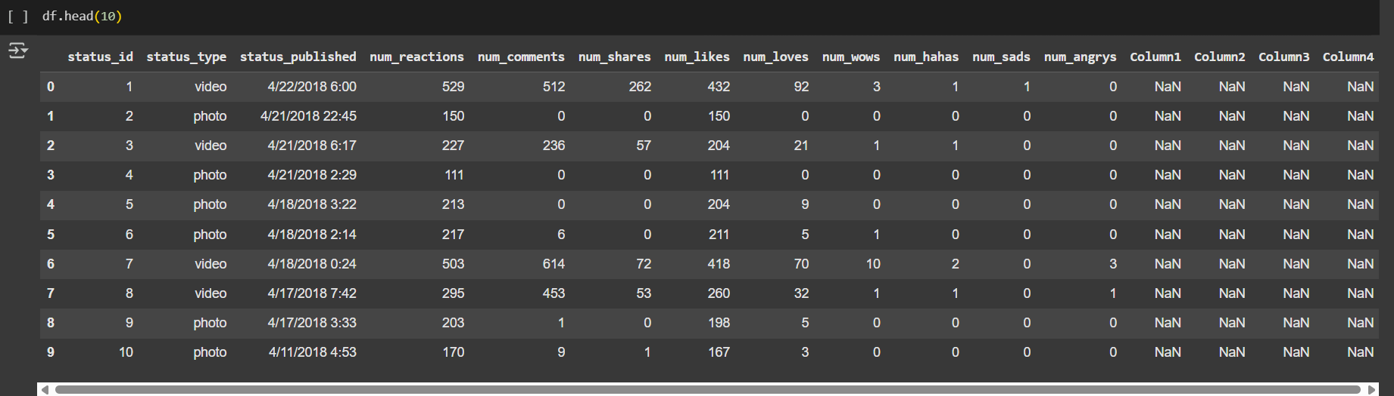
Dataset analysis:
Initial Step:
Display the dataset to be know about the columns and the datatypes present.
Number of NaN values present in each column and either removing them or replacing them with mean or zero.

Slide 3
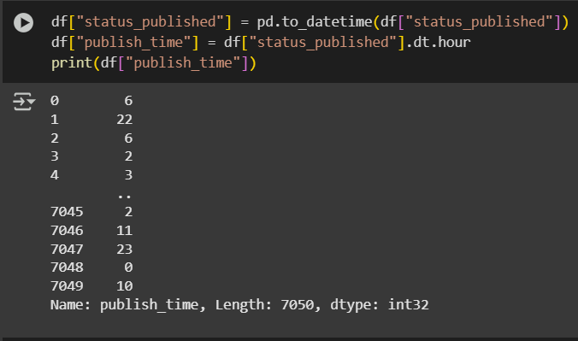
Question-1
How does the time of upload (status_published) affect the num_reaction?

Slide 4
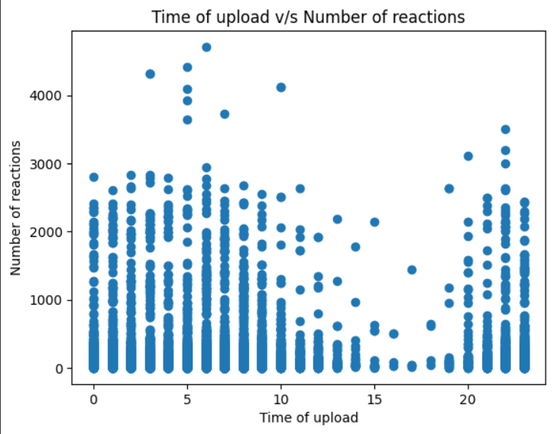
APPROACH:
To extract the time data from the column "status_published" and assigning it a new column as "publish_time"
This ensures that both the elements between which comparison needs to place are present.
Plotting a scatter plot to analyze the relation.
CONCLUSION:
It is evident from the graph that the time of upload significantly influences the number of reactions a post receives. On average, excluding extreme values, the number of reactions appears relatively uniform across different hours. However, the presence of outliers, particularly posts receiving more than 4000 reactions, is concentrated around the early morning hours . This may reflect increased user activity on Facebook shortly after waking up. In contrast, the afternoon hours show a noticeable dip in engagement, likely due to reduced usage during work hours, with most posts receiving fewer than 250 reactions during this period.
INTERPRETATION:
According to the graph:
Early morning uploads receive the highest number of reactions.
Whereas the post uploaded during working hours (ranging from 11am –7pm) receive least number of reactions.

Slide 5
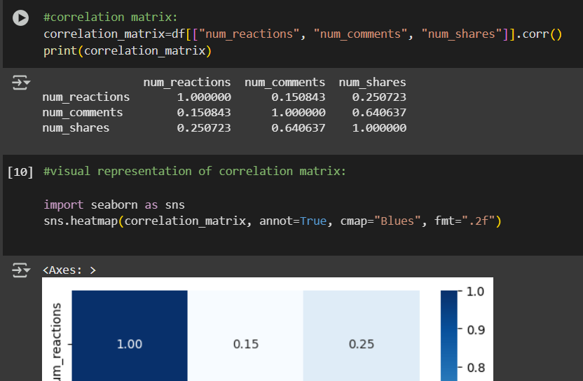
Question-2
Is there a correlation between the number of reactions (num_reactions) and other engagement metrics such as comments (num_comments) and shares (num_shares)? If so, what is the strength and direction of this correlation?

Slide 6
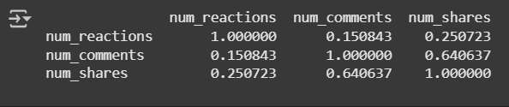
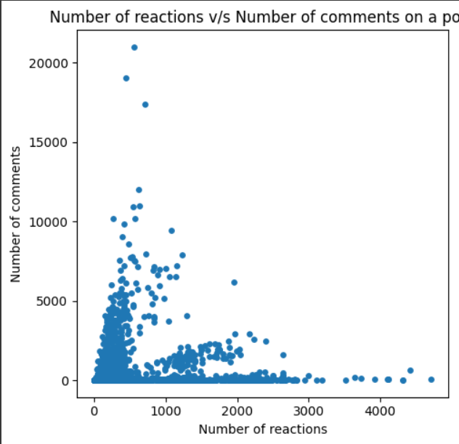
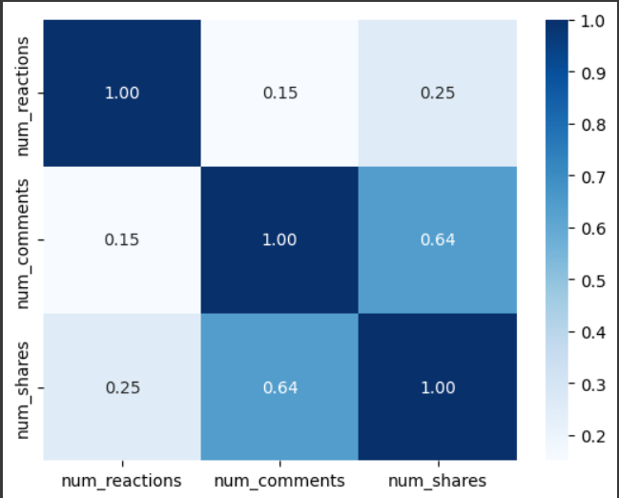
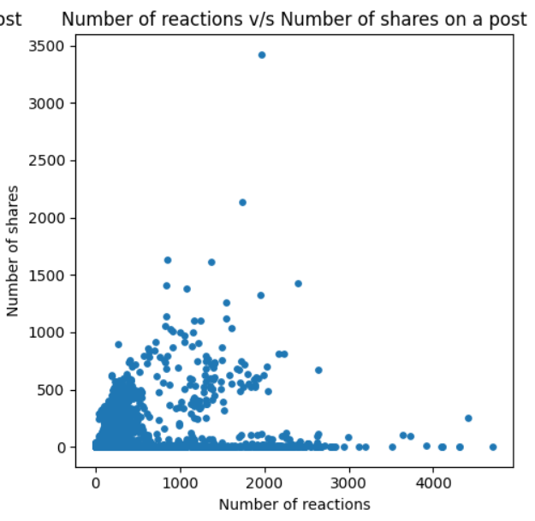
APPROACH:
To check the presence of any NaN (not a number) values.
Started with plotting a scatter plot to visualize the data, but the density of points formed a cluster which was difficult to interpret.
Created a correlation matrix to analyze the data and visualized it by plotting a heatmap.
CONCLUSION:
There is minimal correlation between the number of reactions and number of comments (0.15), as well as between number of reactions and number of shares (0.25). Although the correlations are positive—
Indicating that as reactions increase, comments and shares tend to increase as well—the strength of these relationships
Indirect proportionality
Direct proportionality
INTERPRETATION:
-1
1
A correlation matrix checks the extent of linear proportionality among variables. The above matrix depicts that number of reaction and number of comments as well as number of shares are positively correlated, but the magnitude of correlation is less than 0.3 which represents weak correlation.
is very weak. In contrast, the correlation between number of comments and number of shares is relatively strong, suggesting the presence of a specific audience segment that tends to both comment on and share posts actively.

Slide 7
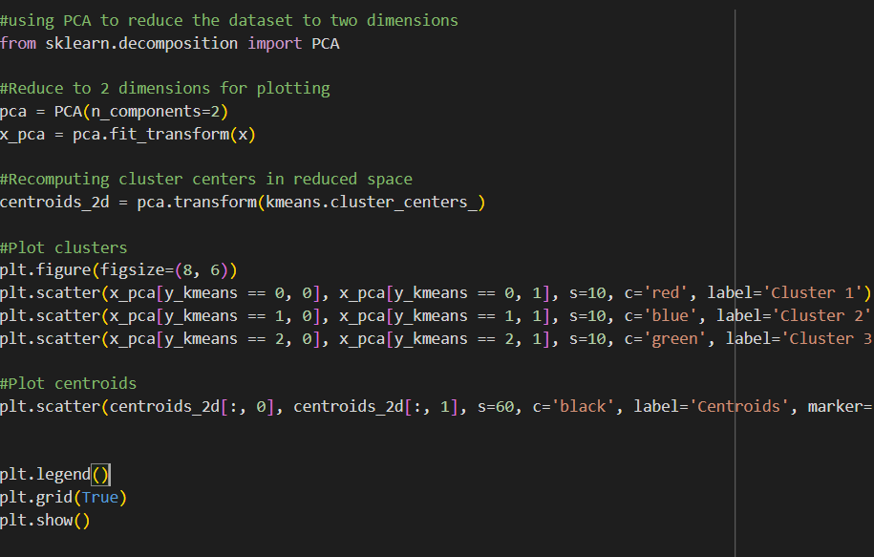
Question-3&4
Use the columns status_type, num_reactions, num_comments, num_shares, num_likes, num_loves, num_wows, num_hahas, num_sads, and num_angrys to train a K-Means clustering model on the Facebook Live Sellers dataset.
Use the elbow method to find the optimum number of clusters.

Slide 8
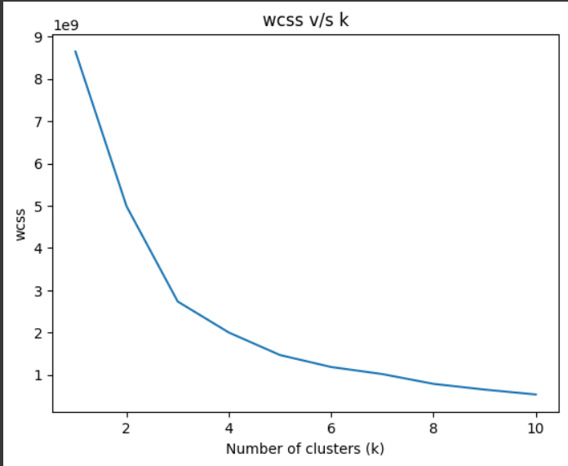
APPROACH:
To create a dataset for K-means clustering model containing all numerical datatype values.
Using elbow method (finding wcss for each model having different k) to find the optimum number of clusters (k).
Training the k-means model with the optimum number of clusters found from the elbow method.
Converting the data into 2d from 10d using PCA (Principal Component Analysis).
Plotting the clusters along with their centroids.
CONCLUSION:
INTERPRETATION:
Using elbow method, from the graph the optimum number of clusters are three. Hence the K-means model is trained by taking number of clusters as 3.
Elbow method is used to find the optimum number of clusters. Graph is plotted between wcss (within cluster sum of squares) and k (number of clusters).
The point of highest dip in the graph after which the decline becomes less significant represents the optimum number of clusters.

Slide 9
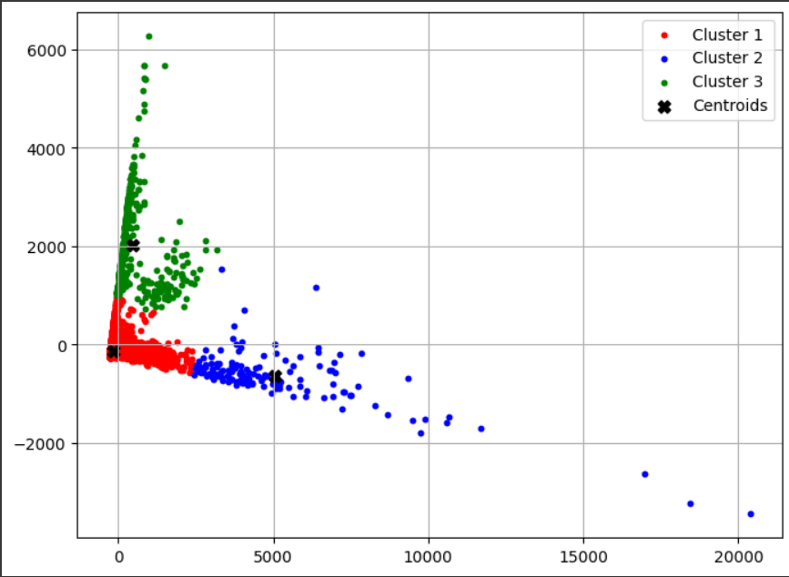
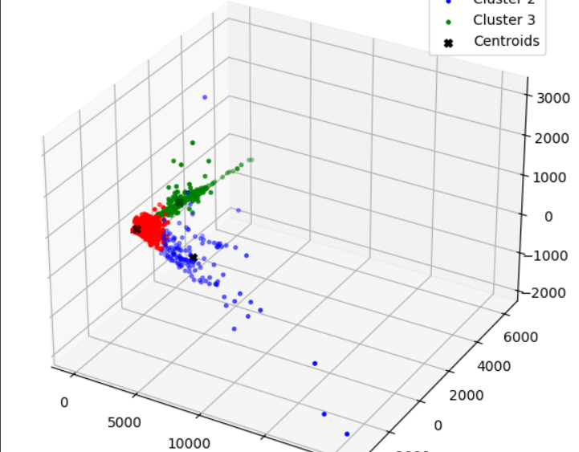
K-MEAN CLUSTER PLOTTING:
Converting the 10d dataset into 2d and 3d model using PCA (principal component analysis).
It is a dimension reduction technique that works based on variance.
The number of clusters remain fixed, PCA only compresses the data point initially as 10d [x,y,z,a,b,c,d,e,f,g] to 2d[pc1, pc2], which are the new axes formed by the combination of 10 columns. This transformation is done by analyzing the covariance matrix to find directions (principal components) along which the data varies the most. Thus, it simplifies the structure of the data, making it easier to visualize and cluster.

Slide 10
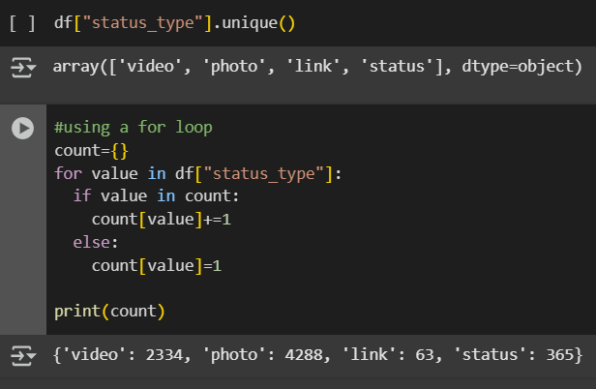
Question-5
What is the count of different types of posts in the dataset?

Slide 11
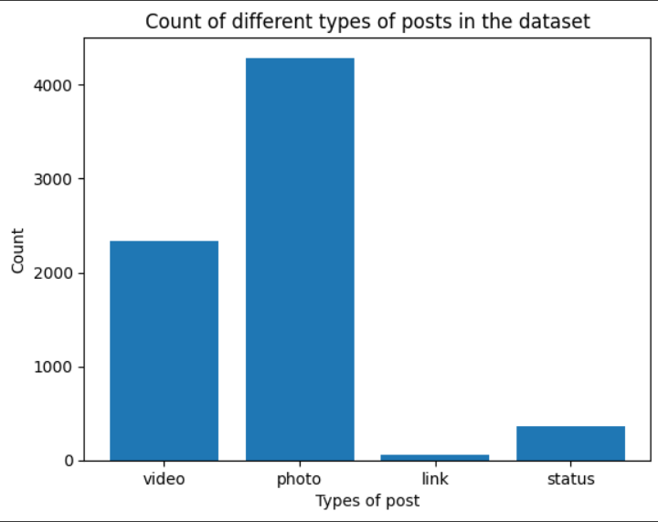
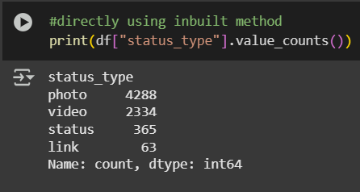
APPROACH:
To find the different types of posts present in the dataset
Creating a dictionary and using for loop with key as type of post and value as the number of such posts.
VISUAL REPRESENTATION USING BAR GRAPH

Slide 12
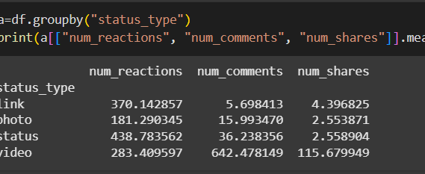
Question-6
What is the average value of num_reaction, num_comments, num_shares for each post type?

Slide 13
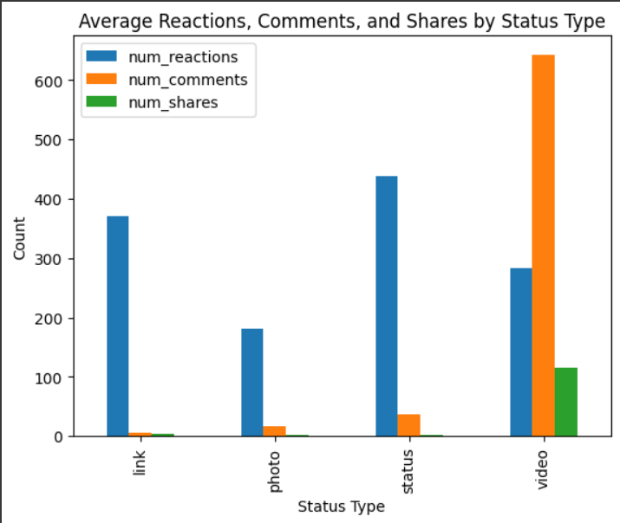
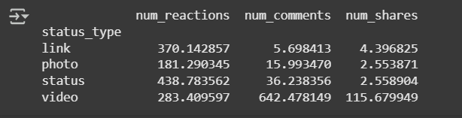
APPROACH:
To segregate the data according the different types of post.
Taking mean of number of reactions, number of comments and number of shares.
Plotting a grouped bar chart to visualize the data

Slide 14
Thankyou!
Google colab link-
https://colab.research.google.com/drive/14XxHp_Otf4y2BaO_mfVMW7L9PzNde_6A?usp=sharing

