Slide 1
case project-2
Wine Quality - Red Wine Dataset
Khushi Shah
IIT Gandhinagar 24110326@iitgn.ac.in

Slide 2
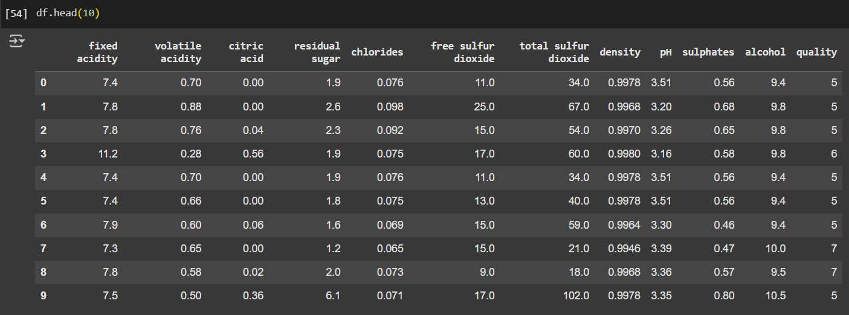
Dataset analysis:
Initial Step:
Display the dataset to be know about the columns and the datatypes present.
Number of NaN values present in each column and either removing them or replacing them with mean or zero.

Slide 3
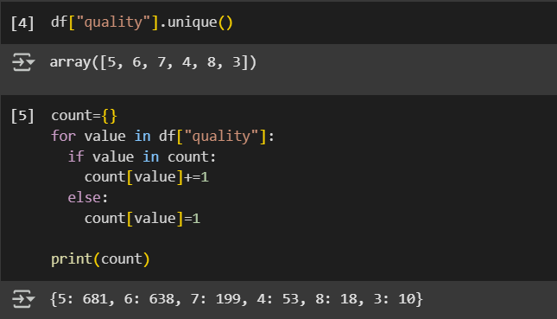
Question-1
What is the most frequently occurring wine quality? What is the highest number in and the lowest number in the quantity column?

Slide 4
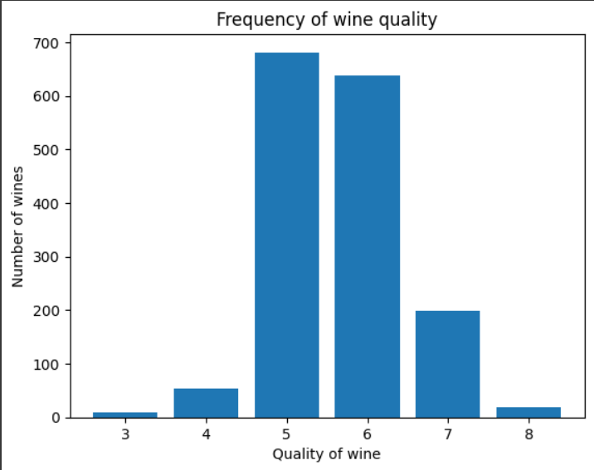
APPROACH:
To find the different qualities of wine present in the dataset
Creating a dictionary and using for loop with key as quality of wine and value as the number of wines of that particular quality.
VISUAL REPRESENTATION USING BAR GRAPH
CONCLUSION:
Quality = 3 | 10
Quality = 4 | 53
Quality = 5 | 681
Quality =6 | 638
Quality =7 | 199
Quality = 8 | 18

Slide 5
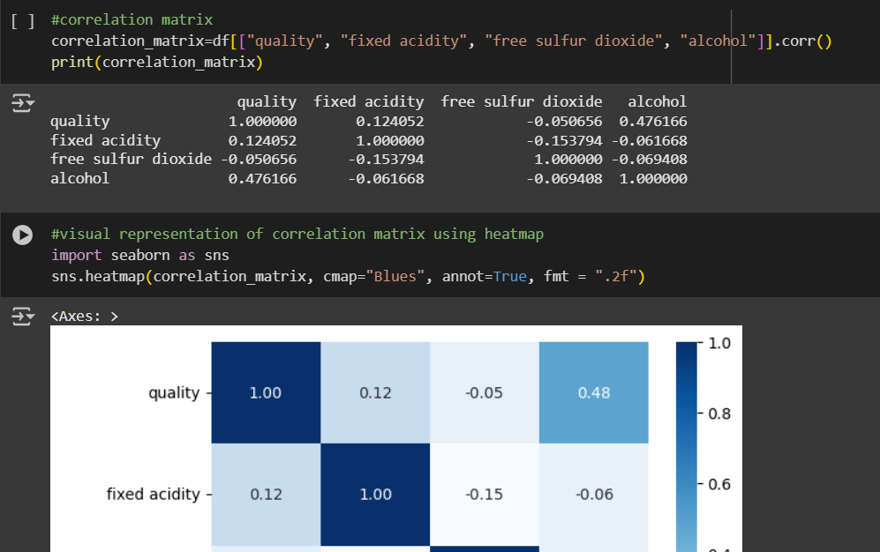
Question-2
How is `fixed acidity` correlated to the quality of the wine? How does the alcohol content affect the quality? How is the `free Sulphur dioxide` content correlated to the quality of the wine?

Slide 6
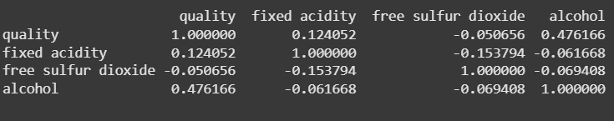
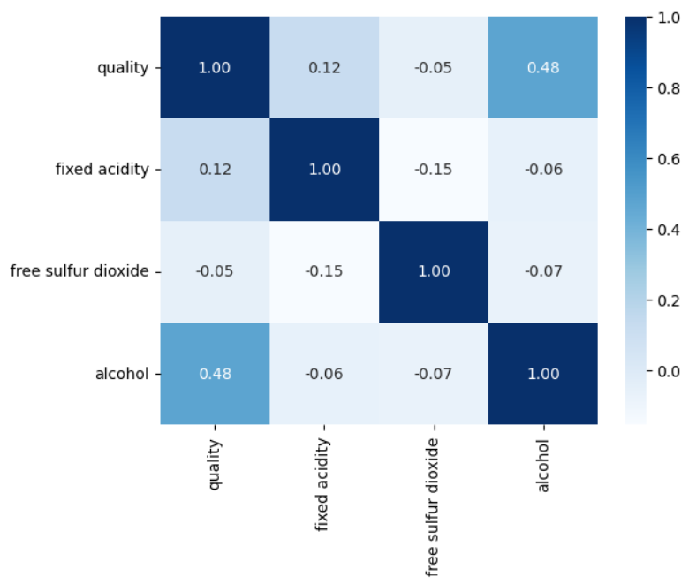
APPROACH:
To check the presence of any NaN (not a number) values.
Created a correlation matrix to analyze the data and visualized it by plotting a heatmap.
CONCLUSION:
Among the variables shown, alcohol content has the strongest positive influence on wine quality (0.47). This indicates that the quality of wine quite strongly depends on quality of wine. The other variables—fixed acidity and free sulfur dioxide show little (0.12) to no (-0.05) meaningful correlation with wine quality.
The negative sign also indicates that at microscopic level increase in amount of free sulfur dioxide reduces the
Indirect proportionality
Direct proportionality
INTERPRETATION:
-1
1
A correlation matrix checks the extent of linear proportionality among variables. The above matrix depicts that there is moderate positive correlation between amount of alcohol and quality of wine, whereas negligible correlation between free sulfur dioxide, fixed acidity and quality of wine.
quality of wine. Hence, alcohol level could be a good predictor of quality, while the others may not significantly affect it.

Slide 7
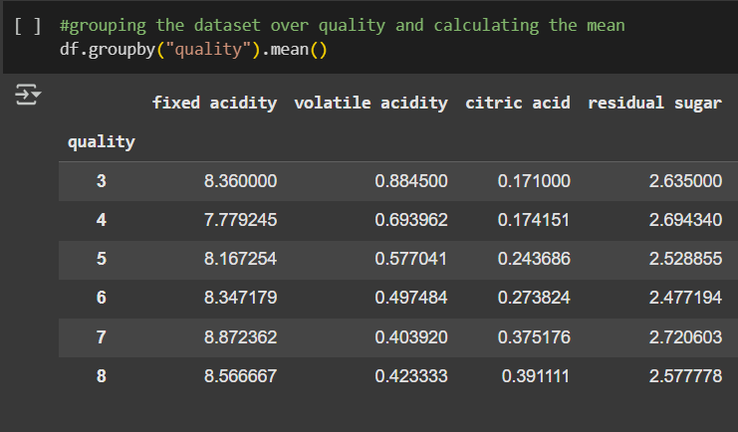
Question-3
What is the average `residual sugar` for the best quality wine and the lowest quality wine in the dataset?

Slide 8
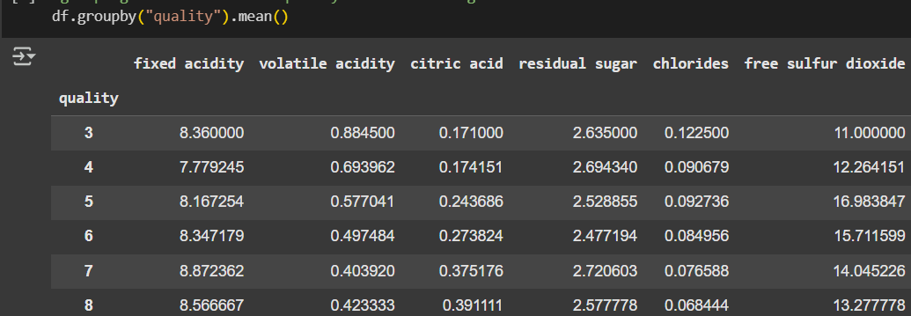
APPROACH:
CONCLUSION:​
To group the data according to wine quality.
Taking the average of the dataset formed based on grouping.
Average residual sugar for best quality wine: 2.57
Average residual sugar for lowest quality wine: 2.63

Slide 9
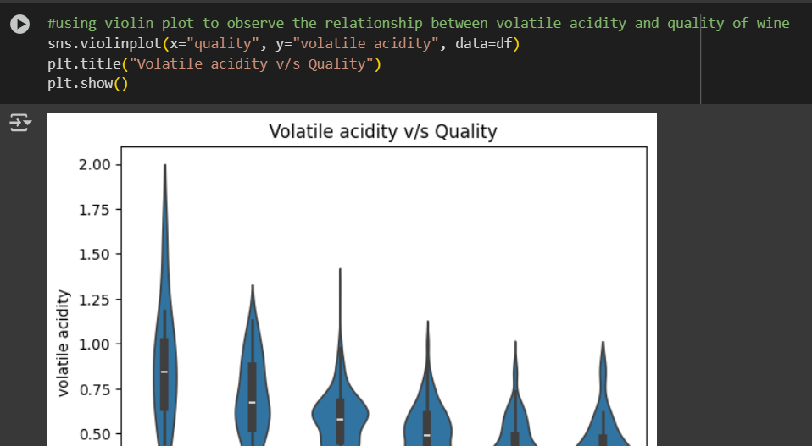
Question-4
Does `volatile acidity` has an effect over the quality of the wine samples in the dataset?

Slide 10
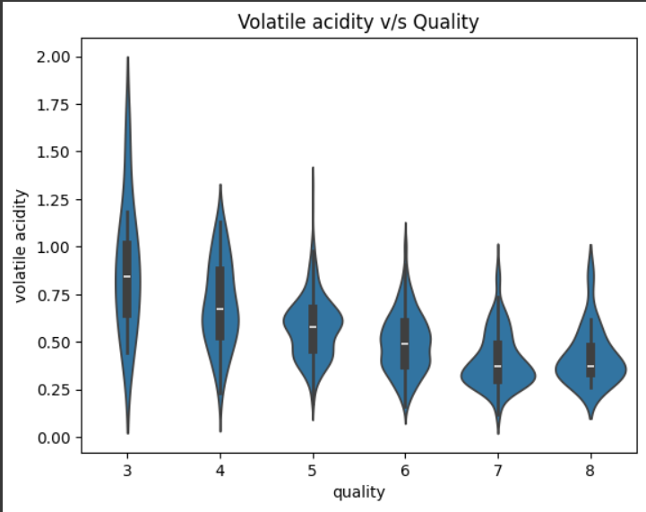
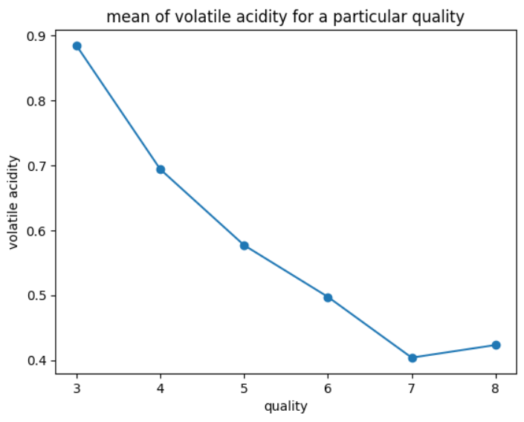

APPROACH:
Creating a violin plot to study the relationship between volatile acidity and quality of wine.
Plotting the mean values to observe the nature of variation of volatile acidity with increasing quality.
Plotting the correlation matrix to find the exact numerical value depicting their dependence.
CONCLUSION:​
Volatile acidity is inversely related to wine quality. Wines with lower volatile acidity are generally rated with higher quality scores, as evidenced by the moderate negative correlation coefficient. From the violin plot, we observe that the distribution of volatile acidity narrows and shifts lower as quality increases. The line plot of mean values clearly shows a downward trend, highlighting that higher quality wines consistently have lower average volatile acidity levels. Thus, minimizing volatile acidity can improve wine quality.

Slide 11
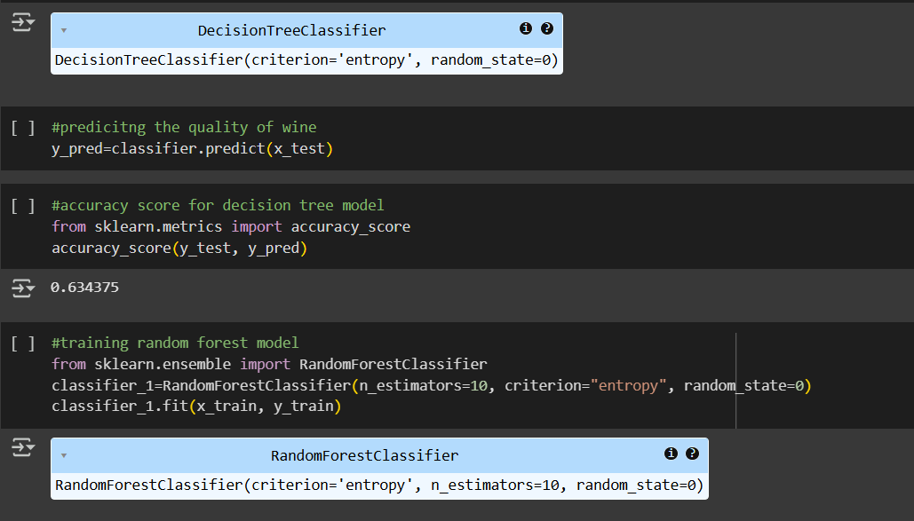
Question-5
Train a Decision Tree model and Random Forest Model separately to predict the Quality of the given samples of wine. Compare the Accuracy scores for both models.
?

Slide 12
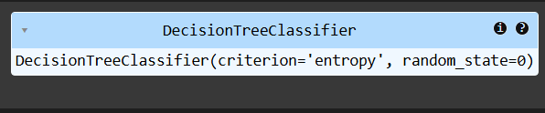
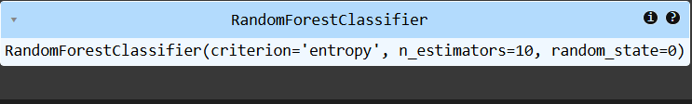
TRAINING DECISION TREE MODEL:
TRAINING RANDOM FOREST TREE MODEL :​
Defining the independent and dependent variables.​
Splitting the dataset into train and test set.​
Importing decision tree model.​
Training the dataset.​
Predicting the value of dependent variable based on the model trained.​
Importing accuracy score function​
Calculating accuracy score.
Defining the independent and dependent variables.
Splitting the dataset into train and test set.
Importing decision tree model.
Training the dataset.
Predicting the value of dependent variable based on the model trained.
Importing accuracy score function
Calculating accuracy score.

Slide 13
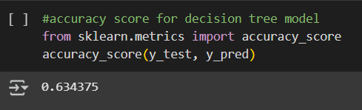
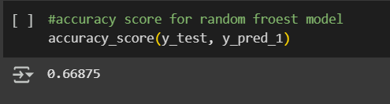
CONCLUSION:
Comparing accuracy score
The Random Forest model outperforms the Decision Tree model, achieving a higher accuracy score by approximately 3.4%. This improvement is expected, as random forests aggregate the results of multiple decision trees, reducing overfitting and improving generalization. Therefore, the Random Forest model is a more reliable and accurate choice for this classification task.
DEFINITION:
The accuracy_score function is used to calculate the accuracy of classification models, i.e., how often the predicted labels match the true labels.
It returns a float value between 0 and 1 representing the ratio of correct predictions to the total number of predictions.

Slide 14
Thankyou!
Google colab link-
https://colab.research.google.com/drive/1rzpYLPIWe_WC55CCC2yWUSaTfT9iTP-e?usp=sharing

