Slide 1


Vishwakarma Government Engineering College,
Chandkheda
Workflow Management System
Presented by:
Sefali H. Kodala (100170107001)
Jaimini N. Joshi (100170107003)
Hemangi S. Chaudhari (100170107093)
Guided by:
Internal Guide: Prof. S. P. Patel

Slide 2
Table of contents
Introduction to system
Conventional system and its limitations
Proposed system and requirements
Tools and technologies used
Features of workflow management system
Roles of participating users in the system
Screenshots
Future enhancement
References

Slide 3
Introduction to system
Workflow automates “Definition, Delegation and Distribution of Tasks”
Makes employees more organized, productive and effective
Allows to track tasks and automate routine work
Delivers efficient project management through a task-centric and simple user interface
Benefits of Workflow
Efficient project and tasks management
Easy to use interface
Integrated time tracking
Access control and permissions

Slide 4
Conventional system & its limitation
Conventionally some process/work done in the organization is manual
There are few functionalities for project manager, project leader and developer
New employee’s details are to be maintained by admin time to time
To evaluate the performance of the employees, it becomes very difficult
The project leader also needs to inform to assign them the projects and work to be carried out under it
The team leader needs to take care of each and every developer and assign them the works. This is a very time consuming process
Also, no security is available in the system as each employee of every level has access to any kind of data of any employee of any level
For effective output all employees must be inspired and motivated. But in current system it is difficult to decide outcome of every employee in terms of work, time, quality of work etc
For large organization it is difficult to manage every employee’s attendance even if it is not taken manually
Proper salary management is based on work, output and efficiency of employee

Slide 5
Proposed system and requirements
To increase the functionalities for project manager, project leader or developer to provide easiness of work.
To track the current progress very easily and effectively
To evaluate the performance of the employees.
To assign the project and work to be carried out under project leader to employee.
The owner need not be at the same location i.e. in the company itself.
To reduce time taken by all processes which are done partial manually.
To provide security in the system as which employee of which level has access to which kind of data of which employee of which level.

Slide 6
Tools and technologies used
Operating System | Windows 7
Tools and Technologies | J2EE, JSP, Servlet, Javascript, Ajax, Hibernate and Apache Tomcat, Eclipse
Database | MySql
Language | Java
Documentation tool | Microsoft office 2007, Visio 2007

Slide 7
Features
Admin can keep a track of daily tasks carried across company
Employee need not run here and there to assign and submit tasks
Tasks are assigned online, so less paper work
Performance evaluation becomes easier
Employees need not be at the same location
Database centrally located on the server
No need to remember complex document formats about work
Simple interface and ease of access

Slide 8

Role of Admin
User registration
Manage designations
User management
Manage projects
Company registration
Manage countries, states & cities

Slide 9

Role of Delivery/Project Manager
Monitor projects
Resource allocation
Manage project leads & developers
Story and its task management
Interaction with client

Slide 10

Role of Project Lead
Story Handling
Task allocation
Handle subordinates queries
Monitor Progress of Developers
Task handling

Slide 11

Role of Developer
Development & update task status
Create/viewstories
Create/view task
Compose message

Slide 12
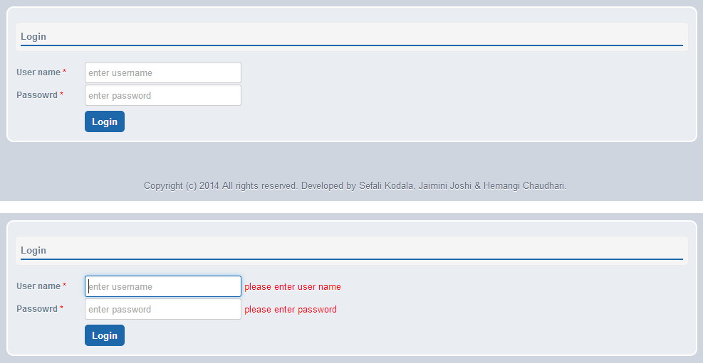
Login screen

Slide 13
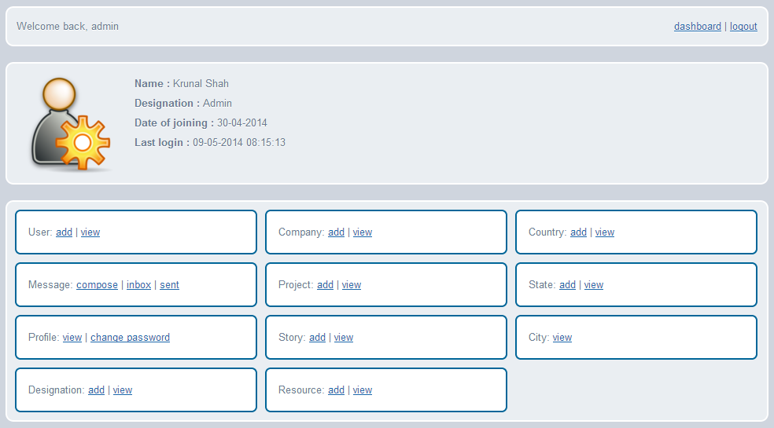
Admin dashboard

Slide 14
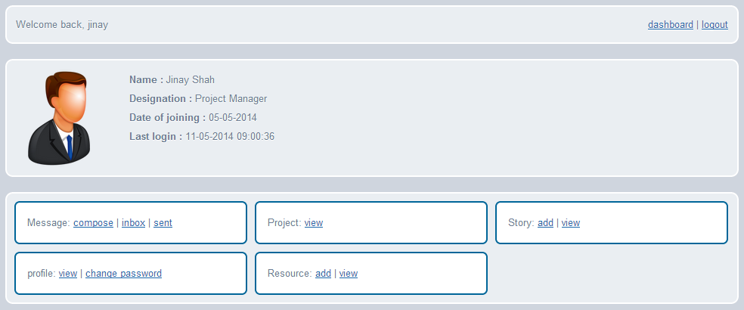
Project Manager dashboard

Slide 15
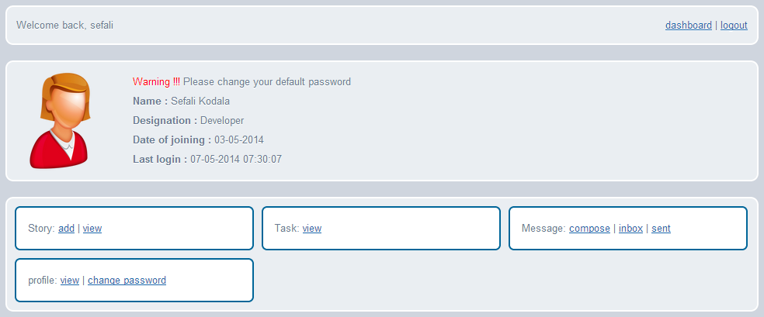
Developer dashboard

Slide 16
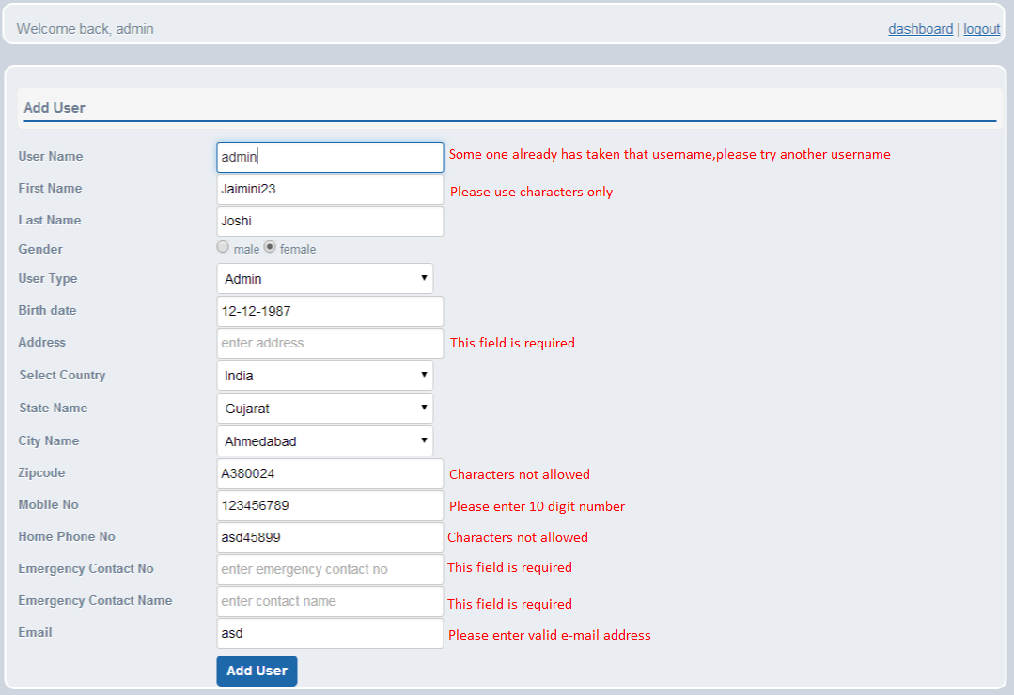
Add user

Slide 17
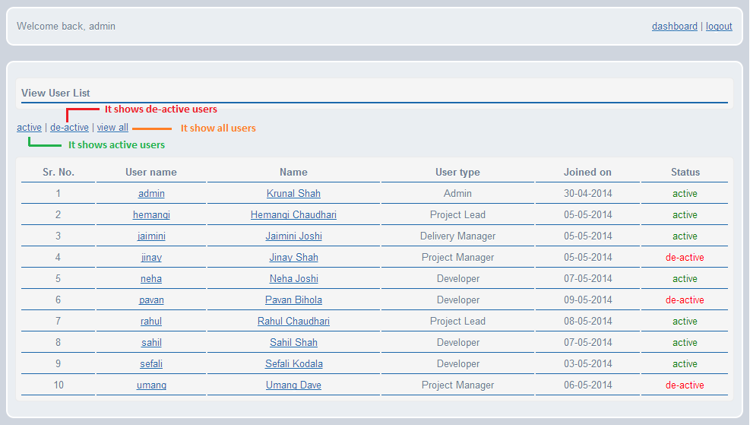
View user list

Slide 18
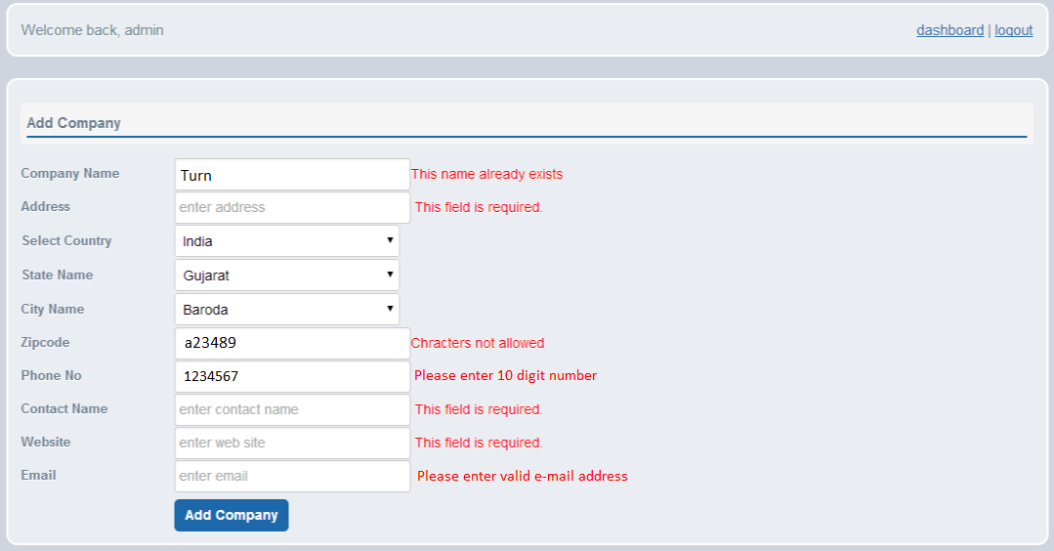
Add company

Slide 19
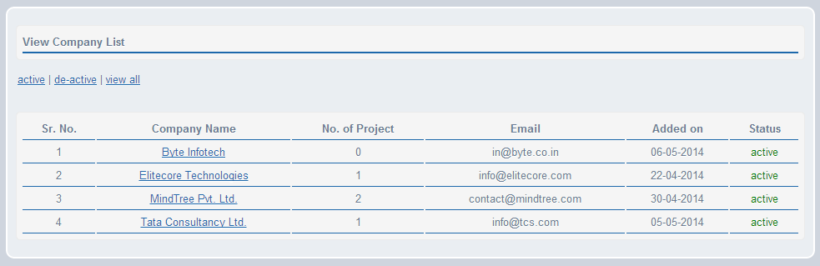
View company list

Slide 20
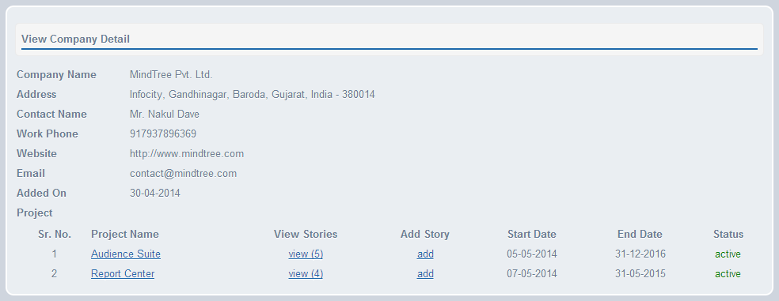
View company details

Slide 21
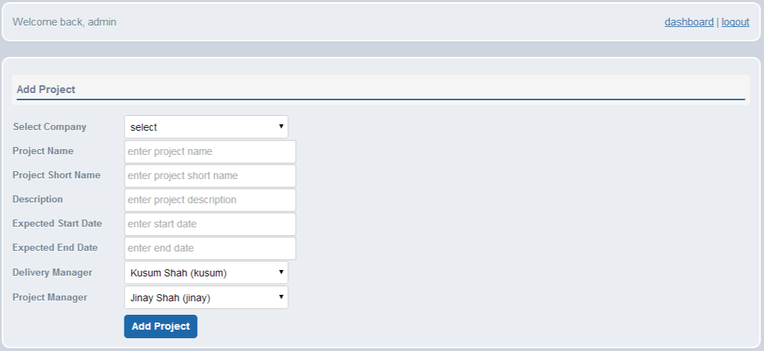
Add Project

Slide 22
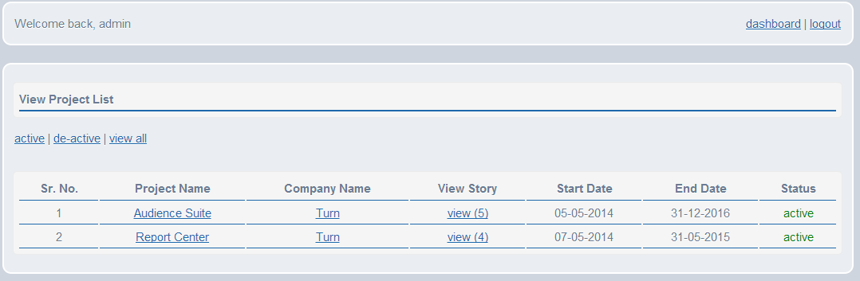
View project

Slide 23
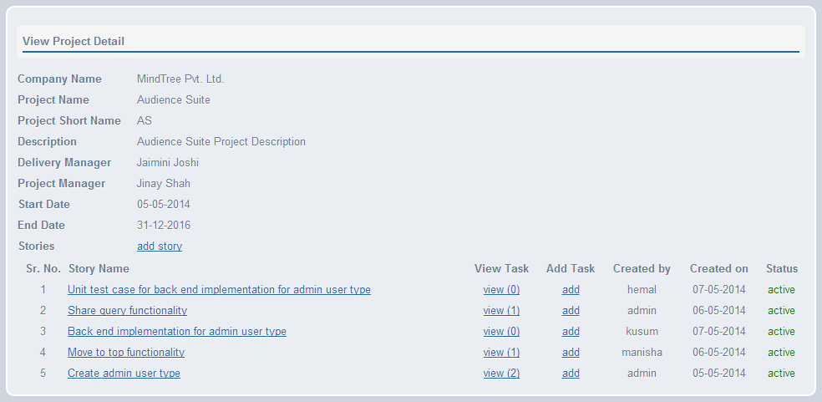
View project details

Slide 24
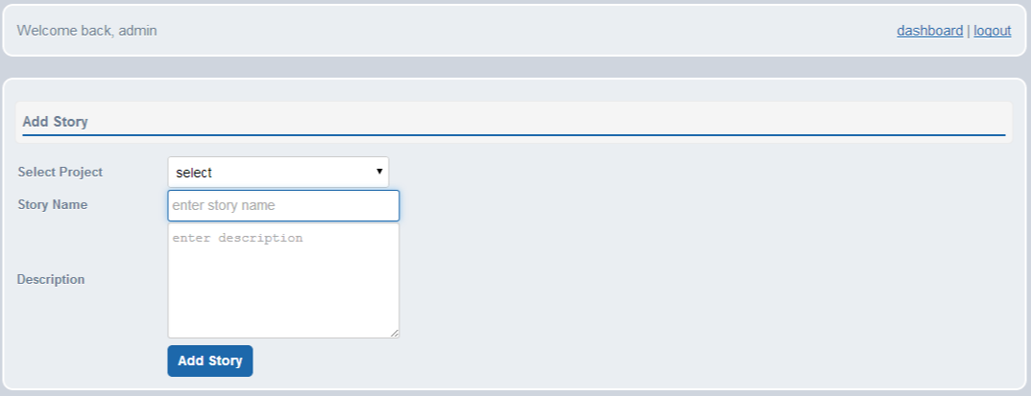
Add story

Slide 25
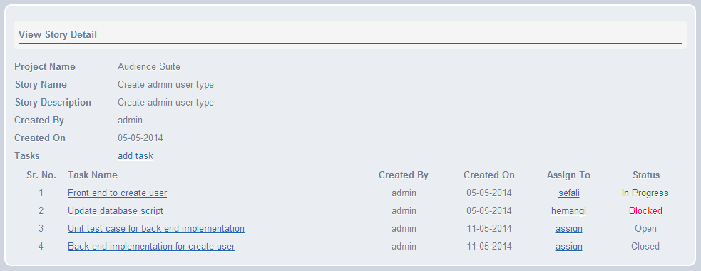
View story details

Slide 26
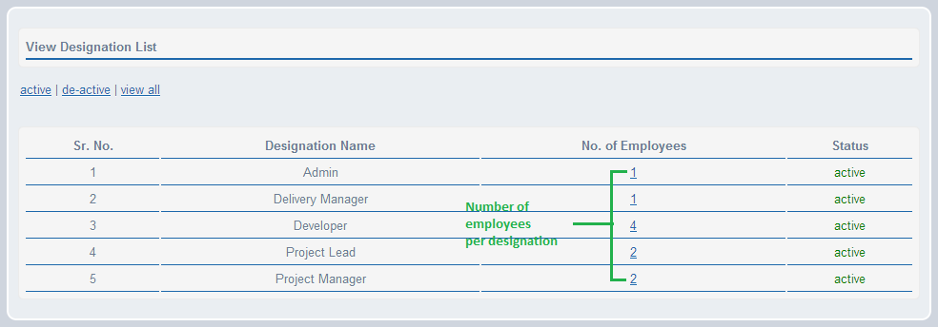
View designation list

Slide 27
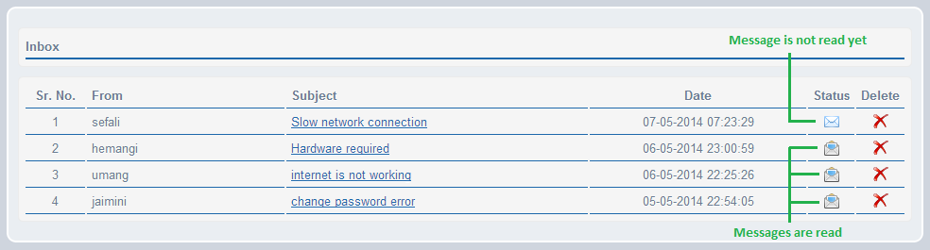
Inbox

Slide 28
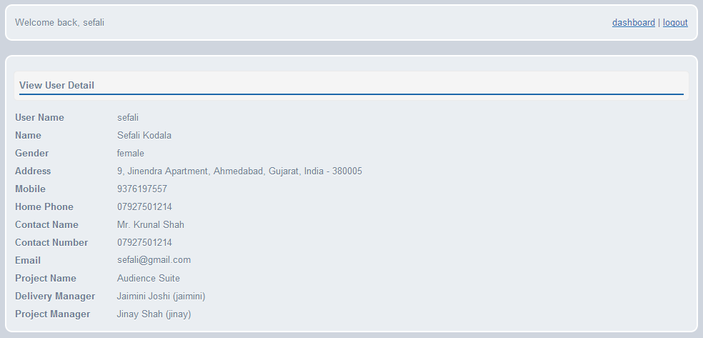
View user profile

Slide 29
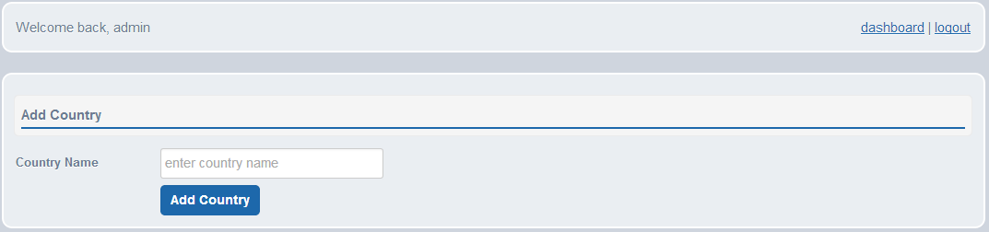
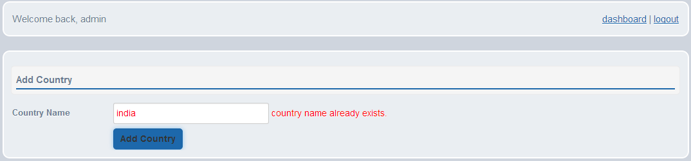
Add country

Slide 30
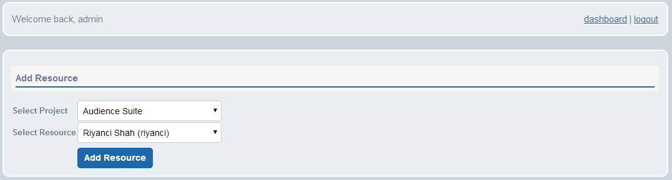
Add resource

Slide 31
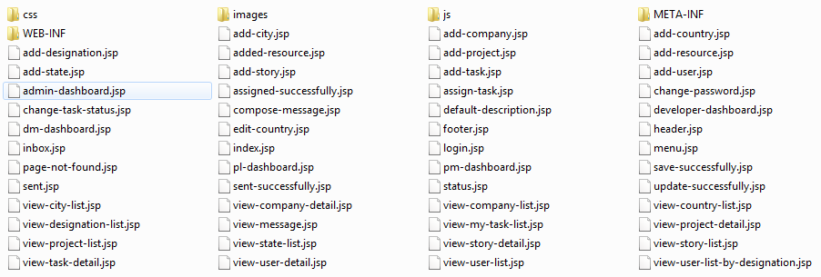
JSPs

Slide 32
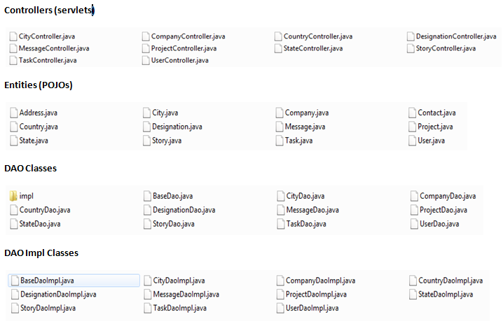
Controllers, DAOs & Entities

Slide 33
Future enhancements
Database back up & recovery
Billing module
Resignation module
Search module
Adding technologies to user profile
Performance measurement
Activity notification to users via messages

Slide 34
References
http://jquery.com/
http://www.eclemma.org/
http://projects.spring.io/spring-framework/
http://www.tutorialspoint.com/ajax/what_is_ajax.htm
https://github.com/
http://en.wikipedia.org/wiki/GitHub
http://getbootstrap.com/

Slide 35
Questions ?

Slide 36
Thank you !!!

