Slide 1
E-mail system
- Gilford Fernandes
- Manan Shah

Slide 2
Contents
Overview
Design
Demo
Protocols
Threading Models
Future Work

Slide 3
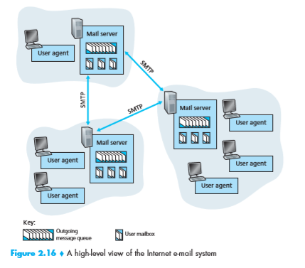
PROJECT OVERVIEW

Slide 4
DESIGN
Server
Java Program running on CS machines ( glados and Utah )
Communicates with other mail servers using SMTP
Communicates with Email clients using custom protocol
Email Client
Web based Application
Allows user to send and view mails in inbox
Can add attachments

Slide 5
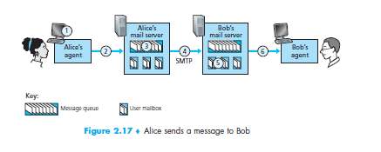
PROTOCOLS USED
Mail server – Mail server communication -> modified SMTP
Email Client – Mail server communication -> custom made
Mail Format
Sender Address
Destination Address
Message
Attachment
_

Slide 6
SMTP (push protocol)
Used for communication between Mail servers
Uses port 25 (we used port 9800)
Uses TCP
Direct connection between communicating mail servers
Persistent connection
5 commands -> Hello, Mail From, Rcpt To, Data, Quit.

Slide 7
Example
Client -> utah.cs.rit.edu
Server -> glados.cs.rit.edu
Client : Hello glados.cs.rit.edu
Server : Hello utah.cs.rit.edu
Client : Mail From gilford.goa@utah.cs.rit.edu
Server : sender ok
Client : Rcpt To manan.shah@glados.cs.rit.edu
Server : receipient ok
Client : Data
Client: Quit

Slide 8
EMAIL CLIENT – mail SERver Communication
On Login
- Email client establishes connection with the mail server, which authenticates the user
- Client sends request to access mails.
- Server sends mails to client

Slide 9
EMAIL CLIENT – mail SERver Communication
Sending mails (push protocol)
Email client establishes TCP connection with its mail server
Sends mail to the server
Server adds the mail to its queue

Slide 10
Threading model
4 Threads(function based) run at the Mail server
Sender Thread monitors the mail queue and sends the mails accordingly
Receiver Thread listens on port 9800
Client communication Thread communicates(sends updates on login / refresh) with the E-mail client on port 9700
Mail queuing Thread communicates(receives mails) with the Email client on port 9900 and adds the mails to the queue

Slide 11
FUTURE work
Use a database at the server.
Encrypt the messages
Adding other folders like draft, trash, etc

Slide 12
Roles of team members
Manan – Worked on the Email client
Gilford – Worked on the mail server

