Slide 1

Fast event matching for Content Based Publish/Subscriber System using parallel approach

Slide 2
Presented by
Miss. Chavan Dhanashree Gaman Exam Seat No:2013BCS208
Miss. Jagtap Sonali Vitthal Exam Seat No:2013BCS211
Miss. Patil Abhilasha Pandurang Exam Seat No:2013BCS217
Guided By
Mrs. M.A.Shah

Slide 3
Contents
Introduction
Objectives
Requirements
Tool used
Algorithm
Design
References

Slide 4
Introduction
Paradigm for interconnecting information providers to information consumers in a distributed environment.
Used to deliver information in large distributed environments.
Information published in the form of events to the pub/sub system.
content-based publish/subscribe system is a hot research area
event is no longer dependent on an external standard
Subscribers subscribe to the event according to the contents of the event , not by the predefined themes.
Proposed design makes use of Parallel Approach and subscription covering for comparing events

Slide 5
Problem Statement
To implement A Fast Event Matching Algorithm for Content Based Publish /Subscribe Systems Using Parallel Approach and Subscription Covering Relationship. Analyze it under certain condition such as increase number of subscribers,publishers,throughput,time etc.

Slide 6
Objectives
• To study the present content based publish/subscribe system with a sequential event matching.
• To design the parallel algorithm that based on multidimensional indexing mechanism and covering relationships .
• To analyze our system n various parameter such as number of processors, input and throughput etc.

Slide 7
Requirements
Hardware Specifications:
1. Pentium onwards.
2. minimum 4GB Ram.
3. Ubuntu 15.4
Software Specifications
  Tools:
eclipse
  Language
    JAVA

Slide 8
Tools Used
  Technology:
      MPI Java
        - Standard library used to implement parallel approach in Java
        - Processes can be located on same system or on a collection of distributed servers.

Slide 9
Subscription Language and Event Model
Dataset
  1. Event:
Event consists of a set of attributes {A1, A2, ... An}, and each attribute is a triple (data type, attribute name, value). Events can be expressed as: Event = ∪ attribute.
2. Constraints:
Constraint is a stateless Boolean expression. It’s expressed as quad (type, attribute ,operator, value).
3. Subscription
Subscription is composed of a constraints set {C1, C2, ... Cn}. The relation between constraints is the conjunction relations, expressed as Subscription = ∪ constraint.

Slide 10
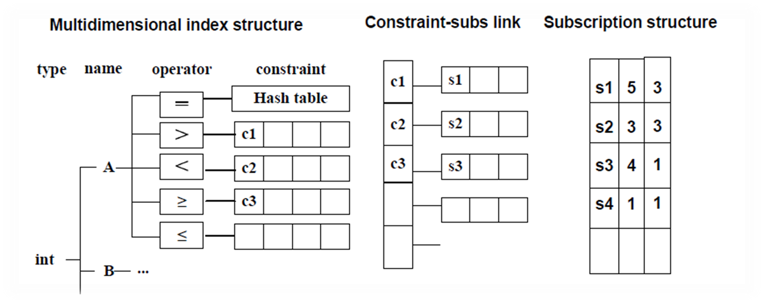
Data structure

Slide 11
Algorithm steps
Input: Dataset of constraints and events. Its near about 50000 records in constraint dataset.
Divide constraints into sub constraints
Read these sub constraints and write them into hashmap.(number of sub constraints = number of hashmap )
Read event dataset and write it into separate hashmap.
Match constraint hashmap with event hashmap.
    Check datatype of event and constraint,if it is matched then goto next.
    Check name of event attribute and name of constraint attribute ,if match then goto next
    Check value of constraint and value of event whether satisfied under constraint operator,if yes matching is done.

Slide 12
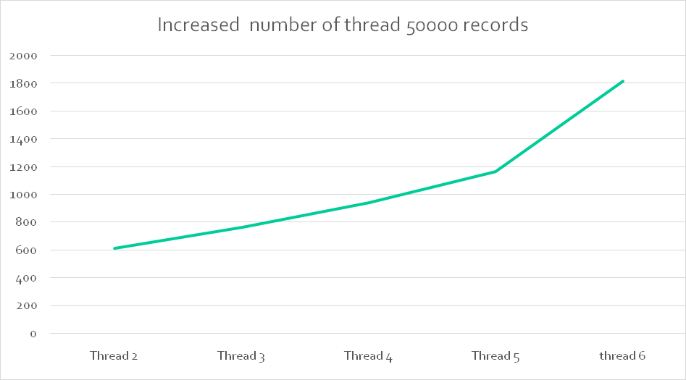
Result Analysis
1. 5.2.1 Increased number of thread but constant 50000 records.

Slide 13
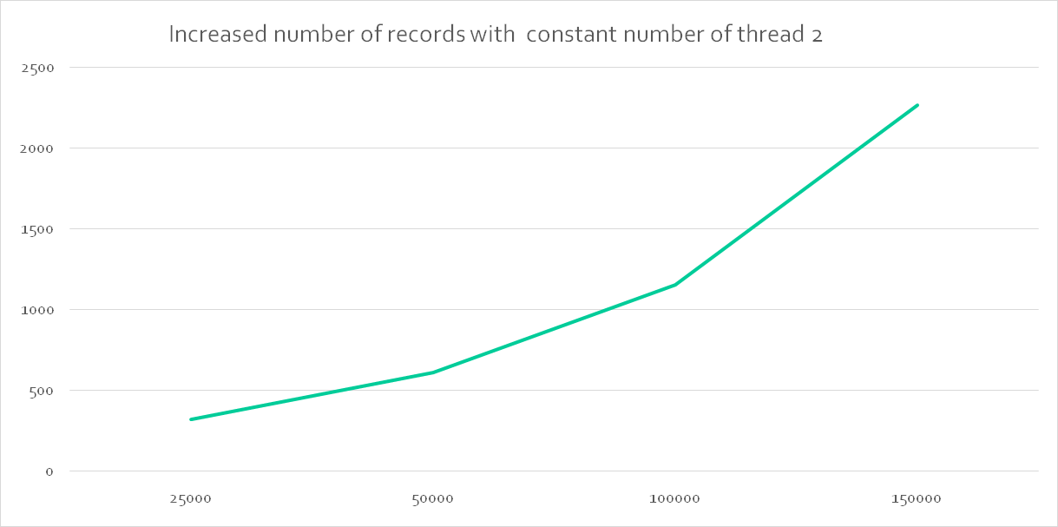
5.2.3 Increased number of records but constant threads.

Slide 14
Performance Analysis
NO | Number of records | Number of thread | Time in Milliseconds
1 | 25000 | 2 | 364
2 | 50000 | 2 | 760
3 | 100000 | 2 | 1155

Slide 15
References
1. A Fast Matching Algorithm for Content-Based Publish/Subscribe Systems Tao Xue and Qi Jia(2004)
2. Aguilera, M., Strom, R., Sturman, D., Astley, M., Chandra, T.: Matching events in a content-based subscription system. In: PODC: 18th ACM SIGACT-SIGOPS Symposium on Principles of Distributed Computing (1999)
3. Carzaniga, A., Rosenblum, D.S., Wolf, A.L.: Design and Evaluation of a Wide-Area Event Notification Service. ACM Transactions on Computer Systems 19(3), 332–383(2001)
4. M. K. Aguilera, R. E. Strom, D. C. Sturman, M. Astley, and T. D. Chandra. Matching events in a content-based subscription system. In Proceedings of the ACM Symposium on Principles of Distributed Computing (PODC), 1999.

Slide 16
Thank You

