Slide 1
Self-Organizing Maps
Shahmeer
Essam
Talha

Slide 2
What is an Artificial Neural Network?
Inspired by Biological Neural Networks (ones in animals)
Such systems "learn" tasks by considering examples, generally without task-specific programming
Basically, there are 3 different layers in a neural network :
Input Layer - All the inputs are fed in the model through this layer
Hidden Layers - There can be more than one hidden layers which are used for processing the inputs received from the input layers
Output Layer - The data after processing is made available at the output layer
They are excellent tools for finding patterns far too complex or numerous for a human programmer to extract

Slide 3
What is an Artificial Neuron?
Basic building block of a Neural Network
In nature, neurons have a number of dendrites (The Input), a cell nucleus (The Processor) and an axon (The Output)
Intended to replicate the way that we humans learn
When the neuron activates, it accumulates all its incoming inputs
The important thing about neurons is that they can learn

Slide 4
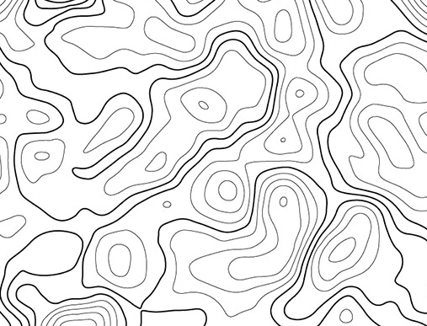
What is a Topographical Map?
In humans, data collected from different senses if mapped onto different regions/neighbourhoods of a brain
In TM’s, each piece of incoming information is kept in its proper context/neighbourhood (at each stage)
Neurons dealing with closely related pieces of information are kept close together
Therefore, the location of an output neuron in a topographic map corresponds to a particular domain or feature drawn from the input space

Slide 5
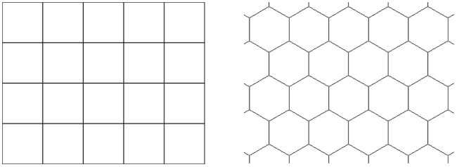
Self Organizing Maps
Basically, the goal of an SOM is to transform an incoming signal pattern of arbitrary dimension into a one or two dimensional discrete map (usually a Rectangle or Hexagon)
This transformation should be performed adaptively in a topologically ordered fashion
Done using Unsupervised Learning, in which the networks learn to form their own classifications of the training data without external help

Slide 6
Self Organizing Maps
In SOM’s a type of Unsupervised Learning, called Competitive Learning is used.
In Competitive Learning, the output neurons compete amongst themselves to be activated, with the result that only one is activated at any one time
This activated neuron is called a winner-takes-all neuron or simply the winning neuron
The result is that the neurons are forced to organise themselves. For obvious reasons, such a network is called a Self Organizing Map (SOM)

Slide 7
Self Organizing Maps
Through multiple iterations, neurons on the grid will gradually gather around areas with a higher density of data points
Areas with many neurons might reflect underlying clusters in the data

Slide 8
Analysis of SOMs Yellow – Green Example
An Example Using Colors:
x, y and z axis representing RGB
Analyzing Yellow and Green
8x8 Grid, 64 Neurons Used
Started at random locations
Each Neuron is activated by a different colour
By 150 Iterations, the map has taken nearly its final shape
Dataset from AlgoBeans

Slide 9
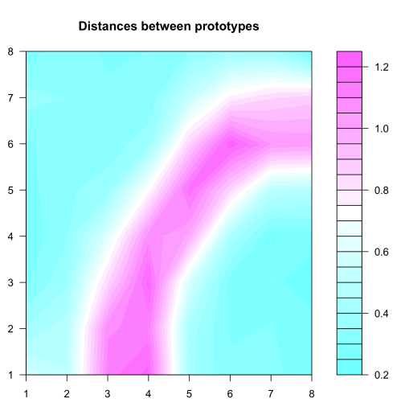
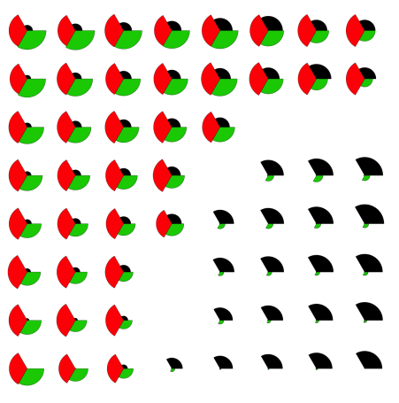
Analysis of SOMs Yellow – Green Example
U Matrix
Actual Dataset (For Confirmation)
Dataset from AlgoBeans

Slide 10
The Algorithm
Step 1: Randomly position the grid’s neurons in the data space.
Step 2: Select one data point, either randomly or systematically, cycling through the dataset in order
Step 3: Find the neuron that is closest to the chosen data point. This neuron is called the Best Matching Unit (BMU).
Step 4: Move the BMU closer to that data point. The distance moved by the BMU is determined by a learning rate, which decreases after each iteration.
Step 5: Move the BMU’s neighbors closer to that data point as well, with farther away neighbors moving less. Neighbors are identified using a radius around the BMU, and the value for this radius decreases after each iteration.
Step 6: Update the learning rate and BMU radius, before repeating Steps 1 to 4. Iterate these steps until positions of neurons have been stabilized.

Slide 11
The Algorithm
Dataset from AlgoBeans

Slide 12
Limitations
Hard to Tackle Discrete Problems
Computationally expensive
Potentially inconsistent solutions.
Notes:
SOM will have to assume that all variables in the dataset are continuous. Plotting categorical (discrete) values will result in data points lining up at discrete values instead of spreading across the plot, not giving desirable results.
A dataset with more variables would require longer times to calculate distances and identify BMUs. To improve computations, by starting the neurons off closer to the data points, less time would be needed to move them to their optimal locations.
As initial positions of neurons differ each time the SOM analysis is run, the eventual SOM map generated will also differ. Therefore, before concluding on the number of clusters, the SOM analysis can be repeated to check for consistency.

Slide 13
Thanks
Shahmeer Khan - 199310
Essam Asif - 199368
Talha Ismail - 199379

