Slide 1
Predicting Yelp Ratings with Restaurant Attributes
By: Mo, Bharath, Adam

Slide 2
Our Inspiration
1 million restaurants
$863 billion in revenue
1.6 million new jobs
10% of workforce

Slide 3
Our Objective
Help plan new restaurants
Help improve existing restaurants

Slide 4
Data Collection & Cleaning

Slide 5
Random Forest
Predictive model
Categorical Input
OOB MAE – 0.36 Test MAE – 0.36
Minimizes Variance
Continuous Output

Slide 6
KNN Imputation
RF cannot handle NA values
Decreased test error
Implications of not imputing
We understand KNN
It just works

Slide 7
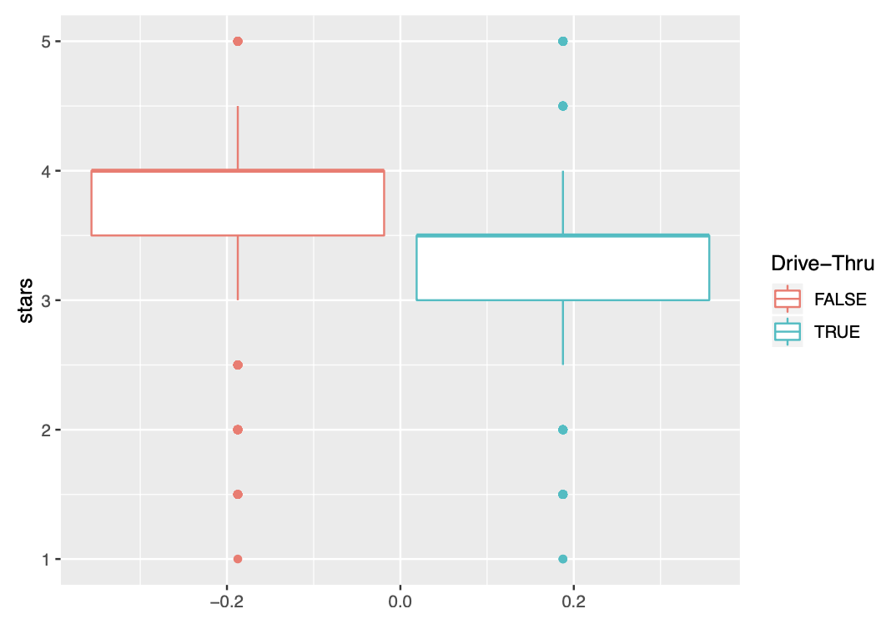
Variable Imp: Drive Through

Slide 8
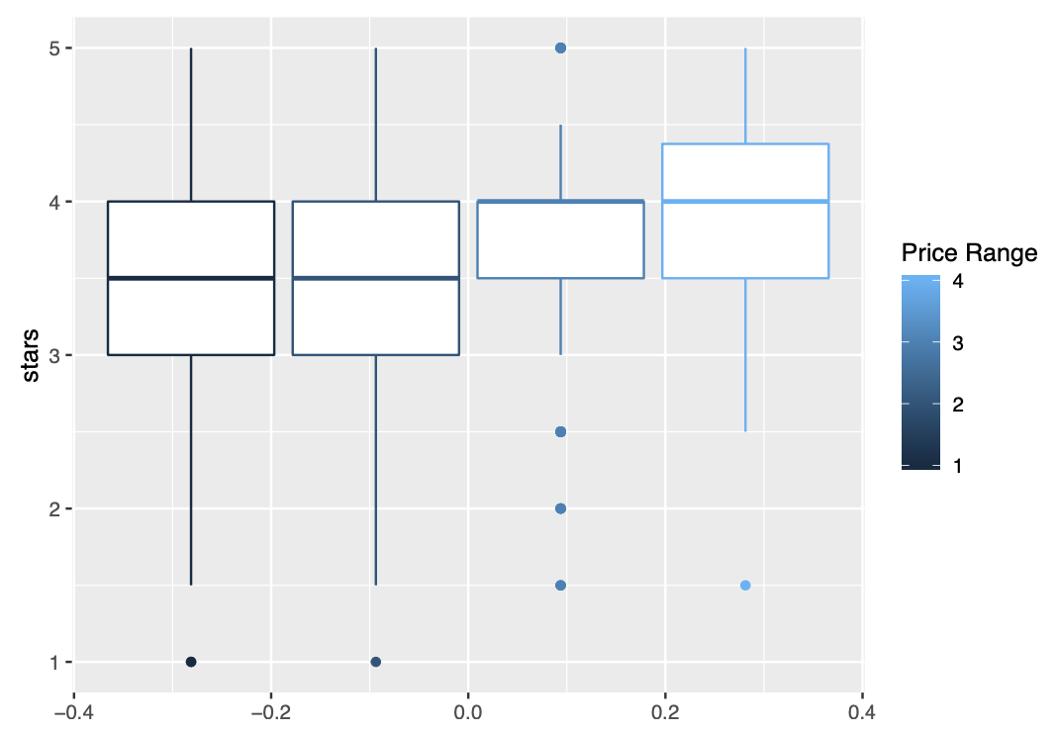
Variable Imp: Price Range

Slide 9
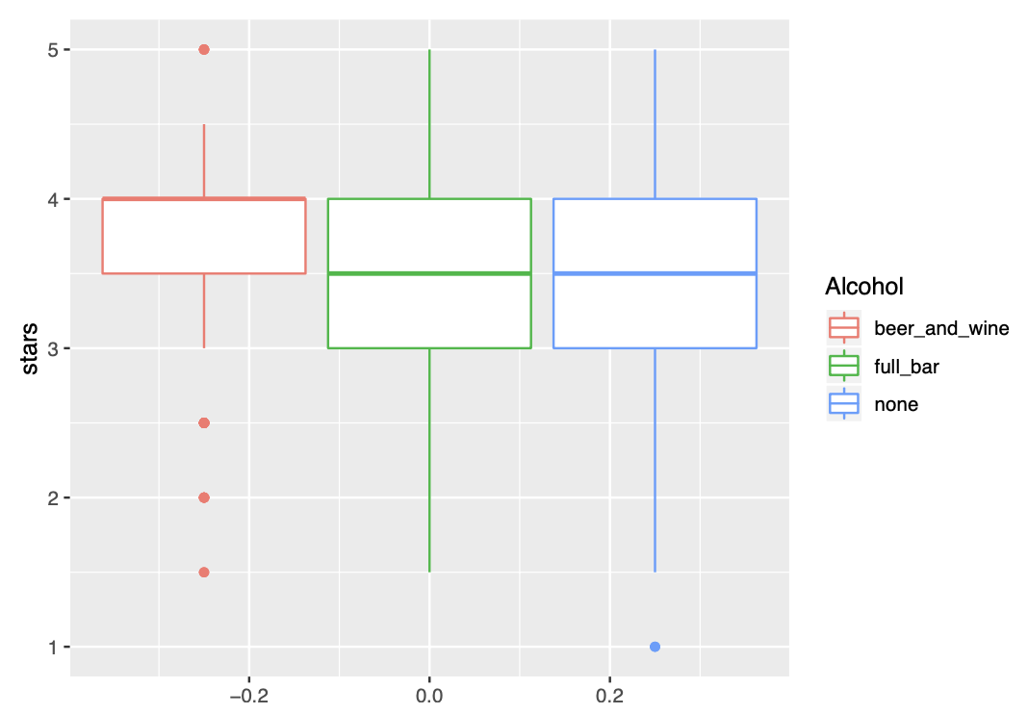
Variable Imp: Alcohol

Slide 10
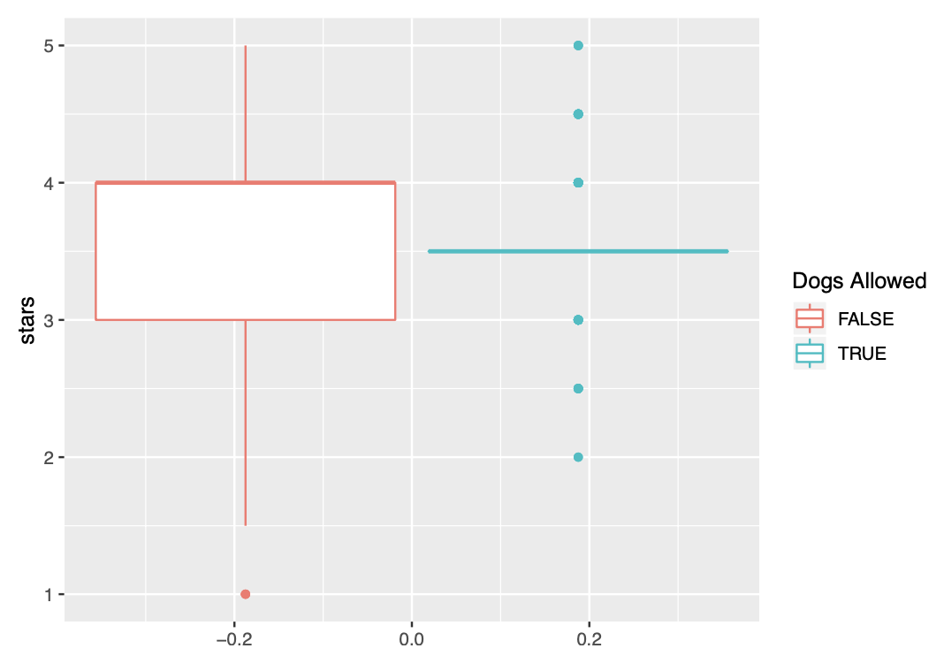
Variable Imp: Dogs Allowed

Slide 11
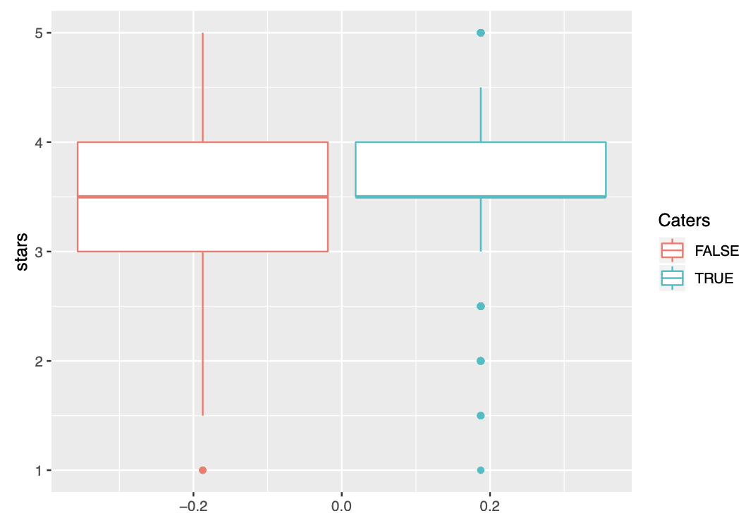
Variable Imp: Caters

Slide 12
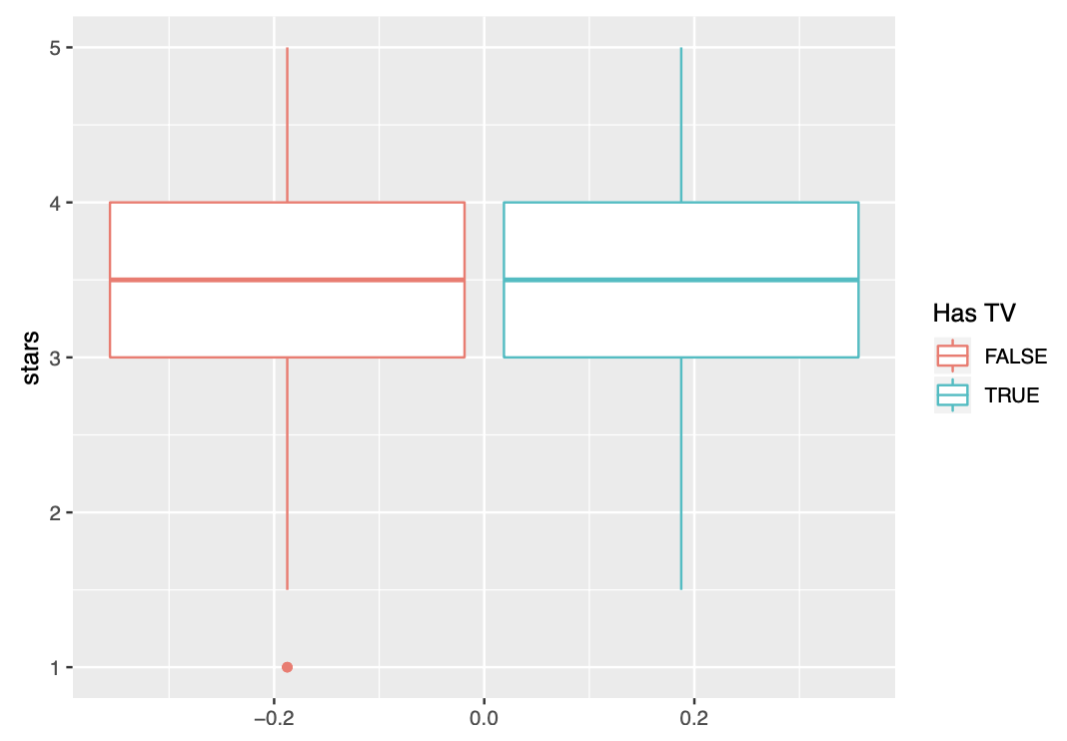
Variable Imp: Has TV

Slide 13
Now for the best Part….. OUR SHINY APP!

