Slide 1

DATA 1301
Introduction to Data Science
Logic and Probability Theory
Amir Shahmoradi
Department of Physics / College of Science
Data Science Program / College of Science
The University of Texas
Arlington, Texas

Slide 2
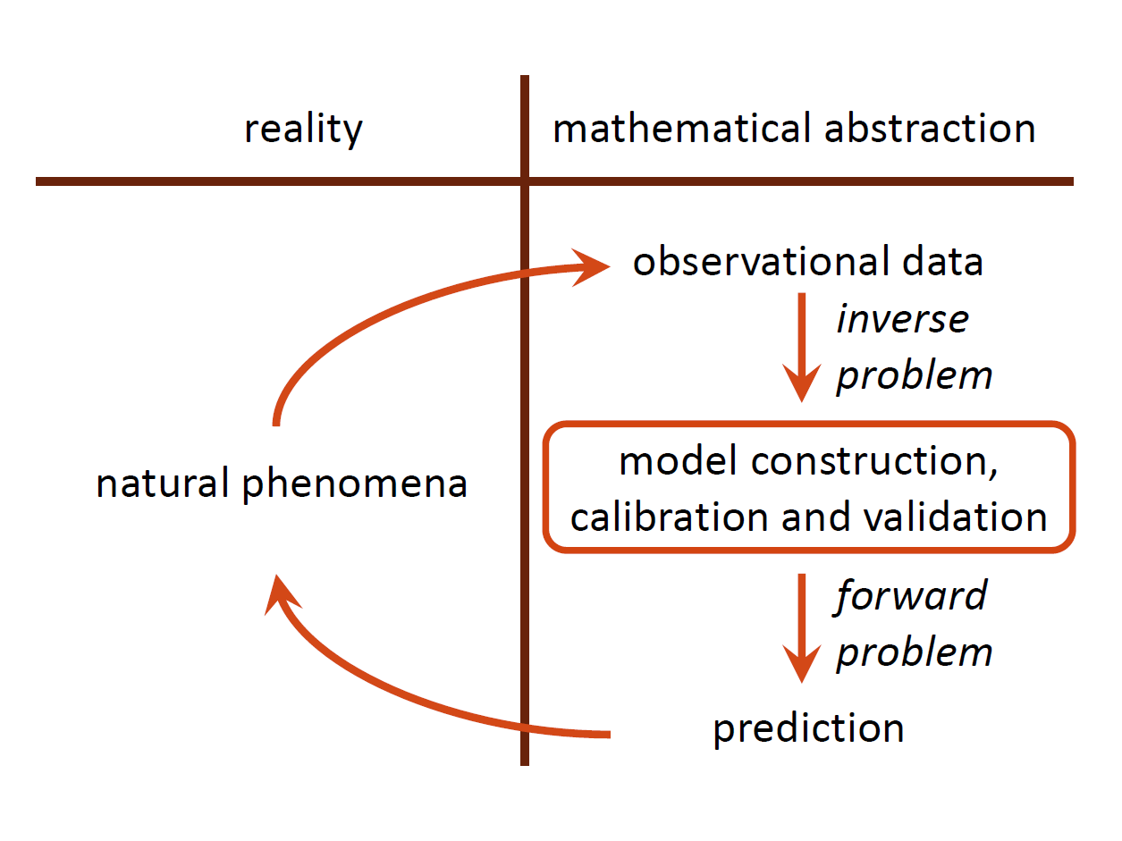
The two classical pillars of science: Experiment and Theory
How do we make a scientific inference?
A very elementary depiction of the scientific method
Notes:
I will begin my talk with a simple question: How do we make a scientific inference?
Here is an elementary depiction of the scientific method: On the left hand side of this table, we have the real world in which natural phenomena occur, and on the right hand side, we have the mathematical abstraction of the physical world.
We perform an initial experiment and collect some data. Then we form a hypothesis or mathematical model for the observed data, calibrate and validate the model, and then make a prediction based on the model and compare the results with more observations from nature.
More formally, we can represent this process by a hierarchical pyramid structure. The right face of the pyramid represents observational data, the left face represents the model, and the rear face is the reality, which we never observed, simply because it is always convolved with complex measurement errors and uncertainties. Then, the scientific methodology starts from the bottom of the pyramid, first we calibrate the model using the calibration data, then we perform model validation to ensure that the model’s predictions are accurate enough for our problem. And finally we make a prediction using the validated model to obtain the quantity of interest in our scientific problem.
For centuries, this methodology has been the workhorse of scientific inference. But, over the past few decades things have slightly changed.

Slide 3
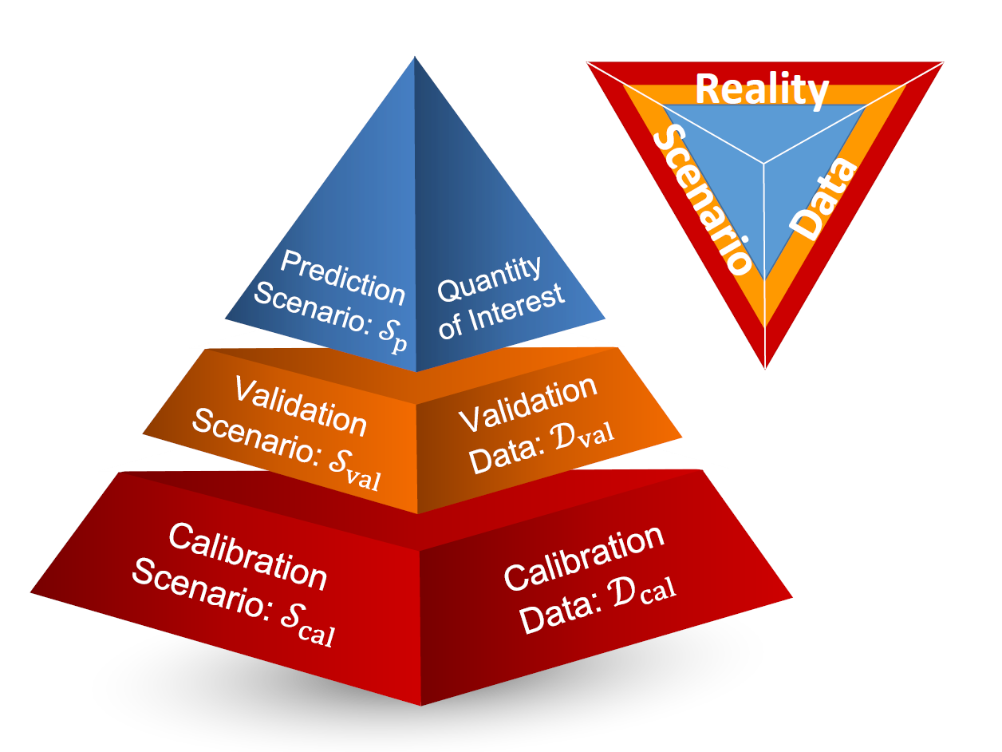
The two classical pillars of science: Experiment and Theory
How do we make a scientific inference?
A very elementary depiction of the scientific method
The prediction pyramid
Notes:
I will begin my talk with a simple question: How do we make a scientific inference?
Here is an elementary depiction of the scientific method: On the left hand side of this table, we have the real world in which natural phenomena occur, and on the right hand side, we have the mathematical abstraction of the physical world.
We perform an initial experiment and collect some data. Then we form a hypothesis or mathematical model for the observed data, calibrate and validate the model, and then make a prediction based on the model and compare the results with more observations from nature.
More formally, we can represent this process by a hierarchical pyramid structure. The right face of the pyramid represents observational data, the left face represents the model, and the rear face is the reality, which we never observed, simply because it is always convolved with complex measurement errors and uncertainties. Then, the scientific methodology starts from the bottom of the pyramid, first we calibrate the model using the calibration data, then we perform model validation to ensure that the model’s predictions are accurate enough for our problem. And finally we make a prediction using the validated model to obtain the quantity of interest in our scientific problem.
For centuries, this methodology has been the workhorse of scientific inference. But, over the past few decades things have slightly changed.

Slide 4
The desiderata of Probability Theory
There is a set of properties that we desire to have in a theory of probability that we wish to construct now.
Degrees of plausibility are represented by real numbers.
Qualitative correspondence with common sense.
Consistency.
If a conclusion can be reasoned out in more than one way, then every possible way must lead to the same result.
We must always consider all the evidence relevant to a question. We should not arbitrarily ignore some information, basing the conclusions only on what remains.
We must always represent equivalent states of knowledge by equivalent plausibility assignments. That is, if the state of knowledge is the same (except perhaps for labeling the propositions) in two problems, then it must assign the same plausibilities in both.

Slide 5

An example of correspondence with common sense
First, let’s learn the conditional notation: A proposition (A) whose truth is conditioned on the truth of another proposition (B) is typically denoted by,
Second, by convention, we will assume that propositions with greater degree of plausibility correspond to greater real numbers.
Therefore,

Slide 6
An example of correspondence with common sense
First, let’s learn the conditional notation: A proposition (A) whose truth is conditioned on the truth of another proposition (B) is typically denoted by,
Second, by convention, we will assume that propositions with greater degree of plausibility correspond to greater real numbers.
Therefore,
says that, given B, A is more plausible than C.
Now, what do we mean by “correspondence with common sense” ? Suppose,
Then, the desiderata of “correspondence with commonsense” requires us to have,

Slide 7
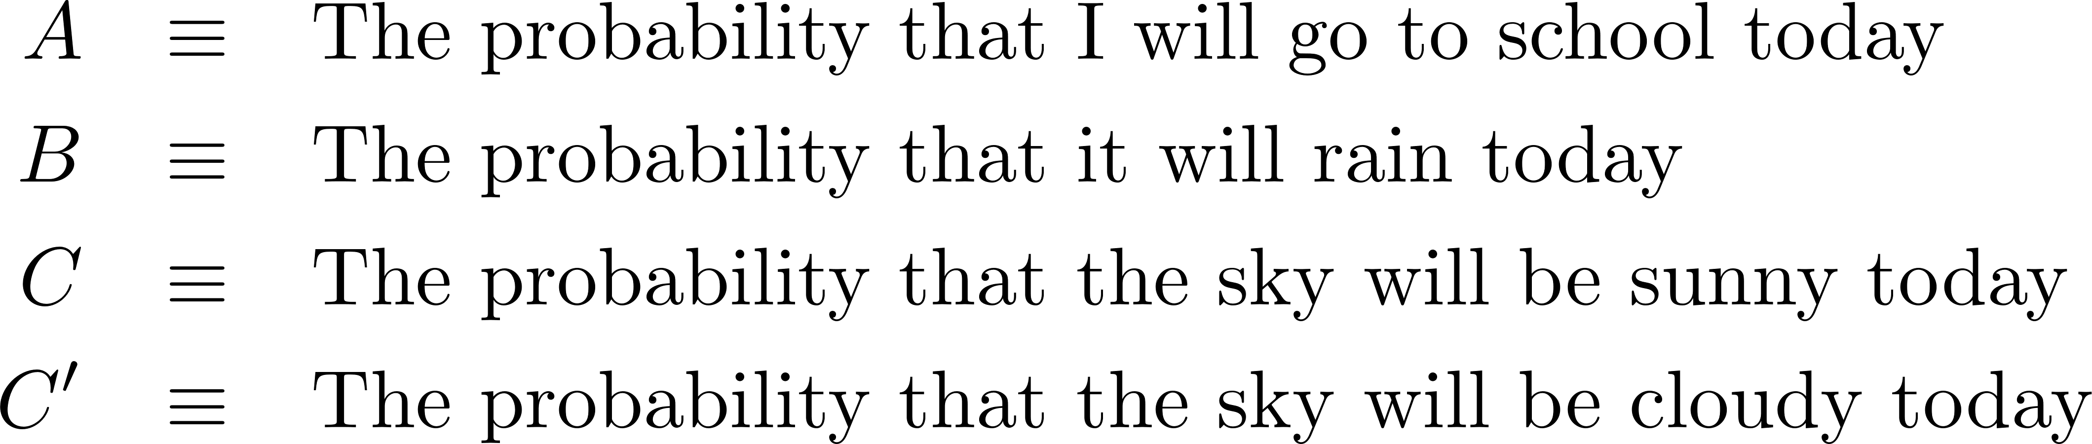
An example of correspondence with common sense
To illustrate the principle of commonsense with an example, consider the following scenario,
Therefore,
Then, the desiderata of “correspondence with commonsense” requires us to have,

Slide 8
Probability is real number whose range must be either [0,1] or [1,+infinity]
To illustrate the principle of commonsense with an example, consider the following scenario,
Therefore,
Then, the desiderata of “correspondence with commonsense” requires us to have,
Without going through proofs, we will state here that our three desiderates probability theory dictate that probability is a real number whose range must be either [0,1] or [1,+infinity].

Slide 9
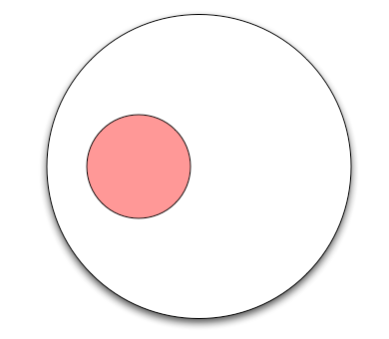
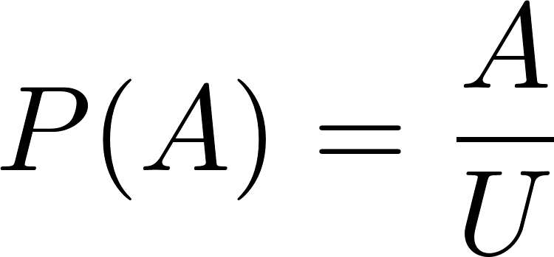
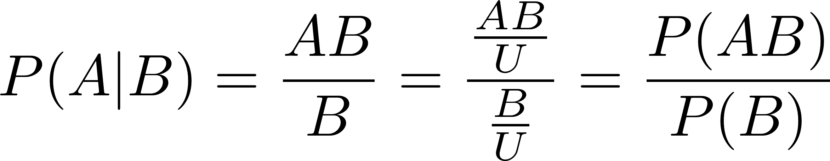
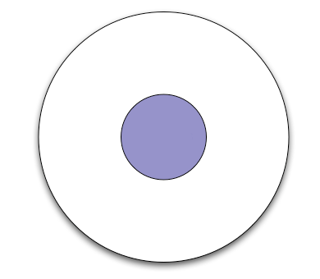
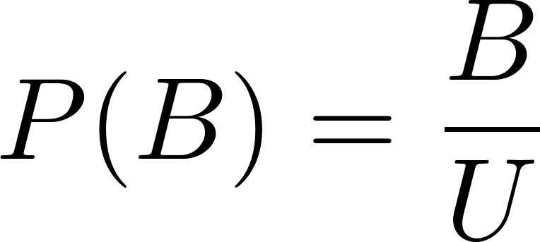
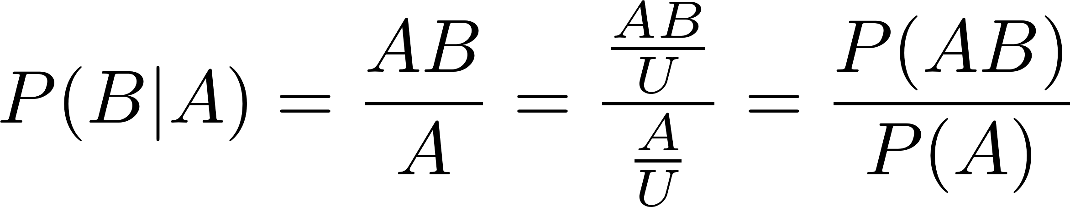
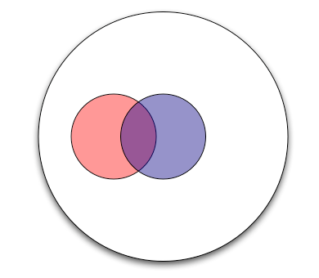
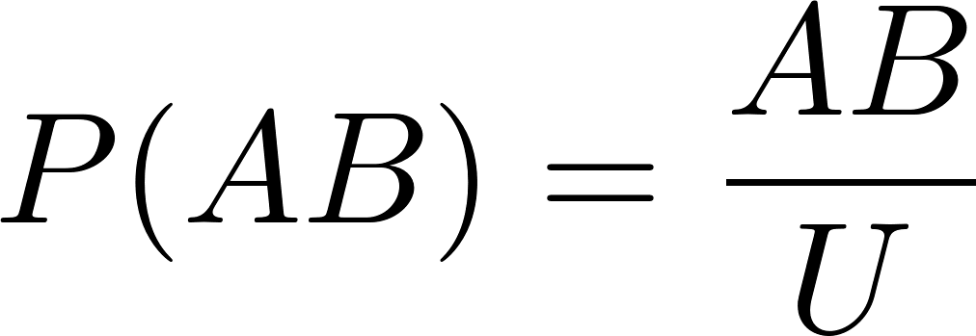
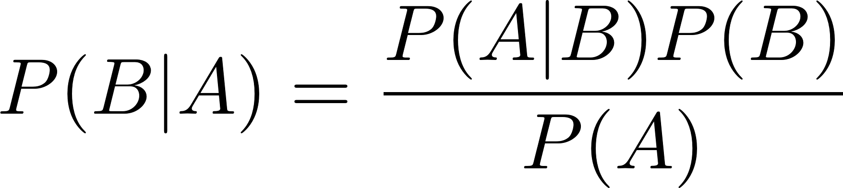






The product Rule (A prelude to the Bayesian Probability Theory)
$$A$$
$$Universe$$
$$B$$
$$Universe$$
Bayes rule
$$A$$
$$AB$$
$$B$$
$$Universe$$

Slide 10
A Tug-of-War in the History of Probability Theory
1700
1840
1940
present
Classical Probability (150 years)
First digital computer
J Bernoulli, de Moivre, Bayes, Laplace, D Bernoulli, Condorcet, Lubbock, Poisson, de Morgan, Maxwell, Jevons, Boltzmann, Gibbs
Poincare, Keynes, Ramsey, de Finetti, Jeffreys, RT Cox, Carnap, Good, Polya, Savage, Zellner, Jaynes, Jeffrey, …
Bayesian Probability
Probability: degree of belief
Prior knowledge: allowed in inference
Popular in: Astronomy, Physics, Economics, Geoscience
Data: scarce
Frequentist Probability (100 years)
Cournot, Ellis, Boole, Venn, Chrystal, Galton, Fisher, von Mises, Reichenbach, Pearson, Kendall, Cramer, Neyman, Feller, …
Probability: relative frequency of occurrence
Prior knowledge: NOT allowed in inference
Popular in: Biology, Statistics, Philosophy
Data: abundant
Propensity
Popper, Gillies, Fetzer, Miller

Slide 11
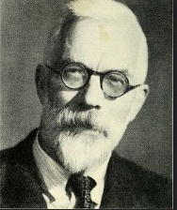
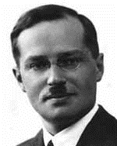
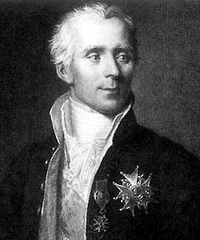
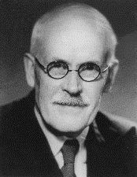
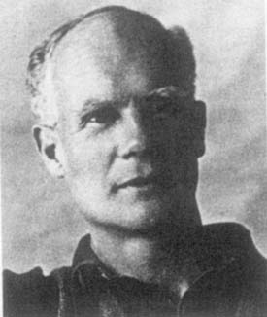
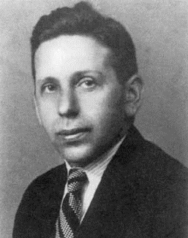
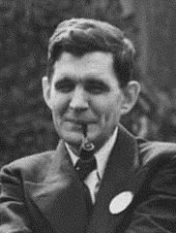
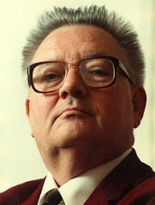
Two Philosophically distinct approaches to Scientific inference
Frequentist Inference
Neyman–Pearson–Wald theory
Bayesian Inference
Bayesian probability theory
Ronald Fisher
(1890 – 1962)
Statistician / Biologist
Jerzy Neyman
(1894 – 1981)
Statistician / Astronomer
Pierre Laplace
(1749 – 1827)
Astronomer / Mathematician
Harold Jeffreys
(1891 – 1989)
Astronomer / Geophysicist
Egon Pearson
(1895 – 1980)
Statistician
Abraham Wald
(1902 – 1950)
Statistician
Richard Cox
(1898 – 1991)
Physicist
Edwin Jaynes
(1922 – 1998)
Physicist
No prior knowledge allowed.
Let the data speak for itself.
- R. A. Fisher
Prior knowledge has a fundamental role in inference along with Data
(via the Bayes’ Rule)

Slide 12
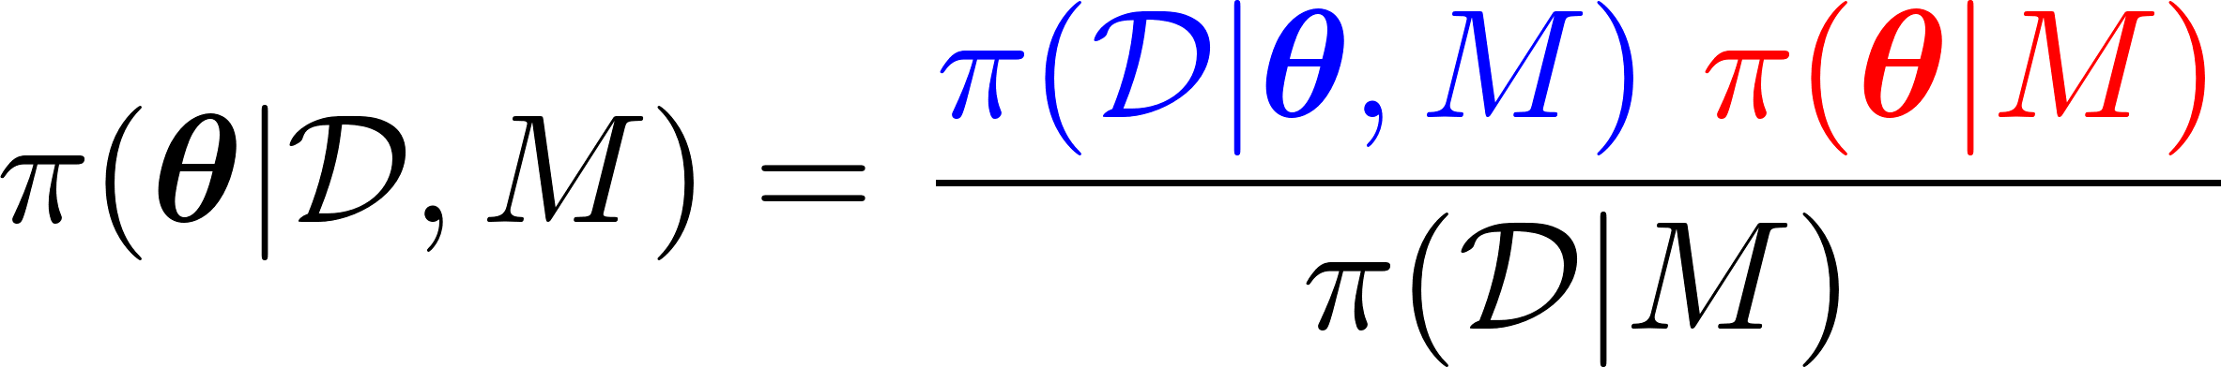
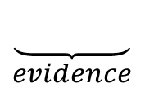



Two Philosophically distinct approaches to Scientific inference
Frequentist Inference
Neyman–Pearson–Wald theory
Bayesian Inference
Bayesian probability theory
Ronald Fisher
(1890 – 1962)
Statistician / Biologist
Jerzy Neyman
(1894 – 1981)
Statistician / Astronomer
Pierre Laplace
(1749 – 1827)
Astronomer / Mathematician
Harold Jeffreys
(1891 – 1989)
Astronomer / Geophysicist
Egon Pearson
(1895 – 1980)
Statistician
Abraham Wald
(1902 – 1950)
Statistician
Richard Cox
(1898 – 1991)
Physicist
Edwin Jaynes
(1922 – 1998)
Physicist
Bayes rule:
$$likelihood$$
$$prior$$
No prior knowledge allowed.
Let the data speak for itself.
- R. A. Fisher
$$\underset{posterior}{\underbrace{ }}$$
$$\underset{evidence}{\underbrace{ }}$$
Notes:
Historically, there has been two fundamentally different approaches to scientific inference.
…
Now I will try to explain the fundamental difference between the two schools of thought by a simple example.

Slide 13

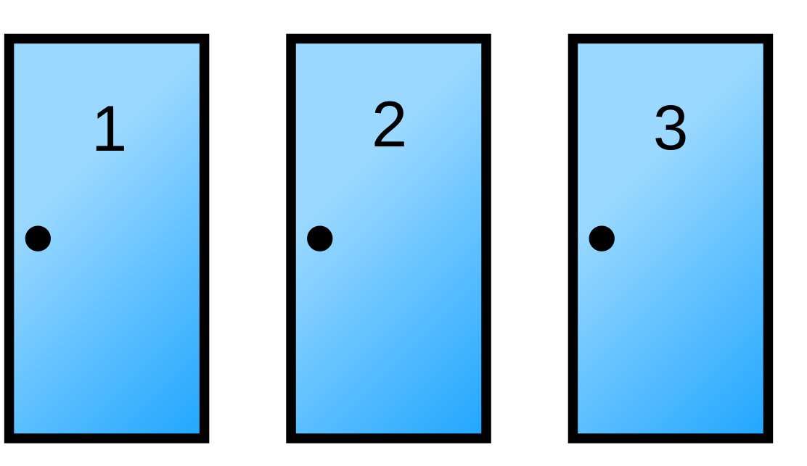
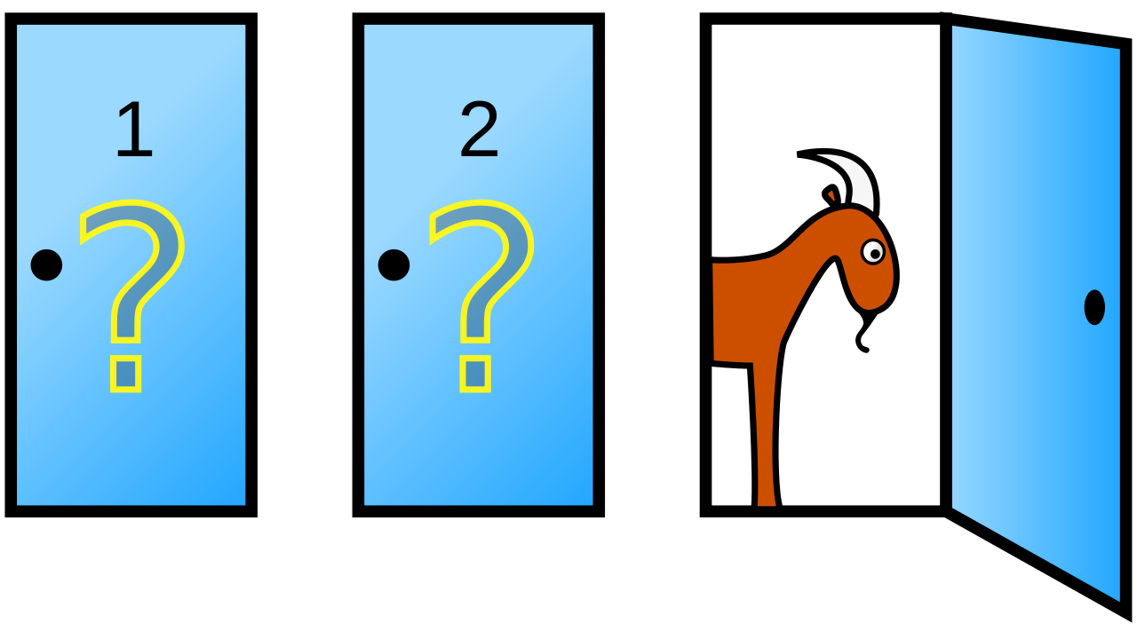
Digression: Bayes rule - The optimal method of inference
The Monty Hall Problem and Bayes Rule
Steve Selvin, 1975, "A problem in probability (letter to the editor)". American Statistician
Correct answer: The advantage of switching door, depends on your knowledge about the host’s decision.

Slide 14
Digression: Bayes rule - The optimal method of inference
The Monty Hall Problem and Bayes Rule
Steve Selvin, 1975, "A problem in probability (letter to the editor)". American Statistician
Suppose you're on a game show, and you're given the choice of three doors: Behind one door is a car; behind the two others, goats. You pick a door, say No. 1, and the host opens another door, say No. 3, which has a goat. He then says to you, "Do you want to pick door No. 2?"
Question:
Is it to your advantage to switch your choice from door 1 to door 2?
Correct answer: The advantage of switching door, depends on your knowledge about the host’s decision.

Slide 15
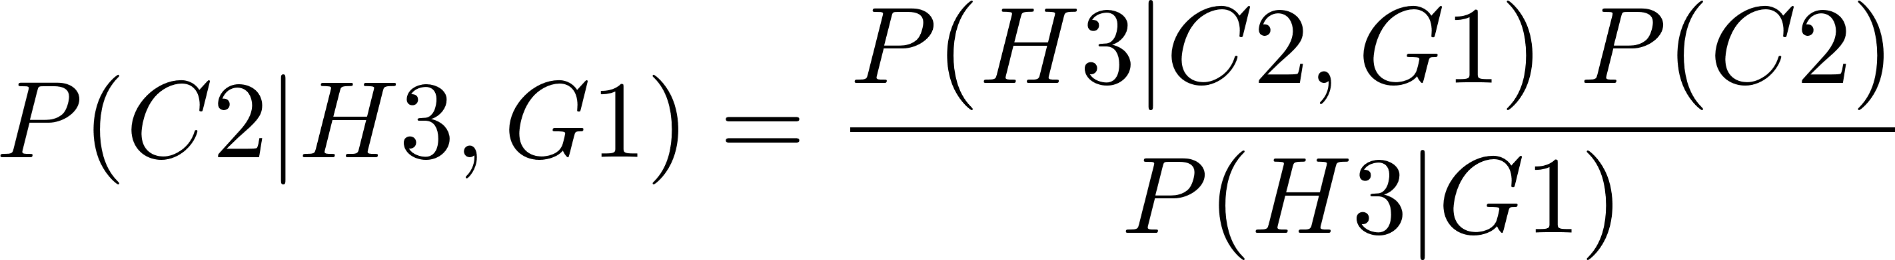
Digression: Bayes rule - The optimal method of inference
Case 1: Informed Host: Knows where the car is and will not open the door that leads to car.
You, the guest, choose door 1. The Informed host consciously opens door 3.

Slide 16
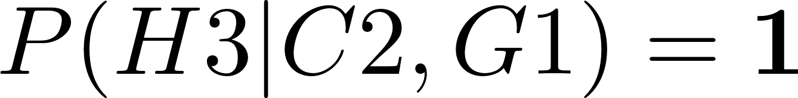
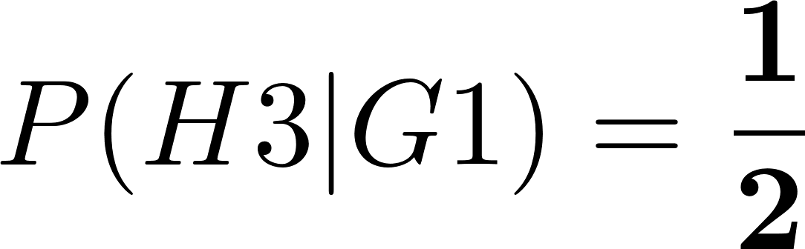
Digression: Bayes rule - The optimal method of inference
Case 1: Informed Host: Knows where the car is and will not open the door that leads to car.
You, the guest, choose door 1. The Informed host consciously opens door 3.
Prior knowledge about the car being behind door 2 ( C2 ):
New knowledge: The informed host chooses door 3 ( H3 ) ( He knows that the car is behind door 2)
Update your knowledge about door C2 using Bayes rule:

Slide 17
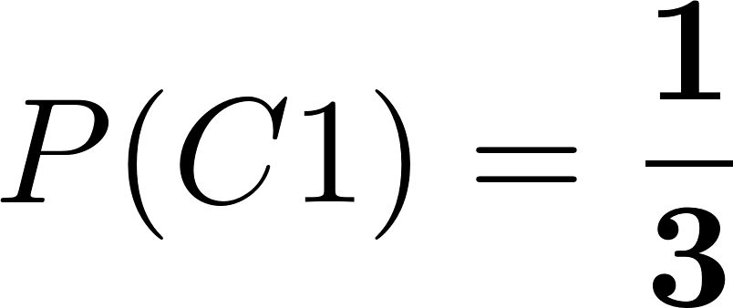
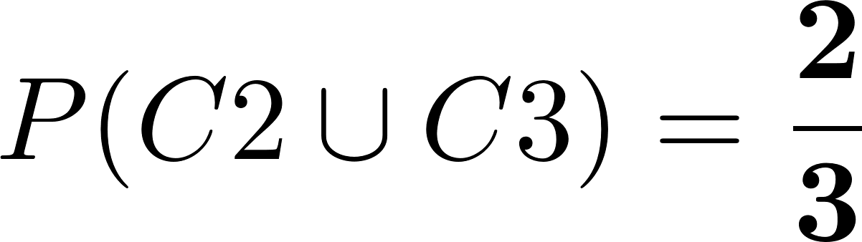
Digression: Bayes rule - The optimal method of inference
Case 1: Informed Host: Knows where the car is and will not open the door that leads to car.
You, the guest, choose door 1. The Informed host consciously opens door 3 (knowing the car is behind #2).
Prior knowledge about the car being behind door 2 ( C2 ):
New knowledge: The informed host chooses door 3 ( H3 ) ( He knows that the car is behind door 2)
Update your knowledge about door C2 using Bayes rule:

Slide 18
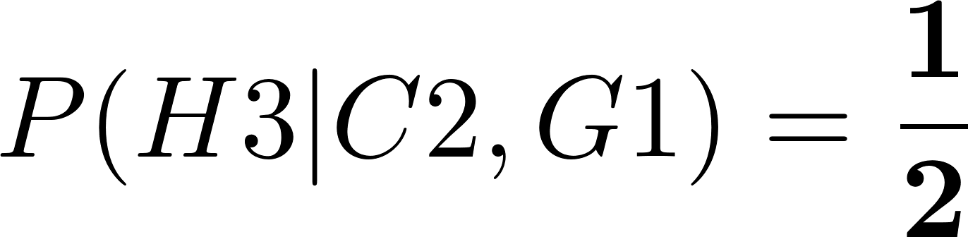
Digression: Bayes rule - The optimal method of inference
Case 1: Uninformed Host
You, the guest, choose door 1. The Uninformed host randomly opens door 3 (knowing nothing a priori).
Prior knowledge about the car being behind door 2:
New knowledge: The Uninformed host chooses door 3 ( H3 ) ( He does not know where the car is)
Update your knowledge about door C2 using Bayes rule:

Slide 19
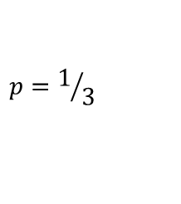
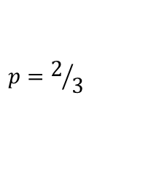
Digression: Bayes rule - The optimal method of inference
$$p=2/3$$
$$p=1/3$$
Notes:
We can only talk about subjective notion of probability. For example in a horse race betting, no race can be repeated in order to apply frequentist notion of probability.

Slide 20
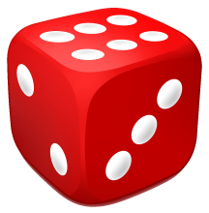
There is only one type of uncertainty in the world – epistemic
Suppose you have blurred vision.
You throw a die once and read your observation (possibly wrong reading).
What is the type of uncertainty in your observation?
Frequentist Inference
Bayesian Inference
The uncertainty is due to my lack of knowledge.
I can reduce uncertainty with better vision.
Therefore, the uncertainty is epistemic.
The uncertainty is due to my lack of knowledge.
I can reduce uncertainty with better vision.
Therefore, the uncertainty is epistemic.

Slide 21
There is only one type of uncertainty in the world – epistemic
Suppose you have perfect vision.
You throw a die multiple times and read your observations.
What is the type of uncertainty (source of variability) in your observations?
Frequentist Inference
Bayesian Inference
The uncertainty is inherent in the experiment.
I cannot reduce uncertainty any further.
Therefore, the uncertainty is aleatoric.
The uncertainty is due to my lack of knowledge:
Wrong / inadequate model.
Lack of sufficiently-detailed data
which leads to inadequate model.
I can reduce uncertainty with better data / model.
Therefore, the uncertainty is epistemic.

Slide 22
There is only one type of uncertainty in the world – epistemic
Suppose you have perfect vision.
You throw a die multiple times and read your observations.
What is the type of uncertainty (source of variability) in your observations?
Frequentist Inference
Bayesian Inference
The uncertainty is inherent in the experiment.
I cannot reduce uncertainty any further.
Therefore, the uncertainty is aleatoric.
The uncertainty is due to my lack of knowledge:
Wrong / inadequate model.
Lack of sufficiently-detailed data
which leads to inadequate model.
I can reduce uncertainty with better data / model.
Therefore, the uncertainty is epistemic.
Physical Model
Aleatoric
Variability
Reality
Noise Uncertainty
Inadequacy Model
Physical Model
Noise Model
Reality
Notes:
These two fundamentally different world-views lead to two entirely different approaches to treating uncertainty in data. For a frequentist, reality is always obscured by inherent variability as well as measurement noise, whereas in Bayesian modeling, the inherent variability is solely due to the inadequacy of the model or the uncertainty in our model, and data is data uncertainty is solely due to noise in the measurements.

Slide 23
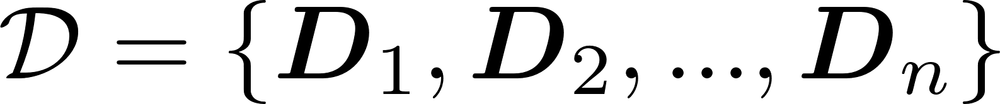

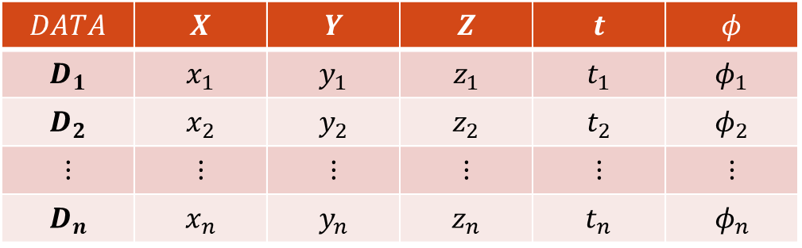
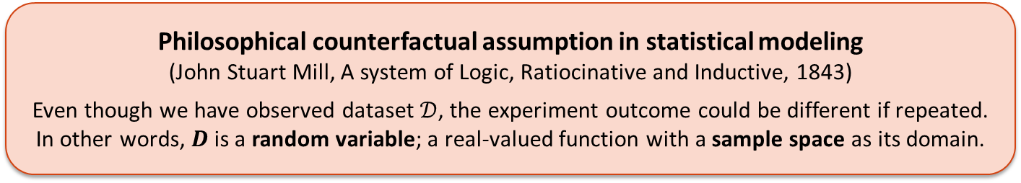
Observations, random variables, and the likelihood principle
Suppose we observe the following data of $n$ events, each described by $m$ variables,
$$DATA$$ | $$X$$ | $$Y$$ | $$Z$$ | $$t$$ | $$φ$$
$$D_{1}$$ | $$x_{1}$$ | $$y_{1}$$ | $$z_{1}$$ | $$t_{1}$$ | $$φ_{1}$$
$$D_{2}$$ | $$x_{2}$$ | $$y_{2}$$ | $$z_{2}$$ | $$t_{2}$$ | $$φ_{2}$$
$$⋮$$ | $$⋮$$ | $$⋮$$ | $$⋮$$ | $$⋮$$ | $$⋮$$
$$D_{n}$$ | $$x_{n}$$ | $$y_{n}$$ | $$z_{n}$$ | $$t_{n}$$ | $$φ_{n}$$
Data tuples
Philosophical counterfactual assumption in statistical modeling
(John Stuart Mill, A system of Logic, Ratiocinative and Inductive, 1843)
Even though we have observed dataset $𝒟$, the experiment outcome could be different if repeated.
In other words, $D$ is a random variable; a real-valued function with a sample space as its domain.
Notes:
We define an event as a subset of these possible outcomes in the sample space.

Slide 24
What is a Data Object?
Data sets are made up of data objects (or data points). A data object represents an entity.
Examples:
In a sales database, the objects may be customers, store items, and sales
In a medical database, the objects may be patients
In a university database, the objects may be students, professors, and courses.
Data objects are typically described by attributes.
Synonyms for Data object: sample, example, instance, data point, or observation.
If the data objects are stored in a database, they are also called data tuples. That is, the rows of a database correspond to the data objects, and the columns correspond to the attributes.

Slide 25
What is a Data Attribute?
An attribute is a data field, representing a characteristic or feature of a data object.
Common synonyms for attribute are,
dimension (frequently used in data warehousing),
feature (frequently used in Machine Learning),
Variable (frequently used by statisticians),
Example:
Attributes describing a customer object can include,
customer ID,
name,
address.
Observed values for a given attribute are frequently known as observations.
A set of attributes used to describe a given object is called an attribute vector (or feature vector).
The distribution of data involving one attribute (or variable) is called univariate.
The distribution of data involving two attributes (or variables) is called bivariate.
The distribution of data involving multiple attributes (or variables) is called multivariate.

Slide 26
What are the kinds of Data Attribute?
Nominal attributes
Nominal means “relating to names”. The values of a nominal attribute are symbols or names of things. Each value represents some kind of category, code, or state, and so nominal attributes are also referred to as categorical. The values do not have any meaningful order. In computer science, the values are also known as enumerations.
Example: hairColor, maritalStatus, gender, occupation, …
Binary Attributes
A binary attribute is a nominal attribute with only two categories or states: 0 or 1, where 0 typically means that the attribute is absent, and 1 means that it is present. Binary attributes are referred to as Boolean if the two states correspond to true and false.
Example: The “smoker” attribute in a patient data object.
Ordinal Attributes
An ordinal attribute is an attribute with possible values that have a meaningful order or ranking among them, but the magnitude between successive values is NOT known.
Example:
Starbucks coffee cup size: small, medium, grande
School grading system: F,D,C,B,A
Ordinal attributes are useful for registering subjective assessments of qualities that cannot be measured objectively; thus, ordinal attributes are often used in surveys for ratings. For example, customer satisfaction in a survey can have the following ordinal categories: 0: very dissatisfied, 1: somewhat dissatisfied, 2: neutral, 3: satisfied, and 4: very satisfied.

Slide 27
What are the kinds of Data Attribute?
Numeric Attributes
A numeric attribute is quantitative; that is, it is a measurable quantity, represented in integer or real values.
Example: room temperature, volume, air density, …
Numeric attributes can be location (interval-scaled) or scale (ratio-scaled) attributes.
Location Attributes do not have a starting value (or zero-point). For example, location of trees in a forest does not a reference point. The temperature in Celsius or Fahrenheit is also a location attribute.
Scale Attributes, unlike location attributes, do have a zeros point, for example, the time since an event, or the temperature in Kelvins.
Data Attribute classification based on the values
Continuous Attributes
An attribute that can take an uncountably infinite number of possible values is continuous. Most numeric attributes are also continuous.
Discrete Attributes
An attribute that can take only a finite or a countably infinite number of possible values is discrete. Integer numeric attributes are common examples of discrete variables. Ordinal and binary attributes are also discrete.

Slide 28
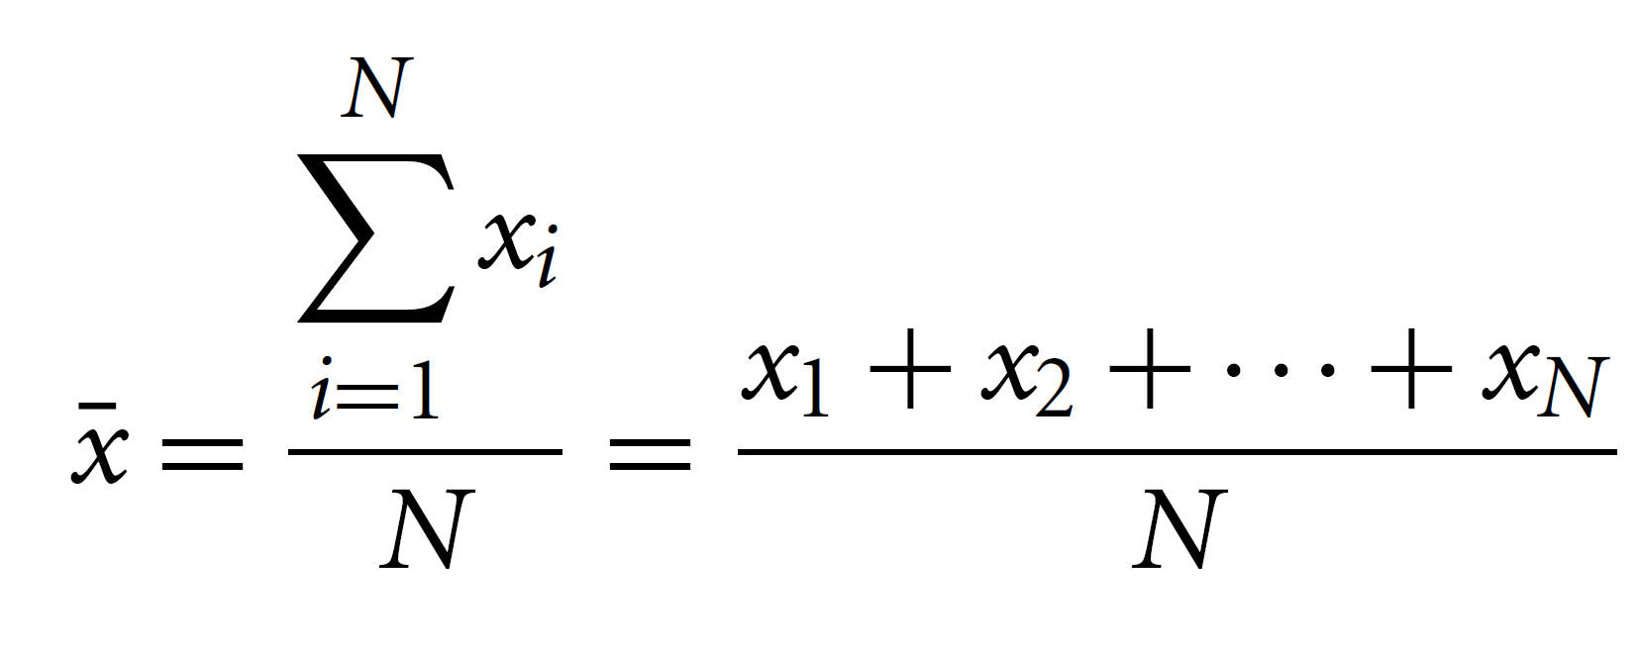
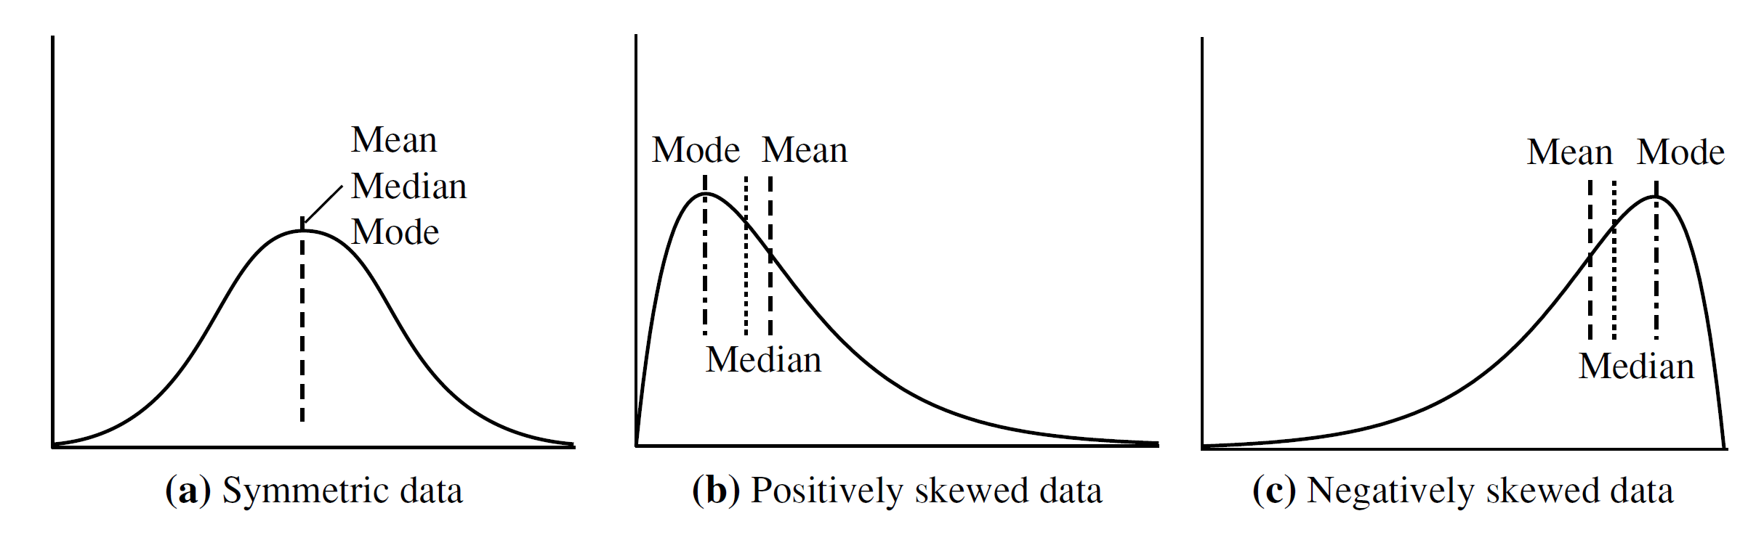
Basic Data Summarization Techniques
Measuring the Central Tendency (mean, median+)
The most common and effective numeric measure of the “center” of a set of data is the (arithmetic) mean. The mean statistic is extremely useful method of summarizing symmetric data.
When data is skewed or asymmetric, the median statistic provides a less biased summary of data. Median is simply the is the middle value in a set of ordered data values.
Arithmetic mean

Slide 29


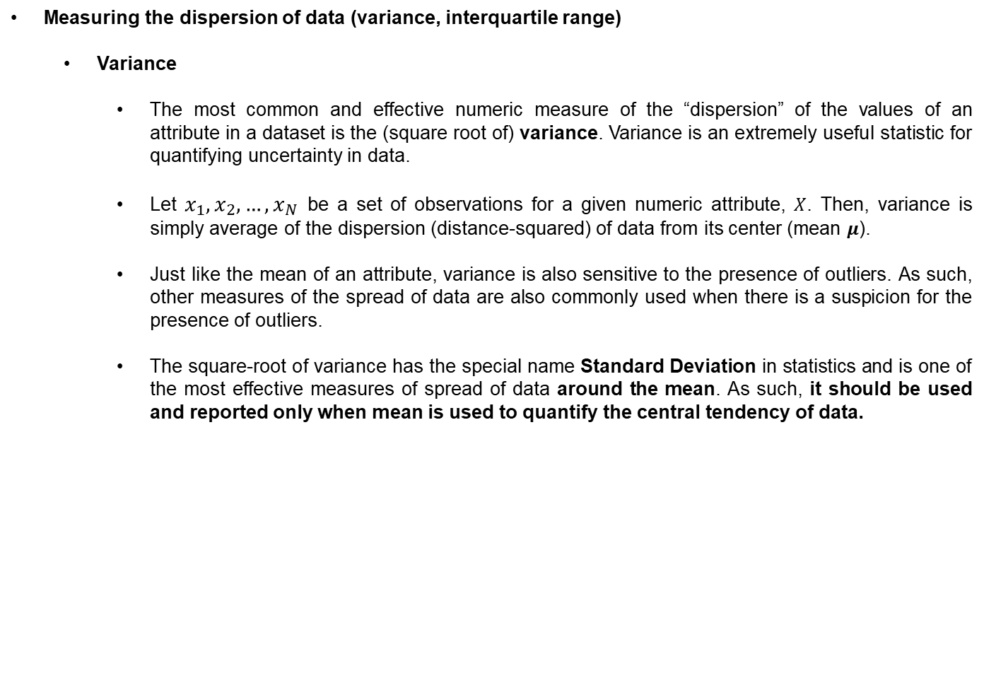
Basic Data Summarization Techniques
Measuring the dispersion of data (variance, interquartile range)
Variance
The most common and effective numeric measure of the “dispersion” of the values of an attribute in a dataset is the (square root of) variance. Variance is an extremely useful statistic for quantifying uncertainty in data.
Let $x_{1},x_{2}, …,x_{N}$ be a set of observations for a given numeric attribute, $X$. Then, variance is simply average of the dispersion (distance-squared) of data from its center (mean $μ$).
Just like the mean of an attribute, variance is also sensitive to the presence of outliers. As such, other measures of the spread of data are also commonly used when there is a suspicion for the presence of outliers.
The square-root of variance has the special name Standard Deviation in statistics and is one of the most effective measures of spread of data around the mean. As such, it should be used and reported only when mean is used to quantify the central tendency of data.

Slide 30
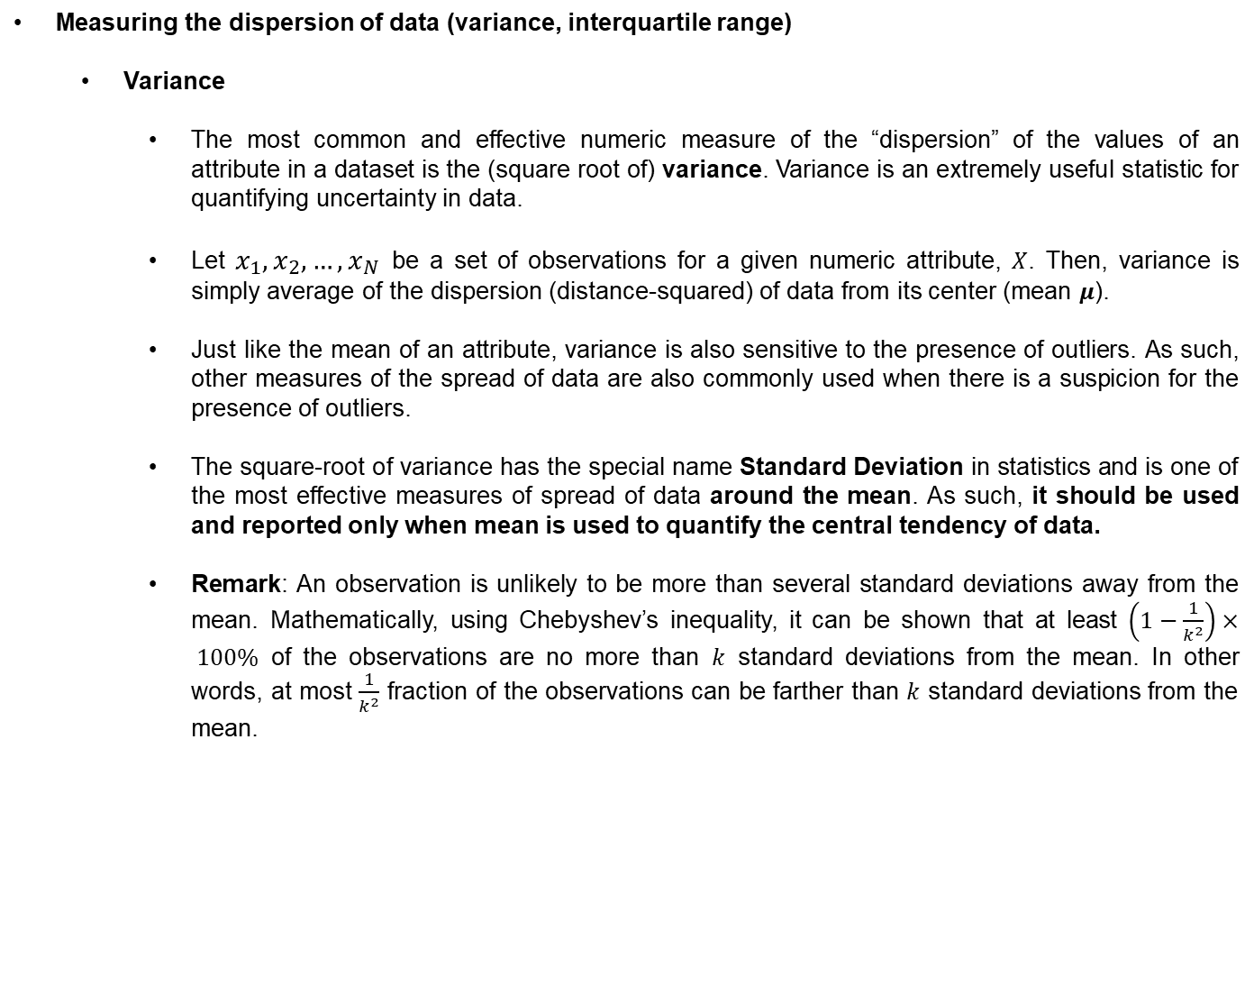
Basic Data Summarization Techniques
Measuring the dispersion of data (variance, interquartile range)
Variance
The most common and effective numeric measure of the “dispersion” of the values of an attribute in a dataset is the (square root of) variance. Variance is an extremely useful statistic for quantifying uncertainty in data.
Let $x_{1},x_{2}, …,x_{N}$ be a set of observations for a given numeric attribute, $X$. Then, variance is simply average of the dispersion (distance-squared) of data from its center (mean $μ$).
Just like the mean of an attribute, variance is also sensitive to the presence of outliers. As such, other measures of the spread of data are also commonly used when there is a suspicion for the presence of outliers.
The square-root of variance has the special name Standard Deviation in statistics and is one of the most effective measures of spread of data around the mean. As such, it should be used and reported only when mean is used to quantify the central tendency of data.
Remark: An observation is unlikely to be more than several standard deviations away from the mean. Mathematically, using Chebyshev’s inequality, it can be shown that at least $\left(1−\frac{1}{k^{2}}\right)× 100\%$ of the observations are no more than $k$ standard deviations from the mean. In other words, at most $\frac{1}{k^{2}}$ fraction of the observations can be farther than $k$ standard deviations from the mean.

Slide 31
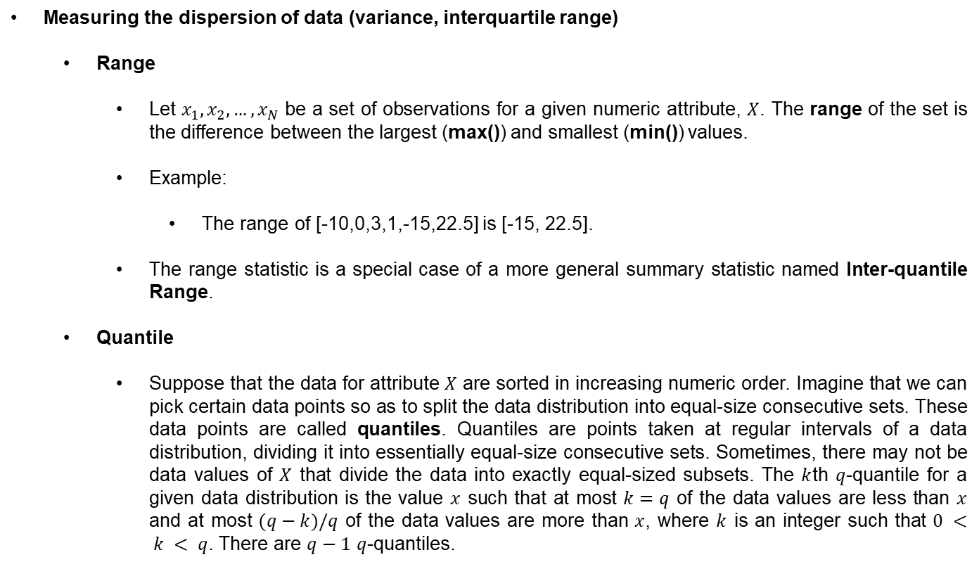
Basic Data Summarization Techniques
Measuring the dispersion of data (variance, interquartile range)
Range
Let $x_{1},x_{2}, …,x_{N}$ be a set of observations for a given numeric attribute, $X$. The range of the set is the difference between the largest (max()) and smallest (min()) values.
Example:
The range of [-10,0,3,1,-15,22.5] is [-15, 22.5].
The range statistic is a special case of a more general summary statistic named Inter-quantile Range.
Quantile
Suppose that the data for attribute $X$ are sorted in increasing numeric order. Imagine that we can pick certain data points so as to split the data distribution into equal-size consecutive sets. These data points are called quantiles. Quantiles are points taken at regular intervals of a data distribution, dividing it into essentially equal-size consecutive sets. Sometimes, there may not be data values of $X$ that divide the data into exactly equal-sized subsets. The $k$th $q$-quantile for a given data distribution is the value $x$ such that at most $k=q$ of the data values are less than $x$ and at most $(q−k)/q$ of the data values are more than $x$, where $k$ is an integer such that $0 < k < q$. There are $q−1$ $q$-quantiles.

Slide 32
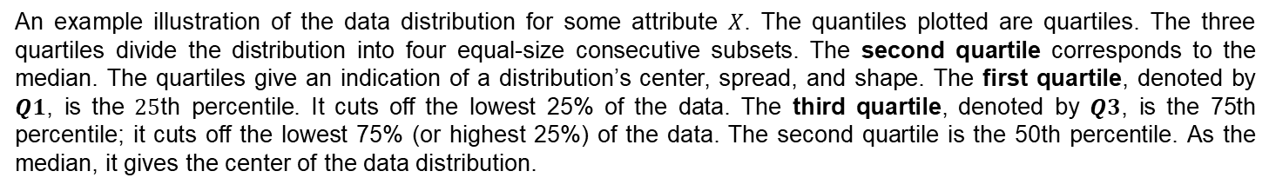
Basic Data Summarization Techniques
Measuring the dispersion of data (variance, interquartile range)
Quantile
The 2-quantile is the data point dividing the lower and upper halves of the data distribution. It corresponds to the median. The 4-quantiles are the three data points that split the data distribution into four equal parts; each part represents one-fourth of the data distribution. They are more commonly referred to as quartiles. The 100-quantiles are more commonly referred to as percentiles; they divide the data distribution into 100 equal-sized consecutive sets. The median, quartiles, and percentiles are the most widely used forms of quantiles.
An example illustration of the data distribution for some attribute $X$. The quantiles plotted are quartiles. The three quartiles divide the distribution into four equal-size consecutive subsets. The second quartile corresponds to the median. The quartiles give an indication of a distribution’s center, spread, and shape. The first quartile, denoted by $Q1$, is the $25$th percentile. It cuts off the lowest 25% of the data. The third quartile, denoted by $Q3$, is the 75th percentile; it cuts off the lowest 75% (or highest 25%) of the data. The second quartile is the 50th percentile. As the median, it gives the center of the data distribution.

Slide 33
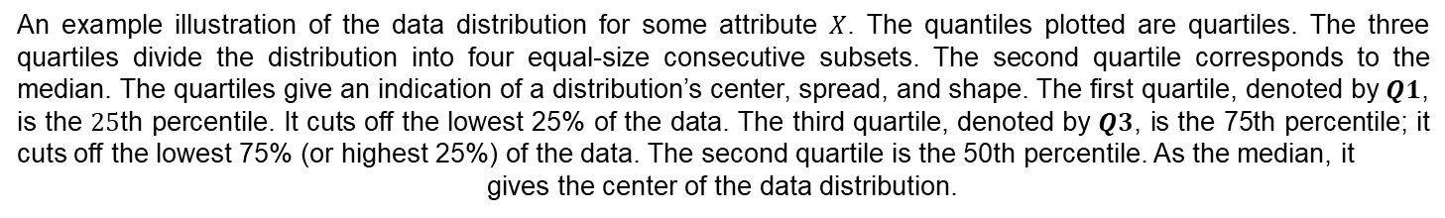
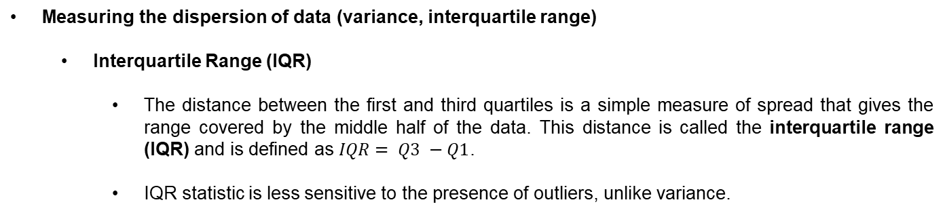
Basic Data Summarization Techniques
Measuring the dispersion of data (variance, interquartile range)
Interquartile Range (IQR)
The distance between the first and third quartiles is a simple measure of spread that gives the range covered by the middle half of the data. This distance is called the interquartile range (IQR) and is defined as $IQR= Q3 −Q1$.
IQR statistic is less sensitive to the presence of outliers, unlike variance.
An example illustration of the data distribution for some attribute $X$. The quantiles plotted are quartiles. The three quartiles divide the distribution into four equal-size consecutive subsets. The second quartile corresponds to the median. The quartiles give an indication of a distribution’s center, spread, and shape. The first quartile, denoted by $Q1$, is the $25$th percentile. It cuts off the lowest 25% of the data. The third quartile, denoted by $Q3$, is the 75th percentile; it cuts off the lowest 75% (or highest 25%) of the data. The second quartile is the 50th percentile. As the median, it
gives the center of the data distribution.

Slide 34
Basic Data Summarization Techniques
Measuring the dispersion of data (variance, interquartile range)
The five-number summary
When data is highly skewed, even the interquartile range can become ineffective summary of data. In such a case, it is more sensible to report the interquartile range of the attribute along with the median (the value at 50%-quantile), as well as the minimum and the maximum of the values. The five-number summary is best illustrated by a special type of visualization known as the Box-Plot as we shall see later on in this course.
An example illustration of the data distribution for some attribute $X$. The quantiles plotted are quartiles. The three quartiles divide the distribution into four equal-size consecutive subsets. The second quartile corresponds to the median. The quartiles give an indication of a distribution’s center, spread, and shape. The first quartile, denoted by $Q1$, is the $25$th percentile. It cuts off the lowest 25% of the data. The third quartile, denoted by $Q3$, is the 75th percentile; it cuts off the lowest 75% (or highest 25%) of the data. The second quartile is the 50th percentile. As the median, it
gives the center of the data distribution.

Slide 35

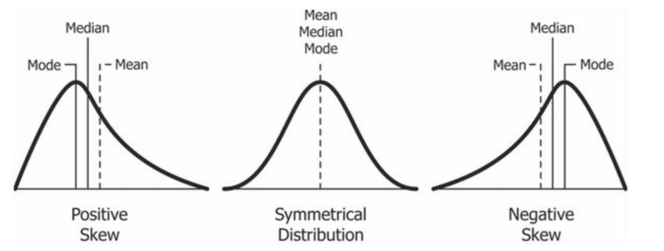
Basic Data Summarization Techniques (optional)
Measuring the asymmetry of data (skewness)
Skewness
The most common measure of the asymmetry in the values of an attribute of a dataset is the skewness.
An attribute with positive skewness has a few extremely large positive values relative to the central tendency of data as measured by attribute’s mean. Its histogram has a long tail toward large positive values.
An attribute with negative skewness has a few extremely large negative values relative to the central tendency of data as measured by attribute’s mean. Its histogram has a long tail toward large negative values.
Skewness can be negative or positive, just like the mean.

Slide 36
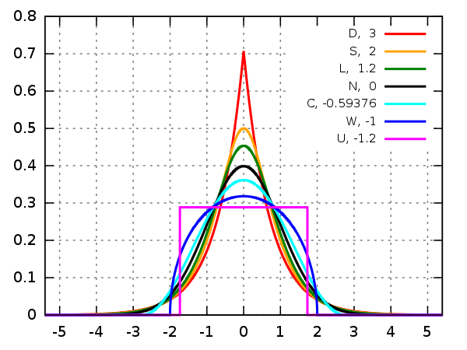
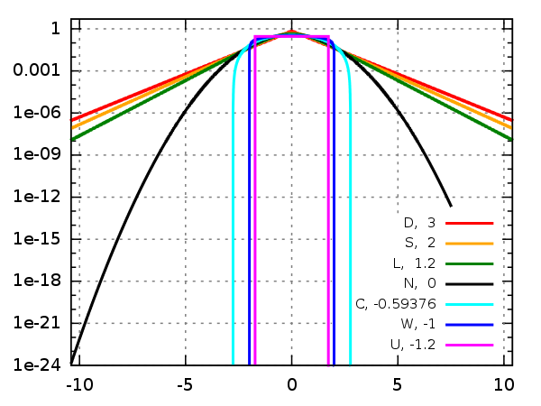

Basic Data Summarization Techniques (optional)
Measuring the tailedness of data (kurtosis)
(Excess-) Kurtosis
The most common measure of the (heavy-)tailedness of the values of an attribute of a dataset is the Kurtosis. Kurtosis is, by definition, a positive number, just like the variance.
Since the Normal distribution has a kurtosis of 3, Kurtosis is commonly normalized to 3 to obtain the excess kurtosis (with respect to the Normal distribution).
Higher kurtosis corresponds to greater extremity of deviations (or outliers) compared to the center of data.
An attribute with zero excess kurtosis are called mesokurtic (for example, Normally distributed).
A distribution with positive excess kurtosis is called leptokurtic, meaning that more outliers are present in the tails of data.
A distribution with negative excess kurtosis is called platykurtic, meaning that it has thinner tails (and fewer outliers in the tails).
Probability density functions for selected distributions with mean 0, variance 1 and different excess kurtosis.
Logarithms of probability density functions for selected distributions with mean 0, variance 1 and different excess kurtosis.

Slide 37

Basic Data Summarization Techniques

Slide 38

Time Series Data
A time series is a series of observations that are sequentially ordered. Typically, this order is determined by the times of observations.
Example Time Series data: The history of US Mortgage rates

Slide 39

Time Series Data
A time series is a series of observations that are sequentially ordered. Typically, this is order is determined by the times of observations.
Example Time Series data: Global temperature increase with a linear hypothesis

Slide 40

Correlation, Dependence, and Causation
Correlation is a statistical concept, typically quantified by a real number between -1 and 1, that represents the amount of co-variation of two random variables with each other.
NOTE: Correlation does NOT necessitate causation.
NOTE: Lack of (linear) correlation does NOT mean independence.
Correlations could be linear or non-linear

Slide 41

Correlation, Dependence, and Causation
Correlation is a statistical concept, typically quantified by a real number between -1 and 1, that represents the amount of co-variation of two random variables with each other.
NOTE: Correlation does NOT necessitate causation.
Correlations could be linear or non-linear

Slide 42
Time Series Data
A time series is a series of observations that are sequentially ordered. Typically, this is order is determined by the times of observations.
Example Time Series data: Global temperature increase with an exponential hypothesis

Slide 43

Correlation, Dependence, and Causation
Correlation is a statistical concept, typically quantified by a real number between -1 and 1, that represents the amount of co-variation of two random variables with each other.
NOTE: Correlation does NOT necessitate causation.
Examples of correlation but no causation:
Internet Explorer usage and Murder Rate in the US

Slide 44

Correlation, Dependence, and Causation
Correlation does NOT necessitate causation.
Eating more chocolate leads to winning more Nobel Prizes! Wrong

Slide 45

Correlation, Dependence, and Causation
Correlation does NOT necessitate causation.
Drinking more milk leads to winning more Nobel Prizes! Wrong

