Slide 1

An Industry Oriented Mini Project Presentation On Crime Pattern Detection, Analysis & Prediction Through Machine Learning
By MIRZA YASSER ALI BAIG (21WJ1A6642)
SYED AFFAN AHMED (21WJ1A6653)
MOHAMMED SHAHNAWAZ (22WJ5A6603)
Under the Esteemed Guidance of
Dr. S. Madhu (Professor & HOD CSE(AIML))
Guru Nanak Institutions Technical Campus (Autonomous)

Slide 2
OVERVIEW of the Presentation:-
Abstract
Introduction
Literature survey
Existing System
Proposed System
System Requirements
System Architecture
Methodologies
Technologies
Data Flow Diagrams
Conclusion

Slide 3
ABSTRACT:
Objective: The project aims to analyze crime patterns, predict dangerous hotspots, and assist in enhancing public safety.
Dataset: Data is sourced from the Toronto Police Service's Public Safety Portal, including columns like occurrence date, type of offense, and neighborhood.
Techniques Used:
Visualization, clustering, and time-series forecasting.
Classification models such as Random Forest.
Clustering using K-Means and PCA for better accuracy and performance.
Outcome: Helps authorities focus on high-risk areas, enables better resource planning, and raises public awareness of safety.

Slide 4
INTRODUCTION:
Importance of Crime Prediction:
Crimes affect societal quality of life and economic growth.
Crime analysis helps in deciding which neighborhoods to avoid or monitor.
Role of Technology:
AI/ML algorithms eliminate human errors and improve identification and prediction accuracy.
Predictive policing schedules officers based on crime predictions.
Goals:
Identify high-crime neighborhoods and times.
Enhance public knowledge about safety.
Use automation to simplify analysis, freeing up resources for innovation.

Slide 5
LITERATURE SURVEY-I:
Title: Crime Data Visualization and Forecasting Analysis with Big Data Technology
Author: Mingchen Feng et al.
Key Points:
Exploratory Data Analysis: Applied to forecast and predict crime trends.
Visualization Techniques: Improve understanding of past crime data for better future predictions.
Effective Models: Prophet and LSTM models achieved superior performance in predicting crime trends.
Decision-Making Aid: Visualized trends assist law enforcement in strategic planning and decision-making.

Slide 6
LITERATURE SURVEY-II:
Title: Spatiotemporal Crime Forecasting Using STL
Author: Abish Malik et al.
Key Points:
Forecasting with STL: Utilizes Seasonal Trend Decomposition using Loss (STL) for crime data analysis.
Crime Prediction: Provides predicted levels of future crime while analyzing past data to reduce crime rates.
Investigative Application: Useful for crime bureau and investigative sectors.
Spatiotemporal Analysis: Highlights its importance in understanding and predicting crime patterns.

Slide 7
LITERATURE SURVEY-III:
Title: Crime Data Analysis and Visualization Techniques
Author: Safiya Mohd, Hithasri Muthyala
Key Points:
Forecasting with SARIMA: Applies the SARIMA algorithm to analyze seasonal and trend components in crime data.
Visualization Tools: Utilizes heat maps and trend lines for effective crime data representation.
Crime Reduction: Aims to aid law enforcement in analyzing past incidents to mitigate future crimes.
Data Normalization: Highlights its importance in enhancing model performance and reducing computational complexity.

Slide 8
EXISTING SYSTEM:
Traditional Crime Analysis Systems:
Focus on reactive rather than preventive policing.
Lack tools for predicting crime locations or times.
Dependence on static historical data, ignoring dynamic factors like urban growth.
Results are often inaccurate due to outdated or manual methods.
Inefficient and error-prone processes require significant time and manpower.
Limited visualization hampers understanding of crime patterns and resource deployment.

Slide 9
PROPOSED SYSTEM:
Features of the Proposed System
AI/ML Algorithms: Analyze and predict crime patterns with high accuracy.
Automation: Automates data processing, minimizing manual effort and errors.
Predictive Policing: Identifies crime-prone areas, times, and types to prevent crimes effectively.
Analytical Techniques Used
Clustering and Visualization: Detects crime hotspots and patterns.
Time-Series Forecasting: Uses ARIMA and SARIMA models to predict temporal crime trends.
Classification Models: Predicts crime categories with models like Random Forest.

Slide 10
PROPOSED SYSTEM:
Benefits of the Proposed System
Optimized Law Enforcement: Enables efficient deployment of resources in high-risk areas.
Public Awareness: Provides actionable insights for individuals to ensure their safety.
Enhanced Decision-Making: Assists authorities in planning preventive measures.
Technological Advantages
PCA Integration: Improves clustering efficiency and processing speed.
Interactive Interface: Facilitates easy access to safety insights for both public and law enforcement.
Error Reduction: AI-driven analysis eliminates human errors in crime prediction.

Slide 11
SOFTWARE REQUIREMENTS
BACK END: PYTHON
OPERATING SYSTEM:
WINDOWS 7
IDE: Spider3

Slide 12
HARDWARE REQUIREMENTS
PROCESSOR: Pentium i3 Processor
RAM: 2GB DD RAM
HARD DISK :250 GB

Slide 13
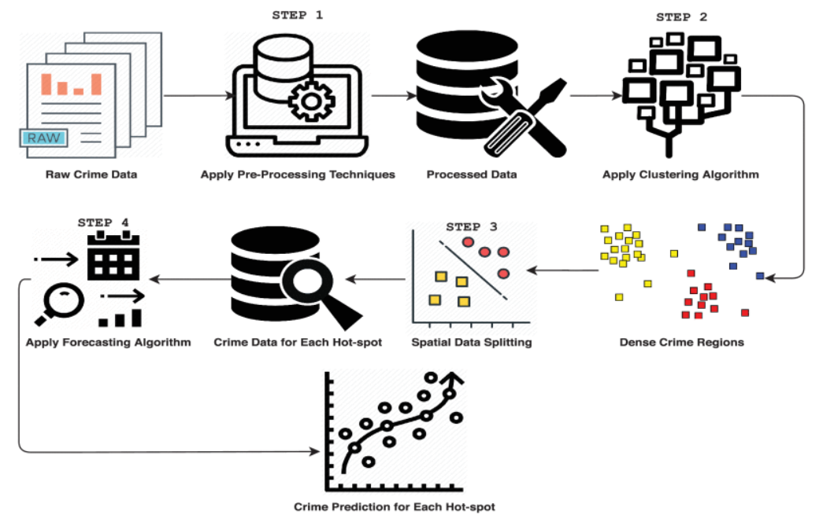
SYSTEM ARCHITECTURE:

Slide 14
METHODOLOGIES:
MODULES NAMES:
Data gathering
Classification / Clustering
Prediction/ forecasting
Exploratory Data Analysis

Slide 15
METHODOLOGIES:
MODULES EXPLANATION
1. Data Gathering
Collect structured datasets from verified sources like government crime records or public datasets.
Data preprocessing includes cleaning, handling missing values, and normalizing the data for consistency.
Tools used: Python libraries like Pandas, NumPy, and OpenCV (for image-based crime records).
2. Classification/Clustering
Clustering: Use K-Means Clustering to identify spatial crime hotspots by grouping similar areas based on crime frequency and type.
Classification: Apply Logistic Regression or Random Forest classifiers to categorize crimes into pre-defined types like theft, assault, etc.
Feature selection ensures relevant variables (e.g., location, time, and offense type) are considered.

Slide 16
METHODOLOGIES:
MODULES EXPLANATION
3. Prediction/Forecasting
Time Series Analysis: Use models like ARIMA (AutoRegressive Integrated Moving Average) or SARIMA (Seasonal ARIMA) to predict crime trends over time.
Identify seasonal patterns (e.g., increased theft during holidays) and temporal crime spikes.
Incorporate weather, demographic, and economic data for higher accuracy.
4. Exploratory Data Analysis
Integrate the outcomes of clustering and forecasting into an actionable prediction model.
Use visualizations like heatmaps, bar charts, and temporal graphs to represent crime trends effectively.
Employ decision-making models for recommendations (e.g., deploying police resources).

Slide 17
TECHNIQUES:
EXISTING TECHNIQUE:
1. Traditional Statistical Methods
Description: Rely on historical crime data to identify patterns and trends.
Techniques Used:
Linear Regression
Descriptive Analytics (mean, median, mode of crime rates)
Limitations:
Lack of predictive capabilities.
Unable to handle large datasets efficiently.

Slide 18
TECHNIQUES:
EXISTING TECHNIQUE:
2. Manual Crime Mapping
Description: Visual representation of crime data using tools like GIS (Geographic Information Systems).
Techniques Used:
Mapping crime hotspots based on historical data.
Limitations:
Time-intensive and prone to human error.
No real-time updating capabilities.

Slide 19
TECHNIQUES:
PROPOSED TECHNIQUE :
1. K-Means Clustering
Purpose: To identify spatial crime hotspots by clustering crime data based on geographic coordinates.
How It Works:
Partitions the data into a predefined number of clusters (e.g., 3 clusters).
Assigns each data point to the nearest cluster center (centroid).
Iteratively updates the centroids to minimize the variance within clusters.
Use Case in Your Project: Clustering crimes based on latitude and longitude to identify high-crime areas.
2. Principal Component Analysis (PCA)
Purpose: To reduce the dimensionality of the data while retaining as much variability as possible.
How It Works:
Converts correlated features into a set of linearly uncorrelated components.
Orders components by the amount of variance they capture.
Selects the top components to represent the dataset in fewer dimensions.
Use Case in Your Project: Reduces the complexity of spatial data for clustering visualization.

Slide 20
TECHNIQUES:
PROPOSED TECHNIQUE :
3. ARIMA (AutoRegressive Integrated Moving Average)
Purpose: To forecast crime trends over time using time series data.
How It Works:
AutoRegressive (AR): Models the relationship between a variable and its past values.
Integrated (I): Differencing the data to make it stationary (removing trends).
Moving Average (MA): Models the relationship between a variable and past errors.
Use Case in Your Project: Predicting future crime counts based on historical data.
4. SARIMA (Seasonal ARIMA)
Purpose: An extension of ARIMA that accounts for seasonality in the data.
How It Works:
Incorporates seasonal terms in the ARIMA model to handle patterns repeating over time (e.g., monthly trends).
Use Case in Your Project: Captures seasonal crime trends, such as increased crimes during holidays or specific months.

Slide 21
DATA FLOW DIAGRAM:
Data Collection
Data Pre-processing
Model Training and Evaluation
Clustering (Hotspot)
Exploratory Data Analysis (EDA)

Slide 22
DATA FLOW:
Data Collection :
Data sourced from the Toronto Police Service - Public Safety Portal.
Contains columns such as occurrence date, month, reporting date, neighborhood, type of offense, and Major Crime Indicators (MCI).
Helps extract meaningful insights for police and public safety.
Identifies dangerous neighborhoods requiring more focus from police agencies.

Slide 23
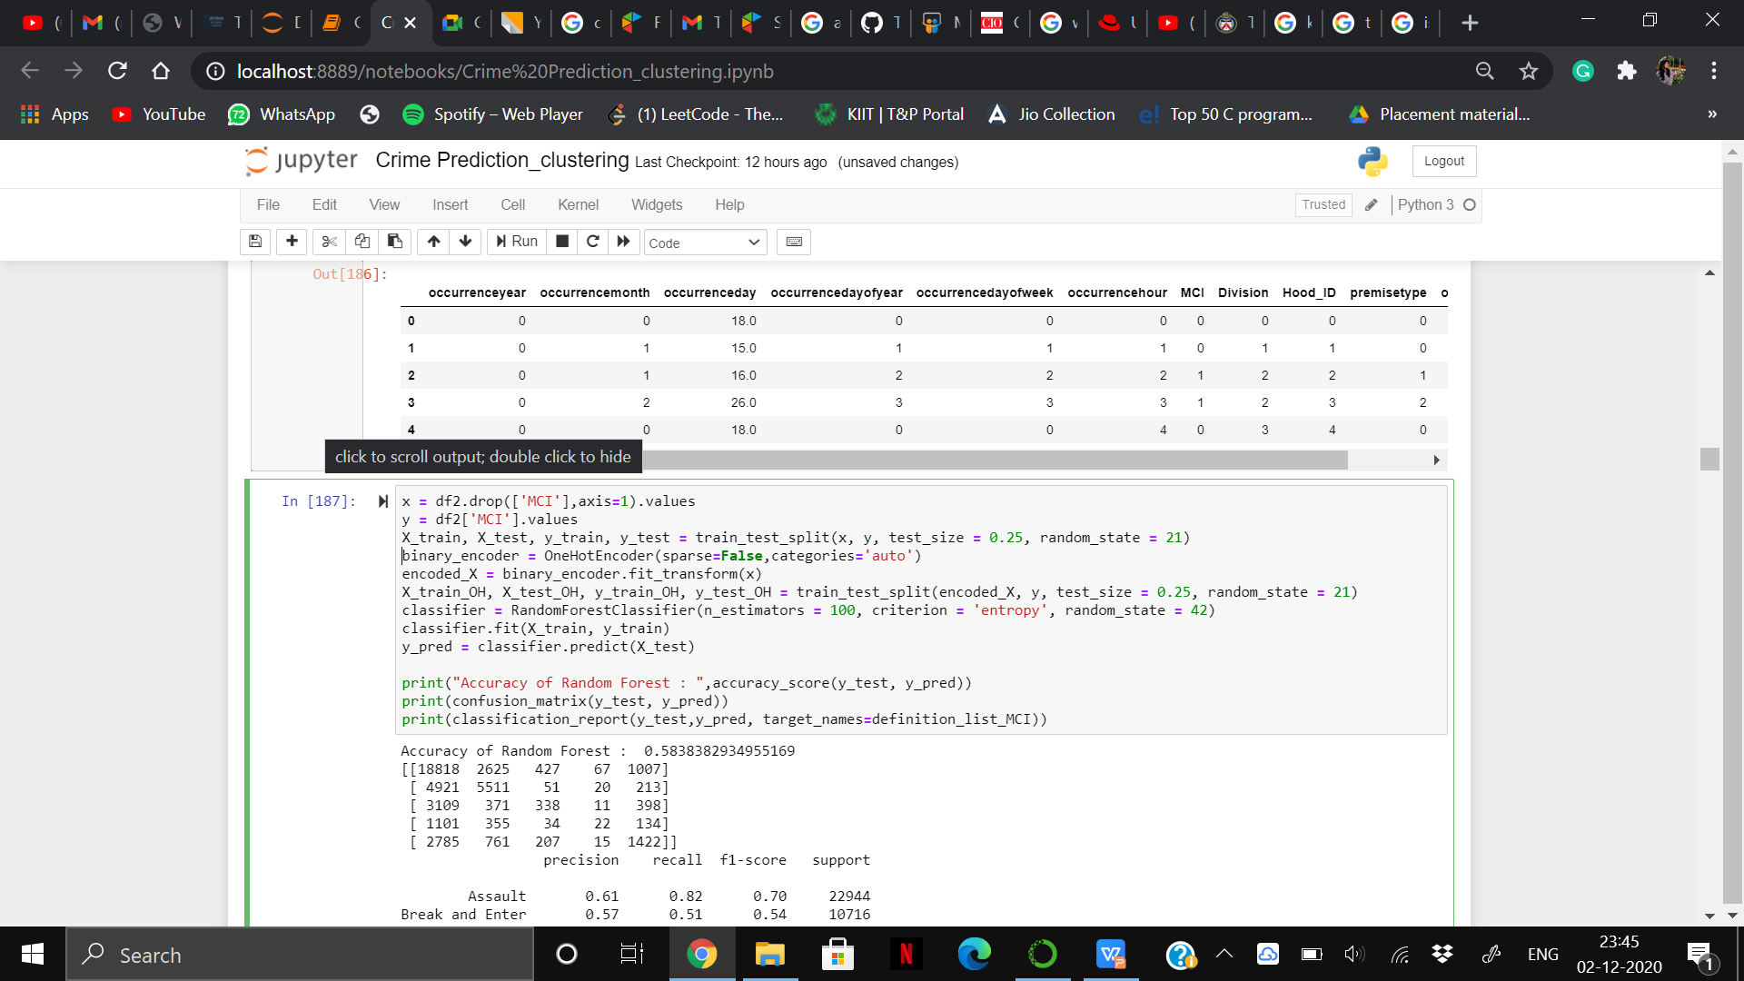
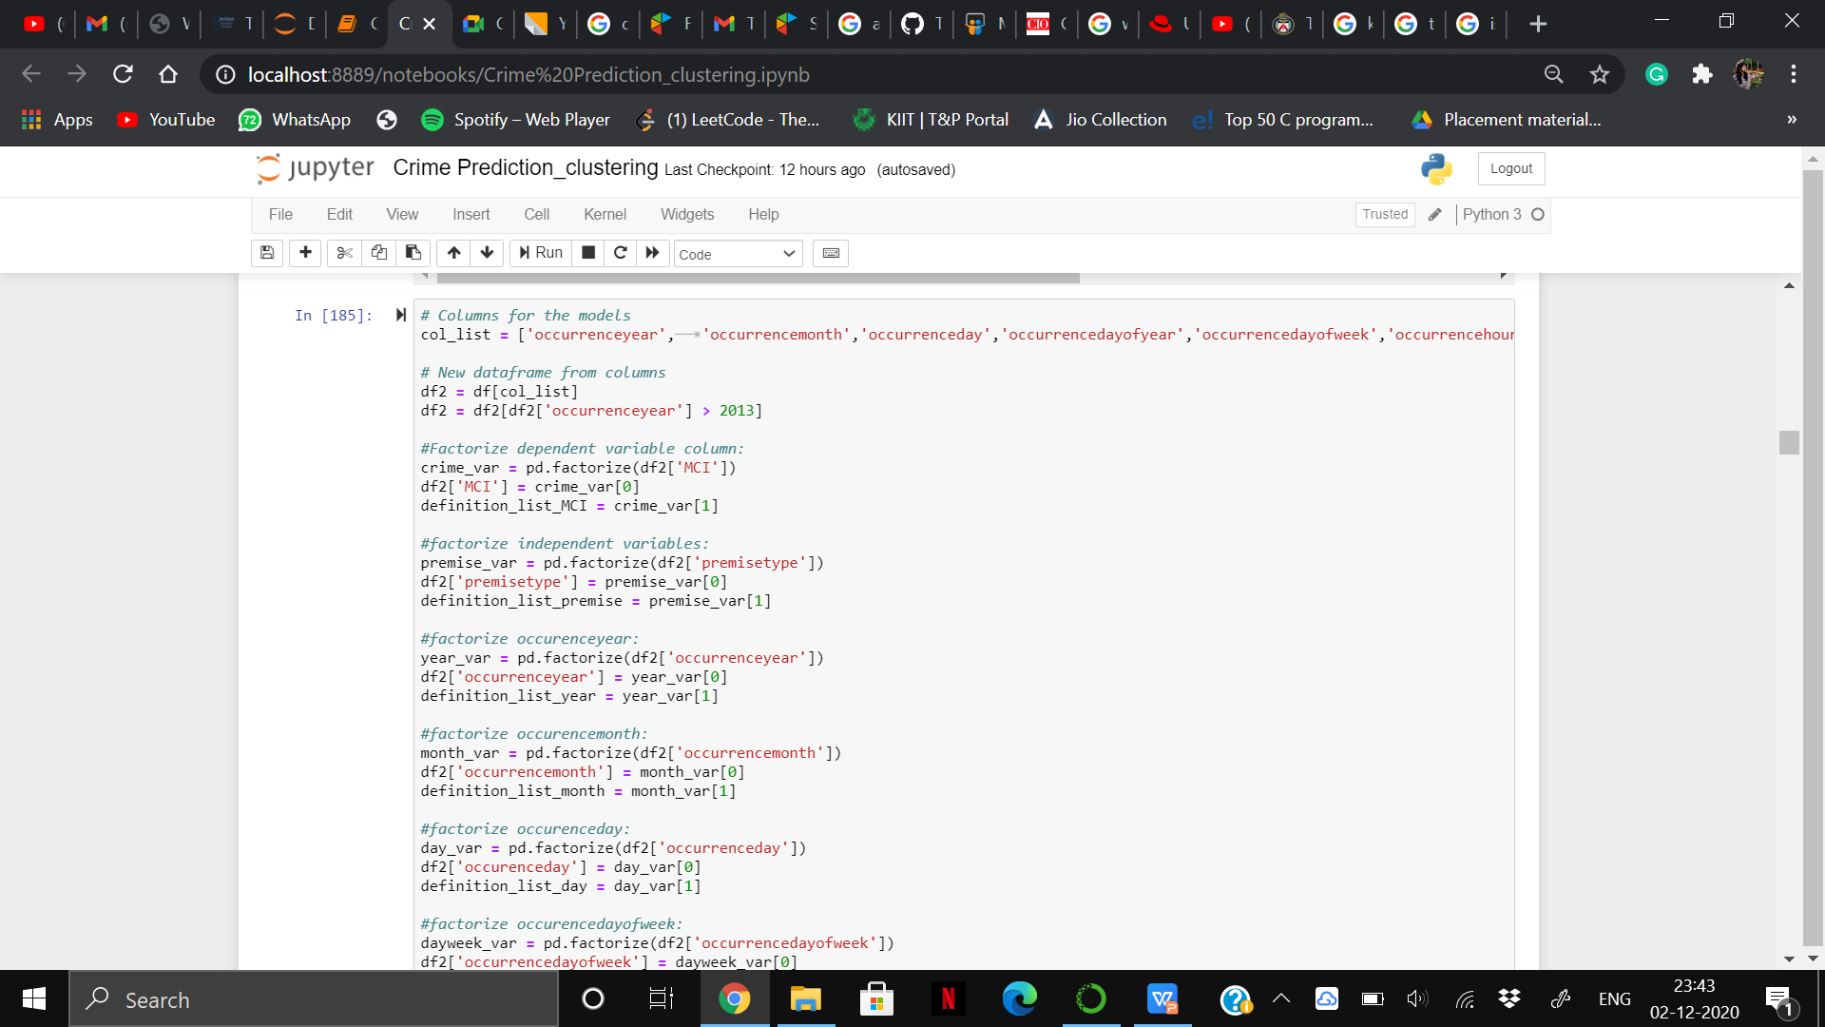
DATA FLOW:
Data Pre-processing:
Removed duplicates and irrelevant columns such as X, Y coordinates, NeighborhoodID, ReportDayOfWeek, etc.
Utilized grouping techniques for data visualization.
Factorized independent and dependent variables for classification.
Applied OneHotEncoder() to X variables for input into the classification model.
Considered crimes after December 2014 due to insufficient data before that period.

Slide 24
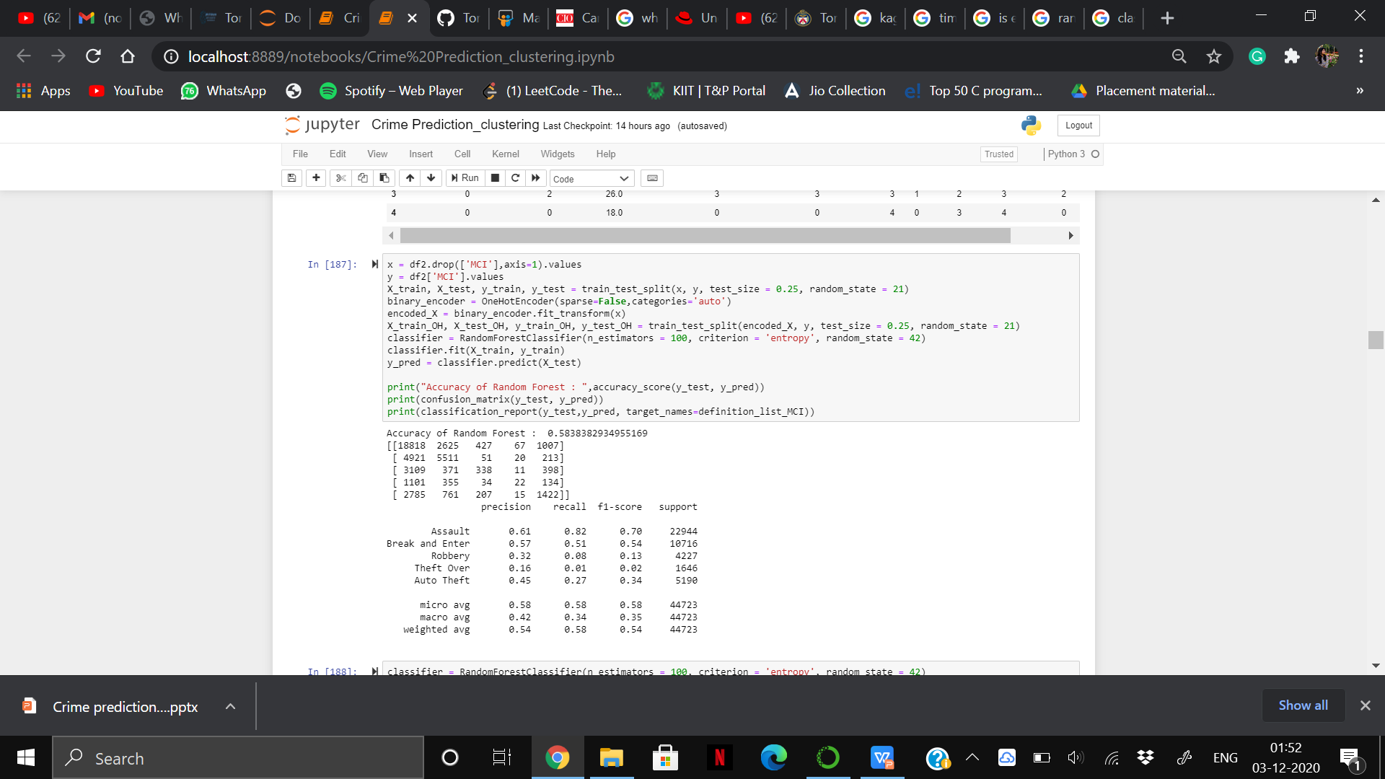
DATA FLOW:
Classification :
Predictive modeling used to assign class labels to input data.
Random Forest Classification algorithm was used in this project.
It constructs multiple decision trees during training.
The final output is based on the mode or mean prediction of individual trees.
Achieved an accuracy of 58.38%.

Slide 25
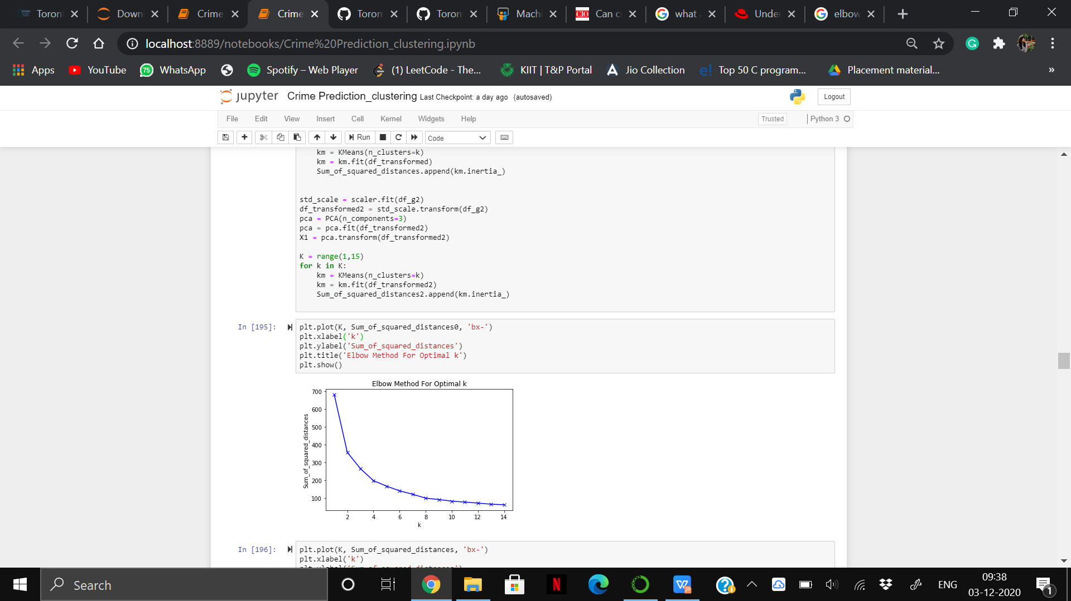
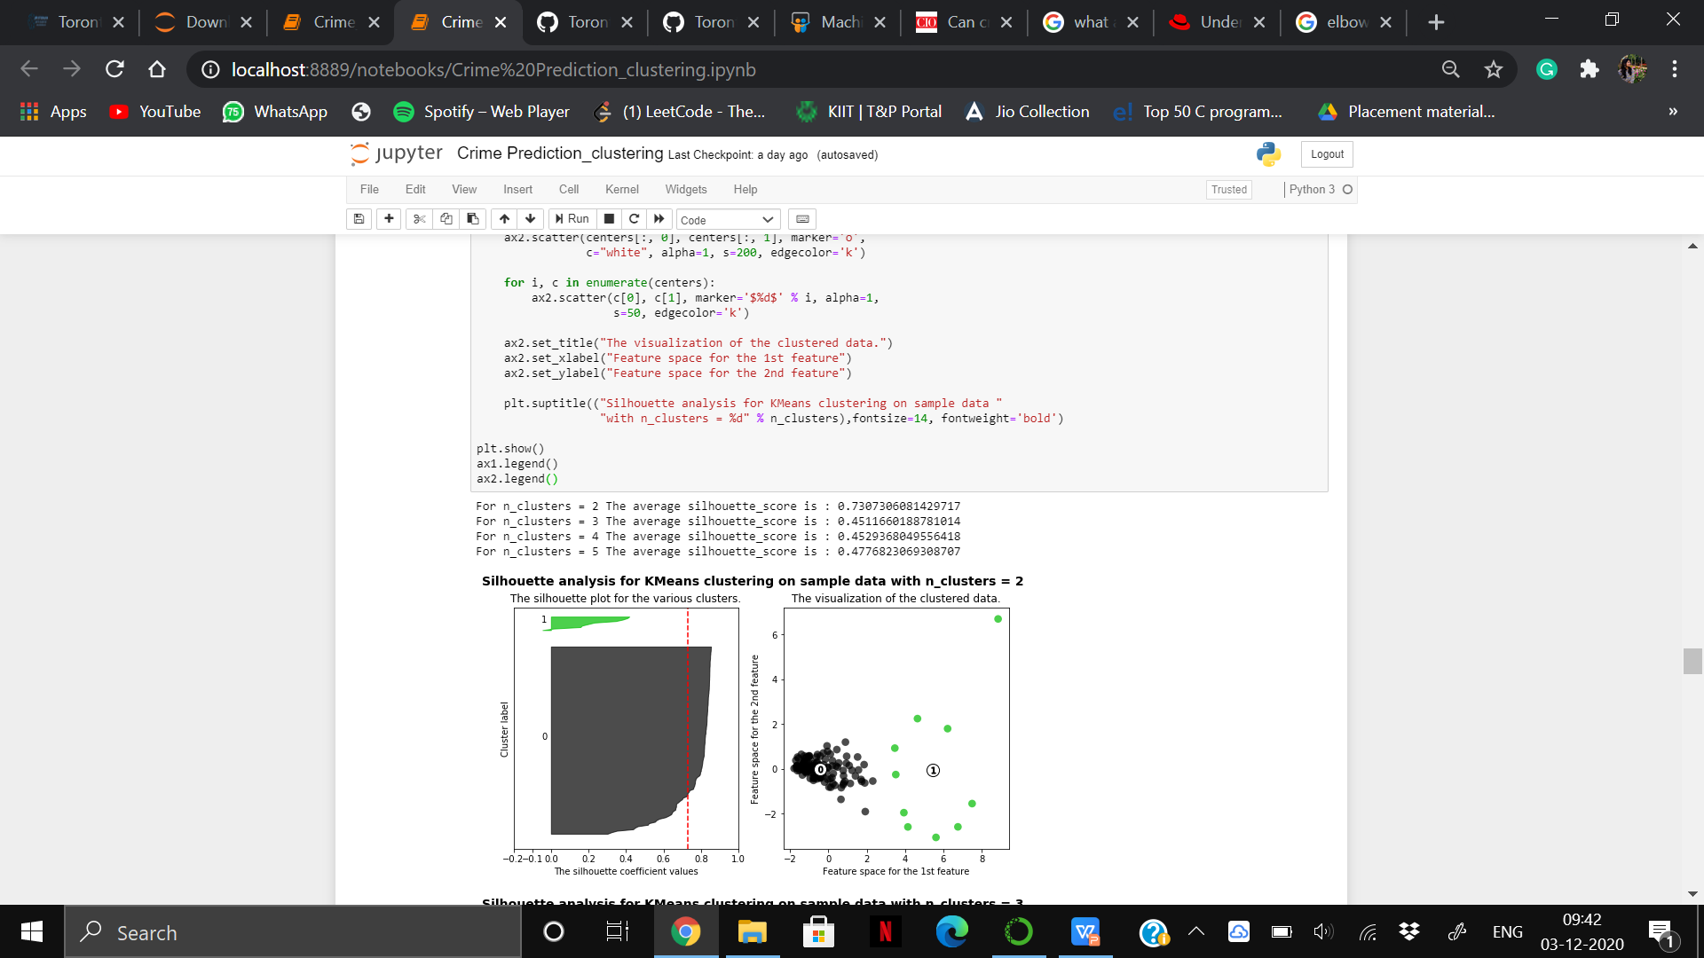
DATA FLOW:
Clustering:
Clustering is an unsupervised machine learning technique that discovers natural groupings in data.
Used K-Means Clustering to partition the dataset into k clusters.
In K-Means, each observation belongs to the cluster with the nearest mean (centroid).
Applied the Elbow Method to determine the optimal number of clusters.
Visualized the clustered data and created a Silhouette Plot for different clusters.
The analysis highlights Crime Neighbourhoods using K-Means clustering.

Slide 26
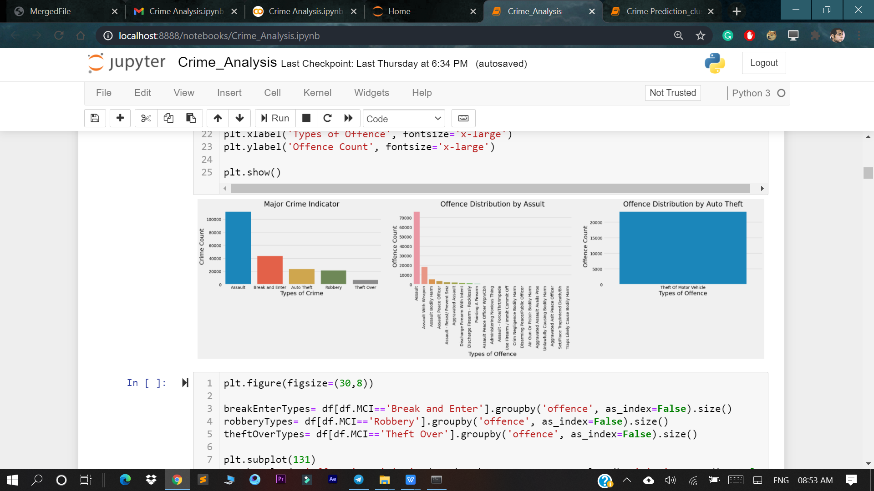
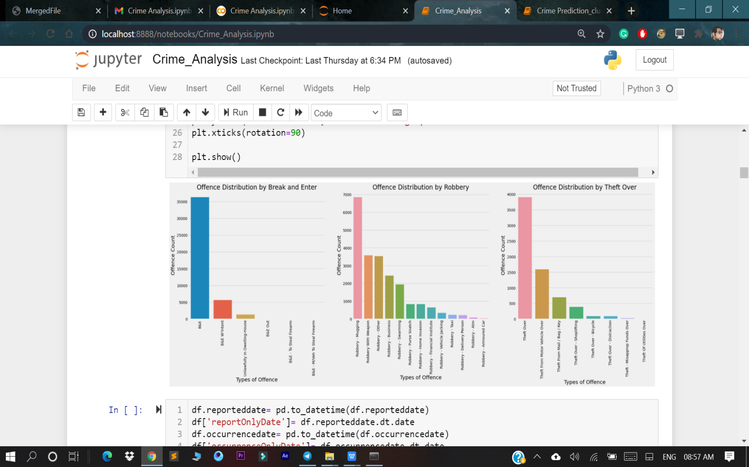
EXPLORATORY DATA ANALYSIS

Slide 27
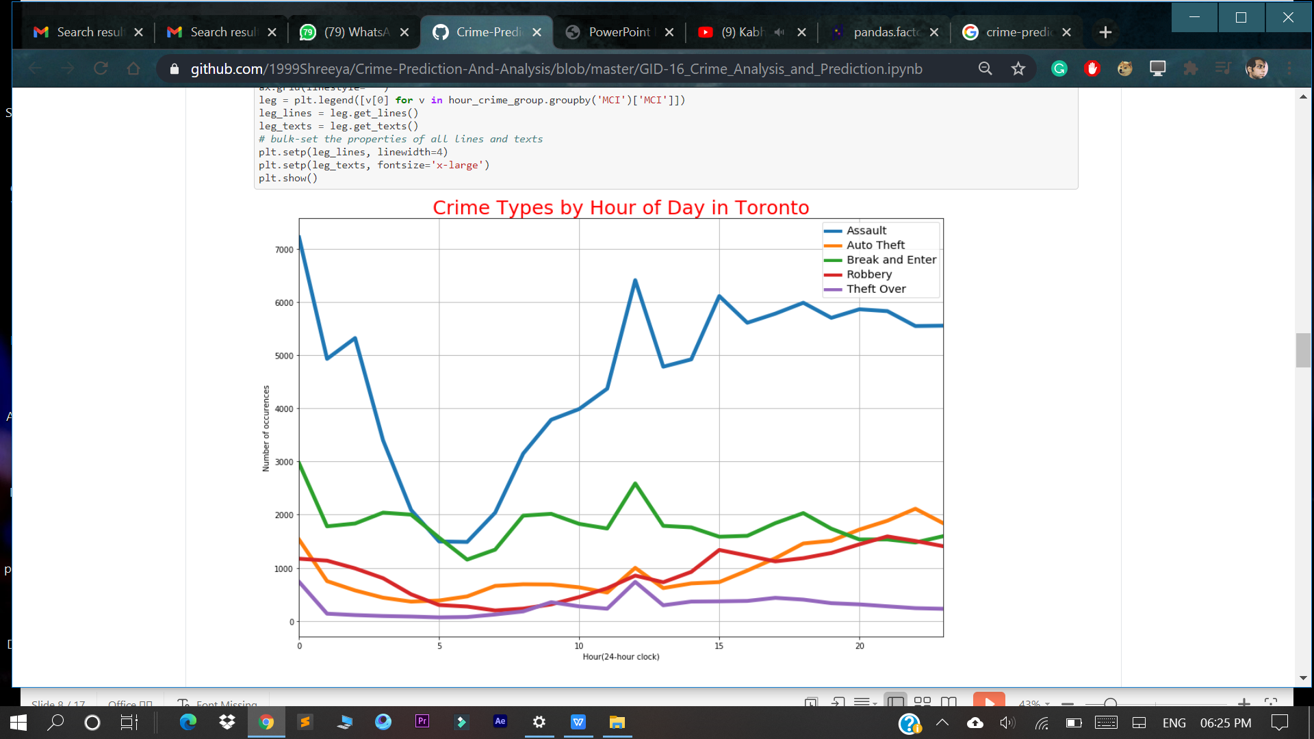
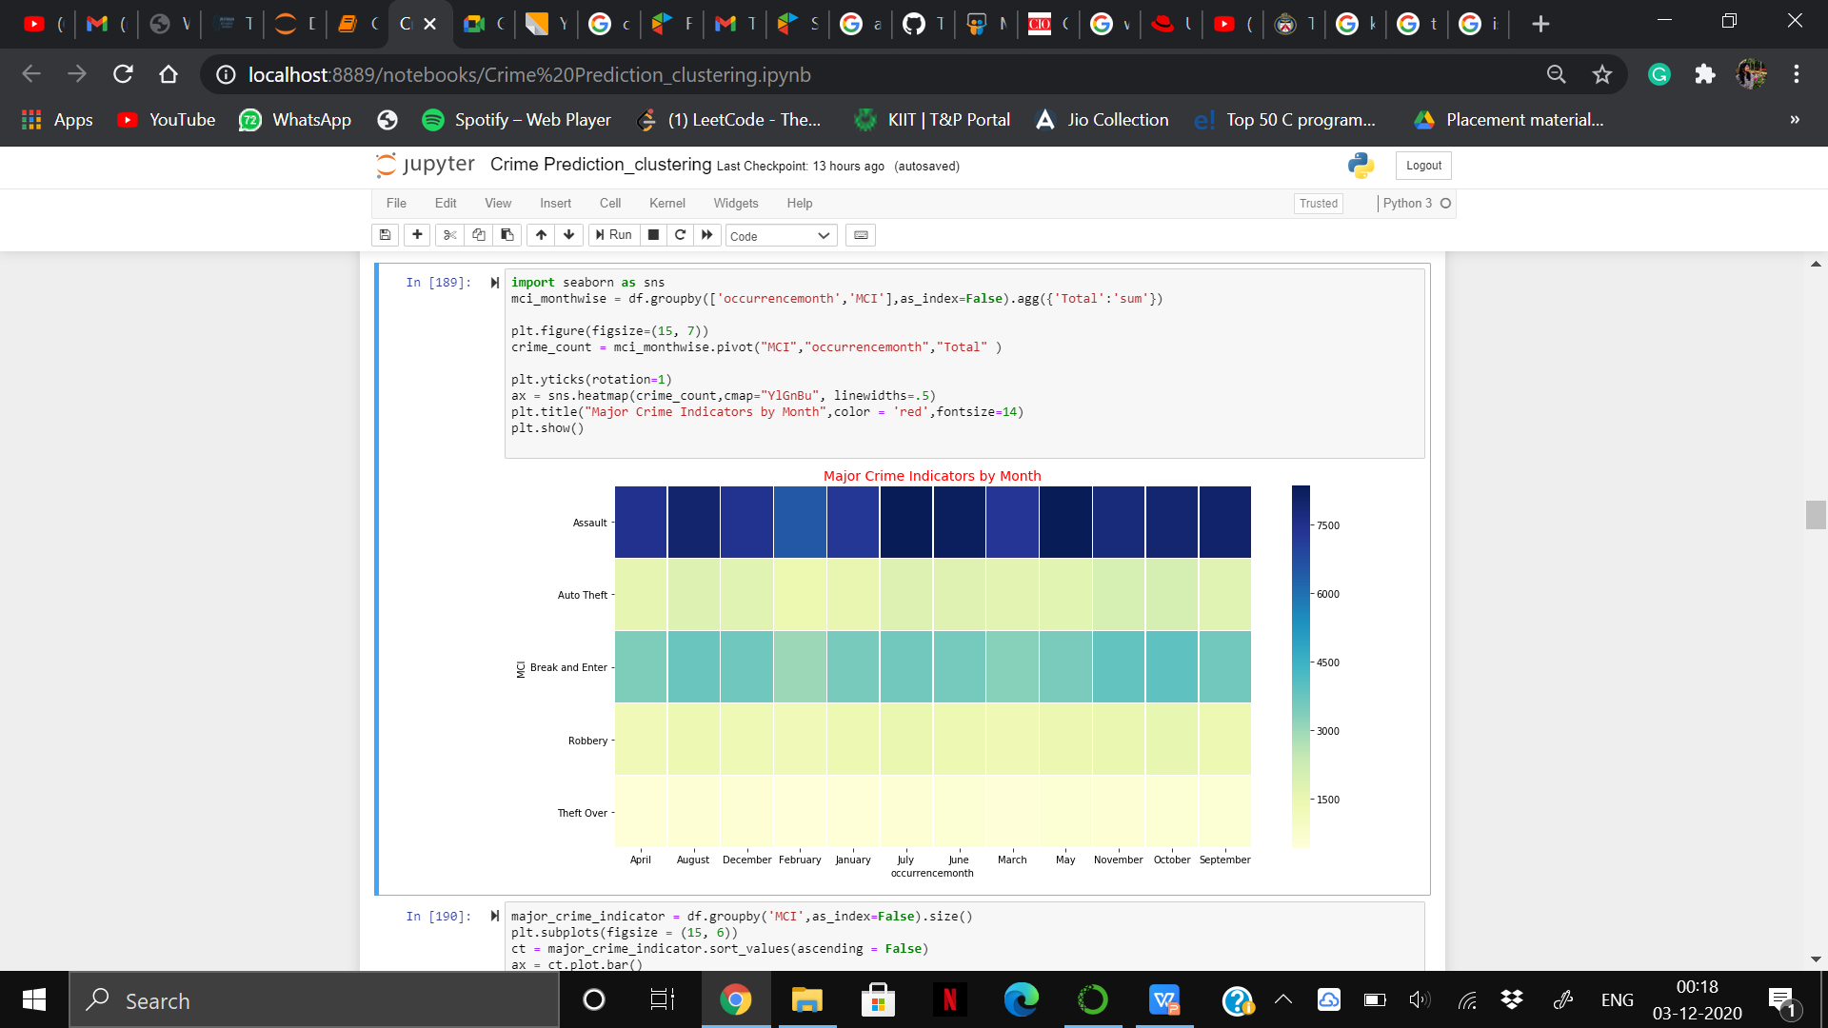
EXPLORATORY DATA ANALYSIS

Slide 28
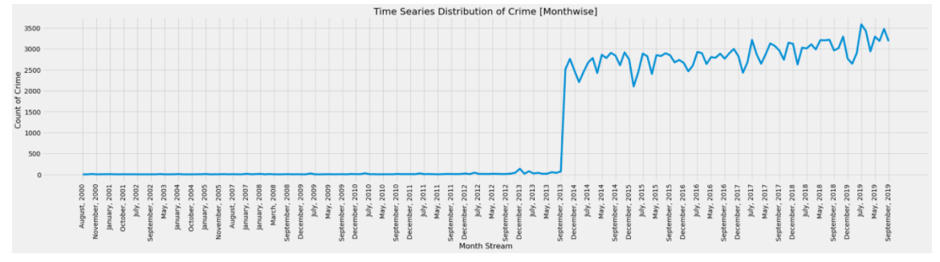
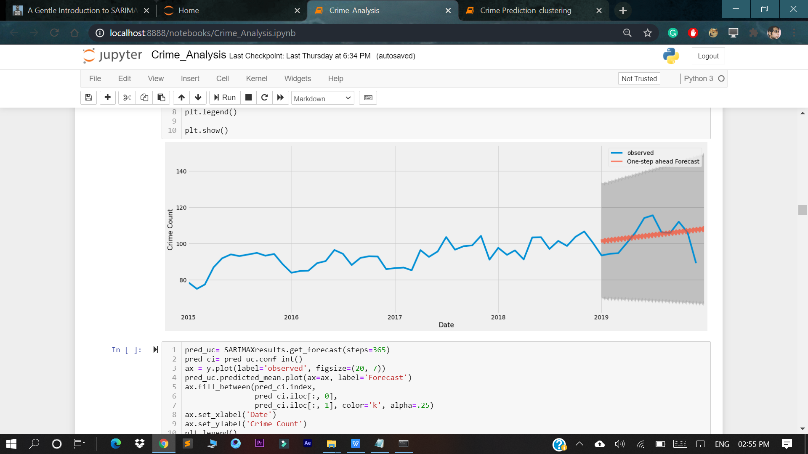
EXPLORATORY DATA ANALYSIS

Slide 29
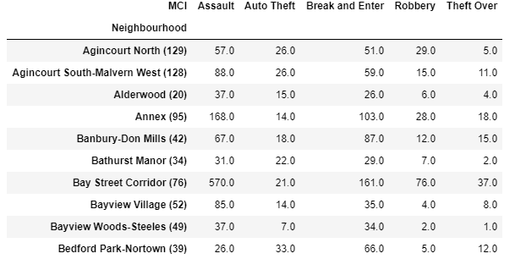
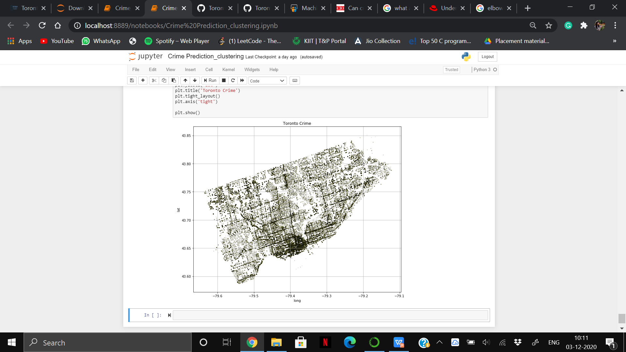
CRIME MAPPING
Places of high-density of crime
Result after grouping Neighbourhood
with MCI

Slide 30
CONCLUSION
The spatial analysis of crime in Toronto links neighbourhood characteristics to higher crime rates.
The analysis shows how certain neighbourhood characteristics are linked to higher crime rates.
This study helps in identifying crime hotspots and predicting dangerous areas at specific times and places.
It assists in planning and implementing safety measures to prevent antisocial activities in the community.
Future goals:
Identify crime perpetrators and understand their motives.
Predict future crime hotspots in more cities.

