Slide 1
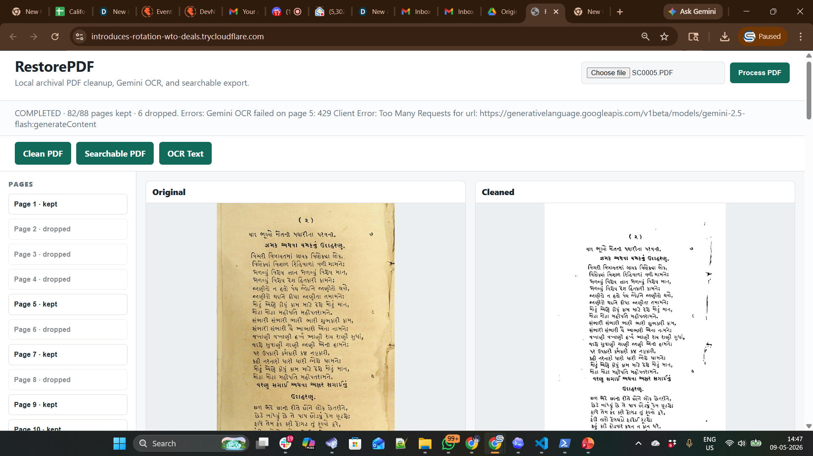

Slide 2
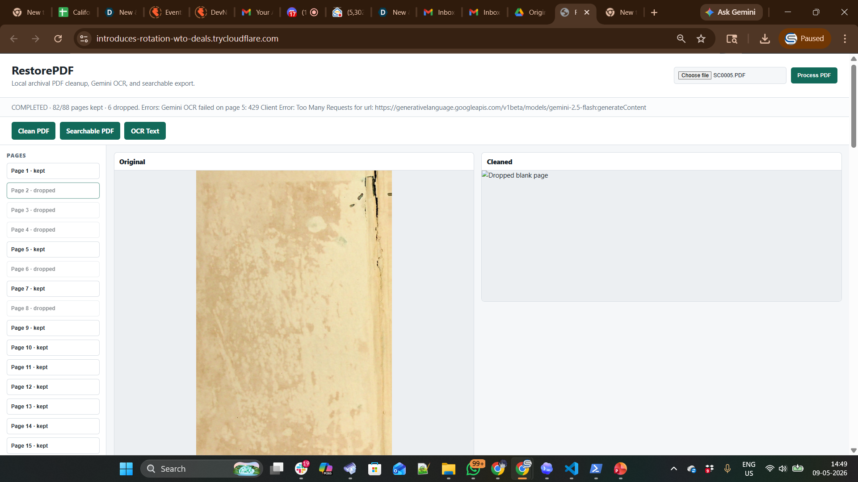

Slide 3
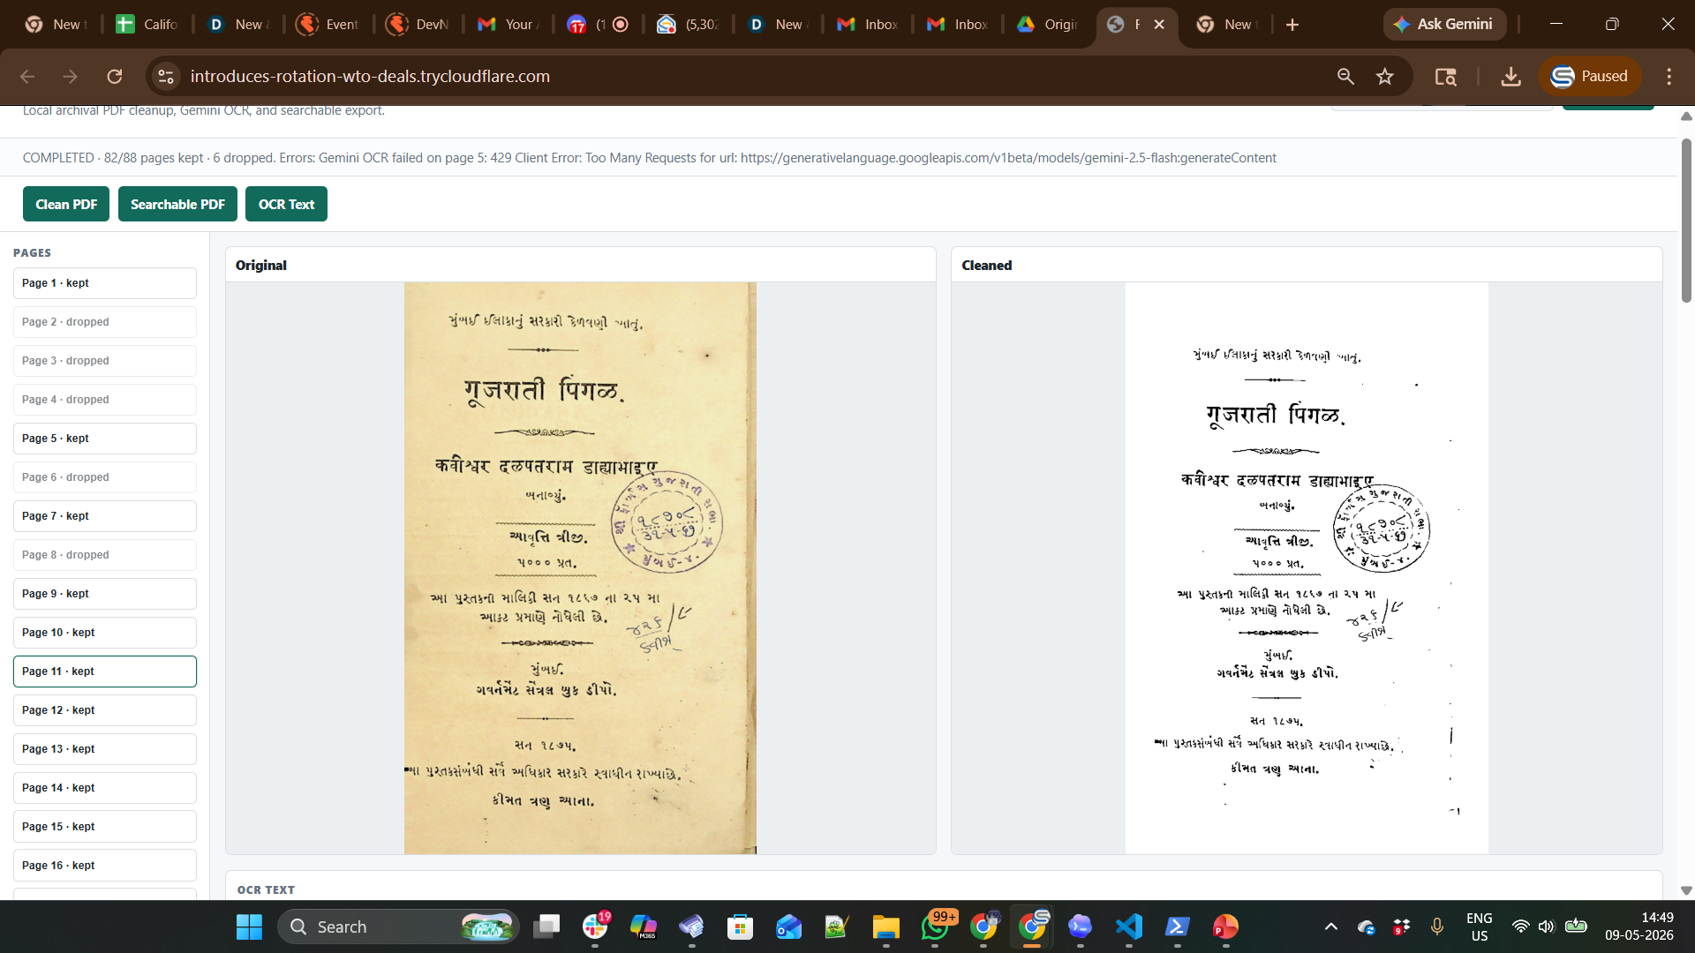
Notes:
Stamp is reatiend

Slide 4
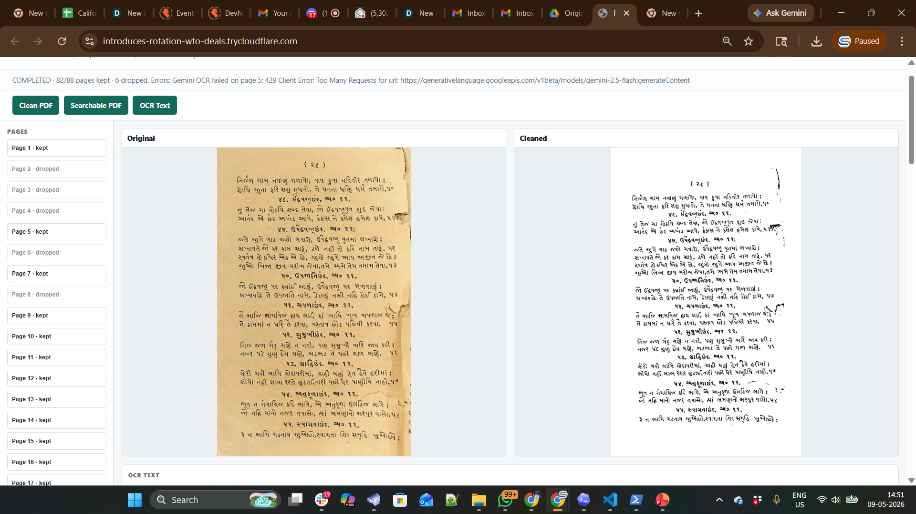

Slide 5
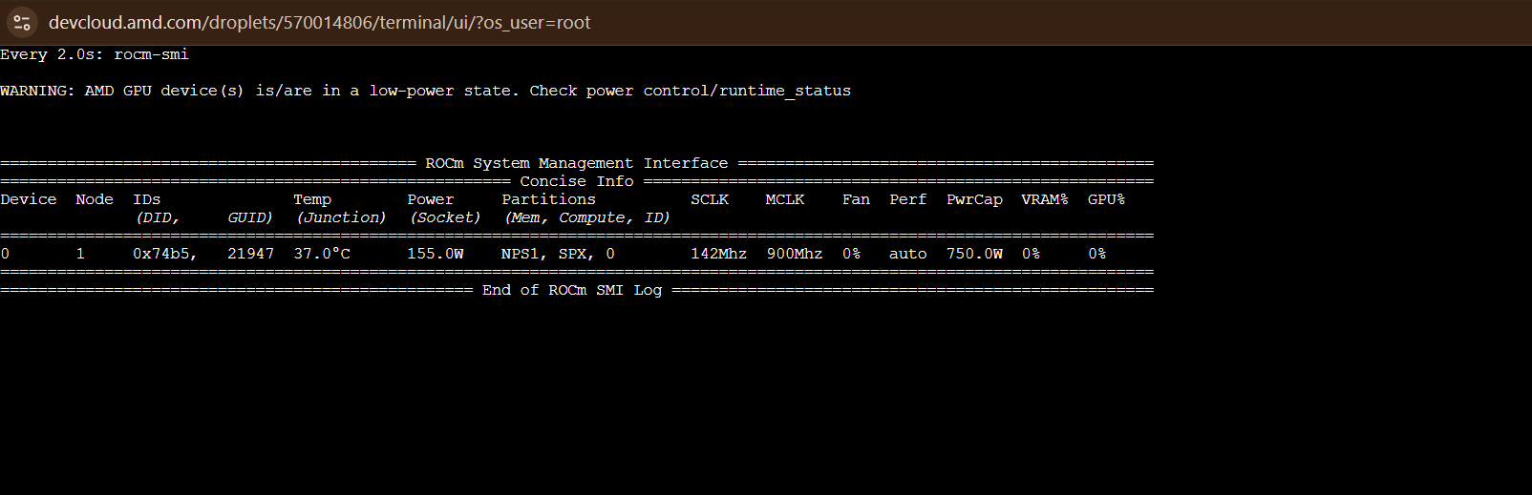

Slide 6
New code to remove / count Stamp
New behavior:
The backend detects circular stamp-like regions.
If a detected stamp does not overlap text/content, it attempts automatic removal with inpainting.
If a stamp overlaps text, the page is flagged as needing manual cleanup.
The portal now shows an Overlapping Stamps button/panel listing page numbers that need manual stamp cleanup.
Those pages are also labeled stamp review in the page list.
Current AMD public URL changed after redeploy:
https://districts-television-husband-respectively.trycloudflare.com

Slide 7
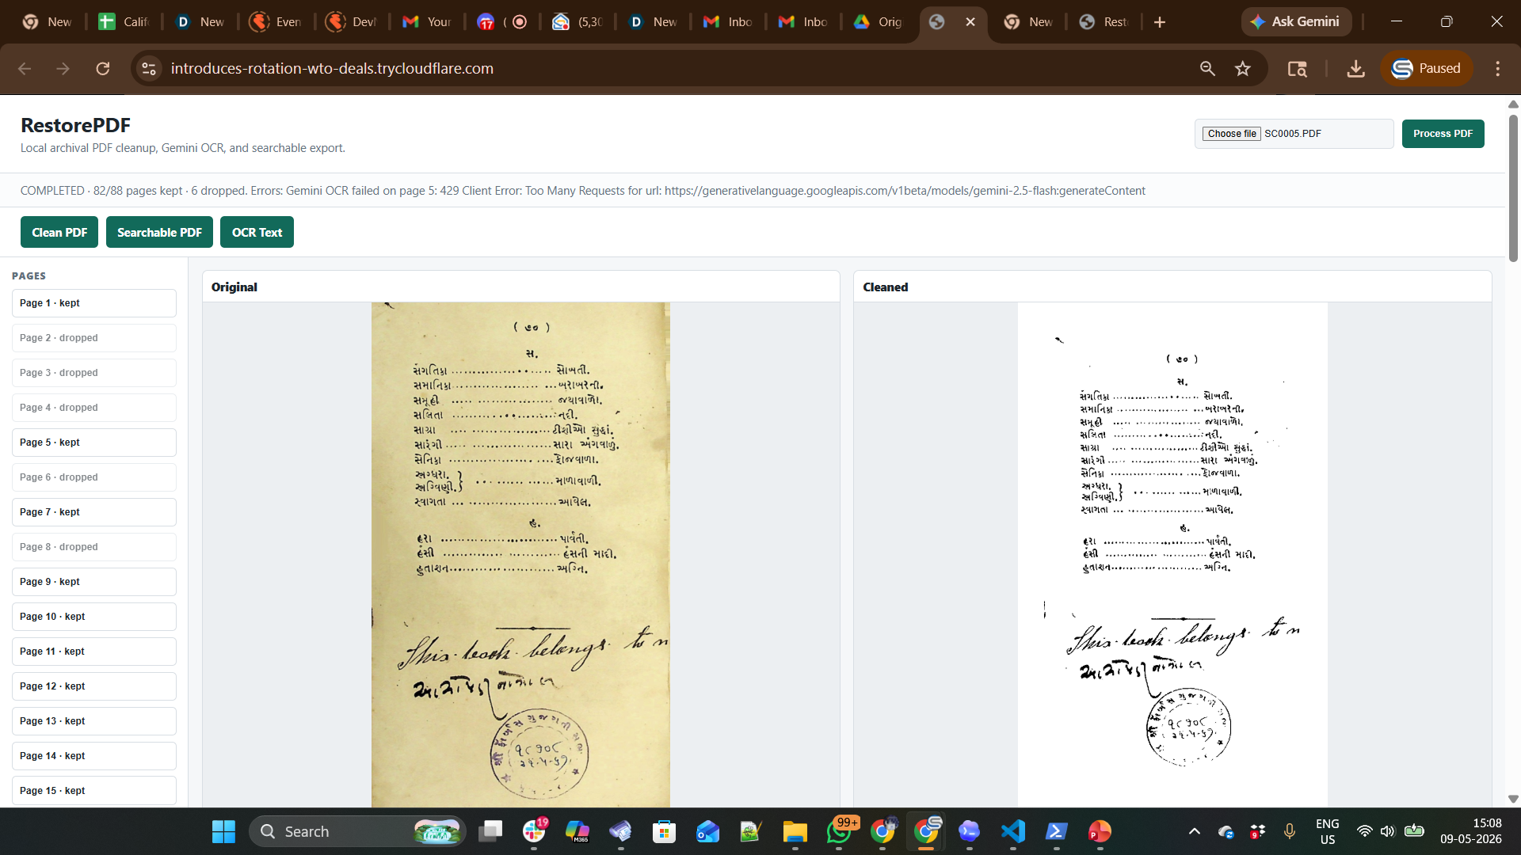
Before

Slide 8
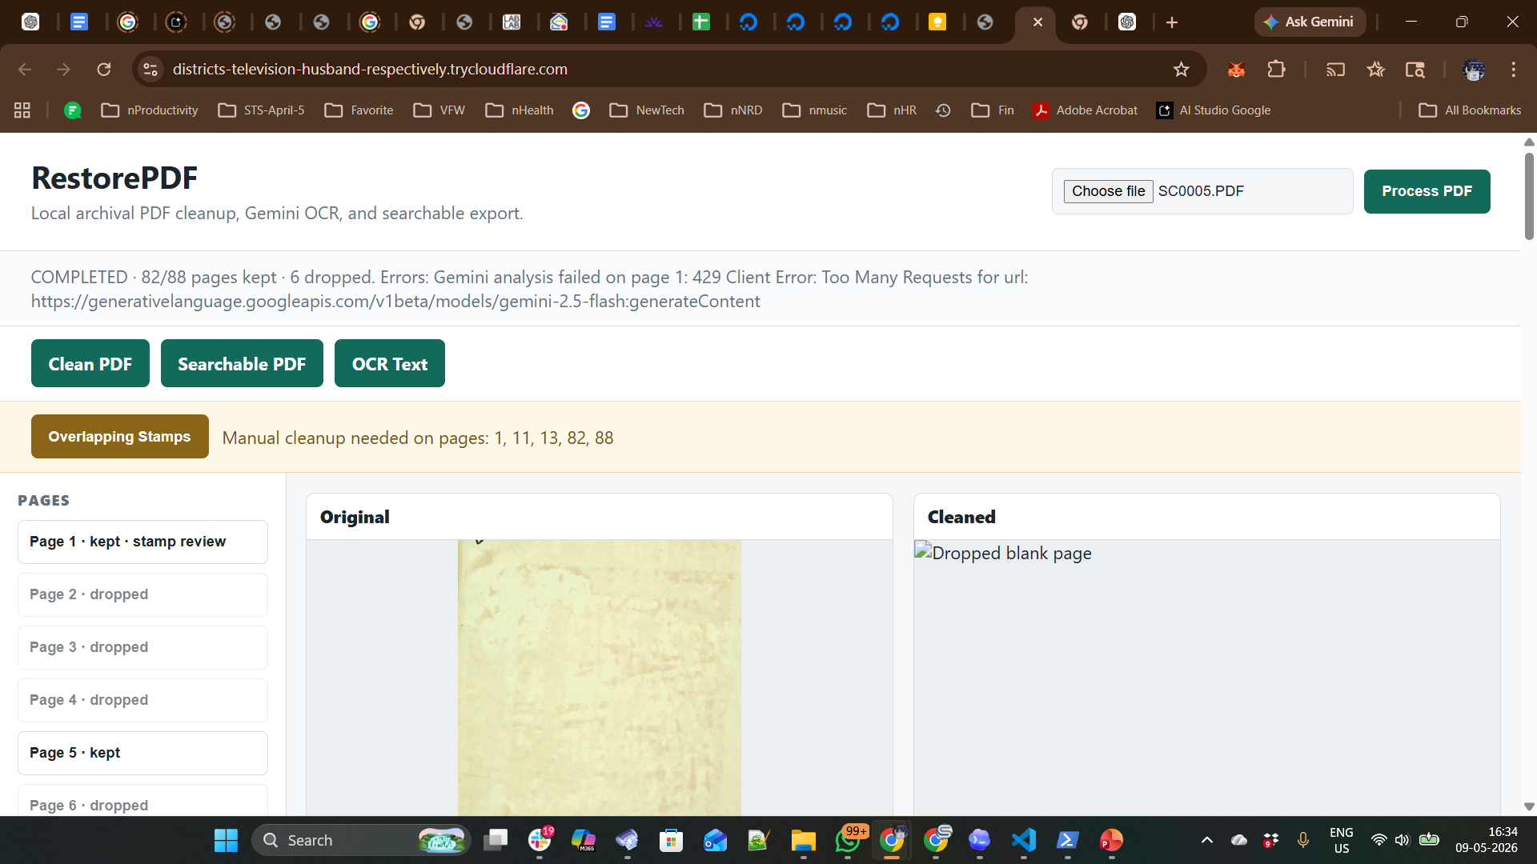
After

Slide 9
