Slide 1
Superstore Dashboard Summary
Visualizing Key Business Metrics with Power BI

Slide 2
Key Performance Indicators (KPIs)
- Total Sales: 168.45K
- Total Profit: 14.63K
- Total Customers: 793
- Total Items Sold: 793

Slide 3
Visualizations Included
- Bar Charts: Total Sales by Sub-Category, Top 5 Products by Profit
- Line Chart: Sales Over Years with 3-Month Forecast
- Donut Chart: Sales by Segment
- Cards for Totals
- Slicers: Category & Region

Slide 4
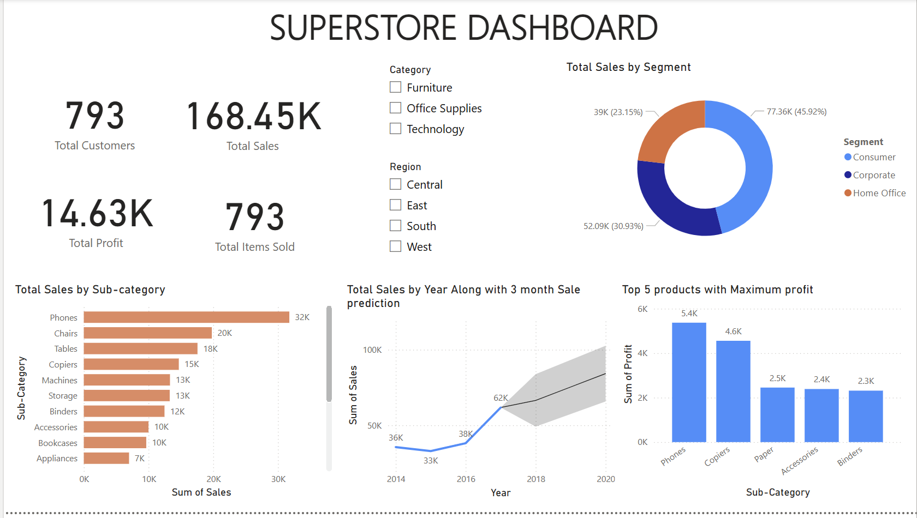
Dashboard Snapshot

