Slide 1
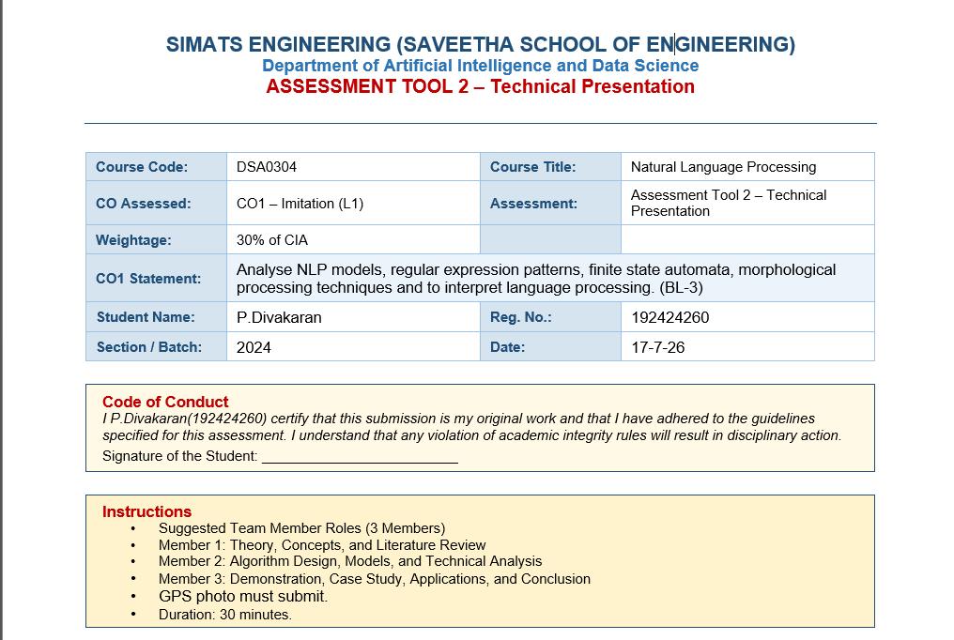

Slide 2
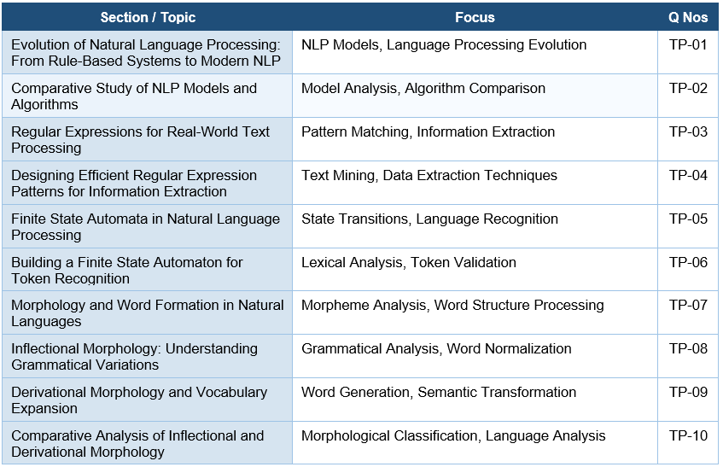

Slide 3
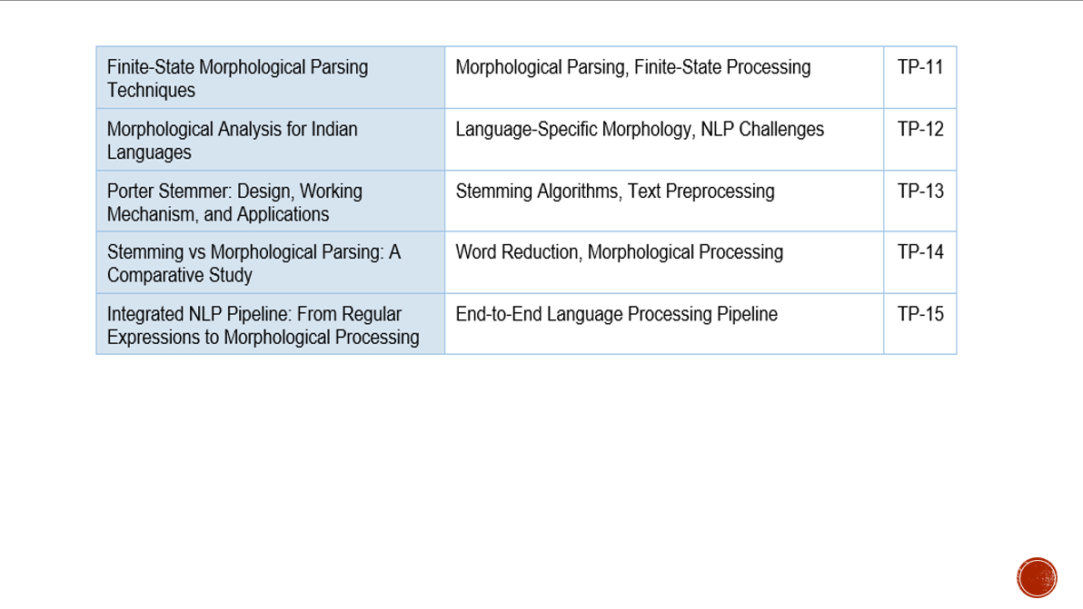

Slide 4

Designing Efficient Regular Expression Patterns for Information Extraction
DSA0304
Natural Language Processing
Guided By
Dr.T.Devi
Presented by
P.Divakaran(192424260)

Slide 5
Introduction
In today's digital world, a huge amount of text is created every day through emails, websites, social media, documents, and online forms. Finding useful information from this large amount of text manually is difficult and time-consuming. This is where Regular Expressions (Regex) help us.
A Regular Expression is a special pattern used to search, match, extract, and validate text. It helps computers quickly find specific information such as email addresses, phone numbers, dates, websites, passwords, and many other types of data.

Slide 6
What is a Regular Expression?
A Regular Expression (Regex) is a sequence of characters that forms a search pattern. It is used to check whether a piece of text follows a particular format.
For example, if we want to find all email addresses in a document, instead of checking every word manually, we can write one regex pattern. The computer will automatically find every email address that matches the pattern.
Regex is supported by many programming languages such as Python, Java, C#, JavaScript, and PHP.

Slide 7
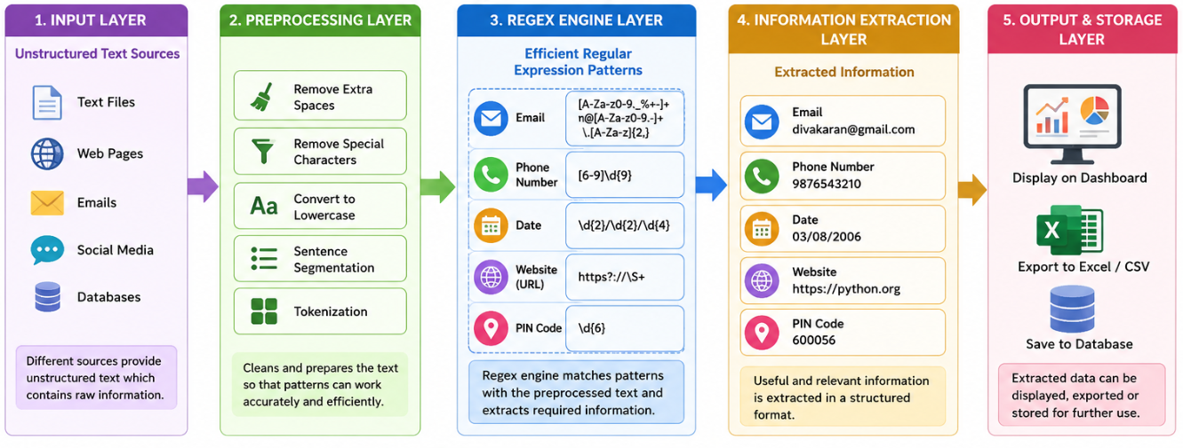

Slide 8
What is Information Extraction?
Information Extraction is the process of identifying and collecting useful information from unstructured or semi-structured text.
People write information in different ways. For example, a document may contain names, addresses, mobile numbers, dates, and email addresses mixed together. Information extraction helps separate these useful details automatically.
For example, consider the following text:
"My name is Ravi. My email is ravi@gmail.com and my phone number is 9876543210."

Slide 9
Why Do We Need Efficient Regular Expressions?
A simple regular expression may work for small data, but when working with thousands of documents, the pattern should be efficient.
An efficient regular expression:
Finds the correct information.
Avoids incorrect matches.
Works faster.
Uses less computer memory.
Is easy to understand and modify.
If the pattern is poorly designed, it may produce wrong results or take more time to execute.

Slide 10
Designing Efficient Regex Patterns
Designing a regex means writing a pattern that finds only the required information.
1. Keep the Pattern Simple
Simple patterns are easier to understand and execute.
2. Avoid Unnecessary Symbols
Using too many special characters makes the regex slow.
3. Match Only Required Data
The pattern should not select unwanted text.
4. Test the Pattern
Always test the regex with different examples before using it.
5. Improve Readability
Well-designed regex patterns are easier to maintain.

Slide 11
Advantages of Efficient Regular Expressions
Fast searching.
Saves time.
Reduces manual work.
Improves accuracy.
Easy to automate.
Works with large datasets.
Supported by almost all programming languages

Slide 12
Conclusion
Designing Efficient Regular Expression Patterns for Information
Extraction is an important concept in Natural Language Processing and text processing. Regular expressions help computers search, match, extract, and validate useful information from large amounts of text quickly and accurately.
Efficient regex patterns improve performance, reduce errors, and simplify text processing tasks. They are widely used in search engines, web applications, data mining, chatbots, banking systems, healthcare, and many other real-world applications.

