Slide 1
CSE400 - Fundamentals of Probability in Computing Course Instructor - Prof. Dhaval Patel
Intelligent Transportation System - s1_its_1
Randomized Route Optimization
Minimizing Average Travel Time and Congestion in Decentralized Traffic Networks

Slide 2
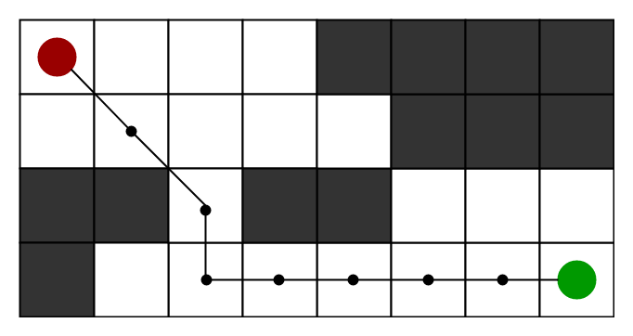
Problem Formulation
The Team
Image Source: https://www.geeksforgeeks.org/a-search-algorithm/

Slide 3


T1: Mathematical Modelling
Dev Kansara - AU2340222
Random Variable: Selected Path (P)
Probability Mass Function:
P1
P2
D
.
.
.
.
S
Cost Function: Actual Cost + * Heuristic Cost
Expected Travel Time:
Pn
Heuristic Cost computed using three types of distances
Euclidean Distance
Manhattan Distance
Diagonal Distance

Slide 4







T1: Mathematical Modelling
Dev Kansara - AU2340222
Euclidean Distance
Manhattan Distance
Diagonal Distance
-> Pure Dijkstra -> no heuristics slow but exact
-> Standard A* -> faster and uses heuristics
-> Randomized -> adds controlled randomness
Exploration v/s Exploitation

Slide 5


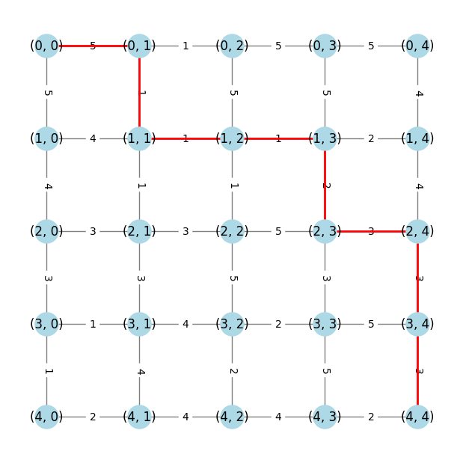
T2: Coding
Param Shah - AU2340192
Libraries:
random
heapq
matplotlib.pyplot
networkx
time
json
Real world Mimicry -
Traffic Congestion
Fastest Route
Algorithm - A* Algorithm

Slide 6
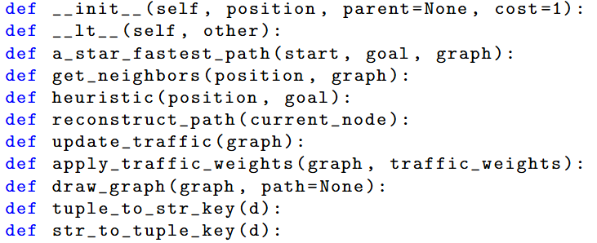
T2: Coding
Param Shah - AU2340192
Implements the A* algorithm to find the shortest path from start to goal using traffic-weighted graph

Slide 7
T2: Coding
Param Shah - AU2340192
Returns valid neighboring nodes and their respective movement costs from the graph

Slide 8
T2: Coding
Param Shah - AU2340192
Calculates the Manhattan distance as the heuristic estimate between the current position and the goal

Slide 9
T2: Coding
Param Shah - AU2340192
Backtracks from the goal node to reconstruct and return the full path

Slide 10
T2: Coding
Param Shah - AU2340192
Randomly generate and apply traffic weights to the graph, allowing consistent simulation of varying traffic conditions

Slide 11
T2: Coding
Param Shah - AU2340192
Visualizes the graph using NetworkX and matplotlib, highlighting the path if provided

Slide 12
T2: Coding
Param Shah - AU2340192
Convert graph dictionary keys between tuple and string formats to save and reload consistent traffic weights via JSON

Slide 13
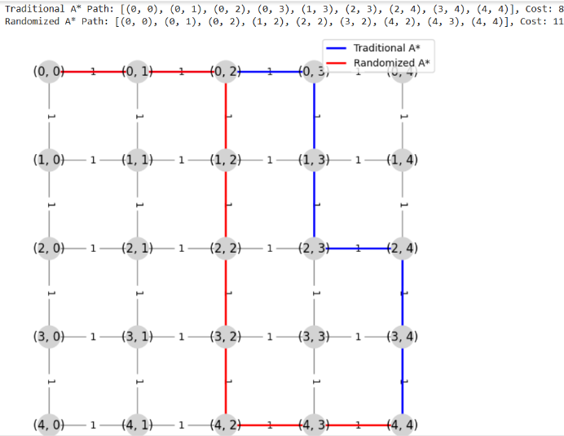
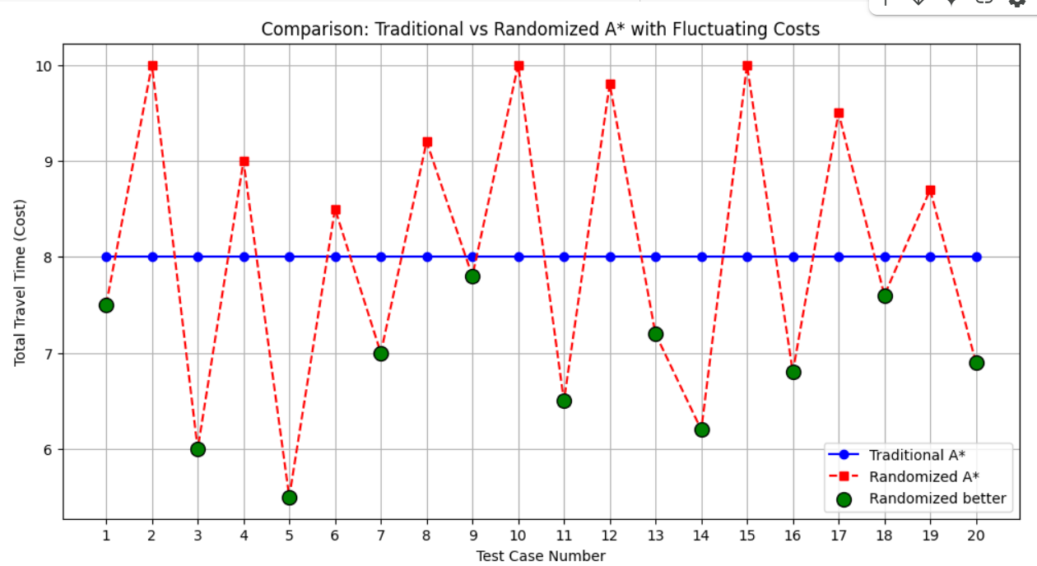
T3: Inference
Hir Gaglani- AU2340136
Project Domain
Scalability in Large-Scale Networks
Algorithmic Efficiency based on travel time
Balancing Exploration &
Exploitation in Pathfinding
Image Source: https://dl.acm.org/doi/10.1145/2834882.2834886

Slide 14





T3: Inference
Hir Gaglani- AU2340136
CS Perspective
Parameters | Randomised A* Algorithm | Deterministic A* Algorithm
Time Complexity | Follows Probabilistic path selection thus, Time complexity= where = additional cost per node | Follows exhaustive search thus, Time complexity= where, b= branching factor d= depth of optimal solution
Number of Flops (Floating point operations per second) used | Total flops per node: | Total flops per node:
Convergence Rate | Converge faster by exploring diverse path probabilistically | Ensures shortest path but takes longer time

Slide 15
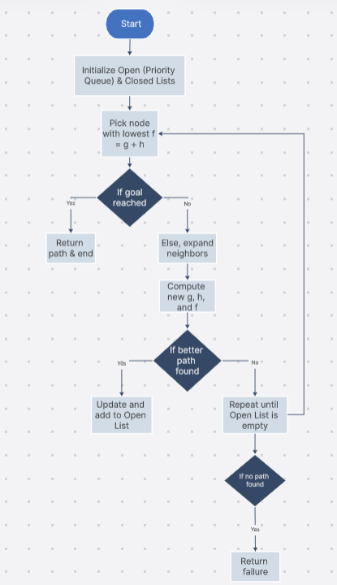
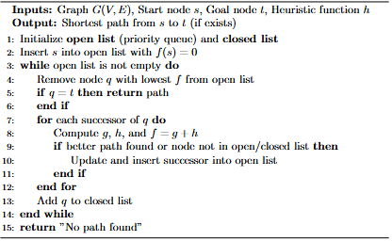
T4: Algorithm(Deterministic and Randomized
Priscilla R - AU2340001
A* Search Algorithm
Notes:
Minimizing Average Travel Time and Congestion in Decentralized Traffic Networks
Dijksta algo dosen’t follow heuristic approach
f(n)=estimated total cost of path
h(n)=A guess of the remaining cost from node n to the goal. It should be admissible (not overestimate).
g(n)=This is the known (actual) cost it takes to reach the node n from the start node.

Slide 16
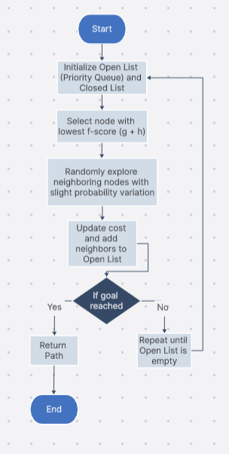
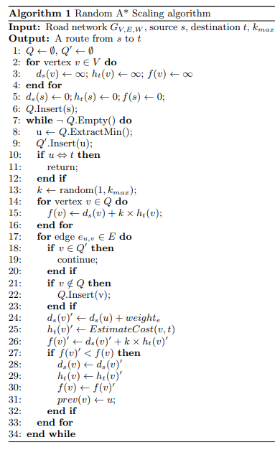
Priscilla R - AU2340001
Random A* Scaling Algorithm

Slide 17


T5: Derivation of Bounds
Hir Vora- AU2340156
For path selection where each path is chosen with probability:
The expected travel time is given by:
Using Chernoff bound the probability that traffic deviates is:

Slide 18

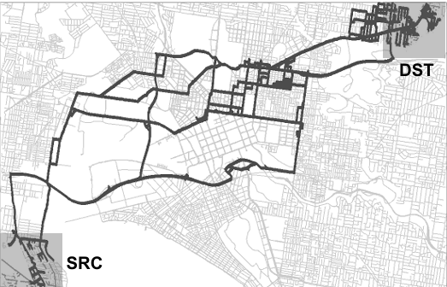


Hir Vora- AU2340156
T5: Derivation of Bounds
Integrating Min-Cut with Chernoff Bounds.
Each path from source to destination has an associated probability,
given by the exponential PMF:
Set A(Contains Src-S)
Set B(contains Dst-D)
Min-cut finds the smallest total capacity separating
the source from the destination:
Incorporating min-cut with Chernoff bound:
06/04/25 | 12

Slide 19
Thank You

