Slide 1
CAR RENTAL SYSTEM
Prepared by:
Student 1 :
Name: Pranshu Shah
Roll no.: 42
Batch: C2
Enrollment no.: 21002170110141
Student 2 :
Name: Devanshi Pathak
Roll no.: 24
Batch: C2
Enrollment no.: 21002170110130
Student 3 :
Name: Rushikaba Gohil
Roll no.: 27
Batch: C2
Enrollment no.: 21002170210029

Slide 2
Project Outline:
Introduction
Overall Description
Requirement Specification
Diagrams
Scope of Project
Conclusion

Slide 3
Introduction:
The Car Rental System project is a transformative initiative aimed at modernizing and optimizing the car rental industry through advanced software solutions. This innovative platform seeks to streamline the traditionally manual processes associated with vehicle inventory management and reservation systems. By introducing user-friendly interfaces, robust security measures, and efficient online payment processing, the project aims to provide a seamless and secure experience for both car rental companies and users. The integration of cutting-edge technologies promises to enhance accessibility, foster trust, and set new standards in the dynamic landscape of the car rental sector.

Slide 4
Overall Description:
The Car Rental System project is a transformative software solution that modernizes the car rental industry. Featuring user-friendly interfaces, secure online reservations, and robust inventory management, the platform caters to both individual and corporate users. With 24/7 web accessibility, advanced reporting tools, and integration with secure payment gateways, the project aims to streamline processes, enhance security, and elevate the overall car rental experience for companies and users alike.

Slide 5
Requirements specifications:
Functional requirements
1.1 Reservation
1.2 Login
1.3 Cars
1.4 Rent
Hardware & Software used
2.1 Server side:
Hardware Requirements Processor: Intel® Xeon® processor 3500 series
HDD: Minimum 500GB Disk Space
RAM: Minimum 16GB
Software Requirements OS: Windows 8.1, Linux
Database: SQL Server 2014 (SQL14)

Slide 6
2.2 Client Side (minimum requirement):
Hardware Requirements Processor: Intel Dual Core
HDD: Minimum 80GB Disk Space
RAM: Minimum 1GB
Software Requirements OS: Windows 7, Linux
3. Non functional requirements
3.1 Usability
3.2 Scalability
3.3 Availability
3.4 Error handling
3.5 Ease of use

Slide 7
4. Performance Requirements
4.1 Response time
4.2 Scalability
4.3 Reliability
4.4 User experience
4.5 Resource utilization
4.6 Performance monitoring

Slide 8
Use case diagram

Slide 9
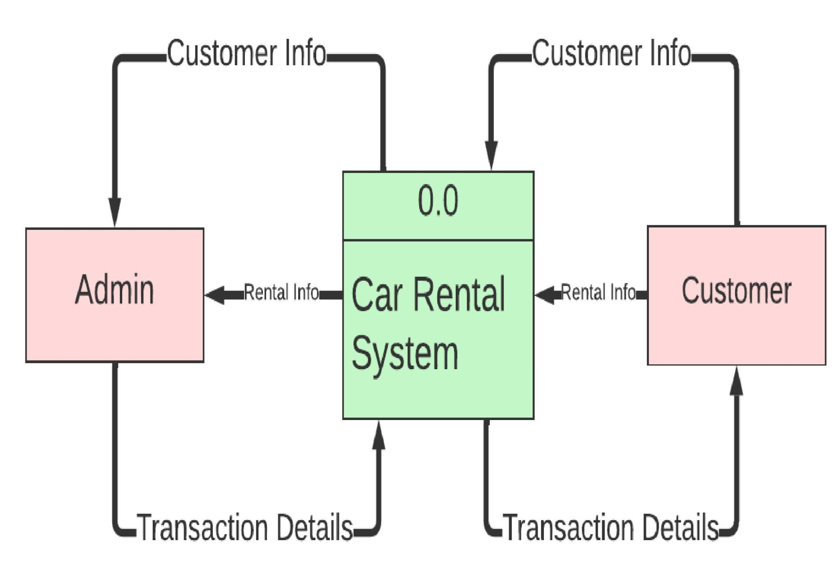
DFD Level 0

Slide 10
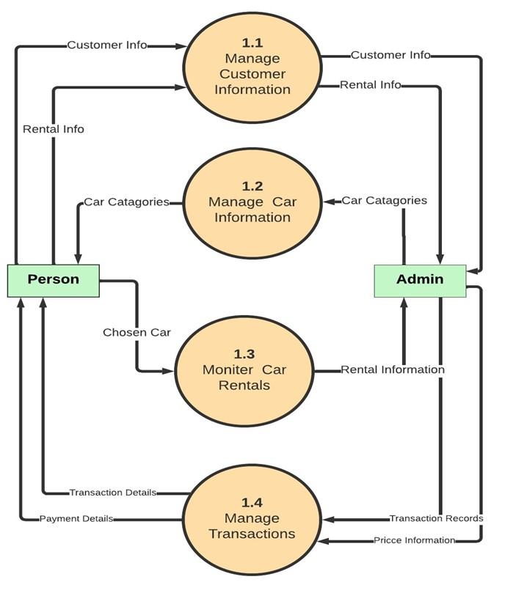
DFD Level 1

Slide 11
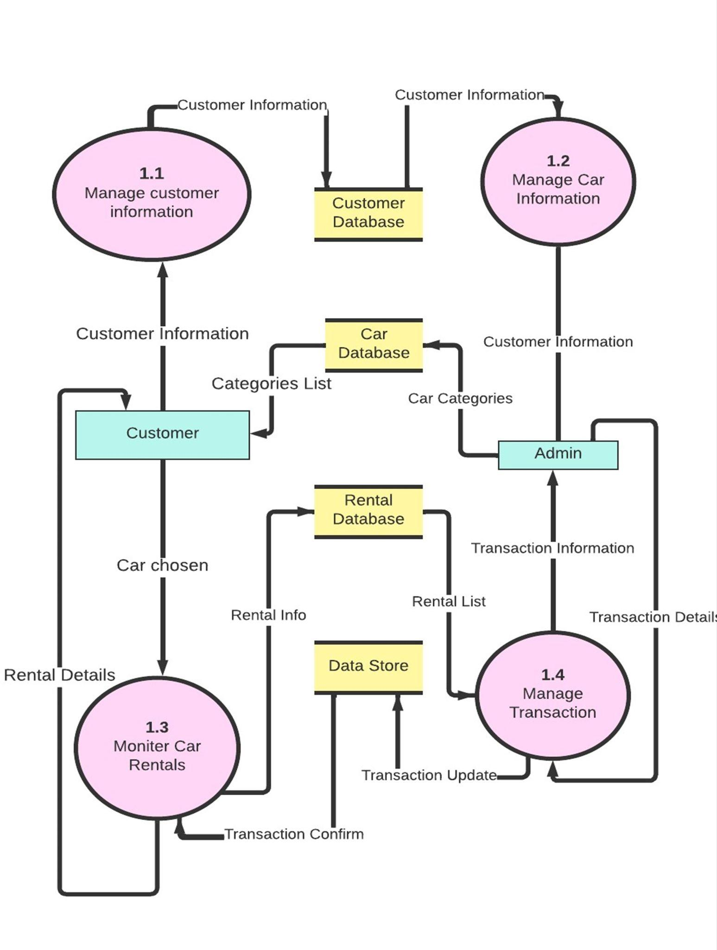
DFD Level 2

Slide 12
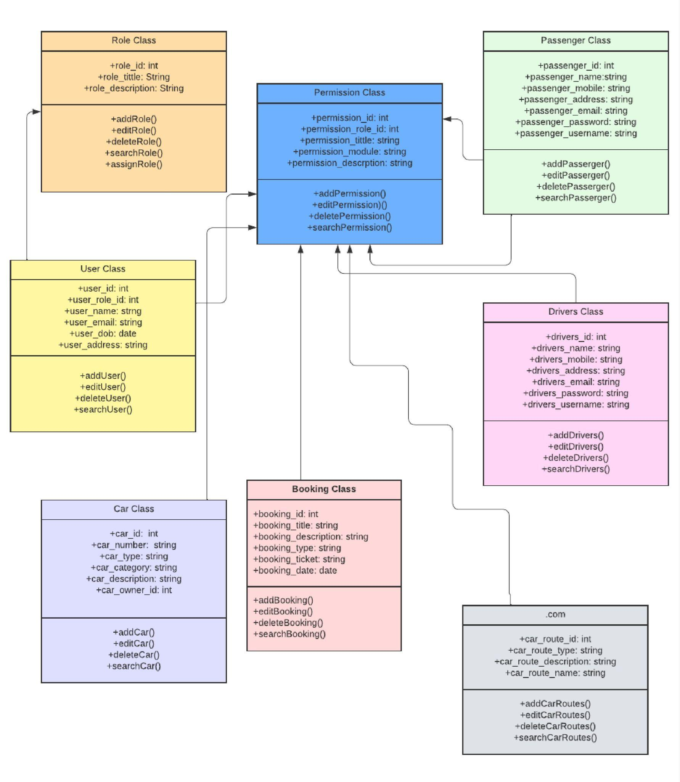
System Interface

Slide 13
Scope of project
The scope of the Car Rental System project encompasses the development of an efficient and user-friendly online platform for automating vehicle reservations and inventory management. The project aims to provide a secure, 24/7 accessible web-based solution, catering to both individual and corporate users. Key features include a streamlined reservation process, robust security measures, advanced reporting tools, and integration with secure payment gateways. The scope is designed to revolutionize the car rental industry by enhancing operational efficiency, user satisfaction, and overall industry standards.

Slide 14
Conclusion
In conclusion, the Car Rental System project signifies a pivotal advancement in the car rental industry, introducing a modernized platform for efficient reservation processes and streamlined inventory management. With user-friendly interfaces, robust security measures, and 24/7 accessibility, the project aims to elevate user experiences and industry standards. The integration of advanced technologies, personalized dashboards, and secure payment gateways positions the system as a comprehensive solution, poised to redefine and enhance the overall car rental landscape.

Slide 15


