Slide 1
AGILE DEV ASSIST
A user story in. Reviewed, repository-ready code out. In minutes.
A developer spends 1-2 days on a small story - most of it finding out: which folder, which pattern, what else must change. Agile Dev Assist does the finding out and the first draft, the way our team writes it.
Story in
Our context
Code out
Trust
ticket, SQL, acceptance criteria
skills, standards, Greenplum tables, code repo
every file, registered, validated, reviewed
confidence score, diff, branch in your name
Nothing leaves the bank except prompts to Azure OpenAI. No key, token or password is ever written to disk.
Notes:
One sentence: story in, reviewed code out. The time saved is the finding out, not the typing.

Slide 2
Why, for whom, what changes – on one page
The problem | Most of the time on a story goes into finding out how our code wants things done (which folder, which file to copy, where to register, which grant to add) – not into the logic itself. Misses show up late, in review or production.
Who it is for | The developers who build IKG, ODM and NLG; then reviewers, new joiners, story writers and the people responsible for standards.
What we built | Knowledge Pack: a context pack with the folders, files, tables, rules and conventions of each system. Dev Assistant: a tool where you attach a story, press Run, and get the plan, the files, a check report and a review – then push it to GitLab under your own name.
What changes | A routine story goes from 2–4 days to the same day. Mechanical mistakes are caught before the code is sent for review. Standards are checked on every file, every time. The knowledge stays current and does not leave with people.
Proof so far | Two real stories: code files generated in a few minutes, for under USD 2 each in token usage, with the mechanical parts right and only business questions left open.
Guardrails | It never merges anything itself; it never rewrites your existing files blindly; it shows exactly which files, tables and rules it used; every branch and commit carries the developer's name; no secrets stored on disk.
What we ask | Write stories that name the tables and columns; keep the knowledge file current; review the result the way you review any merge request.
Days of convention-finding become minutes; the developer keeps the pen and the merge button.

Slide 3
The idea: the model is the expert, the agents are the onboarding
The LLM (GPT-5)
Agile Dev Assist
A brilliant senior developer on day one. Knows SQL, Python, Airflow, Greenplum. Knows nothing about us: what acc_mhh_n means, where profile scripts live, that a new table needs a history script, a config entry and a DAG task.
The onboarding, done every time in minutes instead of once over months: read the ticket, read our documents, look at our tables, walk through our repository - then plan, write, check and review, exactly as a new joiner would be told to.
1
Read the story
2
Learn the conventions
3
Look at the data
4
Walk the repo
5
Plan · write · check
requirements, the SQL in it = the spec
skills, glossary, standards → rules with exceptions
grain, keys, columns, samples
where it belongs, what to imitate, what else must change
every file grounded in evidence, validated, reviewed
Same inputs as a human developer. Same checklist. Minutes, not days - and the checklist is never forgotten.
Notes:
The expert is hired; the tool is the onboarding. Every box is something we tell a new joiner to do.

Slide 4
Architecture: four layers, one rule
INPUTS
story
skills · standards
Greenplum tables
code repository
what a developer would read
RETRIEVAL
search
read file
who registers it
what changes together
exact keyword index (BM25) of the code base and documents, exposed as look-up tools - no vector DB
AGENTS
4 readers
planner
coder
validator · reviewer
4 readers build one context pack → planner → coder → validator + reviewer
DELIVERY
confidence score
diff · savepoints
branch in your name
audit log · cost
what the developer gets
Why agents, not scripts
Why BM25, not vectors
Why it is cheap
each has a goal, tools and a contract: it decides what to look up, and its result is checked and sent back if incomplete
we search for exact names (tables, folders, keywords) - Ctrl-Shift-F, not "something similar"; nothing extra to host
readers' results are cached by input fingerprint (0 calls next time); Azure bills repeated prompt text at 1/10 - ~$0.50 a story
Notes:
Only the agent layer calls Azure OpenAI. Everything else is ordinary code. Three objections answered in the footer: agents, vectors, cost.

Slide 5
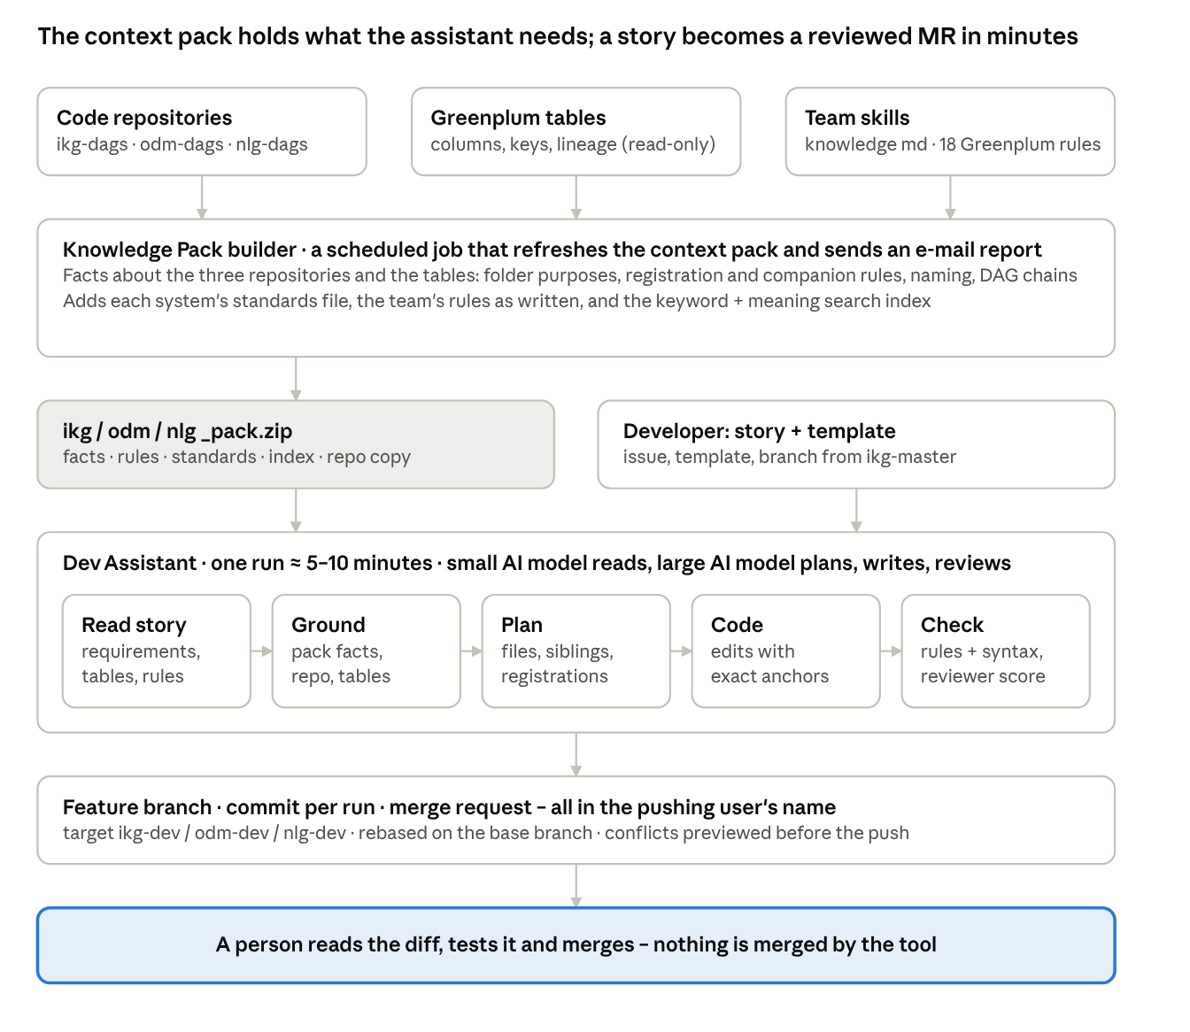
How the two parts fit: the context pack and the assistant
Inputs the three code repositories, the Greenplum tables and the team's notes and rules
Knowledge Pack builder a scheduled job collects the facts – folder purposes, registration and companion rules, naming, standards, search index – into one context pack per system and e-mails what changed
Dev Assistant combines the pack with the story: read → ground → plan → code → check, in about 5–10 minutes
Git feature branch, one commit per run, merge request – all in the developer's name
People decide a person reads the diff, tests it and merges; the tool never merges
The pack holds what the assistant needs to know; the assistant does the routine work of a story; a person merges.

Slide 6
How it works: evidence in, every file checked twice
Story
beneficiary_update_flags_ikg.sql
PLANNER
NEW module: the story's SQL, DISTRIBUTED BY the key
tables it names, SQL it contains - every code block ends up in a file or is declined with a reason
proposes the files
↓
code checks the plan:
file exists? registered? companions? story SQL used?
↓
rejected → plans again
client_beneficiary_profile_curr_ikg.sql
MODIFY: LEFT JOIN + 6 columns, nothing else
Repository
…_profile_ikg.sql (history)
who registers this folder (DAG, config), what changes together (history, archive), what to imitate
MODIFY: mirrors the new columns
ikg_data_refresh.py (DAG)
Conventions
MODIFY: one task, like its siblings
logic in its own module; a profile script only LEFT JOINs it; nothing read from forbidden tables
validate_…ipynb
NEW: checks the result
1
Coder
2
Validator (no AI)
3
Reviewer (independent AI)
one file per call, imitating our patterns, over one shared context
parses every file, runs the team's rules, the DAG dry-run; failures go back to the coder
requirements met? story SQL used? registered? conventions? → findings + score; critical/high are fixed and re-validated
Story 2547 in the demo: 5 files, DAG registered, history mirrored - the companions a human forgets most often.
Notes:
Left: the three sources of evidence. Middle: the planner proposes and ordinary code rejects a plan that misses a registration or a companion. Right: what came out for the real story. Bottom: three checks.

Slide 7
Trust: one number tells you what is left to look at
40%
35%
25%
≥ 85 High
read the plan, skim the diff, push
validator quality
reviewer score
coder confidence
70-84 Medium
100 minus penalties per finding
the independent reviewer's 0-100
the coder's own, averaged over files
fix what the Review tab lists first
capped by what is still open: no review → max 70 · open critical → max 50 · open high → max 75 · weak file → max 80 · −2 per open question
< 70 Low
the tool is pointing at a problem: read the findings
Every finding is listed
Every source is listed
Nothing hidden, nothing stored
status fixed / open / suggestion, with the file and line, clickable
which file, table and document contributed what to the code
diff vs repository, savepoints, full log, tokens and cost; keys never on disk; push with your own token
The ask
Pilot on the next 10 stories of IKG and NLG. Measure: time to first branch, review findings per story, confidence vs. what the human reviewer found. The developer stays accountable for every line - the tool makes the first day of every story a few minutes.
Notes:
Close on the number and the ask. The score is explained, capped, and each cap names the fix. The developer owns the push.

Slide 8
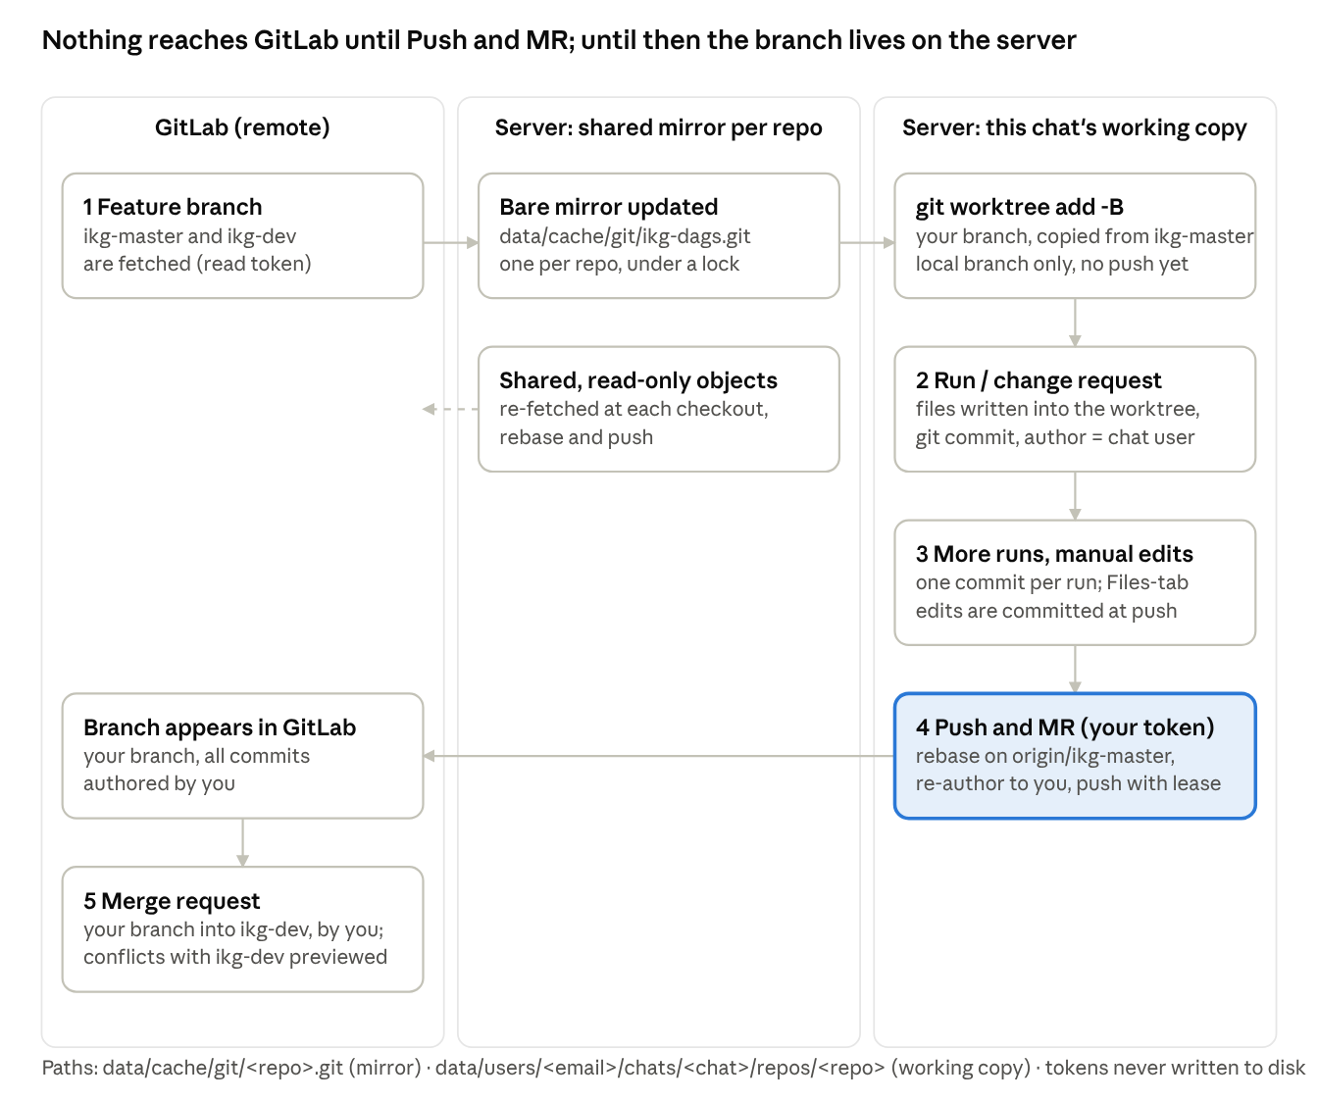
Git: nothing reaches GitLab until Push and MR
1 Feature branch created on the server, in this chat's private working copy, from the base branch; GitLab is only read
2–3 Runs and edits every run and change request is one commit in your name; hand edits are committed at push; nothing is pushed automatically
4 Push and MR with your own token: rebase on the base branch, your name on every commit, push with lease (never overwrites a colleague's work)
5 Merge request opened in your name into the target branch, with the story, files and scores; conflicts with the target are previewed
Isolation one shared read-only mirror per repository; one working copy and branch per chat; your token, your permissions
The same routine a developer follows from a laptop – branch, commit, rebase, push, merge request – on a per-chat working copy, in the developer's name.

