Slide 1
From user story to reviewed, repository-ready code in minutes
AGILE DEV ASSIST
How a team of AI agents onboards an expert model to our applications - and why you can trust what comes out
IKG / STAAT Insights · October 2026
Notes:
Speech section 1. One sentence to remember: the title.

Slide 2
Why, for whom, what changes – on one page
The problem | Most of the time on a story goes into finding out how our code wants things done (which folder, which file to copy, where to register, which grant to add) – not into the logic itself. Misses show up late, in review or production.
Who it is for | The developers who build IKG, ODM and NLG; then reviewers, new joiners, story writers and the people responsible for standards.
What we built | Knowledge Pack: a context pack with the folders, files, tables, rules and conventions of each system. Dev Assistant: a tool where you attach a story, press Run, and get the plan, the files, a check report and a review – then push it to GitLab under your own name.
What changes | A routine story goes from 2–4 days to the same day. Mechanical mistakes are caught before the code is sent for review. Standards are checked on every file, every time. The knowledge stays current and does not leave with people.
Proof so far | Two real stories: code files generated in a few minutes, for under USD 2 each in token usage, with the mechanical parts right and only business questions left open.
Guardrails | It never merges anything itself; it never rewrites your existing files blindly; it shows exactly which files, tables and rules it used; every branch and commit carries the developer's name; no secrets stored on disk.
What we ask | Write stories that name the tables and columns; keep the knowledge file current; review the result the way you review any merge request.
Days of convention-finding become minutes; the developer keeps the pen and the merge button.

Slide 3
A small story costs a developer 1-2 days, and most of it is not typing
1-2 days
~2 hours
#1 defect
from ticket to a branch a reviewer would accept
of that is writing code
the forgotten companion: a script that never runs, an archive that breaks
finding out - knowledge that lives in people's heads and in a 3,000-file repository
typing
1
2
3
4
5
6
Read the story and the SQL in it
Find the folder and a file to imitate
Understand the tables and the glossary
Write it the way the team writes it
Register it: DAG, config, history
Self-review against the standards
Steps 2, 3, 5 and 6 are the expensive ones - and they are the same for every story and every developer.
Notes:
Speech section 1. The cost is in context, not typing.

Slide 4
In plain words: a brilliant developer joined the team this morning
The LLM = the new senior engineer
Agile Dev Assist = the onboarding
Knows SQL, Python, Airflow, R better than anyone
Writes clean, fast, well-structured code on request
Has read millions of repositories - but never ours
Does not know what acc_mhh_n means or where profile scripts live
Does not know a new table needs a history script and a TABLE_CONFIG entry
Left alone: writes correct code that is wrong for us
Hands over the story and explains what is really asked
Points to the wiki, glossary and coding standards
Gives database access and explains the tables
Walks through the repository: "this is how we do it here"
Agrees a design, lets them code one file at a time
Runs the linters and does the code review before merge
Each agent is the same expert given one job, the right documents and the right tools. What it learns is written down and handed on.
Notes:
Speech section 2. This is the slide for the non-technical audience.

Slide 5
The whole system on one page
Story
Standard JSON
7 agents + validator
Git branch
GitLab / GitHub issue, file, text
pushed in the developer's name
analyse: story · knowledge · data · repo
Skills
team how-to documents
plan: design, files, registrations
Plan · review · diff
Glossary
readable before pushing
data dictionary
build: one file each, in parallel
Standards
check: validator (code) + reviewer (agent)
Confidence score
conventions, rules
with what to do to raise it
Greenplum
fix loop until clean
tables, queries (read-only)
Zip · log · tokens
confidence score
Git repository
audit trail and cost
whole code base, indexed
Everything the team already has goes in; everything becomes one standard structure; a reviewed branch comes out. Nothing IKG-specific is hard-coded.

Slide 6
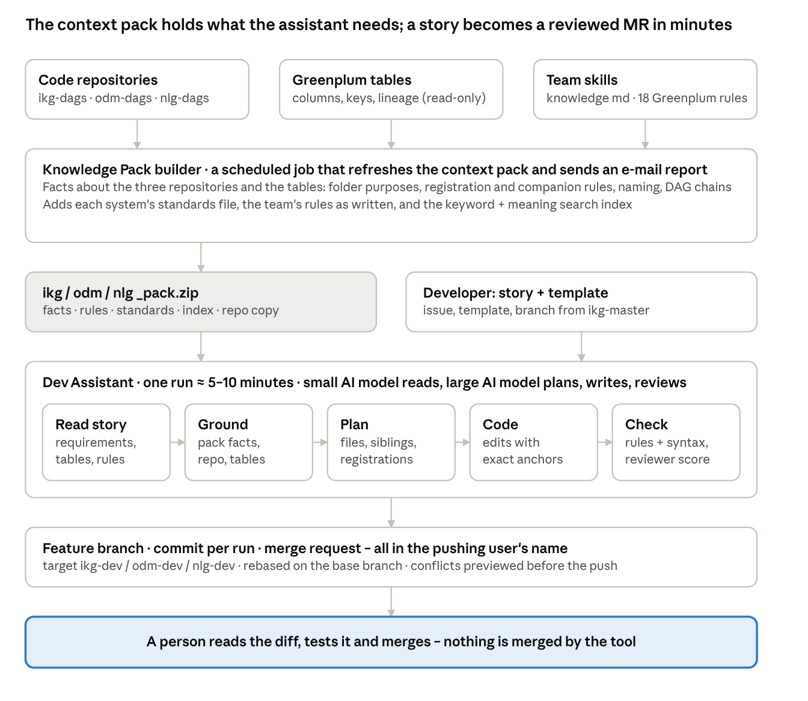
How the two parts fit: the context pack and the assistant
Inputs the three code repositories, the Greenplum tables and the team's notes and rules
Knowledge Pack builder a scheduled job collects the facts – folder purposes, registration and companion rules, naming, standards, search index – into one context pack per system and e-mails what changed
Dev Assistant combines the pack with the story: read → ground → plan → code → check, in about 5–10 minutes
Git feature branch, one commit per run, merge request – all in the developer's name
People decide a person reads the diff, tests it and merges; the tool never merges
The pack holds what the assistant needs to know; the assistant does the routine work of a story; a person merges.

Slide 7
In plain words: what happens to each input, step by step
Story
fact sheet (JSON)
Coder
read with a highlighter
requirements, rules, tables, the SQL = the spec
one file at a time, copying our patterns
Skills · Glossary · Standards
fact sheet (JSON)
Planner
Validator
the wiki, summarised as rules
definitions, conventions, checkable rules
the design review:
which files, why, in what order - checked by code, sent back if anything is missing
plain code checks every file (no AI)
Greenplum
fact sheet (JSON)
Reviewer
a look at the real tables
grain, keys, types, samples
independent AI review, score 0-100
Repository
fact sheet (JSON)
Confidence
the walkthrough: how we do it here
where it belongs, files to imitate, who registers, what changes together
one number: what is left to look at
Four readers work at the same time and write everything down; the planner decides; the coder writes; two checks and one score follow. Nothing lives only in someone's head.
Notes:
Layman slide: each input becomes a fact sheet; the planner is the design review; the rest is build and check.

Slide 8
Six inputs - what each one gives the agents
1
Story
2
Skills
the ticket as written: requirements, rules, acceptance criteria, tables, and the SQL - treated as the specification
how we build things: profile tables, history scripts, DAG registration, what a new table needs
→ story agent
→ knowledge agent
3
Glossary / data dictionary
4
Standards & conventions
what ip_cli_i, acc_mhh_n, _4w, _ytd mean - in the team's words
owner/grant, parameters not literals, no SELECT *, naming - many become automatic checks
→ knowledge agent
→ knowledge agent + validator
5
Greenplum tables & queries
6
Git repository
real columns, types, keys, sample rows; query result shape - read-only
every file indexed: search, read, who registers what, what changes together
→ data agent
→ repo agent + all tools
Accepted as md, yml, txt, csv, xls/xlsx, doc/docx, html. Each input becomes a card in the chat and can be removed; nothing is rewritten for the tool.
Notes:
Speech section 3.

Slide 9
Tools: the agents look things up instead of guessing
search_repo
read_file
grep_repo · repo_tree · example_files
find the files most related to a query (paths, symbols, content)
read any repository file in full
pattern search, folder tree, typical files to imitate
registration_points(folder)
companion_files(path)
references(name)
who lists this folder's scripts: the DAG task list, a task-name file, a config
what changes together with a table: history / archive script, configs with an entry, readers
every place a table / column / function is used - the impact of a change
describe_table · columns_named
define_term · read_section
check (validator)
Greenplum grain, keys, types, samples
glossary definitions, skills / standards sections
parse, lint, rule-check a file before submitting it
The middle row is what makes the code ours: it is how the system finds the DAG, the history script and the config entry for a change - from the repository, not from a hard-coded rule.

Slide 10
Seven agents, seven roles a good team gives a newcomer
1
Story agent
requirements, business rules, acceptance criteria, tables, the SQL in the story
2
Knowledge agent
definitions, conventions, checkable rules with their exceptions
Reads the ticket
Reads the wiki
3
Data agent
grain, keys, column types, samples, how tables join
4
Repo agent
where the change belongs, patterns, files to modify, registrations, companions, impact
Shows the database
Repository walkthrough
5
Planner agent
approach, modules, intermediate tables, every file, test plan, risks, questions
6
Coder agent
one file each in parallel; precise edits for large files
Design review
Pair programming
7
Reviewer agent
requirements, story SQL, registration, impact, standards → score + verdict
Code review
1-4 run in parallel on the inputs; 5-7 run in sequence with a fix loop. Drag agents in the UI to reorder or drop one.
Notes:
Speech section 4.

Slide 11
The pipeline: analyse, plan, build, check, deliver
1 · ANALYSE THE INPUTS (PARALLEL)
Story agent
Knowledge agent
Data agent
Repo agent
requirements, rules, tables, SQL in the story
definitions, conventions, checkable rules
tables, columns, keys, samples
patterns, files to modify, registration, companions, impact
2 · PLAN, BUILD, CHECK
Planner agent
Coder agent
Validator (code, no LLM)
Reviewer agent
design, modules, every file + purpose
one file each, in parallel
syntax, Airflow, SQL parse, team rules
requirements, registration, impact, score
findings → coder fix loop (validator: 2 rounds; review: 1 round) - the review always keeps the last 4 minutes of the budget
3 · DELIVER
Chat change requests
Branch · zip · plan · log
"rename the column" → change agent → re-check
pushed as the developer, not as a bot

Slide 12
An agent is more than a prompt: role, tools, contract, grounding
1 · Role prompt
3 · Contract - a JSON schema
"You are the planner: decide how the story is implemented so a developer can use the result as is ..."
Planner must return approach, design, files, registration_changes, impact, test_plan. Free text is rejected.
Agent
LLM (Azure OpenAI) + role prompt
+ the JSON of previous agents
+ a context budget
+ up to ~12 tool-calling steps
2 · Tools - it looks things up
4 · Grounding - code checks the answer
search_repo · read_file · registration_points · companion_files · references · describe_table · define_term
'modify' of a file that does not exist · a story SQL block nobody used · a companion neither planned nor declined · file does not parse → REJECTED, fix and resubmit
5 · Memory on paper
Results cached per input (re-run only what changed); every call traced with tokens per agent; the output JSON is what the next agent reads - nothing lives only in someone's head.
Notes:
Speech section 4, last paragraph. Grounding is the key differentiator.

Slide 13
How planning works: the AI proposes, plain code verifies and sends it back
1 · Planner proposes
2 · Grounding checks (deterministic)
3 · Accepted - or sent back
a fixed form, not prose: approach, design, files (create / modify), registrations, impact, test plan, questions
every planned 'modify' exists in the repo
every story SQL block is assigned to a file
every registration point and companion is planned or declined with a reason
logic is not pushed into an existing table script
every intermediate table of the design has a file
REJECTED with the exact missing item, e.g. 'dags/ikg_data_refresh.py registers this folder - add it as modify or decline it' (up to 2 more rounds)
fix and resubmit
Safety net outside the AI
Why this matters
after the plan is accepted, a new script whose folder has a registration file (DAG, task list, config) gets that file added as a modify automatically - a script that is never registered never runs
an AI can argue a file away in prose; it cannot argue with a check that reads the repository. The same pattern - propose, verify, send back - is used for the repo agent (registrations, companions) and the coder (the file must parse).
Notes:
Grounding in one slide. The reviewer later checks the same things independently.

Slide 14
Architecture: four layers, one rule
INPUTS
ticket
team documents
read-only tables
code base
story · skills · standards · data tables · git repository
RETRIEVAL
search
read file
who registers
what changes together
index of the code base, exposed to the agents as look-up tools
AGENTS
4 readers
planner
coder
validator + reviewer
read → plan → write → check, each step verified by code
DELIVERY
confidence score
diff + savepoints
branch in your name
audit log
what the developer gets
Azure OpenAI (GPT-5) is called only from the agent layer. Nothing is stored outside the bank; keys are never written to disk.
Notes:
Four layers. The only AI calls happen in the agent layer; every other layer is ordinary code. The rule that ties it together: the AI proposes, deterministic code verifies.

Slide 15
Why look-ups instead of a vector database
It is retrieval-augmented
but the retrieval is exact, not semantic
every agent works from retrieved facts - ticket, tables, code - never from memory
keyword + symbol search over the code base; no embeddings, no vector store
We search for names, not meanings
Every result is explainable
1
2
x_profile_ikg and x_profile_curr_ikg are different files; an embedding calls them the same
"names the folder and lists its scripts" - a reviewer can check it
Nothing extra to run
Easy to add later
3
4
no service to host, sync or secure; index rebuilt in seconds
for large prose wikis or "similar past stories" - a contained change
Chosen, not omitted.
Notes:
Say: it is RAG - retrieval-augmented - but exact retrieval, because the targets are identifiers. A vector store is a contained addition for prose wikis later.

Slide 16
Context pack and the two caches
The model knows nothing about UBS. Everything it answers from is put in front of it for that one call: that is the context. The four readers write it down once as the context pack.
Story
Result cache (ours)
requirements · tables · SQL
CONTEXT PACK
readers' JSON stored under a fingerprint of their inputs
same documents / tables / repo → 0 calls, 0 tokens
knowledge keyed without the story → shared across stories
pack.json
one briefing
read by planner, coder, reviewer
"Sources used" on the Plan tab = its table of contents
Knowledge
conventions · rules · exceptions
Data
Prompt cache (Azure)
columns · keys · samples
every agent step re-sends its whole conversation
the identical prefix is billed at 1/10 price
shows as "cached input tokens" - the cheap part
Repo
patterns · registrations · companions
Planner, coder and reviewer are never cached: their answer depends on the story and the code being written now.
Notes:
Context = the briefing. Context pack = the briefing written down, produced once by the readers. Two caches: ours stores finished reader results (0 calls next time); Azure's stores identical prompt prefixes (tenth of the price).

Slide 17
What a story costs: reading the Tokens tab
99k
239k
36k
$0.50
input tokens - sent to the model, not cached
cached input - repetition served by Azure at 1/10 price
output - plan, files, review, reasoning
one story, GPT-5 list prices
Where the tokens go (share of the uncached input + output)
Planner
reads the whole pack, loops until every file is grounded
Coder
one call per file over one shared, cached context
Reviewer + fixes
all files and diffs, then the coder again per finding
The number to watch is uncached input + output. A high cached share is good: it is repetition we did not pay in full. Readers at 0 calls = result reused from our cache.
Notes:
Three token kinds and one dollar figure. Cached is the biggest number and the cheapest. Most spend is the planner loop and the review fixes - fewer planner rounds = cheaper.

Slide 18
How it decides which code to create or change: three sources of evidence
The story
The repository
The conventions
tables it names, SQL it contains
registration_points: who lists this folder's scripts
companion_files: history / archive script, config entries, readers
references: what depends on the table
skills / standards: 'logic lives in intermediate tables, profile scripts only join'; 'a new profile table needs its history script and TABLE_CONFIG'
→ every code block → a file, or 'not used because ...'
→ each candidate → create / modify, or declined with a reason
→ rules the planner must apply; many become validator checks
The planner must account for every piece of evidence - a file (create / modify) or a decline with a reason - or the plan is REJECTED and sent back with the missing item (up to 2 rounds).
Safety net outside the model: a new script whose folder has a registration file always gets that file added to the plan. A script that is never registered never runs - this is the defect the planner is most likely to argue away.
Notes:
Speech section 5.

Slide 19
Example: story 2547 - one ticket becomes five files
Story 2547
What a plain LLM changes
ikg_beneficiary_outbound/beneficiary_update_flags_ikg.sql
NEW intermediate table: the story's SQL, modularised, DISTRIBUTED BY the key
IRA & TOD outdated, dead and prospect beneficiaries: six new columns on the client beneficiary profile, SQL logic given in the ticket
client_beneficiary_profile_curr_ikg.sql - the only file the story names; all the logic pasted into it
ikg_create_profiles/client_beneficiary_profile_curr_ikg.sql
MODIFY: only a LEFT JOIN + six columns; rest byte-identical
ikg_create_profiles_history/client_beneficiary_profile_ikg.sql
sibling: same table, other folder → same six columns
Why four more files appear - no IKG rule hard-coded
companion_files finds the history script (same stem minus _curr) and the configs that mention the table
registration_points finds the DAG that names the folder and lists its scripts - even for a single-script folder
the knowledge agent extracted the convention 'logic lives in intermediate tables; profile scripts only join'
planner grounding rejects a plan that pushes joins / CASE logic into the existing profile file
the test plan comes from the acceptance criteria of the story
dags/ikg_data_refresh.py
one operator line + task_map entry, copied from the neighbours
notebooks/validate_2547.ipynb
row counts, 0/1 flags, null shares - from the acceptance criteria
Notes:
Speech section 5, last paragraph. The honest history: the first run produced one file; the log told us why; both causes are now deterministic checks.

Slide 20
Code is checked three times before the developer sees it
1 · Coder writes
2 · Validator (code, no LLM)
3 · Reviewer agent (independent)
4 · Developer
complete file, or verbatim-anchored edits for large files; follows the design and the repository patterns; story SQL kept as the specification; self-confidence 0-100
python ast + pyflakes · Airflow DAG checks · SQL parsed with Jinja params substituted; Greenplum clauses understood; unchanged repository statements trusted · team regex rules with scopes and exceptions
requirement coverage, one row each · story SQL respected? · every new script registered, every companion changed? · impact on consumers · performance · standards → findings with file + line, score 0-100, verdict approve / fix_required / reject
reads plan, diff and review; edits inline or asks for changes in chat; pushes with own token - stays the author and the final reviewer; merge request + CI unchanged
blocking findings go back to the coder in fix mode - validator up to 2 rounds, review 1 round, inside the time budget; the review always runs (4 minutes reserved)
fast
independent
human
the validator is ordinary code: no cost, no hallucination
the reviewer never saw the coder's conversation
nothing reaches production without the existing gate
Notes:
Speech section 6, first two paragraphs.

Slide 21
The confidence score: one number a developer can act on
40%
35%
25%
then capped by what is still open
review did not run → max 70
open critical finding → max 50
open high finding → max 75
a file with coder confidence < 60 → max 80
−2 per open plan question (max −10)
+
+
=
validator quality
reviewer score
coder confidence
100 minus penalties per finding: critical 40, high 15, medium 5, low 1
the independent reviewer's 0-100
the coder's own 0-100, averaged over the files
≥ 85
High
70-84
Medium
< 70
Low
read the plan, skim the diff, push
fix what the Review tab lists first
the tool is pointing at a problem - read the findings and the open questions
75% of the score comes from signals independent of the model that wrote the code. The Review tab shows the formula for this run and 'to raise it: ...' - it is a to-do list, not a verdict. Shown as a pill in the header of every chat.
Notes:
Speech section 6, last paragraph. Example from the self-test: 40% x 100 + 35% x 92 + 25% x 86.7 = 94, High.

Slide 22
Confidence score: a worked example
Validator quality
× 40%
= 39.6
94
1 low finding (−1) → 99
Reviewer score
× 35%
= 32.2
approve, score 92
High · read the plan, skim the diff, push
Coder confidence
shown as a pill in the header and in the Review tab with this breakdown
× 25%
= 22.4
files 85 · 96 · 90 · 88 → mean 89.8
sum = 94.2
Same run, one open HIGH finding
sum 94.2 → capped at 75 → Medium. The Review tab says: 'to raise it: fix the 1 blocking finding'. Fix it (chat or inline edit), the validator re-runs, the score goes back to 94.
Caps: nothing open
review ran (no 70 cap) · no critical / high finding open (no 50 / 75 cap) · lowest file 85 ≥ 60 (no 80 cap) · 0 open questions (−0)
Notes:
Walk the arithmetic once; then show that a single open high finding caps the score, which is the point: an average must not hide a real problem.

Slide 23
Enterprise-ready: secrets never stored, sessions per user
🔒
LLM key
1
SSO
environment variable or hidden notebook prompt - never in config, code, cache or logs
header or OIDC in the web app; dev login for the local notebook UI
🔒
Git read token
2
Per-user storage
entered once when the UI starts; used only to read stories and download code
chats, inputs, generated files, outputs and caches under the user's own folder; delete own chats
🔒
Push = personal token
3
Audit trail
always typed in the push form, so branch and commits carry the developer's identity
every agent step and tool call logged; plan, review, findings, tokens per run
🔒
Greenplum password
4
Two packagings
typed in the form, kept in an in-memory vault for the session; read-only connection, statement timeout
web app (Docker, SSO) and notebook (one button opens the same UI); static LLM settings in one YAML
Notes:
Speech section 8.

Slide 24
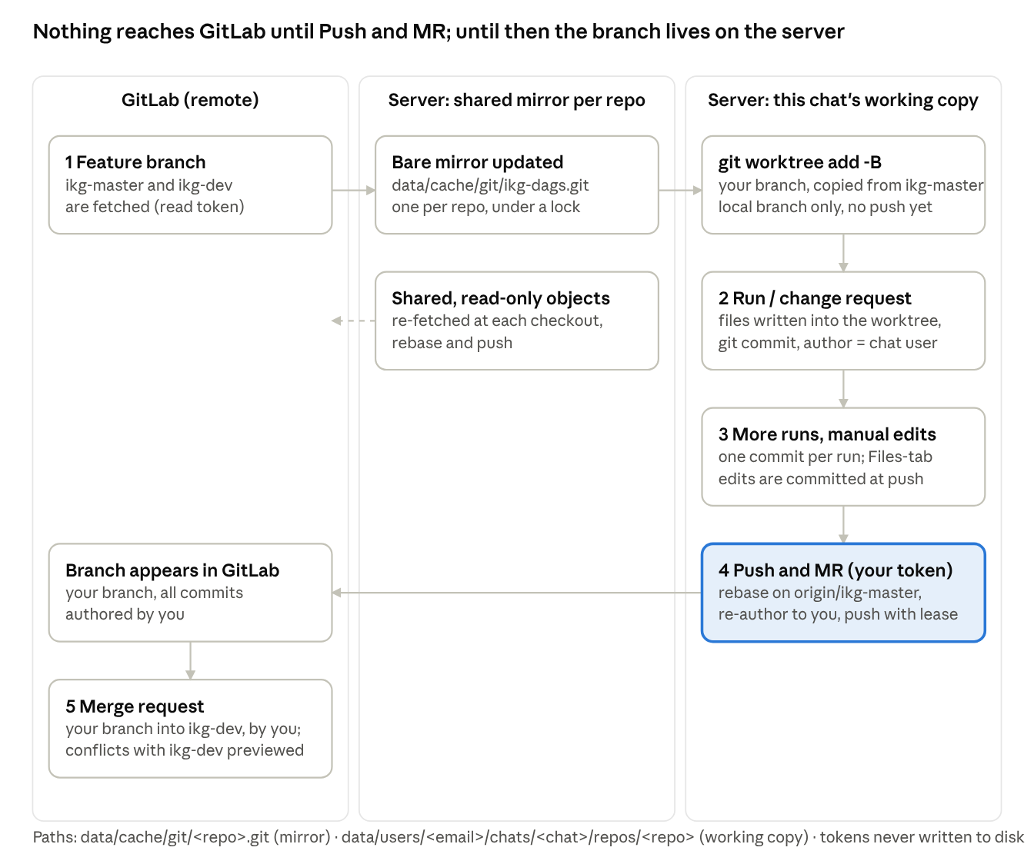
Git: nothing reaches GitLab until Push and MR
1 Feature branch created on the server, in this chat's private working copy, from the base branch; GitLab is only read
2–3 Runs and edits every run and change request is one commit in your name; hand edits are committed at push; nothing is pushed automatically
4 Push and MR with your own token: rebase on the base branch, your name on every commit, push with lease (never overwrites a colleague's work)
5 Merge request opened in your name into the target branch, with the story, files and scores; conflicts with the target are previewed
Isolation one shared read-only mirror per repository; one working copy and branch per chat; your token, your permissions
The same routine a developer follows from a laptop – branch, commit, rebase, push, merge request – on a per-chat working copy, in the developer's name.

Slide 25
Live demo: story 2547
Inputs → pipeline → run → plan → diff → review → change request → push

Slide 26
Demo: what you will see at each step
1
2
3
4
5
Open & sign in
Drag the inputs
Pipeline & Run
Plan · Files · Review
Change & Push
notebook button or web app; a new chat opens
story 2547, skills, glossary, standards, Greenplum tables, ikg-dags repo - each a card
drag agents to reorder; stage chips turn green; Log shows every tool call
five files; diff view; confidence with its formula; requirement coverage
"rename the column" in chat → re-check; push with your token
Watch for
the story summary card: the agents already know the tables and the SQL in the ticket
the Plan tab: five files and a declined registration with its reason
the diff of the profile script: green lines are only a LEFT JOIN and six columns
the Review tab: confidence, how it is built, what would raise it; Tokens tab: cost per agent

Slide 27
VALUE AND NEXT STEPS
Days of context work become minutes; the developer keeps the pen
~10 min
0 forgotten
any team
story → reviewed branch
registrations and companion files
own skills, standards, tables, repos
The ask
Pilot on next sprint's IKG stories - measure time-to-branch and review findings per story
ODM and ingestion teams contribute their skills files - same engine, no code change
Hosted instance with SSO; keep the notebook edition for local testing
Notes:
Speech section 9.

