Slide 1

Phishing Awareness Training
Done By: Shahram Shahzad
For: CodeAlpha

Slide 2
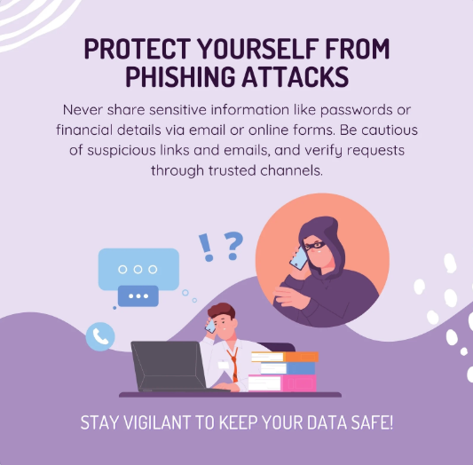
2
INTRODUCTION
What is Social Engineering?
Social engineering is the manipulation or tricking of people into revealing confidential information
This is often through deceptive emails, calls, or messages.
These attacks prey on human psychology, creating a false sense of trust.

Slide 3
3
THE IMPACT OF SOCIAL ENGINEERING
Social engineering is responsible for over 70% of cyberattacks
One phishing attack costs an organization an average of $1.6 million
According to the 2021 Verizon Data Breach Investigations Report, 36% of data breaches involved social engineering techniques
84% of consumers say they are less likely to buy from a company that has experienced a breach.

Slide 4
5
TYPES OF SOCIAL ENGINEERING
1
Human-based Social Engineering:
This involves attackers directly interacting with people to manipulate them into sharing sensitive information. They exploit trust, fear, or authority.
2
Computer-based Social Engineering:
Attackers use technology, like phishing emails, fake websites, or pop-ups, to deceive victims. They trick users into clicking malicious links, downloading malware, or sharing private information.
3
Mobile-based Social Engineering:
Attackers target individuals through mobile phones, using texts (smishing) or calls (vishing). These messages often appear urgent or enticing to pressure quick action

Slide 5
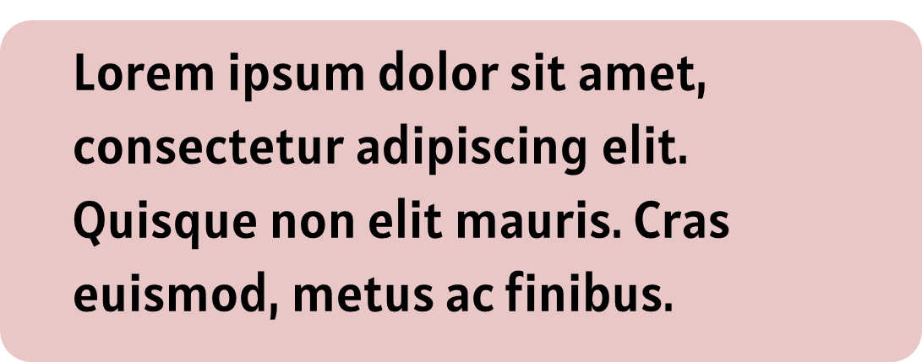


4
COMMONLY USED TYPES
Phishing
Baiting
Attackers use fake emails in order to trick the target into sharing their sensitive information.
Attacker uses tempting offers to lure in greedy users and gathers their information
Pretexting
Vishing
Attacker creates fake scenarios in order to befool the target and gains sensitive information from them.
The attacker uses fraudulent phone calls by using fake voice and impersonates a trusted entity

Slide 6


EMOTIONS COMMONLY TARGETED BY SOCIAL ENGINEERS
Fear: "Your account has been hacked! Act now to secure it.”
Greed: "Congratulations! You’ve won $1,000,000. Click to claim.”
Curiosity: "You won’t believe what’s in this file!”
Helpfulness: "Can you please share your Wi-Fi password? My internet’s not working.”
Urgency: "Immediate action required—your bank account will be frozen!"

Slide 7
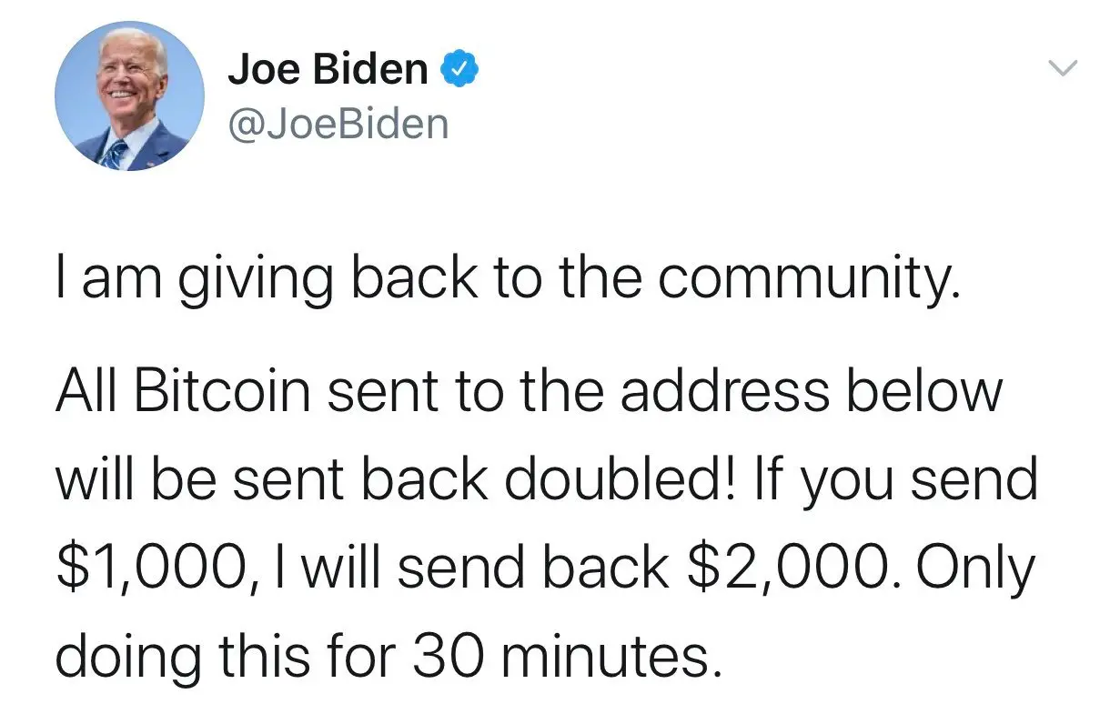
6
REAL-WORLD EXAMPLE
When Social Engineering Broke Twitter
In 2020, hackers sweet-talked their way into Twitter employees’ accounts using phishing tricks.
They hijacked VIP accounts, including Elon Musk, Barack Obama, and Bill Gates
The hackers tweeted, “Send us Bitcoin, and we’ll double it!”
Result? Over $120,000 stolen, proving even tech giants can fall for social engineering!

Slide 8
HOW STOLEN DATA CAN BE USED AFTER SOCIAL ENGINEERING
Identity Theft: Stolen data can be used to open bank accounts, take loans, or commit fraud under your name.
Financial Fraud: Attackers can drain your bank account or make unauthorized purchases.
Blackmail or Extortion: Sensitive information can be used to threaten victims for money or compliance
Corporate Espionage: Hackers sell stolen business secrets or customer data to competitors.

Slide 9
WAYS TO PREVENT SOCIAL ENGINEERING
Be Skeptical of Unsolicited Requests: Always verify the identity of people asking for sensitive information
Double-Check Links and Email Addresses: Hover over links to see if they lead to legitimate websites.
Use Multi-Factor Authentication (MFA):Add an extra layer of security to your accounts.
Educate and Train Employees: Regular training on phishing and social engineering threats can prevent breaches
Keep Software Up to Date: Ensure your system is protected with the latest security patches.
Create Strong, Unique Passwords: Avoid using easily guessable passwords and reuse across accounts.

Slide 10
10
WHAT I DID
Phishing: Sent fake emails pretending to be legitimate organizations to collect sensitive information.
Smishing: Used text messages to trick individuals into sharing personal details.

Slide 11

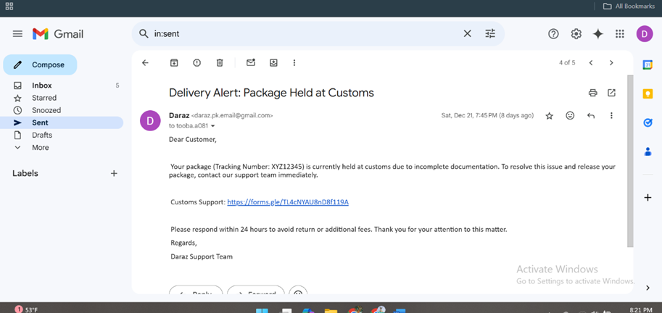
PHISHING
CAN YOU SPOT THE RED FLAGS IN THIS EMAIL ?

Slide 12
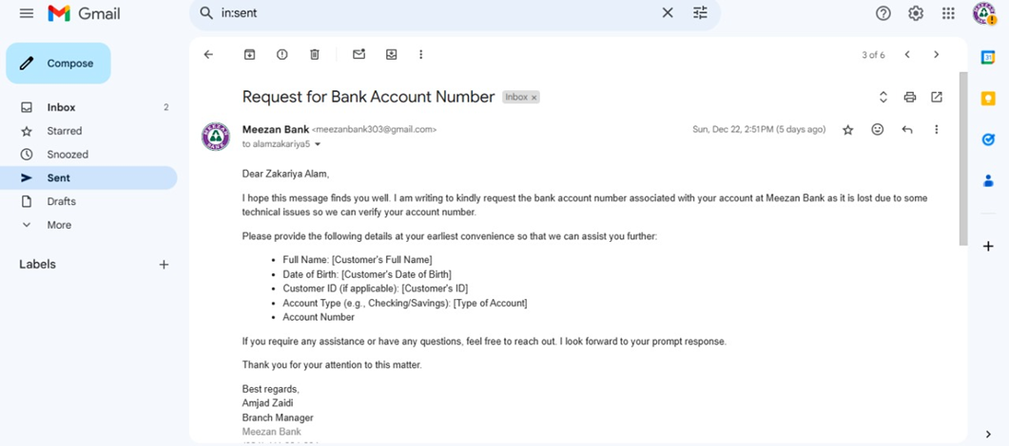
9
PHISHING
Fake Delivery Notification Email
We sent emails to people, pretending to be trusted delivery organizations, to test how easily they could be tricked.
Fake Bank Account Update Email
We asked people to send some basic information saying that it was needed for updating their account

Slide 13

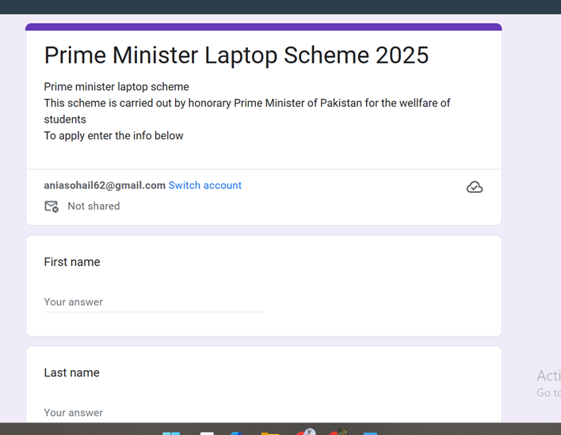
7
FAKE LAPTOP SCHEME FORM
I created a fake form for the Prime Minister Laptop Scheme and sent it to our class group. A total of 18 people fell for it entered their information

Slide 14

8
SMISHING
Password Request: Asked our classmates for passwords to access university email accounts.
Teacher Impersonation: Pretended to be our teacher and asked a student for project details via text.
Money Request: Used a new number to impersonate a friend in need and asked for money.

Slide 15
THANK YOU

