Slide 1






ChargeOpt
VGEC × IBM BOB AI HACKATHON 2026
Shifted to off-peak
₹11.40 → ₹5.60 per kWh
PROBLEM STATEMENT A3 · AUTOMOBILE & MOBILITY
EV Fleet Charging Optimisation Engine
Every vehicle ready for departure. Every kilowatt-hour in the cheapest window that allows it.
−59%
93.9%
93 ms
charging energy cost
per day
projected departure
readiness
full-fleet re-plan
for 100 EVs
EV-042 · P1 emergency
Overrides tariff, charges now
Built with IBM Bob
watsonx-ready design
Figures modelled on a simulated 100-EV fleet: static first-come-first-served baseline vs ChargeOpt rules, same snapshot.
Notes:
Open: Fleet electrification is stalling on a boring problem — when to plug in. ChargeOpt is our answer to Problem Statement A3. It keeps every scheduled EV ready for departure while moving flexible charging out of expensive tariff windows. The three numbers on screen come from the running product: on the same 100-vehicle snapshot, the rule engine cuts planned energy cost by 59%, lifts projected readiness to 93.9%, and re-plans the whole fleet in about 93 milliseconds. All figures are modelled on simulated telemetry and configured tariffs, not measured savings.

Slide 2








Static charging pays peak prices and still misses departures
02 · THE PROBLEM · STATEMENT A3
EV fleets charge on fixed schedules that ignore tariff windows, trip deadlines, charger limits and battery health.
WHO FEELS IT
ONE DAY AT A 100-EV DEPOT · STATIC SCHEDULE
82%
Fleet operators
Everyone plugs in at 6 pm and pays
the ₹11.40/kWh evening peak
Pay the bill, own the uptime
of charging energy lands in the
₹11.40 evening peak window
Depot charging teams
Off-peak ₹5.60
chargers idle
Juggle too few chargers by hand
8 of 66
Drivers & dispatch
Start shifts on a half-full battery
departures at risk, 478 kWh short
of the charge they need
Grid & utilities
12:00
18:00
00:00
06:00
Absorb the 6 pm demand spike
Peak
Shoulder
Off-peak
WHY IT EXISTS
+30–50%
$150–300K
−15–20%
Plug in = charge now
Tariff windows ignored
added to electricity cost
by peak demand charges
wasted per year on a
100-vehicle EV fleet
battery lifespan lost to
suboptimal charge cycles
First-come chargers
No departure priority
Source: PS A3
Source: PS A3
Source: PS A3
WHY IT MATTERS
Charging is the biggest cost a fleet can still control. Get it wrong and electrification stalls.
Notes:
Who: fleet operators, the depot teams who run chargers, drivers and dispatchers, and the grid. What: today vehicles are charged first-come-first-served the moment they plug in. Because the fleet returns together in the evening, the charging spike lands right on the ₹11.40 peak tariff while off-peak chargers sit idle overnight. In our modelled baseline 82% of energy lands in the peak window and 8 of 66 departures are still at risk. Why it exists: static schedules have no notion of tariff windows, departure deadlines, charger contention or battery health. Problem Statement A3 quantifies the pain: peak demand charges add 30–50% to electricity cost, a 100-vehicle fleet wastes $150–300K a year, and batteries lose 15–20% of life.

Slide 3






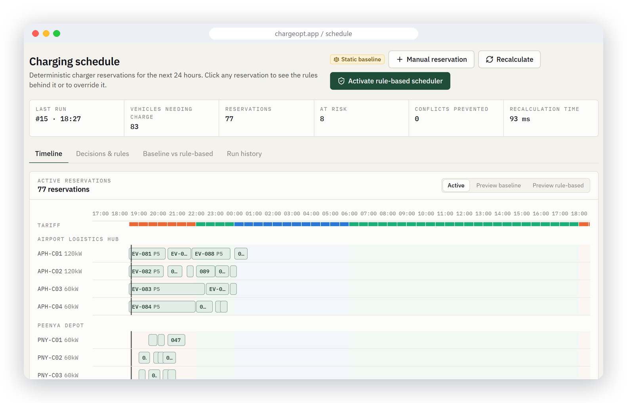







ChargeOpt plans every charge around the next departure
03 · THE SOLUTION
A deterministic rule engine that puts readiness first and cost second, and explains every decision it makes.
1 Sense
2 Size
3 Rank
4 Shift
5 Reserve
6 Adapt
SoC, trips, chargers
and live tariffs
kWh needed to reach
required SoC
P1 emergency
through P5 no trip
Cheapest window that
still makes departure
Conflict-free
charger slots
Re-plan on arrival,
fault or trip change
OPERATOR JOURNEY
Review fleet
Compare plans
Activate rules
Watch live
Override
Explainable by design
Baseline vs rule-based
Each reservation shows the
rule that created it
Both plans compared on the
same live fleet snapshot
LP-benchmarked
At-risk alerts
Within 3.2% of the HiGHS
optimum on price per kWh
Departures flagged before
they fail, with a fix
Every slot cites its rule: R1–R8, P1–P5
OCPP 1.6-J control
6 roles + audit trail
Remote start/stop and
power limits on chargers
Every override and config
change is traced
Notes:
What we built: ChargeOpt, a working fleet charging platform. How it works: every plan runs six steps — sense the fleet state, size the energy each vehicle needs for its next trip, rank vehicles P1 to P5, shift flexible charging into the cheapest window that still meets departure, reserve conflict-free charger slots, and re-plan whenever something changes. Why it is different: it is explainable — every reservation shows the rule that created it — and we benchmark the rules against a linear-programming optimum: they land within 3.2% on price. User flow: an operator reviews the fleet, compares the static baseline with the rule-based plan on the same snapshot, activates the rules, watches sessions live and overrides when reality intervenes. Value: readiness first, cost second, no black box.

Slide 4













An event-driven stack that re-plans 100 EVs in under 100 ms
04 · DEMO & SYSTEM ARCHITECTURE
React, FastAPI, PostgreSQL 16 and OCPP 1.6-J in three Docker containers, around one deterministic decision core.
USERS · 6 ROLES
EXPERIENCE
API & SECURITY
DECISION CORE
INTEGRATIONS
Fleet admin
React 18 SPA
FastAPI
Rule engine
Charge points
OCPP 1.6-J
Fleet manager
TypeScript · Vite
Tailwind · Recharts
TanStack · Leaflet
REST /api/*
WS /api/ws
OCPP /api/ocpp
R1–R8 · P1–P5
93 ms full re-plan
HTTPS
REST · WS
calls
OCPP · API
Fleet / ERP
Ops manager
API-key sync
LP benchmark · HiGHS
Charging operator
Price feed
nginx gateway
Ops loop · event re-plan
JSON · CSV tariffs
Driver
Auth & RBAC
Alerts · webhooks
TLS · static assets
/api proxy · /api/ws
Maps · webhooks
Viewer
JWT cookie · bcrypt
Tariffs · price feed
OSM · outbound alerts
EVENT PIPELINE
PostgreSQL 16
Docker Compose
Event
Re-plan
Reserve
WS push
Alert
15 entities · Alembic migrations
btree_gist exclusion: no double-booking
frontend · backend · db
+ OCPP emulator
Arrival, departure, charger fault or trip change
Notes:
Walk left to right. Six roles sign in through a React single-page app served by nginx, which also proxies the API and the live WebSocket. FastAPI exposes REST, a WebSocket feed and an OCPP 1.6-J endpoint for real charge points, behind JWT cookie auth and role-based permissions. The decision core is the deterministic rule engine, with a HiGHS linear-programming benchmark, an operations loop that re-plans on every event, alerts with webhooks, and a tariff service that accepts dynamic price feeds. PostgreSQL 16 stores 15 entities; a btree_gist exclusion constraint makes double-booking a charger impossible at the database level. Every event — an arrival, a fault, a trip change — triggers a full re-plan in about 93 ms, pushed to every screen over WebSocket. The whole thing ships as three Docker containers plus an optional OCPP charger emulator.

Slide 5








IBM Bob builds the engine; watsonx makes it conversational
05 · IBM TECHNOLOGY INTEGRATION
Bob is our AI engineering partner today. watsonx is the intelligence layer designed for next: AI advises, rules decide.
IBM Bob
IN USE
IBM watsonx
NEXT RELEASE
AI SDLC partner across the build
Intelligence layer around the engine
01 PLAN MODE
02 AGENT MODE
PRD → 11 modules and a
15-entity data model
Built the rule engine,
REST API and React UI
watsonx.data
Granite LLM
Fleet telemetry lake
ChargeOpt
rule engine
Explains every plan
03 ASK MODE
04 /REVIEW
decides,
explains, logs
Traced rule paths R1–R8
across the codebase
Reviewed every diff,
one-click fixes accepted
Granite TTM
watsonx.governance
Forecasts SoC & kWh
Audits AI advice
05 /ERD
06 BOB SHELL
“Why is EV-042
at risk, and what
fixes it?”
Generated the entity-
relationship diagram
Ran Docker, Alembic and
34 backend tests
Bob · Orchestrate
MCP server
Operator asks in chat
Typed fleet tools
AI advises
Rules decide
Everything audited
Why IBM: open Granite models, IP-indemnified on watsonx, deployable on-prem where utility data must stay.
Notes:
IBM Bob is load-bearing in how this was built: plan mode turned the PRD into modules and a data model, agent mode implemented the rule engine, API and UI, ask mode traced the rule paths, /review checked every diff, /erd produced the data-model diagram, and Bob Shell drove Docker, migrations and the test suite. watsonx is the next release, designed around a strict principle: AI advises, rules decide. watsonx.data holds fleet telemetry history; Granite TimeSeries forecasts arrival state of charge and trip energy, which enter the engine as inputs; a Granite language model turns each decision record into a plain-language explanation; watsonx.governance tracks every AI suggestion. An MCP server exposes typed fleet tools so a dispatcher can ask Bob or watsonx Orchestrate 'why is EV-042 at risk?' and get an answer grounded in the engine's own audit trail. The deterministic engine stays the decision authority, so every action remains explainable.

Slide 6







Same fleet, same chargers: 59% lower cost, 93.9% ready
06 · IMPACT & FUTURE SCOPE
Modelled on a 100-EV, 3-depot, 22-charger fleet over the next 24 h: static first-come-first-served baseline vs ChargeOpt.
−59%
93.9%
82% → 21%
−17%
energy cost per day
projected departure readiness
energy in the peak window
peak site load
₹37,570 → ₹15,540
from 87.9% · at-risk 8 → 4
71% now lands off-peak
1,245 → 1,031 kW
WHERE THE kWh LAND · NEXT 24 H
VALUE PER 100-EV FLEET / YEAR
ROADMAP
≈ ₹80 L
≈ ₹16 L
NOW
Hackathon MVP
3 depots · 100 EVs · OCPP 1.6-J
energy cost
avoided
demand charges
avoided
+3 MO
Live depot pilot
Real chargers, measured savings
Annualised from the modelled day
+6 MO
watsonx layer
Granite forecasts and explanations
SOCIAL IMPACT
+12 MO
Scale-out SaaS
1,000+ EVs · V2G · solar & storage
Grid relief
Cheaper EV km
Battery health
WHO BUYS IT
−214 kW at
the evening peak
₹6.60 vs ₹10.78
per kWh
Charge to need,
not to max
E-bus operators
Last-mile logistics
Ride-hailing fleets
Charge-point operators
Notes:
Impact, on the same 100-vehicle snapshot with the same chargers: planned energy cost falls 59%, from ₹37,570 to ₹15,540 for the next 24 hours; projected readiness rises from 87.9% to 93.9% and at-risk departures halve; the share of energy in the peak window drops from 82% to 21%; peak site load falls 17%. Annualised, that is roughly ₹80 lakh of energy cost and ₹16 lakh of demand charges per 100-vehicle fleet — modelled, not yet measured, which is exactly what the pilot is for. Socially: flatter evening grid peaks, cheaper electric kilometres, and batteries charged to what the trip needs rather than to maximum. Roadmap: a live depot pilot with real chargers in three months, the watsonx layer at six, and a multi-city SaaS for 1,000+ vehicles with V2G, solar and storage at twelve. Buyers: e-bus operators, last-mile logistics, ride-hailing fleets and charge-point operators.

