Slide 1


Challenges of Teaching OO Constructs with Databases
Shahram Ghandeharizadeh
Database Laboratory
Computer Science Department
University of Southern California

Slide 2
Outline
An overview of Introductory course to databases.
Object-oriented challenges.
Future role of object-oriented constructs in data intensive applications.

Slide 3
Database Systems
Used almost on a daily basis for either individual or business use.
Relational database vendors were one of the fastest growing sectors during the .COM boom!

Slide 4


Data Models
Build a database of all my assets for licensing and royalty collection

Slide 5


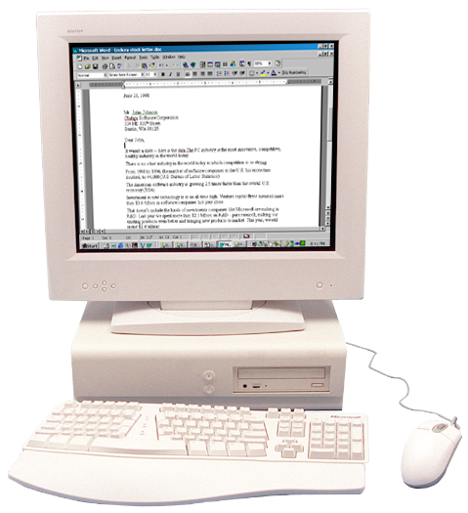
Data Models
Conceptual
Logical
Physical

Slide 6
Relational DBMS
Why?
  Performance!
  Reduced application development time
  Use of SQL makes access to data more uniform:
    Software modularity,
    Extensibility

Slide 7
Challenge 1
Make students aware of the importance of conceptual data modeling.

Slide 8
Challenge 1
Make students aware of the importance of conceptual data modeling.
Solution:
  No-one builds a house without a design.

Slide 9
Challenge 1
Make students aware of the importance of conceptual data modeling.
Solution:
  No-one builds a house without a design.
  Michael Jackson is picky and won’t pay for a system that does not meet his requirements.

Slide 10
Relational DBMS
Why?
  Performance!
  Reduced application development time
  Use of SQL makes access to data more uniform:
    Software modularity,
    Extensibility

Slide 11
Challenge 2
Two ways to teach this course:
  How to implement a DBMS?
    Protocols to realize atomic property of transactions
  How to use a DBMS?
    Setup a web server with a database and build a shopping bag
Key difference: discussion at both the logical and physical levels
Both require use of OO constructs

Slide 12
Challenges
Abstraction, Inheritance, Encapsulation
Conceptual
Reduction to tables with minimal: data duplication, potential for data loss and update anomalies
Logical
Effective use of a DBMS, management of mismatch between tables and OO constructs
Physical

Slide 13
Conceptual Data Models
Entity-Relationship (ER) data model
  Entities, Attributes, Relationships
SS#
name
Emp
address

Slide 14
Conceptual Data Models
Entity-Relationship (ER) data model
  Entities, Attributes, Relationships
SS#
Enrolled
in
Co-Pay
Emp
Health Plan
name
name
address

Slide 15
Conceptual Data Models
Entity-Relationship (ER) data model
  Entities, Attributes, Relationships
  Recursive relationships
SS#
Married
to
name
Emp
address

Slide 16
Conceptual Data Models
Entity-Relationship (ER) data model
  Entities, Attributes, Relationships
  Recursive relationships
SS#
Works
for
name
Emp
address

Slide 17
Conceptual Data Models
Entity-Relationship (ER) data model
  Entities, Attributes, Relationships
  Recursive relationships
SS#
Works
for
date
name
Emp
address

Slide 18
Conceptual Data Models
Entity-Relationship (ER) data model
  Entities, Attributes, Relationships
  Recursive relationships
  Inheritance
student
sid
name
Generalization
ISA
Specialization
Undergrad
graduate

Slide 19
Conceptual Data Models
Abstraction, Inheritance, Encapsulation
Exercise these concepts using in-class examples and homework assignments
  A library database contains a listing of authors who have written books on various subjects (one author per book). It also contains information about libraries that carry books on various subjects.

Slide 20
Conceptual Data Models
Abstraction, Inheritance, Encapsulation
Exercise these concepts using in-class examples and homework assignments
  A library database contains a listing of authors who have written books on various subjects (one author per book). It also contains information about libraries that carry books on various subjects.
  Entity sets: authors, subjects, books, libraries
  Relationship sets: wrote, carry, indexed

Slide 21
Conceptual Data Models
Abstraction, Inheritance, Encapsulation
Exercise these concepts using in-class examples and homework assignments
  A library database contains a listing of authors who have written books on various subjects (one author per book). It also contains information about libraries that carry books on various subjects.
Subject
matter
title
isbn
SS#
authors
wrote
books
index
subject
name
address
libraries
carry

Slide 22
Data Models
SS#
Works
for
name
Emp
address
Logical
Physical

Slide 23
Relational Data Model
Prevalent in today’s market place.
  Why? Performance!
Everything is a table!
Logical data design is the process of reducing an ER diagram to a collection of tables.

Slide 24
Logical Data Design
Trivial reduction:
  An entity set = a table
  A relationship set = a table
Pitfalls:
  Duplication of data
  Unintentional loss of data
  Data ambiguity that impacts software design, resulting in update anomalies

Slide 25
Data Duplication
SS#
Works
for
name
Emp
address
SS# | Name | Address
SS# | MGR SS#
396 | Shahram | Seattle
400 | Asoke | Chicago
200 | Joe | New York
396 | 400
200 | 400
120 | 400

Slide 26
Data Duplication
SS#
Works
for
name
Emp
address
SS# | Name | Address
SS# | MGR SS#
396 | Shahram | Seattle
400 | Asoke | Chicago
200 | Joe | New York
396 | 400
200 | 400
120 | 400
The SS# column is duplicated!

Slide 27
Data Duplication: Solution
Merge the two tables into one:
SS#
Works
for
name
Emp
address
SS# | Name | Address | MGR SS#
396 | Shahram | Seattle | 400
400 | Asoke | Chicago | NULL
200 | Joe | New York | 400

Slide 28
Data Loss
Ford maintains warehouses containing different automobile parts
Records are inserted and deleted based on availability of a part at a warehouse
Part# | Description | Location
123 | Piston | Tijuana
203 | Cylinder | Michigan
877 | Bumper | Michigan
389 | Seats | Arizona

Slide 29
Data Loss (Cont…)
When a warehouse becomes empty, it is lost from the database:
Solution: utilize two different tables
Part# | Description | Location
123 | Piston | Tijuana
389 | Seats | Arizona
Part# | Description | WHID
WHID | Location
123 | Piston | 12
389 | Seats | 45
12 | Tijuana
45 | Arizona

Slide 30
Data Ambiguity
Represent faculty of a department as:
A change of address for a faculty might be for the entire department. This cannot be differentiated with this table design!
Faculty | Department | Location
Ghandeharizadeh | Comp Sci | SAL
Papadopoulos | Comp Sci | SAL
Bohem | Comp Sci | SAL

Slide 31
Data Ambiguity
Utilize two tables:
Faculty | Department
Department | Location
Ghandeharizadeh | Comp Sci
Papadopoulos | Comp Sci
Jenkins | Bio Medical
Bohem | Comp Sci
Comp Sci | SAL
Sex Ed | BOVARD
Bio Medical | HEDCO

Slide 32
Data Ambiguity (Cont…)
Employees of a bi-lingual company having different skills.
Update anomalies!
Employee | Skill | Language
Asoke | Teach | Hindi
Asoke | Cook | French
Asoke | Null | German
Asoke | Program | English

Slide 33
Data Ambiguity: Solution
Utilize two tables:
Employee | Language
Employee | Skill
Asoke | Hindi
Asoke | French
Asoke | German
Asoke | English
Asoke | Teach
Asoke | Cook
Asoke | Program

Slide 34
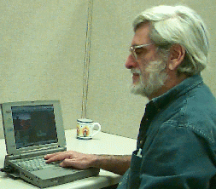
Logical Data Design
A quest to flatten objects with minimal data duplication, loss of data, and update anomalies!
William Kent, “A Simple Guide to Five Normal Forms in Relational Database Theory”, Communications of the ACM 26(2), Feb 1983, 120-125.

Slide 35
Data Models
SS#
Works
for
name
Emp
address
Logical Data Design
SS# | Name | Address | MGR SS#
396 | Shahram | Seattle | 400
400 | Asoke | Chicago | Null
Physical

Slide 36
Physical Implementation
Reconstruct main memory objects for manipulation and presentation:
  Specify class definitions
    Typically correspond to entity-sets
  Populate an instance of a class by issuing SQL queries to a DBMS
  Update instances in memory
  Flush dirty instances back to DBMS
    Potential use of transactions

Slide 37
Type Mismatch
A column of a row must be a primitive such as an integer, real, etc.
  It may NOT be an array of integers or object pointers
A property (attribute) of a class might be of a multi-valued type, e.g., an array, a vector, etc.
Changes in software may impact the design of tables. (Management of type mismatch by the system designer.)

Slide 38
Implementation
Set operators in the DBMS
  Does set A contain set B?
  Does value v1 appear in set A?
Aggregates in the DBMS
  Compute average employee salary
  Count the number of employees
  Find the oldest employee

Slide 39
Challenges
Abstraction, Inheritance, Encapsulation
Conceptual
Reduction to tables with minimal: data duplication, potential for data loss and update anomalies
Logical
Effective use of a DBMS, management of mismatch between tables and OO constructs
Physical

Slide 40

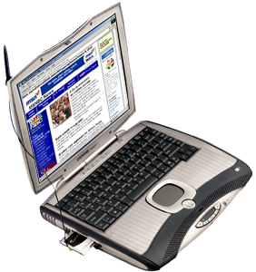
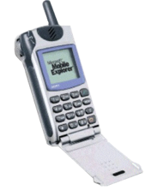

A Shift in Computing
Internet
1985-2000
1999+
Server-centric Distributed
Dumb clients Smart clients
Hardware-driven Software-driven
User to app User to app; app to app
Information access Information action
One-way Two-way
Monolithic islands peer-to-peer
Integration an afterthought Integration by design
Challenge: scale Challenge: value

Slide 41

Future Vision
In the future, any two IT components will automatically integrate and “communicate” with one another, even though they were not specifically designed to interoperate
How?
  Semantics
  Standards
  Concept of “software and data” as a service, web service, e.g.,
    Google as a web service
    Microsoft Teraserver web services
    Experian (TRW) credit report web services
    Etc.

Slide 42
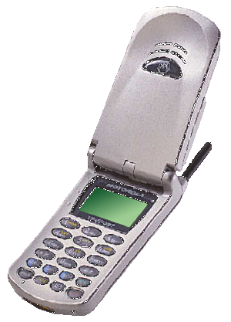
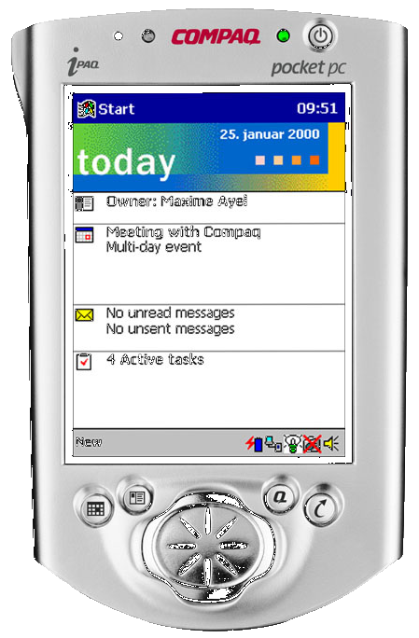
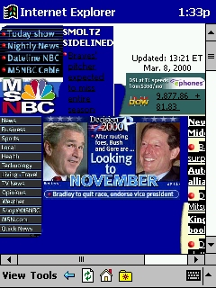


XML
A standard for data interoperability among web services
  Language independent
    Sun’s Java, Microsoft’s C#
  Device and software platform independent
Motorola i85s
J2ME
Compaq iPAQ
Windows CE
StrongARM
.NET
SQL 2000
Commerce server
Windows 2000
PERL
Apache 2.0
MySQL
Linux

Slide 43
Future Challenge
Educate students to see Internet as an object-oriented software platform!
Software at an Internet scale must be:
  Robust: Physical location independence
  Ensure availability of data and functionality at all times
  Modular and Extendible
  Integrate with other software components

