Slide 1

Every company gets 5× the applicants.
Nobody added 5× the recruiters.
Aster is the AI recruitment platform that reads every resume, ranks applicants against the role, and books the interviews, so hiring starts from a shortlist instead of a pile.
AI screening & ranking
Interview scheduling
One shared pipeline
Series A · Investor deck · August 2026

Slide 2
WHY NOW
Screening is the bottleneck, and it's the task AI does best
The shape of hiring changed. Applications exploded while recruiter capacity stayed flat, and the first pass, reading and ranking every CV, is exactly what modern AI does faster and more consistently than a person.
▲
⧗
◆
The volume
The squeeze
The unlock
One-click apply and job boards put dozens to hundreds of applicants on every open role. The pile grew; the day didn't.
Recruiter headcount is flat or shrinking. The same team is expected to screen far more, far faster.
Generative AI reads, structures and scores a resume in seconds, at a cost measured in cents, for the first time.
The window: the buyer now feels the pain and, for the first time, an AI-native platform can solve it at a price SMBs will pay. That gap is the opening Aster is built for.
Aster · Investor deck
2

Slide 3
THE PROBLEM
Manual screening is slow, costly and hard to defend
Reading CVs one at a time doesn't scale. The cost shows up in speed, in money, and in decisions nobody can explain later.
23 hrs
The best leave first
5 gut calls
spent screening per hire, on average, before the first real conversation.
Top candidates accept elsewhere while strong applications sit unread in the pile.
Five interviewers, five opinions, no shared record. Good hires are luck, not process.
The tooling makes it worse
Legacy applicant tracking systems store CVs but don't read them. AI point tools screen but don't run the workflow. Everyone else lives in spreadsheets, inboxes and calendars, where candidates fall through the gaps.
Screening-time figure is an industry-reported average; shown for context, not an Aster measurement.
Aster · Investor deck
3

Slide 4
THE SOLUTION
Start from a shortlist, not a pile
Aster does the first pass on every applicant, so hiring managers open a ranked, reasoned shortlist the moment they log in.
R
AI
→
Reads every CV
Ranks against the role
Books the interviews
Structured skills, experience and a one-line summary in seconds, however each candidate wrote it.
A match score with the reasons, strongest fits on top, so you know who to talk to first.
Candidates self-book, a Meet or Teams link is created automatically, and reminders cut no-shows.
3× faster shortlists
46 → 3 applicants to shortlist
~2 weeks sooner to hire
Aster product outcomes; results vary by role and volume.
Aster · Investor deck
4

Slide 5
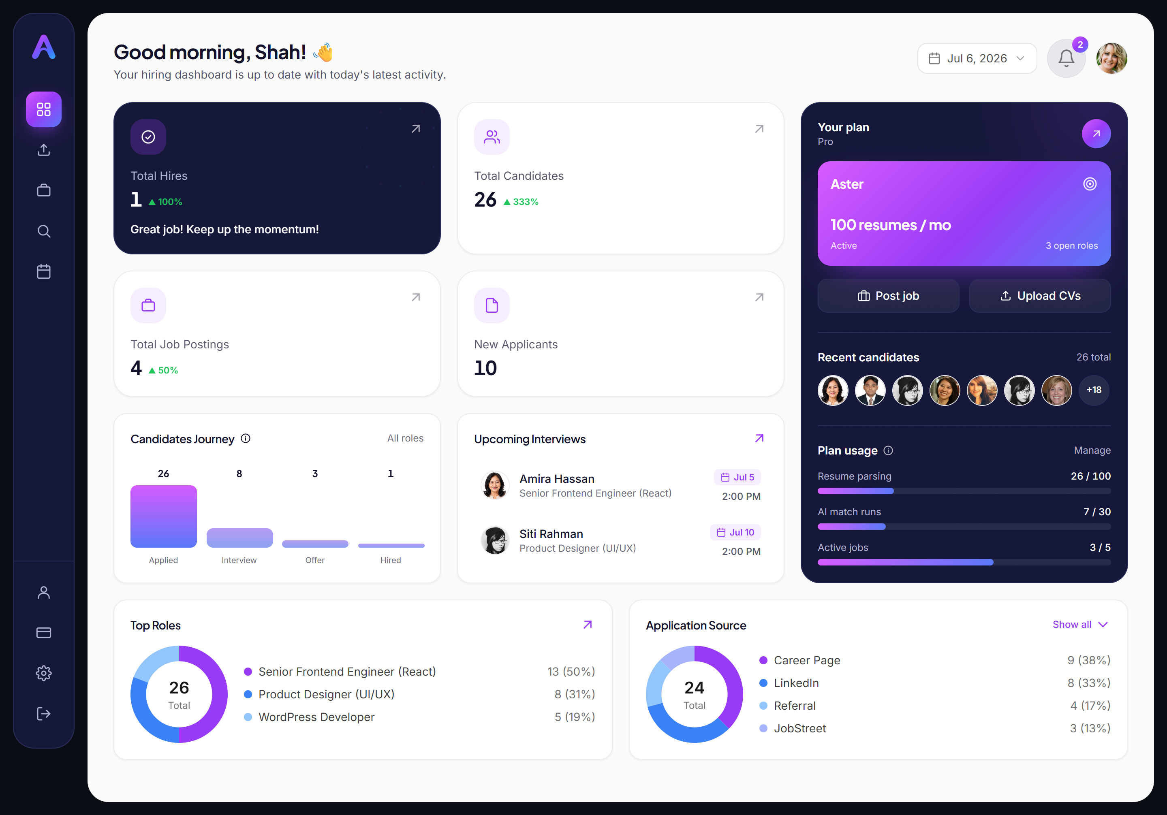
THE PRODUCT
One hiring command center
Built and shipping today
A live funnel from Applied to Interview to Offer to Hired.
Ranked shortlists with a match score and reasons on every applicant.
Interviews, scorecards and offers tracked on one candidate record.
Source performance and time-in-stage analytics.
Usage and plan limits, always visible.
Not a prototype. A working platform, in market, that a team can run a real hire on today.
Live Aster hiring dashboard.
Aster · Investor deck
5

Slide 6
THE MOAT
We engineered our cost of goods
Every AI task runs on the cheapest model that does it well. Our cost per hire stays low as volume scales, a structural margin edge over tools that route everything through one frontier model.
AI task | Model | Why this model
Job description drafting | Opus (top tier) | Low volume, highest writing quality where it shows.
Resume screening & parsing | Sonnet (mid tier) | Accurate structured extraction at high volume.
Candidate ranking | Sonnet (mid tier) | Reasoned scoring against the role, with explanations.
Experience insights | Haiku (fast tier) | High volume, fast and cheap, quality is sufficient.
Interview questions | Haiku (fast tier) | High volume, fast and cheap, quality is sufficient.
The result: 80–91% gross margin on AI usage, held by design, not by hoping model prices fall. Competitors copying the features still can't copy the cost structure.
Aster · Investor deck
6

Slide 7
BUSINESS MODEL
Recurring subscriptions, plus usage that expands
Four tiers with unlimited seats remove the adoption barrier; usage-based AI credits then grow revenue inside every account as they hire more.
Launch
Scale
Elite
Enterprise
RM99 / mo
RM599 / mo
RM1,399 / mo
Custom
First roles
Small teams
Hiring at volume
Own AI account
1
Land
2
Expand
3
Ascend
4
Retain
Unlimited seats and a low entry price get the whole team onto one board fast.
Every extra hire consumes AI credits, so revenue grows with the customer's success.
Volume hirers move to Elite and Enterprise, where the biggest budgets live.
The pipeline becomes the system of record, and the switching cost, for hiring.
Land-and-expand: low friction to start, revenue that compounds as each account hires more.
Aster · Investor deck
7

Slide 8
UNIT ECONOMICS
Every layer of revenue is higher-margin than the last
Gross margin rises as an account grows: from subscription, to AI credit top-ups, to Enterprise running AI on its own account.
Plan subscriptions ~68%
Blended across tiers, after AI cost, Stripe fees, infrastructure and the 10% channel-partner share on plan revenue.
AI credit top-ups ~80–91%
Priced per action with a minimum top-up. Pure margin expansion on top of the subscription, no partner share.
Enterprise ~95%+
Customer connects its own AI account, so Aster carries almost no variable AI cost. Licence from RM30k/mo.
Margins modeled from provider pricing (Anthropic, Stripe, infrastructure). Detail in the pricing model.
Aster · Investor deck
8

Slide 9
MARKET
A large market, growing fast, at the AI inflection
AI recruitment is the fastest-growing slice of HR tech, and it is moving from experiment to default workflow right now.
14.3% CAGR
What's driving it
AI in HR crossing from pilot to standard practice.
Generative AI making per-hire screening genuinely cheap.
Hiring teams growing faster than recruiter headcount.
Buyers consolidating off fragmented, manual tools.
Aster's wedge: AI-native, priced for SMB through enterprise, multi-currency, with a Southeast Asia home market that global players underserve.
Source: AI recruitment platform market outlook, 2026 (US$6.1B in 2026 to US$17.9B by 2034, 14.3% CAGR).
Aster · Investor deck
9

Slide 10
WHY WE WIN
AI-native, full-workflow, priced for the mid-market
Legacy ATS platforms store CVs but don't read them. AI point tools screen but don't run the hire. Aster does both, at a price the mid-market will pay.
 | Aster | Legacy ATS | AI point tool
AI screening & ranking built in | ✓ | — | ✓
Full workflow: career site to offer | ✓ | ✓ | —
Unlimited seats | ✓ | — | ~
Usage-based AI pricing | ✓ | — | —
Multi-currency, SEA focus | ✓ | ~ | —
Engineered, multi-model AI cost | ✓ | — | —
Comparison is directional, across typical products in each category, not a specific vendor.
Aster · Investor deck
10

Slide 11
VISION
From screening tool to hiring system of record
Screening is the wedge. The pipeline is the platform. Every hire adds data that makes the next hire faster and the account harder to leave.
Now
Next
Later
LIVE TODAY
12–18 MONTHS
THE PLATFORM
AI screening, ranking & insights
Interview self-scheduling
One shared pipeline & scorecards
Usage-based AI credits
Talent CRM & candidate re-engagement
HRIS & job-board integrations
Deeper hiring analytics
SSO, audit & white-label for Enterprise
Predictive sourcing & outreach
Multi-language screening across SEA
Partner & template marketplace
The hiring data layer for a region
The same pipeline serves a founder's first hire and an enterprise's thousandth, so the market expands underneath a single product.
Aster · Investor deck
11

Slide 12
THE MODEL
Revenue scales fast with a few enterprise logos
Illustrative account-mix scenarios on current pricing. A handful of Enterprise accounts (RM30k/mo floor) is the swing factor.
CONSERVATIVE
BASE
GROWTH
RM883K
RM2.31M
RM5.62M
projected ARR
projected ARR
projected ARR
Accounts 60 · 30 · 10 · 1
Accounts 120 · 70 · 25 · 3
Accounts 250 · 150 · 60 · 8
~68% blended gross margin at base case. Accounts shown as Launch · Scale · Elite · Enterprise.
Illustrative scenarios on current pricing, not a forecast or committed revenue.
Aster · Investor deck
12

Slide 13
THE ASK
Raising a Series A to turn the product into a category leader
RAISING
Where it goes
RM10M
45%
Product & AI engineering
Ship the Next roadmap: CRM, integrations, enterprise readiness.
≈ US$2.5M
35%
to reach RM10M ARR in 36 months.
Go-to-market
Sales and marketing to land and expand paying accounts.
12%
Customer success
Onboarding and retention that drives net revenue expansion.
8%
G&A
Finance, compliance and the hires that support scale.
Raising RM10M (≈ US$2.5M) to reach RM10M ARR within 36 months. Allocation is indicative and adjusts with the plan.
Aster · Investor deck
13

Slide 14
Start from a shortlist,
not a pile.
AI recruitment for growing teams, from first hire to enterprise. Built, in market, and engineered to scale at margin.
hireaster.com · shahramly83@gmail.com

