Slide 1

Dental Clinic Problem

Slide 2

Submitted To
Dr. Md. Nawab Yousuf Ali
Professor Department of Computer Science & Engineering

Slide 3
Submitted By
1. B M Shahria Alam
2021-3-60-016
2. Tasmiah Rahman Orpa
2021-3-60-021
3. Sidratul Moontaha
2021-3-60-048

Slide 4
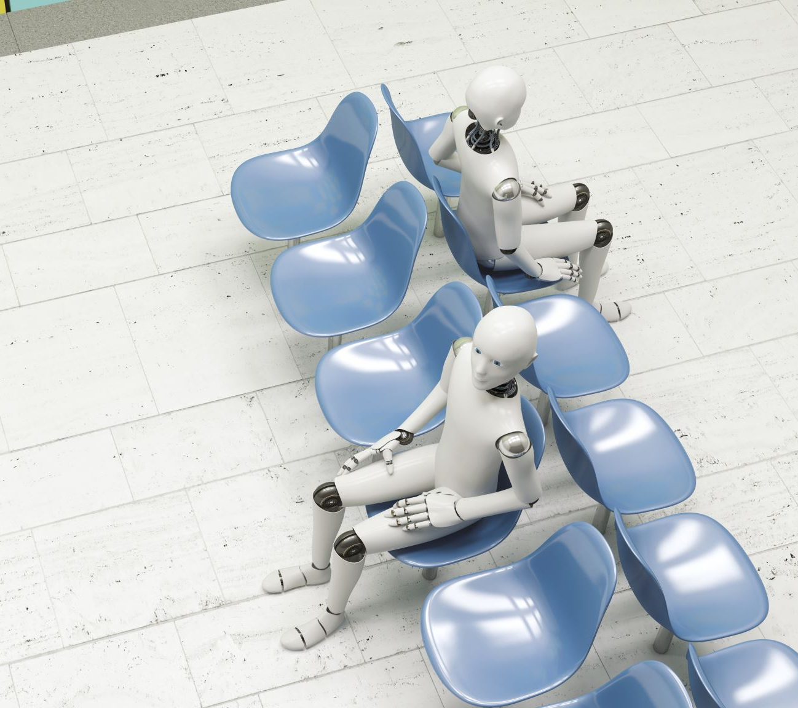
Project Description
The question states that this dental clinic has one dentist with one dental chair and n chairs for waiting. When there is no patients , the dentist sleeps in his chair. When a patient arrives he has to wake up the dentist. Only one patient can attend the dentist at a time. Other patients will wait if there is empty chairs otherwise they will leave.

Slide 5

Topics we have used

Slide 6
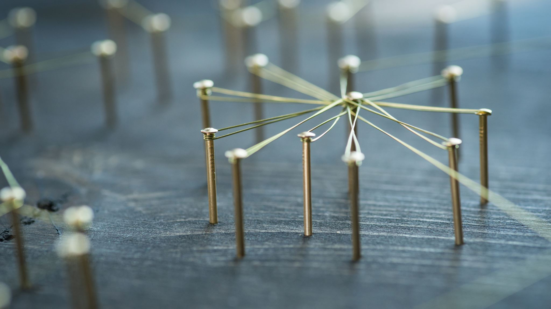
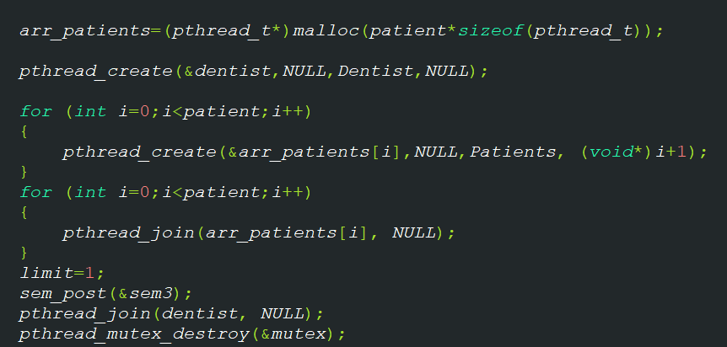
Threads

Slide 7

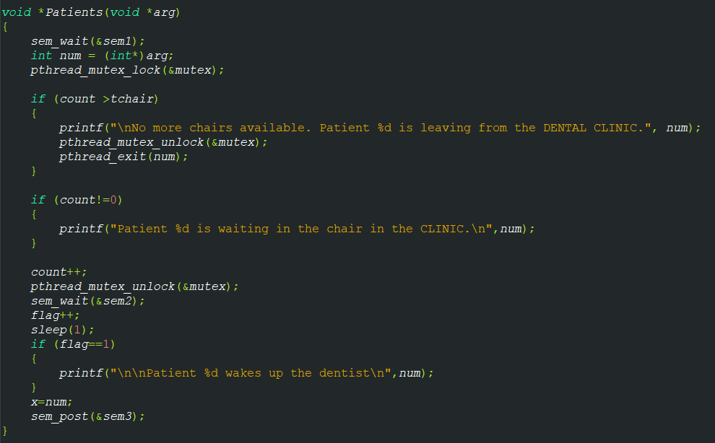
MUTEX LOCK

Slide 8

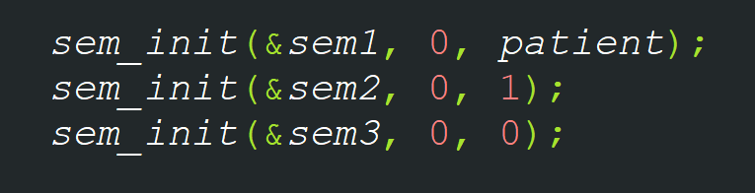
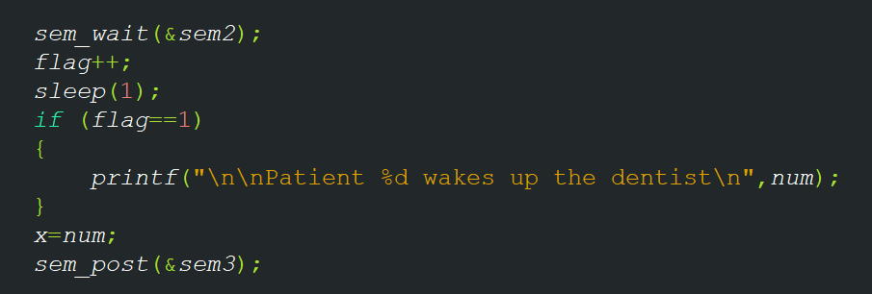
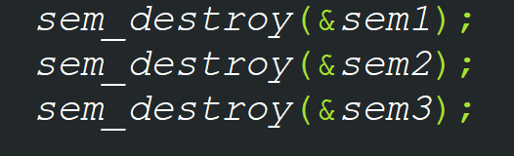
semaphores

Slide 9


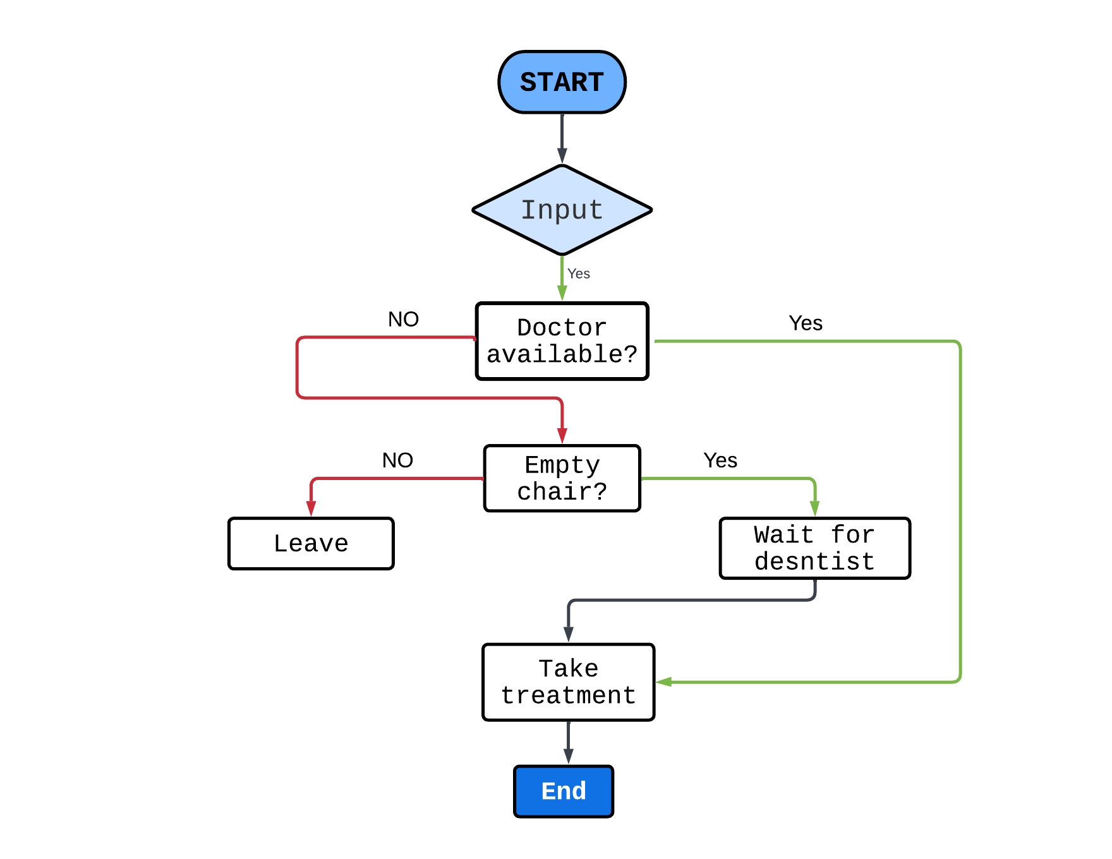
Flow Chart

Slide 10
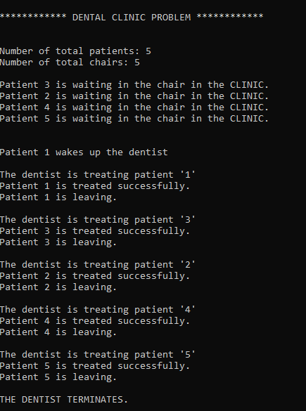
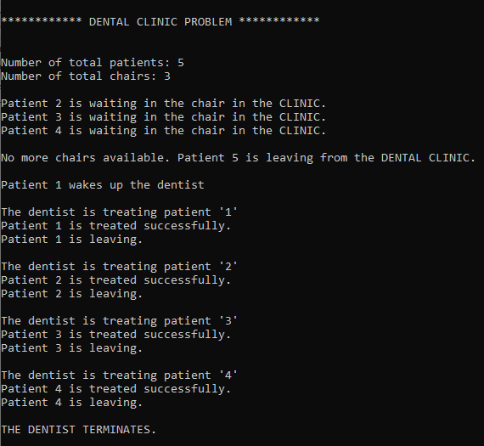

Output

Slide 11
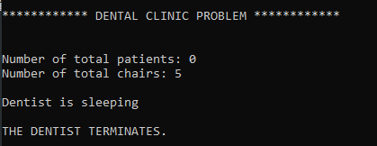
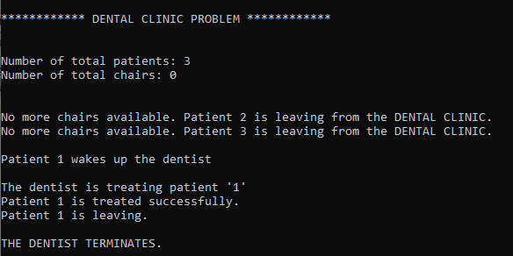
OUTPUT

Slide 12

Thank you

