Slide 1

IMPORTANCE OF ETHICS
IN ENGINEERING CAREER
Prepared by
Abdullah Shahriar
ID- 1711037
Department of Materials & Metallurgical Engineering

Slide 2
DEFINITION
WHAT IS ENGINEERING ETHICS?
Engineering ethics is the set of rules and guidelines that engineers adhere to as a moral obligation to their profession and to the world.
It is the study of moral issues and that reflects the individual personality.
WHY FOLLOW ENGINEERING ETHICS?
The primary obligation of an engineer is to protect the safety, health, property and welfare of the public.
No matter what type of engineer one is, engineering ethics is important because if it is not followed one might be putting his own and someone else’s life in danger.
So engineers should always be aware that their safety and the safety of those around them comes before anything.

Slide 3
WHAT ARE THE COMMON ETHICAL VALUES?
ETHICAL VALUES
Some of the most important ethical values which must be followed in both personal and professional life is-
Honesty
Tolerance
Has to be honest in speech and action
Should be tolerant of others opinions
Truthfulness
Respect
Always express the truth
Should be respectful to others
Loyalty
Public Safety
Should be faithful and obedient
Public safety should always be prioritized
Confidentiality
Diligence
Confidentiality of the project should be maintained
Has to be persistent in work and effort

Slide 4
IMPORTANCE
IMPORTANCE OF
ETHICS
IN ENGINEERING CAREER
SAFETY
SAVE WORLD & ENVIRONMENT
01
Following proper ethics in professional life can ensure the safety of thousands of lives
04
Damage towards environment and our planet can be reduced
MINIMIZE LOSS
SELF SATISFACTION
02
Financial loss of a company or country can be minimized
05
Being ethical in profession is a matter of true satisfaction
WELFARE
RELIABILITY
03
Through the ethical actions of an engineer the welfare of public and country can be secured
06
Most importantly it makes an engineer such an individual on whom one can rely on

Slide 5

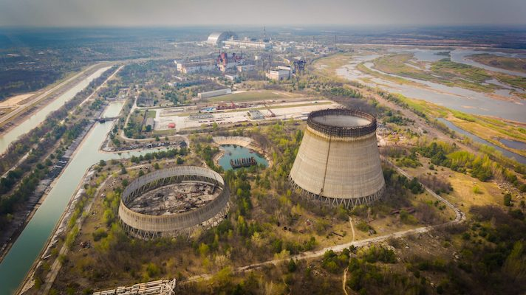
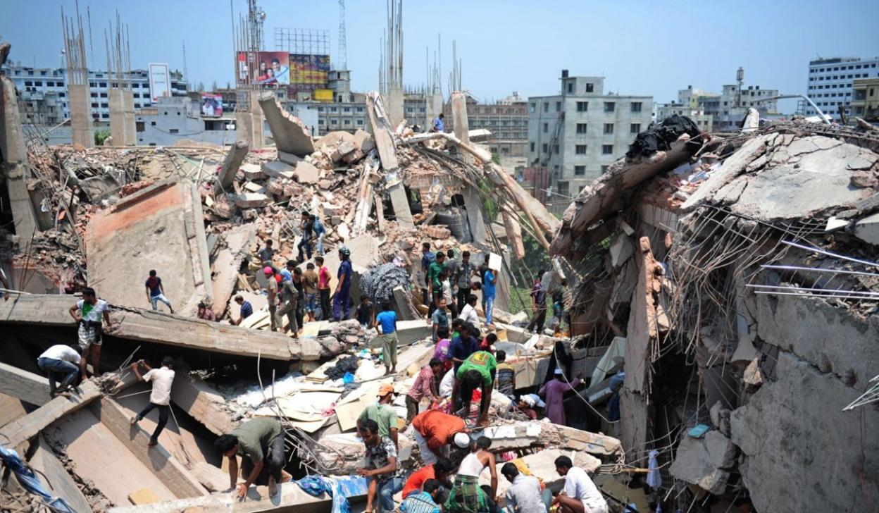
WHAT HAPPENS WHEN ETHICAL VALUE COLLAPSES?
CONSEQUENCES OF
FAILURE
Columbia Disaster
2003
Rana Plaza Tragedy
2013
Chernobyl Disaster
1986

Slide 6

Thank you!

