Slide 1
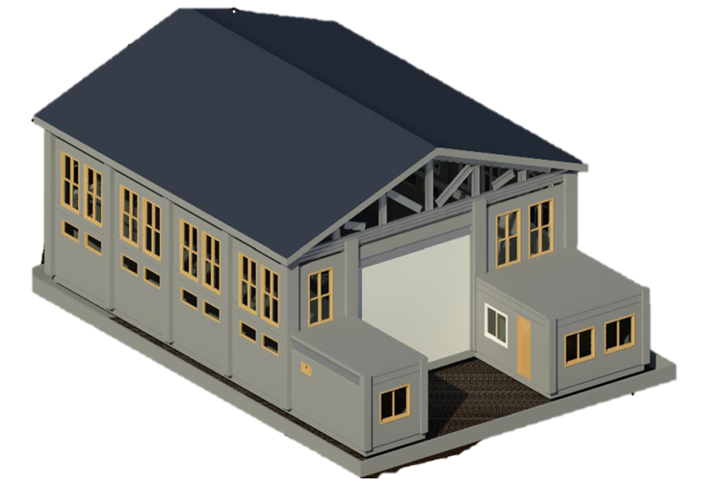

GROUP 4
A MODEL SOLID WASTE MANAGEMENT SYSTEM AT COMMUNITY LEVEL
CE 404
Capstone Project
Presented By
1904070 Humaira Jannat Taki (DTL)
1904072 Shahriare Mahmud Sakib (TL)
1904075 Muaz Hossain Mahi
1904076 Fahim Zafri
1904080 Md. Ausaf Alam
1904082 Akash Saha
|| PAGE 1

Slide 2


Background and Vision of the project
Problem of Statement :
Rapid population growth in Dhaka has overwhelmed the current solid waste management system.
Existing infrastructure is unsustainable, causing pollution, land wastage, and inconvenience to city life.
A redeveloped Secondary Waste Transfer Station will enable:
Efficient waste compaction, segregation, and recycling
Reduction in environmental pollution and resource wastage
Doorstep segregated waste collection
Better waste transport systems
|| PAGE 2

Slide 3
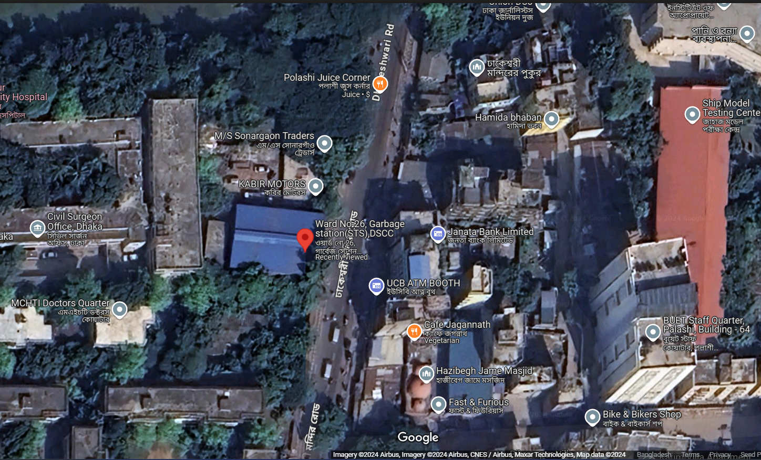
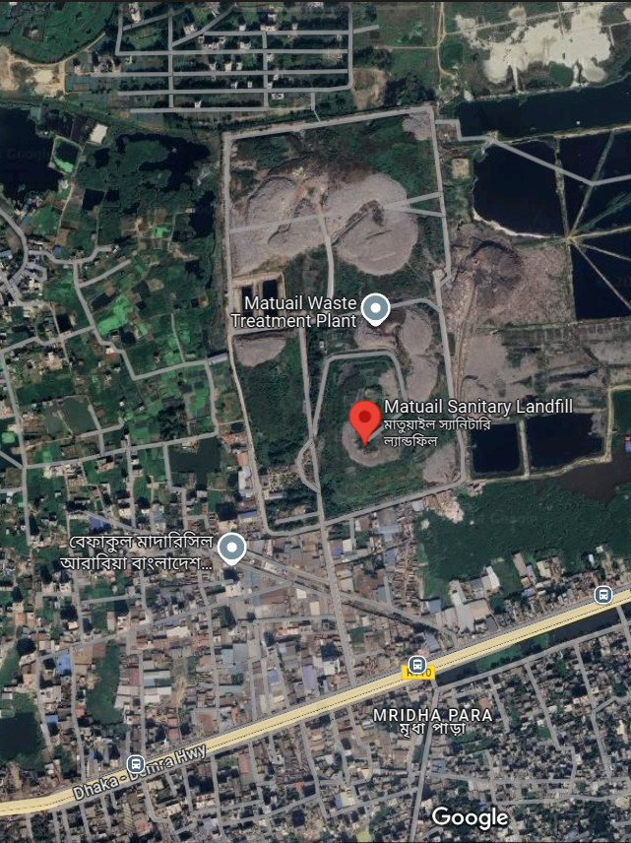
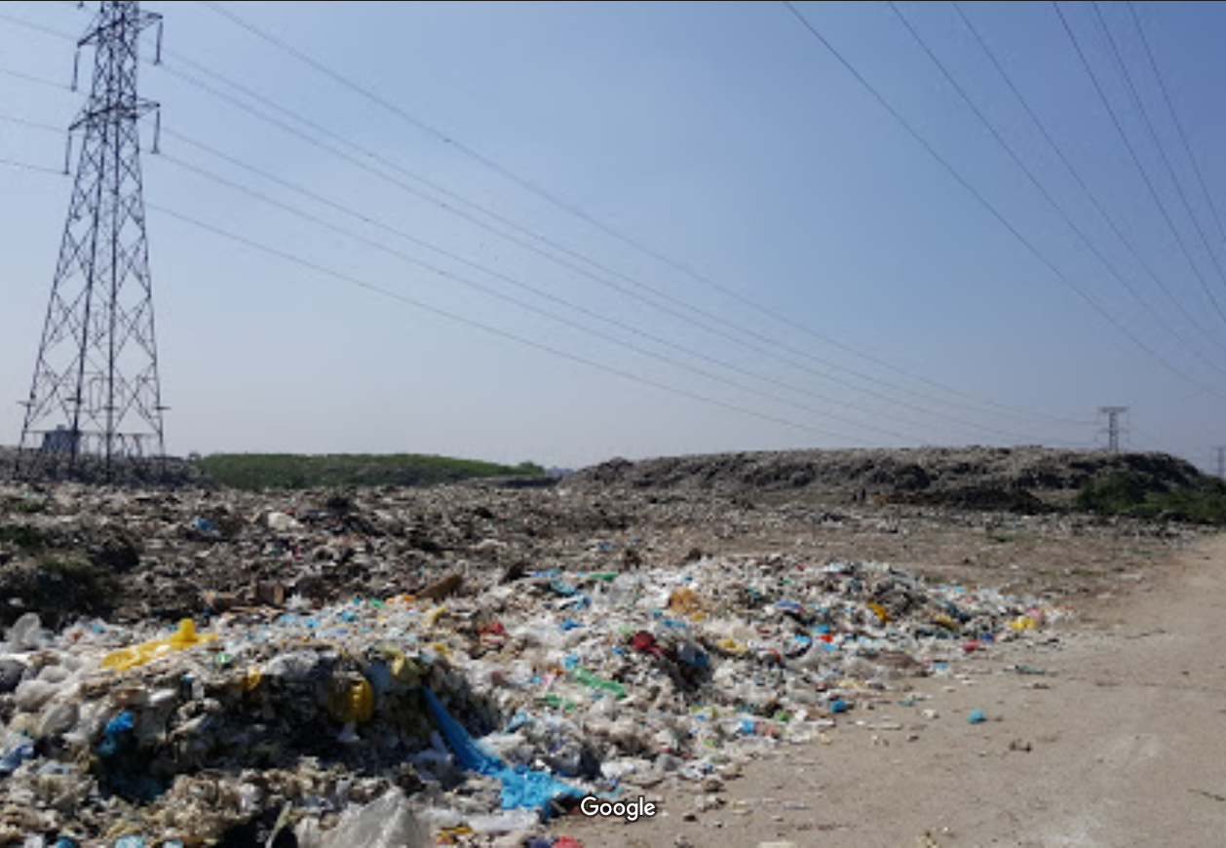

Project Description & Location
Project Background
(a)
(b)
(c)
Figure: Google Map: (a) Polashi Waste Transfer Station; (b)Disposal land, Matuali; (c) Effect of Present Solid Waste Management at Matuail
Project Location
Dhakeshwari Road,
Ward No. 26
Dhaka South City Corporation.
Latitude 23° 72' 42" and Longitude 90° 38' 86"
|| PAGE 3

Slide 4
Basic Information
Sponsoring Ministry
Implementing Agency
Project Objective
Estimated Project Budget
Ministry of Local Government
Dhaka South City Corporation (DSCC)
Implement a Sustainable Solid Waste Management System
4.10 Crore (BDT)
Sector & Sub-Sector
Project Category
Geographic Location
Project Duration
Environment
Yellow
Dhaka South City Corporation, Lalbag, Dhaka, Bangladesh
1 Years
|| PAGE 4

Slide 5
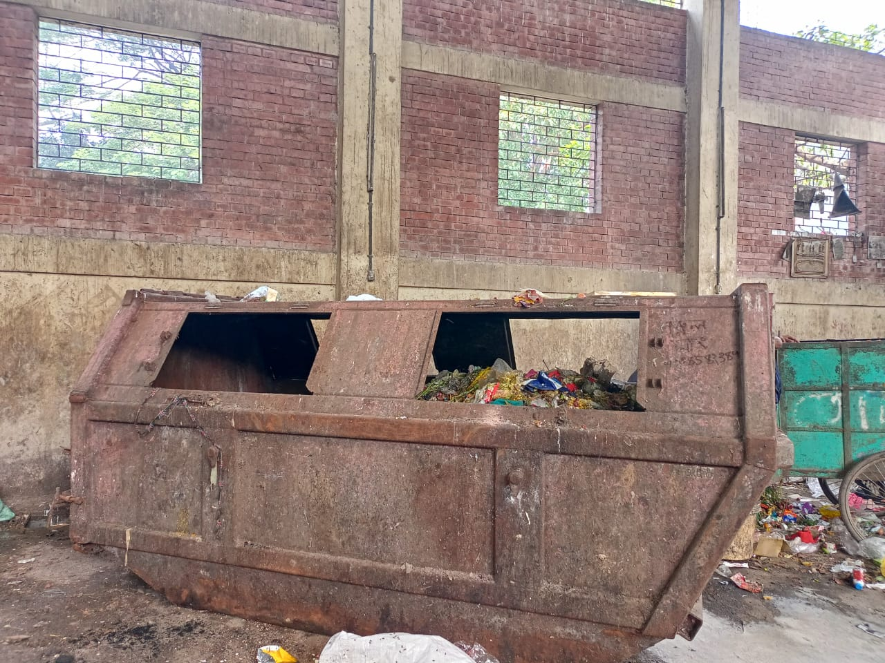
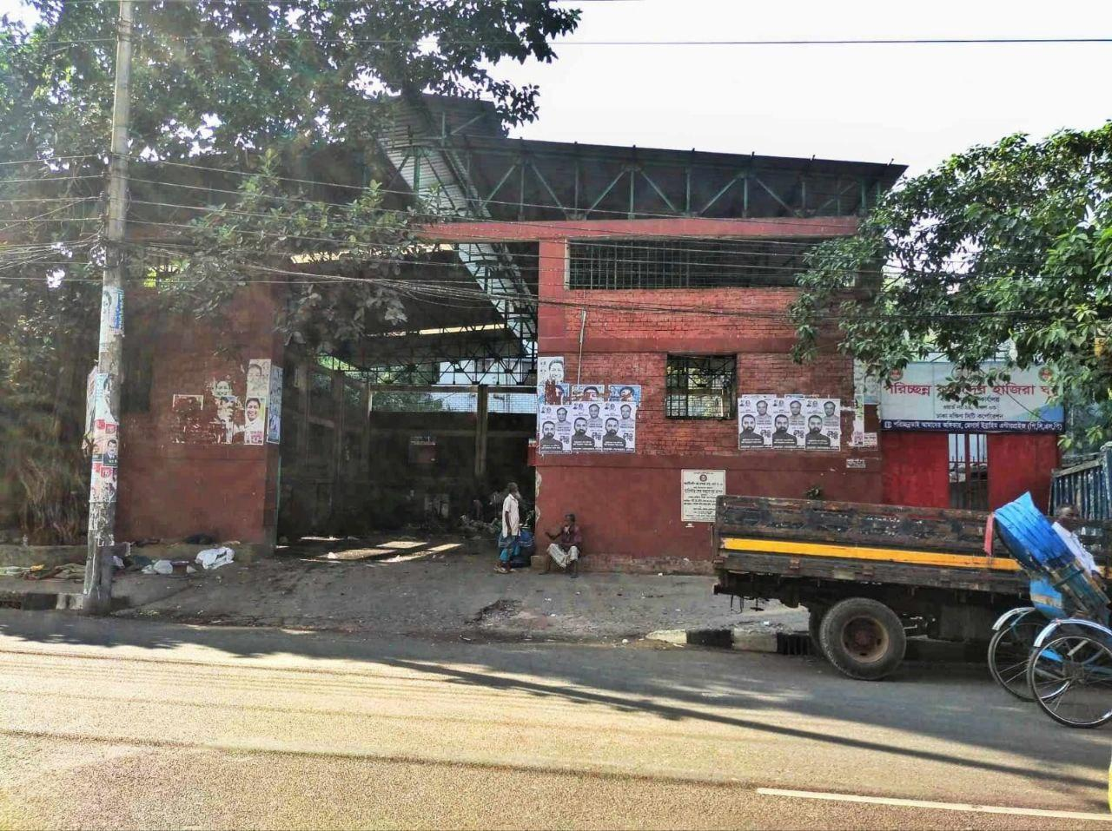
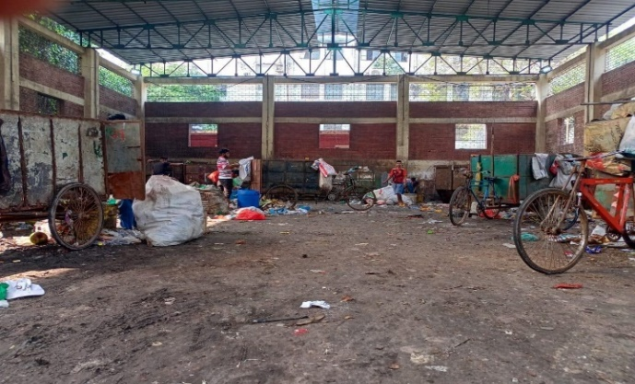
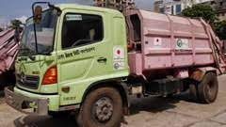
Feasibility Analysis
Field Visit and Conditional Survey
A. Existing Condition
B. Containers
Number-7
Volume- 5 tons
Dimension- 10’x5.5’x6’
C. Vans
Number-30
Volume- 1500 kg
Dimension- 2m x1m x 2m
Collection points: Chawkbazar,
Lalbagh, Azimpur Colony
2 trips per day per van
D. Trucks
Number-2 (One container at a time)
Time: 11:30 PM- 12:00 AM
Transferred to Jatrabari
|| PAGE 5

Slide 6
Feasibility Analysis
Case Study
 | Star Square Ultra-Modern Mechanized Garbage Transfer Station at Indore, India | Jinxiang Wet Garbage Station at Changsha, China | Waste Compaction Station at the city of Kolkata, India | Secondary Waste Transfer Station at Lalbagh, Dhaka
Waste Collection Process | Separate (Dry-Wet) | Separate (Dry-Wet) | Separate (Dry-Wet) | Mixed
Waste Segregation System | Both manual and Automatic | Automatic | Manual | Absent
Waste Recycling Process | Moderate | Full | Partial | No Recycle
Compactor | Auto Pilot mode | Full automatic computerized | Manual mode | Absent
|| PAGE 6

Slide 7

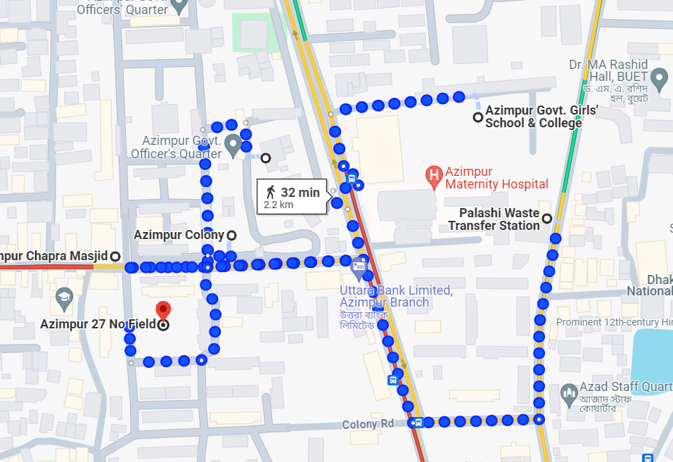
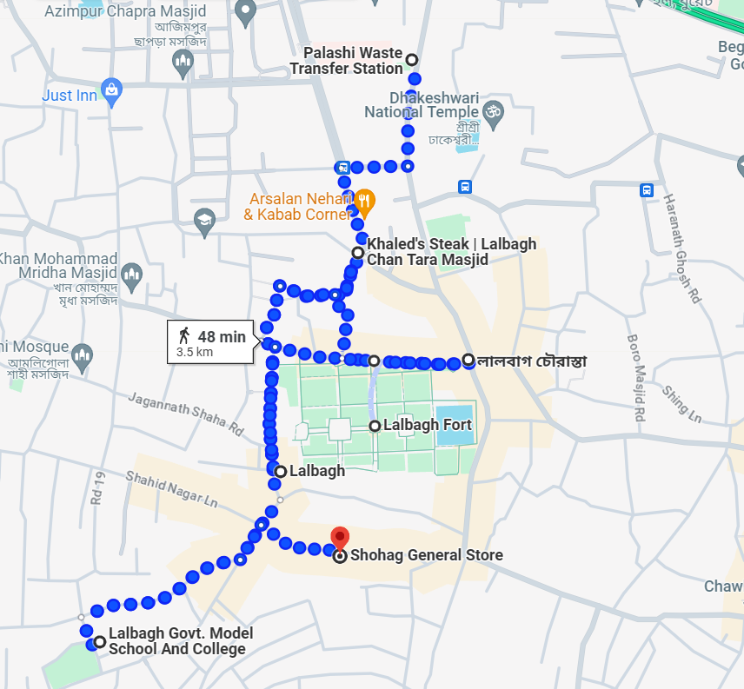
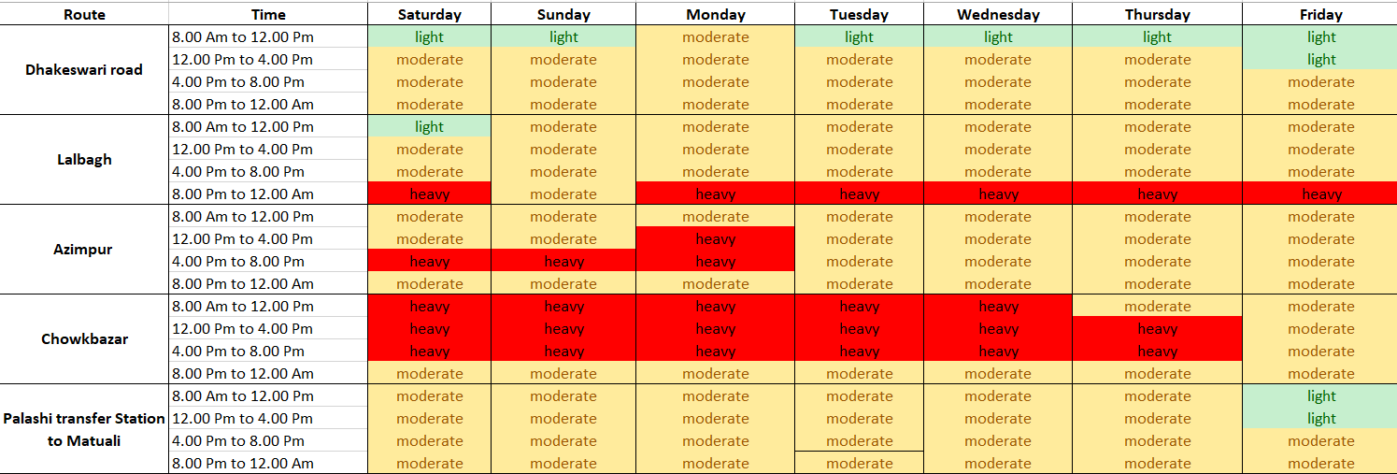
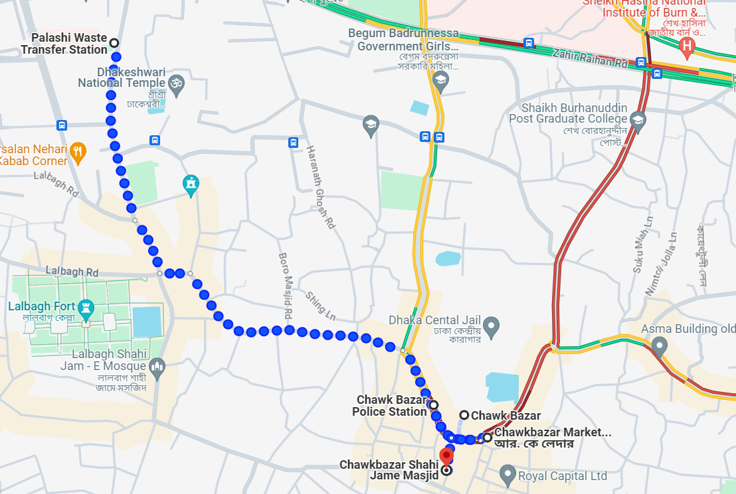
Feasibility Analysis
Traffic Impact Analysis
Table: Traffic Flow situation
a
b
c
Capacity
2424 PCU/hour
Figure: Collection routes: (a) Azimpur Colony; (b) Chawkbazar; (c) Lalbagh
Demand
2041 PCU/hour
|| PAGE 7

Slide 8
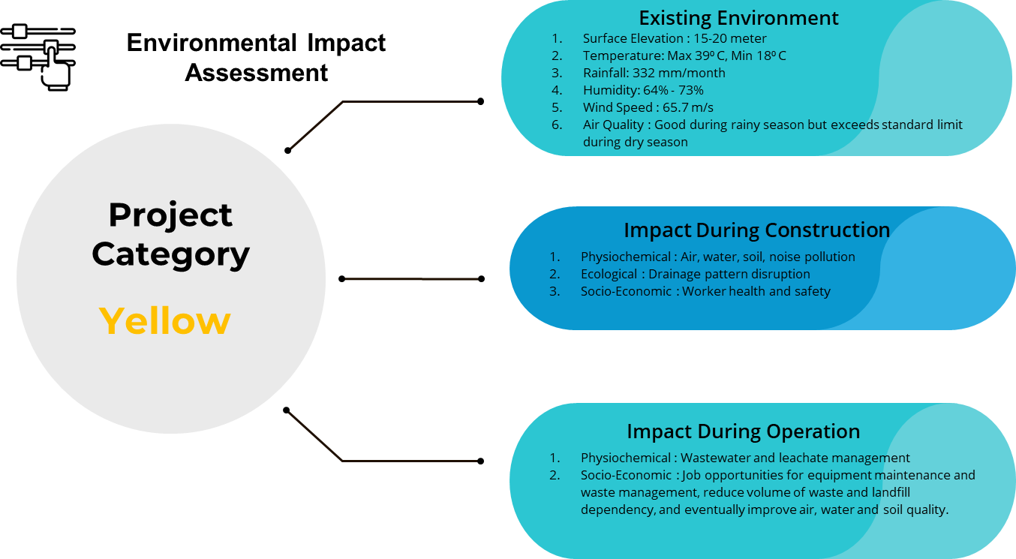
Feasibility Analysis
|| PAGE 8

Slide 9
Feasibility Analysis
A
Pre- Construction
Community awareness
Traffic & Access Planning
A
B
During Construction
Noise Pollution Check
Air Pollution Check
Water quality Check
Soil Pollution Check
Worker health and safety
Environmental Mitigation Measures
B
C
Post Construction
Segregated waste collection system
Adequate drainage for leachate
Recycling of dry waste
D
D
Environmental Management Plan
Air, Noise, Soil, Water Quality Check
EHS Officer Appoint
Cost of Monitoring : 48,94,000 BDT
C
|| PAGE 9

Slide 10
Feasibility Analysis
Preliminary Cost Estimate
Soil Investigation Cost | : 1.84 Lac BDT
Foundation Cost | : 37.43 Lac BDT
Super-structure Cost | : 109.32 Lac BDT
Additional Super-structure Cost | : 71.95 Lac BDT
Other Building Cost | : 27.52 Lac BDT
Equipment Cost | : 72.25 Lac BDT
Grand Total Construction Cost | : 463.03 Lac BDT
|| PAGE 10

Slide 11

Feasibility Analysis
TOTAL COST
PRE-CONSTRUCTION
PHASE
CONSTRUCTION PHASE
POST CONSTRUCTION
PHASE
Cost Benefit Analysis
Operation &
Maintenance
Soil Investigation
Materials, Labor
& Equipment
Environmental Monitoring
60 lac BDT
1 lac 84 thousands BDT
4 crore 12 Lac 40 Thousands BDT
Legal & Administrative Cost
48 lac 50 thousands BDT
12 lac 45 thousands BDT
Quality Assurance Cost
3 lac BDT
SOURCE | RATE | TOTAL REVENUE PER YEAR
Reuse/ Recycle | TK. 25,000 per ton | 350 Lacs
Waste Collection Bill | TK. 60,000 per month | 7 Lacs 20 Thousands
REVENUE BREAKDOWN
|| PAGE 11

Slide 12
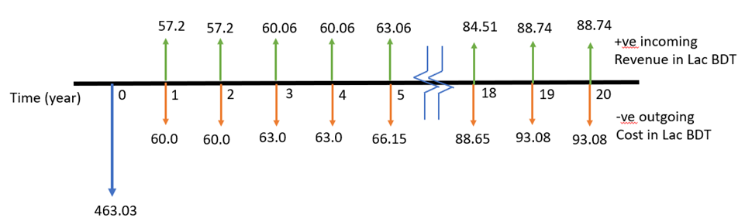
Feasibility Analysis
Cost Benefit Analysis
NPV
DISCOUNT RATE
4 Crore 87 Lac BDT
12%
IRR
BENEFIT-COST RATIO
0.2%
0.73
|| PAGE 12

Slide 13
Basis of Design (BOD)
Design life : 20 years
Design Standard: BNBC 2020, ACI 318-08, AISC 14
Fire design Standard: ASCE 29, BNBC 2020, Part IV, Chapter 1
Wind Load Provision
Earthquake Load Provision
Others
Site Class: SC Seismic Design Category: SDC C
Damp proof course:
A 60mm C15 fine aggregate concrete layer is
Exposure Category: A
Occupancy Category: III
Gravity load :
BNBC 2020, Part VI, Chapter 2
Occupancy Category: III
Importance Factor: 1.15
Wall construction:
190mm hollow concrete blocks with a density of 1,280kg/m³ and a strength grade of MU15
Importance Factor: 1.15
Basic Wind Speed: 65.7 m/s
Seismic Zone: 2 (z=0.2)
Doors & Windows:
Wooden door and sliding glass windows
|| PAGE 13

Slide 14
Basis of Design (BOD)
Building Area:
Building Dimension
Building Construction
Total Area: 300 m²
Base Area: 368 m²
1. Office Building :
Dimensions: 5.48 x 4.87 m and 5.48 x 3.2 m
Floor Area:
26.68 m² and 17.53 m²
Height: 3.048 m
1. Wall Body: Brick Masonry
Roof:
Office: RCC Roof
Station: Steel Truss Roof
2. Floor: Cement mortar floor,
tile floor
3.Windows & Doors:
Glass Window, Wooden Door
for office
Plastic door for bathroom
Steel Shutter for station building
Structural Style:
Foundation: Shallow and Square Foundation
Main Body: RCC Frame Structure
2. Transfer Station:
Dimensions: 17.07 x 14.96 m
Floor Area: 255.36 m²
Height: 9.144 m
|| PAGE 14

Slide 15
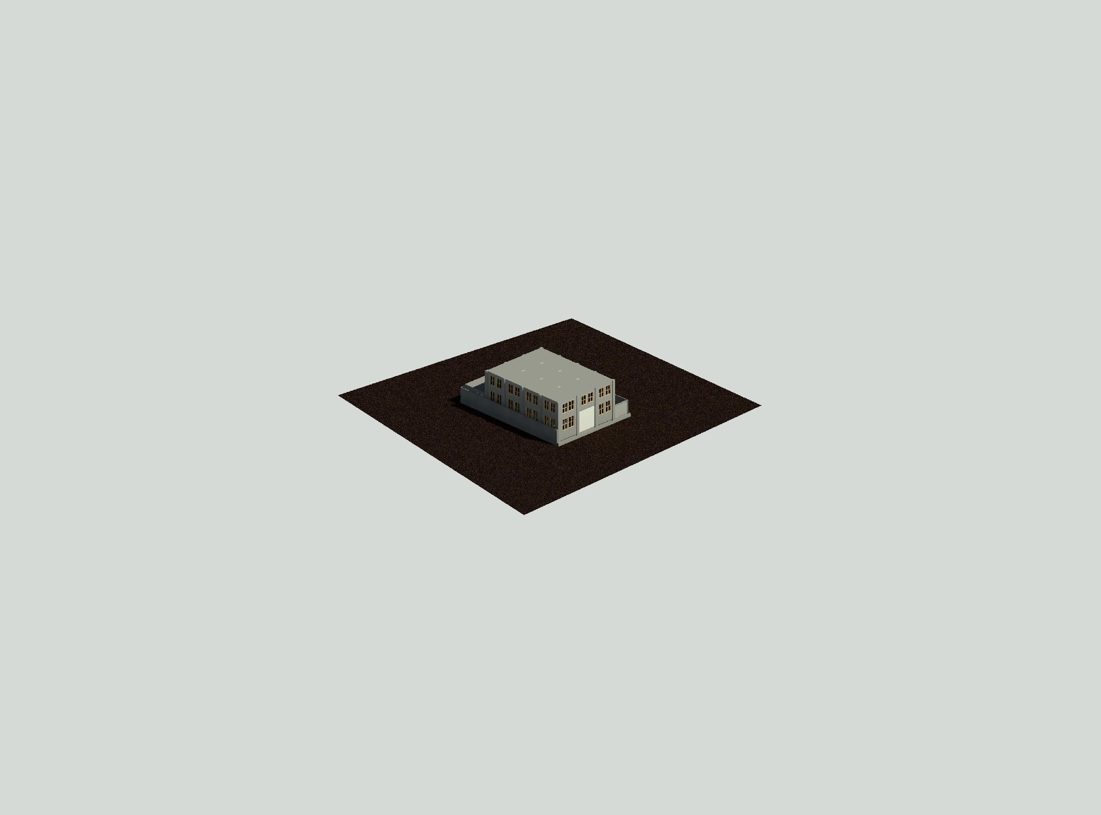
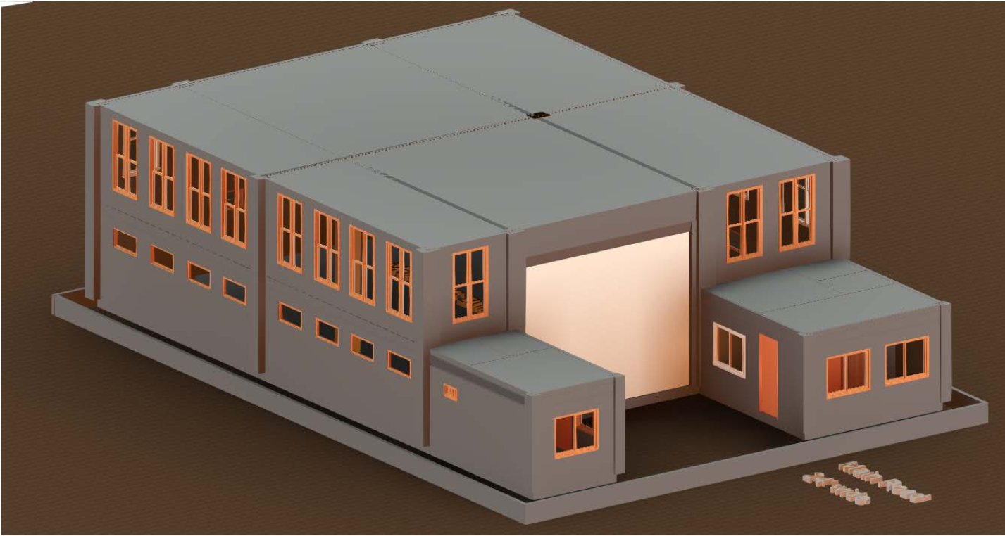
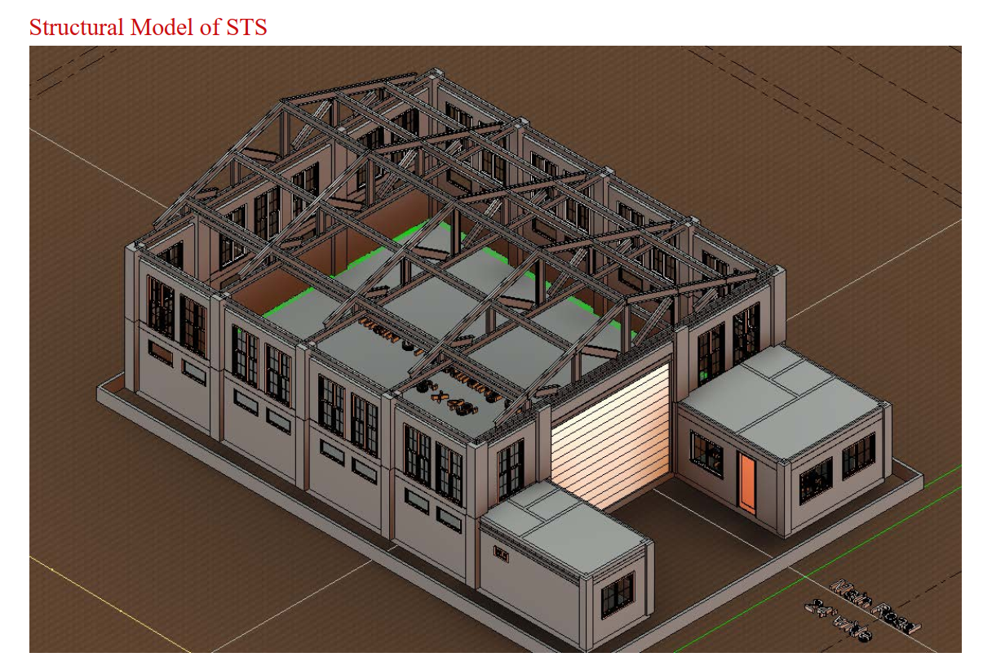
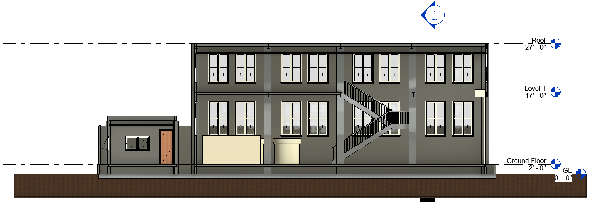
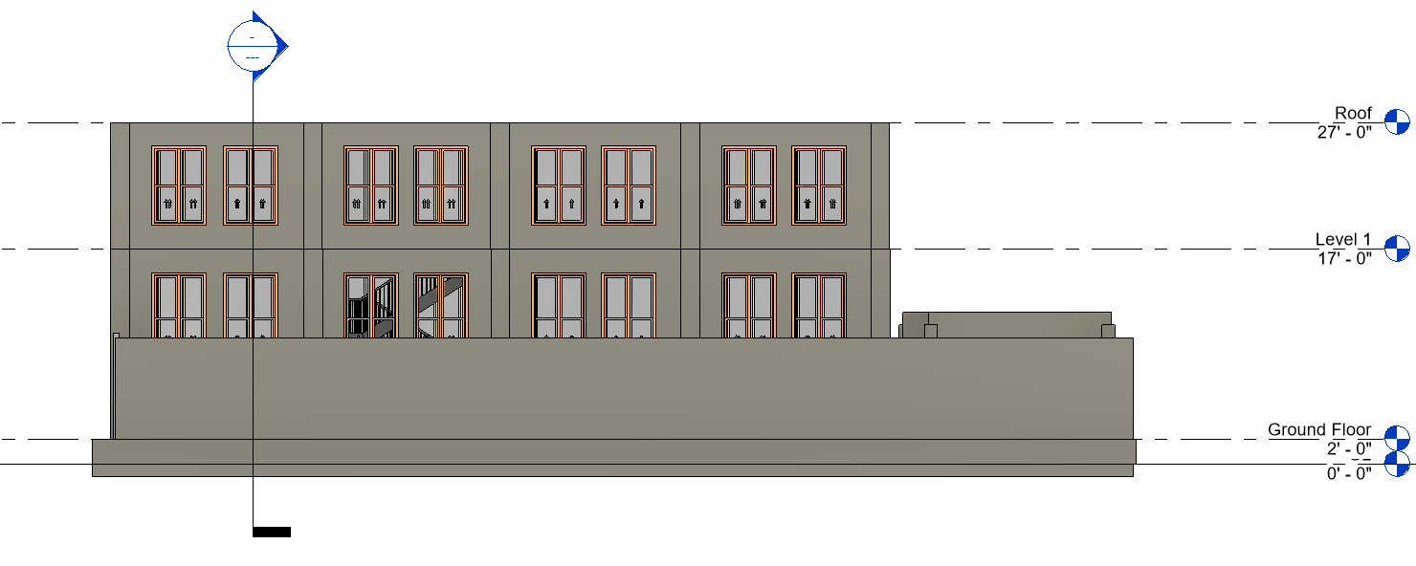
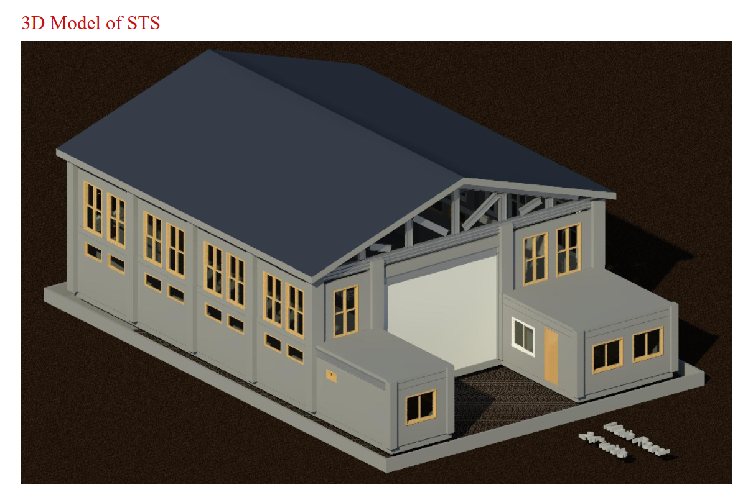
ARCHITECTURAL DRAWING WITH ALTERNATIVES
(1)
(2)
(3)
|| PAGE 15

Slide 16
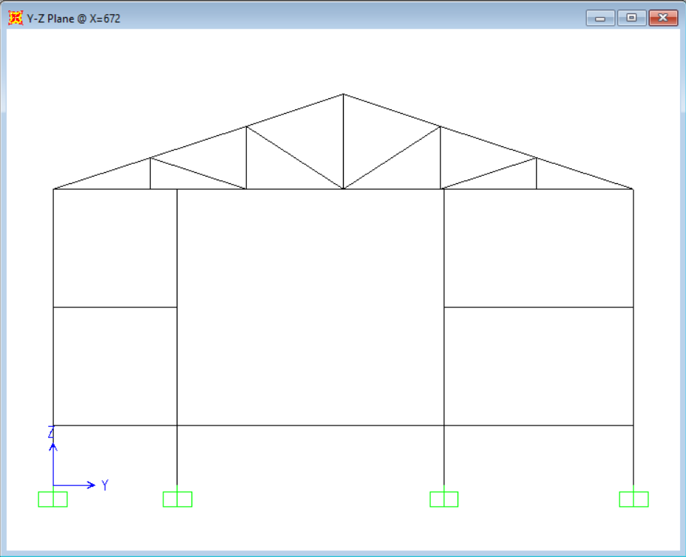
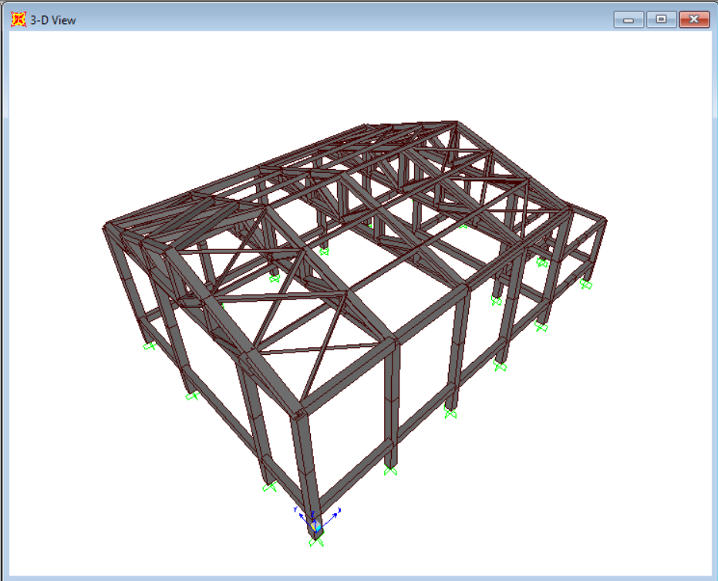
TECHNICAL AND ENGINEERING ANALYSIS
1.4D
1.2D + 1.6L
1.2D + (Lor 0.8W)
4. 1.2D+ 1.6W + L
5. 1.2D+ E+ L
6. 0.9D+ 1.6W
7. 0.9D+ E
Design Load Combination
|| PAGE 16

Slide 17
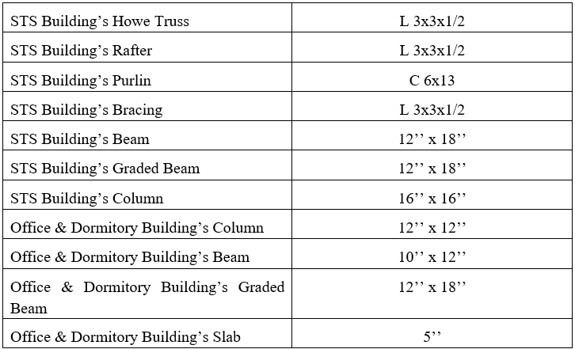
TECHNICAL AND ENGINEERING ANALYSIS
Finalized Design Sections
|| PAGE 17

Slide 18
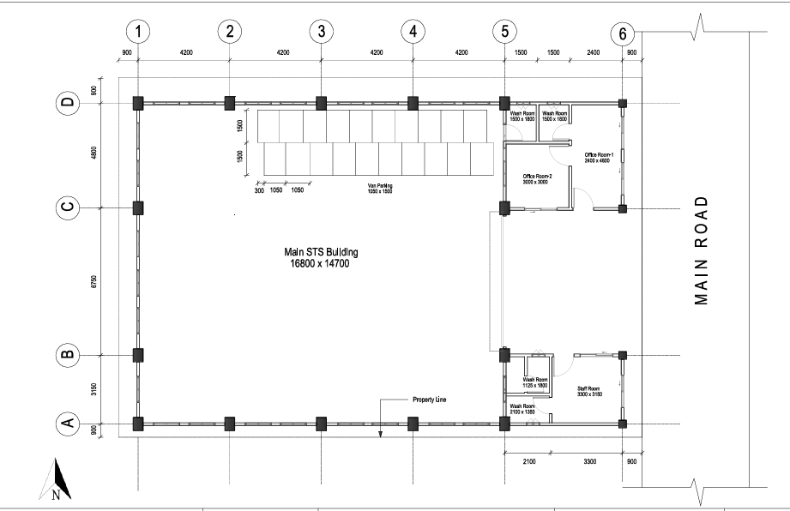
1904080
Details Drawing
Ground Floor Plan
Building Dimensions:
16,800 x 14,700 mm
Key Sections:
Office Room 1: 2600 x 4600 mm
Office Room 2: 3000 x 3000 mm
Staff Room: 3300 x 3150 mm
Additional Features:
Van Parking: 1050 x 1300 mm
Fig: Ground Floor plan
|| PAGE 18

Slide 19
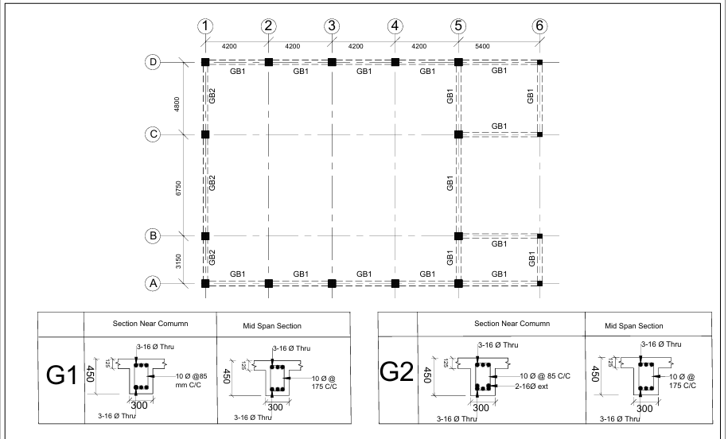
1904080
Details Drawing
Grade Beam Layout
Type of Beam
Rectangular Beam
12”x 18”
G1:
Section Near Column:
3-16 Ø Thru, 10 Ø @ 85 mm C/C.
Mid Span Section:
3-16 Ø Thru, 10 Ø @ 175 mm C/C.
G2:
Section Near Column:
3-16 Ø Thru, 10 Ø @ 85 mm C/C, 2-16 Ø Ext.
Mid Span Section:
3-16 Ø Thru, 10 Ø @ 175 mm C/C.
Fig: Grade beam layout
|| PAGE 19

Slide 20
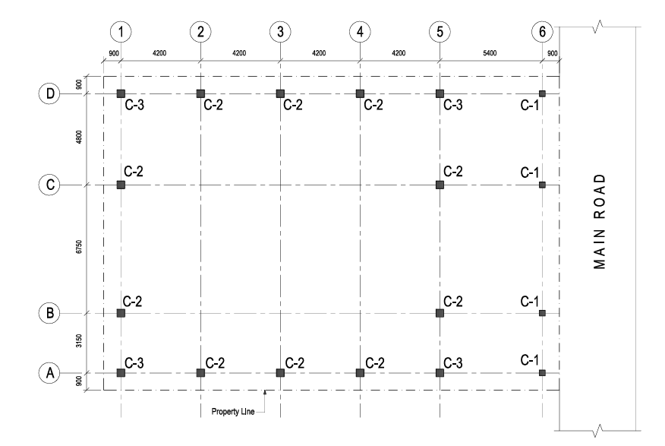
1904080
Details Drawing
Column Design Overview
Type of column
Square Column
Reinforced with Longitudinal bars and lateral ties
Column Dimension
Office Col : 12”x12” , 10’ height
STS Col : 16”x16”, 20’ height
3 Types of Detailing: C1, C2, C3
C1: 100 mm | S: 200 mm | lo: 450 mm | L: 3000 mm
C2:125 mm | S: 250 mm | lo: 925 mm | L: 6000 mm
C3:125 mm | S: 250 mm | lo: 925 mm | L: 6000 mm
Fig: Column Layout
|| PAGE 20

Slide 21
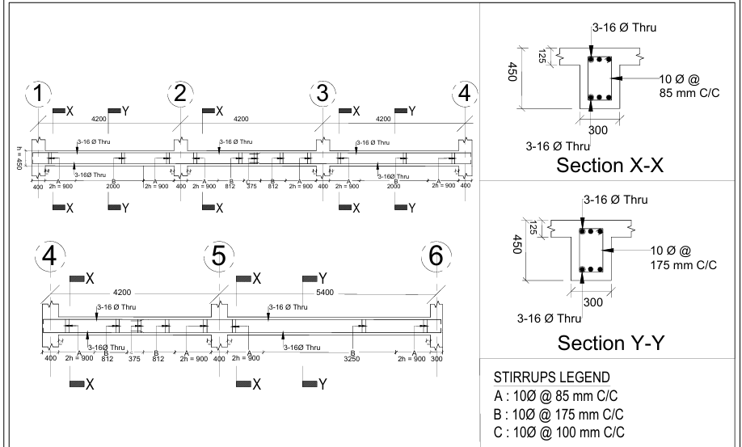

vRectangular Beam
1904080
Details Drawing
Beam Design overview
Beam Layout:
Section Details:
Section X-X:
3-16 Ø Thru, 10 Ø @ 85 mm C/C.
Section Y-Y:
3-16 Ø Thru, 10 Ø @ 175 mm C/C.
Stirrups Legend:
A: 10 Ø @ 85 mm C/C
B: 10 Ø @ 175 mm C/C
C: 10 Ø @ 100 mm C/C
Fig: Beam Detailing
|| PAGE 21

Slide 22
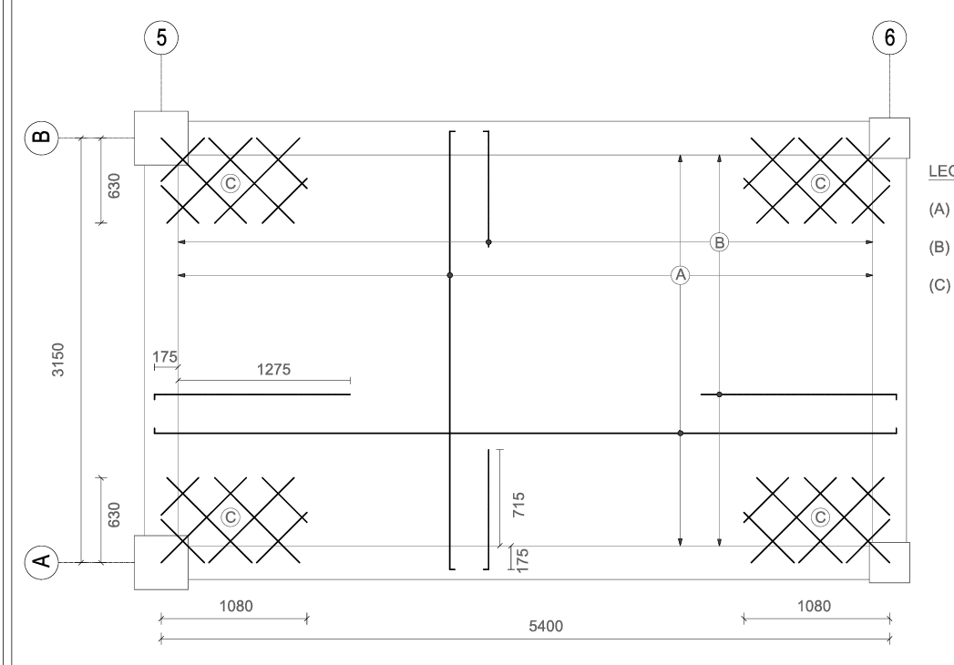
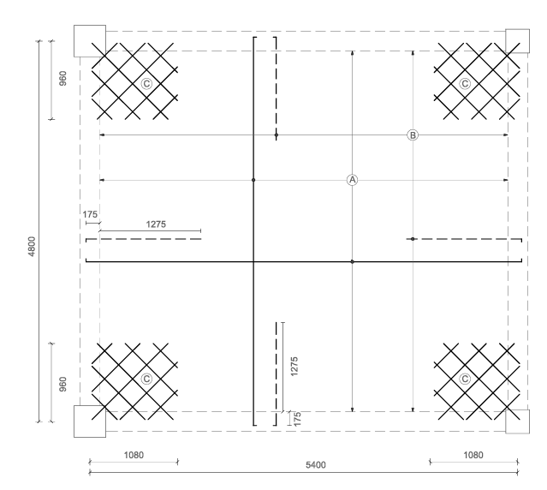
Details Drawing
Type of Slab
Edge Supported Two way slab
Discontinuous at four edges
Office room
(A): Ø10 mm bar @ 225 mm c/c (Straight Bottom)
(B): Ø10 mm bar @ 250 mm c/c (Straight Top)
(C): Ø10 mm corner bar @ 250 mm c/c
Diagonally at top, perpendicular at bottom
Staff room
(A): Ø10 mm bar @ 250 mm c/c (Straight Bottom)
(B): Ø10 mm bar @ 250 mm c/c (Straight Top)
(C): Ø10 mm corner bar @ 250 mm c/c
Diagonally at top, perpendicular at bottom
Fig: Slab layout
|| PAGE 22

Slide 23
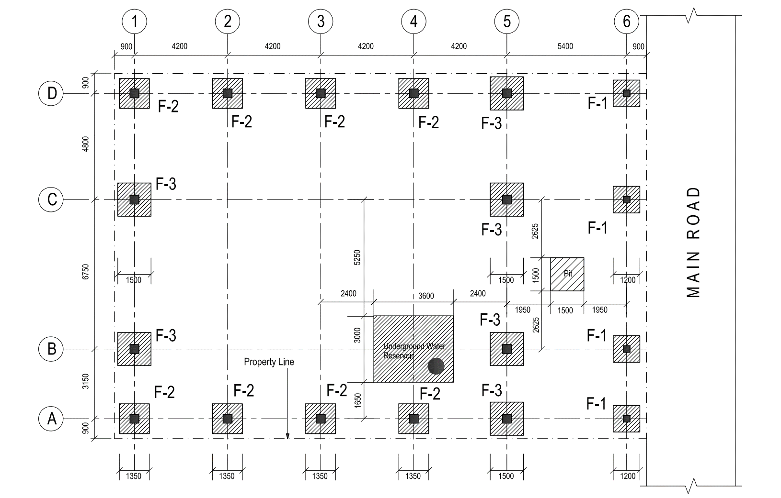
Details Drawing
Type of Footing
Square footing
Reinforced with Longitudinal bars and lateral ties
Footing Layout and Reinforcement Details
Footing Layout:
Footing Types: F1, F2, F3
Gridlines: A-D (Vertical) and 1-6 (Horizontal).
Underground Water Reservoir and Pit marked.
Reinforcement Schedule:
F1: 1200 x 1200 mm
Ø12 mm @ 150 mm c/c (Bottom & Top Bars).
F2: 1350 x 1350 mm
Ø16 mm @ 200 mm c/c (Bottom & Top Bars).
F3: 1500 x 1500 mm
Ø16 mm @ 175 mm c/c (Bottom & Top Bars).
Fig: Footing layout
|| PAGE 23

Slide 24
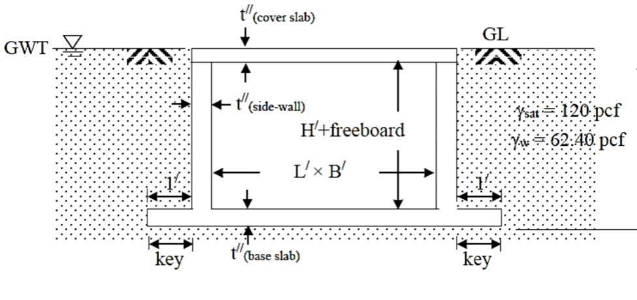
Details Drawing
Design consideration
Cover slab – design for horizontal bending (slab action)
Side walls – design for vertical bending (cantilever action) and horizontal bending (slab action)
Base slab – design for horizontal bending (slab action)
Design conditions – 3 Types
When tank is full with water and no soil Outside
When tank is full with water and saturated soil Outside
When tank is empty and saturated soil Outside
Critical Design condition:
Considering last condition as Critical one for design underground water reservoir
Cover and base slab- two way edge supported slab
Fig: Underground water reservoir
|| PAGE 24

Slide 25
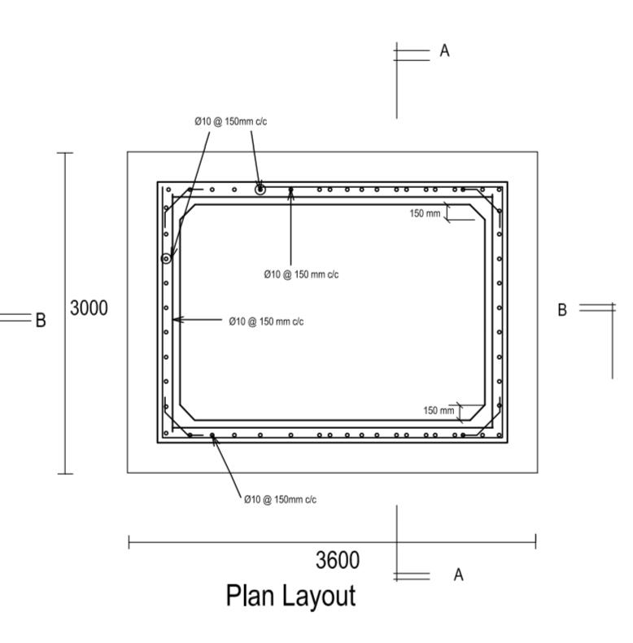
Details Drawing
Design Results
Reservoir dimensions – 3.6 X 3 X 1.8 m
Reinforcement required at the both sides of side wall
Extended base slab act as anti-uplift shear key
No direct tension steels needed in base slab and Side wall
Fig: Underground water reservoir
|| PAGE 25

Slide 26
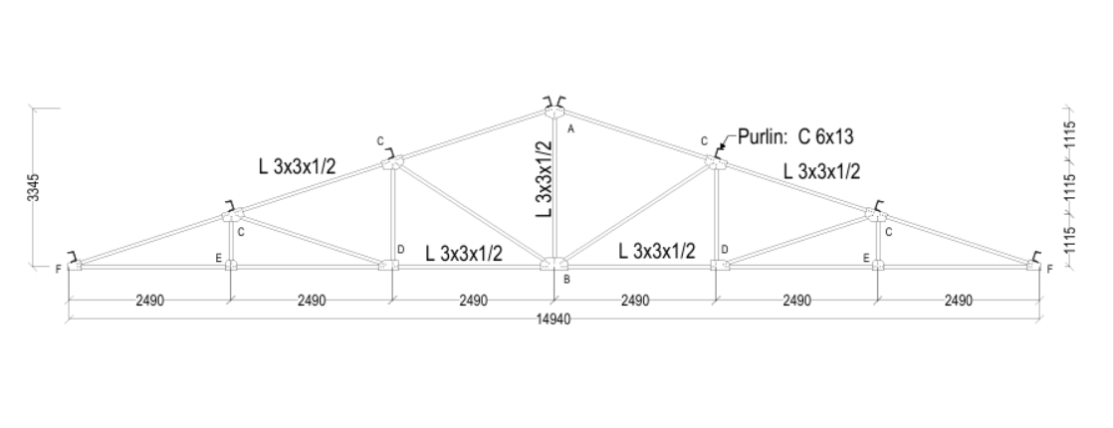
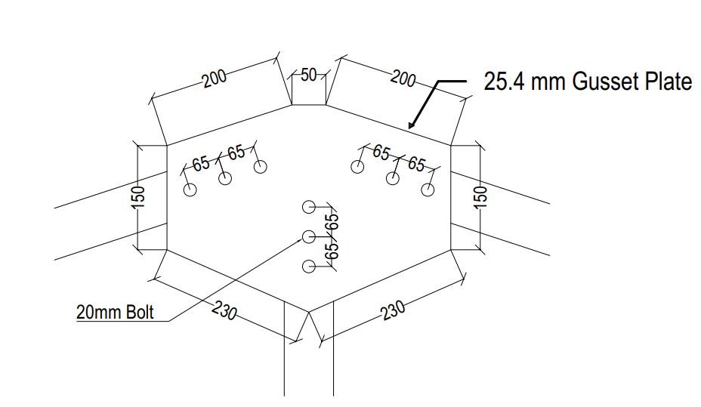
Details Drawing
Roof Truss Joint
Symmetrical 2D Pratt truss
Joints are connected through bolts and gusset plate
Truss Dimensions:
Span: 14,940 mm
Height: 3,345 mm
Member Details:
Main Members: L 3x3x1/2
Purlins: C 6x13
Joint Spacing:
Horizontal: 2,490 mm (each segment)
Vertical: 1,115 mm
Key Sections:
Supports at F and central joint A
Diagonal bracing for structural stability
Fig: Roof truss joint
Fig: Truss joint Connections
|| PAGE 26

Slide 27
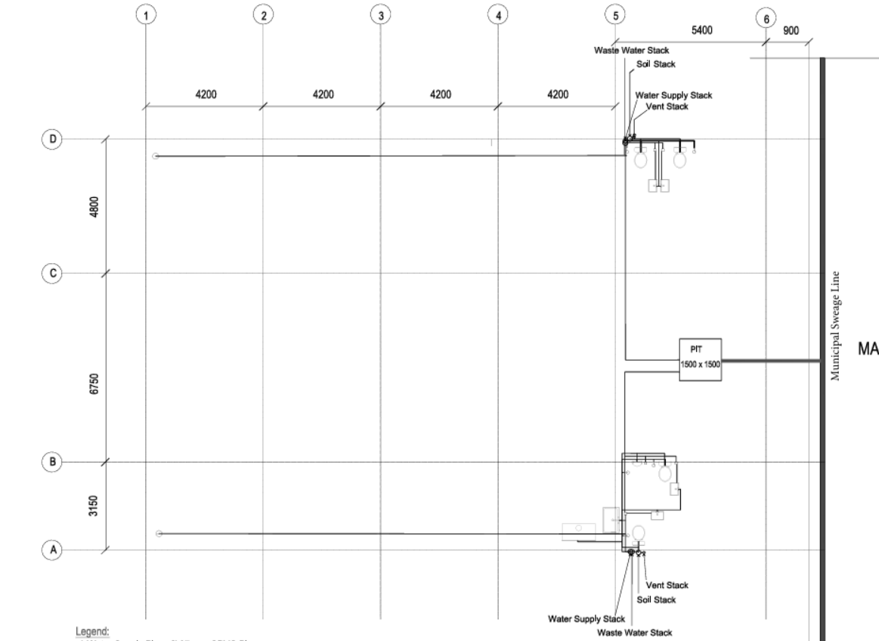
Details Drawing
Plumbing Layout Plan
Key Features:
Water Supply Stack: Ø 37 mm CPVC Pipe
Wastewater and Soil Stack: Ø 100 mm UPVC Pipe
Vent Pipe: Ø 50 mm UPVC Pipe
Grid Alignment:
Vertical: A-D
Horizontal: 1-6
Main Elements:
Pit: 1500 x 1500 mm
Connections to Municipal Sewage Line.
Fig: Plumbing Layout
|| PAGE 27

Slide 28
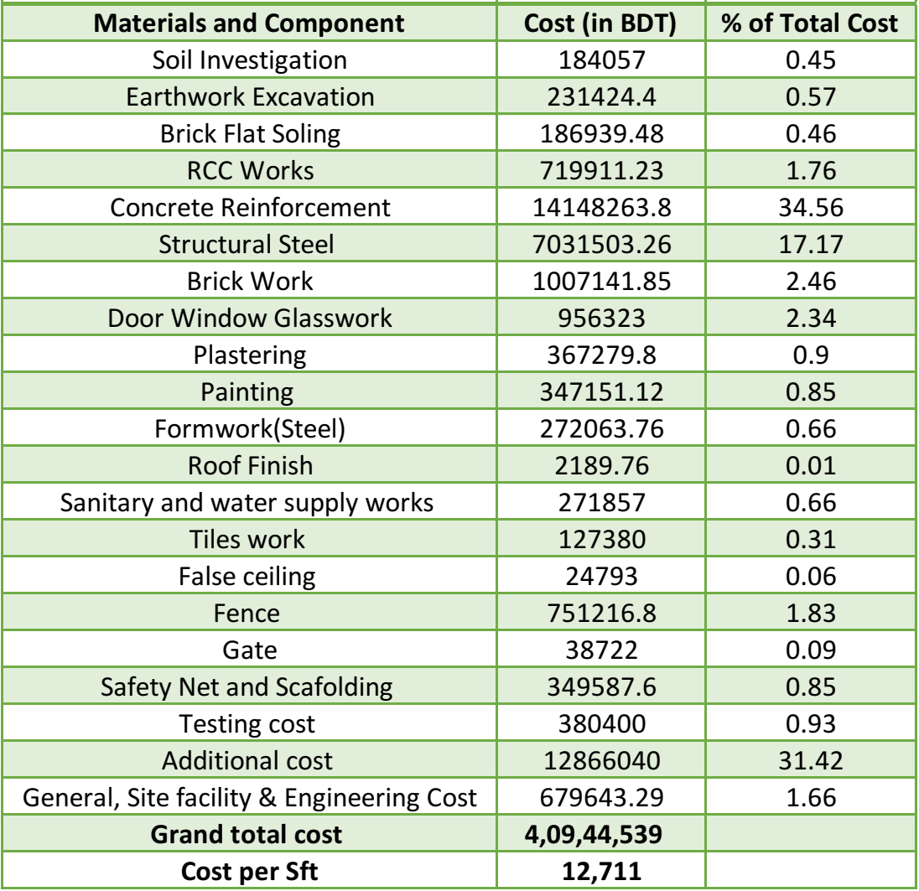
Bill Of Quantity(BOQ)
Grand Total Cost: 4,09,44,539 BDT
Four Crore Nine Lac Forty Four Thousand
Five Hundred Thirty Nine Taka
|| PAGE: 28

Slide 29
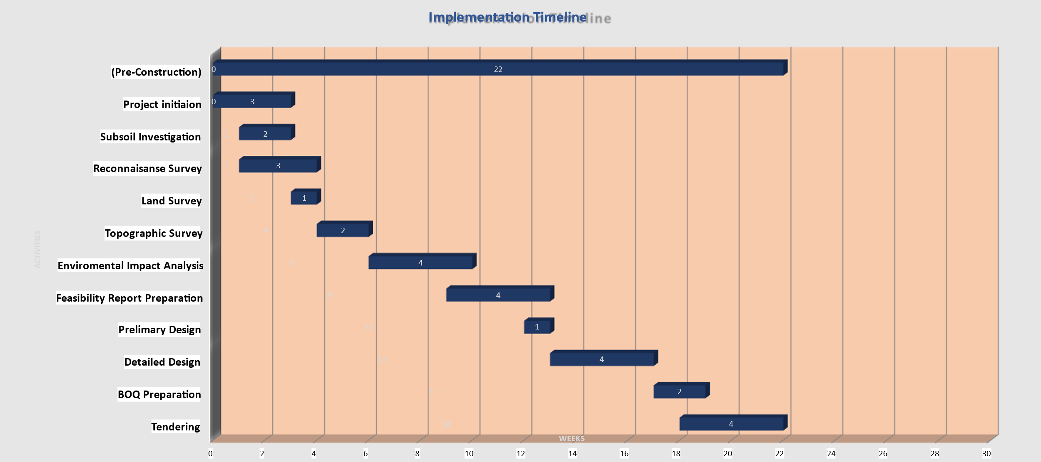
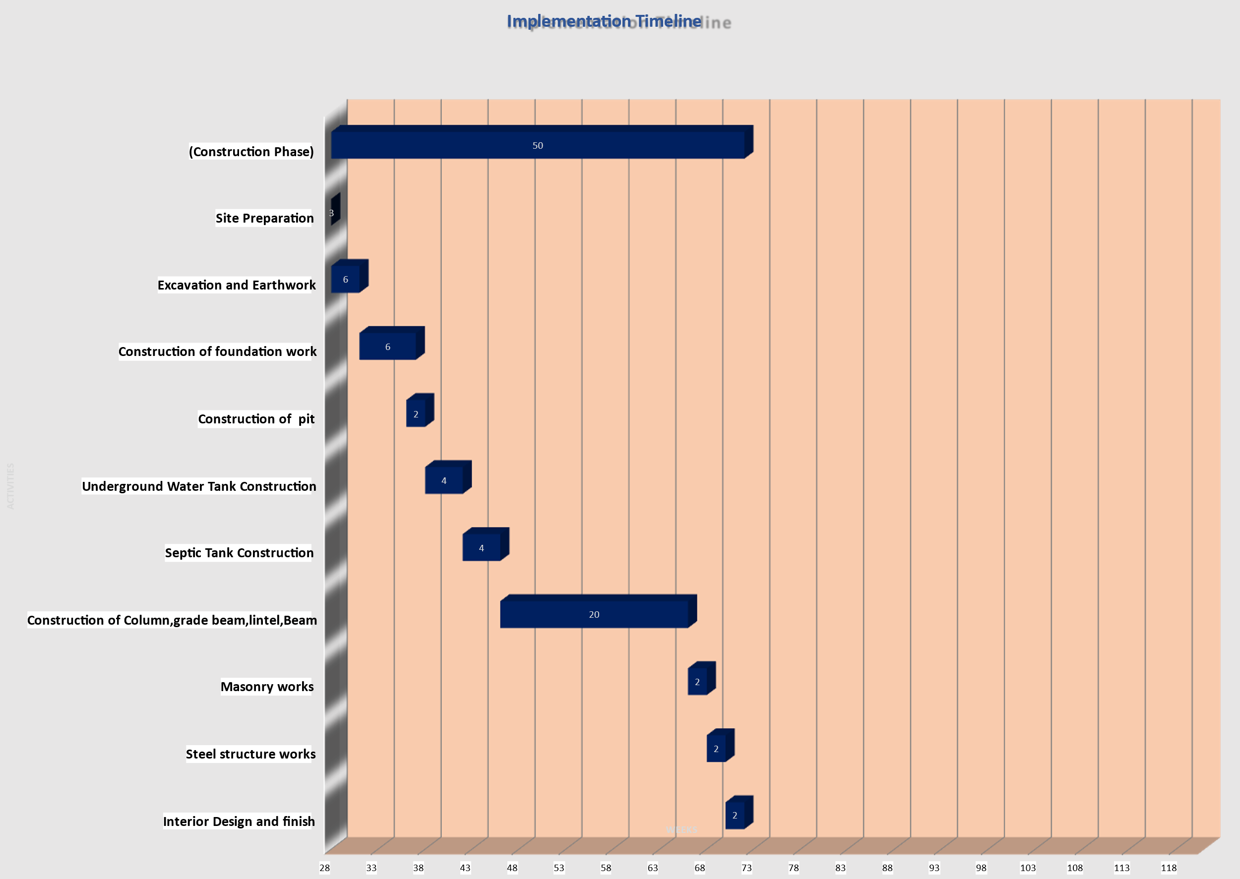
Implementation Timeline
Pre-Construction Phase (Weeks 0-22)
Key Activities:
Project Initiation: 3 weeks
Subsoil Investigation: 2 weeks
Reconnaissance Survey: 3 weeks
Land & Topographic Surveys: 1-2 weeks
Environmental Impact Analysis: 4 weeks
Feasibility Report Preparation: 4 weeks
Preliminary & Detailed Design: 4 weeks
BOQ Preparation: 2 weeks
Tendering: 4 weeks
Construction Phase (Weeks 28-50)
Key Activities:
Site Preparation: 3 weeks
Excavation and Earthwork: 6 weeks
Foundation Work: 6 weeks
Pit Construction: 2 weeks
Underground Water Tank: 4 weeks
Septic Tank: 4 weeks
Columns, Grade Beams, Lintel, Beams: 20 weeks
Masonry Works: 2 weeks
Steel Structure Works: 2 weeks
Interior Design and Finish: 2 weeks
|| PAGE 29

Slide 30
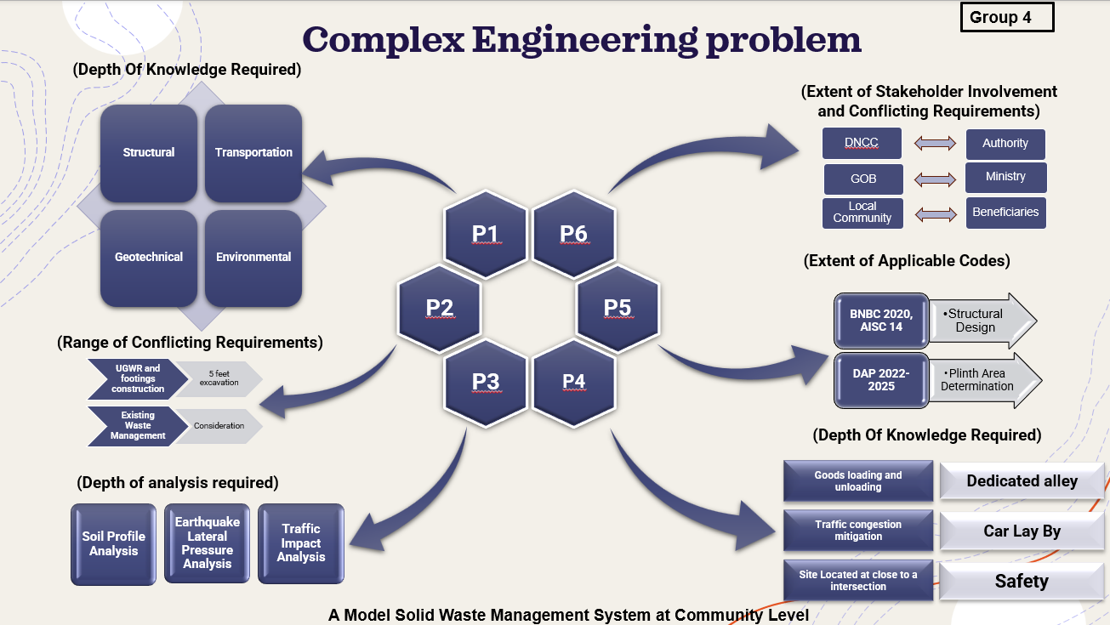
|| PAGE 30

Slide 31
Conclusion
Modernization and Expansion:
Expansion of the existing STS with modern container trucks and advanced waste compaction techniques
Environmental and Social Benefits:
Adherence to Environmental Conservation Rules 2023 to minimize impact and improve residents' quality of life.
Economic Viability:
Despite initial financial challenges, the project demonstrates long-term benefits for the environment, public health, and society.
Innovative Solutions:
Use of advanced technologies, including compartmentalized tricycles and steel frame structures, setting benchmarks for urban waste management.
|| PAGE 31

Slide 32
THANK YOU! ANY QUESTIONS?
|| PAGE 32

