Slide 1



ELISA CHALLENGE · SINCE AI HACKATHON 2026 · TURKU
buildR
Chat
Keep what experts know.
Give it to the next engineer.
Graph
Capturing silent knowledge from Teams, email and SMS for Elisa's autonomous network
Fix
Team buildR
Notes:
We are team buildR. We took the Elisa challenge: how to collect silent knowledge without extra work for specialists.

Slide 2
Elisa’s challenge and our SMART goal
ELISA’S PROBLEM STATEMENT
OUR SMART GOAL
Capturing and linking human-generated contextual metadata for autonomous network operations
Specific Link every expert tip to its device, site and time
S
M
Measurable Repeat faults fixed in minutes, not hours
In plain words: the network finds the fault, but the fix often lives only in a chat, an old email or one expert’s head.
A
Achievable Reads Teams, email and SMS; experts do nothing extra
R
Relevant Removes the human stop in autonomous operations
1 h 45 min lost finding a barrier key
19 min lost on a fix only one expert knew
T
Time-bound Working prototype by the end of the hackathon
Notes:
Two real Elisa cases. One: the AI found the fault, but the engineer was stopped by a locked barrier. The key location was only in an email. Two: after an SFP change the link is up but traffic does not come back. Only the expert knew the fix.

Slide 3



The answers already exist, but they are hidden
Field engineer
Is this written down somewhere?
Teams
Email
SMS
Memory
Expert
No. We learned it over the years.
Not searchable. Not linked to the device. Easy to lose.
Our rule: experts do nothing extra. They just keep talking.
Notes:
Elisa's question: how to collect this without extra work for specialists. That is our main design rule.

Slide 4



Our idea in 3 steps
1. Listen
2. Link
3. Help
Reads Teams, email and SMS in the background
Connects each tip to the right device, site and time
Gives the fix when the same problem comes again
Notes:
Listen: we connect to the channels people already use. Link: we bind each piece of knowledge to the network graph with a time window. Help: an AI agent gives the fix during the next incident.

Slide 5




How it works
SOURCES
CONNECT
CAPTURE
STORE
USE
Teams
Graph
Investigator
Email
Connect
Collector
Neo4j
AI agent
MCP
AI agent
Search
Engineer
SMS
Chroma
Web app
Every tip is saved with: device · source · author · valid from / valid to
Notes:
Messages come in through MCP connectors. The Collector agent pulls out useful tips, links them to devices in the Neo4j graph and also stores them in Chroma for search. When an incident opens, the Investigator agent reads both and gives the engineer an ordered plan. Everything runs in Docker and works offline.

Slide 6



Right device. Right time.
Example: the key for the SAL-03 barrier
AI asks here
Old advice
is closed, not deleted
Key at village shop
NEW · valid now
OLD · closed
Keybox · ask the NOC
Two experts disagree
both are shown, safest step first
Oct 2024
2026
Today
time
Plain search finds both answers. Our graph knows which one is still true.
Secret codes
are never saved, only who has them
Notes:
This follows Elisa's layer model: every context assertion is bound to a graph entity and has valid_from and valid_to. Old advice gets a valid_to. Conflicts are flagged, never hidden. Secrets like gate codes are not stored.

Slide 7
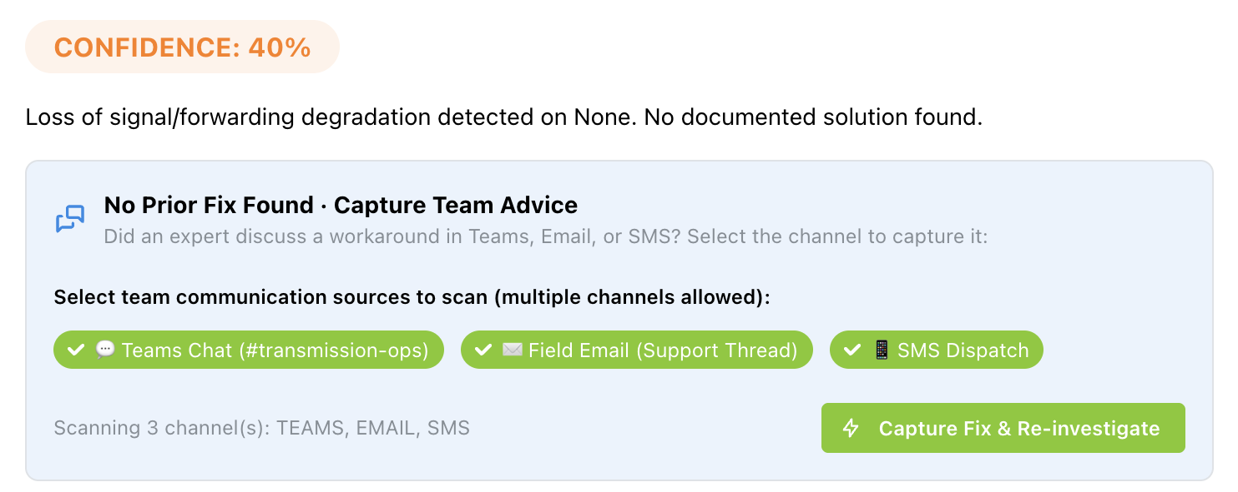
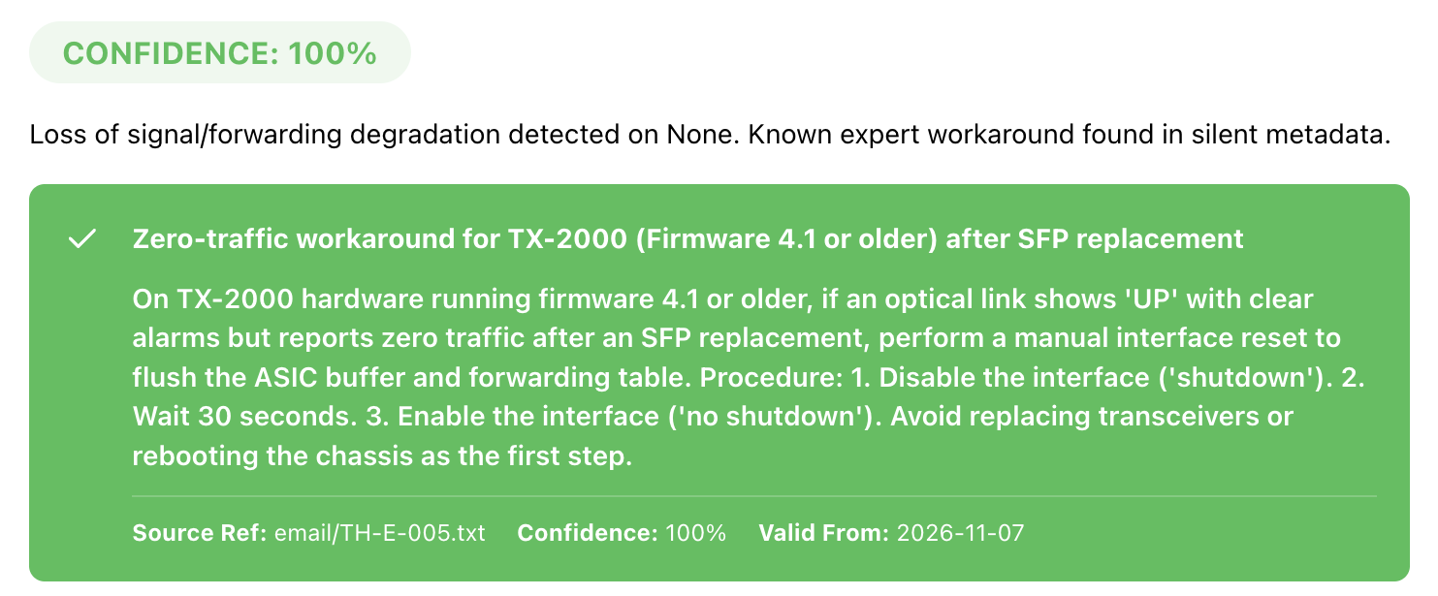

Demo: one click, from 40% to 100%
BEFORE
AFTER
Capture
1
No fix found
2
Reads team chats
3
Ready plan, with source
Plan for TRN-117: check counters → interface off → wait 30 s → on. Do not reboot.
Notes:
Live demo. Open incident WO-2026-1107-003 on TRN-117. Before: no fix, 40% confidence. Click Capture: the Collector reads Teams, email and SMS. After: 100% confidence, the expert's workaround, its source and an ordered plan. No new SFP, no reboot.

Slide 8



Fewer stops for the autonomous network
Faster fixes
minutes, not hours
Fewer drives
no second visit
No dead ends
key info before travel
WORKS TODAY
NEXT
Teams, email, SMS → graph
Old and conflicting advice handled
Runs in Docker, also offline
Teams bot reply: "Saved as a tip"
Phone call notes as a source
Link to Elisa's AI fault analysis
Kiitos! Thank you · Team buildR
Notes:
Impact: fewer human stops in the autonomous cycle. What works today, and what we would build next with Elisa. Thank you.

