Slide 1

CSE303 Project Presentation
LankaBangla Finance Limited

Slide 2
Team
Prantika Roy | 2021040

Slide 3
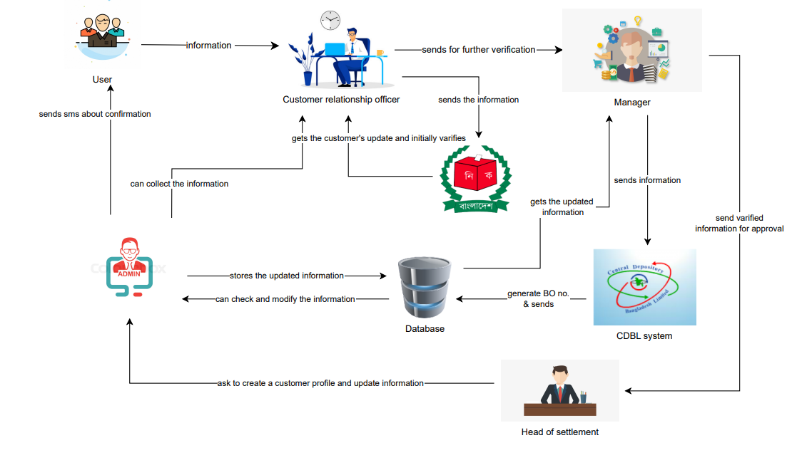
Rich Picture (AS IS)

Slide 4
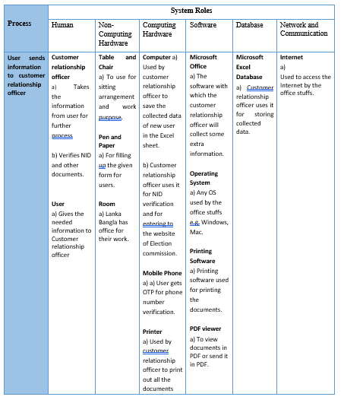
Six Element Analysis of Existing System

Slide 5
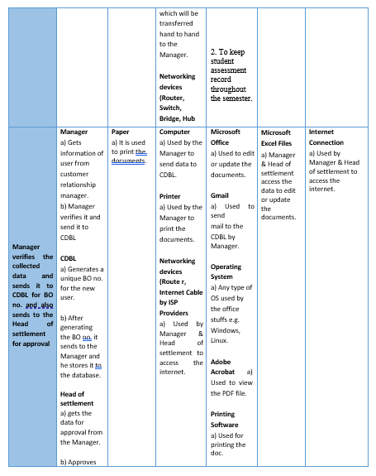
Six Element Analysis of Existing System

Slide 6
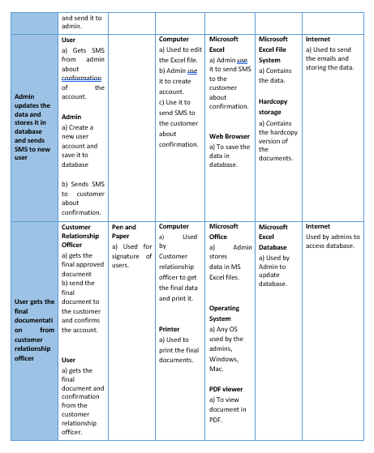
Six Element Analysis of Existing System

Slide 7
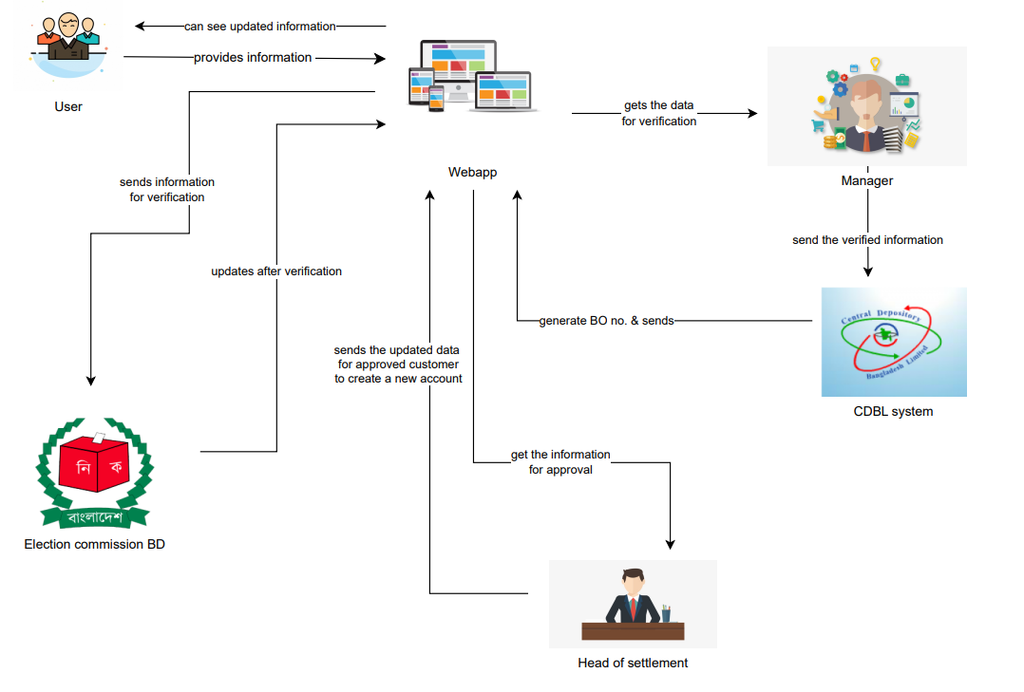
Rich Picture (TO BE)

Slide 8
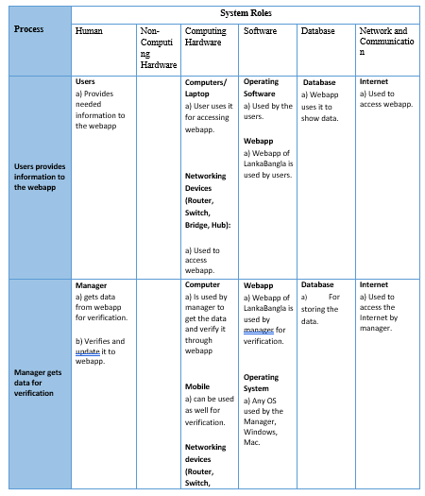
Six Element Analysis of Proposed System

Slide 9
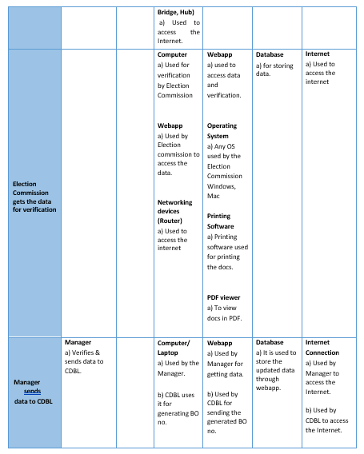
Six Element Analysis of Proposed System

Slide 10
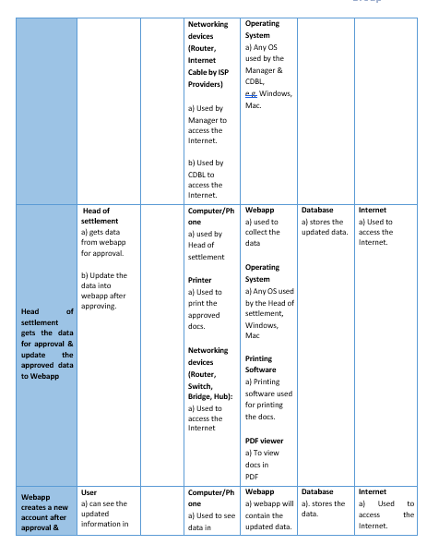
Six Element Analysis of Proposed System

Slide 11
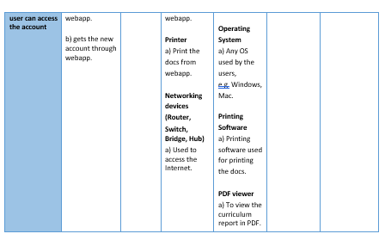
Six Element Analysis of Proposed System

Slide 12
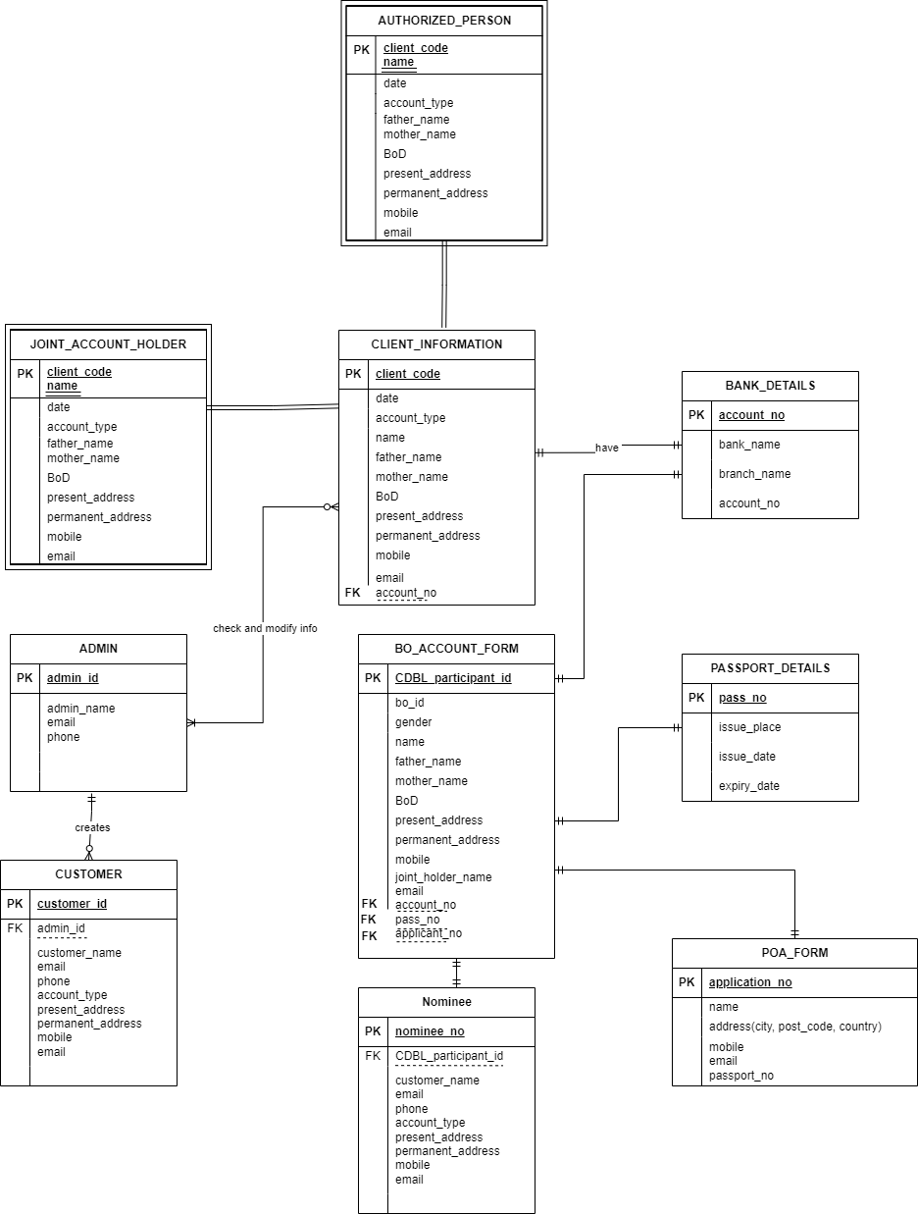
EERD

Slide 13
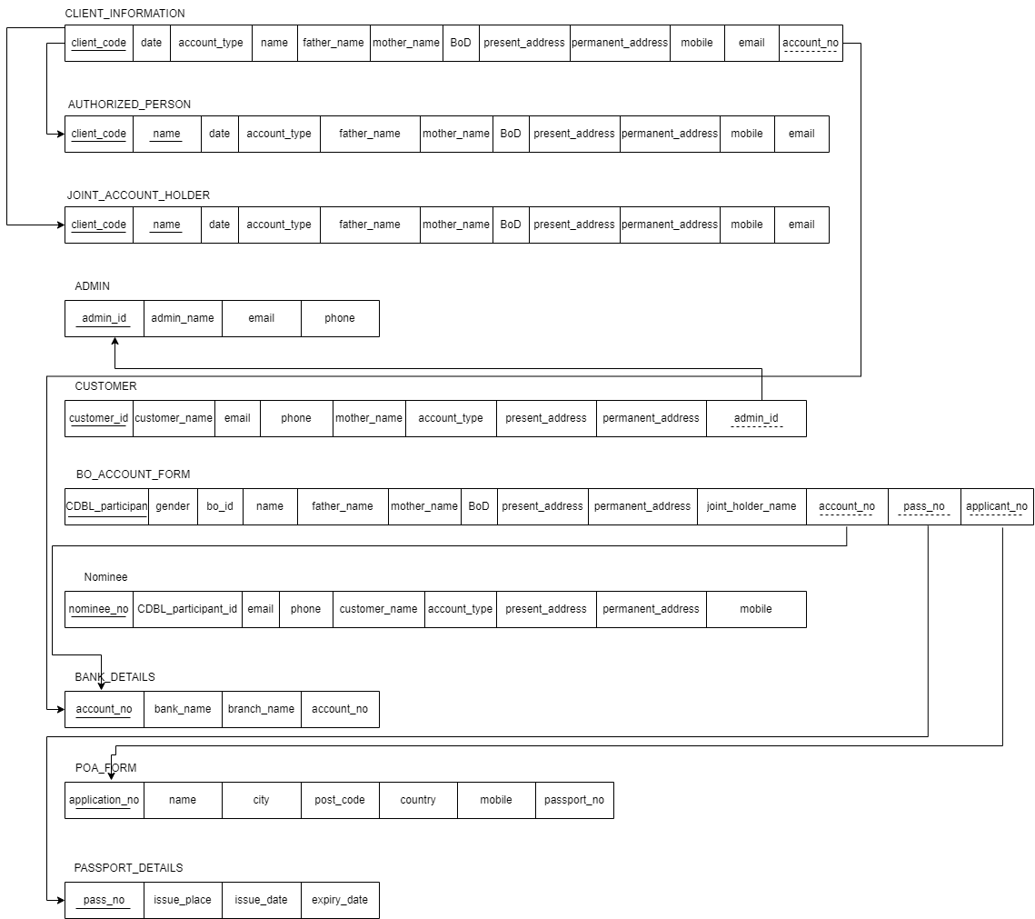
Relation Schema

Slide 14
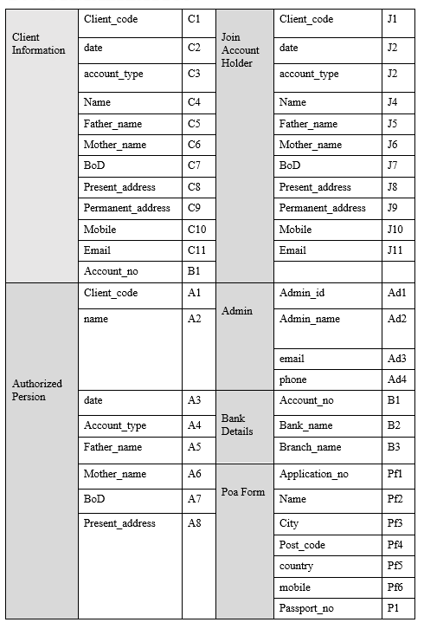
Normalization

Slide 15
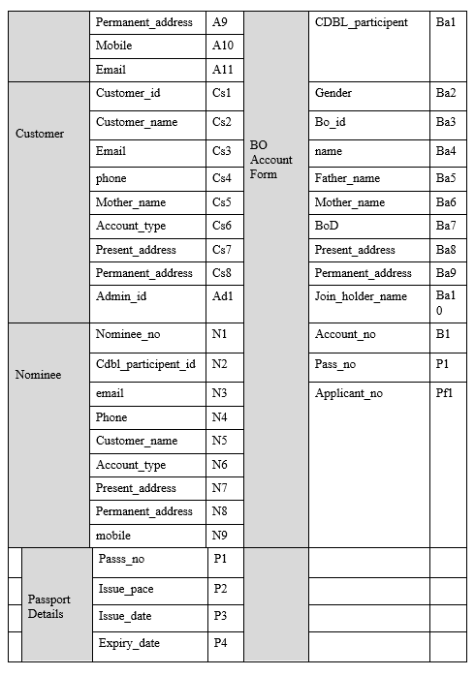
Normalization

Slide 16
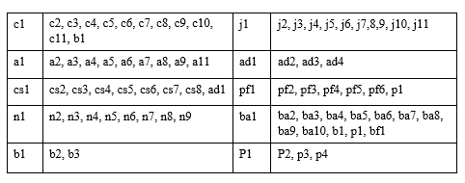
Normalization

Slide 17
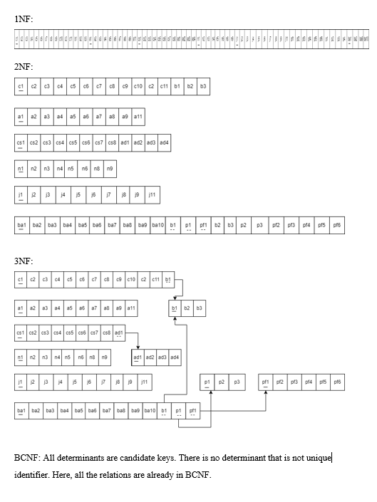
Normalization

Slide 18
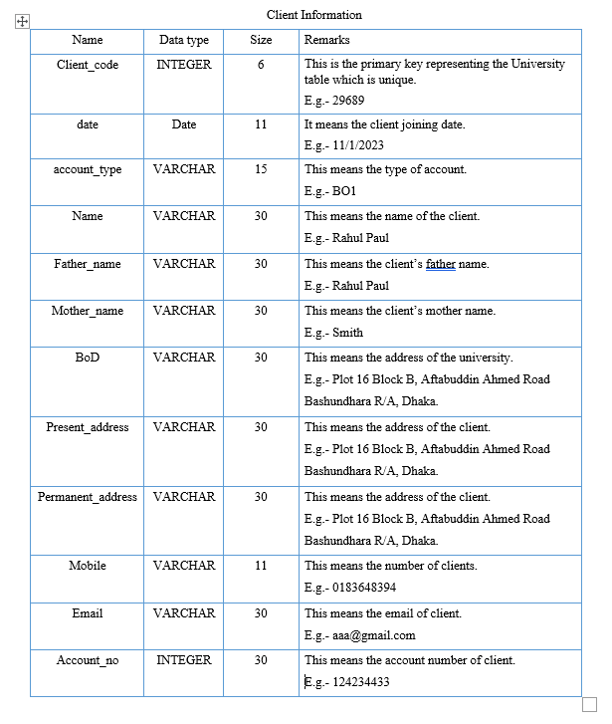
Data Dictionary

Slide 19
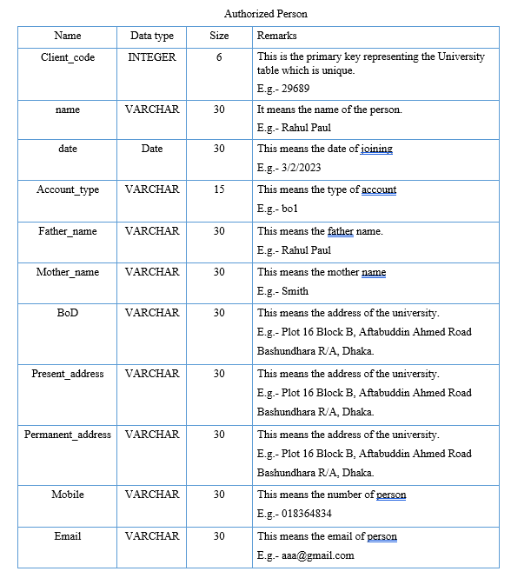
Data Dictionary

Slide 20
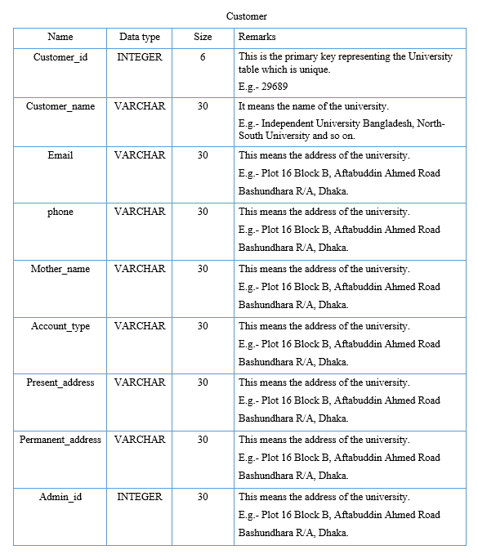
Data Dictionary

Slide 21
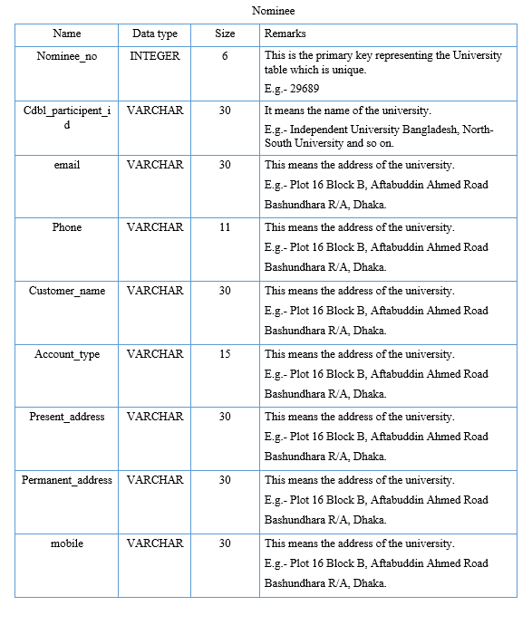
Data Dictionary

Slide 22
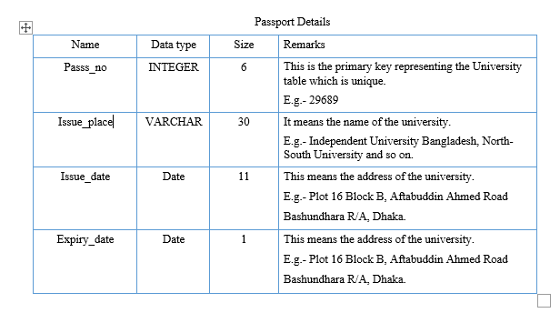
Data Dictionary

Slide 23

Thank You

