Slide 1
An Approach to classify pneumonia infection data using Deep learning with GoogLeNet
Presented By:
Shahriar Zaman Sunve: 2015-3-60-028
Maksuda Akhter Meem: 2015-3-60-047
Tanjina Nasreen Mim: 2015-3-60-017
Supervised By:
Dr. Taskeed Jabid
Chairperson Associate Professor Department of Computer Science and Engineering East West University

Slide 2

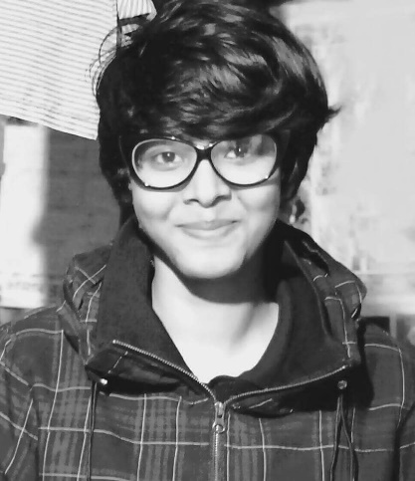

Members Of This Group
Maksuda Akther Meem
Student ID: 2015-3-60-047
Tanjina Nasreen Mim
Student ID: 2015-3-60-017
Shahriar Zaman Sunve
Student ID: 2015-3-60-028

Slide 3
Outline
Introduction
AI ML in healthcare sector
Our project
Model
Inception V3
Dataset
Data pre-processing
Methodology
Evaluation Technique
Result
Accuracy Model
Loss Model
Confusion Matrix
Key Point
Conclusion
Reference

Slide 4
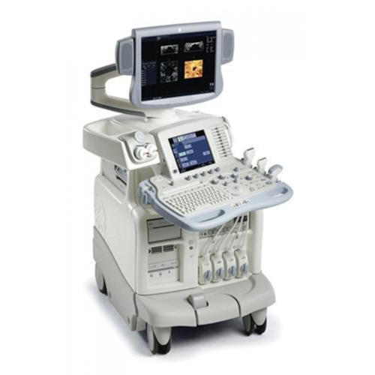
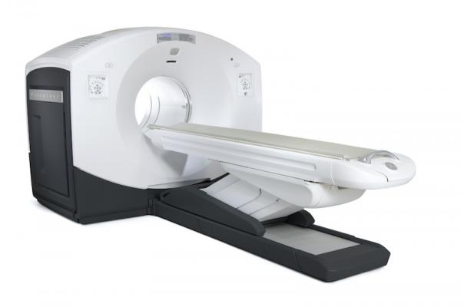
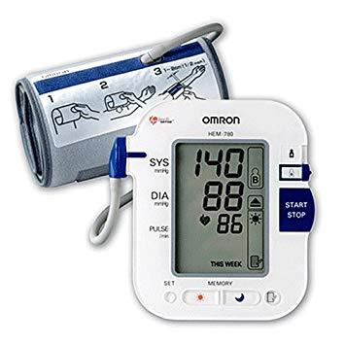
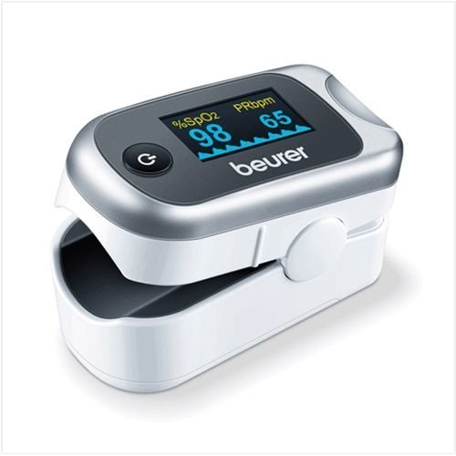
Introduction
Healthcare is not unknown to the advances of technology, instead it actually enhances the quality of healthcare people have received over the years
Starting from daily healthcare household items to big licensed machineries.

Slide 5
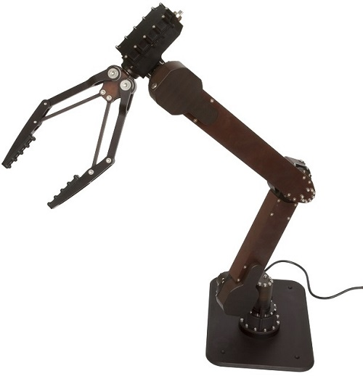
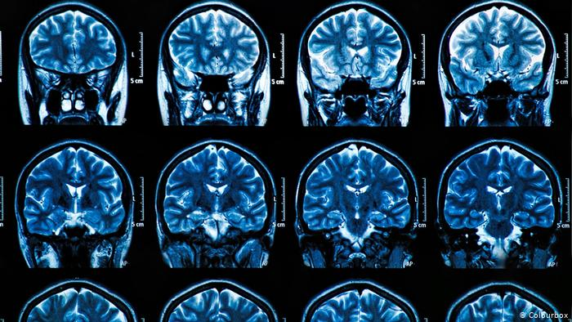
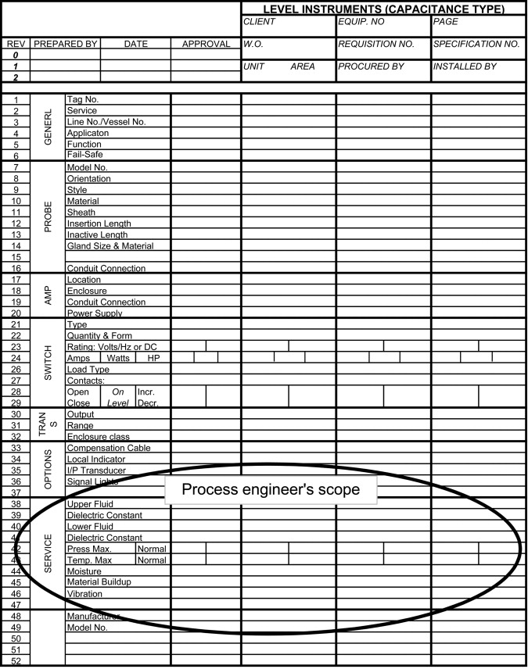

AI Machine Learning in Healthcare Sector
Doesn’t mean robots operating on patients.
Analyzing datasets to improve accuracy if diagnosis

Slide 6
AI Machine Learning in Healthcare Sector
Some examples:
PATHAI MORE ACCURATE CANCER DIAGNOSIS WITH AI (Location: Cambridge, Massachusetts)
BUOY HEALTH AN INTELLIGENT SYMPTOM CHECKER (Location: Boston, Massachusetts)
ZEBRA MEDICAL VISION AI-POWERED RADIOLOGY ASSISTANT (Location: Shefayim, Israel)

Slide 7
AI Machine Learning in Healthcare Sector: Benefits
Fast Response
Accuracy Rate
Large Number Of Data Diagnosis Within The Same Time
Detects And Classifies Even When Missed By The Human Diagnosis
However, it is key to note these systems will not just be left alone without human supervision.

Slide 8
Our Project
We use pneumonia dataset, provided by kaggle to classify pneumonia infected image
Our goal is to achieve highest precision and recall by applying our algorithm

Slide 9
Our Model
We use transfer learning method to developed our model
We use a pre-trained model in our project to train our dataset
Our pre-trained model is Inception v3

Slide 10
Inception v3
Former GoogleNet module
Have more than 2 million parameters
The pre-trained weighted structure can be easily found to re-use
Help to achieve better result than other models

Slide 11
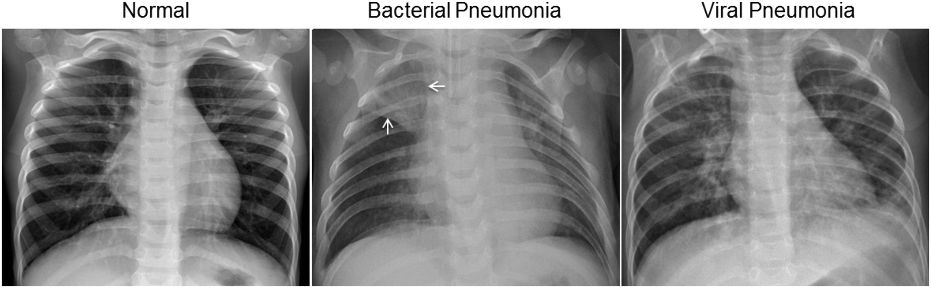
Dataset

Slide 12
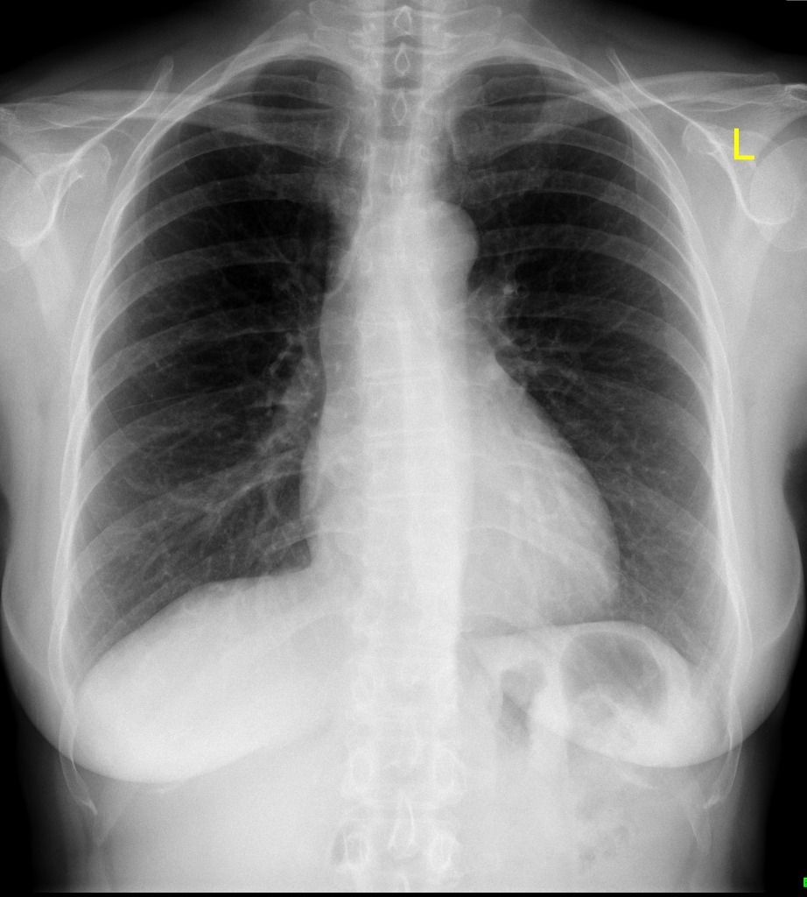
Dataset: Preprocessing
Classification into categorical order 2. Resize Image using SKIMAGE
Converting into greyscale
Raw Data
Pre-processing Mechanisms Used
Ready For Use

Slide 13
Implementation Steps
Load Data
1
Preprocessing
2
These are all the sets we had to make for our research work, lets take a look at them one by one.
Inception V3
3
Add Weight
4
Custom Layer
5
Fine Tune
6
Compile & Fit
7

Slide 14
Implementation Steps
Load Data
1
Preprocessing
2
We load the data into the system for training and testing
Inception V3
3
Add Weight
4
Custom Layer
5
Fine Tune
6
Compile & Fit
7

Slide 15
Implementation Steps
Load Data
1
Preprocessing
2
Now we have to preprocess the data to make it ready for the model we are using.
Classification into categorical order
Resize Image using SKIMAGE
Converting into greyscale
Inception V3
3
Add Weight
4
Custom Layer
5
Fine Tune
6
Compile & Fit
7

Slide 16
Implementation Steps
Load Data
1
Preprocessing
2
Create a pre-trained model of inception V3
A merge of inceptionV1 and inceptionV2: inceptionV3
Basic attributes set like weight set as ImageNet –
C1: include_top as ‘False‘
C2: rezise (150 x 150 x 3)
Inception V3
3
Add Weight
4
Custom Layer
5
Fine Tune
6
Compile & Fit
7

Slide 17
Implementation Steps
Load Data
1
Preprocessing
2
Load the “pre-trained” model with IMAGENET dataset weight and discard the last layer.
Inception V3
3
Add Weight
4
Custom Layer
5
Fine Tune
6
Compile & Fit
7

Slide 18
Implementation Steps
Load Data
1
Preprocessing
2
Add a custom layer in the end of this pre-trained layer.
Inception V3
3
Add Weight
4
Custom Layer
5
Fine Tune
6
Compile & Fit
7

Slide 19
Implementation Steps
Load Data
1
Preprocessing
2
Fine-tune by freezing layers.
Run the dataset through this obtained model with a batch size of 64 and for 30 epoch.
Inception V3
3
Add Weight
4
Custom Layer
5
Fine Tune
6
Compile & Fit
7

Slide 20
Implementation Steps
Load Data
1
Preprocessing
2
Compile the model with setting loss, optimizer and metrics parameter.
Fit the model for outcome.
Inception V3
3
Add Weight
4
Custom Layer
5
Fine Tune
6
Compile & Fit
7

Slide 21
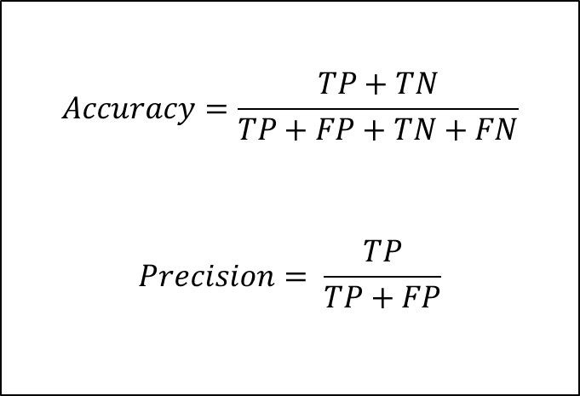
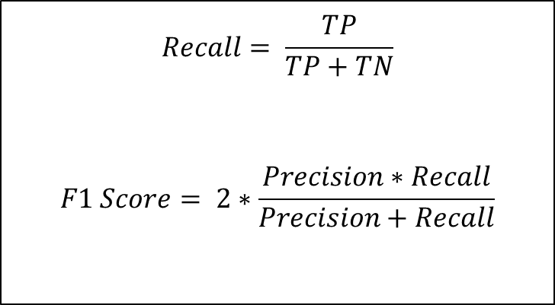
Evaluation Techniques
We have evaluated our results’ accuracy using the following process:
$$Accuracy=\frac{TP+TN}{TP+FP+TN+FN}$$
$$Precision= \frac{TP}{TP+FP}$$
$$Recall= \frac{TP}{TP+TN}$$
$$F1 Score= 2∗\frac{Precision∗Recall}{Precision+Recall}$$
TP: true positive, TN: true negative, FP: false positive, and FN: false negative.

Slide 22
Results: After Evaluation
Accuracy | 90.1%
Precision | 90.2%
Recall | 94.7%
F1 Score | 93.15%

Slide 23
Results: After Evaluation
Closeness of the classifying to the real value
Accuracy | 90.1%
Precision | 90.2%
Recall | 94.7%
F1 Score | 93.15%

Slide 24
Results: After Evaluation
Closeness of the classifying to the real value
Precision is the percentage of relevancy within the results.
Accuracy | 90.1%
Precision | 90.2%
Recall | 94.7%
F1 Score | 93.15%

Slide 25
Results: After Evaluation
Closeness of the classifying to the real value
Precision is the percentage of results that were relevant.
Accuracy | 90.1%
Precision | 90.2%
Recall | 94.7%
F1 Score | 93.15%
The percentage of total relevant results correctly classified by our algorithm.

Slide 26
Results: After Evaluation
Closeness of the classifying to the real value
Precision is the percentage of results that were relevant.
Accuracy | 90.1%
Precision | 90.2%
Recall | 94.7%
F1 Score | 93.15%
The percentage of total relevant results correctly classified by our algorithm.
Weighted average of Precision and Recall, making it more reliable than accuracy.

Slide 27
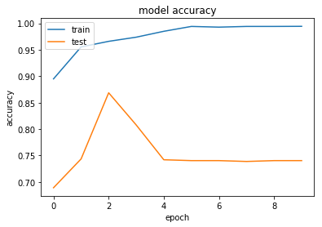
Accuracy Model

Slide 28
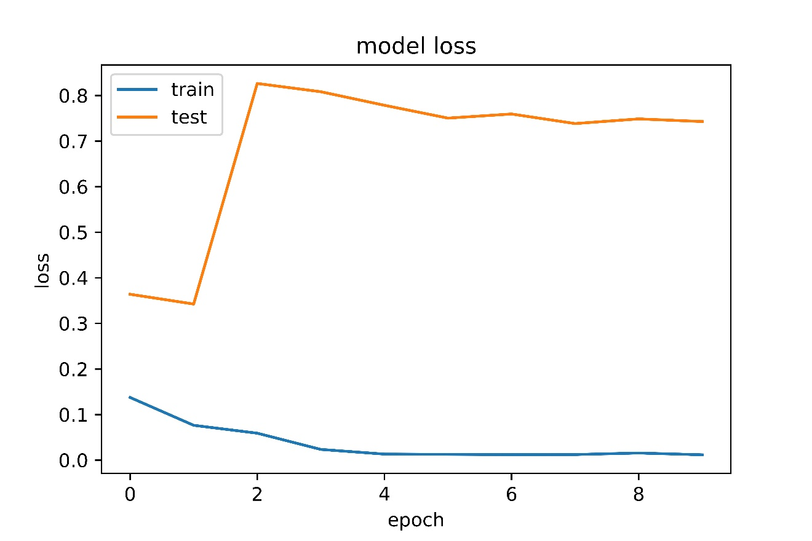
Loss model

Slide 29
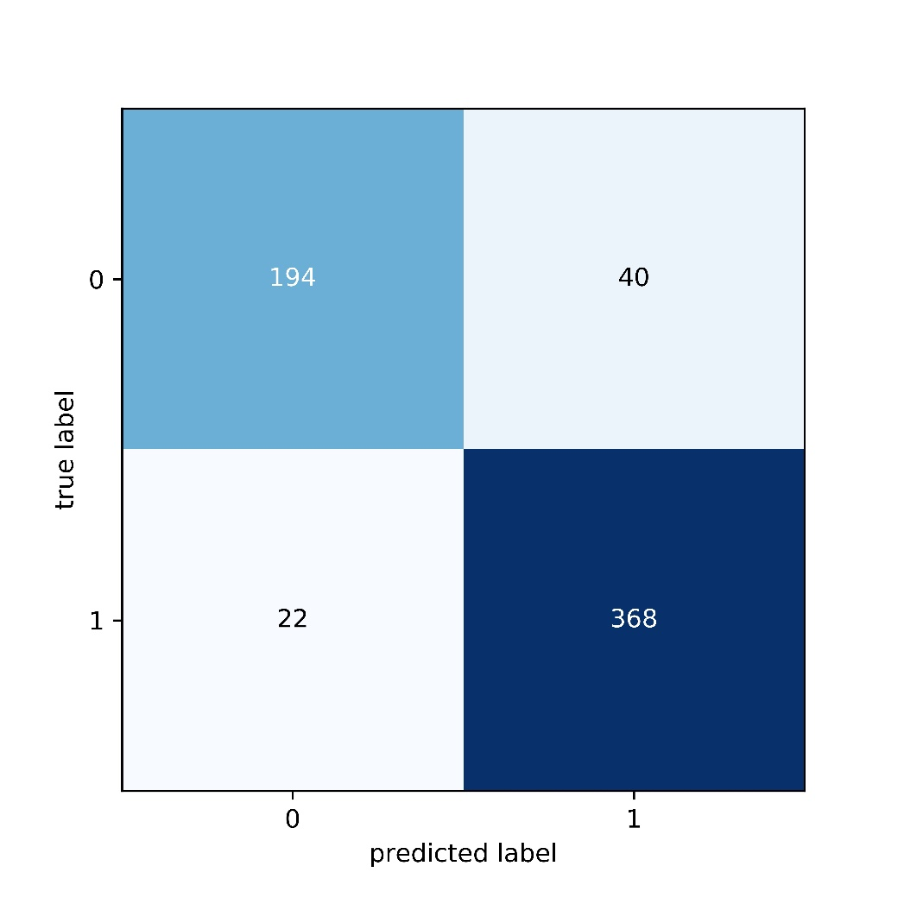
Confusion Matrix

Slide 30
Key point
Dataset have imbalanced ratio between normal and pneumonia
So, our goal is to achieve more precision and recall specially

Slide 31
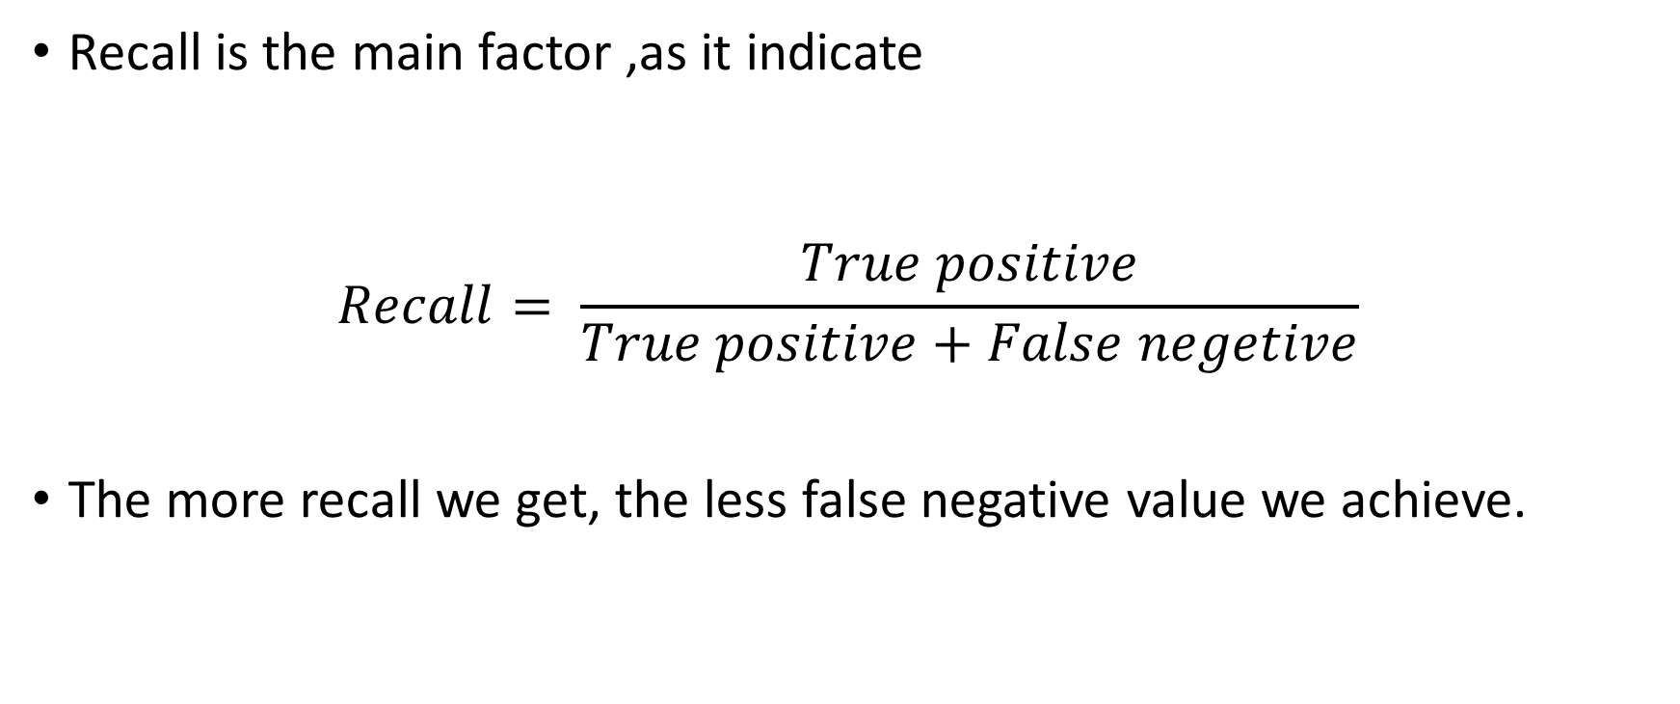
Continue…
Recall is the main factor ,as it indicate
$$Recall= \frac{True positive}{True positive+False negetive}$$
The more recall we get, the less false negative value we achieve.

Slide 32
Conclusion
In concluding this report, GoogleNet architecture is a great way of learning and detecting pneumonia from images as a diagnosis since through this ImageNet we get over 90% accuracy from the mechanism. However, it is always to be noted that human supervision and crosschecking is a must for the remaining 10% of uncertainty. The advancements of deep learning in healthcare sector is a remarkable approach and will allow more efficient ways of diagnosis and help decrease the scale of population remaining under privileged with a proper healthcare system. This will also allow more cost efficient approaches to health care once adopted within developing countries.

Slide 33
Reference
[1] Szegedy, C., Vanhoucke, V., Ioffe, S., Shlens, J. and Wojna, Z., 2020. Rethinking The Inception Architecture For Computer Vision. arXiv.org. doi:https://arxiv.org/abs/1512.00567
[2] O. Stephen, M. Sain, U. J. Maduh, and D. U. Jeong, “An Efficient Deep Learning Approach to Pneumonia Classification in Healthcare,” J. Healthc. Eng., vol. 2019, 2019, doi: 10.1155/2019/4180949.

