Slide 1
Getting Started with Eclipse
Smita B Kumar

Slide 2
What’s Eclipse?
It is a free software / open source platform-independent software framework for delivering what the project calls "rich-client applications". Eclipse is also a community of users, constantly extending the covered application areas.
Eclipse was originally developed by IBM as the successor of its VisualAge family of tools.
Eclipse is now managed by the Eclipse Foundation, an independent not-for-profit consortium of software industry vendors.

Slide 3
Installing Eclipse
Download free of charge from www.eclipse.org
Eclipse is installed by default in all of the on-campus computers.

Slide 4
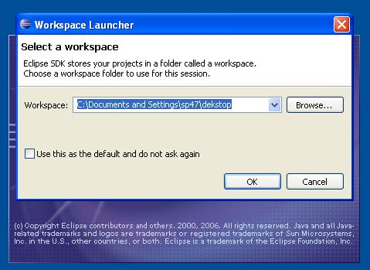
Running a program
Step 1: Open Eclipse, choose your workspace
Ex: My workspace was “sp47” so the path to be set is “C:\Documents and Settings\sp47\dekstop”

Slide 5
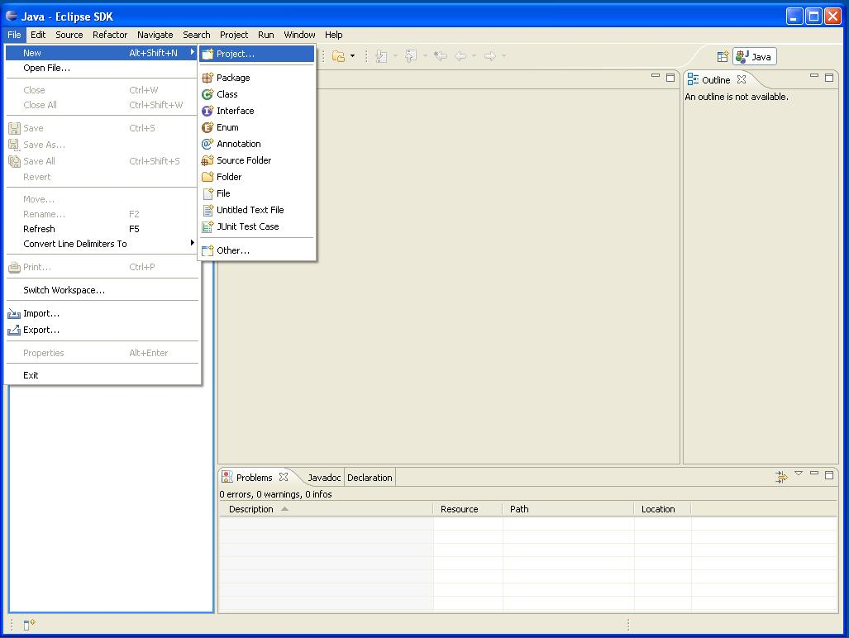
Starting an Eclipse project
Step 2: In eclipse whenever you want to create a class , you need to select a New Project by default.

Slide 6
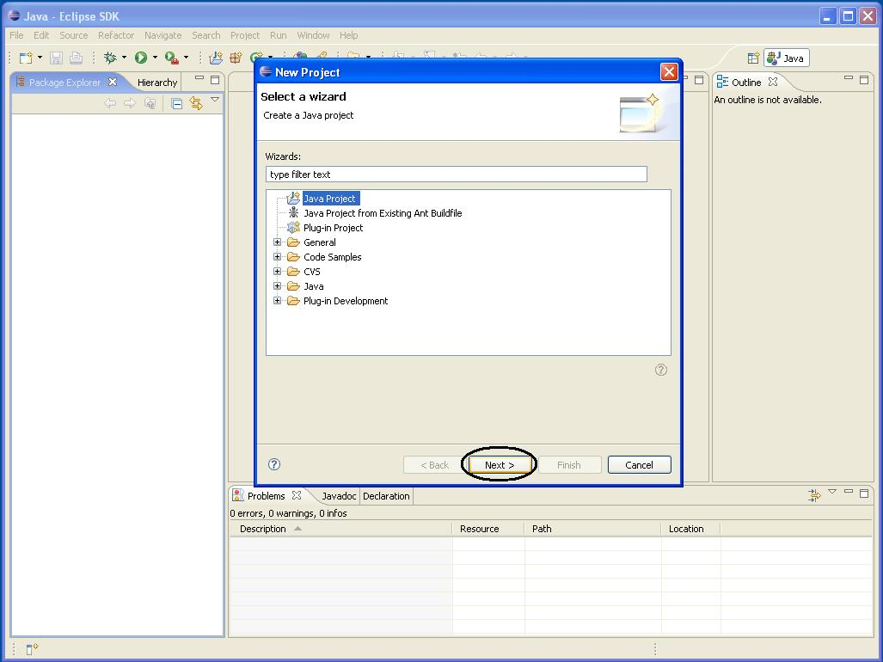
Step 3: Select Java Project and click the Next button.

Slide 7
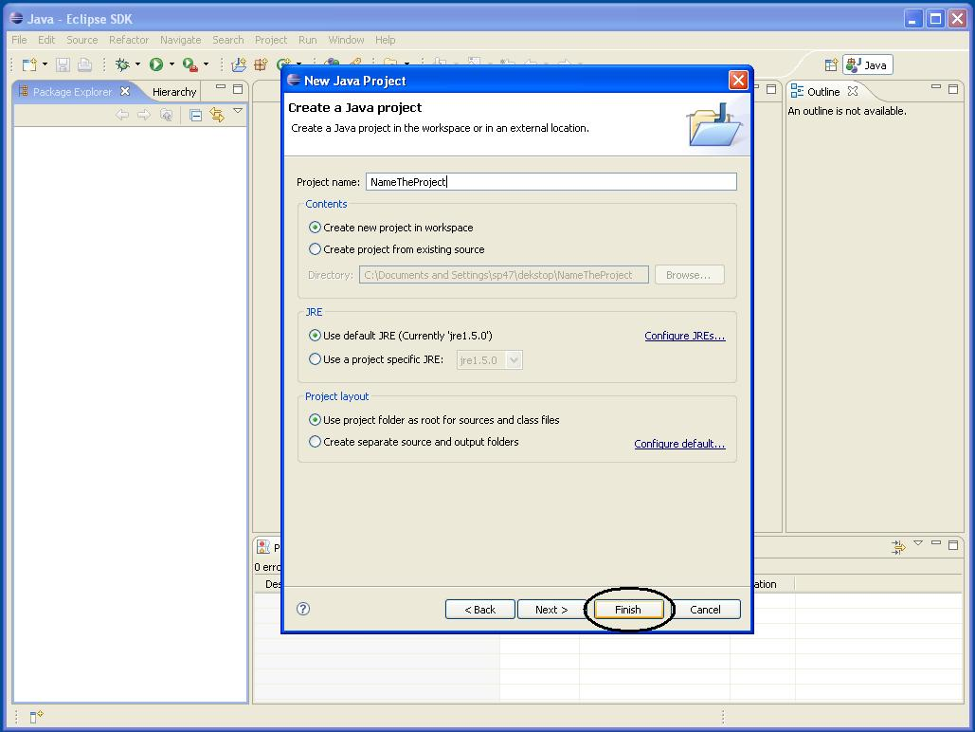
Step 4: Name the project and click the Finish button.

Slide 8
Creating your code
You have these choices:
Create a file directly
Import a file
Creating a .jar file
Importing a .jar file
The links above take you directly to that portion of this presentation, or you can follow through them in sequence.

Slide 9
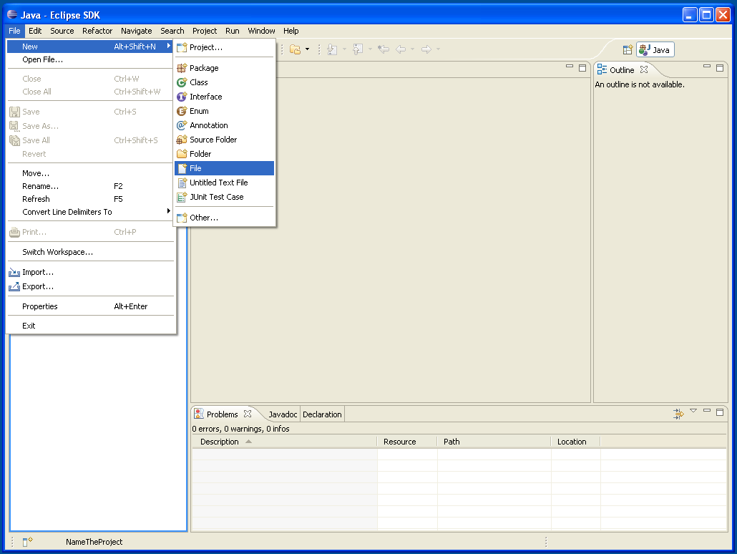
Step 5: Create a java file by selecting File, New and New File.

Slide 10
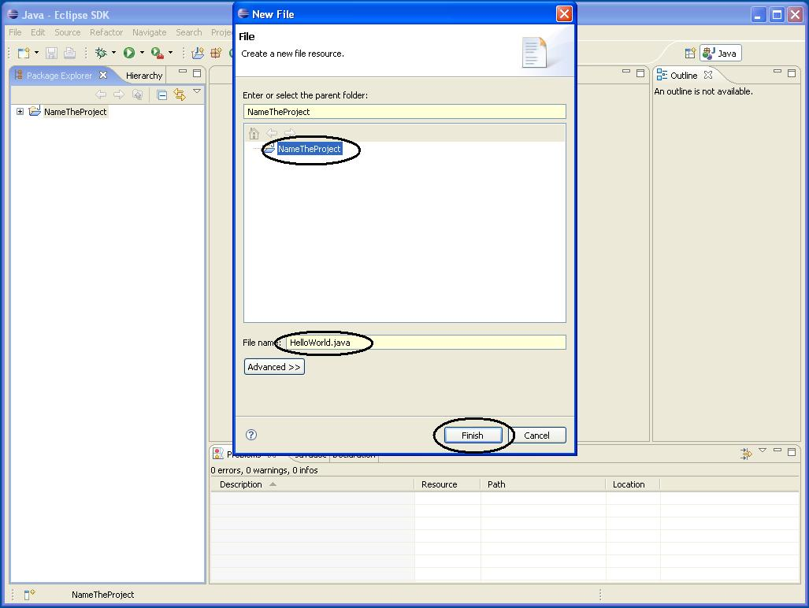
Step 6: Select the project, name the Java class with extension and click “Finish”

Slide 11
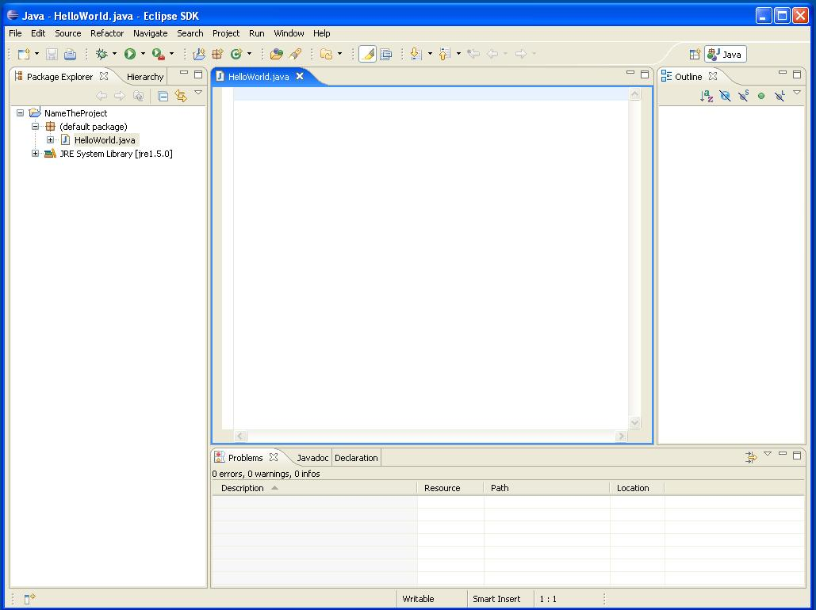
Step 7: Using the java editor, start coding.

Slide 12
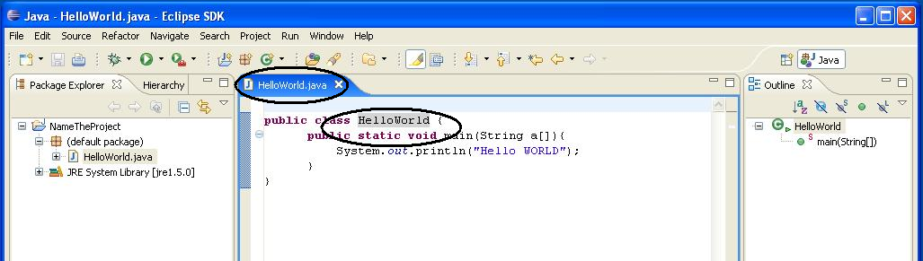
Writing code
Step 8: In Eclipse when ever you save the file, it will compile the code by default.
Basic tip: Class name and the file name should be same.

Slide 13
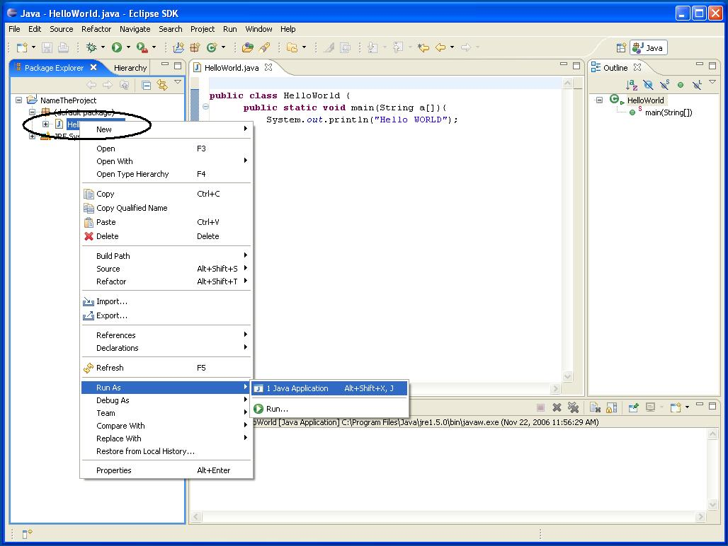
Step 9: Running the Java class. Right click on the class file and choose Run.

Slide 14
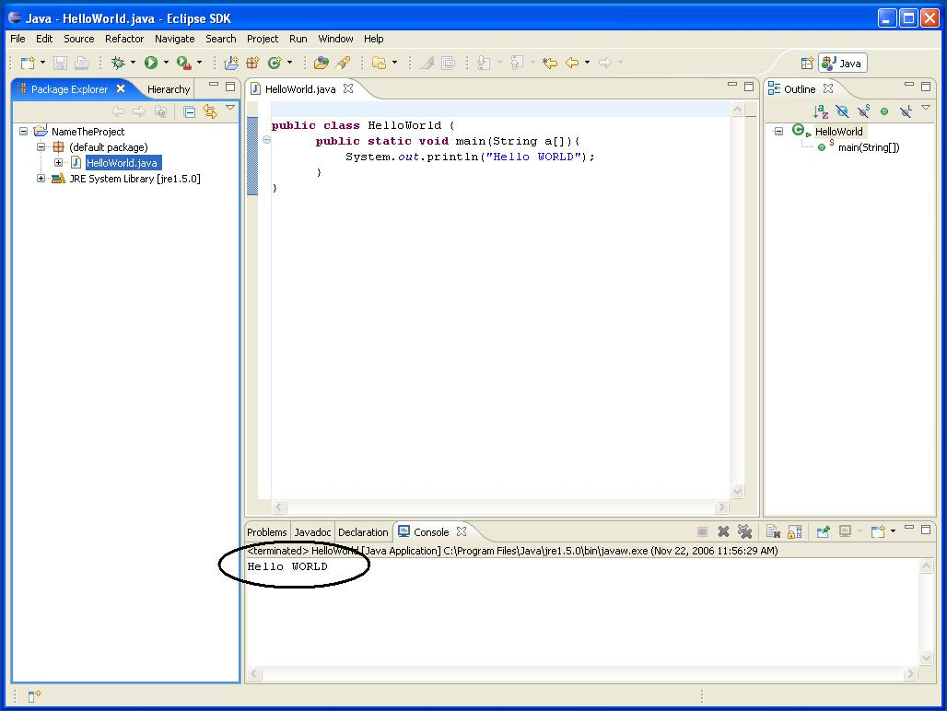
Step 10: Here is the output.

Slide 15
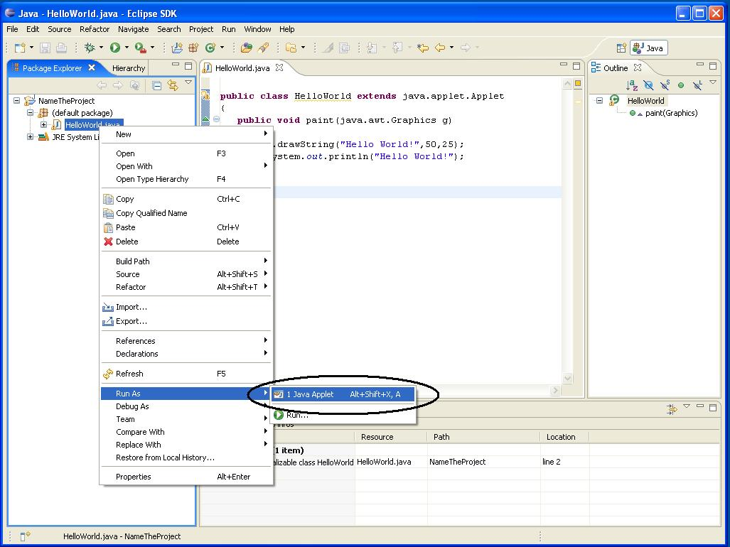
Running an Applet
Creating an applet essentially same as a normal java file. When we try to run it, Eclipse runs the code as a Java Applet.

Slide 16
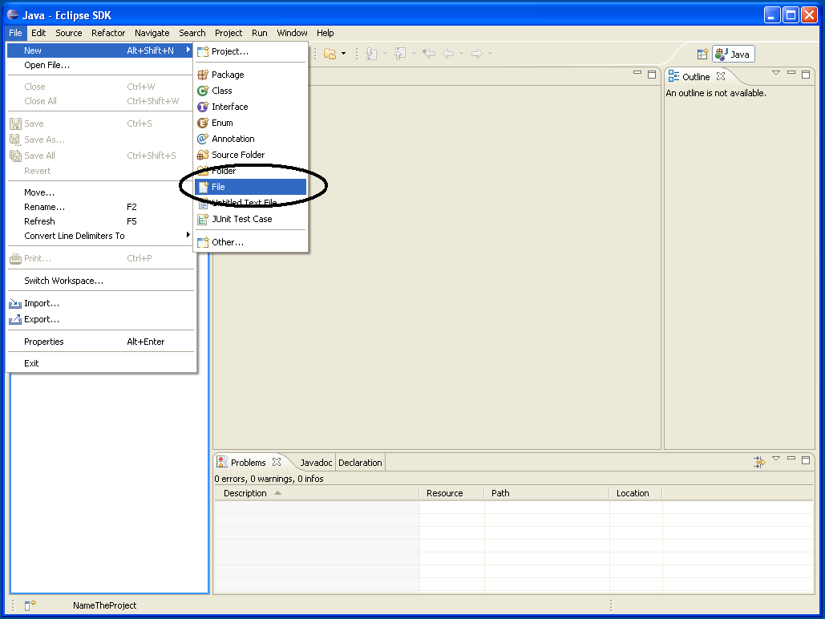
Importing a file into Eclipse
Step 1: File option, choose Project and New File as shown in the figure below.

Slide 17
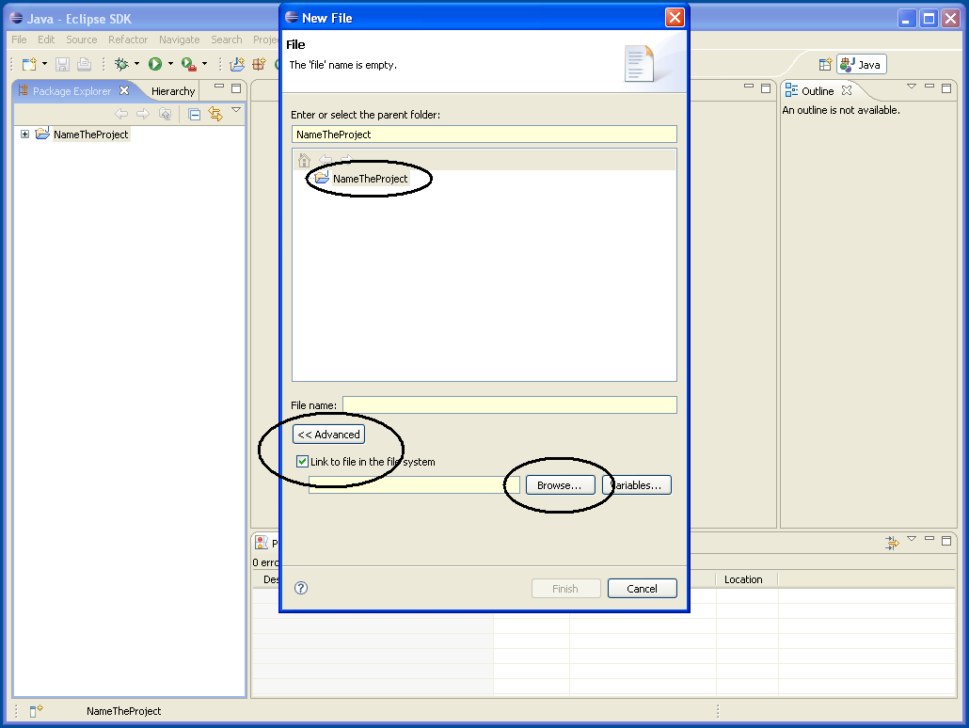
Step 2: Select Project, choose Advanced option, click check box and Browse.

Slide 18
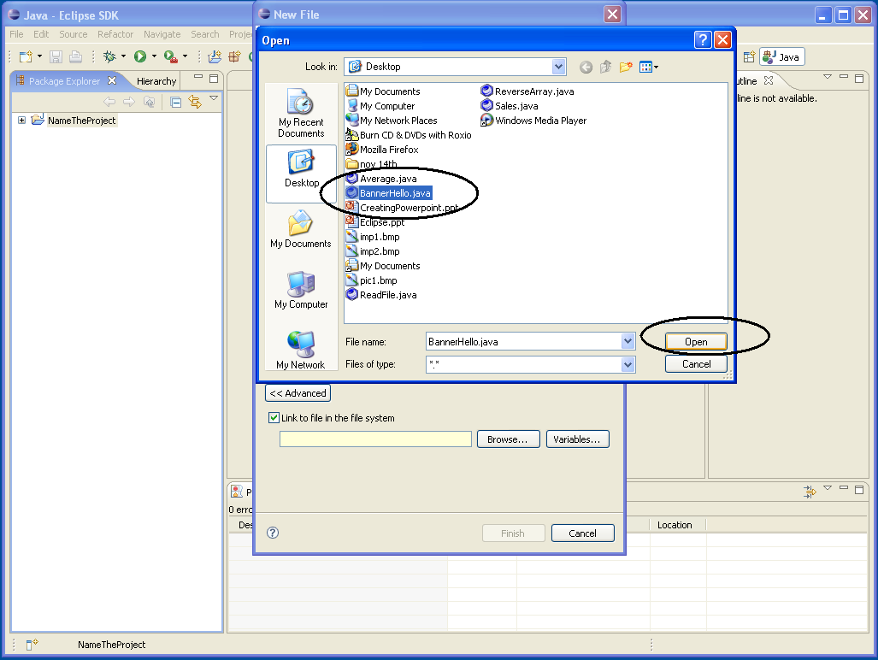
Step 3: Select your file and Open it

Slide 19
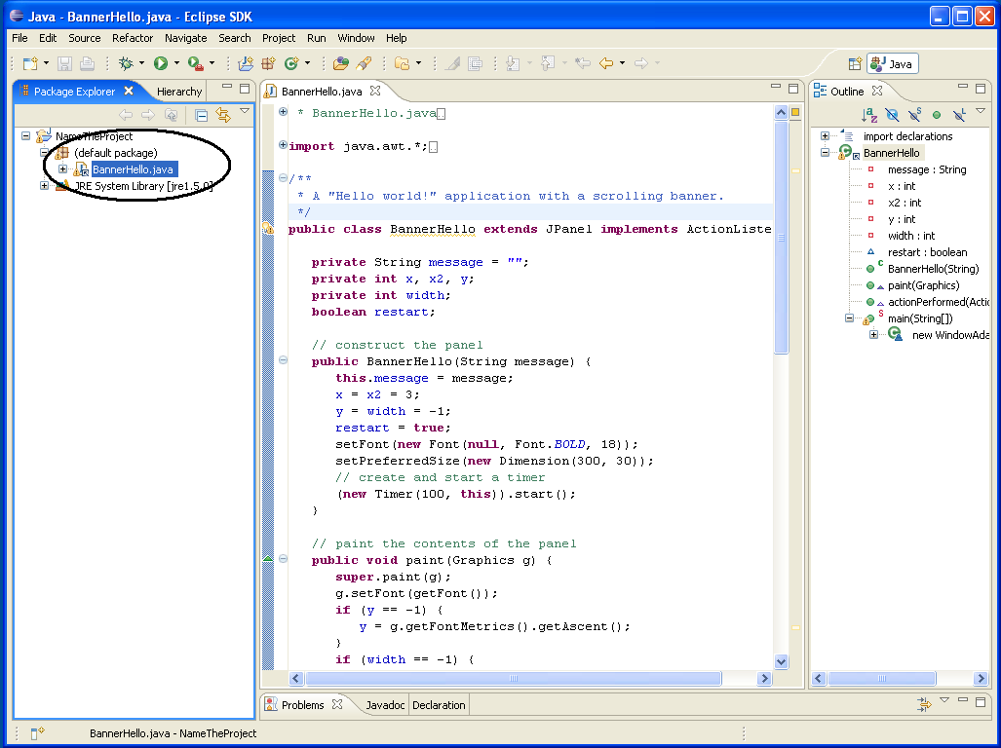
Imported file is shown in work space and loaded as the Default Package of the selected Project.

Slide 20
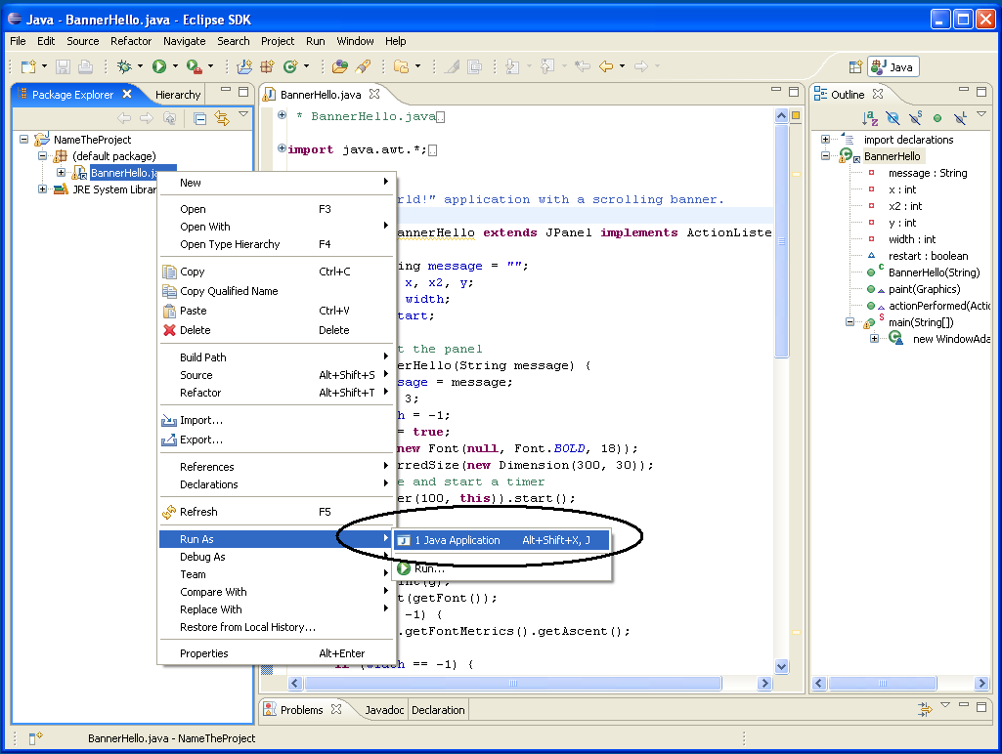
Step 4: Select the file and run it.

Slide 21
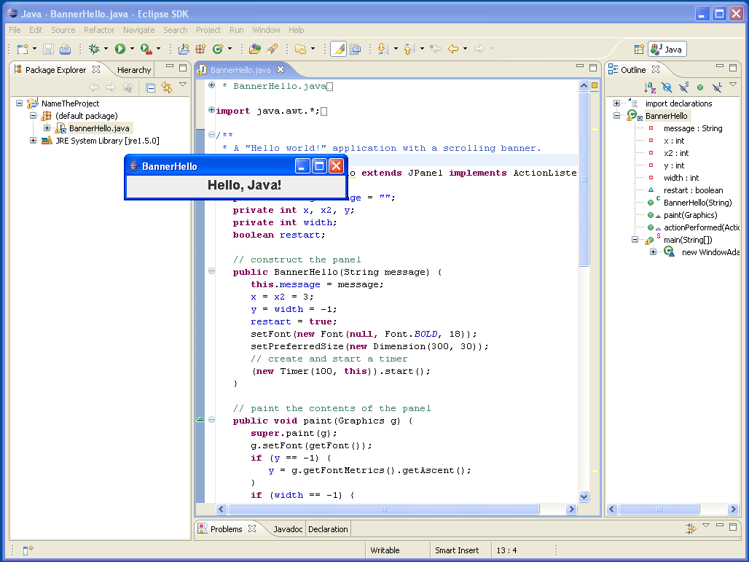
Here is the output of your applet.

Slide 22
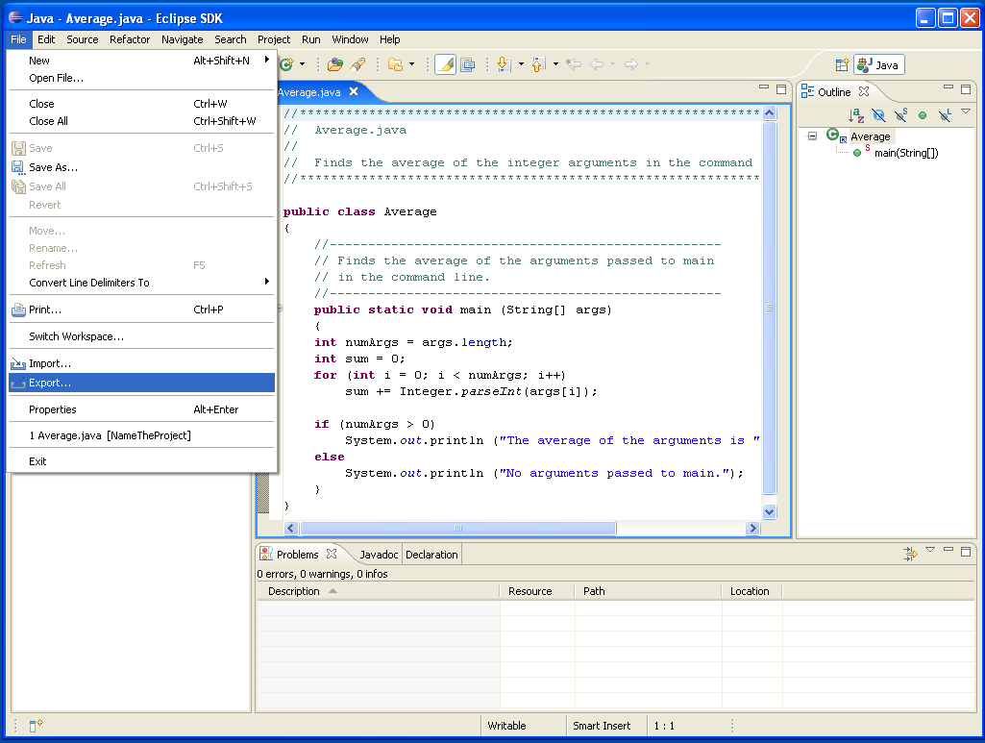
Creating a .jar file
Step 1:Select ‘file’ and choose ‘export’ as shown below

Slide 23
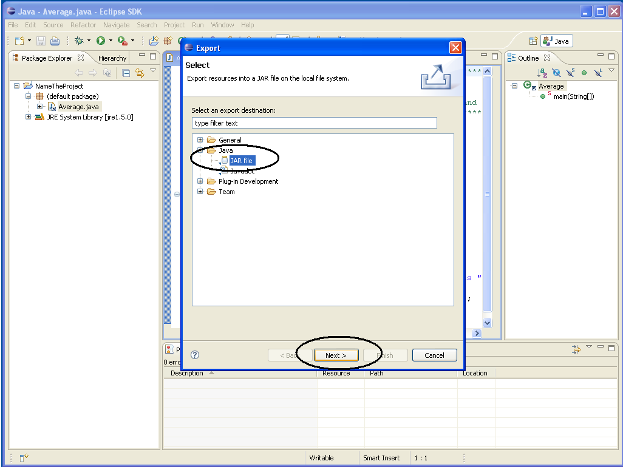
Step 2: Choose Java and select Jar File, then Next.

Slide 24
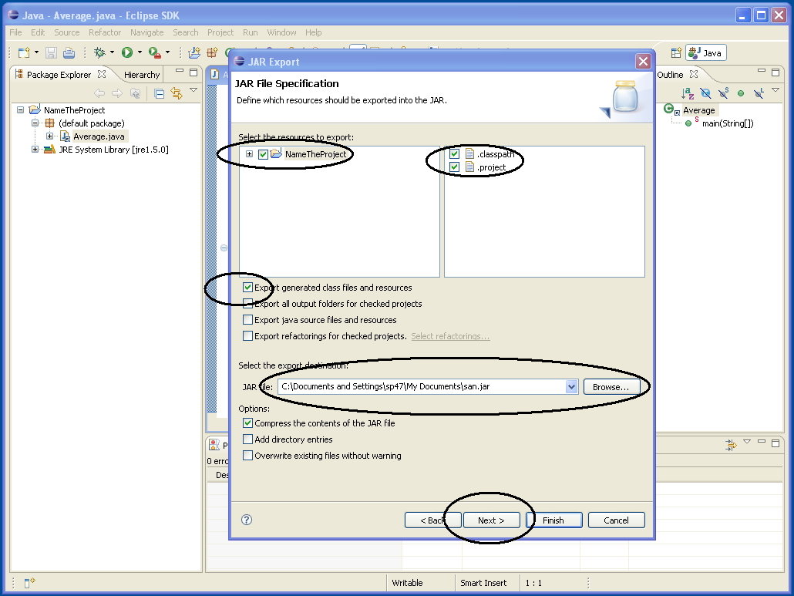
Step 3: Select the Project and the Files you want to add. Use Browse to select your destination file.

Slide 25
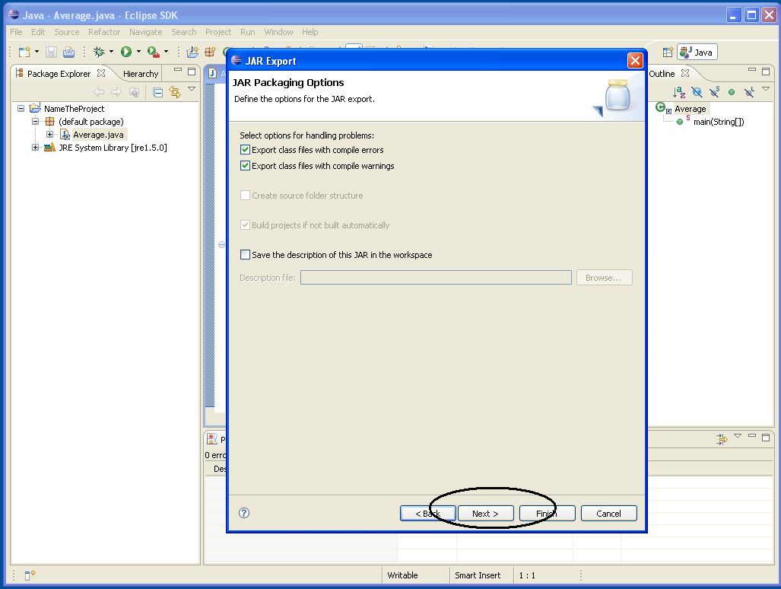
Step 4: In the JAR Packaging options, the first 2 options are usually enough.

Slide 26
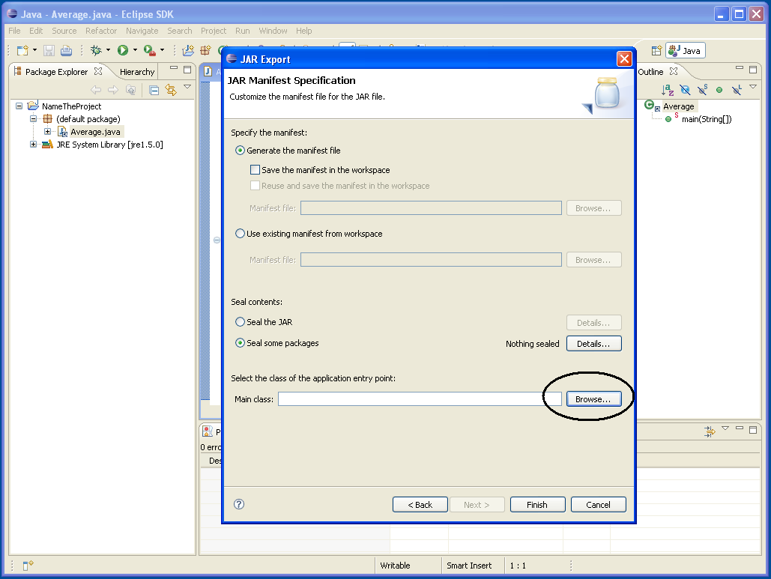
Step 5: Jar export. The options chosen here are the basics. Then browse and select the class file.
Read the headings before selecting the options.

Slide 27
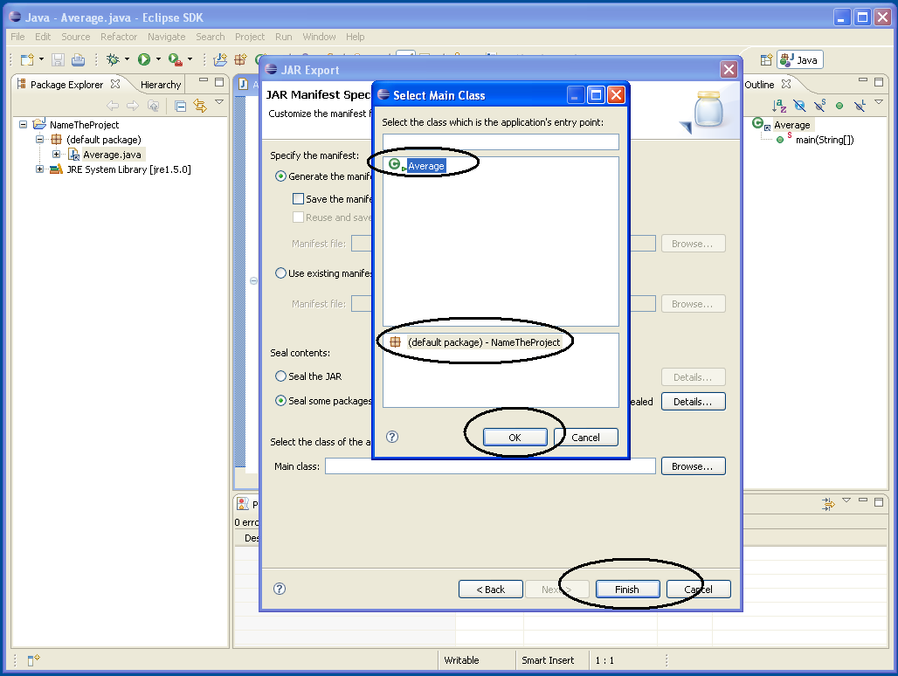
Step 6: Eclipse by default shows the class files and the projects available. We just need to choose the right one. The jar file is created.

Slide 28
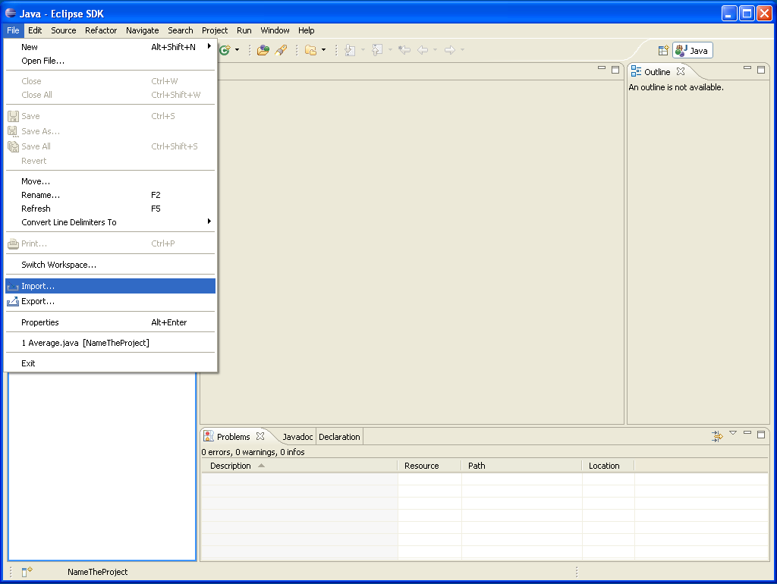
Importing a .jar file
Step1: Select the ‘file’ and ‘import’ option.

Slide 29
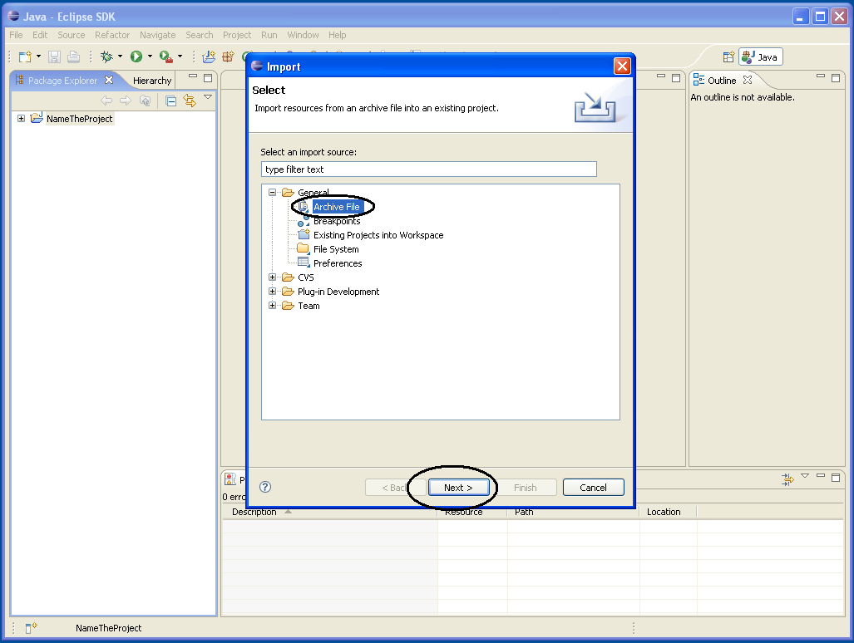
Step 2: Select ‘General’ and ‘Archive File’ as .jar file is a file.

Slide 30
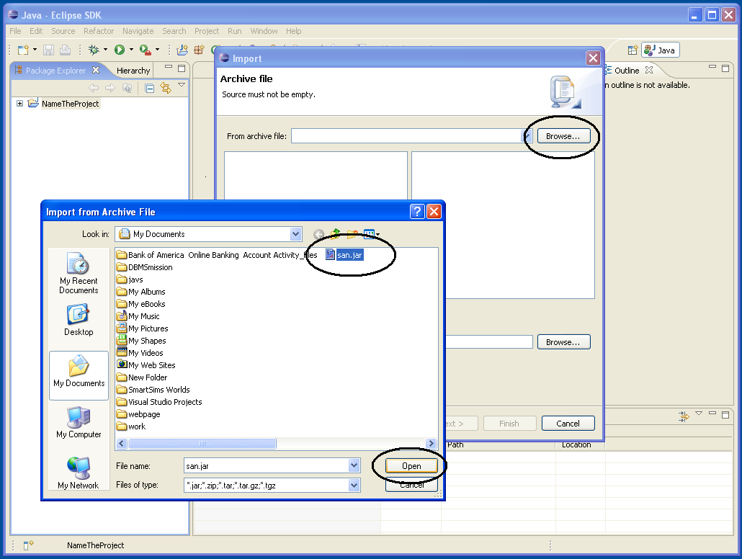
Step 3: In the Archive file, choose the browse option and then upload your file. Here it is ‘san.jar’ and open it.

Slide 31
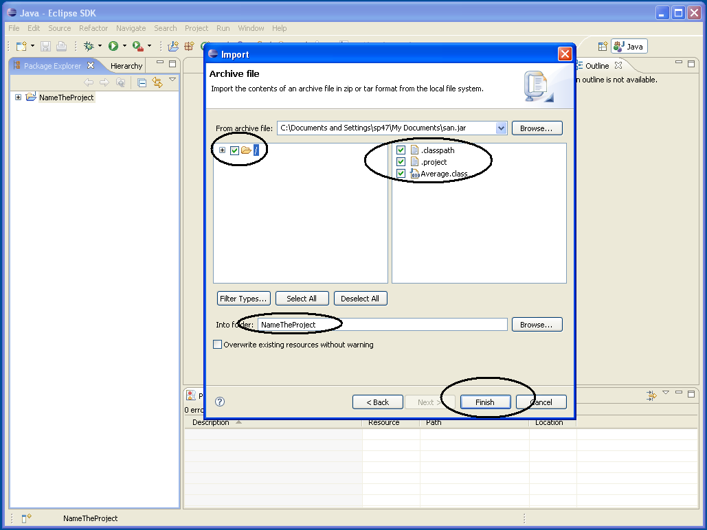
Step 4: Check the boxes for the directory , files you need and choose the destination folder.

Slide 32
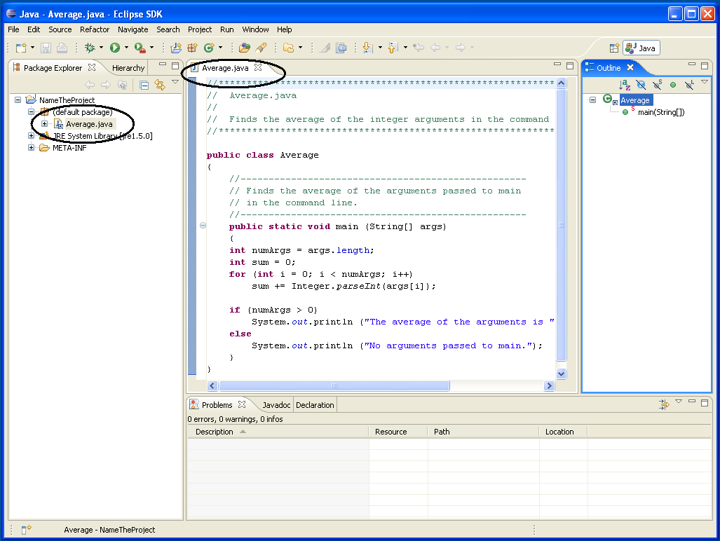
Step 5: Check the directory where it is placed and the file is ready to access.

Slide 33
Reference
www.eclipse.org
www.java.sun.com
www.wikipedia.org

