Slide 1



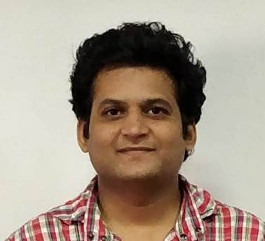


InsureMotion Motor Insurance Portal

Slide 2

Problem Statement
We offered Online Vehicle Insurance services such as Buy a Policy and having multiple functionality like queries and policies.

Slide 3
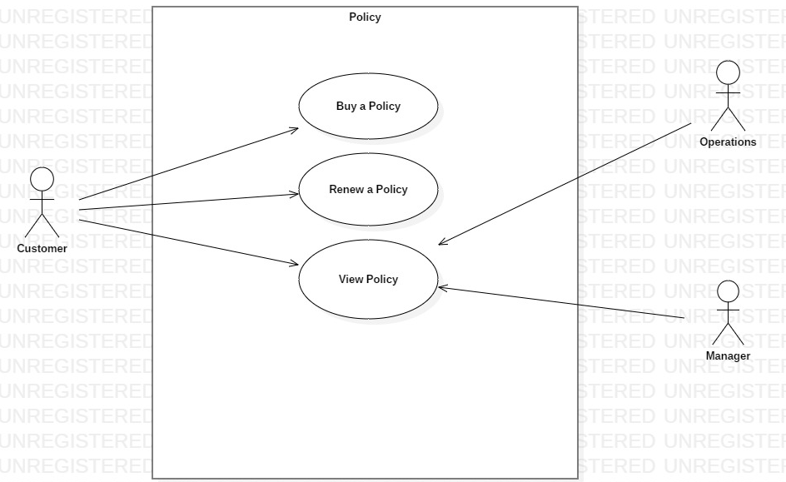
Use case diagrams
Policy

Slide 4
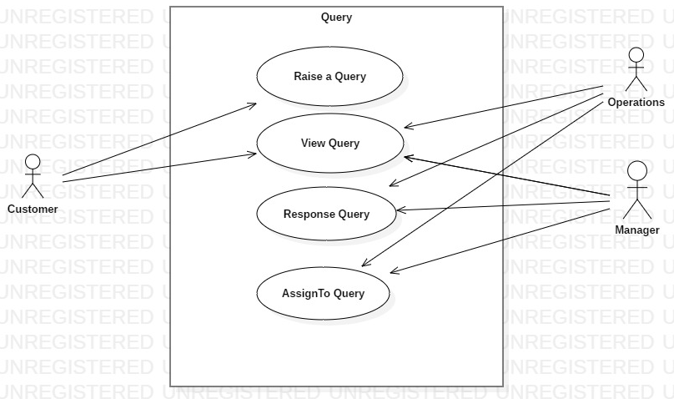
Use case diagrams
Query

Slide 5
Assumptions and Scope of project

Slide 6


Technologies, tools, frameworks with versions used in the project
Technologies :
Spring - v4.0.9
Oracle- SQL v11.9
Angular - v7.0.0
Bootstrap - v3.4.0
JPA
Rest Service
Tools:
Eclipse – vNeon2 Release (4.6.2)
Visual Code- v1.30.2

Slide 7
Salient features of the project
Multi Role
Authentication
Real time User Name Validation
Multi-Page form Submission
Multiple Menu Display
Client –Side Validation
Role based feature
Web Storage

Slide 8
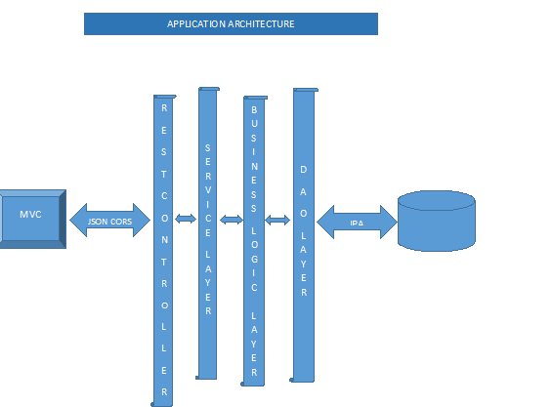
Application architecture

Slide 9
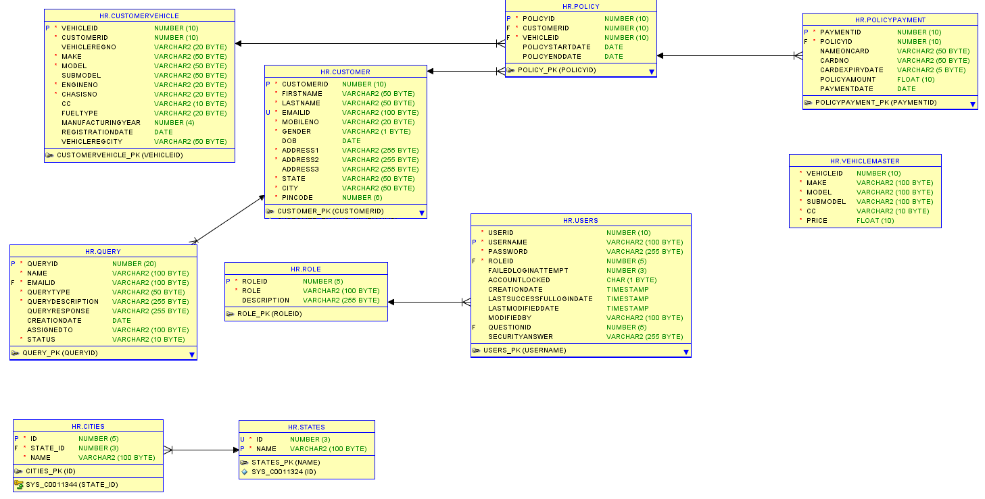
Class Diagram

Slide 10

What next? Future plan
Save Quote
Claim functionality
Forgot password
Staff registration by Admin
Report generations
Logging

Slide 11


Thank you

