Slide 1


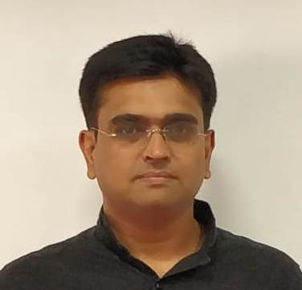



Slide 2




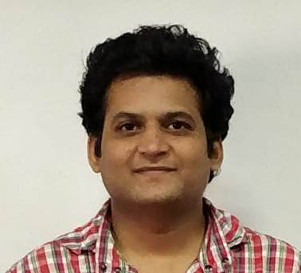


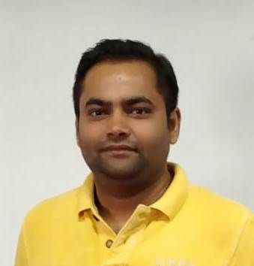





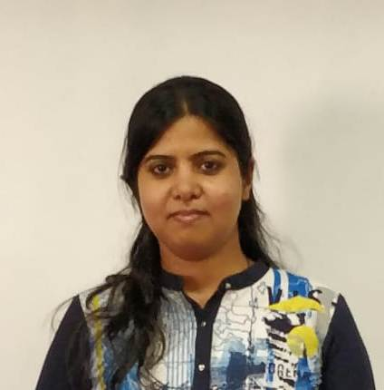

Slide 3

Problem Statement

Slide 4
Use case diagrams

Slide 5
Swim lane activity diagram

Slide 6
Assumptions and Scope of project

Slide 7


Technologies, tools, frameworks with versions used in the project

Slide 8
Salient features of the project
Feature 1
Feature
Feature
Feature
5Feature
6Feature
features
text
text

Slide 9

Application architecture

Slide 10
Class Diagram

Slide 11

What next? Future plan
Plan 1
Plan 2

Slide 12


Thank you

