Slide 1






InsureMotion Motor Insurance Portal

Slide 2

Problem Statement
The Vehicle Insurance Management System has been developed to override the problems prevailing in the existing manual system. So, the idea is to automate the existing manual system by developing full-fledged, error free, secure, reliable online solution that can store non-redundant and valuable data for a longer period and provide good performance and better services to the customer.
According to existing system, the agent would act as a mediator between the insurer (service provider) and the insured(Customer). It leads to excess charges of payment in terms of brokerage and token money to the Customer. Also, there are no means for tracking status of the insurance application issued for the Customer. The Customer validation is done only via staff of the service provider.
The proposed vehicle insurance policy system is a web-based application that aims to develop a complete and fully functional independent system to manage records of vehicle insurance companies. It is developed with the intent of providing such insurance companies and online platform for accurate processing, organized data handling and efficient retrieval and storage of records
The Key Features of the Proposed System are:
Proper management of vehicle insurance details like add new vehicle details, modify existing records, delete existing records etc.
The system provide facilities such as Buy a policy, renew policy, view policy, raise a Query, view Query.

Slide 3
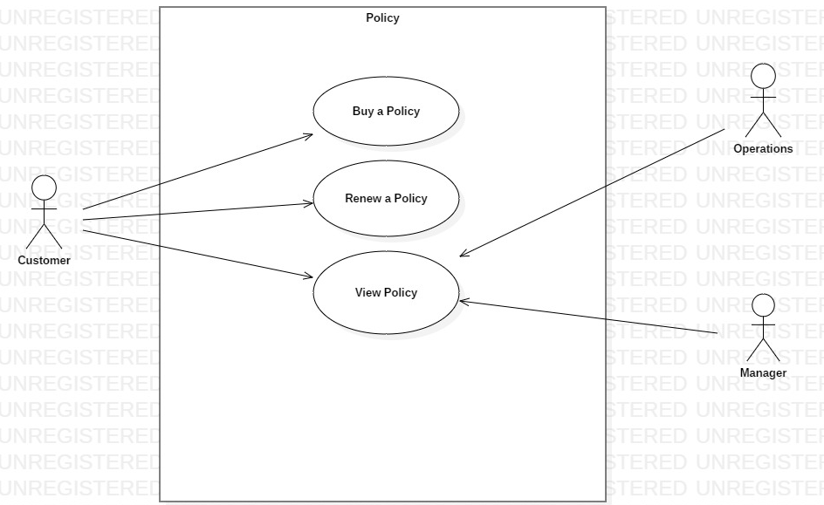
Use case diagrams
Policy

Slide 4
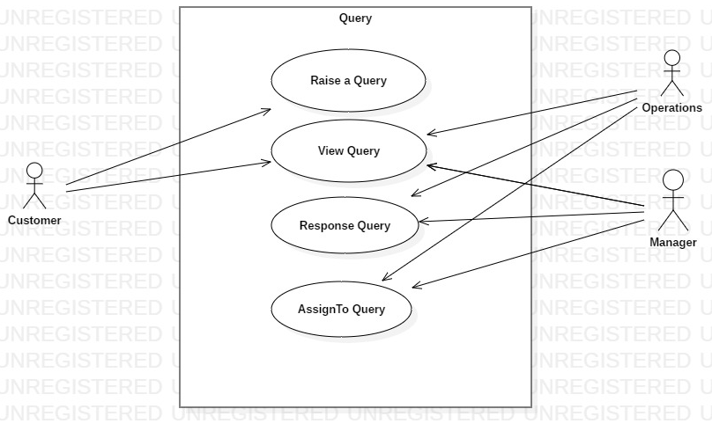
Use case diagrams
Query

Slide 5
Assumptions and Scope of project

Slide 6


Technologies, tools, frameworks with versions used in the project
Technologies :
Spring - v4.0.9
Oracle- SQL v11.9
Angular - v7.0.0
Bootstrap - v3.4.0
JPA
Rest Service
Tools:
Eclipse – vNeon2 Release (4.6.2)
Visual Code- v1.30.2

Slide 7
Salient features of the project
Multi Role
Authentication
Real time User Name Validation
Multi-Page form Submission
Multiple Menu Display
Client –Side Validation
Role based feature
Web Storage

Slide 8
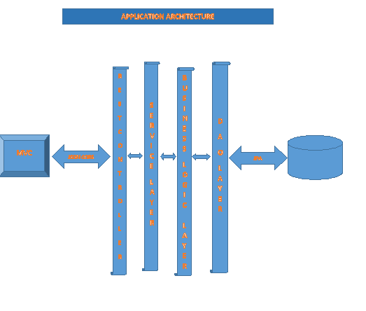
Application architecture

Slide 9
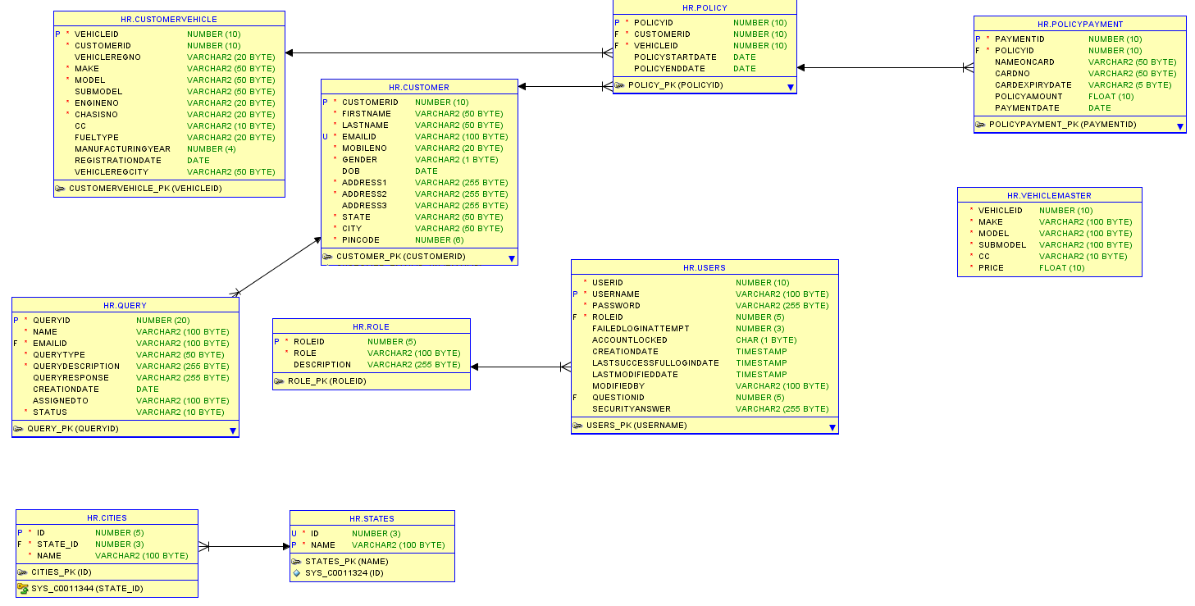
Class Diagram

Slide 10

What next? Future plan
Save Quote
Claim functionality
Forgot password
Staff registration by Admin
Report generations
Logging

Slide 11


Thank you

