Slide 1






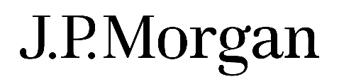
InsureMotion Motor Insurance Portal
Developed by
RnD Team
Ritesh Shah
Darshan Chaudhari

Slide 2

Problem Statement
Implement Motor Insurance Management System to
Provide full-fledged, error free, secure, reliable online solution that can store non-redundant and valuable data for a longer period
Provide online facilities for customers to buy a policy, renew policy, view policy
Provide facility for customer to raise claims
Facility for customer to raise any queries and view status of their queries
Facility for staff to view customer policy data and respond to customer queries

Slide 3
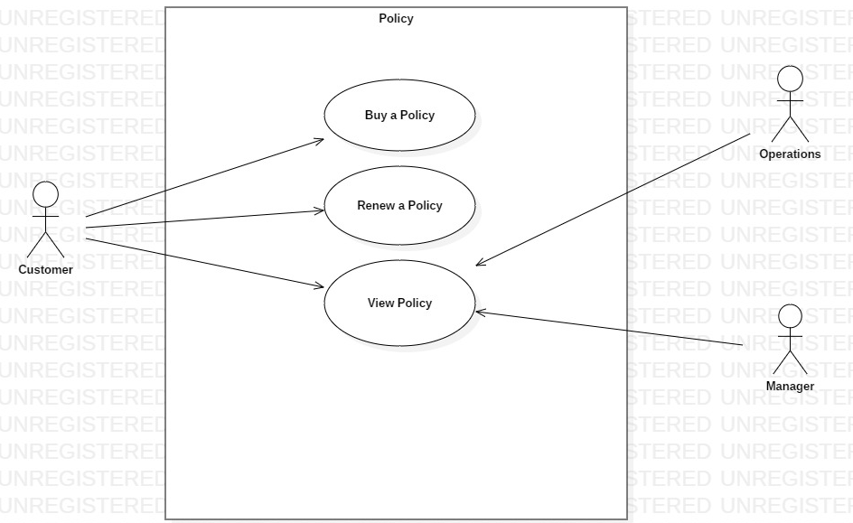
Use case diagrams
Policy

Slide 4
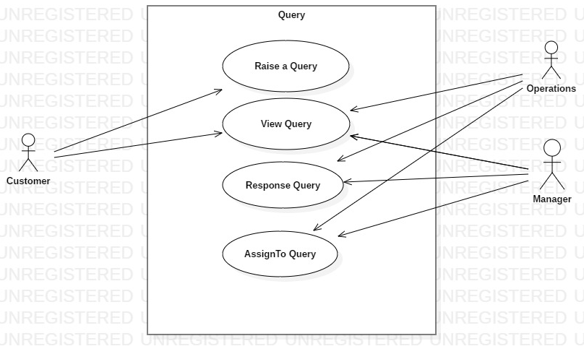
Use case diagrams
Query

Slide 5
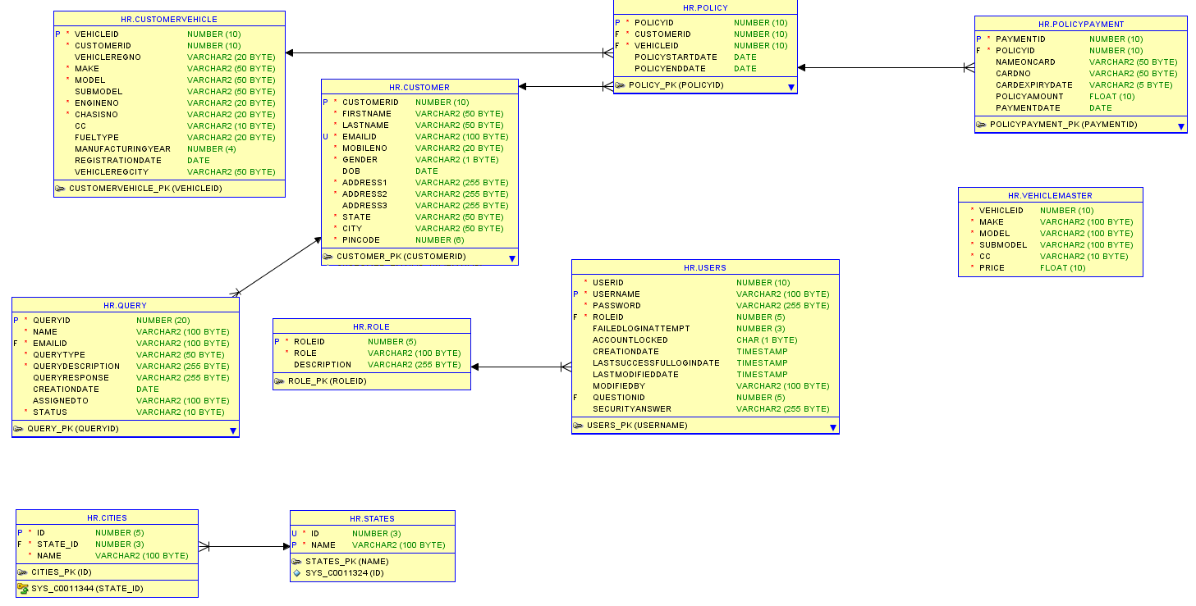
ER Diagram

Slide 6
Assumptions and Scope of project
Assumptions
Payment Gateway will be available for payment validation and money transfer
Master data related to Vehicles, state ,city etc. is available and loaded in Database manually
Login Id’s for staff will be created manually
Scope
Login
Registration for Customers
Policy – Buy, Renew, View
Queries – New, View

Slide 7
Application architecture
Application Architecture
Rest Controller
Service Layer
DAO Layer
MVC
Oracle DB
JSON
JPA
Technologies/Frameworks
Angular – v7.0.0
Bootstrap – v3.4.0
Spring – v4.0.9 JPA – v4.3.1
Java JDK – v1.8
Oracle – v11.9
Tools/IDE/Servers
Eclipse vNeon2 Visual Code v1.30.2 SQL Developer v18.1
Tomcat v8.5 Postman Github (source control)

Slide 8
Salient features of the project
Multi Role
Authentication
Real time User Name Validation
Multi-Page form Submission
Multiple Menu Display
Client –Side Validation
Web Storage

Slide 9


What next? Future plan
Claim functionality
View Quote for guest user
Staff registration by Admin
Forgot password
Reporting module
Logging

Slide 10


Application Demo & Feedback

Slide 11
Thank you

