Slide 1
Title : Madrid Housing Market Analysis
Name: Shahroj
Batch: B9
Tool Used: Power BI
Dataset: houses_Madrid.csv

Slide 2
Project Overview
Objective:
Analyze Madrid housing data using Power BI
Identify price trends and investment opportunities
Build an interactive dashboard
Key Focus Areas:
Data cleaning & transformation
Price analysis
Market segmentation
Interactive dashboard

Slide 3
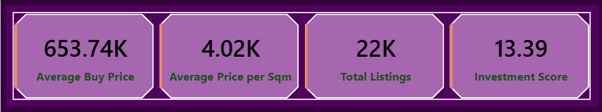
Data Preparation & Measures
Steps Performed:
Loaded dataset into Power BI
Checked data types and null values
Created calculated measures:
  Average Buy Price
  Average Price per Sqm
  Total Listings
  Investment Score

Slide 4
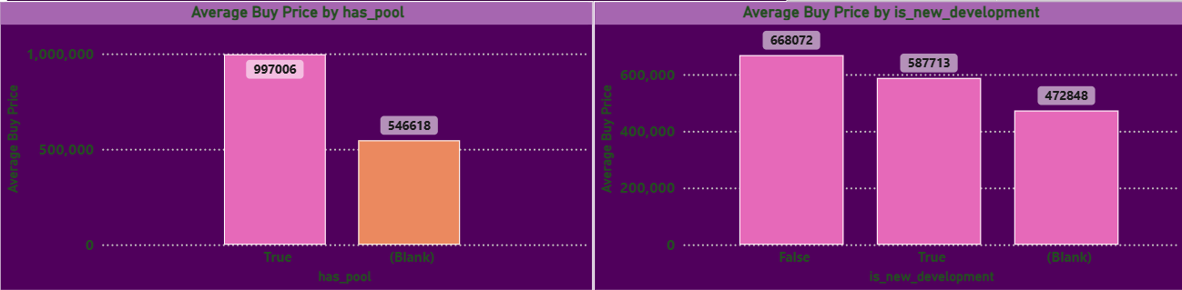
Impact of Pool & New Development on Property Prices
Properties with a has pool have a significantly higher average buy price.
Listings marked as new developments generally show higher prices compared to older properties.
Blank values indicate missing feature information and were kept as-is to maintain data integrity.
These features strongly influence property valuation and investment decisions.

Slide 5
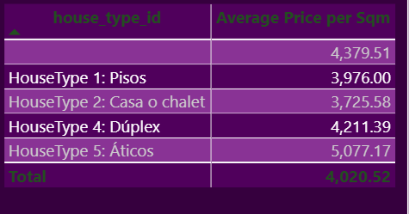
Average Price per Square Meter by Property Type
Apartments (Pisos) have a moderate price per square meter.
Casa o chalet properties are relatively cheaper per sqm.
Duplex properties show a higher price compared to standard apartments.
Aticos (Penthouses) have the highest average price per square meter.

Slide 6
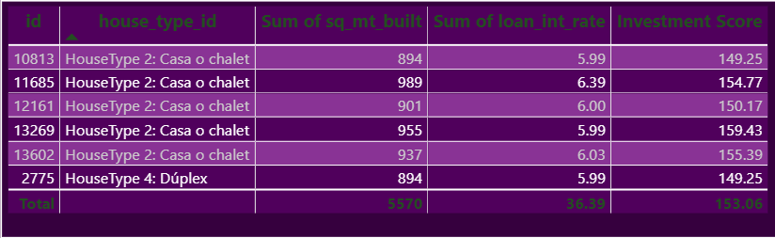
Top Investment Opportunities (Top 5)
Top 5 investment opportunities are identified
based on built area and loan interest rate.
Higher investment score indicates better opportunities.

Slide 7
Conclusion
This Power BI project provides valuable insights
into Madrid’s housing market.
It helps users understand pricing trends,
feature impact, and investment opportunities
through interactive visualizations.

