Slide 1
Comsat University Islamabad , Lahore Campus
Course Tittle
: Information and communication technology
Assignment
: 02
Topic
: Introduction to ICT
Submitted by
: Shahrooz Anwar
Registration
: FA25-BBA-152
Section
: C
Submitted to
: Miss Sameet Fatima
Date of submission
: Thrusday,October 9 ,2025

Slide 2
Introduction to ICT
Tables of contents
Introduction
Definition and Meaning of ICT
Components of ICT
Importance and Applications of ICT
Benefits and Challenges of ICT
Conclusion

Slide 3
Introduction
Information and Communication Technology (ICT) is one of the most influential forces shaping the modern world. It refers to the use of digital technology to communicate, store, create, and manage information. From smartphones to the internet and cloud computing, ICT has revolutionized the way individuals, businesses, and governments operate. This assignment explores the meaning, components, applications, benefits, and challenges of ICT in the 21st century.
2. Definition and Meaning of ICT
ICT is a broad term that encompasses all technologies used to handle telecommunications, broadcast media, intelligent building management systems, audiovisual processing, and transmission systems, and network-based control and monitoring functions.
UNESCO Definition:
CT refers to a diverse set of technological tools and resources used to transmit, store, create, share or exchange information.

Slide 4
Examples of ICT tools include:
• Computers and laptops
• Mobile phones
• Internet and broadband
• Email and video conferencing tools
• Cloud computing platforms
• Telecommunication networks
3. Components of ICT
ICT is composed of several interrelated components, including:
Hardware The physical devices like computers, servers, mobile phones, routers, and switches.
Software Programs and operating systems that run the hardware (e.g., Windows, Android, MSOffice). Data The raw facts and figures that are processed into useful information.
People Users, developers, IT professionals, and support staff involved in managing and using CT systems.
Processes The procedures and instructions that govern how the technology is used

Slide 5
4. Importance and Applications of ICT
ICT has become essential in every aspect of life. Some of its major applications include:
Communication:
Email, instant messaging, and video conferencing enable real-time global interaction.
Education:
Online learning platforms, smartboards, and educational apps have transformed teaching and learning.
Healthcare:
Telemedicine, electronic medical records, and health monitoring devices improve patient care.
Business:
E-commerce, cloud storage, and enterprise resource planning (ERP) systems streamline operations.
Government:
E-governance enhances transparency, reduces corruption, and provides services efficiently.

Slide 6
6. Benefits and Challenges of ICTBenefits:
• Increased productivity and efficiency
• Faster and more accurate communication
• Access to global information and knowledge
• Improved decision-making through data analytics
• Enhanced learning and teaching methods
Challenges:
• Cybersecurity threats (hacking, data breaches)
• Digital divide and lack of access in rural areas
• High costs of infrastructure and maintenance
• Dependency on technology
7. Conclusion
ICT is an essential pillar of the modern information society. It facilitatescommunication, enhances productivity, and transforms how people interact, learn, and conduct business. However, alongside its numerous benefits, ICT also presents several challenges that need to be addressed through responsible use, education, and policy-making. A foundational understanding of ICT is therefore critical for all students, professionals, and citizens in the digital age.

Slide 7
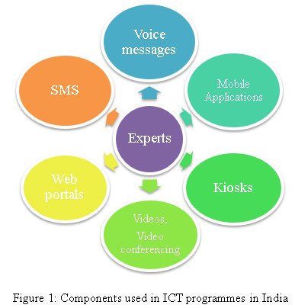
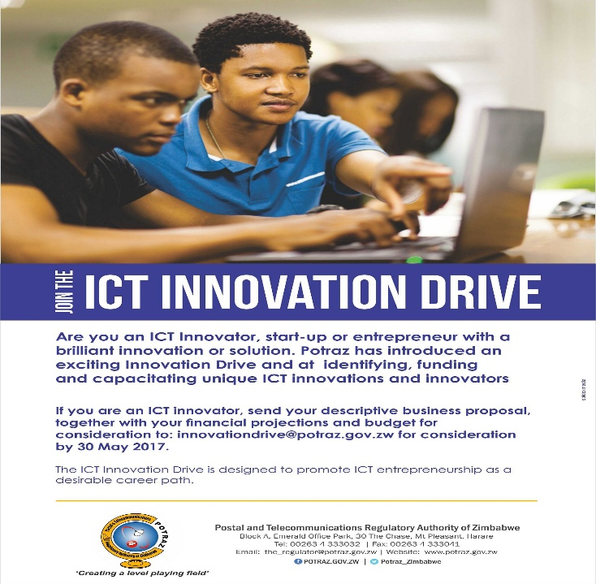
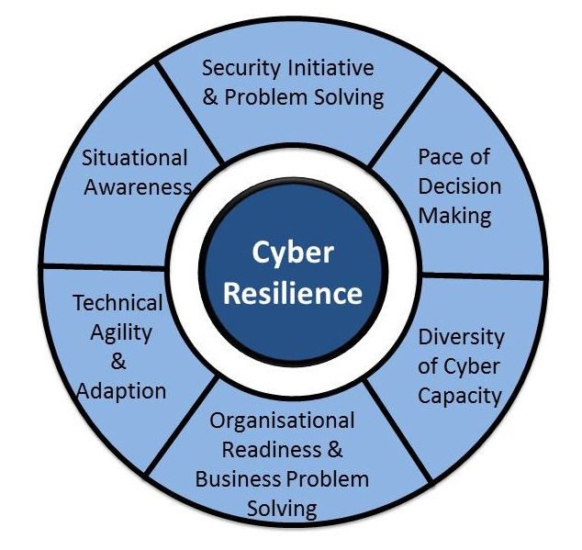
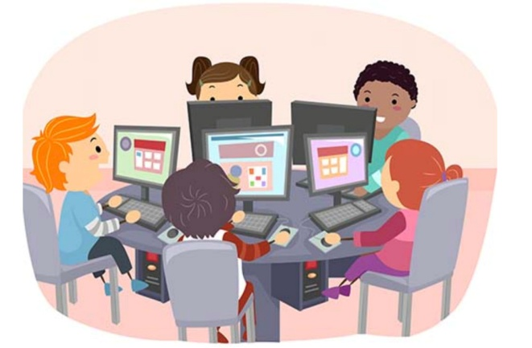
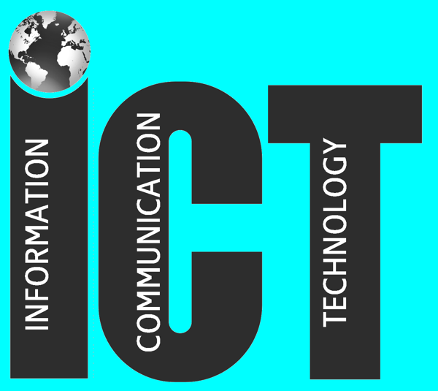

Slide 8
Thank you

