Slide 1
DevOps
.

Slide 2
AWS vs K8S Auto Scaling
In AWS we take our application as a image and just it will create a complete new application and instance but in k8s we can scale particular service which having huge customer traffic
we have to give % of Load to create a new instance or application but in k8s it will be managed by cluster or cloud providers
in AWS we can’t communicate server to server, and we can just give the port numbers which can be open but in kubernetes the servers can communicate one with another easily and we have multiple services to expose our application
if we want to implement any changes in application then we need to stop the service and again take that instance as a backup image then we can again start the application but in k8s the changes will be reflected instantly
AWS is resource level auto scaling but K8S is application level auto scaling

Slide 3
Reasons to Approach Kubernetes
Fast scalability
Application Management is very easy
Self healing
visibilities (monitoring containerized applications)
Rolling updates and rolling back
Statefullset deployment
cost optimization (k8s is open source and AWS is managed service)
multi-cloud migration flexibility
No down time
Handles more Micro services
Maintains and monitors the container site with Cluster
It can be used on cloud and data center

Slide 4
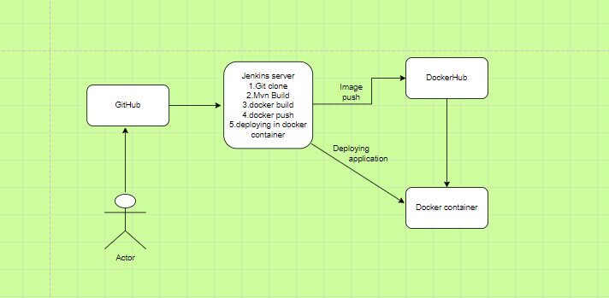
DevOps Workflow:

Slide 5
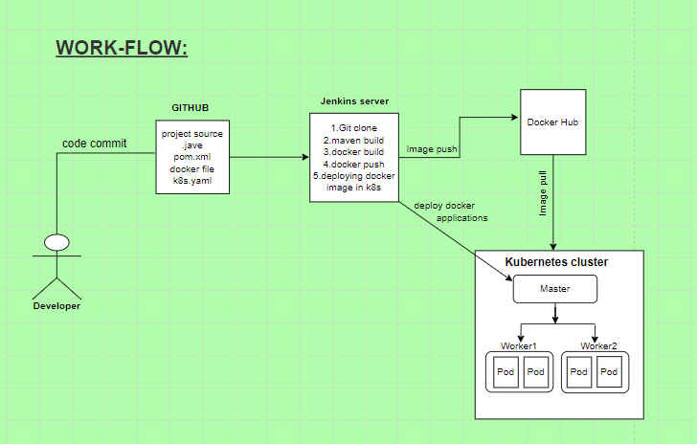
.

Slide 6
Thank You

