Slide 1
JUnit
By ANKISH GUPTA

Slide 2
Why create a test suite?
Obviously you have to test your code—right?
You can do ad hoc testing (running whatever tests occur to you at the moment), or
You can build a test suite (a thorough set of tests that can be run at any time)
Disadvantages of a test suite
It’s a lot of extra programming
True, but use of a good test framework can help quite a bit
You don’t have time to do all that extra work
False! Experiments repeatedly show that test suites reduce debugging time more than the amount spent building the test suite
Advantages of a test suite
Reduces total number of bugs in delivered code
Makes code much more maintainable and refactorable

Slide 3
JUnit
JUnit is a framework for writing unit tests
A unit test is a test of a single class
A test case is a single test of a single method
A test suite is a collection of test cases
Unit testing is particularly important when software requirements change frequently
Code often has to be refactored to incorporate the changes
Unit testing helps ensure that the refactored code continues to work

Slide 4
JUnit helps the programmer:
Define and execute tests and test suites
Formalize requirements and clarify architecture
Write and debug code
Integrate code and always be ready to release a working version

Slide 5
Why JUnit
Allow you to write code faster while increasing quality
Elegantly simple
Check their own results and provide immediate feedback
Tests is inexpensive
Increase the stability of software
Developer tests
Written in Java
Free
Gives proper uniderstanding of unit testing

Slide 6
JUNIT 5
JUnit 5 is the next generation of JUnit. The goal is to create an up-to-date foundation for developer-side testing on the JVM. This includes focusing on Java 8 and above, as well as enabling many different styles of testing.

Slide 7
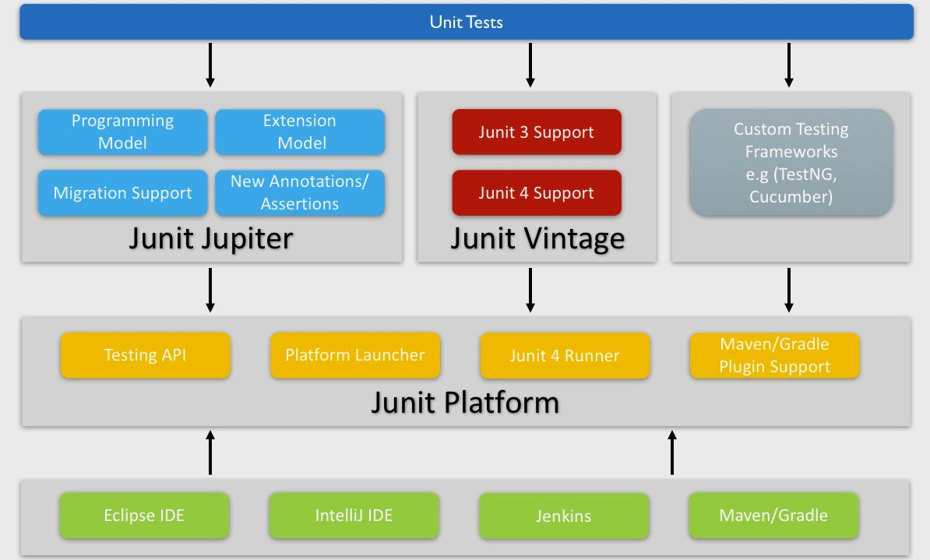
JUNIT 5 ARCHITECTURE

Slide 8
@JUnit 5 Annotations
This annotation denotes that a method is a test method. Note this annotation does not take any attributes.
@Test
import org.junit.jupiter.api.Test;
import static org.junit.jupiter.api.Assertions.assertEquals;
class JUnit5Test {
@Test void helloJUnit5()
{ assertEquals(10, 5+5);
}
}
Parameterized tests make it possible to run a test multiple times with different arguments.
They are declared just like regular @Test methods but use the @ParameterizedTest annotation instead.
@ParameterizedTest
JUnit 5 has the ability to repeat a test a specified number of times simply by annotating a method with @RepeatedTest and specifying the total number of repetitions desired.
@RepeatedTest
@DisplayName
Test classes and test methods can declare custom display names that will be displayed by test runners and test reports.

Slide 9
THANK YOU

