Slide 1
Multithreading
A web of stack

Slide 2

Confusing at times.

Slide 3

Run() as fast as you can. All I need is a job. Am I Runnable?
Start() Running!!!

Slide 4

-Runnable -Start() -Blocked..

Slide 5

Scheduled everything...
Randomly.

Slide 6
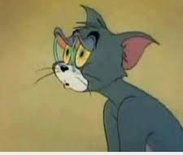
Sleeping...
Organises stuff???

Slide 7
WHY SYNCHRONIZE()????

Slide 8

THE ONE TRUE KEY!!!!

Slide 9
THANK YOU!!

