Slide 1
Software Quality Project: Restaurant Review System

Slide 2
1.
Software Background
The background information of the software being improved

Slide 3
Basic Idea
Software System to facilitate restaurant reviews
The system has two types of users:
Reviewers: write reviews for restaurants
Owners: write responses for reviews
Each review has a unique ID
Also there are three types of restaurants:
Restaurants
Takeout Restaurants
Licensed Restaurants

Slide 4
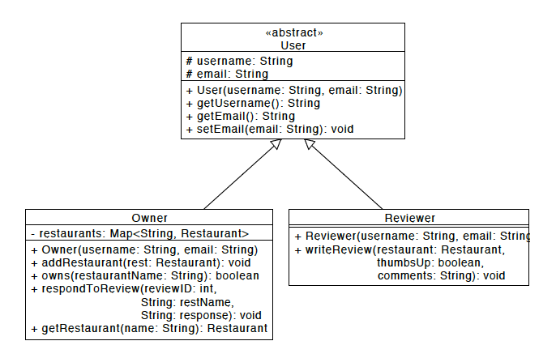
UML Design
Different types of user classes in a simple diagram
Place your screenshot here

Slide 5
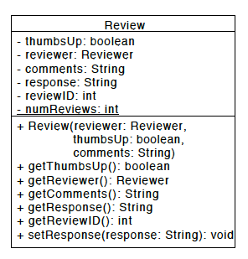
UML Design
Characteristics of the Review class in diagram format
Place your screenshot here

Slide 6
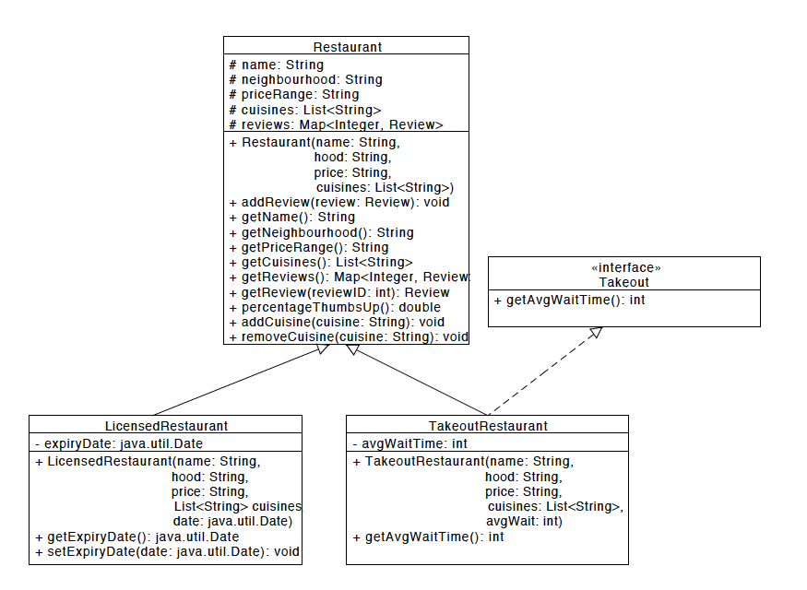
UML Design
Different types of restaurants in design format
Place your screenshot here

Slide 7
2.
Refactoring & Testing
How did we improve the software quality

Slide 8
Testing Method
JUnit 4 to test the Owner class and Review class
Fast and easy setup
🔑

Slide 9
Tested Methods
Review Class
getThumbsUp()
getReviewer()
getComments()
getResponse()
setResponse()
Owner Class
Owner()
addRestaurant()
respondToReview()
getRestaurant()
owns()

Slide 10
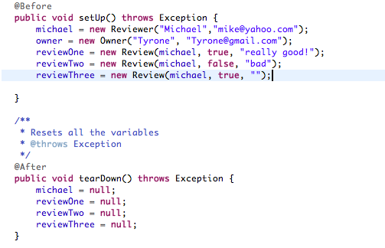
Test Methods Screenshots For Review Class

Slide 11
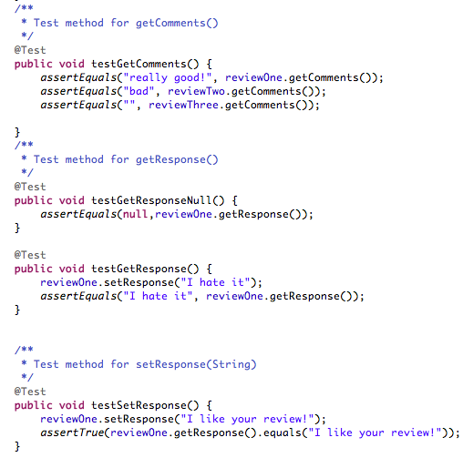
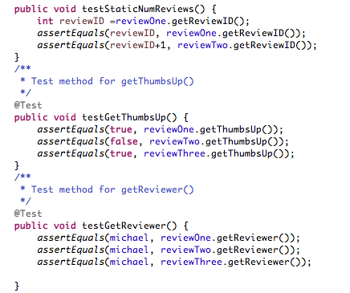
Test Methods Screenshots For Review Class

Slide 12
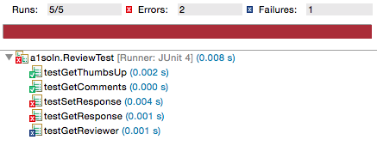
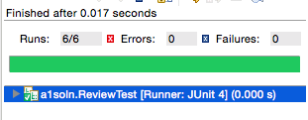
Test Results for Review Class
Before
After
Changes/Bug Fixes
The following changes were made:
Added functionalities to null or empty cases
Added functionalities for restaurants to have multiple reviews

Slide 13
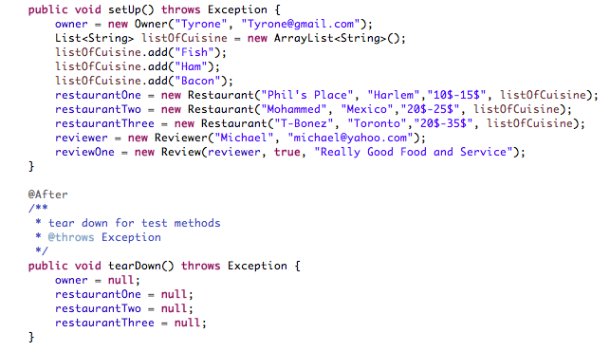
Test Methods Screenshots for Owner Class

Slide 14
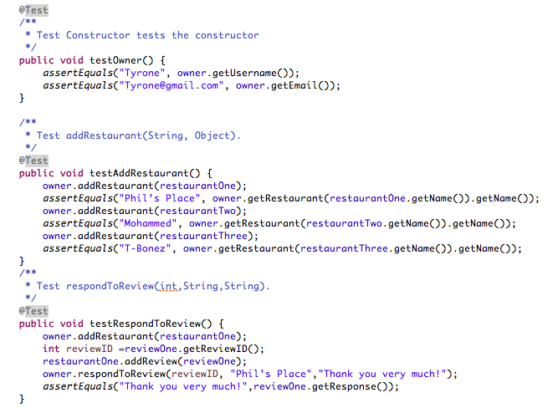
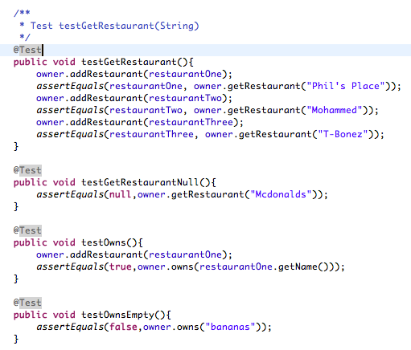
Test Methods Screenshots for Owner Class

Slide 15
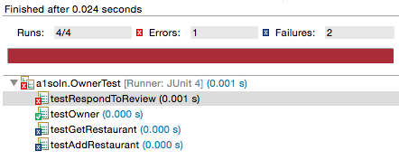
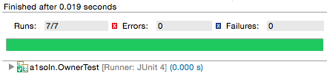
Test Results for Owner Class
Before
After
Changes/Bug Fixes
The following changes were made:
Added functionalities to null or empty cases
Added functionalities for owners to own multiple restaurants
Added owns method to find out if owner actually owns a particular restaurant

Slide 16
44% Error Rate
0% Error Rate
100%
That’s a lot of Mistake!
After bug fixes through our tests
Total success!

Slide 17
Thanks!
👍
Any questions?

