Slide 1
RAXSOFT
SOFTWARE SYSTEM CONSULTANT
Shahrul Haniff
http://www.raxsoft.cf

Slide 2
About Us
Raxsoft System Consultant are officially establish company since March 2018 registered under SSM (TR0190927-X).
I (we raxsoft) had done one project for REAL.
I have finished my study before and continue my study in higher education and from the inside, I observe many students behavior to select the best member as my staff.
My team members are a selected by me on how they study, work, dedication, responsibility and their integrity and we will continue to grow this company from now on.

Slide 3
General
Quotation
1
2
Local Order
Invoice
3

Slide 4
4
Delivery Order
Supplier Performance
5
Payment.
To complete the work outlined in the project scope, we will need approximately 12 -16 weeks
to finish the system building, depending on when we receive feedback at each milestones.
Once the agreement is signed we will start working immediately.

Slide 5
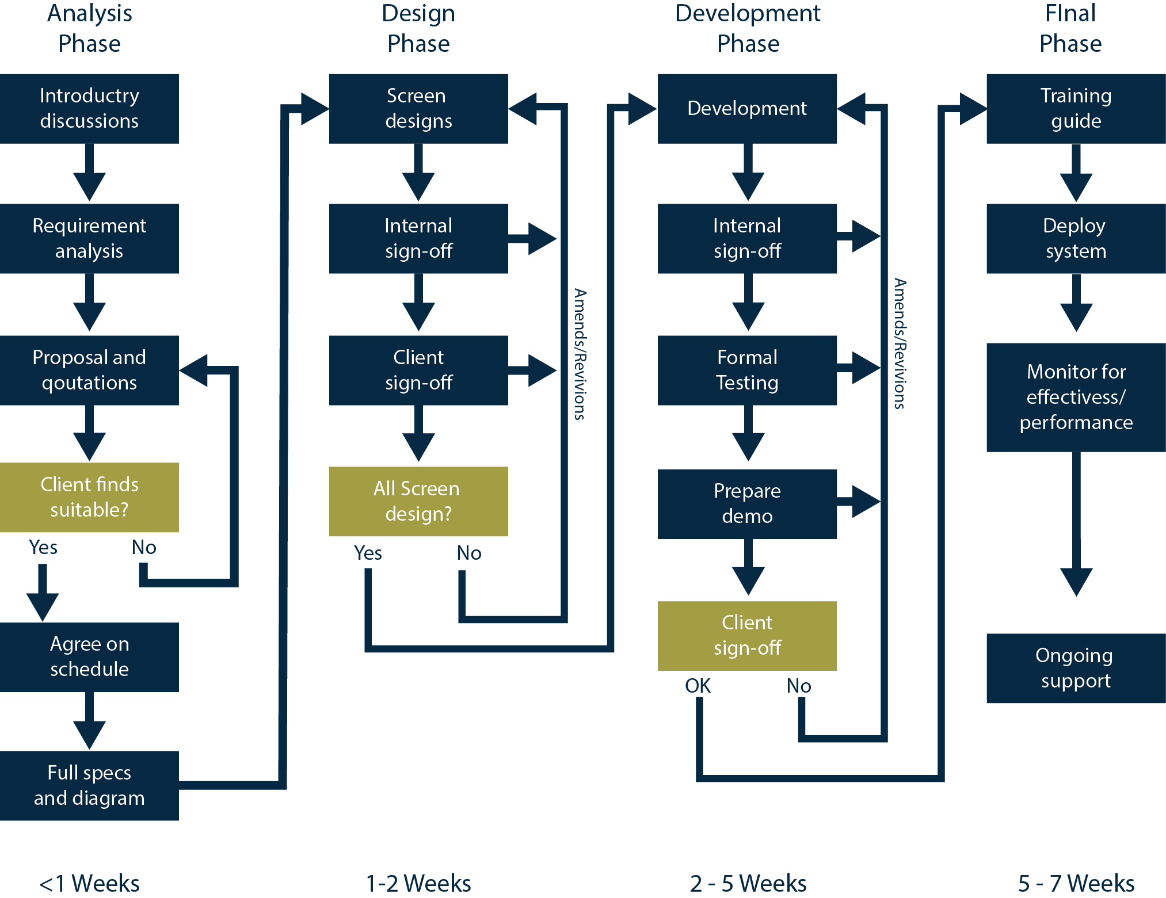
Timeframe

Slide 6
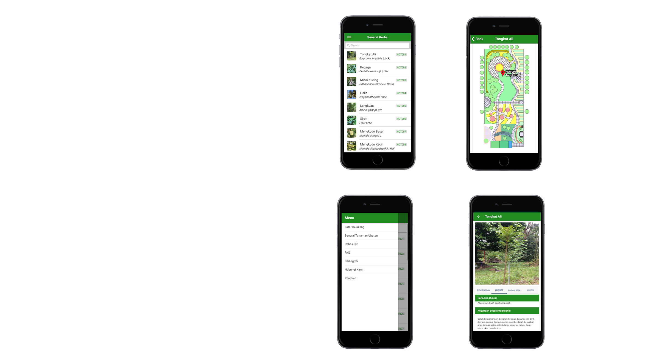
1
Project
Done

Slide 7
At the End
This project is not done alone, I still hire a team developer that among with my professional friends.
Still, client is always involved.

Slide 8
Thank you!
Any questions?
RAXSOFT SYSTEM CONSULTANT

