Slide 1
Exploratory Analysis and Recommendations for Efficient Customer Service
Shahrzad Khayatbashi
13th January 2025

Slide 2
Objectives of the Analysis
Finding patterns and trends in customer interactions
Finding the major reasons for customer contacts
Finding top countries in which orders are made and compare the revenue and order amounts in USD
Exploratory Analysis and Recommendations for Efficient Customer Service
Shahrzad Khayatbashi
13th January 2025

Slide 3
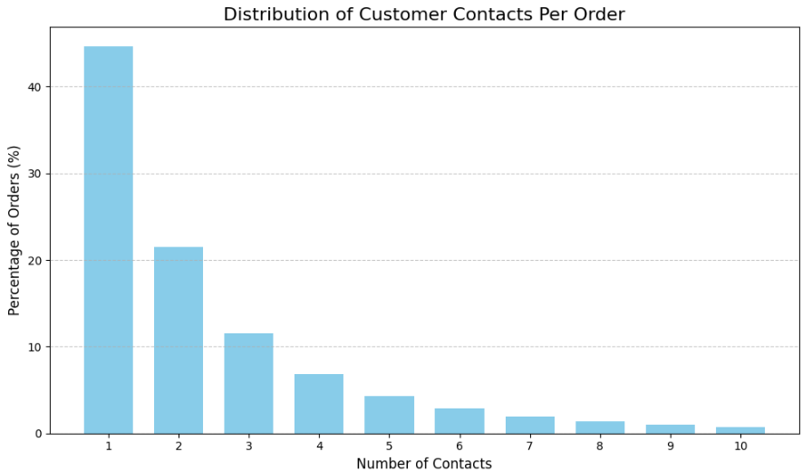
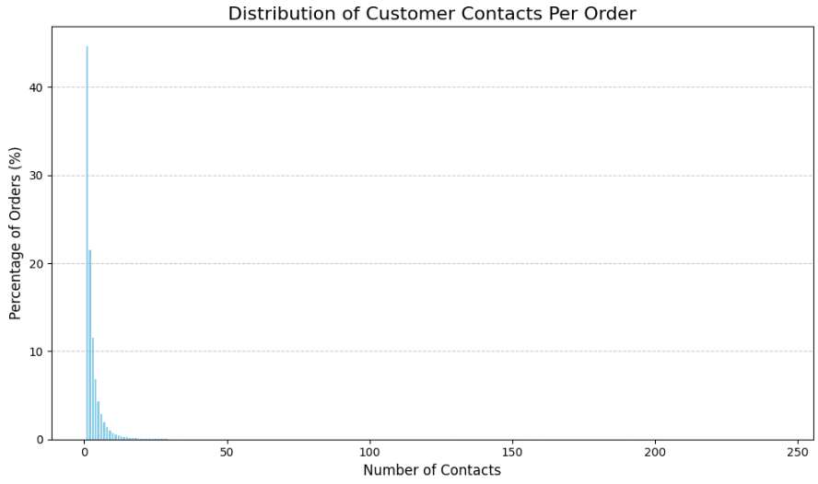

Distribution of Number of Contacts per Order
Exploratory Analysis and Recommendations for Efficient Customer Service
Shahrzad Khayatbashi
13th January 2025

Slide 4
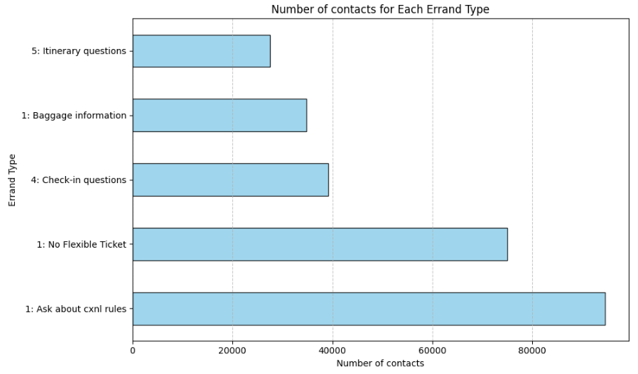
Top five Reasons for Customers Contacting only Once
Question: What type of channel customers use for contacting?
Exploratory Analysis and Recommendations for Efficient Customer Service
Shahrzad Khayatbashi
13th January 2025

Slide 5
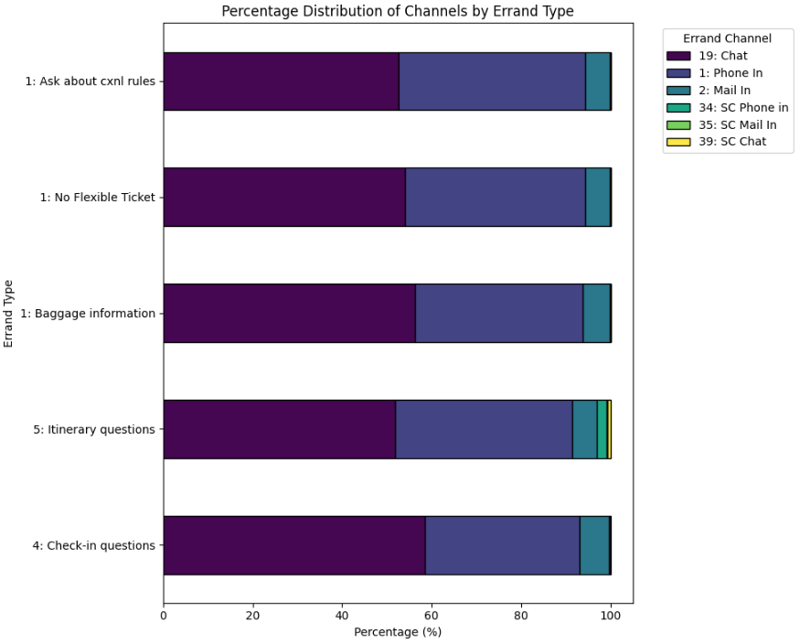
Types of Channel Used by Customers for Contacting
Recommendations:
Using NLP techniques to investigate the most repettitive patterns in ’chat’ and ’email’.
Use models like whisper to convert audios to text for ’Phones’ to find out the questions and concerns that customers call.
Probably Implementing chatbots to handle answering the most asked questions to reduce costs can be helpfull.
Exploratory Analysis and Recommendations for Efficient Customer Service
Shahrzad Khayatbashi
13th January 2025

Slide 6
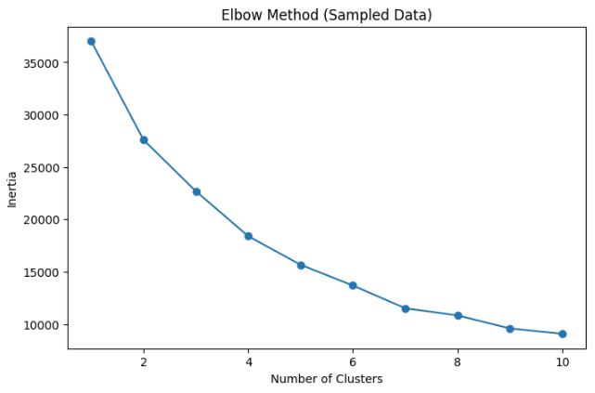

Applying Elbow Method on Sample 20,000 Rows
Selected features:
Brand A
Bran B
Brand D
Brand Others
Partner A
Partner B
Partner C
Partner Others
order:num_of_booking_system
order:num_of_pnr
Exploratory Analysis and Recommendations for Efficient Customer Service
Shahrzad Khayatbashi
13th January 2025

Slide 7
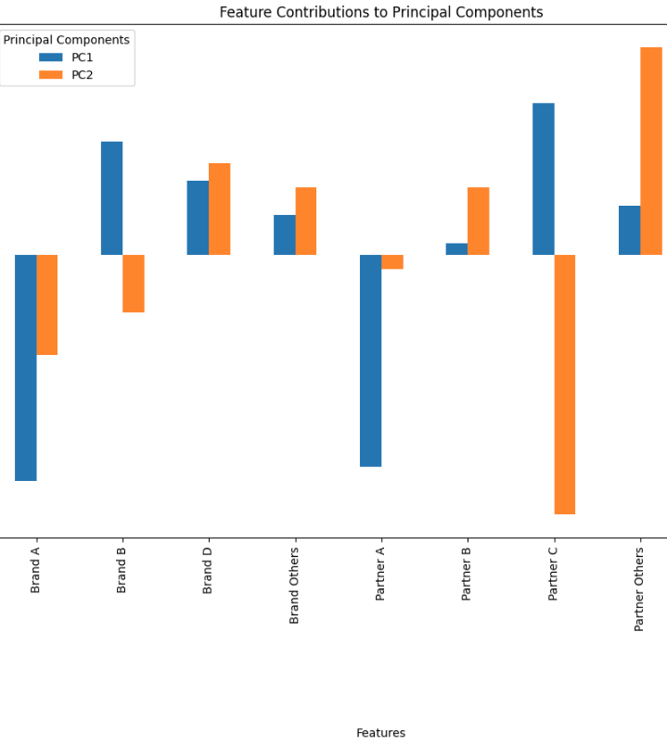
Related Features (PCA)
Exploratory Analysis and Recommendations for Efficient Customer Service
Shahrzad Khayatbashi
13th January 2025

Slide 8
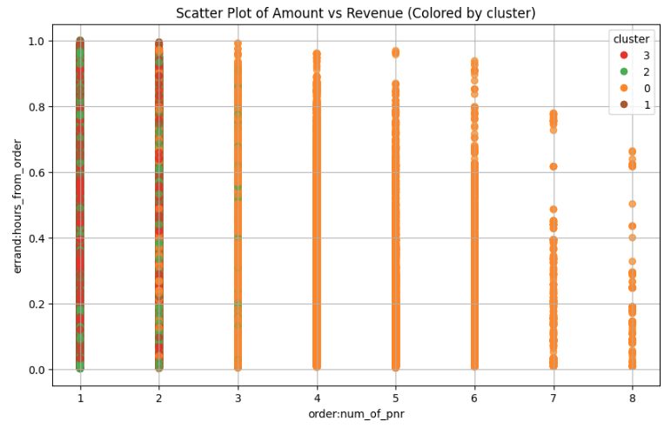
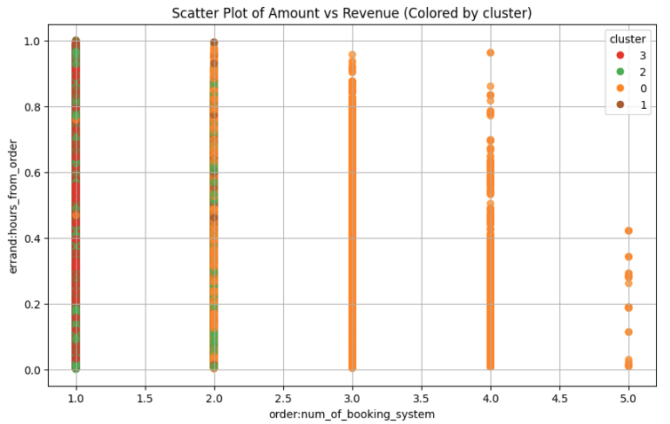
Exploratory Analysis and Recommendations for Efficient Customer Service
Shahrzad Khayatbashi
13th January 2025

Slide 9
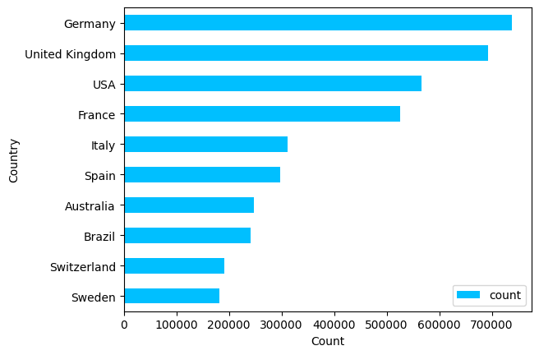
Financial Analysis
Top countries from which orders are made
Exploratory Analysis and Recommendations for Efficient Customer Service
Shahrzad Khayatbashi
13th January 2025

Slide 10
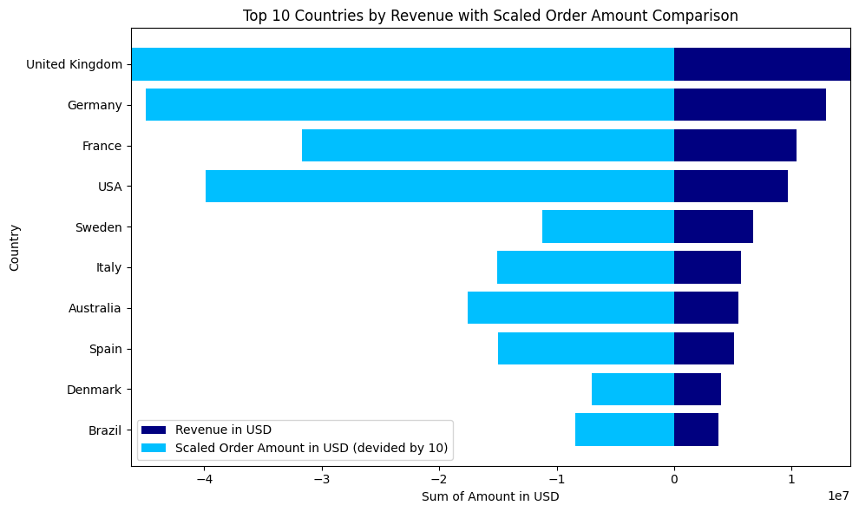
Financial Analysis (continue)
Comparing top ten countries by sum of revenue and order amounts
Exploratory Analysis and Recommendations for Efficient Customer Service
Shahrzad Khayatbashi
13th January 2025

Slide 11
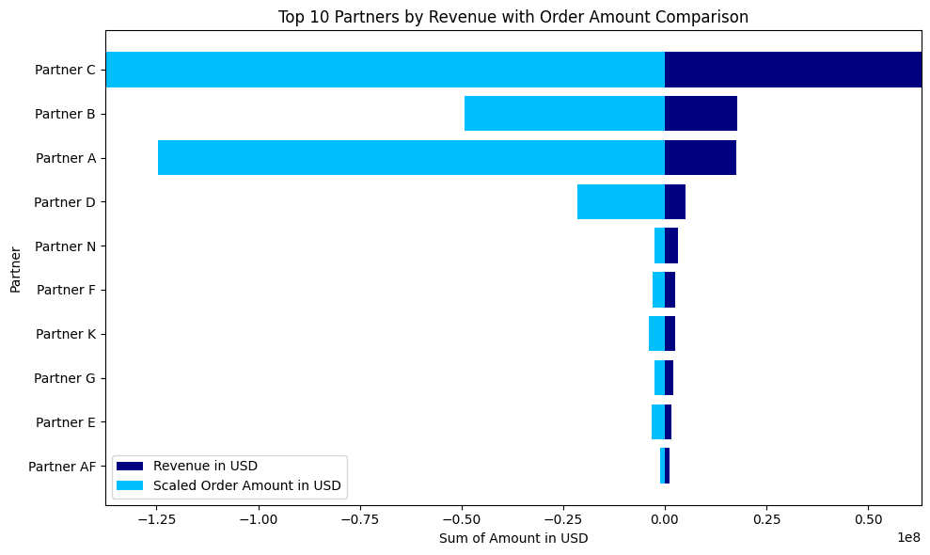
Financial Analysis (continue)
Comparing revenue and order amount in USD for top ten partners
Exploratory Analysis and Recommendations for Efficient Customer Service
Shahrzad Khayatbashi
13th January 2025

Slide 12
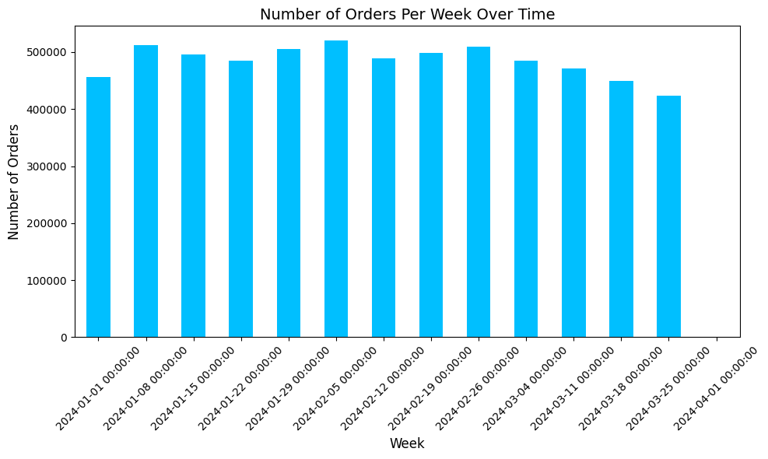
Financial Analysis (continue)
Number of Orders per week over time
Exploratory Analysis and Recommendations for Efficient Customer Service
Shahrzad Khayatbashi
13th January 2025

Slide 13
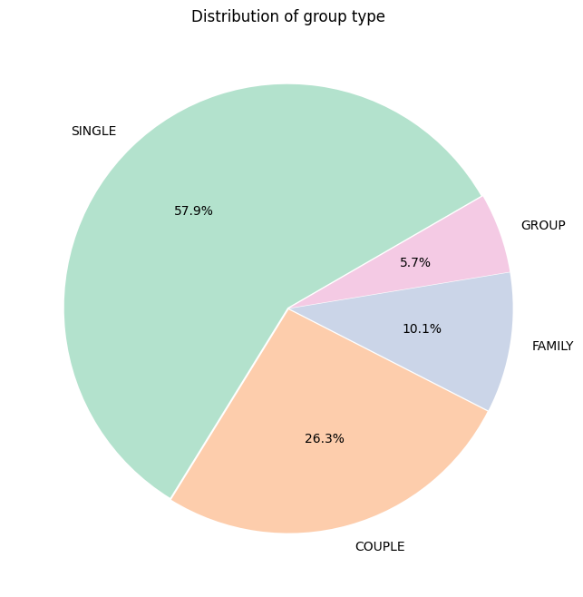
Customer and Booking Context Analysis
Distribution of group type in booking
Exploratory Analysis and Recommendations for Efficient Customer Service
Shahrzad Khayatbashi
13th January 2025

Slide 14
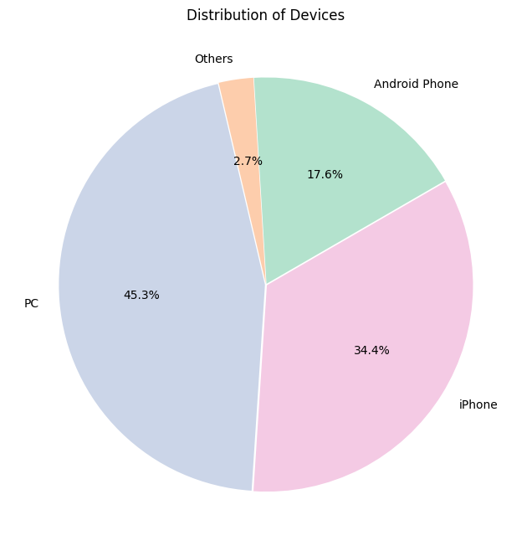
Customer and Booking Context Analysis
Distribution of devices used for booking
Exploratory Analysis and Recommendations for Efficient Customer Service
Shahrzad Khayatbashi
13th January 2025

Slide 15
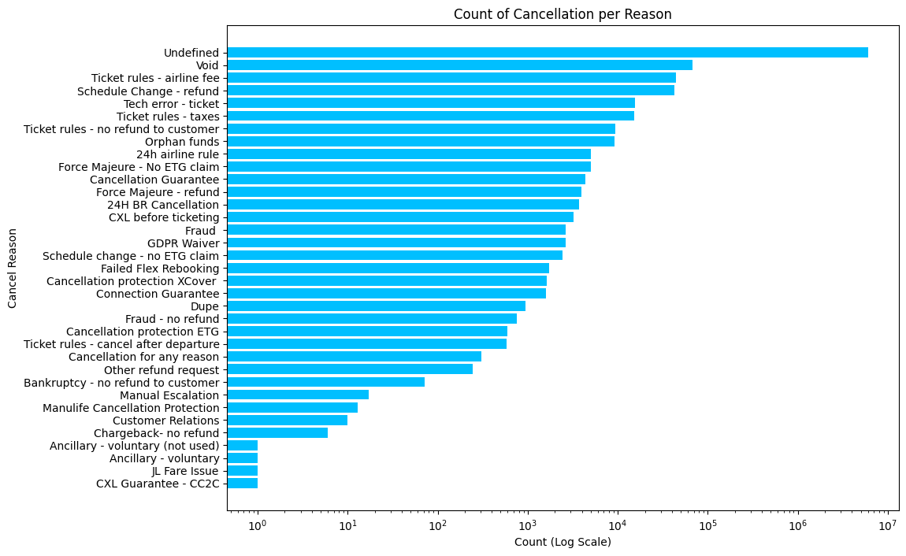
Cancellation Analysis
Exploratory Analysis and Recommendations for Efficient Customer Service
Shahrzad Khayatbashi
13th January 2025

Slide 16
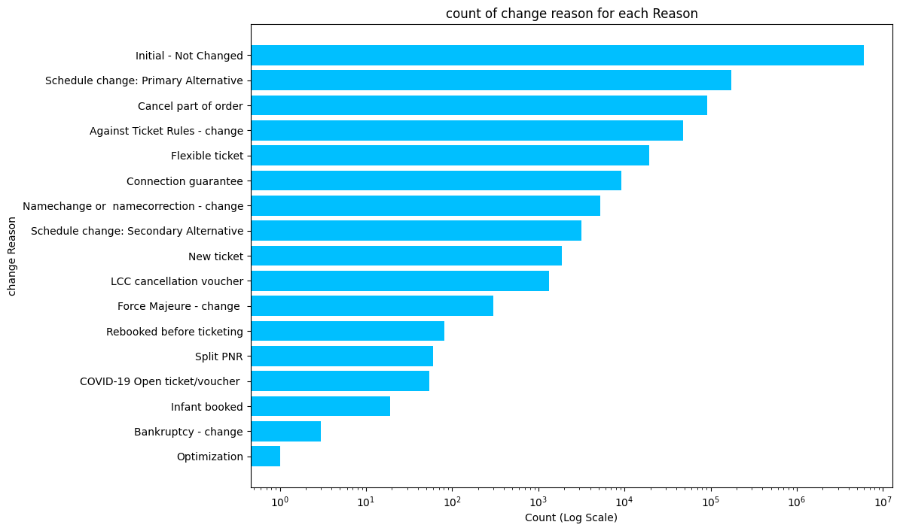
Change in booking Analysis
Exploratory Analysis and Recommendations for Efficient Customer Service
Shahrzad Khayatbashi
13th January 2025

Slide 17
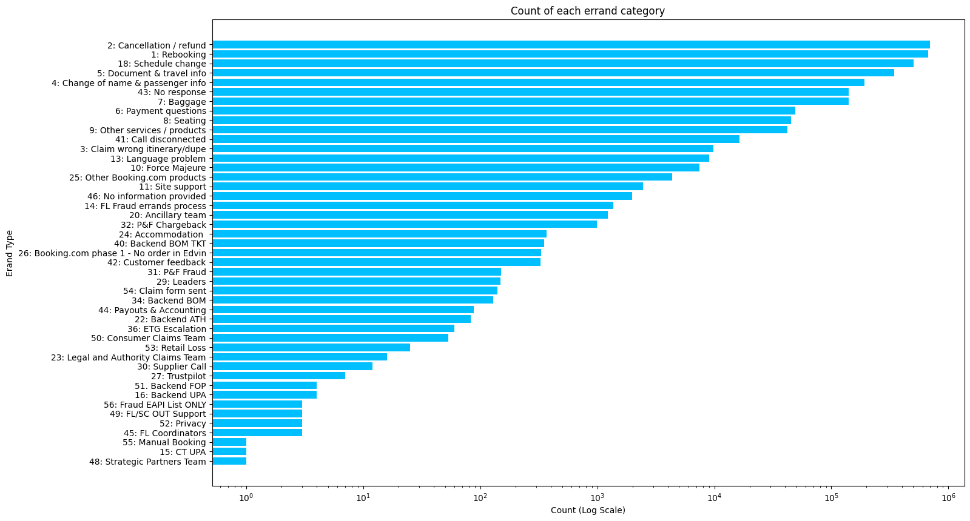
Errand Category Analysis
Exploratory Analysis and Recommendations for Efficient Customer Service
Shahrzad Khayatbashi
13th January 2025

Slide 18
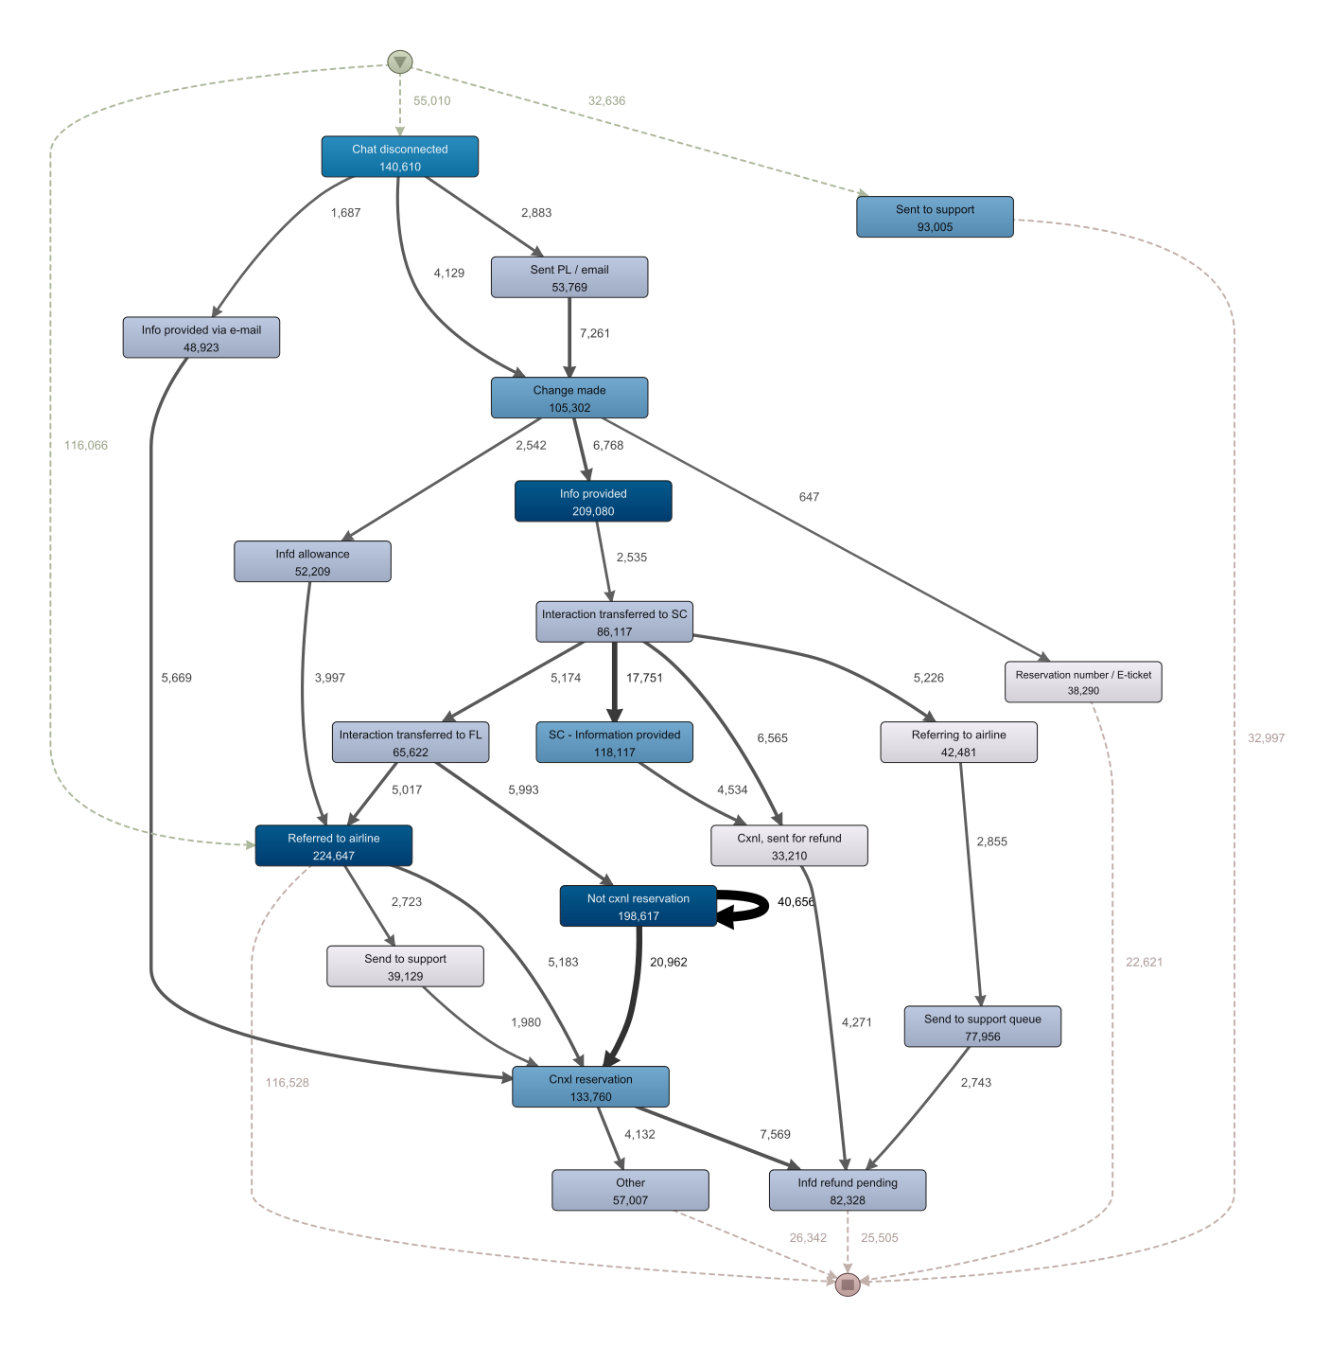

Customer Interactions Process Profile 1
Filter:
Include:
All actions
Exclude:
Create Order
Already on support
No change made
Zoom:
6.4%
Exploratory Analysis and Recommendations for Efficient Customer Service
Shahrzad Khayatbashi
13th January 2025

Slide 19
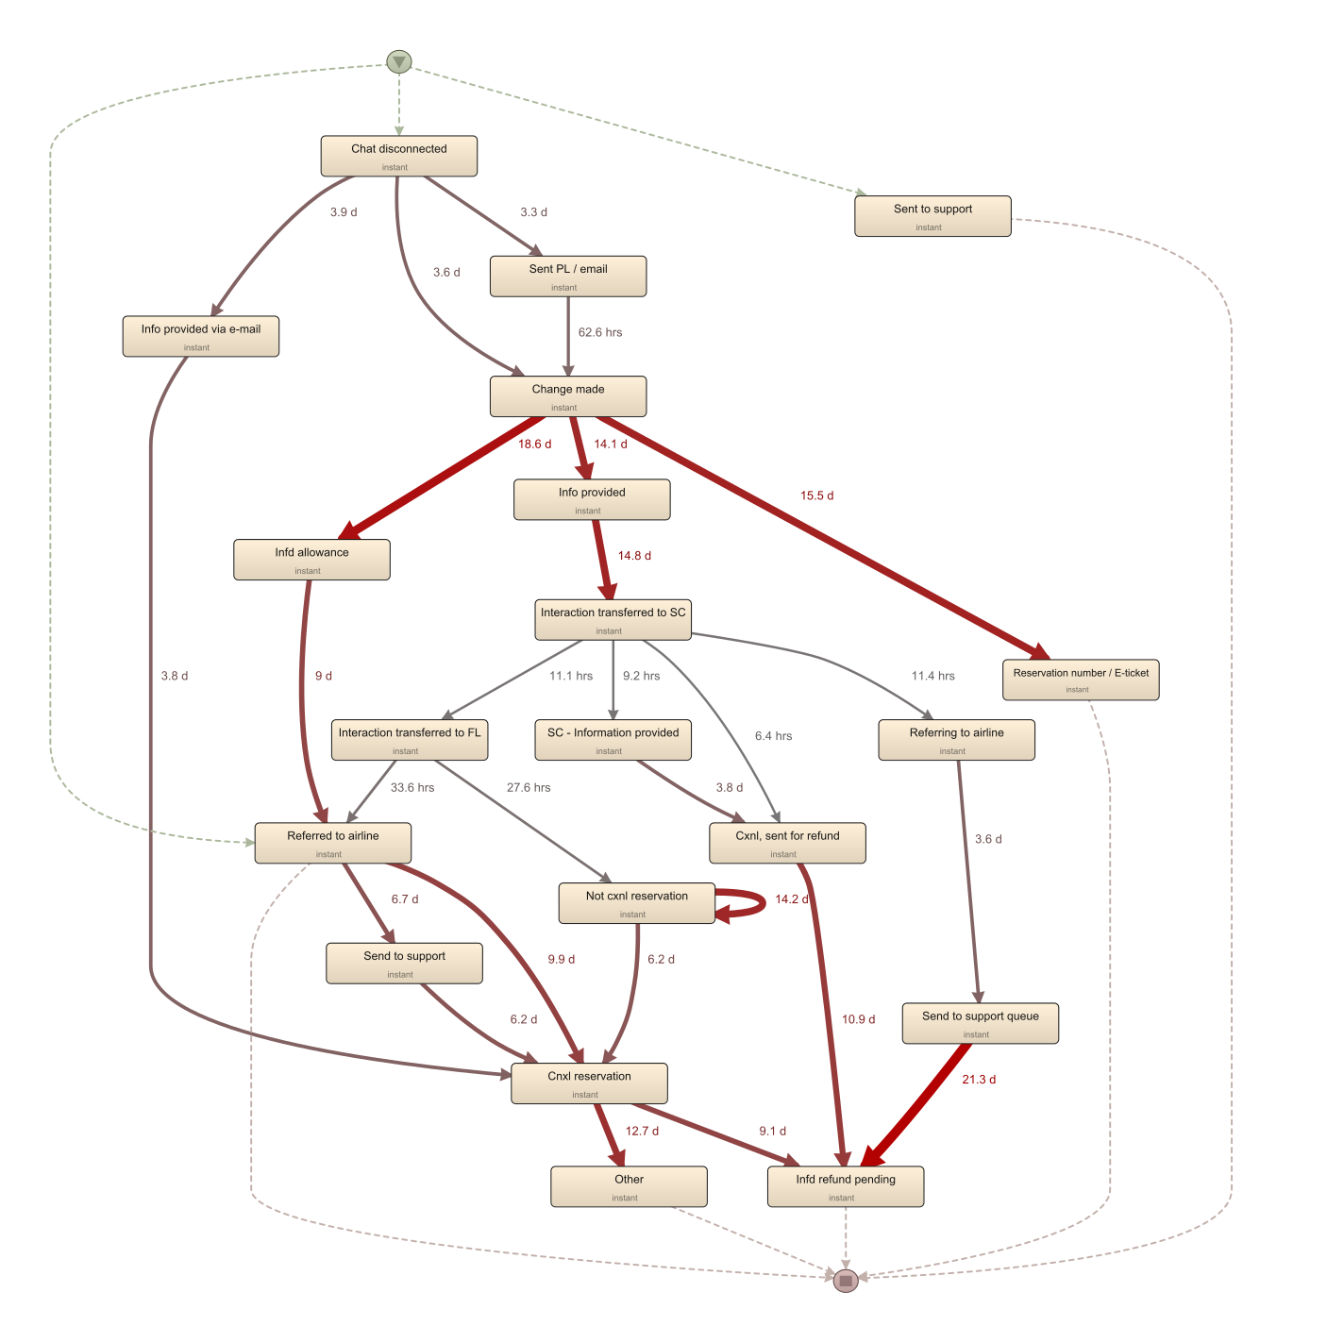
Customer Interactions Process Profile 1
Filter:
Include:
All actions
Exclude:
Create Order
Already on support
No change made
Zoom:
6.4%
Exploratory Analysis and Recommendations for Efficient Customer Service
Shahrzad Khayatbashi
13th January 2025

Slide 20
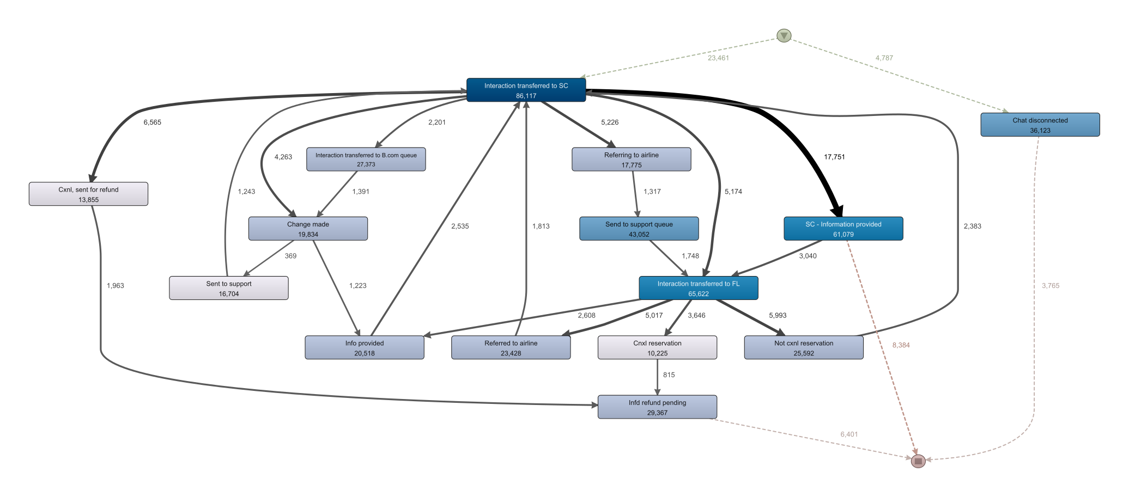




Customer Interactions Process Profile 2
Filter:
Actions:
Include:
Transferred …
Exclude:
Create Order
Zoom:
Already on support
No change made
6.3%
Exploratory Analysis and Recommendations for Efficient Customer Service
Shahrzad Khayatbashi
13th January 2025

Slide 21
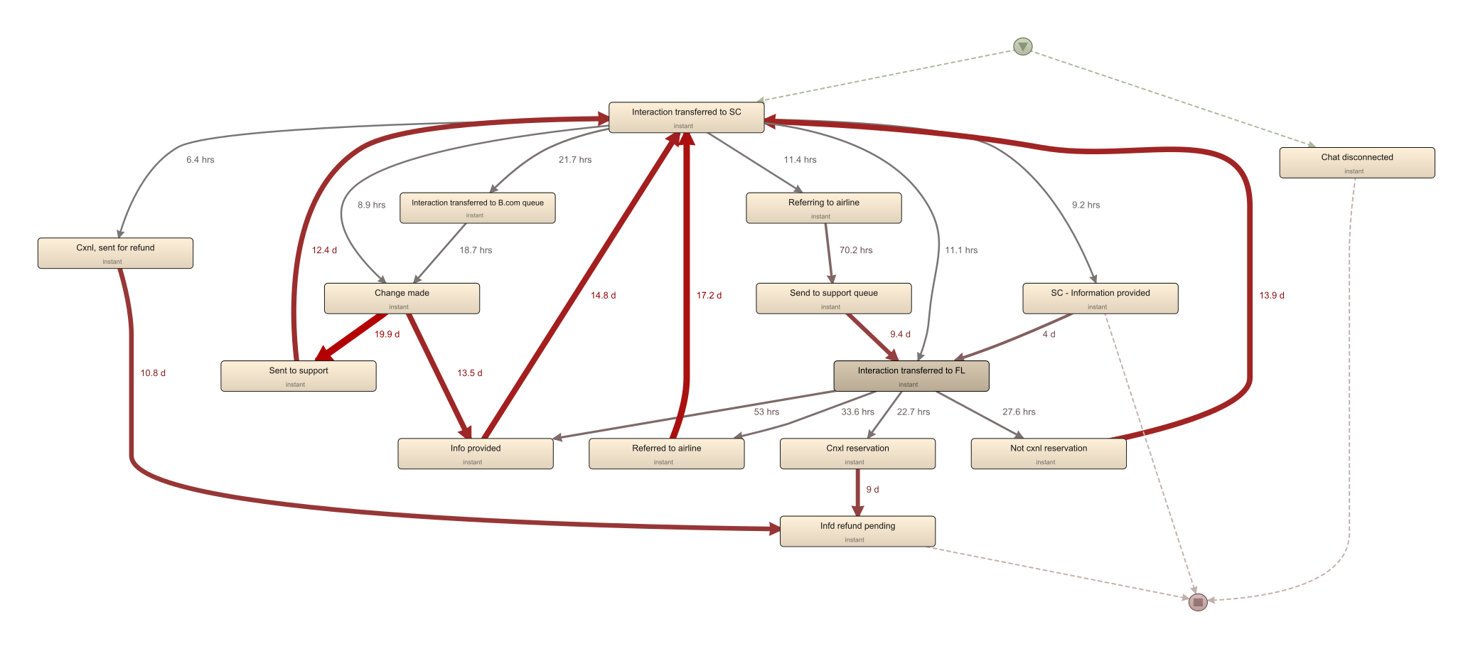
Customer Interactions Process Profile 2
Filter:
Actions:
Include:
Transferred …
Exclude:
Create Order
Zoom:
Already on support
No change made
6.3%
Exploratory Analysis and Recommendations for Efficient Customer Service
Shahrzad Khayatbashi
13th January 2025

Slide 22
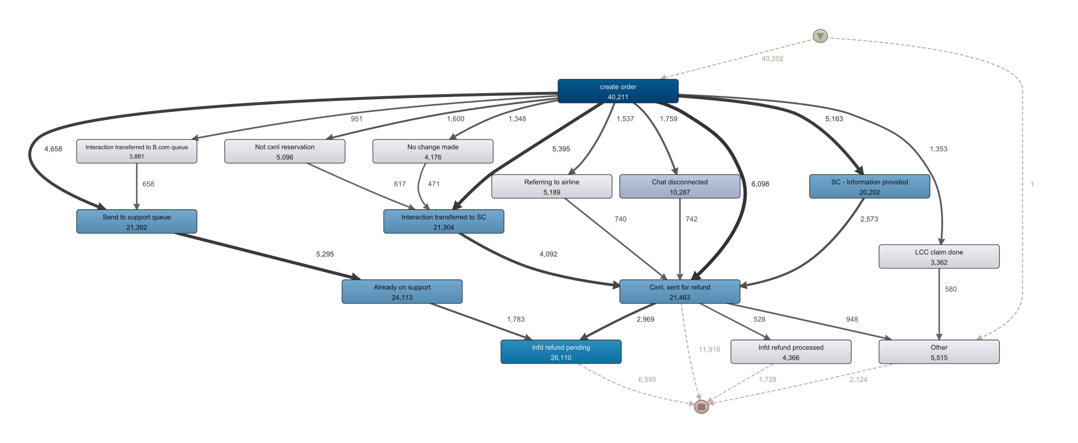

Customer Interactions Process Profile 1
Filter:
Actions:
Include:
All actions
Cancellation
Reasons:
Exclude:
Create Order
Schedule Change
Already on support
Exclude:
Zoom:
No change made
All Reasons
8%
Exploratory Analysis and Recommendations for Efficient Customer Service
Shahrzad Khayatbashi
13th January 2025

Slide 23
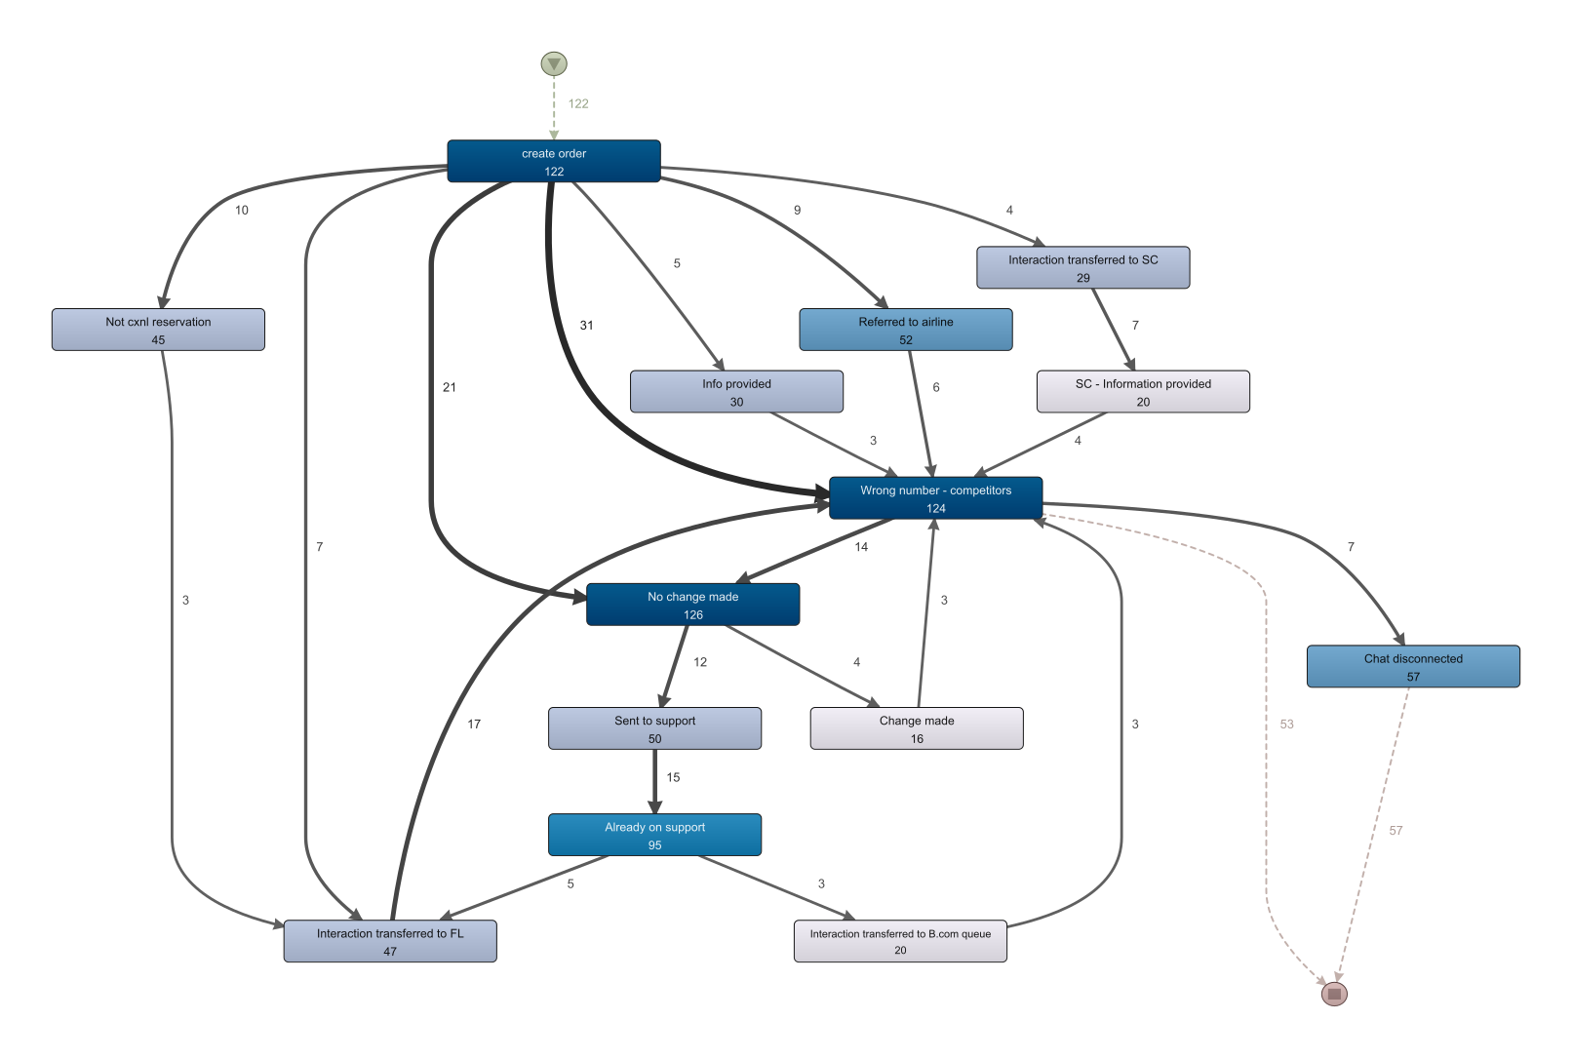
Cases with (Wrong number – competitors) action (top 20% of activities)
My Assumption (needs to be validated):
These cases shows how competitors aimed to get information from company?
Exploratory Analysis and Recommendations for Efficient Customer Service
Shahrzad Khayatbashi
13th January 2025

Slide 24
Key Findings
- Highlighted insights
- Importance of findings
- Alignment with company goals
Exploratory Analysis and Recommendations for Efficient Customer Service
Shahrzad Khayatbashi
13th January 2025

Slide 25
Recommendations
- Suggestions for next steps
- Potential impact or benefits
- Strategic roadmap
Exploratory Analysis and Recommendations for Efficient Customer Service
Shahrzad Khayatbashi
13th January 2025

Slide 26
Conclusion
- Summary of key insights
- Relevance to the company
- Enthusiasm to contribute further
Exploratory Analysis and Recommendations for Efficient Customer Service
Shahrzad Khayatbashi
13th January 2025

Slide 27
Overview of Exploratory analysis
We can categorize these exploratory analysis to the followings:
Financial Analysis
Customer and Booking Context Analysis
Order Changes, Cancellation, and Errand Categories
Exploratory Analysis and Recommendations for Efficient Customer Service
Shahrzad Khayatbashi
13th January 2025

