Slide 1
2022 Summer Data Management and Database Design
Hospital Management System
By : Sanay Shah

Slide 2

Mission / Objective
Help a hospital franchise with a chain of outlets, better exercise its resources while administering treatments to patients.
Becoming more adept at handling special pandemic induced situations.
Enable efficient interconnectivity between all franchise branches by shifting the management system online.
Notes:
This project aims to help a hospital franchise with a chain of outlets, better exercise its resources while administering treatments to patients.
It also allows for a more adept handling of special pandemic situations by helping the franchise manage its entire array of clinical outlets.
This enables an efficient interconnectivity between all franchise branches by shifting the management system online.

Slide 3


Index
Business Problems Addressed
Business Rules
ERD
Highlights of our database
Reports and visualization

Slide 4
Building a paperless system for efficient functioning of a particular hospital franchise.
Managing day to day activities of various labs, wards, hospital staff, ambulances.
Managing the clinic, pharmacy, rooms, staff, medicines.
Quickly fetching relevant data depending on a situation at hand.
To serve patients in a better way and improve efficiency.
Business Problems Addressed
Notes:
1. Building a paperless system for efficient interaction of a particular hospital franchise.
2. Managing day to day activities of various labs, wards, hospital staff, ambulances.
3. Managing the clinic, dispensary, rooms, staff, medicines.
4. Fetching relevant data depending on a situation.
5. To serve patients in better way and improve the efficiency

Slide 5
Business Rules
Each hospital will maintain the records for resources, medical devices, ambulances and medicines to check for availability.
Each hospital will have multiple wards.
Each staff member will be appointed to a department.
Each hospital will have one lab where all tests are conducted.
A doctor works in one particular hospital only and may have a specialty.
A patient will be assigned one bed only, in the room of a particular ward.
A patient may have to undergo a few tests.
Each staff member has an assigned department.
A particular ward may have multiple rooms.
A room can have one or more beds.
A patient may have multiple case files.
A case can have multiple bills.
Notes:
Each hospital will maintain the records for resources, medical devices, ambulances and medicines to check availability.
Each hospital will have multiple wards.
Each staff member will be appointed to a department.
Each hospital will have one lab where all tests are conducted.
A doctor works in one particular hospital only and may have a specialty.
A patient will be assigned one bed only, in the room of a particular ward.
The patient may have to undergo a few tests.
Each staff member has an assigned department.
A particular ward may have multiple rooms.
A room can have one or more beds.
A patient may have multiple case files.
A case can have multiple bills.

Slide 6
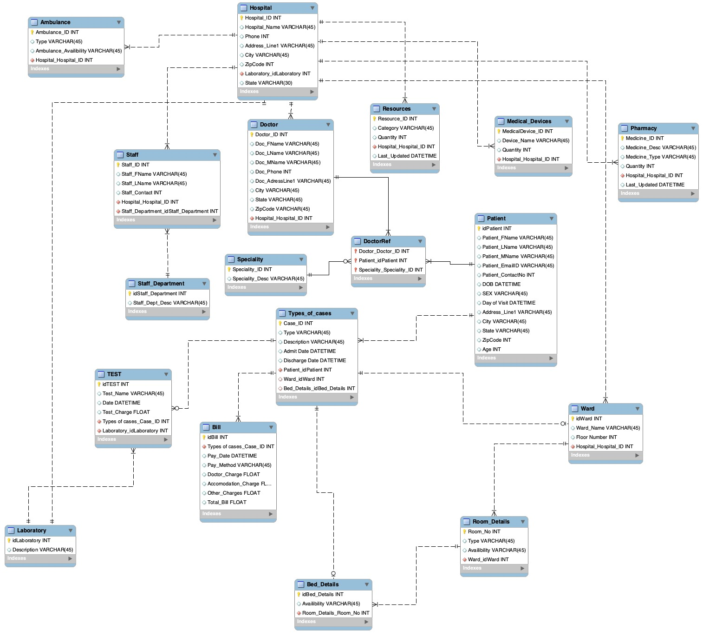
ERD

Slide 7
FUNCTIONS
CONSTRAINT
TRIGGERS
CREATE FUNCTION dbo.AgeCal
Compute the Age column for the Patient Table.
Highlights in our Database

Slide 8
FUNCTIONS
CONSTRAINT
TRIGGERS
CREATE FUNCTION dbo.BedAvailCk
(Table-level Constraint
for Types_of_Cases)
If a bed is available only then will it
be allocated.
Highlights in our Database

Slide 9
FUNCTIONS
CONSTRAINT
TRIGGERS
CREATE Trigger Trig_Order_Total_Bill
To calculate the total bill by adding the test charge from the test table and other charges from the bill table.
CREATE Trigger Trig_BedAvail
For updating the bed availability when a patient is discharged or admitted.
Highlights in our Database
Notes:
Trig_Order_Total_Bill: on Bill
Trig_BedAvail: on Types_of_Cases

Slide 10
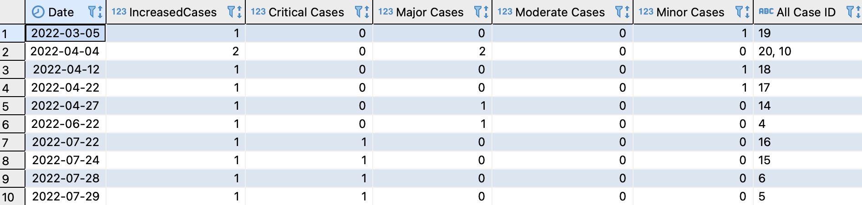
VIEWs for reports
DailyIncreasedCases
To check the daily increase/decrease in the number of cases and the type of cases.

Slide 11
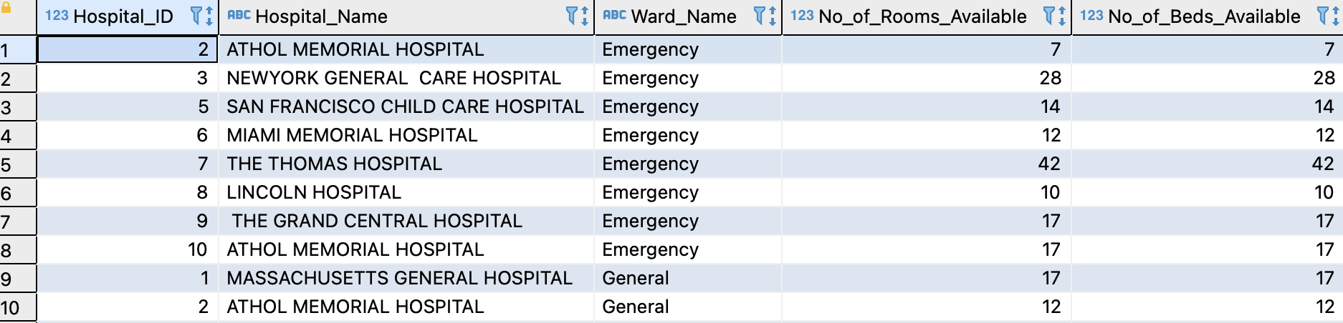
To check the current status of the number of rooms and beds available in the hospital.
VIEWs for reports
Availability

Slide 12
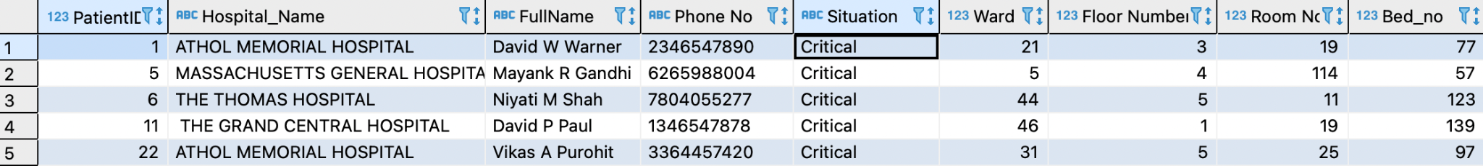
VIEWs for reports
Admitted_Patients
To check which hospital patients are admitted into, i.e which ward, room and bed they have been allocated. This, in turn, would be extremely informative for any visitors.

Slide 13
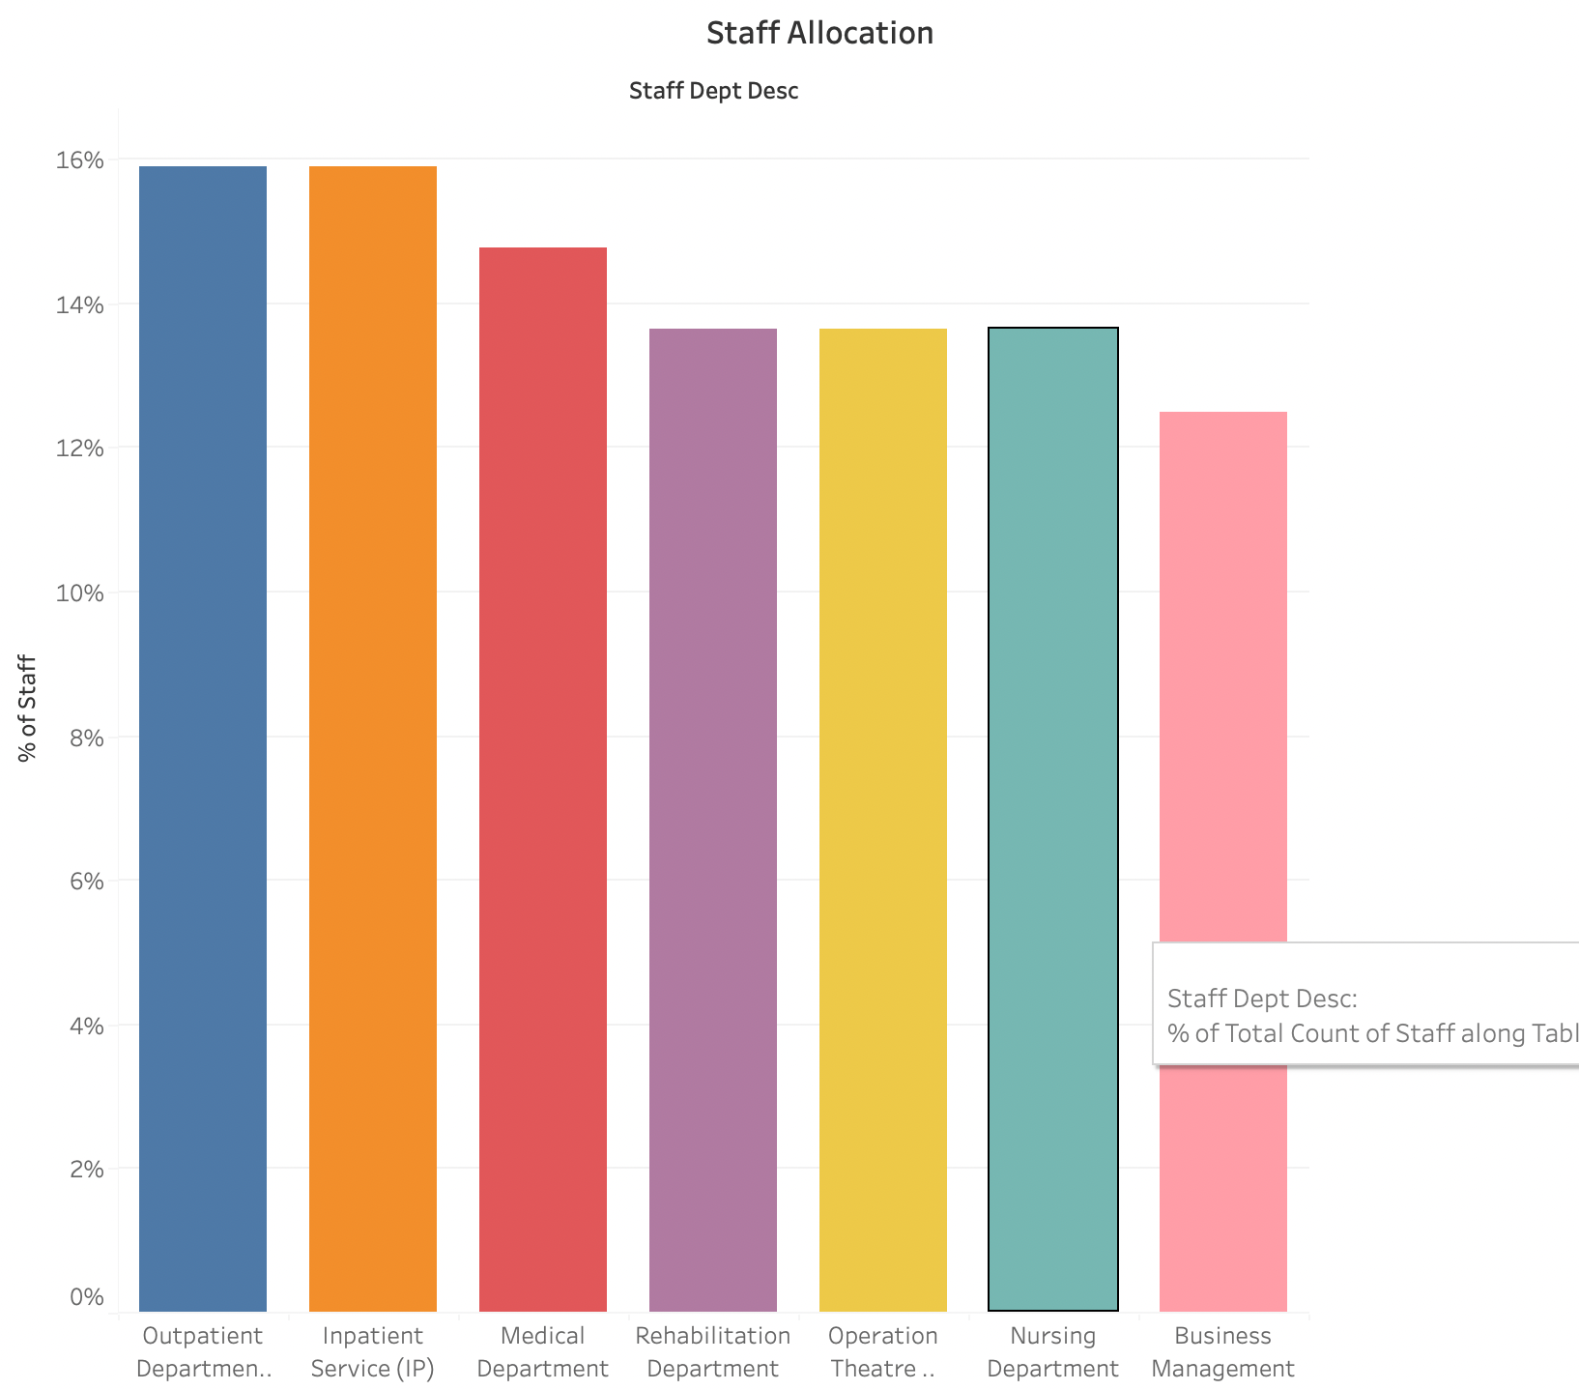
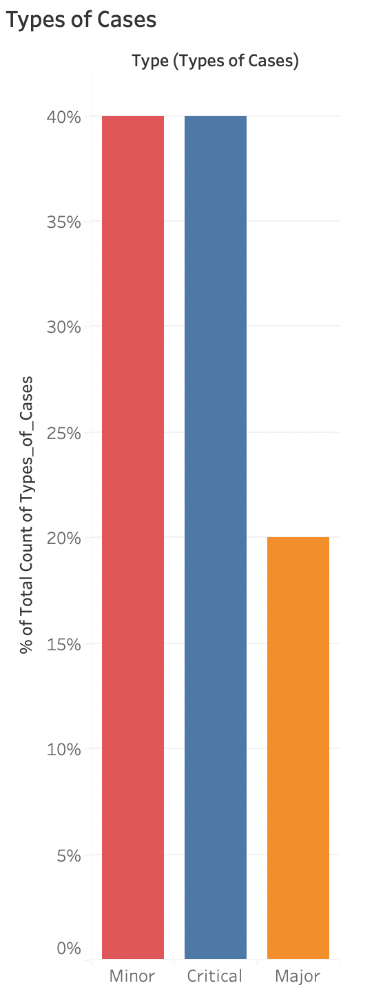
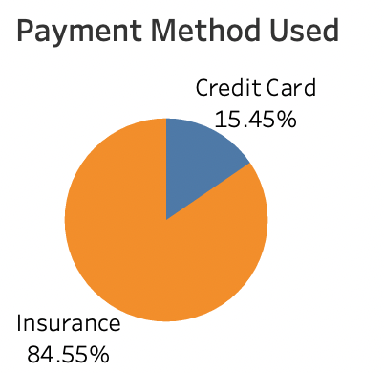
Reports and Visualizations

Slide 14
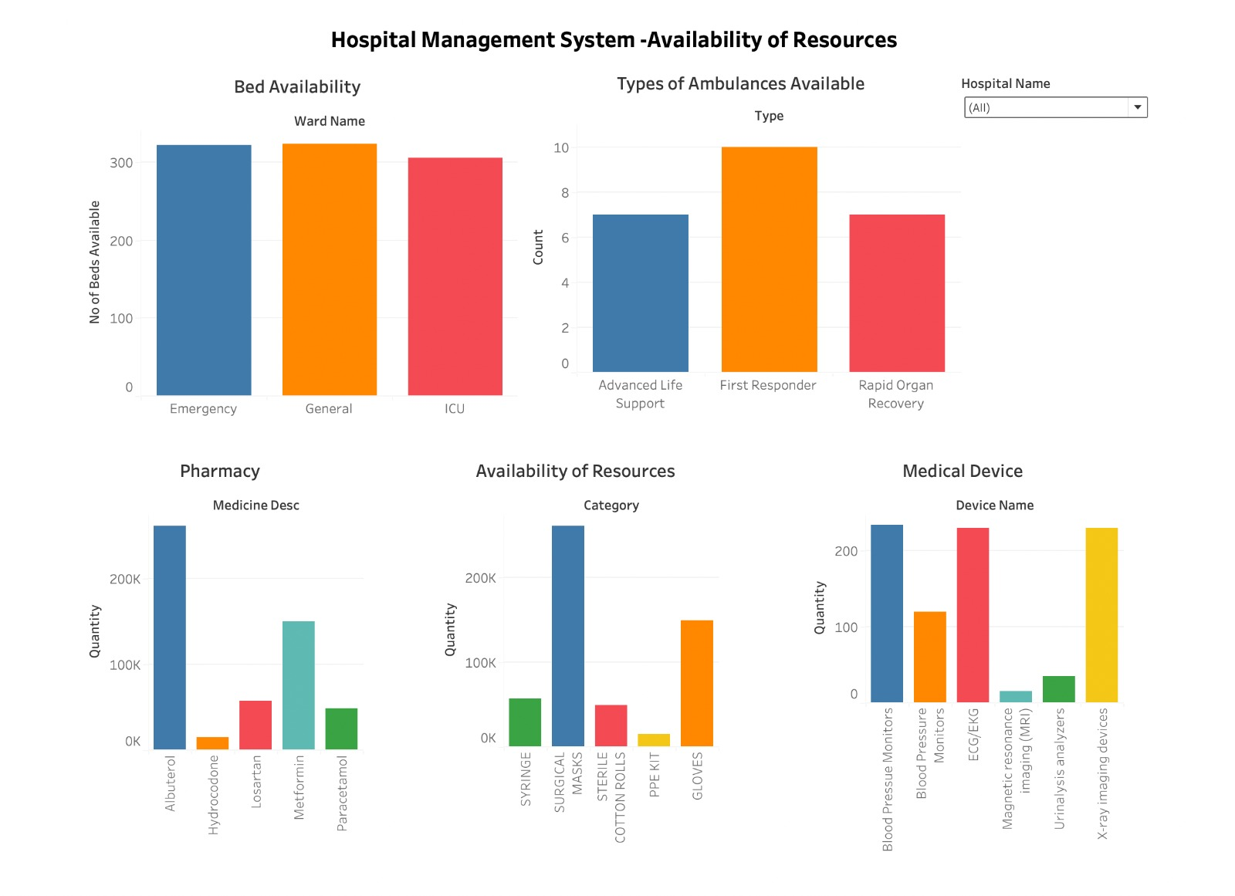
Reports and Visualizations

Slide 15
2022 Summer Data Management and Database Design
Thank you everyone!
– Q&A

