Slide 1
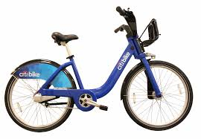
NYC Citi Bike Data Analysis
INFO 7250
Neha Firodiya and Smit Shah

Slide 2

About
Citi Bike is New York City's bike sharing system. Intended to provide New Yorkers and visitors with an additional transportation option for getting around the city, bike sharing is fun, efficient and convenient.
Citi Bikes are available 24/7, 365 days a year
507 stations across New York and Jersey City
Station locations are based on population and transit needs

Slide 3
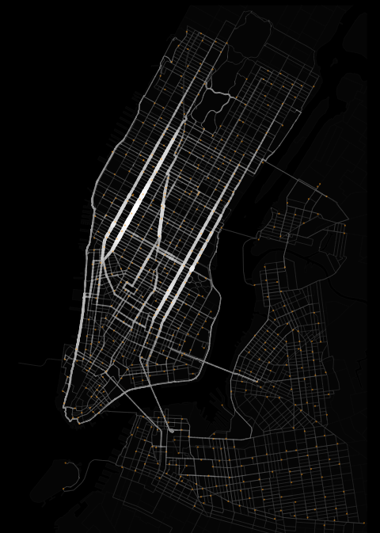
About the dataset (2014-15)
Trip duration
Start and Stop
Time
Date
Station Name
Station Id
Latitude and Longitude
Bike ID
User
Type (Customer/ Subscriber)
Gender
Year of Birth

Slide 4


External data sets (2014-15)
Weather
SNWD (Snow Depth in mm)
SNOW (Snow in mm)
PRCP (Precipitation in 10’s of mm)
Temp (Avg Temperature in 10’s of degree celcius)
Holiday
Weekday/ Weekend
National Holiday

Slide 5
Implementations
Data Cleaning
MapReduce
Analysis
MapReduce
HIVE
R
Tableau
* We will be working on 3GB’s of data

Slide 6





Tools and Technology
Hadoop 2.7.2
Hive 2.0.0
AWS – EMR (4.6.0)
AWS – S3
RStudio
Eclipse IDE
Tableau

Slide 7
Analysis

Slide 8
Number of Bike Rides (Hive)
Gender
User Type - By Year, Months
Age Group - By Year, Months
Holiday’s - Rides by national holidays
Weekdays /Weekend
Daily
Time
Pick-up
Drop-off
* Hive output is visualized on Tableau

Slide 9
Average Trip Duration (Hive)
Age Group
Gender
User Type
* Hive output is visualized on Tableau

Slide 10
Locations: Source to Destination (Total counts/ frequency) MapReduce
Top Pick-up locations
Top Drop-off locations
Top Routes
* Jobs ran on EMR
* MapReduce output is visualized on Tableau

Slide 11
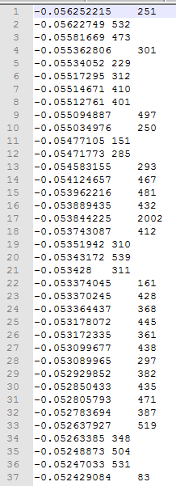
Page Rank
Page Rank implementation of destination location using MapReduce
based on bikes coming from a specific source (which is counted as a
vote)
* Jobs ran on EMR

Slide 12
R
Multivariate Regression
Trips based on weather conditions
Prediction
ARIMA Time series model (Autoregressive Integrated Moving Average)
Neural Networks

Slide 13
Arima Prediction
Prediction of number of bike rides based on 4 months each of 2014 and 2015 January to April:
#[1] 3964.292271 3283.014734 3432.335700 3605.968658 4077.019842 3686.878056
#[7] 3583.430920

Slide 14
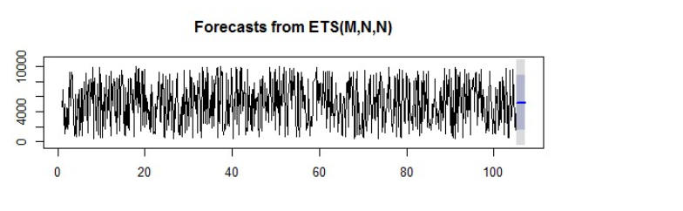
Prediction using tSeries Model
Year 2014 – 2015

Slide 15
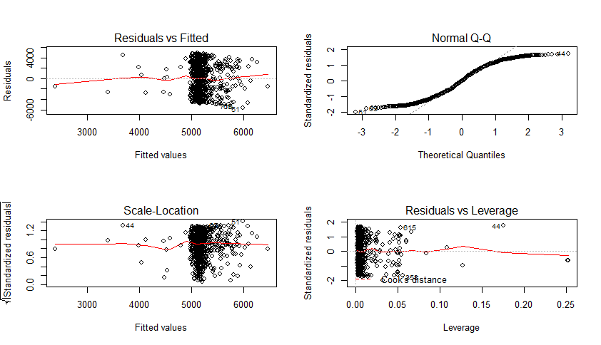
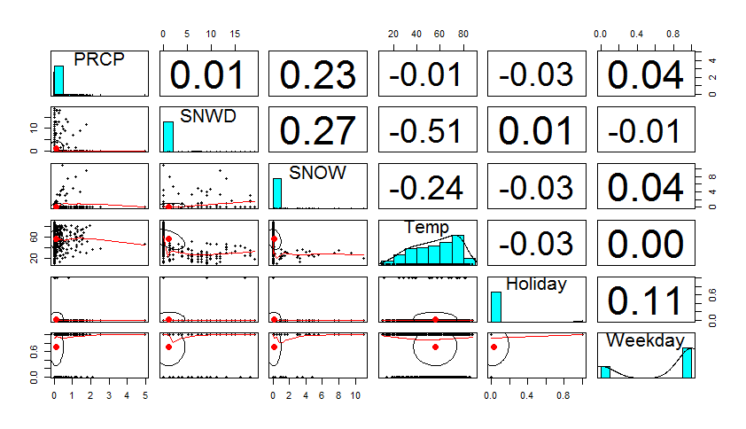
Regression Analysis

Slide 16
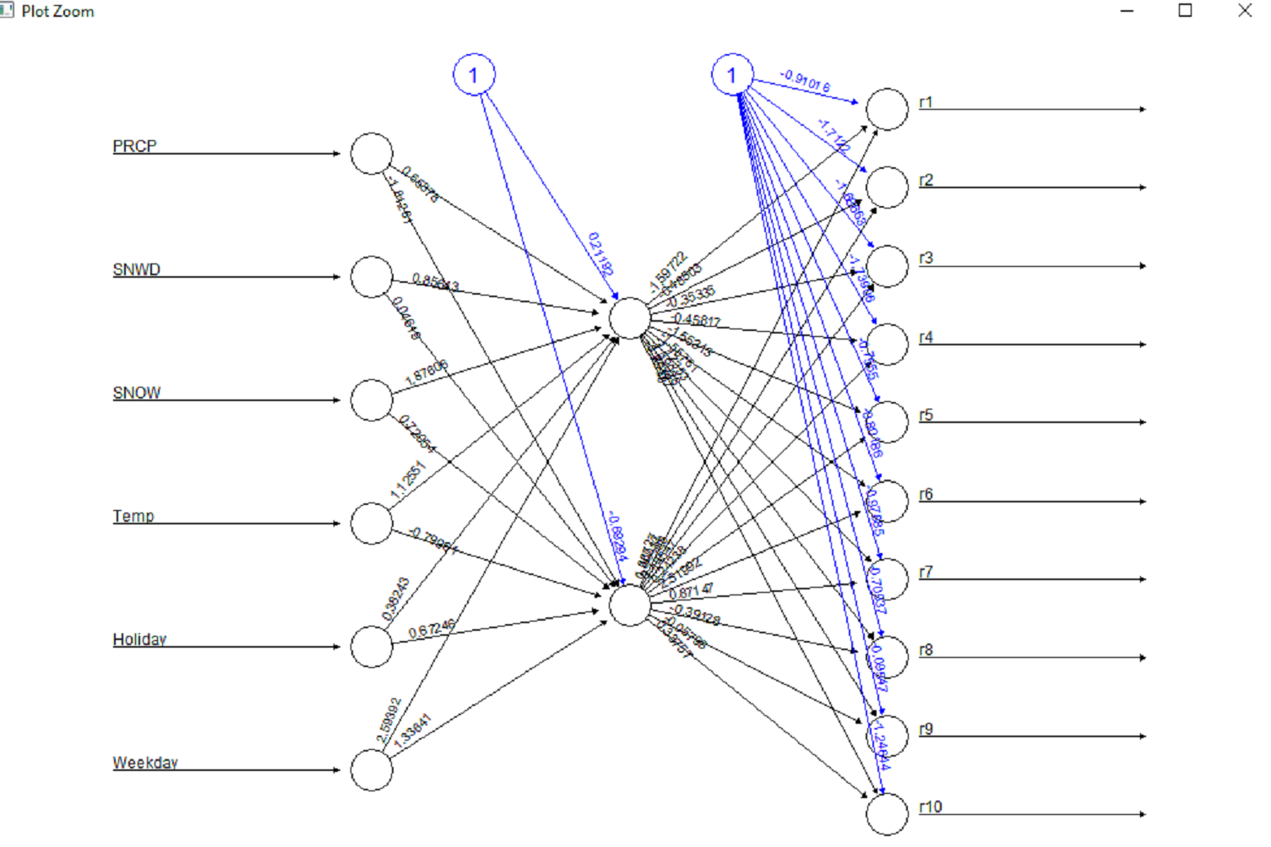
Neural Networks

Slide 17
Conclusion
Peak hours is during business hours – more between 7 am and 10 am, 4 and 8 pm
Average trip duration increases with increase in age
Males ride faster than females
Age group 31-40 use bikes more often
Customer use bike less during holidays
Bike usage is high during weekdays
Overall usage has increased by 100k in 2015 as compared to that in 2014
Top places: near Madison Square Garden and NYU
Best roots found: (West St & Chambers St to 12 Ave & W 40 St) and (Grand Army Plaza & Central Park S to Broadway & W 60 St)
Number of trips is more influenced by Snow depth and snow rather than prcp and temperature

Slide 18
Future Scope
We can calculate the google maps estimate for the ride vs the actual trip duration and compare and analyze the results.
We can find the shortest path while a person wants to go through several stations to a destination and can optimize the path
We can improve on our Neural Network for accurate prediction
Rebalancing of bikes and optimal technique to rebalance the bikes

Slide 19
Thank You!!

